Slide 1
OESC Updates &
Workforce Transformation
November 12, 2025
Trae Rahill
Chief Executive Officer

Slide 2
OESC connects Oklahomans to the workforce through reliable and innovative services for a more prosperous Oklahoma.

Slide 3
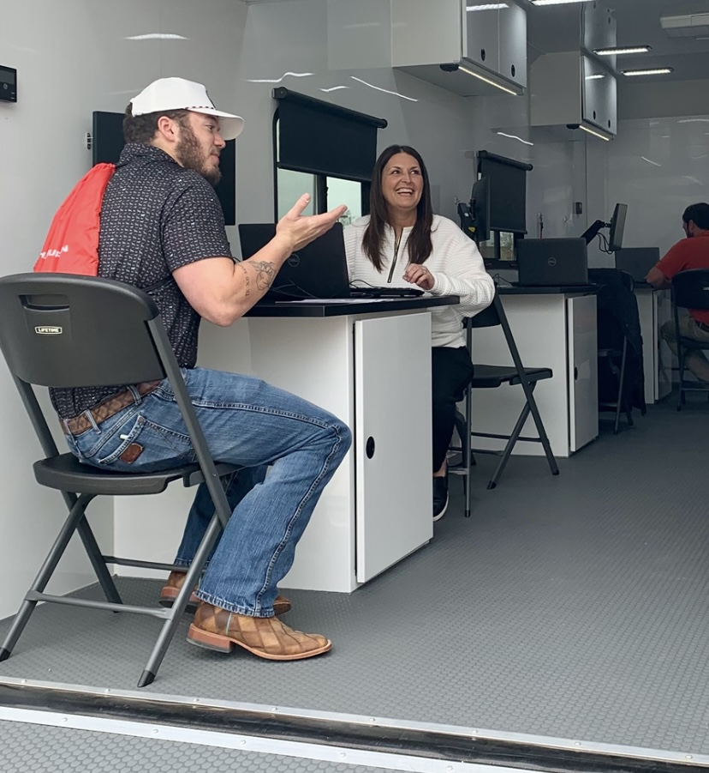
Employer Services
Recruitment
  OESC field offices work with local employers
    write job announcements/descriptions
    screen and send candidates
    host local hiring events
    provide space for interviews and orientations
Hiring Incentives
  Work Opportunity Tax Credit and Federal Bonding programs, to incentivize hiring certain target populations or demographics
Research and Economic Statistics
  OESC publishes industry data to inform businesses of economic conditions statewide, by county, and by metro area

Slide 4

Individual Services
Employment Services
  Resume and job search assistance, mock interviews, case management, job and resource fairs, to help individuals secure employment
Veterans Services
  Case managers work with veterans and the employer community to make targeted connections for filling available jobs
Unemployment Insurance
  Individuals who lose work may be eligible for unemployment insurance compensation while they search for new work

Slide 5
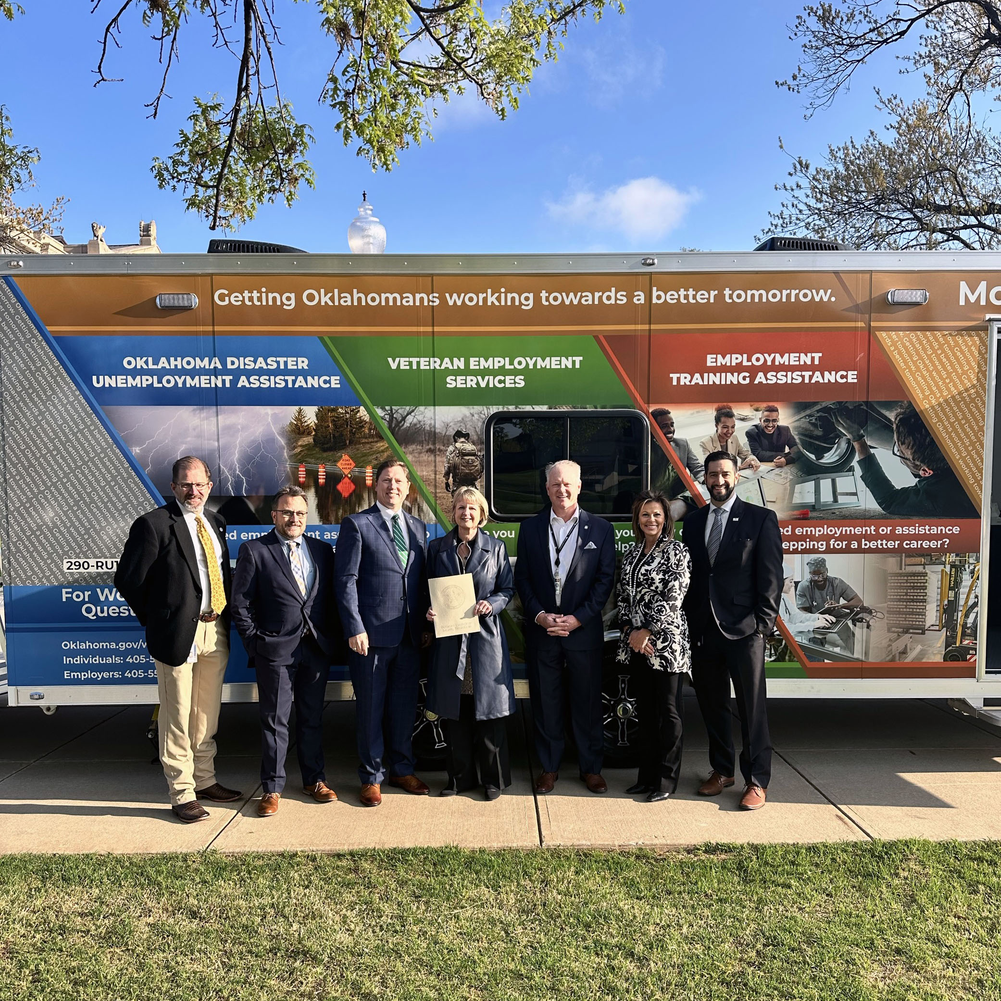
Recent Wins
New Mobile Units Launched!
  OESC secured a federal grant to procure 4 new trucks and trailers to deploy in response to natural disasters and other significant employment events
Tax Decrease Legislation Passed
  Largest ever decrease to the tax rate table, decrease to the taxable wage base benefitting all employers
New Claimant Portal Launched!
  Largest technology replacement in agency history, hard-launched statewide July 8, safeguards employer tax dollars against fraud and abuse
Workforce System Advancement
  Partnership vision casting, consolidations of workforce boards, workforce system redesign, expanded service impacts, reducing administrative costs at state and local levels, OK now ranks #1 nationally in many areas, Chair Gray and Trae both stepping into national roles

Slide 6

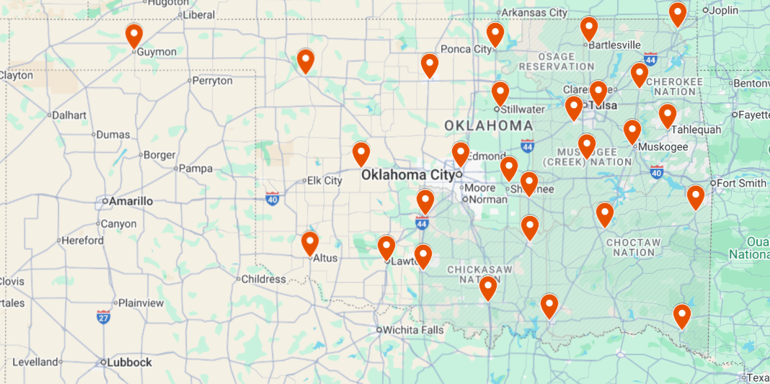
OESC operates 27 American Job Centers

Slide 7
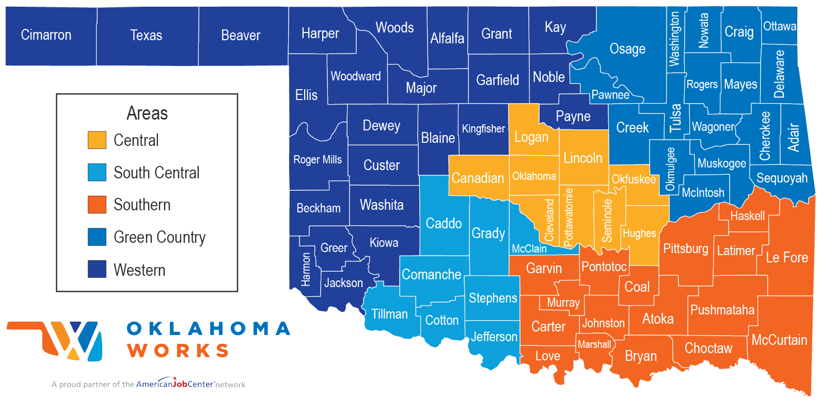
OESC operates 27 American Job Centers

Slide 8
Workforce Transformation

Slide 9
Measuring Transformation
Oklahoma’s Workforce Delivery System is a supply chain. We must measure its success by the outcomes the institutions are meant to deliver, and by their ability to recognize and respond to changing industry conditions.
Metrics
Growth of private business
  retention, growth, care and feeding of existing businesses
  establishment of new businesses
Increased labor force participation rate
Decreased unemployment rate
Educational improvement; learning outcomes, career exposures, guides for parent partners
Robust and diverse career pathways
Populational attainment; veterans, disabled, justice-involved, etc.
Challenges
High school graduation requirements
College “readiness” needs significant remediation
300,000 Oklahomans without high school diplomas
Disparate historical strategies, lacking vision
Fragmented agencies with competing priorities
Siloed points of view in policy-making
Fragmented oversight groups with no absolute authority

Slide 10
Stakeholders and Components
A broad and diverse network of stakeholders is involved in overseeing and executing an array of different workforce programs that comprise the “workforce delivery system.” We must align these component programs such that they work together in the most optimal ways, to best serve Oklahomans.
Oklahoma Employment Security Commission (OESC)
Oklahoma Department of Career and Technology Education (CareerTech)
Oklahoma State Regents for Higher Education (OSRHE)
Oklahoma Department of Rehabilitation Services (DRS)
Oklahoma State Department of Education (OSDE)
Oklahoma Department of Human Services (OHS/OKDHS)
Oklahoma Department of Commerce (Commerce)
Oklahoma Department of Corrections (ODOC)
Governor
Lt. Governor
Governor’s Council for Workforce and Economic Development (GCWED)
Private business
Training institutions
Oklahoma Workforce Commission (OWC)
State Chamber of Oklahoma
Local chambers of commerce
Local workforce boards
Local elected officials
Local school districts
U.S. Department of Labor
U.S. Department of Education

Slide 11
Stakeholders and Components
Performance accountability across the institutions participating in the supply chain requires roles and expectations to be defined, and organizational outcomes defined and prioritized.
Oklahoma Employment Security Commission (OESC)
Oklahoma Department of Career and Technology Education (CareerTech)
Oklahoma State Regents for Higher Education (OSRHE)
Oklahoma Department of Rehabilitation Services (DRS)
Oklahoma State Department of Education (OSDE)
Oklahoma Department of Human Services (OHS/OKDHS)
Oklahoma Department of Commerce (Commerce)
Oklahoma Department of Corrections (ODOC)
Governor
Lt. Governor
Governor’s Council for Workforce and Economic Development (GCWED)
Private businesses
Training institutions
Oklahoma Workforce Commission (OWC)
State Chamber of Oklahoma
Local chambers of commerce
Local workforce boards
Local elected officials
Local school districts
U.S. Department of Labor
U.S. Department of Education

Slide 12
Consolidation and Oversight Improvements
OESC is now the single point of accountability for all WIOA funds and programs in Oklahoma (5 of the 7 federal workforce programs are at OESC)
    OESC has overhauled the Governor’s Council on Workforce and Economic Development
    OESC has been convening all core partner agencies with each local workforce board in the State every month for the last 3 years
Purpose of collaboration is to facilitate better teamwork across agency lines, for joint project planning, data sharing, and more integrated service to Oklahoma industries and people
    Partners in 2025:
        Commerce, DHS, Libraries, Goodwill, WorkReady, SDE, SWODA, Oklahoma Workforce Commission, Governor’s Council on Workforce and Economic Development, State Regents for Higher Education, Job Corp, Tribal Partners, and key legislators such as Chairman Brian Hill

Slide 13
Consolidation and Oversight Improvements
Goals of consolidation and improved oversight:
      Reduced administrative burden at local and State level
      Deconstruction of siloed programs
      Co-located and integrated service delivery
      Local users’ design, rather than federal agency’s design
      Universal intake and data dashboard across participating agencies
      Increased employer access to skilled workers and free resources
      Facilitated career pathways and registered apprenticeships for job seekers
      Fostered community and industry partnerships to create rising tides

Slide 14
Comprehensive Partnership Sprint Sessions
    Approx. 20 workforce organizations represented in each planning session
    All workforce agencies, local workforce boards, oversight bodies, and community partners
    Joint planning for braided service delivery, physical co-location, regional strategic planning, local resource deployment, industry engagement, data capture and analytics, and legislation

Slide 15

Partner Commitments to 4 Pilot Sites
OESC
Career Tech
State Regents for Higher Education
All 5 Local Workforce Development Boards
Tribal Nations
Department of Rehabilitative Services
Department of Human Services
Oklahoma Workforce Commission
Job Corp
WorkReady
Library Systems
Department of Education K-12
Department of Commerce
Economic Development Associations

Slide 16
Oklahoma’s next steps represent an unprecedented opportunity to build a national model for workforce and economic development… but accountability is key to operating the supply chain correctly.

Slide 17
Questions?

