Slide 1
Office of Title Services (OTS)
Office Hours
September 10, 2026

Slide 2
Topics
Due Dates
Reminders
Training Opportunities
Grants Management Year-At-A-Glance for September

Slide 3
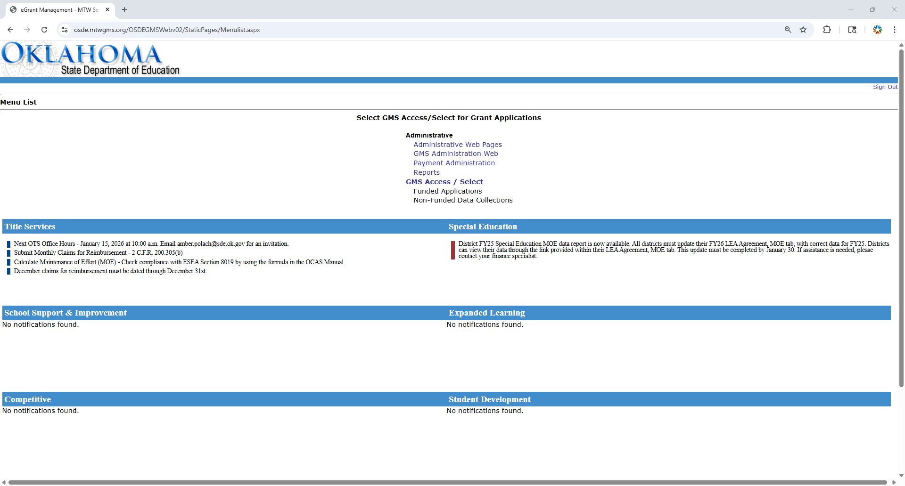
Due Date Communication

Slide 4
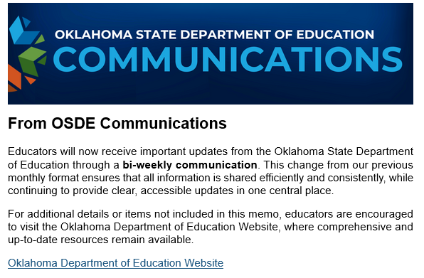
Due Date Communication

Slide 5
FY27 ESEA Consolidated Budget Application
Release Date – August 5, 2026
Due Date – September 30, 2026
Instructional document available.
Notes:
The vendor is still working on loading the Title III, Part A Consortia allocations.

Slide 6
ESEA Equitable Services to Nonpublic Schools
OTS will host a training opportunity for districts that have participating nonpublic schools.
September 29, 2026
1:00 p.m.
Registration

Slide 7
ESEA Equitable Services to Nonpublic Schools
In the ESEA Consolidated Budget Application, the Nonpublic School pages are not ready.

Slide 8
Family Engagement Training Opportunity
Five Simple Principles to Engage Every Family
When: Sept. 22
Where: Moore Norman Technology Center
Time: 9 a.m. - 3:30 p.m.
Click here for more information!
Registration Link: https://events.bizzabo.com /954385/home
Notes:
Dr. Constantino

Slide 9
OSDE’s Family and Community Engagement
Family & Community Engagement
Notes:
Dr. Constantino

Slide 10
Grants Management Year-At-A-Glance
Grants Management Year-At-A-Glance

Slide 11
Grants Management Year-At-A-Glance
September
Conduct a beginning of year evaluation of the federally funded services after the benchmark assessment is completed.
Establish rank order lists, based on multiple criteria, of students most at risk of failing in a Title I Targeted Assistance Program, create Title I, Part A staff schedules, begin services when all universal screening and data-collection is completed and analyzed.

Slide 12
Grants Management Year-At-A-Glance
Obligate the Title I, Part A: 2nd Year Carryover before September 30.
Collect any extra duty or stipend documentation to submit for a claim for reimbursement.
Collect Monthly Personnel Activity Reports as time distribution records (TDR) for employees working on multiple cost objectives (jobs) AND paid with multiple funding sources.

Slide 13
Office Hours Topics
Refresher on time distribution record requirements?

Slide 14
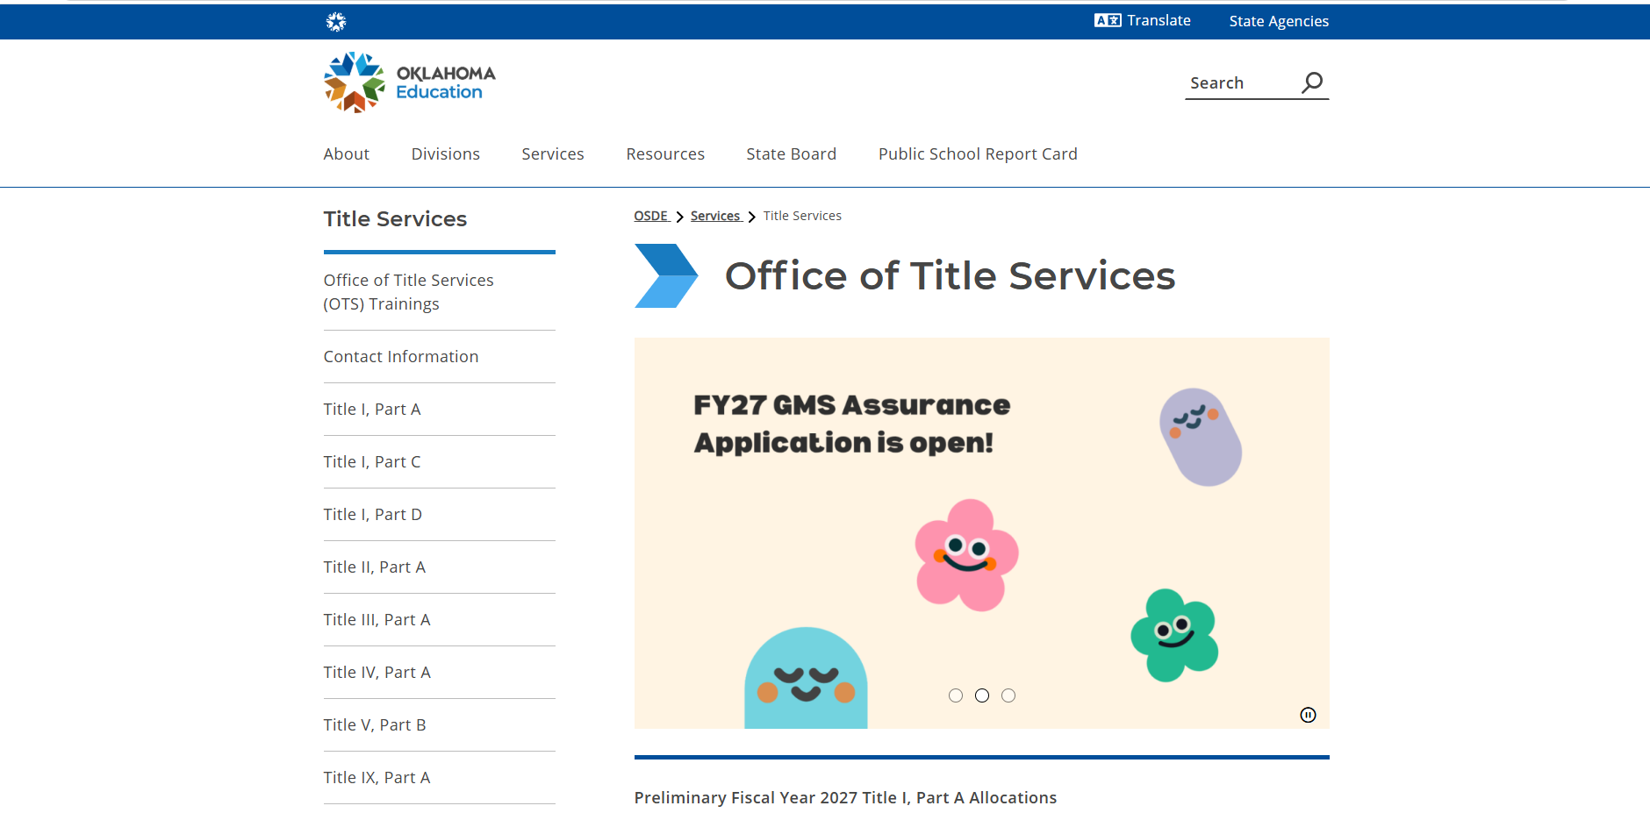
Office of Title Services (OTS) Webpage

Slide 15
Contact Information
Phone: (405) 521-6850
Email: FirstName.LastName@sde.ok.gov
Address: 2500 North Lincoln Boulevard Oklahoma City, Oklahoma 73105-4599
Website: Office of Title Services
Office of Title Services

