Slide 1
Tiered Process for Exception
November 30, 2023
Notes:
Welcome to the Tiered Process for Exception presentation.

Slide 2
Introduction
Locating Information
Expectations
Contact Information
Notes:
The topics are as follows.

Slide 3
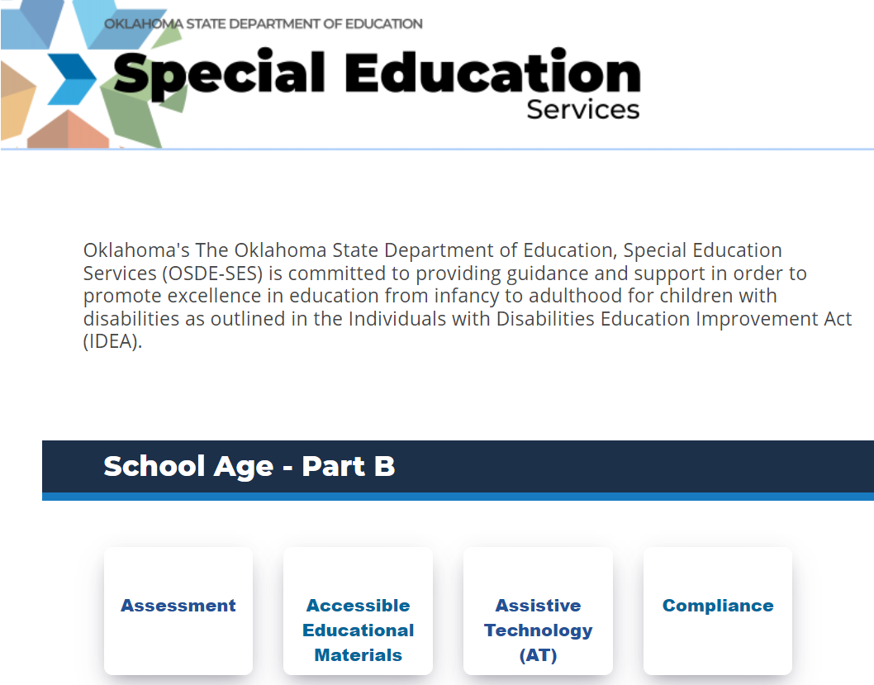
Notes:
This information is located on the compliance page on the sde website.

Slide 4
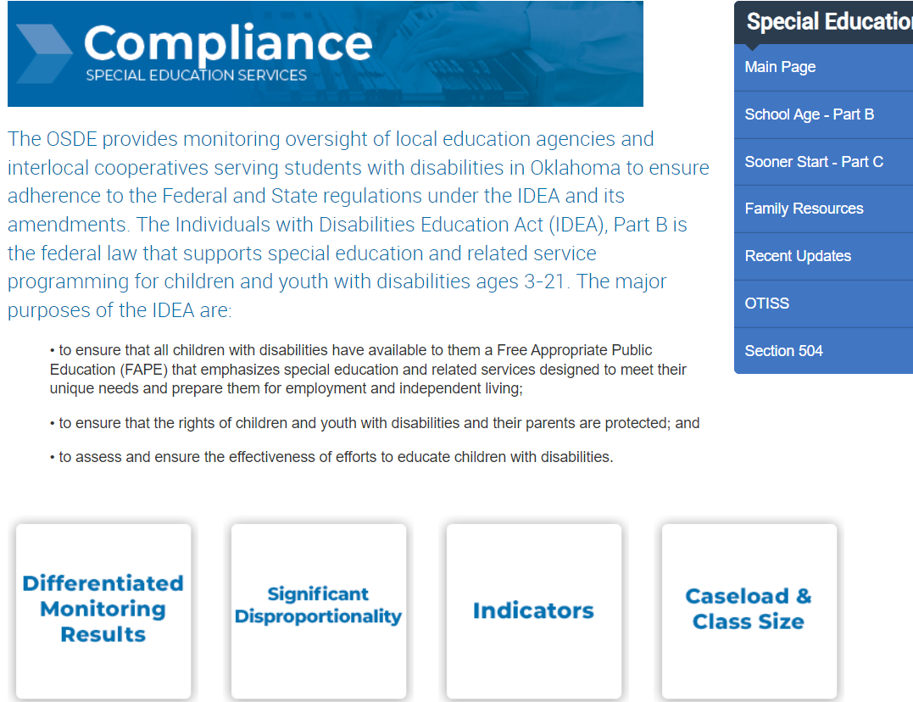
Notes:
Select Differentiated Monitoring Results (DMR)

Slide 5
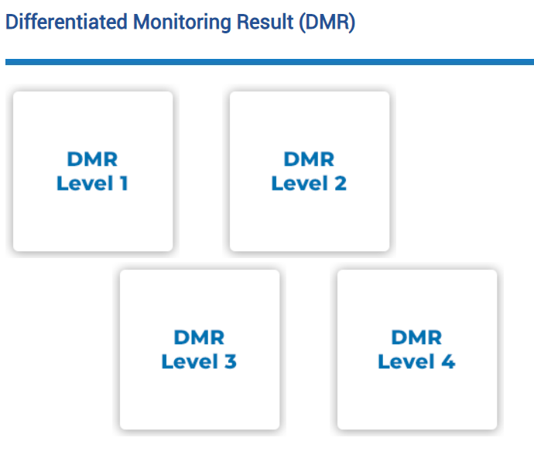
Notes:
Select the appropriate DMR Level

Slide 6
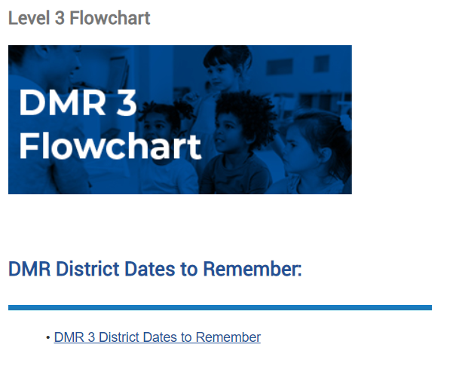
Notes:
The Flowchart will provide information for Indicators 4, 9, & 10; 11, 12, & 13, and 1, 2 3, 7, and Fiscal .
Exception expectation information can be found here.

Slide 7
Notes:
The Compliance Dates to Remember will provide you with all the dates for all your expectations including the Exception Requirements.

Slide 8
Exception
If a district has been identified noncompliant and/or not met state target in the same area/indicator for three consecutive years, the district must also complete additional activities.
Activities are developed on a tiered system depending on the number of consecutive years for an area with a growth measure built in.
Notes:
If a district didn’t meet the target three consecutive years for the same area/indicator, you’ll need to complete additional activities.
The purpose of the activities is for the LEA to work with the staff and community as a team to meet compliance requirements and performance expectations.
You can review the current DDP and the past 2 years DDP to determine if you fall in this group.
If you want additional detailed information reference pages 14-16 in the General Supervision System.

Slide 9

Exception:Tiered Process
Tier 1-3rd Year
Review past 2 years root cause findings
Tier 2-4th Year
Review past 3 years root cause findings
Tier 3- 5th Year Plus
Review past 4 years root cause findings
Utilize 615 funds to address improvement plan.
Develop/utilize Parent Advisory Board
Use 615 funds to address improvement plan implementation.
Use 615 funds to address improvement plan implementation.
Develop/utilize parent advisory board.
Invite parents of students with disabilities to school board meeting.
Notes:
Activities are developed on a tiered system based on the number of consecutive years for one area with a growth measure built in.
If a 10% growth is demonstrated while implementing the improvement plan, the current tier will be the same for the next year. If there is not growth or decline the district can move to the next tier below placement.
Note: Beginning this school year 23/24, if the district is identified as DMR Level 3 or DMR Level 4 and did not complete the confidential student file monitoring by the deadline may receive a Notice on the accreditation report.
You can reference the General Supervision System for additional detailed information on pages 14-16.

Slide 10

General Supervision System
Notes:
23/24 General Supervision System Manual is located on the sde website under compliance.
Reference pages 14-16 for information for continuous noncompliance and/or not meeting target in multiple years.

Slide 11
615 Funds
Must be budgeted for the full amount no later than
December 1, 2023
Budget it with a placeholder
After the team has developed the new plan, and the SDE has approved the plan, the budget can be amended to align with the plan.
Notes:
Project 615 Funds must be budgeted by December 1st. The budget can be amended after the plan has been developed to align with the plan.

Slide 12
615 Budget ideas
Stipends for after school hours to review data/plan progress
Travel to another district to gain ideas
Contracting with someone to support the district
Notes:
These are some things to consider when budgeting 615 funds

Slide 13

Completing the Requirements
Gather
Gather a team
Review the past two years’ root cause to assist in developing an improvement plan.
Identify
Identify the plan to utilize 615 fund to support improvement plan.
Invite
Invite parents/community to school board meeting to discuss the plan for improvement
Notes:
When completing requirements make sure you gather a team. Identify the plan to utilize 615 funding.
Invite parents and community to a school board meeting to discuss the improvement plan.

Slide 14
Dates to Remember
1 Dec. 2023
Budget 615 funds
March 31, 2024
First Progress Review
Jan-May 2024
Implement Plan
May 31, 2024
Professional Development
Final Progress Review
January 12, 2024
Toolkits due in EdPlan
30 June 2024
Project 615 funds spent
Notes:
This is a summary of the expectations. You will need to keep the Dates to Remember document that also includes the expectations for Exceptions LEAs.
Budget 615 funds
Toolkits due by January 12th
Implement your plan Jan-May
Submit progress reviews in March and May
Submit Professional Development in May
Make sure funds have been expended by June 30th

Slide 15
Contact Information

Slide 16
Contact Information: Compliance Team
Felica Denton
Fiscal Monitoring Coordinator
Felica.Denton@sde.ok.gov
405-522-9562
Megan Withers
Early Childhood Specialist
Megan.Withers@sde.ok.gov
405-522-5168
Tina Spence
Assistant Program Director of Special Education Services
Tina.Spence@sde.ok.gov
405-521-4513

