Slide 1
Differentiated Monitoring System
Indicators 11, 12, & 13
Notes:
Welcome to the presentation for Indicators 11, 12, & 13. This session is recorded and posted on the Compliance page of the SDE website as well as the power point. This will allow you access to review the information as needed.

Slide 2
Introduction
Indicator 11, 12, 13
Understanding the Indicators
Website Updates
Timelines
Introduction to EdPlan Monitoring Tool
Recap
Contact Information
Notes:
Topics to discuss
We will be discussing the indicators in-depth, including data to review as districts work on their indicator toolkits.

Slide 3
Indicators 11, 12, & 13
Required Activities
Notes:
First, let’s talk about the required activities for these indicators

Slide 4
Who | Required | What | When
If the district was identified of noncompliance and /or did not meet the 100% state target, complete the required activities. | Required | Complete the appropriate toolkit for the indicators below 100% Address the guiding questions Identify the root cause. Develop improvement plan | January 12, 2024
 | Required | Review improvement plan progress twice: 1st progress plan review 2nd progress plan review | March 31, 2024 May 31, 2024
 | Required | Professional Development | May 31, 2024
Notes:
If a district was identified noncompliant and/or did not meet state target, the activities listed must be completed.

Slide 5
Exception
If a district has been identified noncompliant and/or not met state target in the same area/indicator for three consecutive years, the district must also complete additional activities.
Activities are developed on a tiered system depending on the number of consecutive years for an area with a growth measure built in.
Notes:
If a district did not meet the target three consecutive years for the same area/indicator, they will complete additional activities.
The purpose of the activities is for the LEA to work with the staff and the community as a team to meet compliance requirements and performance expectations.
If the district has been identified as having a three year exception, there is an additional recorded presentation with additional detail, that will be located on the Compliance landing page, and titled “three year exception”
To determine if you fall in this group, you will need to locate and review the current DDP, as well as the previous two DDPs. Your monitoring coordinator will also be in touch with you about this.
For additional detailed information reference pages 14-16 in the General Supervision System manual.

Slide 6

Exception: Tiered Process
Tier 1-3rd Year
Review past 2 years root cause findings
Tier 2-4th Year
Review past 3 years root cause findings
Tier 3- 5th Year Plus
Review past 4 years root cause findings
Utilize 615 funds to address improvement plan.
Develop/utilize Parent Advisory Board
Use 615 funds to address improvement plan implementation.
Use 615 funds to address improvement plan implementation.
Develop/utilize parent advisory board.
Invite parents of students with disabilities to school board meeting.
Notes:
These activities are developed on a tiered system based on the number of consecutive years for one area with a growth measure built in.
If a 10% growth is demonstrated while implementing the improvement plan, the current tier will be the same for the next year. If there is not growth or decline the district can move to the next tier below placement.
Note: Beginning this school year 23/24, if the district is identified as DMR Level 3 or DMR Level 4 and did not complete the confidential student file monitoring by the deadline may receive a Notice on the accreditation report.
Again, refer to General Supervision System for additional detailed information on pages 14-16.

Slide 7

Located on the Special Education Services landing page, with the current Policy & Procedures handbook

Slide 8
Indicator 11 Child Find
Indicator 11 Percent of children who were evaluated and eligibility determined within 45 school days of parent consent.
Purpose
This district has been notified of noncompliance for indicator 11. Please refer to the Annual District Determination and District
Data Profile for results. Districts are federally required to resolve and address noncompliance at the student and systemic level.
Address the Guiding Questions and describe the root cause of noncompliance (by January 12th).
Develop an improvement plan (including professional development aligned to the indicator (by January 12th).
Submit an assurance statement signed by the Superintendent and Special Education director ensuring correction of noncompliance to 100% in accordance with 34 CFR 300.600(e) (by January 12th).
Review the progress of the improvement plan twice (by March 31st and again by May 31st).
Submit professional development documentation (summary and sign-in sheets (by May 31st).
Notes:
Indicator 11 Toolkit activities. We’ll talk more about locating the toolkit in a moment. Here you’ll see the activities required within the toolkit, as well as the dates items are due. These dates are also listed on the dates to remember form

Slide 9
Indicator 11 Child Find Actions
Step 2: As a team, consider why the district did not meet 100% compliance for this indicator by addressing the guiding questions below. Data and other information the team feels is relevant should also be considered.
If noncompliant last year for Indicator 11, describe the progress made last school year. Explain the next steps for improvement.
Describe the processes to conduct evaluations that determine the student's strengths and needs if identified as needing an initial evaluation for possible special education services.
Describe the professional development training provided to staff for initial evaluations and eligibility determinations to ensure compliance with the 45-day time frame.
Describe how the Review of Existing Data (REDs) is utilized to document current data that assists the team in identifying the next steps for the student.
Describe the staff's procedures to document allowable exceptions to the timeframe 100% of the time.
Explain the policy and/or procedures for staff detailing the process from the date of parent consent to eligibility.
Notes:
Indicator 11 guiding questions. Once the team has been identified, one of the first activities is to review the guiding questions. This will assist the team as it considers the available data and what factors affected the district’s indicator 11 data. Once these questions have been considered, a summary should be included in the indicator toolkit.

Slide 10

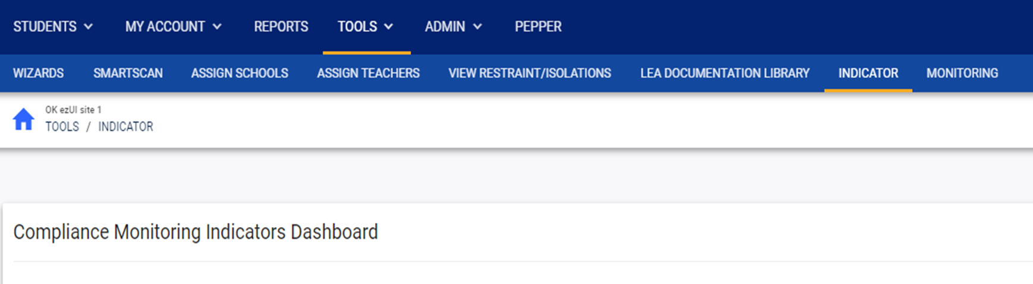
Notes:
Now we’re going to locate the indicator toolkit for indicator 11.
In EdPlan, when you click Tools, the secondary menu bar opens, and you will click on the Indicator tab.

Slide 11
Notes:
Select indicators on the menu bar.

Slide 12
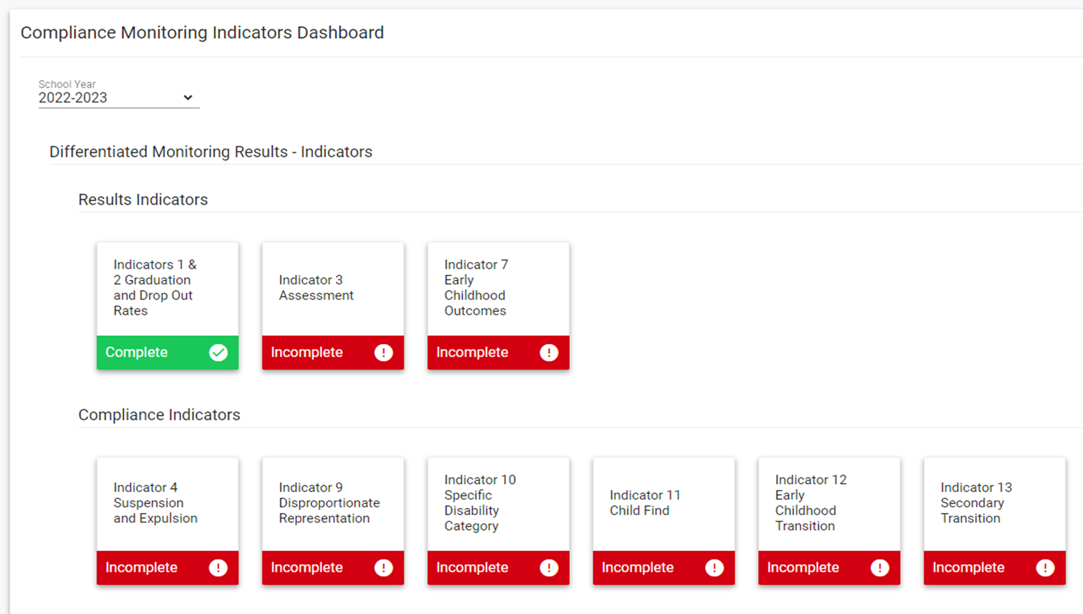

Notes:
Select the current school year.
You will be able to return to the previous year’s plan to review the plan and progress from the previous by selecting the previous year.
This will assist you with completing the current year’s plan.

Slide 13
Notes:
Select the appropriate indicator and open it. .

Slide 14
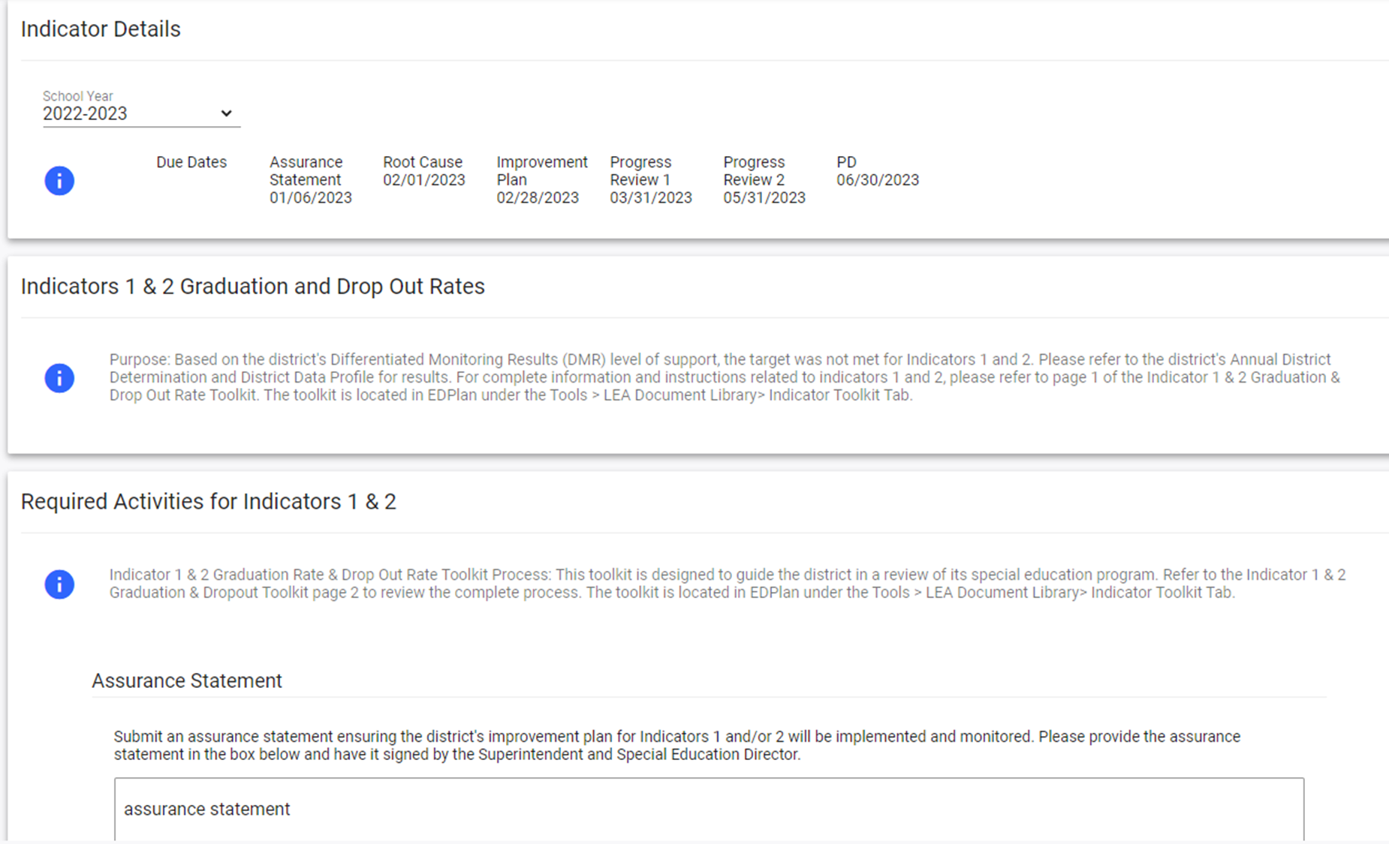

Notes:
The Indicator tile will open to the indicator detail page. Select the current year.

Slide 15
Notes:
Review the indicator details and due dates for documentation timelines.

Slide 16
Notes:
Each toolkit will list the purpose of the indicator.

Slide 17
Notes:
Each toolkit will list the required activities.
There is a reminder of where toolkits are located ensuring you have all the necessary information.

Slide 18
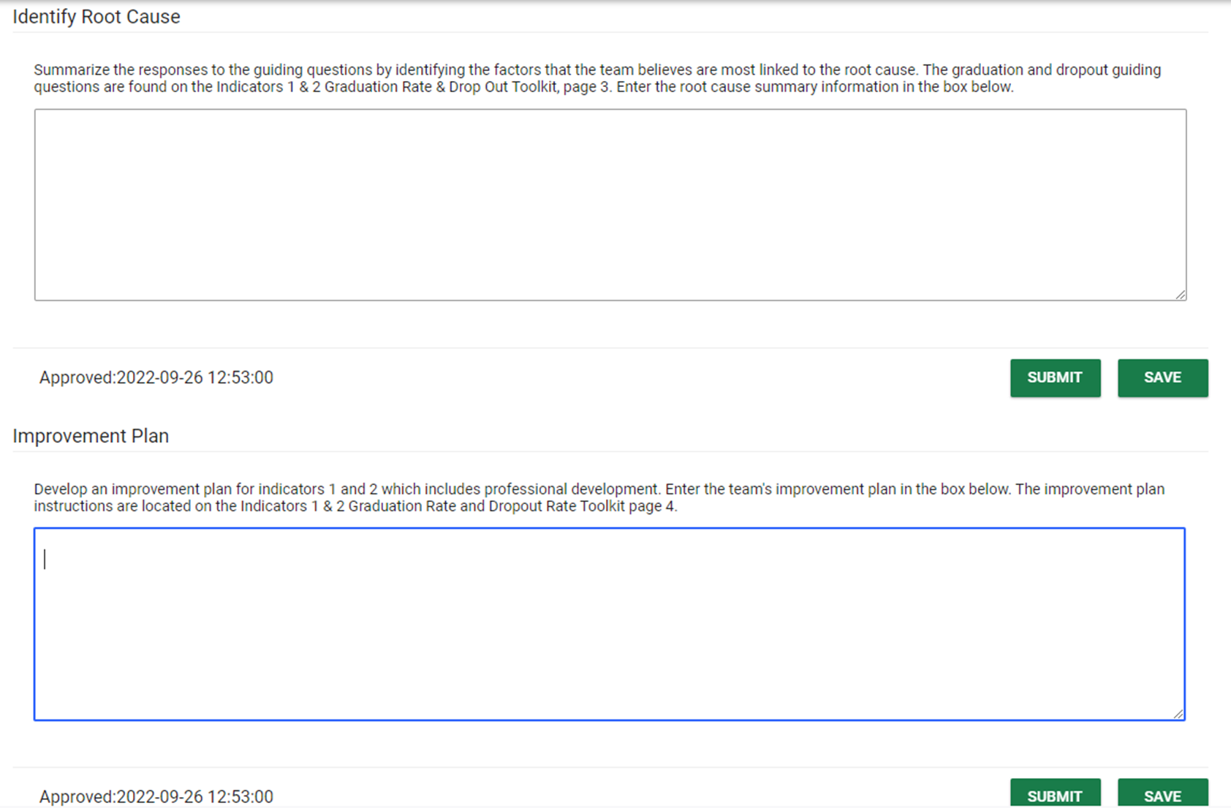

Notes:
Identify and submit the root cause summary here.

Slide 19
Notes:
Detail the improvement plan here and submit.

Slide 20

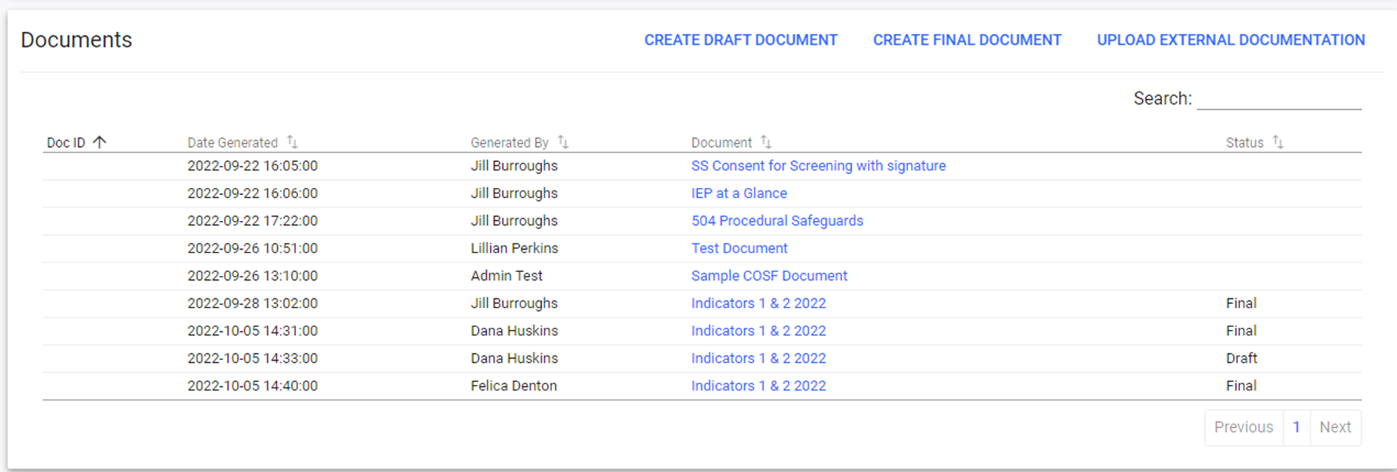
Notes:
Upload any supporting documentation here.
Located at the bottom is where you will upload supporting documentation. Please title your uploads with a title that describes what the file is.

Slide 21

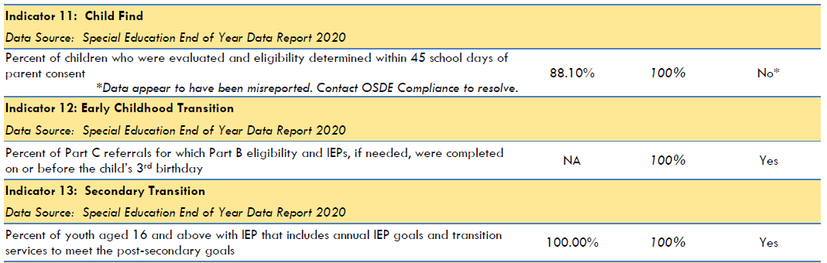
DDPs for Indicator 11, 12, & 13
Notes:
Review the DDP for compliance results. This is noncompliant the target is 100%.

Slide 22
DDPs for Indicator 11, 12, & 13
Notes:
Review the DDP for compliance results. In this case, the LEA score was less than the state target of 100%, so the target was not met.

Slide 23
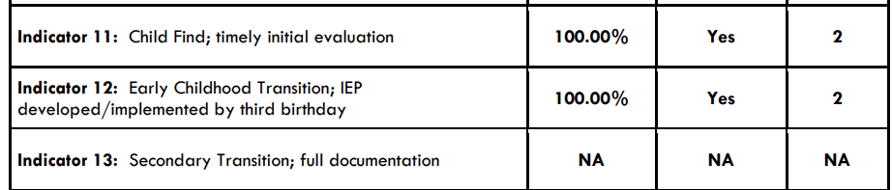
Determinations for Indicator 11, 12, & 13
Notes:
The target was met.

Slide 24
Determinations for Indicator 11, 12, & 13
Notes:
You can also review the Determinations for compliance results. The 100% target was met and points were received.
Don’t click until finished here!!

Slide 25
Understanding the Indicators
Notes:
Next let’s look at the specific indicators and where districts can find additional data related to each indicator

Slide 26
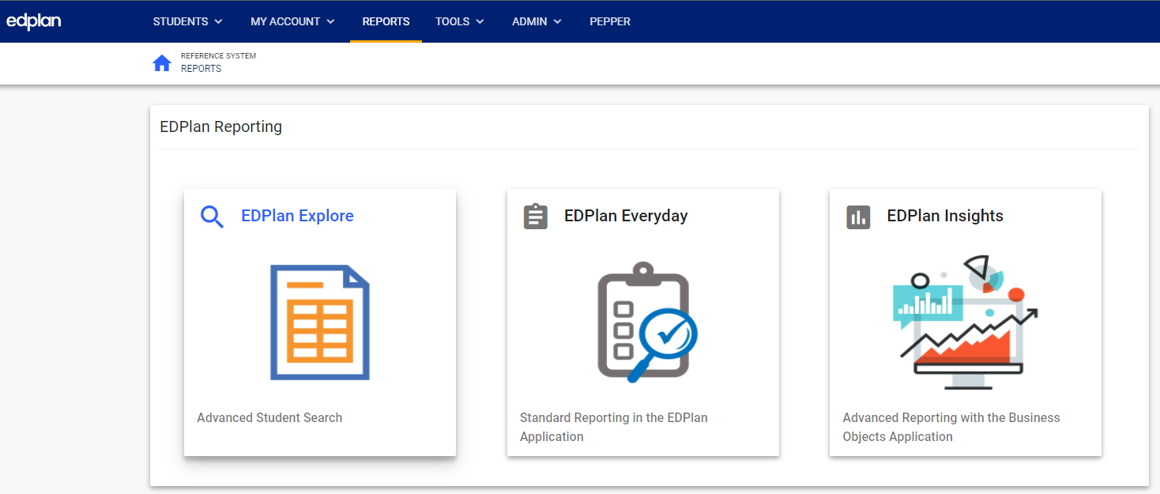
Notes:
Using EdPlan reports is one way to access data for root cause analysis. To access the reporting in EdPlan, select Reports on the menu page.

Slide 27
Notes:
Select EdPlan Insights.

Slide 28
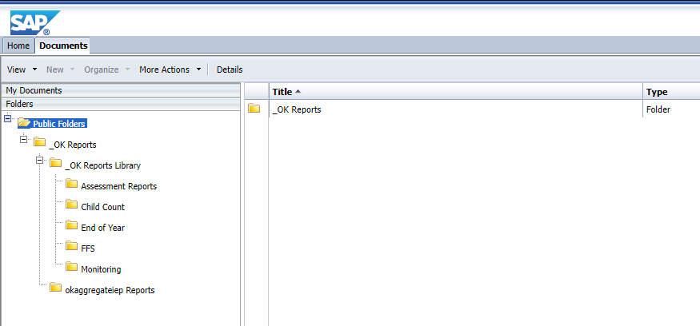
Notes:
Select Public Folders, then OK Reports

Slide 29
Notes:
OK Reports Library

Slide 30
Indicator 11
Indicator 11 – Child Find
  percent of children with parental consent to evaluate, who were evaluated, and eligibility was determined within 45 school days.
Notes:
Indicator 11 is for the percent of children with parental consent to evaluate, were evaluated and had eligibility determined within 45 school days.

Slide 31
Consider the Following
Data to consider
  EdPlan – Advanced Reporting – Eligibility Timeline Report
Questions to consider
  Does your district have established detailed written policy and procedures for initial evaluations?
  All staff receive ongoing professional development for providing an initial evaluation and making eligibility determinations within the required 45-day timeline.
  Who or how are you monitoring to ensure the timeline is met?
Notes:
This is what you want to consider.

Slide 32
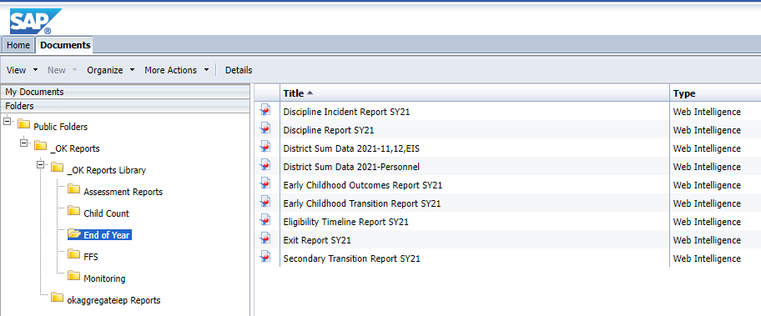
Notes:
The data can be accessed in EdPlan, to review the data go to Advance Reporting>End of Year

Slide 33
Notes:
Select Eligibility Timeline Report

Slide 34
Indicator 12
Indicator 12 – Early Childhood Transition
  percent of children transitioning from the Part C program found eligible who had an IEP by their third birthday.
Notes:
Indicator 12 is the percent of children referred from Part C with eligibility completed and IEP in place by their third birthday.

Slide 35
Consider the Following
Information to consider
  EdPlan – Advanced Reporting
    Early Childhood Transition Report
    Initial Eligibility Timeline
Questions to consider
  How does your district respond to LEA notifications?
  Do you communicate regularly with your local SoonerStart staff?
  Are your staff attending Transition Planning Conferences (TPC)?
Notes:
This is what you want to consider.

Slide 36
Notes:
The information is in EdPlan, go to Advance Reporting>End of Year.

Slide 37
Notes:
Select Early Child Transition.

Slide 38
Indicator 13
Indicator 13 – Secondary Transition
  Percent of youth with IEPs who meet secondary transition requirements.
Notes:
Indicator 13 is the percent of youth meeting secondary transition requirements with IEPs.
Make sure you finalize within the timeline.

Slide 39
Consider the Following
Data to consider
  EdPlan – Advanced Reporting – Current IEP/Eligibility Compliance & Secondary Transition Annual Goals
Questions to consider
  Are the secondary transition annual goals updated annually?
  Are IEPs completed with secondary transition information by the anniversary date? Are staff finalizing documents quickly after the meeting?
  Is there evidence that the measurable postsecondary goals were based on age-appropriate transition assessments?
Notes:
This is what you want to consider.

Slide 40
Notes:
The information is in EdPlan, go to Advance Reporting>End of Year.

Slide 41
Notes:
Select Secondary Transition Report

Slide 42
Sample Goal
Weak
  Will provide staff training regarding Child Find.
Strong
  After a review of the reasons for not meeting child find, we have identified the need to develop guidelines for staff to follow. This will ensure all staff follow the same expectations from parent consent to eligibility. Once the guidelines are implemented, data will be monitored to identify strengths and areas of continued improvements.
Notes:
Next, we are going to look at examples of tasks completed, and what would be considered a strong example of each
This is an example of a sample goal.
Note the detail involved in the second one.

Slide 43
Sample: Progress Review
Weak
  Professional development was provided on February 25, 2021.
Strong
  We have developed guidelines for child find and provided staff training on the new expectations. We also reviewed the expectations for initial eligibility timelines. As of today, it appears the plan is appropriate and staff are demonstrating compliance. We plan to continue to implement the current plan and monitor to ensure compliance.
Notes:
Here we have to examples of a progress review. Again – note how much more detail (while still being just a paragraph) is involved in the second one.

Slide 44
Sample: Progress Review
Weak
  Progress
Strong
  After developing the guidelines for child find and providing training, the data has indicated all initial eligibility timelines have been held within 45 days of parent consent.
Notes:
Here’s another one.

Slide 45
Website Updates

Slide 46
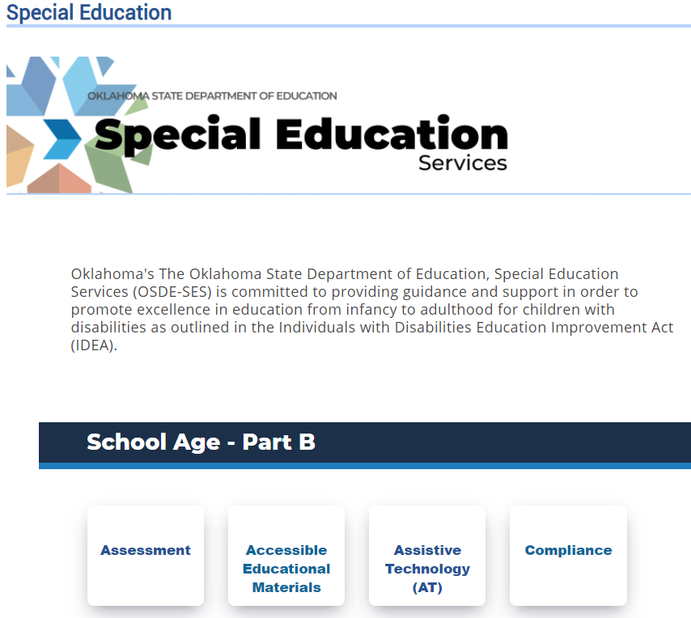

Notes:
The compliance tab on the OSDE-SES website is where numerous resources are located. Special Education > Compliance

Slide 47
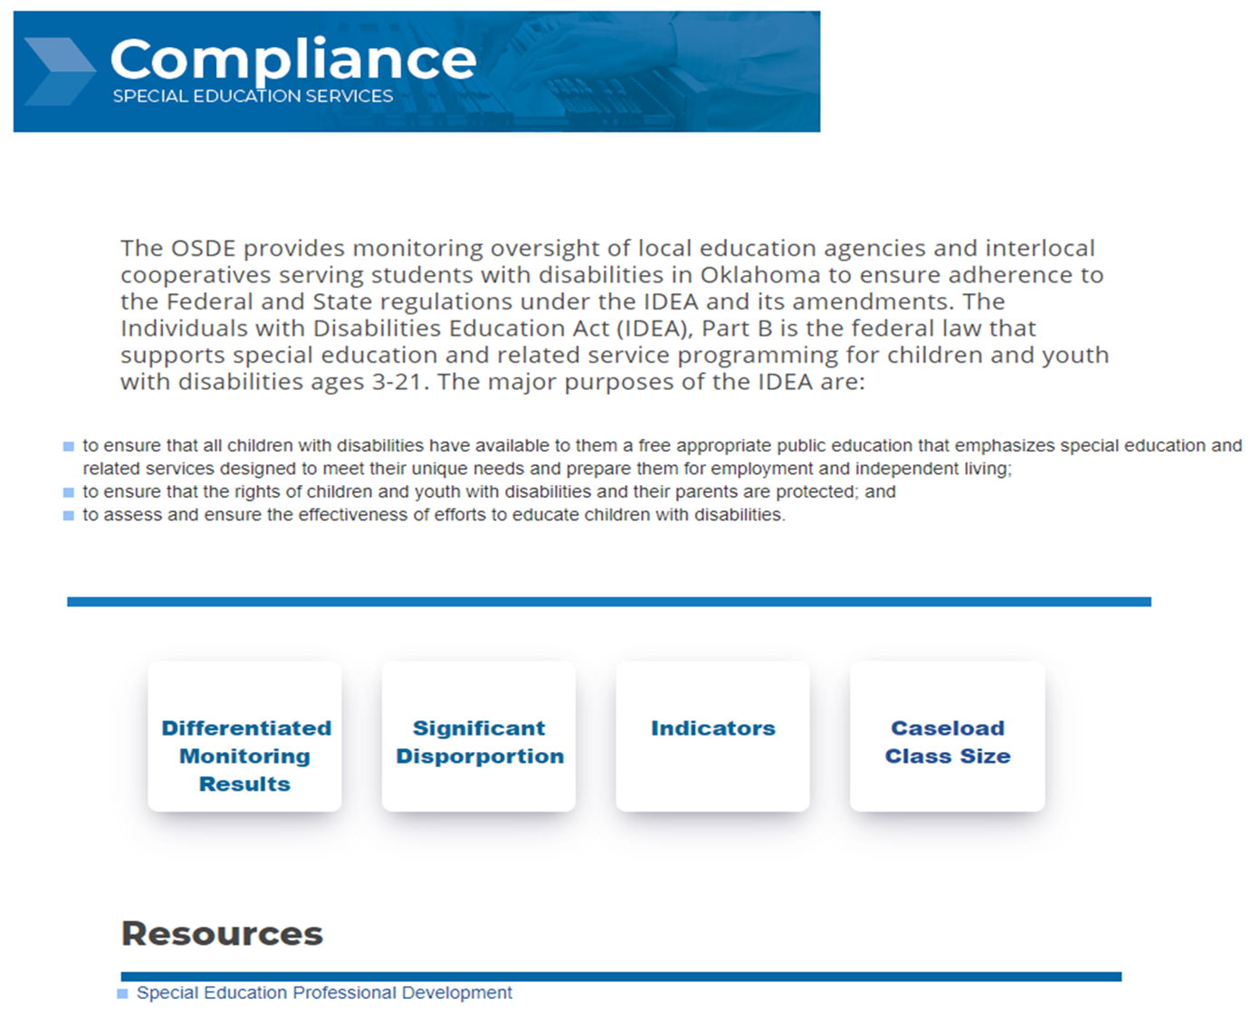

Notes:
Select Indicators.

Slide 48
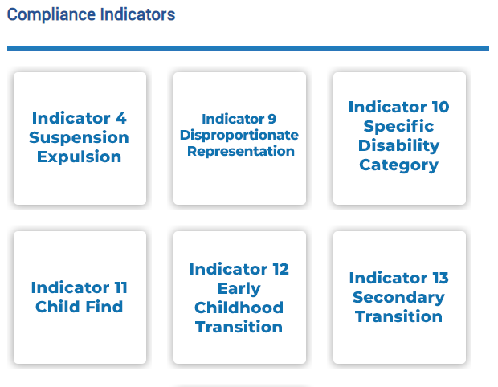

Notes:
This is one place to find specific indicator information and resources.

Slide 49
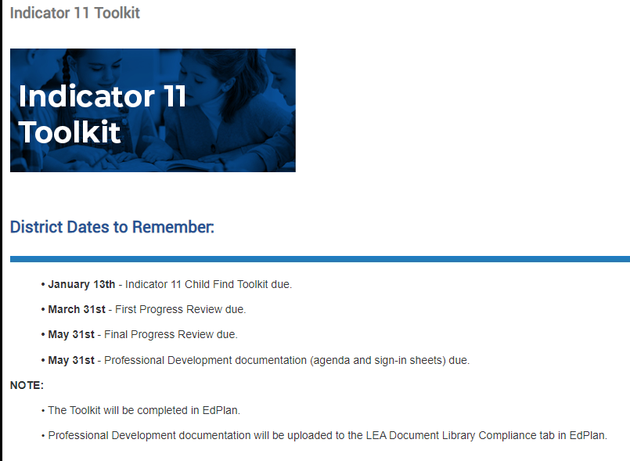

Notes:
These resources include the Dates to Remember
Toolkit due January 12th
DMR and Compliance Dates to Remember has information dates for all activities

Slide 50
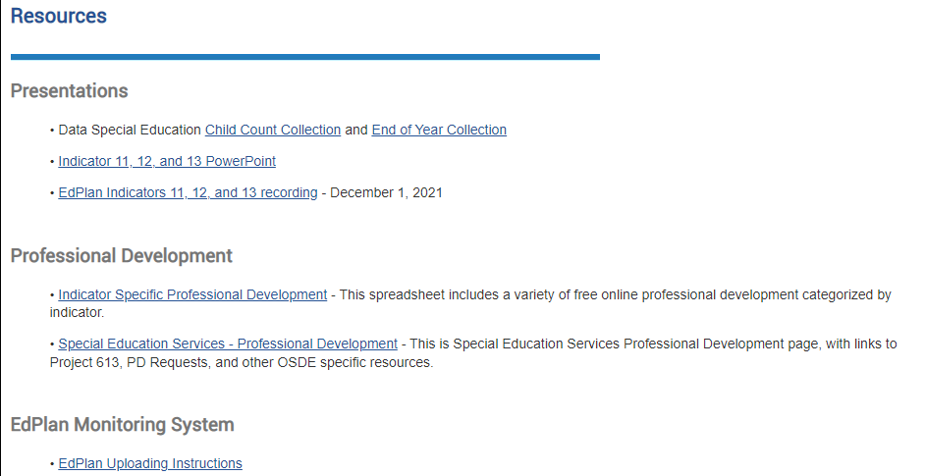
Notes:
This section will be updated and include all Compliance presentations.

Slide 51
Timelines

Slide 52

Timelines
January 12, 2024
  Complete the Toolkit located in EdPlan
March 31, 2024
  First Progress Review
May 31, 2024
  Final Progress Review
  Professional Development

Slide 53
Recap

Slide 54
Activities
Complete the Toolkit aligned to the appropriate indicator.
1
Address guiding questions, identify root cause, develop and implement the improvement plan.
2
Review improvement plan progress.
3

Slide 55
Contact Information

Slide 56
Contact Information: Data Team
Travis Thompson
Project Manager of Data
Travis.Thompson@sde.ok.gov
405-522-5203
Brooks Sawyer
Specialist of Data
Brooks.Sawyer@sde.ok.gov 405-521-4871

Slide 57
Contact Information: Compliance Team
Felica Denton
Fiscal Monitoring Coordinator
Felica.Denton@sde.ok.gov
405-522-9562
Megan Withers
Project Manager, Early Childhood
Megan.Withers@sde.ok.gov
405-522-5168
Tina Spence
Assistant Program Director of Special Education Services
Tina.Spence@sde.ok.gov
405-521-4513

