Slide 1
Differentiated Monitoring System
Level 2 Support
Notes:
Welcome to the DMR Level 2 presentation

Slide 2
Introduction
What are differentiated monitoring results (DMR)
Summary/review of the required activities
Understanding the Indicators
Review Monitoring Activities
Contact Information
Notes:
Today we will:
Ensure you understand the Differentiated Monitoring Results commonly known as DMR.
Understand activities to assist in gaining a better understanding of why the district is struggling in specific areas.
Gain a better understanding of the indicators
Review the EdPlan Monitoring Tool.
And our contact information.

Slide 3
What is DMR
Notes:
Now let’s talk about our Differentiated Monitoring Results.

Slide 4
Differentiated Monitoring Result (DMR) System
The differentiated monitoring results system expands state monitoring of district performance into two areas beyond IDEA compliance:
  Fiscal risk to the state
  Student outcomes
This expansion meets two federal intents:
  A requirement to assess subgrantees’ risk to the state education agency (SEA)
  A goal to move towards “result-based accountability”
Notes:
Oklahoma’s Differentiated Monitoring Results, commonly known as DMR, expands our state monitoring of districts performance into two areas beyond IDEA compliance but look at a district’s fiscal risk to the state and student outcomes.
This system allows us to review a districts risk to the state education agency and to move towards a results-based accountability. Both of which are federally required.

Slide 5
Differentiated Monitoring Results (DMR)
OSDE-SES identifies each district’s DMR based on a Risk score and a Determination Rating (Accounts for IDEA compliance and student performance reporting requirements).
The DMR is reported as the level of support a district is assigned for the designated school/fiscal year.
Notes:
The DMR system assesses each district based on a Risk score and a Determination Rating. The risk score accounts for the districts risk to the SDE.
The Determination rating accounts for IDEA compliance and the student performance rating.
These two areas provide each district with the DMR Level of supports.
Refer to the General Supervision Manual for more detailed information. It can be located on the SDE website, compliance, DMR tab.

Slide 6
Level 2 Expectations
Required Activities
Notes:
In this section we will discuss information specific to DMR Level 2 districts.

Slide 7
What is Level Two Support?
Level Two Support assigned to districts identified as either:
Risk Tier 2 (Low Risk)
Four Levels of Support
Levels 1 to 4
Level 4 is most intensive, for districts that really struggle
Determination Level 2 (Needs Assistance)
Notes:
There are four differentiated monitoring result levels. Levels 1 to 4, with Level 4 being the most intensive.
You are here because you are struggling in either Risk or Determination.
To identify which area (s) you are needing to focus on for improvements , refer to the Special Education Data packet that was emailed to the Superintendent and Special Education Director.
The packet has a cover page summarizing the data. You can locate this information on the District Determination document and on the District Data Profiles.

Slide 8
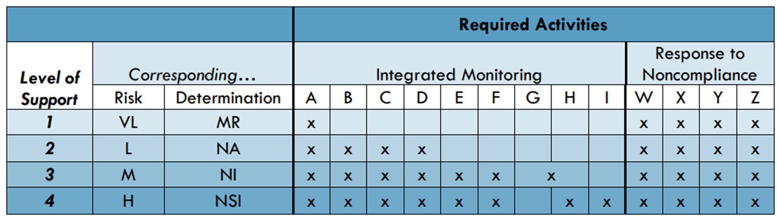

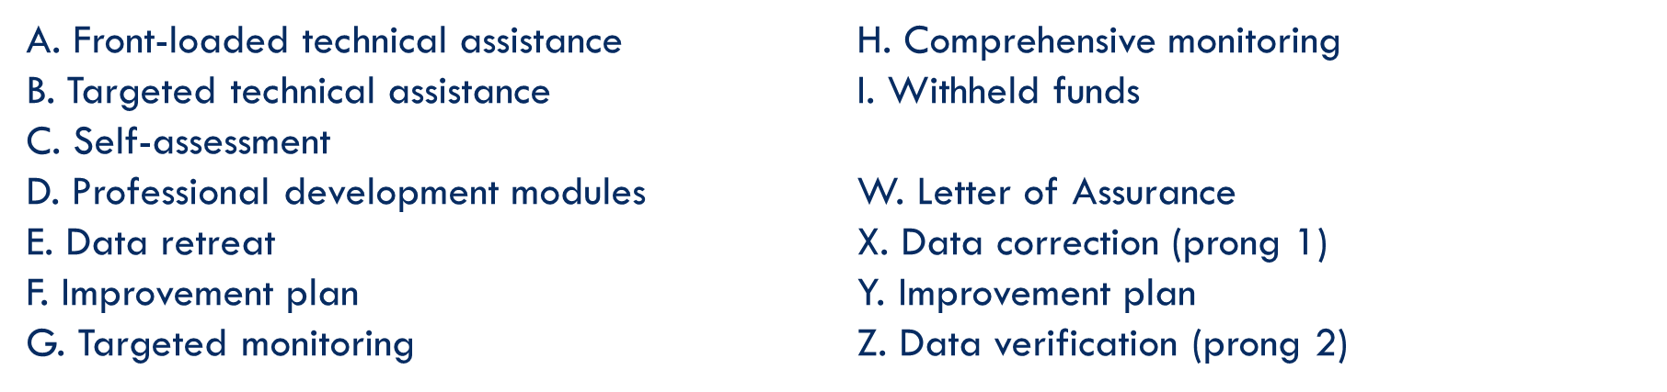
Notes:
This chart shows the expectations for each level.

Slide 9
Notes:
Here you see the corresponding columns for risk and determinations.
DMR Level of supports are identified by looking at your risk and determination score.
Which of the two is furthest from Level 1 will be your DMR Level of support and that will also be your focus of either Risk or Determinations.

Slide 10
Notes:
Under Required activities you will find the integrated monitoring activities for each level of support. Below you will find explanation for the integrated monitoring activities.
As you can see, Level 2 is expected to complete integrated monitoring activities A through D.

Slide 11
Notes:
The Response to Noncompliance, letters W through Z are required for all levels.
Each time we are working with a district to improve in an area required under IDEA, the SDE requires a letter of assurance to ensure the district will strive for compliance.
The improvement plan is your guide to improvement.
Improvement plans are reviewed to ensure the district has identified the root cause and also to determine what we can do to support the plan.
Last, there are data corrections (Prong 1) is to correct all data.
Prong 2 is for systemic compliance verification. The SDE is required to ensure the district has systemic compliance, meaning the learned knowledge has now been implemented across the district.

Slide 12
Level 2: Required Improvement Activities
Front-loaded technical assistance
Targeted technical assistance
Toolkit(s)
Professional development (PD)
Notes:
From the chart we just reviewed, here is the list of activities for DMR Level 2.
Front-loaded TA just means we will provide any TA needed to support the district.
Targeted TA is technical assistance specific to the areas of needed supports.
Toolkits are documents designed to assist the district with identifying the root cause, developing improvement plans, and identifying data to monitor progress.
Toolkits are located in EdPlan and must be completed in EdPlan. You can reference the toolkits on our website.
The district must also identify professional development to support the improvement plan. PD is not an improvement plan it is a step in the process.
The SDE recommends continuous data review to ensure movement towards compliance and to continue to review district data once a district is compliant to remain compliant.

Slide 13
Completing the Requirements
Meet with the team and review data to determine reasons for noncompliance
Establish PD to assist in correcting noncompliance
Document the identified PD
Verify root cause identified by the team
Notes:
The first step is to gather a team. This should never be one person developing a plan because then you are missing the views of other staff that may be vital for improvement.
The team should include the Special Education Director, special education teacher, an administrator, and general education teacher (if areas of need is early childhood, then the general education teacher should be employed to work with students in pre-K).
Review data and identify what is needed to assist the team to determine the root cause.
Then determine the root cause, develop an improvement plan with PD aligned to the improvement plan.

Slide 14

Data Review
Purpose: to decrease reasons for low achievement in a particular area
Content:
A series of “inquiring questions” that are intended to drive the search into low achievement
A series of “helpful hints” for data collections
A conclusion statement that summarizes the district’s search
An action statement defining improvement steps
A plan for the PD requirement
Notes:
Reviewing data is vital to ensure the root cause is identified to assist in making the improvement plan.
The data should identify the inquiring questions helping to identify additional data that assists in drilling down to the root cause.
Sometimes a district has to review data and inquiring questions several times before the true root cause is determined.
Reviewing progress, once the plan has been implemented, will determine if the true root cause has been determined. If no progress, the team may need repeat the data review process.

Slide 15

Toolkits
Complete
Complete the appropriate toolkits
Identify root cause
Develop improvement plan
Identify professional development (PD) Needed
Provide
Provide the PD & implement the improvement plan
Monitor
Monitor improvement plan and report progress twice.
Notes:
Completed toolkits in EdPlan.
Toolkits are intended to guide the district through the data review process to identify the root cause to develop a plan for improvement.
When the root cause is identified the district can develop and implement an improvement plan, then align PD needed for improvement.
The district is expected to monitor progress using data identified in the improvement plan. If the progress review indicates little to no progress, the district may need to return to the data review and root cause to identify the needed changes.
Use the progress reviews to identify progress or lack of progress. Do not wait to make changes to your plan. If the plan is needing changes, change it.

Slide 16
Goal
Weak Goal:
We will monitor our dropout numbers.
Strong Goal:
The team will meet monthly to identify students at risk for dropping out of school. We will implement a one-on-one mentoring program and identify students that may need additional supports. When needed, we will connect with our community partners to provide the needed supports for individual students.
At this meeting, we will assign staff to connect with students that have dropped out to provide support.
For the students at risk, we will identify strategies that are working and if needed, new strategies or community supports for each student and will continue to connect, support, and monitor.
Notes:
The next few slides are examples of weak and strong goals.
Here you see the weak goal stating:… It is clear the goal is not tied to any data and a true root cause has not been identified. We also do not have a clear understanding of how the district plans to monitor the data and what are they going to do with the information?
A strong goal will identify the plan so that everyone has a clear understanding of the process, who has what responsibilities for implementation, and what data will be used to determine the effectiveness of the plan.

Slide 17
Data
Weak
Obtain a report from the high school on the numbers of students that have dropped out of school each semester.
Strong
The team plans to review the number of students that have dropped out at our monthly meeting. We will compare the attendance and grades for these students.
The team will also identify students at risk for dropping out. To provide the appropriate supports to these students, we will review attendance data and grades.
Notes:
Here the weak goal states the district will review the dropout report each semester. It does not identify what they plan to do with the data. Another concern is that the district plans to look at the information twice a year. Reviewing data twice a year is not enough to make progress.

Slide 18
Progress Review Examples
Weak:
Data shows progress.
Strong:
As of today, we have assisted four students as they return to school. We have a staff assigned to each student to check in weekly. We still have two students we are still working with to encourage them to complete their education.
We have identified ten students at risk for dropping out of school and have assigned staff to meet regularly with them. In the past two months, we have noticed their attendance has increased by 10% and their grades have increased by 25%.
Notes:
Here is an example of a progress review. This is not expected to report to the SDE however it is highly recommended.
Twice this school year each district will be expected to report their progress towards the improvement plan. Once by March 31st and again by May 31st.
The weak example provides no specific information to help guide the team in determining if the plan is working or if the team needs to go back and review data and develop a revised plan.
The other example …..

Slide 19
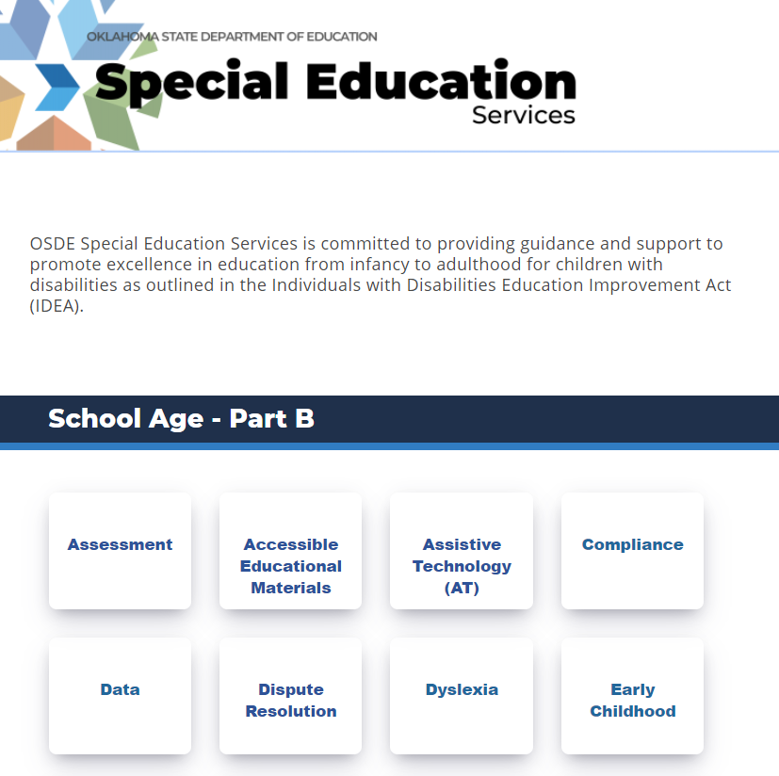
Notes:
The SDE is updating the website. Here you see the compliance tab under part B.

Slide 20
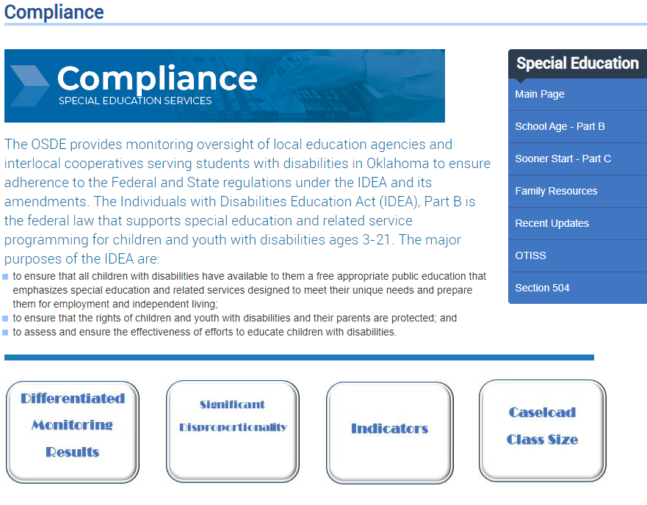
Notes:
This is the homepage for compliance. Here is the tab for caseload which will provide you the information and documents.

Slide 21
Notes:
This is the homepage for compliance. Here is the tab for DMR. Once you click on this tab, it will open for additional DMR level tabs.

Slide 22
Notes:
This is the homepage for compliance. Here is the tab for the IDEA indicators. Here you will find a tab for each indicator with information to gain a better understanding.

Slide 23
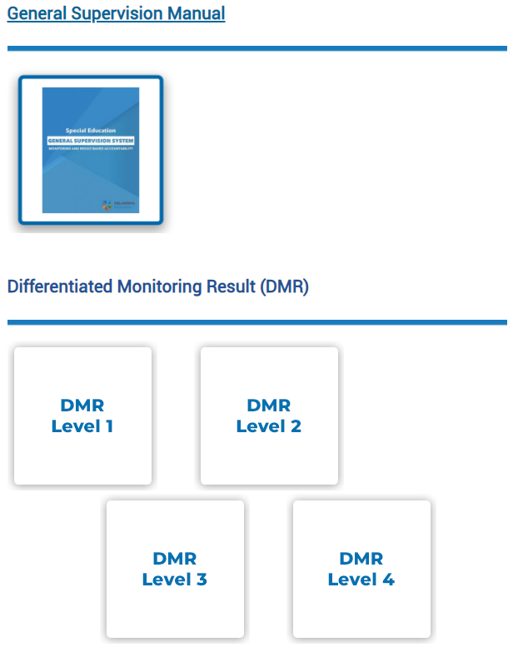
Notes:
Tab for the General Supervision System Manual.

Slide 24

Notes:
This is the 23/24 Updated General Supervision System

Slide 25
Professional Development: Expectations
The proposed PD should:
Connect to the most challenging area of performance/weakest indicator
Be designed to support district improvement in this area
The proposed PD must be described in the indicator Toolkit in EdPlan.
Title and description
Date
Audience
Notes:
*Reminder that PD is only a step in the improvement plan. It cannot stand alone. The PD should be aligned to the improvement plan.

Slide 26
Exception
If a district has been identified noncompliant and/or not met state target in the same area/indicator for three consecutive years, the district must also complete additional activities.
Activities are developed on a tiered system depending on the number of consecutive years for an area with a growth measure built in.
Notes:
If a district did not meet the target three consecutive years for the same area/indicator, you will complete additional activities.
The purpose of the activities is for the LEA to work with the staff and the community as a team to meet compliance requirements and performance expectations.
To determine if you fall in this group, you will need to locate and review the most recent and the past two year’s DDPs.
For additional detailed information reference pages 14-16 in the General Supervision System.

Slide 27

3-Year Exception: Tiered Process
Tier 1-3rd Year
Review past 2 years root cause findings
Tier 2-4th Year
Review past 3 years root cause findings
Tier 3- 5th Year Plus
Review past 4 years root cause findings
Utilize 615 funds to address improvement plan.
Develop/utilize Parent Advisory Board
Use 615 funds to address improvement plan implementation.
Use 615 funds to address improvement plan implementation.
Develop/utilize parent advisory board.
Invite parents of students with disabilities to school board meeting.
Notes:
LEAs will have additional required activities if found in noncompliance and/or have not met the state target in the same area/indicator for
three consecutive years.
Activities are developed on a tiered system based on the number of consecutive years for one area with a growth measure built in.
The purpose of these activities is for the LEA to work with district staff and the community as a team to meet compliance requirements and performance expectations.
If 10% growth is demonstrated while implementing the improvement plan, the current tier will be the same for the next year. If there is no growth or a decline the district will move to the next tier below placement.
Refer to General Supervision System for additional detailed information on pages 14-16.

Slide 28
Dates to Remember:
Toolkits due in (EdPlan)
Jan.–May 2024
Implement & monitor improvement plan
Progress review is due by March 31st
31 May 2024
Submit PD
Submit Final progress review
12 Jan. 2024
Notes:
This is a summary of the expectations.
Indicator toolkits are due for indicators 1 & 2, 3, 7, 11, 12, & 13 for fiscal January 12th
Improvement plan is expected to be implemented and monitored January through May
1st progress review due March 31st.
2nd progress review due
PD is due is May 31st.

Slide 29
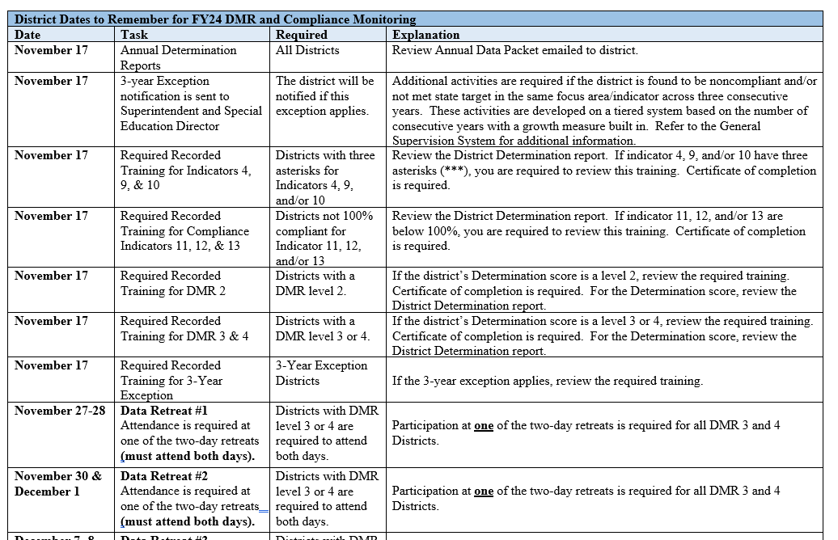
Dates to Remember
Notes:
23/24 Dates to Remember
The document is also located under compliance on the website.

Slide 30
Understanding the Indicators
Notes:
Now let’s review the indicators.

Slide 31
Assessment
Indicator 3A for reading and math (grades 4, 8, & 11): percent of students with disabilities participating in statewide assessments.
Indicator 3B at what rate are these students proficient or advanced on math and reading academic standards
  Always reported a year behind: 2022 results reported in Feb. 2023
  DDPs/Determinations based on the previous February APR submission.

Slide 32
Consider the Following
Data to consider
  State assessments for the past several years
  District benchmark data
Questions to consider
  What is the assessment data showing?
  How do you analyze data to determine program effectiveness for students with disabilities?
  Is the IEP developed and implemented to promote growth?
Notes:
What you should consider.

Slide 33
Early Childhood
Indicator 7 (A1, B1, C1): percent of students aged 3-5 that show improvement on their EC Outcome ratings between entry to and exit from the EC program.
  Data collected through the End-of-year data collection on June 30 for the previous full year.
  DDPs/Determinations based on the future February APR submission.

Slide 34
Consider the Following
Information to consider
  EdPlan Advanced Reporting – Early Childhood Outcomes report
  Policy, procedures, and/or practices
Questions to consider
  What tools are staff using to ensure consistent evaluation?
  Are parents and general education staff included in the entry and exit determination?
  How do you analyze data to assess whether early childhood students are improving?
Notes:
What you should consider.

Slide 35
Graduation
Indicator 1: percent of students with disabilities(IEPs) (ages 14-21) who graduated with a High School Diploma (reported as graduated).
  Source – exiting data for prior year pulled from EdPlan.
  DDPs/Determinations based on the future February APR submission.

Slide 36
Consider the Following
Data to consider
  Attendance data
  Suspension data
  State assessment data
Questions to consider
  How do you analyze attendance data to determine if there is a relationship between the attendance rates of students with and without disabilities who do not graduate on time and/or have dropped out of school?
Notes:
What you should consider.

Slide 37
Drop-out
Indicator 2: percent of students with disabilities(IEPs) (ages 14-21) dropping out of High School (reported as dropped-out).
  Source – exiting data for prior year pulled from EdPlan.
  DDPs/Determinations based on the future February APR submission.

Slide 38
Consider the Following
Data to consider
  Data on student’s reasons for dropping out (past two years)
  Transcripts of past two years students dropped out
Questions to consider
  Do you have a program to identify students at risk of dropping out?
  How do you analyze the transcripts of students who drop out? What have you learned?
Notes:
What you should consider.

Slide 39
Fiscal Risk (Finance)
Level 2 Support for Risk:
Not meeting Excess Cost requirements
Audit findings related to SPED
Working with finance staff is critically important to avoid Excess Cost and/or Audit findings
Notes:
*Review Risk Report sent out in annual November packet.

Slide 40
Consider the Following
Information to consider
Policy, procedures, and/or internal practices relating to funding requirements:
Maintenance of effort (MOE)
Claim submission process
Questions to consider
How do you monitor the use of Federal IDEA funds and state funds for students with disabilities?
Have you submitted a late claim? Why?
Notes:
What you should consider.

Slide 41
Introduction to EdPlan Monitoring

Slide 42
EDPlan Monitoring
Streamlines the monitoring process
Allows SDE and districts to maintain compliance documentation in one central location
Provides districts with a structure for ongoing internal monitoring
Streamlines the monitoring process
Allows SDE and districts to maintain compliance documentation in one central location
Notes:
All compliance monitoring is now set up in EdPlan.
The monitoring process is streamlined, and it is in a central location.

Slide 43

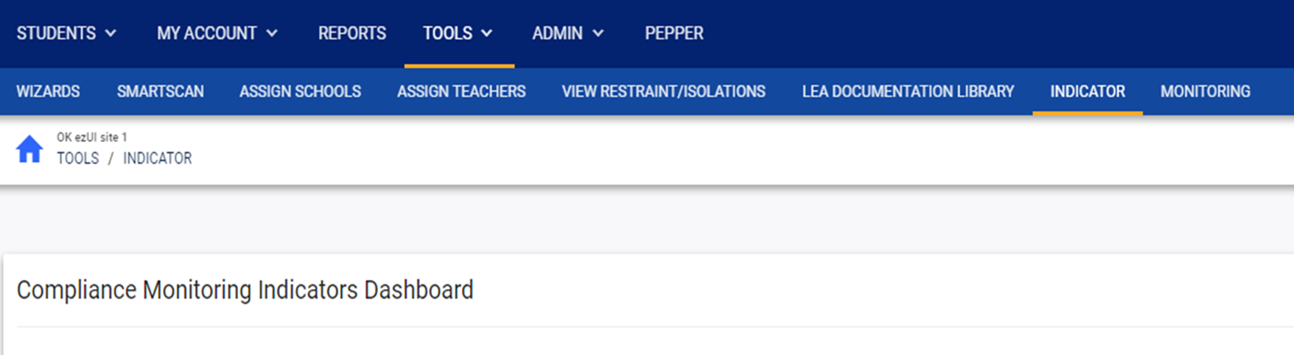
Toolkits
Notes:
Toolkits are located in EdPlan. Select Tools from the menu bar.

Slide 44
Indicator Toolkits
Notes:
Once you click Tools, the secondary menu bar opens, and you will click on the Indicator tab.

Slide 45
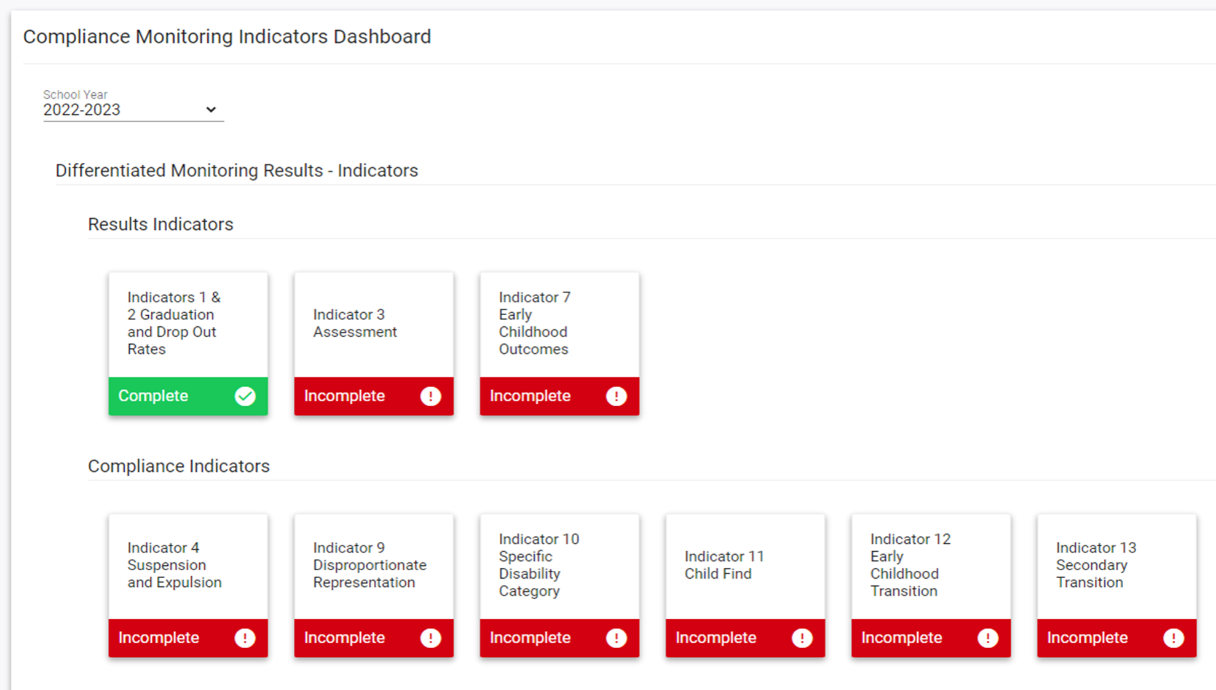

Notes:
Select the current school year.
You will be able to return to the previous year’s plan to review the plan and progress from the previous by selecting the previous year.
This will assist you with completing the current year’s plan.

Slide 46
Notes:
Select the appropriate indicator and open it.
If the indicator is noncompliant , you will be able to open the indicator. If it is compliant, you will not be able to access it.

Slide 47
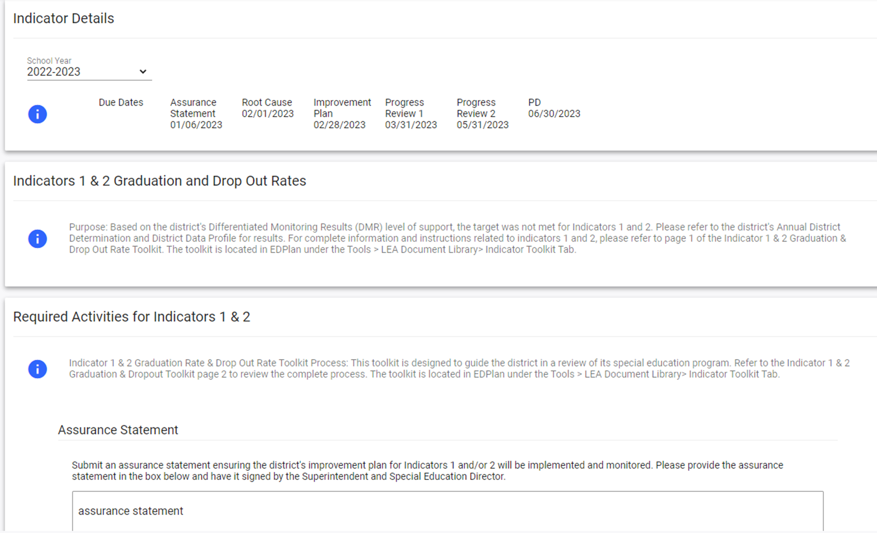

Notes:
The Indicator tile will open to the indicator detail page. Select the current year.

Slide 48
Notes:
The Indicator tile will open to the indicator detail page. Review timelines.

Slide 49
Notes:
Each toolkit will list the purpose of the indicator with a reminder for the toolkit location.

Slide 50
Notes:
Each toolkit will list the required activities.
Complete the Assurance Statement.

Slide 51
Notes:
Each toolkit will list the required activities.
There is a reminder of where toolkits are located ensuring you have all the necessary information.

Slide 52
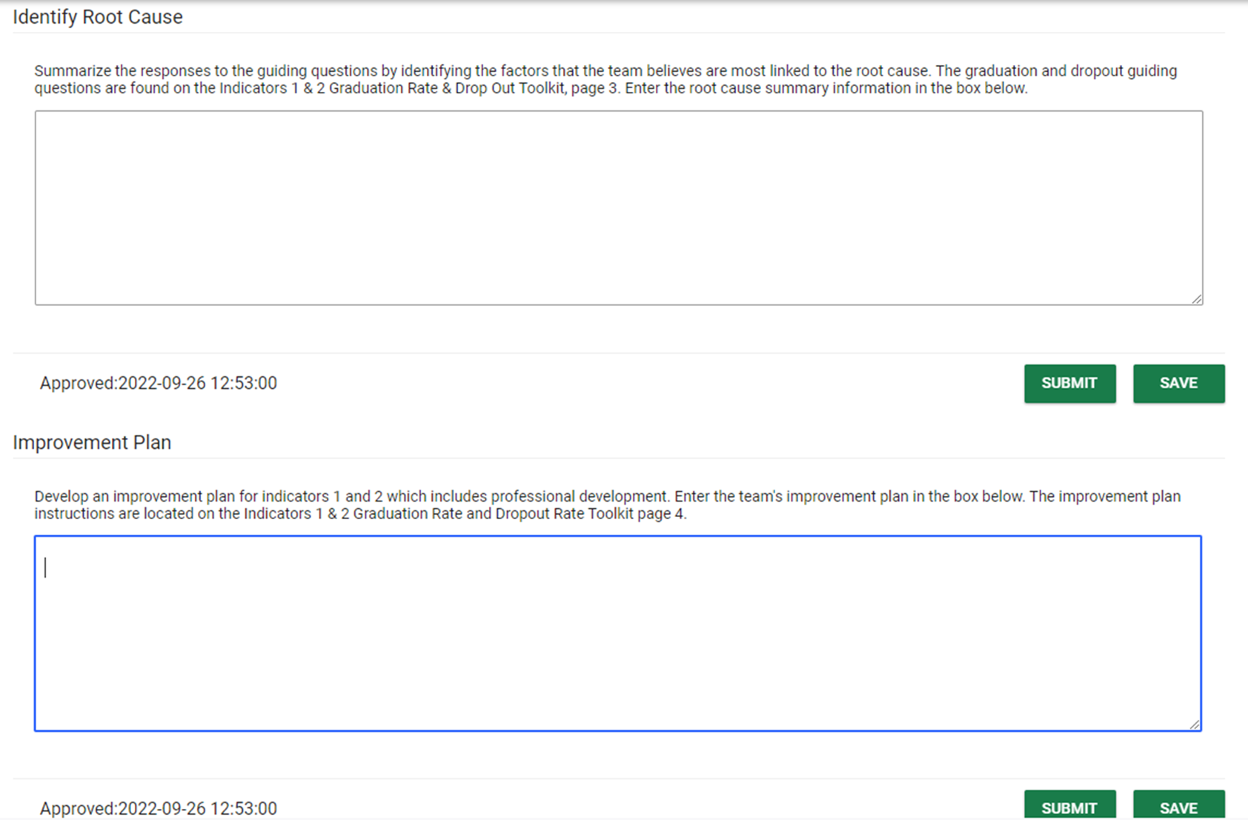

Notes:
Identify and submit the root cause summary here.

Slide 53
Notes:
Identify and submit the improvement plan here.

Slide 54

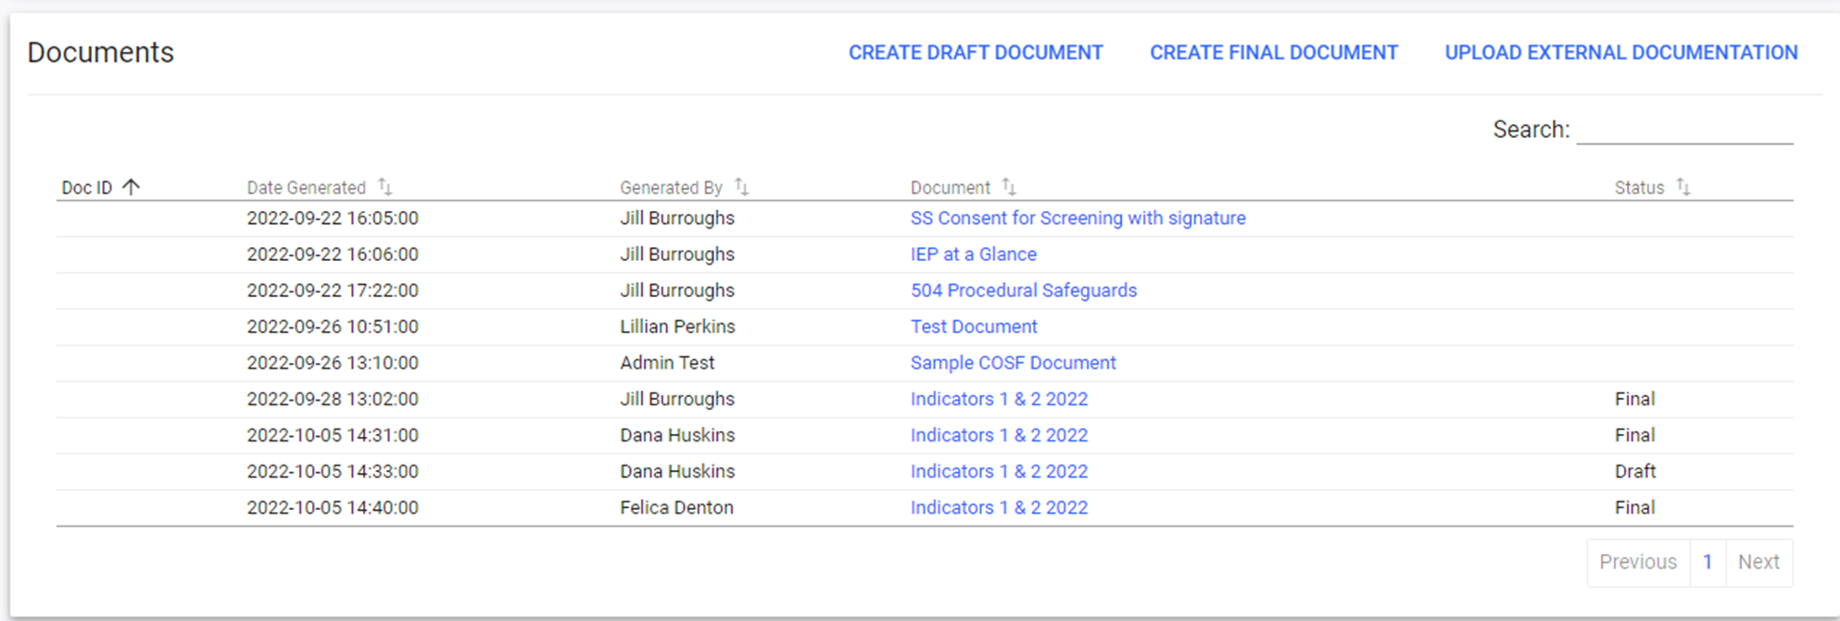
Notes:
Upload supporting documentation here.
Located at the bottom is where you will upload your policy, procedures, and practices. Please make sure and title your uploads.

Slide 55

LEA Document Library
Notes:
Upload supporting documentation here.
Located at the bottom is where you will upload your policy, procedures, and practices. Please make sure and title your uploads.
OSDE and EDPlan District Admins can upload documentation here

Slide 56
LEA Document Library
Notes:
Once you click Tools, the secondary menu bar opens, then click the LEA Document Library tab to upload documentation.
OSDE and EDPlan District Admins can upload documentation here

Slide 57
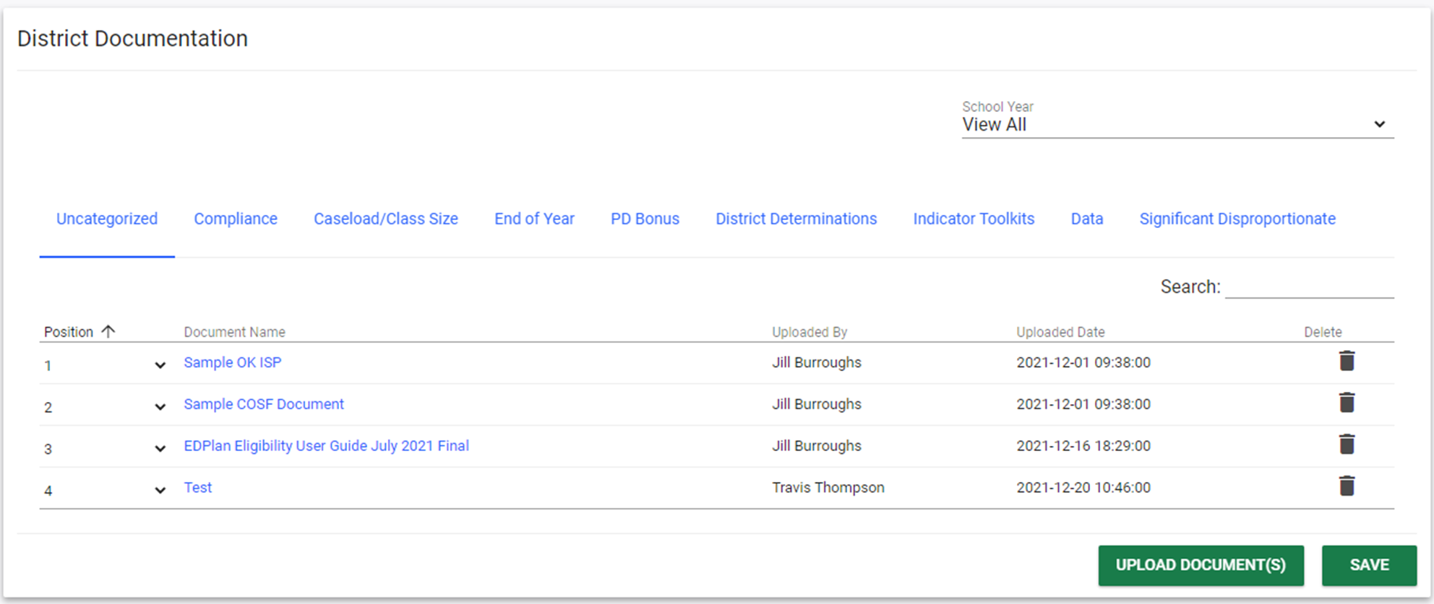

District Documentation Page
Notes:
Select year.
OSDE and EDPlan District Admins can upload documentation here

Slide 58
District Documentation Page
Notes:
Select the category to upload documentation.
OSDE and EDPlan District Admins can upload documentation here

Slide 59
District Documentation Page
Notes:
Select upload documents at the bottom of the page.
OSDE and EDPlan District Admins can upload documentation here

Slide 60
EDPlan Monitoring Tool
District Level Monitoring Roles
LEA IDEA Admin
  Can upload documents to District Documents page
  Can assign LEA Monitor role for other staff
  Responsible for overseeing and finalizing the district’s monitoring review
Notes:
Districts select staff who will do first level monitoring.
This could be the special education teacher, or a district wide consultant…it’s up to the LEA IDEA Admin

Slide 61
Recap

Slide 62
DMR Level 2 Expectations
Complete the appropriate Toolkit – Due January 12th
Provide the identified professional development (PD) – Due May 31st

Slide 63
Dates to Remember:
Toolkits due in (EdPlan)
Jan.–May 2024
Implement & monitor improvement plan
Progress review is due by March 31st
31 May 2024
Submit PD
Submit Final progress review
12 Jan. 2024
Notes:
This is a summary of the expectations.
Indicator toolkits are due for indicators 1 & 2, 3, 7, 11, 12, & 13 for fiscal January 12th
Improvement plan is expected to be implemented and monitored January through May
1st Progress review due March 31st.
2nd progress review due May 31st.
PD is due is May 31st.

Slide 64
Contact Information

Slide 65
Contact Information: Data Team
Travis Thompson
Data Coordinator
Travis.Thompson@sde.ok.gov
405-522-5203
Brooks Sawyer
Specialist of Data
Brooks.Sawyer@sde.ok.gov
405-521-4871

Slide 66
Contact Information: Compliance Team
Megan Withers Felica Denton
Early Childhood Specialist Fiscal Monitoring Coordinator Megan.Withers@sde.ok.gov Felica.Denton@sde.ok.gov
405-522-5168 405-522-9562
Tina Spence
Director of Compliance Monitoring
Tina.Spence@sde.ok.gov
405-521-4513

