Slide 1
Charter Schools’ IDEA Obligation to Serve Students with Disabilities
Nancy Goosen
Program Manager, Policies and Procedures

Slide 2
Individuals with Disabilities Education Act (IDEA)
The IDEA, Part B, is the federal special education law protecting the rights of students ages 3 through 21 with disabilities. Part C of IDEA covers birth through age 2 and in Oklahoma that is SoonerStart.
The IDEA was originally enacted by Congress in 1975 to ensure that students with disabilities have the equal opportunity to receive a free appropriate public education (FAPE).

Slide 3
Oklahoma Statue § 70-3-136(A)(1)&(7)
“Rules and standards to be incorporated into charter.
A. A charter school shall adopt a charter which will ensure compliance with the following:
A charter school shall comply with all federal regulations and state and local rules and statutes relating to health, safety, civil rights and insurance.”
AND
7. A charter school shall comply with all federal and state laws relating to the education of children with disabilities in the same manner as a school district;
Notes:
Civil Rights include students on Section 504 Accommodation Plans. Today I am only speaking of students who are eligible for special education and related services through an Individualized Education Program (IEP), but want to bring to your attention Charter schools are also responsible for

Slide 4
O.S. §70-3-136(A)(3): Charter School for the Deaf or Charter School for the Blind
“No charter school shall be chartered for the purpose of offering a curriculum for deaf or blind students that is the same or similar to the curriculum being provided by or for educating deaf or blind students that are being served by the Oklahoma School for the Blind or the Oklahoma School for the Deaf;”

Slide 5
Special Education Teacher Certification Chapter 13 of P&P
Special Education Comprehensive
Mild/Moderate
Severe/Profound
Deaf/Hard-of-Hearing/Hearing Impairment
Blind/Visual Impairment

Slide 6
O.S. § 70-6-122.8
Issuance of standard certificate to teach in the area of mild-moderate or severe-profound disabilities.
Notwithstanding any other provision of law, the State Board of Education shall issue a standard certificate in the area of mild-moderate or severe-profound disabilities to any individual who has:
Earned a bachelor's level college degree from an accredited institution of higher education;
Successfully completed the prescribed coursework that may be required for a master's degree in special education from an accredited institution of higher education and any examinations required to obtain a standard certificate in mild-moderate or severe-profound disabilities;
Successfully completed the appropriate subject area competency examination as required pursuant to Section 6-187 of this title;
On file with the State Board of Education a national criminal history record check as required pursuant to Section 5-142 of this title; and
Submitted an application and payment of the required certification fee.
Notwithstanding any other provision of law, an individual who holds a current standard certificate pursuant to subsection A of this section can satisfy the highly qualified teacher requirement for early childhood education or elementary education by successful completion of the early childhood education or elementary education examinations.

Slide 7
Highly Qualified
TOR for an IEP
Mild/Moderate
Severe/Profound (Multiple Disabilities)
Special Education Comprehensive
Deaf/Blind
Blind/VI
Hard-of-Hearing/HI
TOR Placing a Grade on a Transcript/Report Card
Early Childhood
Elementary Ed
Secondary Core Area (e.g., English)
High School Alternate Standards (Early Childhood or Elementary Ed)

Slide 8
O.S. § 70-6-105 – Special Ed Subs
C. Beginning with the 2007-08 school year, any substitute teacher employed to teach special education for the same assignment for more than fifteen (15) consecutive or thirty (30) total school days during a school year who does not hold a valid certificate to teach special education shall be required to complete in-service training as prescribed by the State Board of Education. The training shall be provided at no cost to the substitute teacher.
Long-term Sub Training Modules in EDPlan
Long-term Sub cannot serve as a special education teacher (i.e., cannot write an IEP, or sign an IEP, or carry a caseload of students).

Slide 9
Pathways for Special Education Certification
No Emergency Certification Allowed in Special Education.
Boot Camp Route (Provisional Teacher Certificate until completion of 18 hours towards a master’s degree in Special Education).
Paraprofessional Route (Provisional Teacher Certificate until completion of 12 hours of education coursework which must include a minimum of 3 hours in reading instruction).
Speech-Language Pathologist (SLP) or Speech-Language Pathologist Assistant (SLPA). Must pass the OSAT in special education to receive a Provisional Teacher Certificate until the PPAT is passed, including, if necessary, the OSAT for the core subject area – such as English/Math/Science or SS, or Elementary Ed or Early Childhood, etc.).
Master’s Degree in Special Education

Slide 10
Other Pathways
General Education Teacher Route (If traditionally certified in Early Childhood, Elementary Education, or a core subject area such as English, science – Biology, social studies – U.S. History/Government/Economics, math – Intermediate Mathematics) then may take OSAT in special education and meet the passing cut score, may add to certificate.
Traditional route for Special Education Teacher Certification.

Slide 11
Child Find
Child Find obligation contains three components locating, identifying and evaluating that lead to the determination of whether a student has a disability and requires special education.
Oklahoma Special Education Policies and Procedures: Chapter 2: Child Find – and
IDEA Code of Federal Regulations: 34 C.F.R. § 300.111

Slide 12
Charter School Limited to Age or Grade
Students are identified through Child Find activities.
SoonerStart: Infants and Toddlers from Birth through age 2, who are in need of early intervention and related services.
Public Schools: Children from age 3 through 21, who are in need of special education and related services.
Charter Schools may limit admission to students within a given age group or grade level; and therefore, may only provide special education and related services to the same age group or grade level for students with disabilities as they do for students without disabilities.

Slide 13
Free Evaluation in Need of Special Education and Related Services
At Least 2 Different Ongoing Public Awareness Activities (e.g., posters, brochures, flyers, newspaper, website, etc.) to inform the general public of Child Find (e.g., information regarding the specific disabilities listed in IDEA; who does the public notify if they think their child is in need of an initial evaluation and concerned that their child may have one of these disabilities; what age/grades does this included, etc. ).
Maintain Child Find documentation of these public awareness activities by dating them and keeping 5 years.

Slide 14
What is required? Chapter 2 Child Find
Written Child Find Procedures.
Professional Development documentation all school personnel have been trained on an annual basis (e.g., sign-in sheets, agendas, PPTs, handouts, etc.)
Universal Screening to determine which students are at-risk
Coordinated Early Intervening Services (e.g., targeted supports using evidence-based interventions with progress monitoring).

Slide 15
Who may request an initial evaluation?
A parent may request an initial evaluation at any time to determine if their child is a child with a disability, regardless of whether the child has participated in an MTSS framework.
34 C.F.R. § 300.301(b)
Outside evaluation provided by parent must be considered (34 C.F.R. § 300.502(c))
A teacher
An administrator or other individual involved with the student.

Slide 16
What happens when a child is eligible for special education services?
An Individualized Education Program (IEP) is written by the IEP team, which required members consist of Special Education Teacher, Regular Education Teacher, Parent, and Administrator.
An IEP is a written statement of the educational program designed to meet a child’s unique needs.
OK EdPlan, Oklahoma’s web-based IEP system must be utilized.

Slide 17
What is placement in the least restrictive environment (LRE)?
To the maximum extent appropriate, all students with disabilities, 3 through 21 years of age, are to be educated with age-appropriate peers who are nondisabled.
34 C.F.R. § 300.114
There is a continuum of placement options that must be considered by an IEP team when making a placement decision.
A child on an IEP may have accommodations and modifications in the LRE.

Slide 18
Oklahoma Special Education Policies and Procedures

Slide 19
Special Education Policies
The Oklahoma Special Education Policies includes nine (9) State requirements which exceed the federal regulations of the Individuals with Disabilities Education Improvement Act of 2004 (IDEA) to ensure equity, accountability, and excellence for children with disabilities.

Slide 20
Referral Timeline to Parent Consent
1. Ten (10) school day timeline between the review of existing data and parent consent for initial evaluations.
(34 CFR § § 300.300(a)(1)(i), and 300.305)
IDEA: No timeline
Oklahoma: The date the parent signs the Review of Existing Data (RED) form to the date the parent signs Special Education Parent Consent form for an initial evaluation must be within 10 school days.

Slide 21
Required Evaluation Components
2. Required evaluation components defined per category of suspected disability.
(34 CFR § 300.304(b)(1)(i)(2)(3))
IDEA: “Use a variety of assessment tools and strategies to gather relevant functional, developmental, and academic information about the child, including information provided by the parent, (2) Not use any single measure or assessment as the sole criterion for determining whether a child is a child with a disability; and (3) Use technically sound instruments that may assess the relative contribution of cognitive and behavioral factors, in addition to physical or developmental factors.”
Oklahoma: Defined required components that make up a comprehensive evaluation.

Slide 22
45 School Day Initial Evaluation Timeline
3. From the date of parent consent for the initial evaluation to the date of the eligibility meeting must be within 45 school days.
(20 USC § 1414(a)(1)(C)(i)) and 34 CFR § 300.301(c)(1)(i)(ii)):
IDEA: “to determine whether a child is a child with a disability within 60 days of receiving parental consent for the evaluation” or “If the State establishes a timeframe within which the evaluation must be conducted”;
Oklahoma: The initial eligibility determination must be completed within 45 school days of receiving parental consent for the initial evaluation.

Slide 23
Eligibility Team Members
4. Defined qualified professionals required to attend the eligibility team members
(34 CFR § 300.306 and § 300.308)
IDEA: A group of qualified professionals and the parent. For Specific Learning Disability determination requires the child’s regular teacher.
Oklahoma: For all disability categories require the following team members to attend the eligibility determination meeting: Parent, Administrator, Special Education Teacher, General Education Teacher (at least one) and Qualified Professional(s) who have the credentials to administer and interpret evaluation tools (e.g., school psychologists, school psychometrists, speech language pathologists, remedial reading teacher, occupational therapist, physical therapists, etc.).

Slide 24
Move-In or Transfer
5. An IEP for new move-in or transfer students must be in place within 10 school days of the student’s first day of attendance.
(20 USC § 1414(d)(2)(C)(i)(I) and 34 CFR § 300.323)
IDEA: No timeline
Oklahoma: The LEA must provide comparable services described in the previously held IEP, in consultation with the parent until the district either formally accepts the IEP from the previous district as written or develops and implements a new subsequent IEP within ten (10) school days from the date of the student’s first day of attendance.

Slide 25
Service Types Defined
6. Special Education and Related Services are provided in a variety of service types and are defined.
(34 CFR § 300.39(b)(3))
IDEA: “Specially designed instruction means adapting, as appropriate to the needs of an eligible child, the content, methodology or delivery of instruction to address the unique needs.”
Oklahoma: Defined the variety of services: consultation, monitoring, collaboration, co-teaching, and direct instruction.

Slide 26
Secondary Transition Services
7. Exceeding the IDEA requirement for Secondary Transition from age 16 to being in effect on or before age 15.
(34 CFR § 300.320(b))
IDEA: “Transition services. Beginning not later than the first IEP to be in effect when the child turns 16, or younger if determined appropriate by the IEP Team and updated annually.”
Oklahoma: Transition services. The IEP must include secondary transition services that are in effect before the beginning of the student’s ninth grade year, or on or before the student’s 15th birthday, whichever comes first, or younger, if determined appropriate by the IEP team and updated annually.

Slide 27
Shortened Day/Week
8. Before making the determination to shorten the student’s day/week based on behavior requires the LEA to conduct a Functional Behavioral Assessment (FBA) and implement a Behavioral Intervention Plan (BIP).
(20 U.S.C. § 1415(1)(D)(E))
IDEA: Requires FBA/BIP if the conduct of the student was a manifestation of the child’s disability, but no requirement for shortening the student’s day/week.
Oklahoma: Before determining the need to shorten a student’s day/week based on behavior, the IEP team must conduct an FBA/BIP. The IEP team may also want to consider increasing special education service time for direct instruction in behavioral and/or social skills.

Slide 28
Caseload/Class Size
9. Maximum number of students with disabilities per special education classroom, and the maximum number of students on an IEP a Teacher of Record can manage or oversee.
IDEA: No requirement
Oklahoma:
Maximum 10 students per self-contained for K-4 grades.
Maximum 15 students per classroom for 5-12 grades.
NOTE: Refer to chart for class size and caseload based on formula per placement in the Oklahoma Special Education Policies and Procedures manual.

Slide 29
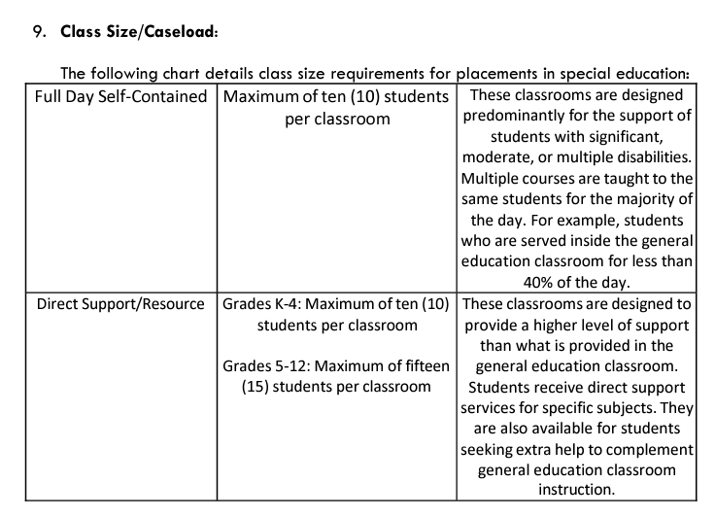
Class Size

Slide 30
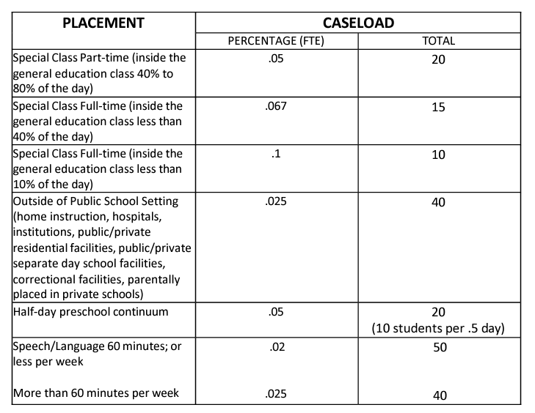
Caseload Examples

Slide 31
Federal Reporting Requirements
Child Count – number of children on IEPs in the district on October 1st of each year.
Data Reports – End of the Year Report (due June 30th) includes Annual Performance Report, Personnel, Related Service, Students Exiting, Suspensions.
Assurances and LEA Agreement Finance (due June 30th)
IDEA Consolidation Application/Budget (Closes October 31st)
Expenditure Reporting/Claim Reimbursement

Slide 32
Resources
Oklahoma Special Education Policies and Procedures (2022)

Slide 33
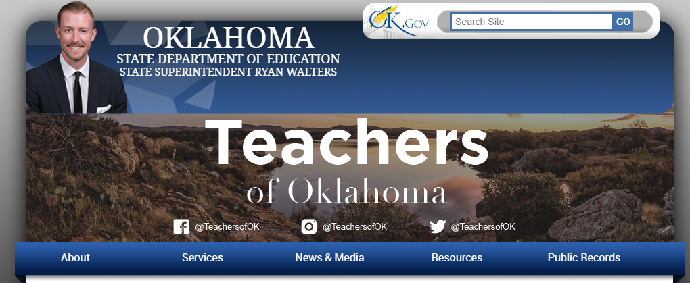
OSDE Website: sde.ok.gov

Slide 34

Special Education Policies and Procedures
https://sde.ok.gov/
Scroll down on Special Education Services main page to find orange icon

Slide 35
P & P
Chapter 8 Private, Charter, Residential and Other Settings
Section 2
Provides information specific to Charter Schools

Slide 36
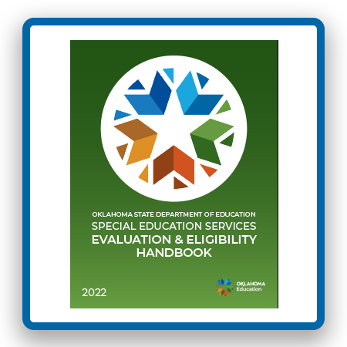
Evaluation and Eligibility Handbook

Slide 37
Special Education Contact
Sherri Coats, Program Director, Office of Special Education Services
Tina Spence, Assistant Program Director, Office of Special Education Services (Compliance/Monitoring)

Slide 38
Special Education Contact Information
Nancy Goosen, Program Manager, Policies and Procedures
Dr. Elana Grissom, Project Manager, Alternative Placements
Carolyn Thomas, Project Manager, Special Education Personnel
Kristen Coleman, Project Manager, Professional Development
Lori Chesnut, Project Manager, Secondary Transition
Alexa Hudak, Project Manager, State Systemic Improvement Plan (SSIP)
Phone (405) 521-3351

