Slide 1
CHARTER SCHOOL TRAINING August 31, 2023
Katherine Black, Program Manager
Financial Accounting and Audits
Katherine.Black@sde.ok.gov
(405) 522-0275

Slide 2
Paragraph A, Item 6
A charter school, to the extent possible, shall be subject to the same reporting requirements, financial audits, audit procedures, and audit requirements as a school district. The State Department of Education or State Auditor and Inspector may conduct financial, program, or compliance audits. A charter school shall use the Oklahoma Cost Accounting System (OCAS) to report financial transactions to the sponsoring school district.
70-3-136

Slide 3
OCAS History
OCAS was established to provide standardized accounting and reporting of revenue and expenditures and to maintain a system of accountability.
The accountability function would focus on compliance with state and federal laws, improved comparability of school district financial data, enhanced data support as they directly pertain to the collection, analysis, application, and reporting of financial data from local districts.
OCAS is based on the federal handbook, Financial Accounting for Local and State School Systems, Revised 2009

Slide 4
OCAS Statutory Authority
Oklahoma State Statute 70 O.S.§ 5-135.2
Report of Financial Transactions and Costs
oksenate.gov/sites/default/files/2019-12/os70.pdf
Oklahoma Administrative Code
State Department of Education Rules for Finance
Title 210:25
https://rules.ok.gov/code?q=
Notes:
5-135.2 PDF page 269

Slide 5
OCAS Purpose
Each year, the Financial Accounting office at OSDE receives the financial transactions for the preceding fiscal year from over 550 Oklahoma school districts, charter schools, and interlocals.
The data received becomes part of an information network accessed daily by any party interested in the use of public education funds.
Oklahoma State Statue 70 §5-135.2 and Oklahoma Administrative Code Title 210:25 require districts to furnish their expenditure and revenue information.
Notes:
Some of the entities include: The Governor’s office, the Legislature, The U S Department of Education, The National Center for Education Statistics, The State Auditor and Inspector’s office, Several Education Professional Organizations and the General Public. This is why clarity and accuracy in reporting of the district data is imperative.

Slide 6
Oklahoma Cost Accounting System (OCAS)
Permits local education agencies (LEAs) to accumulate expenditures and revenue to meet a variety of specialized management and reporting requirements, regardless of whether they are district, state, or federal with the following categories:
EXPENDITURES (27)
Project Job Oper’l. FY Fund Reporting Function Object Program Subject Class Unit
XX XX XXX XXXX XXX XXX XXXX XXX XXX
REVENUE (17)
Project Source Oper’l. FY Fund Reporting of Revenue Program Unit
XX XX XXX XXXX XXX XXX

Slide 7
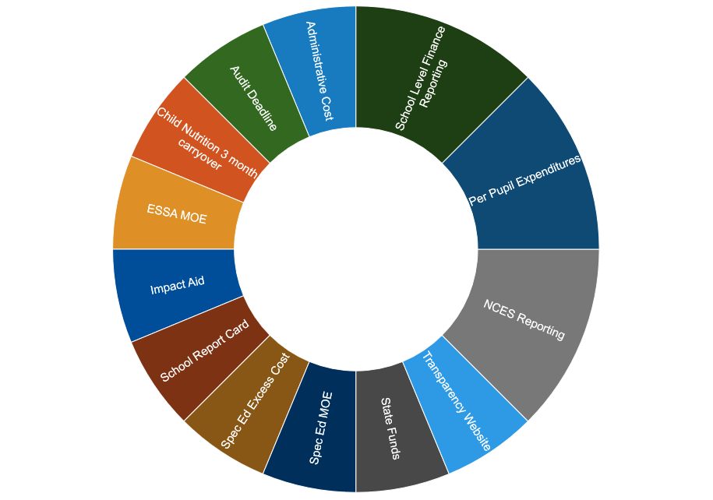
O C A S

Slide 8
OCAS Purpose OCAS data is used to:
Determine per pupil expenditure (PPE)
Determine federal program compliance for Maintenance of Effort for Special Education and ESSA.
Determine the Indirect Cost Rate for each school district
Determine compliance with Excess Cost Requirements for Special Education, and
Determine Administrative Cost and General Fund Carryover Penalty

Slide 9
Financial Officers
Superintendent, Chief Executive Officer/Head of Charter School
Treasurer (Can be contracted)
Encumbrance Clerk
Board Minutes Clerk
Activity Fund Custodian
All these positions must have a Surety Bond that are paid by the district

Slide 10
Financial Officers Training
Encumbrance Clerks and Treasurer are to receive training on the school finance laws of Oklahoma, accounting, ethics, and the duties and responsibilities of their positions.
Requirement: Newly employed encumbrance clerks and treasurer, twelve (12) hours of the above training must be completed within nine (9) months of employment. The same individuals, twelve (12) hours of continuing education must be completed every three years (70 § 5-190)

Slide 11
Financial Software
There are 8 Oklahoma Cost Accounting Vendors approved by the Oklahoma State Board of Education
No other Software vendor can be used for your financial accounting system.
The approved vendor list is on the Financial Accounting Website.
https://sde.ok.gov/financial-accounting

Slide 12
Financial Reporting Timeline
September 1 – District’s final Revenue and Expenditures for preceding fiscal year must be submitted to Financial Accounting via the web-based Oklahoma Cost Accounting System (OCAS) reporting system.
September 30 - The year-end financial report recording and summarizing all revenue and expenditure financial transactions will be completed and certified.

Slide 13
Penalty for Late OCAS Submission
70 O.S. § 5-135.2, Paragraph B
Reduction in Monthly State Aid payment
First Month 1%
Second Month 2%
Third Month 3%
Fourth Month 4%
Each Subsequent Month 5%
Penalty may be waived by the State Board of Education.

Slide 14
Financial Reporting Timeline
October 1 – District must submit one copy of either the Estimate of Needs or the Budget (for those districts on the School District Budget Act) to Financial Accounting and the County Excise Board.

Slide 15
Estimate of Needs/School Budget
School Laws of Oklahoma
Financial Statements and Estimates of Needs of All School Districts shall be filed with the county excise board on or before October 1 of each year. Said financial statements and estimates shall have attached thereto an affidavit showing the publication thereof as required herein, or they may be filed, and the said affidavit attached thereto at any time within five (5) days after the filing thereof.

Slide 16
Estimate of Needs/School Budget
Upload one copy of either the Estimate of Needs or the Budget (for those districts on the School District Budget Act) to the State Department of Education through the OCAS application in SingleSign On by October 1.
Note: Make Sure all Affidavits are signed and notarized. Required signatures are Clerk of Board of Education, President of Board of Education, Treasurer of Board of Education and School Board Member’s present at the time of approval. OSDE does not need the Excise Board signatures.

Slide 17
Audits
Oklahoma Statute Title §70-22-108(A)
Each audit of the financial statements of a school district required by the Oklahoma Public School Audit Law shall be completed and the auditor’s opinion thereon shall be submitted by the firm to the district board of education within nine (9) months after the close of the fiscal year of the district board of education.
June 30

Slide 18
Financial Reporting Timeline
March 31 – Districts who are identified as having expended $750,000 or more in federal awards must have their audit submitted to Financial Accounting.
April 30 – Districts who are identified as having expended less than $750,000 in federal awards must have their audit submitted to Financial Accounting.
June 30 – Audit contract between the district and the independent auditor must be submitted to Financial Accounting.
Notes:
April 30 -- Per SB 2034, this date was moved from May 31.

Slide 19
Audits
Districts who have expended $750,000 or more in federal money are what is referred to as an “A” audit. These audits must be completed, presented to the local board of education and submitted to Financial Accounting no later than March 31.
Districts who have expended less than $750,000 in federal money are what is referred to as an “B” audit. These audits must be completed, presented to the local board of education and submitted to Financial Accounting no later than April 30.

Slide 20
Penalty for Late Audit Submission
Pursuant to 70 O.S. § 22-112
(State Aid withheld for failure to comply with article):
“All further “payment” of State Aid for each district shall be withheld until the provisions of this article have been fulfilled by said district.”

Slide 21
Audits
Regardless of which type of audit performed, the audit must be submitted to Financial Accounting thirty days after it has been presented to the local board of education.
70 O.S. § 22-108
“Thirty (30) days after the audit presentation to the local board of education, forward one copy of the audit report to the SDE”

Slide 22
Audits
Findings – District must submit a Corrective Action Plan (CAP). The CAP should include why the finding occurred, what is being done to prevent it from recurring, name(s) of contact person(s responsible for the CAP, and anticipated date of completion for the CAP.
Exceptions and/or recommendations – District must give a response.
Notes:
CAP – Our office does have a format that can be provided.
Responses – District can use the CAP format as a template.

Slide 23
Audits
Approved Auditors are listed on the Financial Accounting website or the State Auditor and Inspector’s website.
https://sde.ok.gov/financial-accounting
https://www.sai.ok.gov/

Slide 24
Publications Available
https://sde.ok.gov/financial-accounting
Coding Obstacles Districts Encounter Daily (CODED)
OCAS Manual
https://sde.ok.gov/office-legal-services
School Laws of Oklahoma
SDE Permanent Rules (Chapter 25 Finance)

Slide 25
Contact Information
Katherine Black, Program Manager 405-522-0275
Financial Specialists:
Counties
Elaine Schein (1-17) 405-521-3197
Pam Honeysuckle (18-32 & Charters) 405-522-3273
Krystalen Ibanez (33-48) 405-521-3272
Paula Koch (49-62, Plus 64) 405-521-2517
Kelly Freeman (63-77, Minus 64) 405-521-2349
Email contact at- firstname.lastname@sde.ok.gov

