Slide 1
Charter School Training
Office of Assessments
8/31/23

Slide 2
Spring 2023 Reporting
All final scores have been posted in the educator portal and the parent portal.
This year, CCRA ELA and math OPI scores were added to the parent portal and will be added to the Individual Student Reports.
The Individual Student Reports are being printed and sent to districts. The CCRA reports should arrive by 9/18/23. OSTP reports should arrive by 10/19/23.

Slide 3
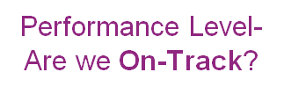
ESSA – Goals for States
Must adopt challenging academic standards
Math & ELA/reading assessed in grades 3-8 & once in grades 9-12
Science assessed at least once in grades 3-5, 6-9, and 10-12
95% participation on assessments.
1% may take alternate tests.
Notes:
States may also elect to assess other content areas or grade levels. Oklahoma assesses US History according to State Law. The Naturalization test is another assessment required by state law, but it is not a part of the OSTP.

Slide 4
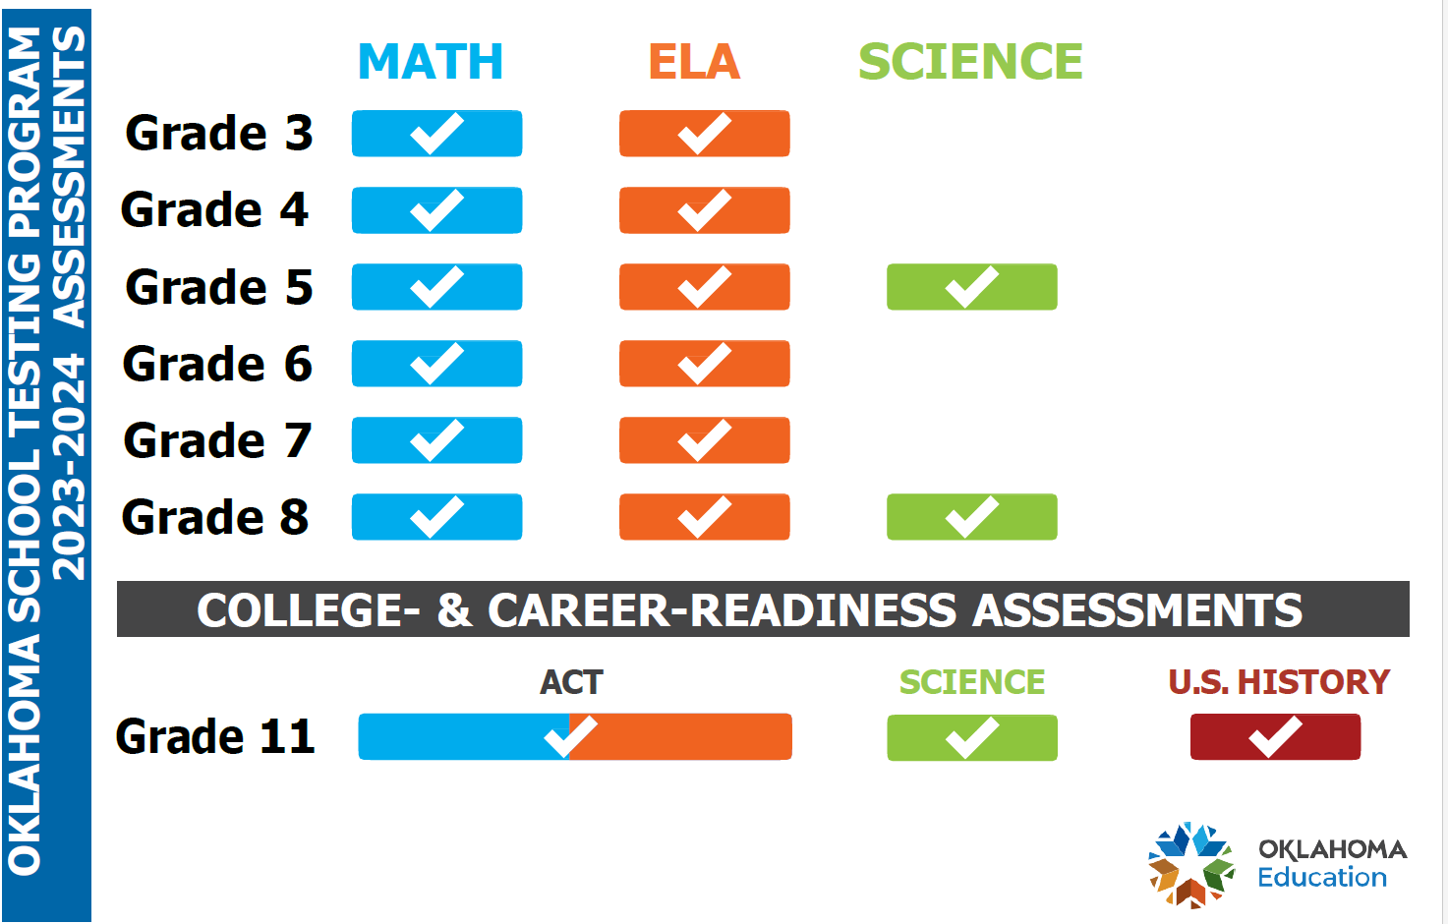
Notes:
This chart shows which subjects are assessed at each grade level. There have been no changes recently. Please note that Grade 3 ELA assessments affect RSA status. CCRA Assessments are required for graduation.

Slide 5
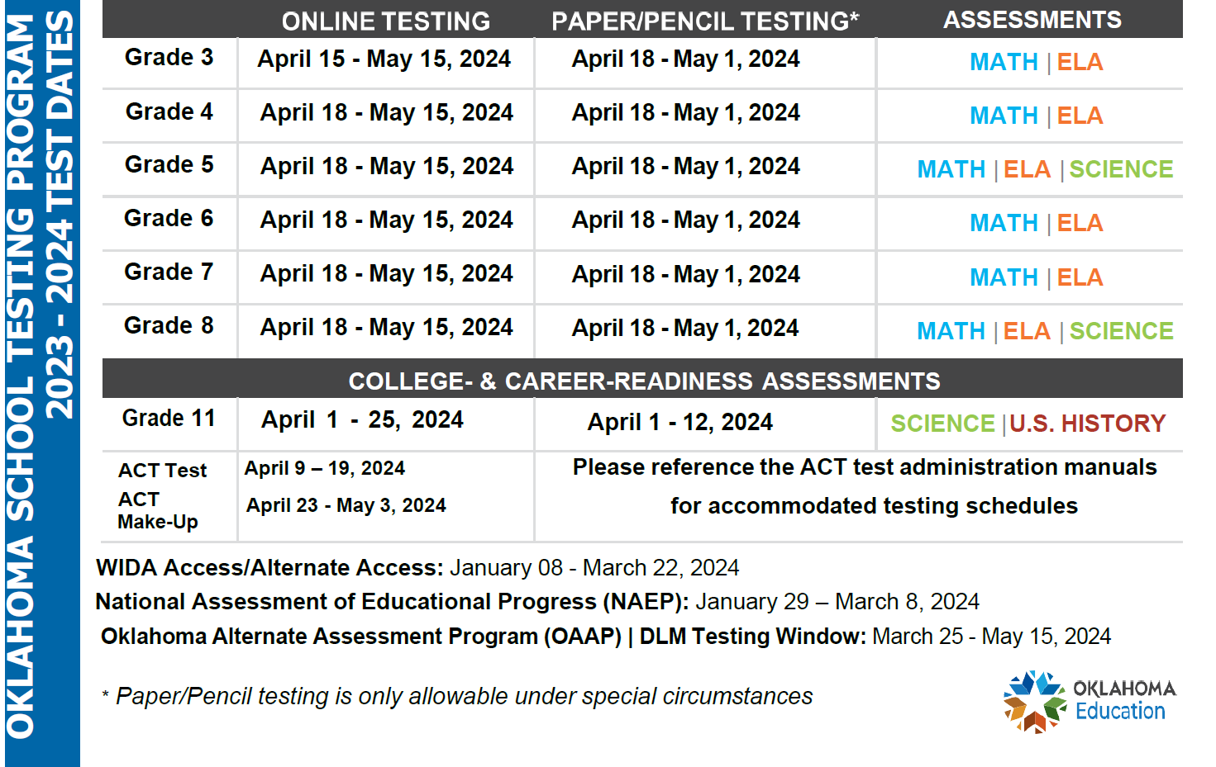
Notes:
This is the OSTP calendar for the 2023-2024 school year. As you can see, the CCRA window is first, to allow districts plenty of time to complete the HS testing before starting grades 3-8. Grade 3 tests now start on April 15 and all other grades start on April 18. All testing is online except for certain accommodations. Paper tests must be completed by April 12 for CCRA and by May 1 for grades 3-8. All online testing should be completed by April 25 for CCRA US History and Science, by May 3 for ACT, and by May 15 for grades 3-8.

Slide 6
Preliminary Scores
Preliminary scores will only be available for the following:
All science grades (5, 8, 11)
CCRA US History
CCRA ELA and Math
Grades 3-8 ELA and math will undergo standard setting in the summer of 2024, so those scores will be available in final reports only.

Slide 7
Updates
The Spring 2024 ELA assessments will be fully aligned to the 2021 Oklahoma Academic standards for ELA.
The Spring 2024 Math assessments will be fully aligned to the 2022 Oklahoma Academic standards for math.
Assessments that normally have a calculator in the kiosk (math grades 6-8 and science grades 8 and 11) will have a Desmos calculator provided.
Handheld calculators may still be provided by the district, provided that they meet the calculator policy.
SAT no longer offers the essay; ACT is the only CCRA ELA and math vendor this year.

Slide 8
District Testing Coordinator (DTC)
Is designated by the Superintendent via our DTC Designation Form.
MUST be trained by OSDE during our required DTC Training in February.
Maintains the secure distribution and collection of test materials.
Security of all testing information/materials is crucial.
Ensure that all needed materials are ordered/received.
Ensure that all testing staff have the portal user accounts needed.
Serve as the contact and liaison for all Building Test Coordinators, Cognia, ACT, DLM, and SDE.
Should oversee the selection and training of Building Test Coordinators, Test Administrators, Test Proctors, and other key staff.
Should ensure that there are proper procedures in place to ensure testing security at the district.

Slide 9
Other Testing Staff
Building Test Coordinator – site level; works with the DTC to schedule and oversee assessments at the site level.
Test Administrators – certified employees who administer the test.
Test Proctors – adult employees or volunteers who support the TAs and maintain test security.
Technology Coordinator – ensures that all site readiness tests have been performed, that all devices have the kiosks or appropriate browsers loaded and are ready for the test administration

Slide 10
Oklahoma Alternate Assessment Program (OAAP)
For students with the most significant cognitive disabilities
Mirrors the general assessment system in regard to grade levels and subjects assessed
Utilized Dynamic Learning Maps (DLM)
Student participation should be determined by the IEP team.
If a district exceeds 1% of the testing population on OAAP, justification and monitoring information may need to be submitted.

Slide 11
Statewide Virtual Charter Schools
Statewide virtual charter schools offering online courses or programs will provide, and are responsible for the cost of, at a minimum, six alternative testing locations.
At least one testing site will be located in each quadrant of the state.
One testing site will be located in each of the two metropolitan areas of the state.
Testing locations and a testing plan must be submitted to the SDE for approval.

Slide 12
Naturalization Test
Beginning with the Class of 25, Oklahoma students must take a 100-question test using the questions from the US Citizenship and Immigration Services website. The law requires that students get at least 60 of the 100 questions correct.
Not a part of the OSTP
Administered and tracked at the district/site level
Districts can offer the test as early as 8th grade and must offer the test at least once per school year. Retake opportunities must be offered to students upon request.
OAAP students shall be exempt from the naturalization test.
An FAQ document is linked on our home page.

Slide 13
Office of Assessment
Catherine Boomer, Program Director, State Assessments
Eric Jones, Program Manager, State Assessments
Samantha Sheppard, Project Manager, Science
Caroline Misner, Project Manager, OAAP
Alyssa Tyra, Project Manager, ELA
Rebecca Logan, Project Director, NAEP
Roni McKee, Program Manager, ELP
Janna Corn, Project Manager, ELPA Indicator Assessment
Hanna Hensley, Project Manager, ELPA
Chelsea Lewis, Administrative Assistant
Main Line: (405) 521-3341

