Slide 1
Senate Education Committee February 4, 2019
Matt Holder Deputy Superintendent of Finance and Federal Programs
matt.holder@sde.ok.gov
405-522-3713

Slide 2
State Aid Funding Formula History
The State Aid Funding Formula is designed to create “vertical and horizontal equity” among school districts. The current formula was adopted in the early 1980’s and amended in 1989 and 1996.
Laws 1981, H.B.1236, Chapter 347, Sections 13 & 15

Slide 3
State Aid Funding Formula History
Vertical Equity – Cost to Educate Students
Average Daily Membership (ADM)
Weights: Grade, Pupil Categories, and District
Horizontal Equity – Wealth of the District
Local and County Revenue
State Dedicated Revenue
State Appropriated Revenue
Provide funding equity across districts.

Slide 4
State Aid Funding Formula
State Aid formula calculation sheet consists of three (3) parts.
Foundation Aid:
Weighted Average Daily Membership (WADM) times Foundation Aid Factor
Less Chargeables (Local (15+), County, & State Dedicated)
Transportation:
Average Daily Haul Times Per Capita
Times Transp. Factor
Salary Incentive Aid:
WADM times Salary Incentive Aid Factor
Less Adjusted Valuation
Times Incentive Mills (20)
Basic State Aid Allocation
(Sum of 1 + 2 + 3)
70 O.S. §18-200.1

Slide 5
Seven Sources of Formula Revenue
LOCAL AND COUNTY REVENUES:
1. AD VALOREM TAXES (used in Foundation and Salary Incentive Aid)
COUNTY 4-MILL
STATE - DEDICATED REVENUES:
3. GROSS PRODUCTION TAX
4. MOTOR VEHICLE COLLECTIONS
5. RURAL ELECTRIFICATION ASSOCIATION (REA) TAX
6. STATE SCHOOL LAND EARNINGS
STATE APPROPRIATED:
7. FINANCIAL SUPPORT OF SCHOOLS (FORMULA FUNDING)

Slide 6
Chargeables (used to calculate Foundation Aid*)
LOCAL AND COUNTY REVENUES:
1. AD VALOREM TAXES (used in Foundation and Salary Incentive Aid)
COUNTY 4-MILL
STATE - DEDICATED REVENUES:
3. GROSS PRODUCTION TAX
4. MOTOR VEHICLE COLLECTIONS
5. RURAL ELECTRIFICATION ASSOCIATION (REA) TAX
STATE SCHOOL LAND EARNINGS
*Foundation aid factor end-of-year calculated at $1,567.00

Slide 7
District WADM Components
Average Daily Membership with Grade Level Weights
Special Categories
(Special Education, Economically Disadvantage, Gifted, Bilingual)
Teacher Index
District Calculations
(Greater Weight of Small School or Isolation)
70 O.S. §18-201.1

Slide 8
Data Elements for Weighted ADM
ATTENDANCE AUDITS (FQSR & ASR)
SPECIAL ED. COUNTS (OK EdPlan)
BILINGUAL COUNTS (Consolidated Rpt.)
ECONOMICALLY DISADVANTAGED
(Free / Reduced ELIGIBLE Counts)
GIFTED COUNTS (Consolidated Rpt.)
70 O.S. §18-201.1

Slide 9
Grade Weights
PK 3 (3 yr. old w/ IEP) 1.2
Early Child. / PK (Half Day) 0.7
Early Child. / PK (Full Day) 1.3
Kindergarten (Half Day) 1.3
Kindergarten (Full Day) 1.5
1st - 2nd grade 1.351
3rd grade 1.051
4th - 6th grade 1.0
7th - 12th grade 1.2
Out-of-Home Placement 1.5
70 O.S. §18-201.1

Slide 10
Weighted Pupil Categories
Hearing Impairment (HI) 2.90
Speech or Language Impairment (SI) 0.05
Vision Impairment (VI) 3.80
Emotional Disturbance (ED) 2.50
Orthopedically Impairment (OI) 1.20
Other Health Impairment (OHI) 1.20
Specific Learning Disabilities (LD) 0.40
Deaf-Blind (D/B) 3.80
Multiple Disabilities (MD) 2.40
Autism 2.40
Traumatic Brain Injury (TBI) 2.40
Intellectually Disabled (ID) 1.30
Spec. Educ. Summer Program 1.20
Gifted 0.34
Bilingual 0.25
Economically Disadvantaged 0.25
70 O.S. §18-201.1

Slide 11
Student Weights Example
First Grade Student 1.351
Learning Disability 0.40
Economically Disadvantaged 0.25
Total weight for this student 2.001

Slide 12
Teacher Index
Number Of Teachers
Level Of Degree
Index Is Determined By Comparing Prior Year Total To The State Average
70 O.S. §18-201.1

Slide 13
District Weights
SMALL SCHOOL WEIGHT
Small school district calculation shall apply only to school districts whose average daily membership (ADM) is less than 529
If ADM is less than 529, calculate the small school weight
70 O.S. §18-201.1

Slide 14
District Weights
SPARSITY/ ISOLATION WEIGHT
If district area in square miles is greater than the state average area in square miles (136): compute areal density
If district areal density is less than 2.47, calculate the district sparsity isolation weight
70 O.S. §18-201.1

Slide 15
District High Year WADM Comparison
2016-17 2017-18 2018-19
WEIGHTED ADM First Nine Weeks
Average Daily Membership 3,479.83 3,515.41 3,453.14
With Grade Weights 600.23 597.50 593.67
Special Ed. Weights 464.25 482.60 582.60
Summer Program 12.00 8.40 6.00
Gifted 49.98 46.24 45.22
Bilingual 45.00 54.50 50.75
Teacher Index 0.00 0.00 0.00
Economically Disadv. 551.75 557.00 546.50
Small School 0.00 0.00 0.00
OR
Isolation 0.00 0.00 0.00
TOTAL WEIGHTED ADM: 5,203.04 5,261.65 5,277.88

Slide 16
District High Year WADM
FY2016-17
5,203.04
FY2017-18
FY2018-19
TOTAL WADM:
X (TIMES)
FORMULA FACTORS *
TOTAL $$ EQUALS:
5,261.65
X
$ 3,422.04
$ 18,005,576
JULY
FUNDING*
5,277.88
X
$ 3,422.04
$ 18,061,116
JANUARY
FUNDING*
**
Growing District
*Chargeables Not Considered
**Assuming no midyear factor change

Slide 17
District High Year WADM
FY2014-15
FY2015-16
FY2016-17
TOTAL WADM:
X (TIMES)
FORMULA FACTORS *
TOTAL $$ EQUALS:
1,495.12
X
$ 3,422.04
$ 5,116,360
JULY
FUNDING*
1,379.42
1,175.55
$ 4,022,779
JANUARY
FUNDING*
**
District with Decreasing Weights
*Chargeables Not Considered
**Assuming no midyear factor change

Slide 18
Transportation
Figured by using:
Transportation Factor -1.39 the same since 1983
Average Daily Haul
-Most Recent Data
Area Served -Total Square Miles
70 O.S. §18-200.1

Slide 19
Salary Incentive Aid
WADM times Salary Incentive Aid Factor
(end-of-year calculated at $71.93)
Less Adjusted Valuation
Times Incentive Mills (20)

Slide 20
Revenue Comparison (traditional vs charter)
Revenue Source | District A | Charter A | Difference
County 4-Mill | $75,000 | $0 | ($75,000)
School Land | $25,000 | $0 | ($25,000)
Gross Production | $50,000 | $0 | ($50,000)
State Aid | $1,050,800 | $1,575,800 | $525,000
Foundation Aid (15 Mills) | $150,000 | $0 | ($150,000)
Incentive Aid (20 Mills) | $200,000 | $0 | ($200,000)
Motor Vehicle | $25,000 | $0 | ($25,000)
REA Tax | $0 | $0 | $0
Total | $1,575,800 | $1,575,800 | $0

Slide 21
Districts “Off the Formula” Not Receiving State Appropriated Money
All Districts are “ON THE FORMULA”.
Revenue typically considered as “local wealth” may prevent a district from receiving State appropriated money.

Slide 22
“Off the Formula” Not Receiving State Appropriated Money
District’s local, county and state dedicated revenue may limit their calculation for Foundation and Salary Incentive Aid.
Districts with no Foundation and/or Salary Incentive Aid may still receive Transportation. These Districts receive no other state aid through the formula.
Districts during FY 2018-19:
No Foundation Aid: 72 Districts
No Foundation or Salary Incentive Aid: 38 Districts

Slide 23
Why Districts Are Not Receiving State Appropriated Money
Local District Valuations – 22 Districts
Gross Production
Example of Industry that has taken Districts “Off the Formula”
Wind
Gross Production
Oil reserves
Google
Electric Generation Plants
Refineries

Slide 24

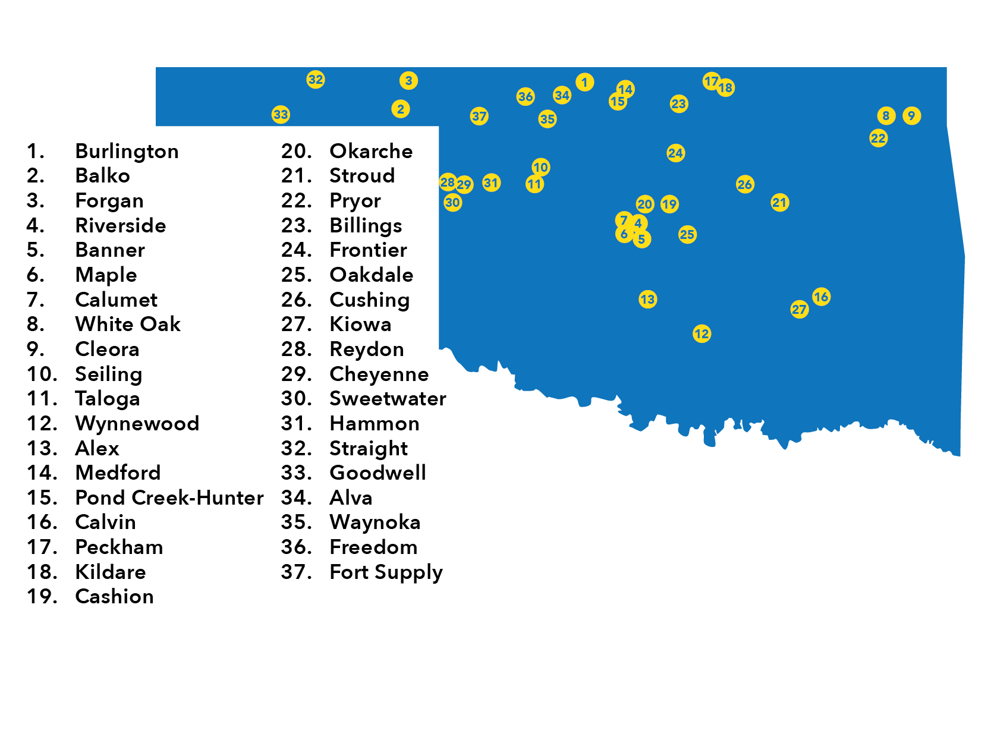
FY17 Districts Not Receiving State Appropriations through the Formula

Slide 25
Legislative Appropriations SB 1600
Financial Support of Public Schools (Formula): $2,278,122,289
Support of Public School Activities: $91,319,026
Flexible Benefit Allowances: $487,383,116
Administrative/Support functions of the SDE: $15,980,190
Instructional Materials/Textbooks: $33,000,000
OTRS Revolving Fund/School Consolidation Assistance Fund: $7,180,526

Slide 26
What makes up the Formula? $2,278,122,289
$1,373,201,301 from the General Revenue (GR) Fund
$818,166,976 from the Education Reform Revolving Fund (1017)
$50,470,751 from the Common Education Technology Fund
$3,970,888 from the Mineral Leasing Funds
$32,312,373 from the Oklahoma Lottery Trust Fund

Slide 27
Formula Sources
1017 Fund:
62 OS §34.89
Individual Income Tax
Corporate Income Tax
Use Tax
Special License Plates
Tribal Gaming
Cigarette Tax
Horse Track Gaming
Tobacco Products Tax
Business Activity Tax

Slide 28
Formula Sources
Common Education Technology Fund:
68 OS §1004
25.72% of oil produced under the 7% tax rate
22.5% of oil produced under the 4% tax rate
23.75% of oil produced under the 5% tax rate (HB 1010xx)
Total allocated to Common Ed Tech combined with other apportioned funds – $150m. = approx. $50m per year for Common Ed Tech

Slide 29
Formula Sources
Mineral Leasing Fund:
62 OS §34.48 (effective 1920)
Income to this fund is from a share of lease sales and royalty payments on oil and gas production on federal lands within the state.
Funds are used for the financial support of public schools.

Slide 30
Formula Sources
Oklahoma Education Lottery Trust Fund:
3A OS §713
45% to K-12 education/early childhood development
45% to Higher Education/CareerTech
5% to School Consolidation Assistance Fund
5% to Teachers’ Retirement System Dedicated Revenue Revolving Fund

Slide 31
Textbook Allocations
$33,000,000 line item restored for textbooks/ instructional materials
Disbursed based on ADA
Instructional materials may be printed/nonprinted and include textbooks, technology-based and other educational materials
2018-19 – Districts will purchase Math textbooks

Slide 32
Flexible Benefit Allowance Allocation
(Providing Health Insurance to over 84,000 Oklahoma Educators)
(In Millions $)
FY 2020 request: $503,415,468
Increase of: $19,682,352
Notes:
This year we finally see the topping of half a billion dollars needed to cover the health insurance costs of teachers and support staff. With estimated premium and staff increases, we expect to need an additional $19.6 million next fiscal year to meet the state’s obligations.

Slide 33
History of Ad Valorem Reimbursement $92,700,000 appropriated in SB 1600

Slide 34
Building Fund
Building Fund is generated solely from local ad valorem taxes.
A maximum of 5 mills by the Constitution can be used for the purpose of erecting, remodeling and repairing school buildings, or for the purchase of furniture.
In the early history of the state, it was envisioned that the 5 mills might be sufficient to provide money necessary for building facilities for the many school districts. However, it has now become unrealistic for most districts.

Slide 35
Building Fund
Through various legal interpretations, the use of the Building Fund has been liberalized so that it can be used not only for maintenance, but also the purchase of equipment. In some cases it can be used for operational expenses.

Slide 36
Questions?

