Slide 1
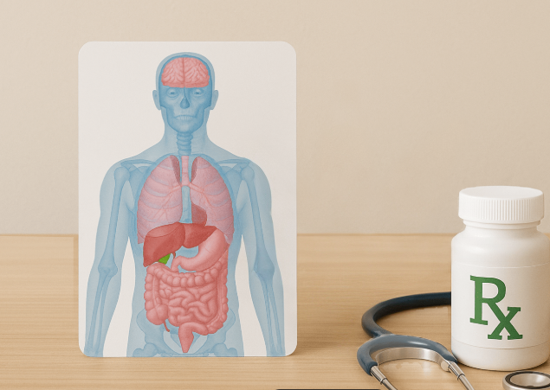

Medical Marijuana
& The Physician’s Responsibilities

Slide 2

Statewide Trends
Since legalization: 188% increase in adults, 55% increase in college-age, and 73% youth age.
In the Nation- Adult use ranked #11 (was #42), College age use ranked #20 (was # 39), and Youth use ranked #3 (was #43).
March 2023- 7,066 growers and 2,759 dispensaries across the state with over 373,525 registered patients.
April 2026- 2,136 growers, 1,417 dispensaries across the state with over 316,629 registered patients

Slide 3
Patient Evaluation:
Step-by-Step Standards
Step 1: Establish a patient/physician relationship. One-time encounter is insufficient.
Step 2: Confirm a Condition or Diagnosis- Clearly and precisely in the record
Step 3: Documentation
Step 4: Assess Risk Factors and Informed Consent, risk and benefits, and education
Step 5: Follow-up Schedule
Step 6: Ongoing Obligations: Duty to Terminate

Slide 4
Step 1
Establish Care
Step 1- Face-to-face or Telehealth visits must be completed, with the patient needing to be aware of follow-ups prior to authorizing the card.

Slide 5
Step 2
Confirm
Confirm a Medical Qualifying Condition or Diagnosis
Medical Benefits of Cannabis include:
Pain Management and Relief
  Neuropathic pain
Arthritis pain
Cancer-related pain
  Fibromyalgia
  Anxiety and Depression
  Insomnia
  Anorexia (During treatment)
  Sexual Dysfunction
  Nausea and vomiting
  PTSD

Slide 6
Step 3 Documentation
Medical records must reflect:
  A discussion of risks and benefits
  Educate EVERY PATIENT to avoid operating vehicles or heavy machinery while impaired by cannabis.
    This conversation must be explicitly documented in the medical record
  Consideration of alternative treatments with past treatment failures
  A plan for ongoing monitoring (follow-ups) of the patient’s response to cannabis treatment
  Patient’s milligrams per day
  Medical conclusion for the reasoning to prescribe Medical marijuana
  PMP review noted in the clinical record at the initial and follow-up visits

Slide 7
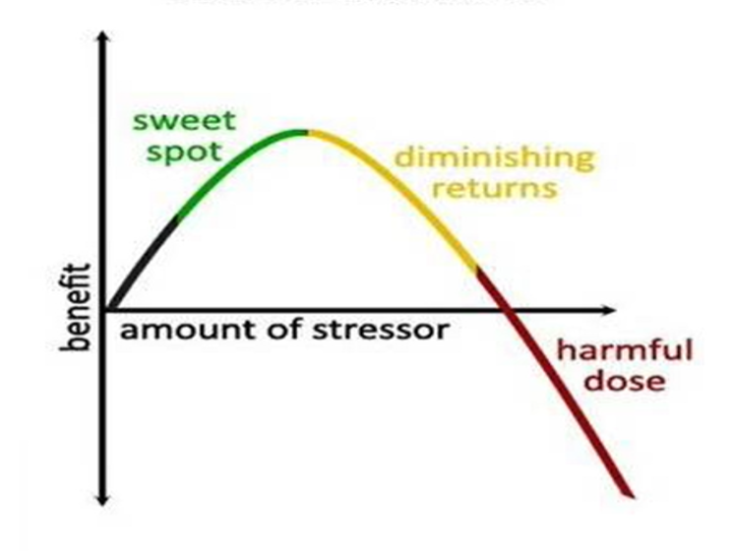
The Dose Matters
2.5 mg to 20mg per dose QD, BID, or TID
40mg to 90mg
90mg or above

Slide 8

Edibles
Slow onset, long duration, and stable relief –
  60 mins to 2 hours to manifest
Easier to titrate with dosing per piece
Ideally, for chronic pain, not acute
Attractive to children with appealing packaging

Slide 9
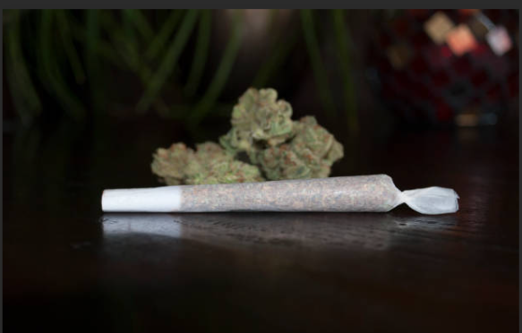
Inhalation
Immediate symptom relief for breakthrough pain (10-15 mins), wearing off in about 3 hours
Easy to control dosing through puff frequency
  Count the puffs
Smoking may cause respiratory irritation
Smoking can worsen asthma or breathing conditions
Shorter duration requires frequent dosing
Flower Vaporizer over a joint or a vape pen

Slide 10
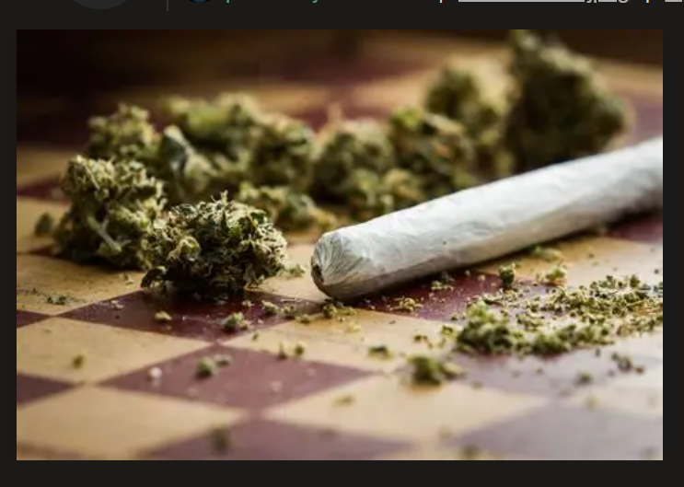
Caution – Calculate Dose
Assuming that a joint is .3 gm to .5 gm. [300 – 500 mg]
Average THC content is 24%.
The average joint in Oklahoma produces 72 mg to 120 mg of THC through inhalation. This is well outside the range of medically effective use.
300 x .24 = 72 500 x .24 = 120

Slide 11
Step 4: Assess and Consent
Assess Risk Factors
  Screen for contraindications: psychosis history, pregnancy, severe cardiovascular disease, and substance use disorder risk.
Informed Consent
  Discuss risks, benefits, alternatives, and legal limitations with the patient. Obtain and document written, signed consent before authorizing the card.

Slide 12

Cannabis Use Disorder (CUD)
It's your responsibility to be vigilant for and to treat the patients who develop Cannabis use disorder.
CUD doesn’t just affect recreational users.
Can happen at any age, with a higher percentage in users 25 years or less.

Slide 13
Step 5 Follow up
Initial Visit- Establishing Care
6 months: Full Reassessment & Record Update
  Comprehensive clinical reassessment (Review Medication and screens)
After the 6-month follow-up, the physician should continue to see the patient every six months at a minimum.
Follow-ups must continue until the card’s renewal or till the card expires.

Slide 14
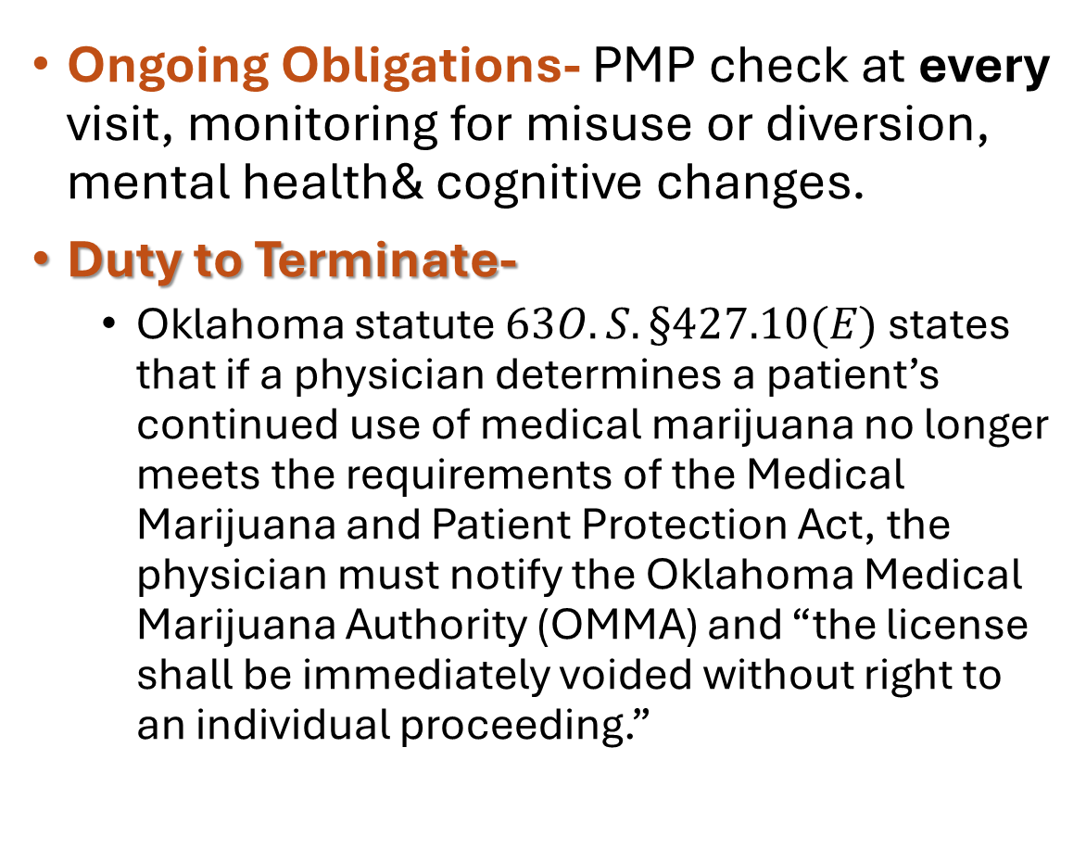
Step 6 Obligations and Duty to Terminate
Ongoing Obligations- PMP check at every visit, monitoring for misuse or diversion, mental health& cognitive changes.
Duty to Terminate-
  Oklahoma statute $63O.S.§427.10(E)$ states that if a physician determines a patient’s continued use of medical marijuana no longer meets the requirements of the Medical Marijuana and Patient Protection Act, the physician must notify the Oklahoma Medical Marijuana Authority (OMMA) and “the license shall be immediately voided without right to an individual proceeding.”​

Slide 15
Causes for Termination
The underlying qualifying condition has resolved or substantially improved, so the expected benefit of cannabis is no longer present.
The patient has developed significant adverse effects or complications attributable to cannabis (e.g., repeated hyperemesis episodes. Psychosis temporally associated with high‑THC use, severe anxiety, or cognitive impairment.​
Risk now outweighs benefit because of new comorbidities or medications (e.g., unstable coronary disease with recurrent cannabis‑related tachycardia and chest pain, new pregnancy in a patient where you judge continued use medically inappropriate).​
You can no longer safely manage or monitor the condition (repeated no‑shows, refusal of indicated work‑up, persistent non‑adherence with agreed treatment plan despite counseling).
If you reasonably suspect diversion, fraudulent use, or unsafe patterns.

Slide 16
How to Terminate
OMMA specifies that a physician who wishes to terminate must use the “Physician Termination of Patient License Form” to notify OMMA that the patient no longer meets requirements; once received, OMMA immediately terminates the license.
The Oklahoma boards’ termination‑of‑care guidance also requires a written termination letter for the patient stating the reason (e.g., non‑compliance, safety concerns), providing 30 days of urgent‑care coverage and referrals, and ensuring continuity of other necessary medications; this same framework is prudent when withdrawing a marijuana recommendation.
Both must be completed

Slide 17
Thank you
Kristi Johnson, Director of the Education Program
5400 N. Grand Blvd., Ste 130
Oklahoma City, OK 73112
405-641-0740
Kristi.Johnson.CTR@osboe.ok.gov

