Slide 1

Physical Evidence: Packaging & Submitting to the OSBI Lab
Oklahoma State Bureau of Investigation (OSBI)
Criminalistics Services Division

Slide 2
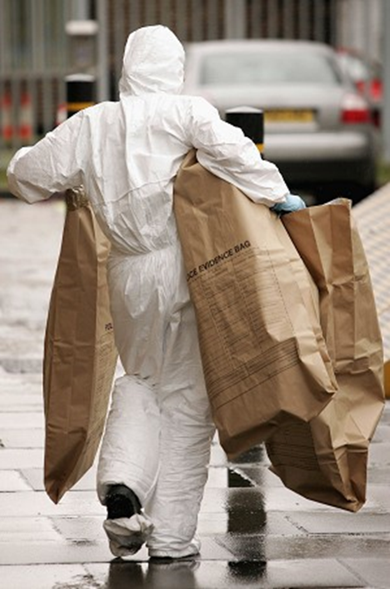
Objectives
Proper evidence handling
Proper evidence packaging
Submitting evidence to OSBI
Discipline-specific submissions
Expediting analysis
Destruction
Notes:
Evidence packaging will include:
Proper containers, labeling & seals
OSBI evidence submission will include:
OSBI Evidence Acceptance Policy
Request for Laboratory Examination (RFLE) (laboratory submission form)
OSBI facilities & hours of operation
Alternative submission routes besides in-person (i.e. evidence lockers, mail)

Slide 3
Evidence Handling
Physical Evidence: Packaging & Submitting to the OSBI Lab

Slide 4
Basic Types of Property
Evidence – Property directly related to a crime that may prove or disprove a person’s involvement in a crime
Found Property – Property having no evidentiary value that appears to be lost or abandoned with no apparent owner
Safe Keeping – Property having no evidentiary value that is acquired at accident or crime scenes and cannot be immediately returned to the owner; includes firearms seized per a lawful court order (e.g. protective orders)
Property for Destruction – Property a citizen or officer has turned in and asked to have destroyed such as found drugs or other contraband which is not associated with any criminal investigation

Slide 5

Purpose of Proper Evidence Handling
Preserve critical evidence
Package evidence appropriately so it can be easily identified, located, and analyzed
Safety of officers
Maintain chain of custody
Notes:
Chain of custody is very important, especially if the case goes to court because if the chain has not been established and shown to remain intact, the entire case can be thrown out by the court.

Slide 6
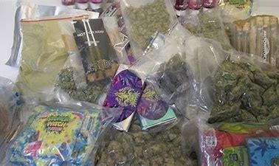

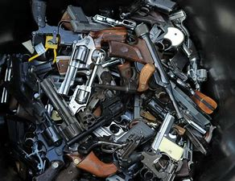
Take Special Care with the Big Three…
Notes:
DRUGS
MONEY
GUNS
You want to make sure all of these are correctly handled and packaged to prevent loss, secure the evidence, and maintain chain of custody!

Slide 7
Evidence Packaging
Physical Evidence: Packaging & Submitting to the OSBI Lab

Slide 8
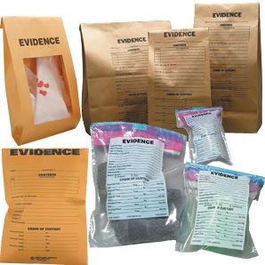
Basic Packaging Requirements
Proper package/container
Ensure it is suitable for the size of the evidence
Must be made of material that will preserve the integrity of the evidence
Must protect the evidence from loss, cross-transfer, or contamination
Notes:
Property shall be packaged in a container suitable for its size. Don’t stuff packages/containers overly full – leave some “flex” room. Items too large to fit in an Evidence Envelope may be packaged in a brown paper sack, box, plastic bucket, or brown paper packaging.

Slide 9
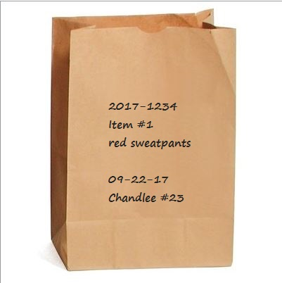
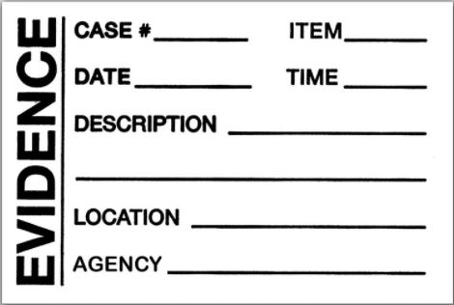
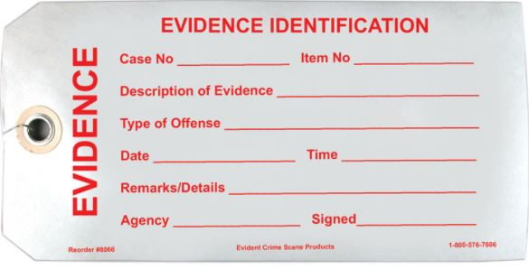
Basic Packaging Requirements
Proper labeling
Your agency case number &/or subject’s name
Description of item(s)
MUST BE LEGIBLE
Can be handwritten or applied with labels or tags
Notes:
Let us know if the evidence is sharp, fragile and/or biohazard. There are stickers for these things that can be added to the evidence packaging during submittal.

Slide 10
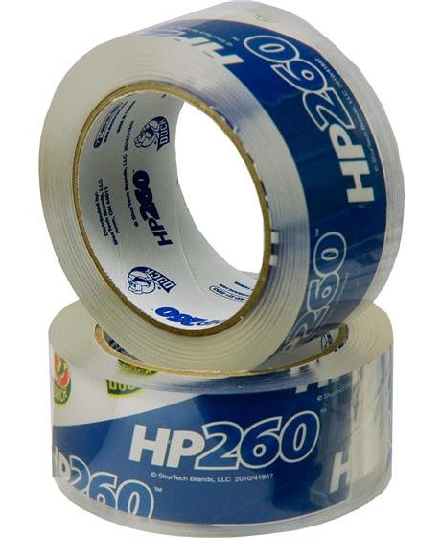
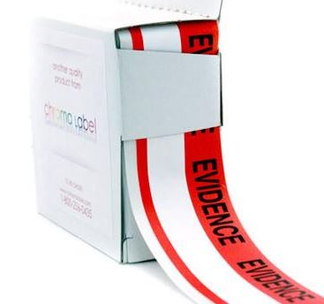
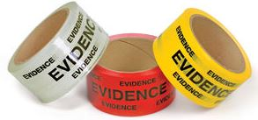
Basic Packaging Requirements
Proper seal
2” clear tape (Duck HP 260 or equal/better), evidence tape or a combination; heat sealing is also acceptable when necessary
Initials or other unique identifier of person sealing the evidence
Date recommended
Notes:
A container is considered “appropriate” and “properly sealed” only if its contents cannot readily escape and only if entering the container results in obvious damage/alteration to the container or its seal.
There are only 2 kinds of tape the OSBI uses (per accreditation requirements):
2” clear tape (Duck HP 260 or equal/better) – recommended for sealing boxes, sacks & envelopes
Evidence tape (red used by OSBI but can be any color) – required for sealing plastic containers/tubes, metal cans, Rubbermaid containers, etc. because clear tape will lift of these surfaces easily whereas evidence tape is designed to “self-destruct” and show alteration to the seal if tampered with
Recommend investing in your tape so that initials don’t fade over time or smudge off, and so that the tape does not easily lift from the packaging as it ages (have seen this with a lot of cold case evidence).
Initial ALL pieces of tape used to seal evidence; a Sharpie is preferred for initialing. This is so we can show the condition of the evidence/packaging before we (OSBI) received it – shows it was not tampered with while in our lab system. Recommend initialing both ON/OFF the SEAL/PACKAGE (will show examples in a minute)
The submitting officer will be expected to correct improperly sealed evidence prior to the evidence being accepted by the lab. So, it’s important for the person collecting and packaging the evidence initially to do it properly, especially if they are not going to be the one to submit it. If another officer brings in the evidence to the lab that’s improperly packaged/sealed, and is required to fix it, it can cause confusion for them, especially if we have questions about the contents of the package/evidence itself. Also, properly packaged evidence is important for court.

Slide 11
Evidence Seals
Envelopes: Seal top flap with 2”clear tape (or evidence tape), covering the entire seal
Boxes: Seal top and bottom seams with 2” clear tape (or evidence tape); sides are not required
Sacks: Fold down top of sack and seal across the flap and around the edges of the sack with 2” clear tape (or evidence tape)
All seals require initials or other unique identification of the person sealing the evidence on top of ANY piece of tape
Notes:
[If there are physical demo examples of properly sealed containers - begin showing them as you move thru the categories.]
You can use plain manila envelopes in lieu of evidence envelopes, but we do provide evidence envelopes to you at no charge
Do not lick envelopes to seal them – introduces DNA contamination
Note, for gun boxes, if it is just a gun for NIBIN/Firearms or just for LEU, you can decide if you want to seal over the holes; however, if it is for DNA, you must seal over all of the holes in the box.
Additionally, we do not accept luggage as a packaging – we will make you take out the contents and put it into a box

Slide 12
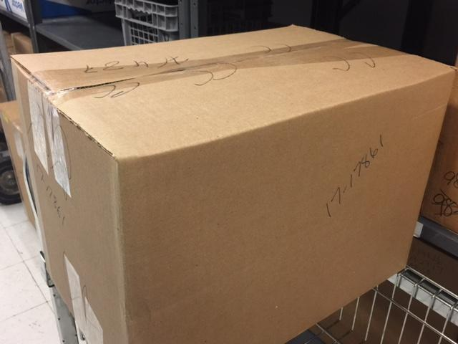
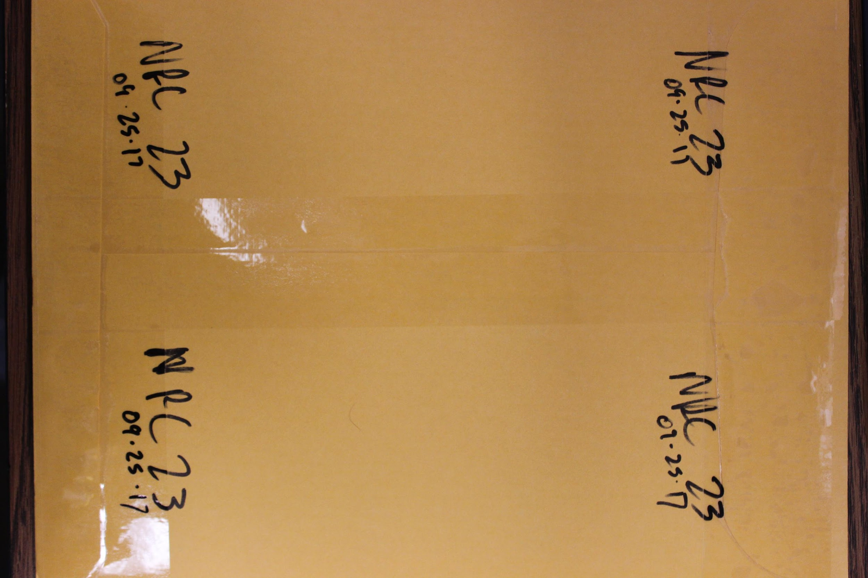
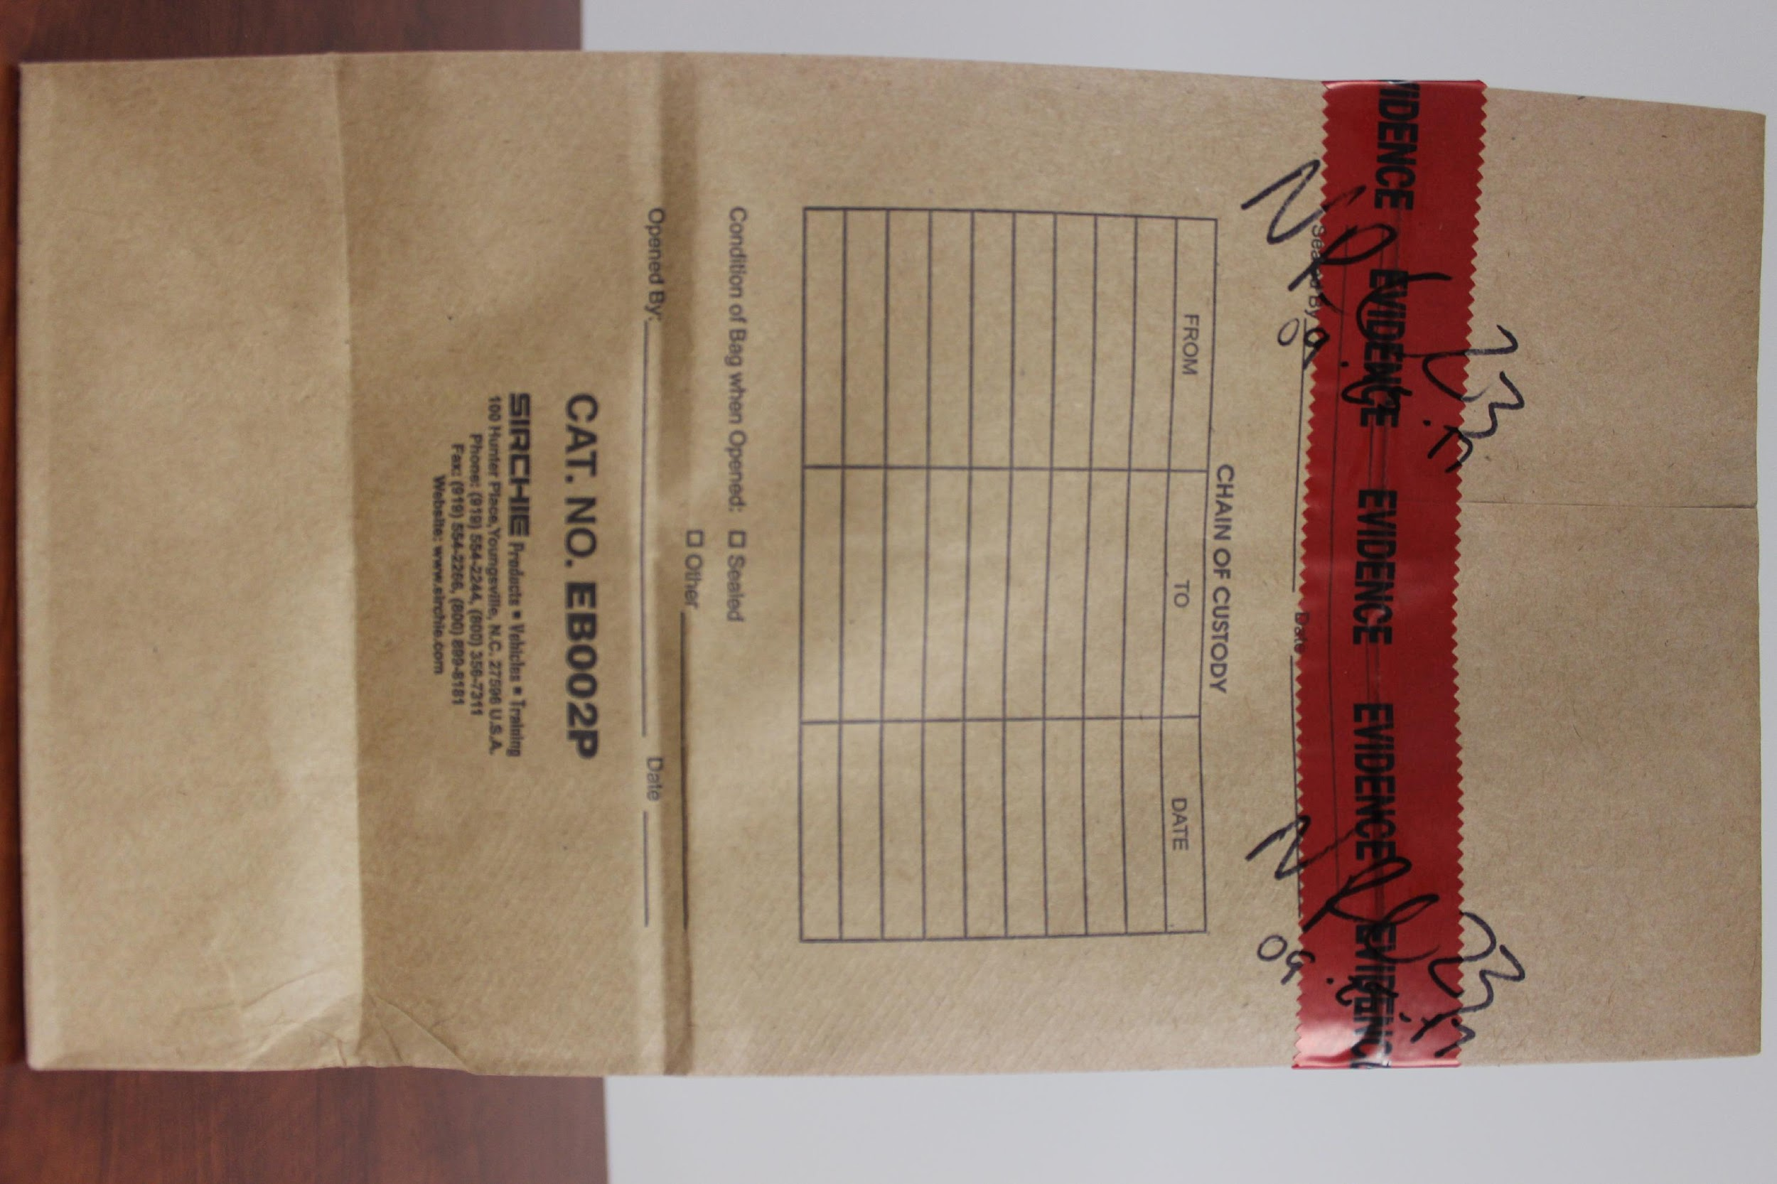
Evidence Seals
Notes:
Notice how the initials are both ON/OFF the clear tape and evidence tape in the pictures – this makes it harder to remove the tape because the initials will remain on the package

Slide 13
Evidence Seals
Plastic containers: Seal using evidence tape, either one continuous piece or two pieces across from each other; 2” tape may be used to reinforce the evidence tape, if necessary, as long as both pieces are initialed
Cans: Seal with one continuous piece of evidence tape across the top and down the sides (including buckets with lids) or two separate pieces of evidence tape across from each other; no clear tape can be used on cans if it can be peeled off without evidence of removal
All seals require initials or other unique identification of the person sealing the evidence on top of ANY piece of tape

Slide 14
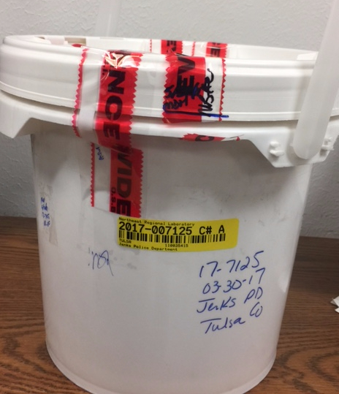
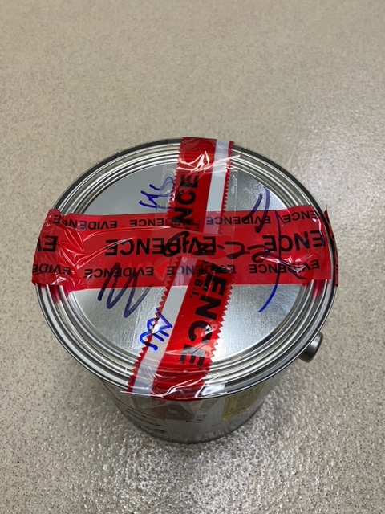
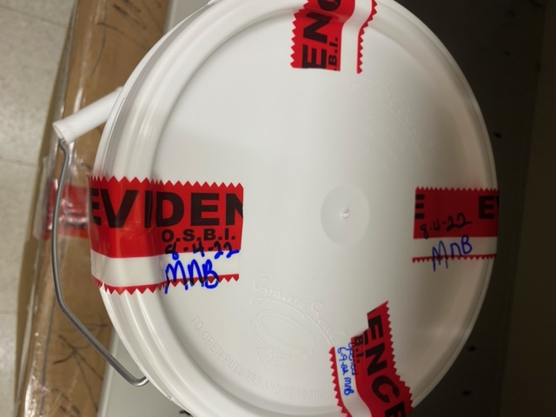
Evidence Seals

Slide 15
Evidence Seals
Kits: Boxed sexual assault kits, GSR kits, and other purchased kits are acceptable with the seal provided by the kit manufacturer, and envelope-style sexual assault kits shall meet the OSBI evidence sealing requirement for envelopes
Bulky Evidence: Evidence that does not lend itself to a container (e.g. doors, car bumpers, etc.) should have the area of interest for analysis isolated, protected and marked or initialed
All seals require initials or other unique identification of the person sealing the evidence on top of ANY piece of tape
Notes:
Some examples of Kits:
Gun shot residue kits (provided upon request)
DUI/DUID blood kits (provided to police departments/sheriff’s offices [not provided to hospitals directly])
Drug-facilitated sexual assault kits (provided to hospitals)
Sexual assault kits (provided to hospitals)
Kit seals are provided inside the kits, which can be used. For all the kits that come in a box (DUI, drug-facilitated SAKs), the provided seals are acceptable as they meet the requirements for sealing box seams; OSBI will have you add tape to the seals for any envelope-style kits though upon submittal (SAKs) in order to meet the requirements for sealing envelopes (tape entirely across the seal)
With bulky evidence, we may have to improvise packaging if needed

Slide 16
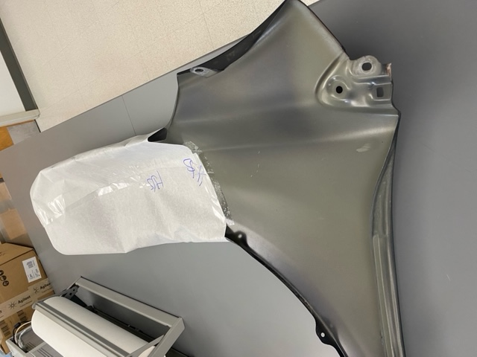
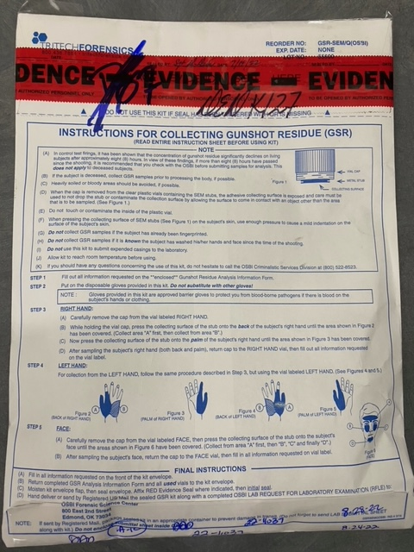
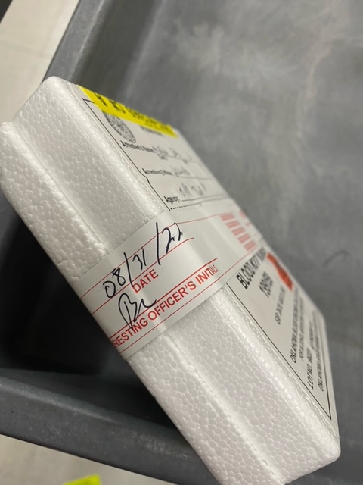
Evidence Seals

Slide 17
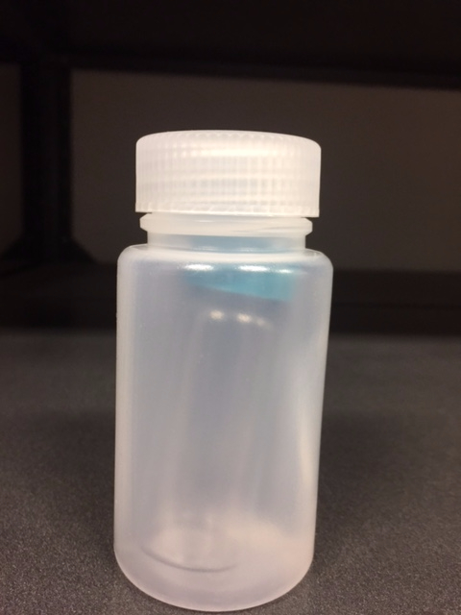
Other Packaging Requirements
Liquids: May require multiple containers; they must be in something that will contain the liquid if it should leak (e.g. glass jar inside of plastic sample jar or placed in a bucket)
Glass Containers: Should be placed inside a container that will also protect the glass from breaking
Notes:
It’s not necessary to tape over any heat seals

Slide 18
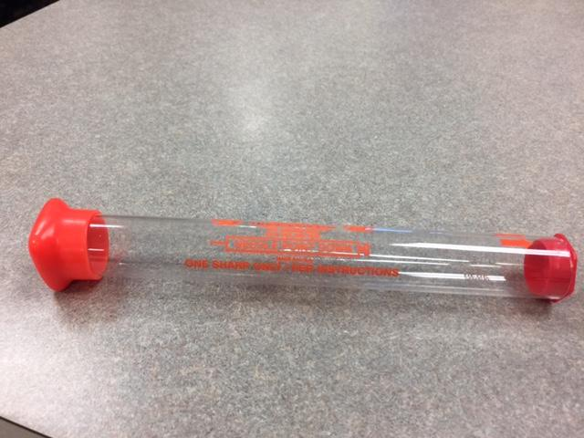
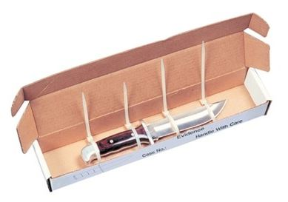
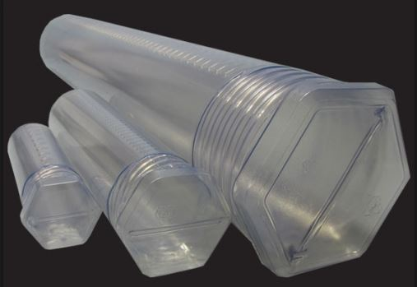
Other Packaging Requirements
Fentanyl: If evidence is an unknown powder or possible Fentanyl, package envelope in a K-PAK bag or similar packaging and label outer package as “Possible Fentanyl” when suspected
Biohazards: Must be packaged in paper and labeled
Sharps Must be packaged in appropriate containers
Notes:
Label the package if it contains a sharp item, like a knife
If boxes or tubes are used, they must be tape sealed with initials or identifying marks

Slide 19
Evidence Submission
Physical Evidence: Packaging & Submitting to the OSBI Lab

Slide 20
Evidence Acceptance Policy
https://osbi.ok.gov/forensic-services/quality-system-overview
Use Chrome or Firefox browsers; do not use Internet Explorer
Quality system/accreditation
Evidence submission information
Policies/procedures
Notifications
Feedback
Notes:
Evidence Acceptance Policy and evidence submission forms are on our website along with a lot of other resources and information.

Slide 21
Evidence Acceptance Policy
The evidence must be submitted by an individual or agency authorized to request services
Agencies and individuals authorized to request services are listed in Title 74, Sections 150.2 and 150.5
The lab cannot accept evidence from private citizens or other individuals/agencies not listed in statute

Slide 22

Evidence Acceptance Policy
The evidence must be relevant to a criminal investigation which should, in most circumstances, be expected to result in criminal charges being filed
Your request for analysis should be for “probative” evidence &/or reasonable, e.g. Does the analysis help answer an investigative question?
Evidence relevant to civil investigations or non-criminal product cases such as food or drugs suspected of being old, faulty, etc., will not be accepted for analysis
Notes:
OSBI only accepts criminal cases – no civil cases
Collect & submit evidence within the scope of the crime being investigated

Slide 23
Evidence Acceptance Policy
Evidence must have a legitimate associated service request which complies with OSBI policies
OSBI reserves the right to select the most appropriate testing method(s) and to select the item(s) most appropriate for analysis
Evidence will not be accepted for the purpose of long-term storage or if the lab cannot meet the needs of the customer

Slide 24
Evidence Acceptance Policy
Evidence must be submitted in person, via evidence locker, or through a delivery service such as the United States Postal Service (USPS), United Parcel Service (UPS), or Federal Express (FedEx)
Different units do have certain submittal requirements and exceptions
Notes:
We will discuss the specific submittal requirements for each unit soon in this presentation

Slide 25
Evidence Acceptance Policy
Evidence samples submitted for the purpose of comparison (paints, fibers, projectiles, DNA, etc.) must be accompanied by the appropriate reference samples
Exception: This does not apply to samples submitted for comparison to a database
Evidence must not include syringes, which under normal circumstances will not be accepted for analysis
Exceptions to this will be evaluated on a case-by-case basis and must be approved by a Criminalistics Administrator or the CSD Director
Explosives/fireworks will not be accepted for analysis
All weapons must be submitted in person
Notes:
OSBI will take syringes for drug destruction purposes only (will discuss this later)
Can send explosives/fireworks to the ATF

Slide 26
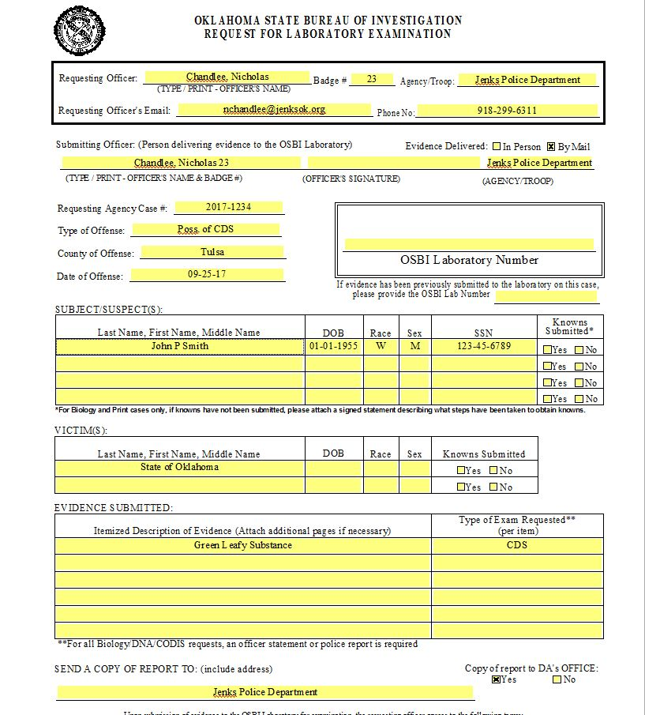
Request for Laboratory Examination (RFLE)
Complete the entire form
Print legibly or type
Officer contact info
Case info
Suspect(s) info (if known)
Victim(s) info
Description of items being submitted and type of exam(s) requested
Check Yes or No for a copy of the report to be made available to the District Attorney
Sign the form
Notes:
RFLE/Laboratory Submittal Form is essentially the contract between the laboratory and you/your agency. You must fill in all of the blanks, legibly! Make sure all names, DOBs, etc. are correct – should have a suspect and/or victim listed. (Note, for an undercover buy, you may not have a (S)/(V) listed, and we will use your case # in this instance.) Whomever transports/submits the evidence will have to sign the RFLE.
One thing to note, if there is an item listed on the RFLE that you will not be submitting, please line thru/initial it.
Also, highlighting items/information for any reason is NOT recommended because it may not show up when the form is imaged into our system.
When deciding on whether a copy of the report needs to go to the DA or not, all of our reports are available online. If you check “No” we do not/can not provide the report to the DA, EVEN IF THEY CALL AND ASK FOR A COPY.
For McGirt cases, if you need a report to go to the Feds, you can notate that on the RFLE in this area.

Slide 27
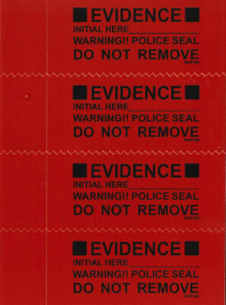
Other Things to Document on RFLE
If evidence has been removed from a body cavity
If powder is possible Fentanyl
If glass or sharps are inside of puncture proof containers

Slide 28
Evidence Acceptance Facilities
Forensic Science Center
800 E 2nd St; Edmond
(405) 330-6724
Northeast Regional Laboratory
1995 Airport Pkwy; Tahlequah
(918) 456-0653
McAlester Evidence Facility
(Evidence Submission Only)
701 W Carl Albert Pkwy; McAlester
(918) 423-6672
Lawton Evidence Facility
(Evidence Submission Only)
1010 SW Railroad St; Lawton
(580) 291-8127
Notes:
For the convenience of OSBI CSD customers, evidence may be submitted at any CSD facility. OSBI CSD personnel will transport evidence between facilities when necessary to provide the appropriate or most timely analysis.
If evidence needs to be transported to another lab for analysis not offered at the lab to which it is submitted, OSBI personnel will transport the evidence to the necessary lab.
NOTE: The Lawton facility accepting evidence effective 04/05/23.
Days and hours of operation will be:
Tuesday* 8:30 AM to 4:00 PM
Wednesday* 8:30 AM to 4:00 PM
Thursday* 8:30 AM to 4:00 PM

Slide 29
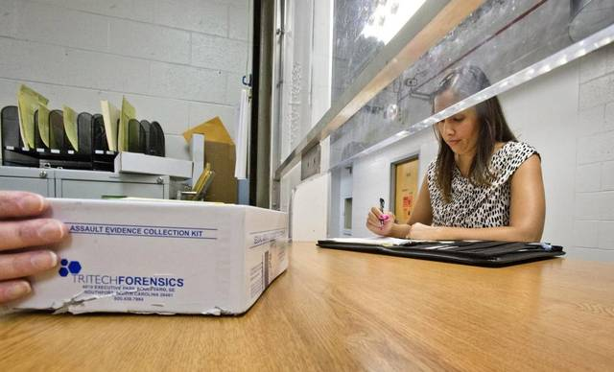
Evidence Acceptance Hours
Evidence is accepted between 8am – 4pm Monday thru Friday
Notes:
Evidence accepted between 8am – 4pm Monday thru Friday.
Officers submitting evidence must be at one of our facilities before 4pm to begin submitting evidence. Our Evidence Technician Units will close promptly at 5pm each day. As a result, if an evidence submittal is started before 4pm but not completed by 5pm, the remaining evidence will be returned to the officer, and he/she will be required to return the next business day to complete the evidence submittal. Therefore, to avoid any inconvenience, officers with large amounts of evidence to submit are encouraged to submit the evidence to the OSBI early in the day.
Lawton Evidence Facility:
Days and hours of operation will be:
Tuesday* 8:30 AM to 4:00 PM
Wednesday* 8:30 AM to 4:00 PM
Thursday* 8:30 AM to 4:00 PM

Slide 30
OSBI Evidence Lockers
Located in the evidence receiving facilities in Edmond, Tahlequah, McAlester, and Lawton, and accessible during normal laboratory operating hours
Available for your convenience should a Physical Evidence Technician (or other OSBI Criminalistics personnel) not be available to receive evidence from you
Each case will still need a submittal form (RFLE) filled out and left with the evidence
Chain of custody for the OSBI laboratory system will not begin until your evidence is retrieved from the evidence locker by an authorized individual
Once the evidence is logged in, the evidence receipt will be available to you on the Report Portal

Slide 31
OSBI Evidence Lockers
Evidence that can not be placed into evidence lockers:
Firearms
Wet items
Items that need to be stored in the refrigerator or freezer
DNA/Biology cases
Exceptions: Known reference (buccal) swabs and sexual assault kits – submittal envelope 1 can be submitted via the evidence locker without prior approval / submittal envelope 2 can only be accepted via the evidence locker with prior approval from Specialized Biology Unit personnel
If you need to submit these types of items to McAlester or Lawton, please call your laboratory before traveling to ensure someone will be available to accept your evidence

Slide 32
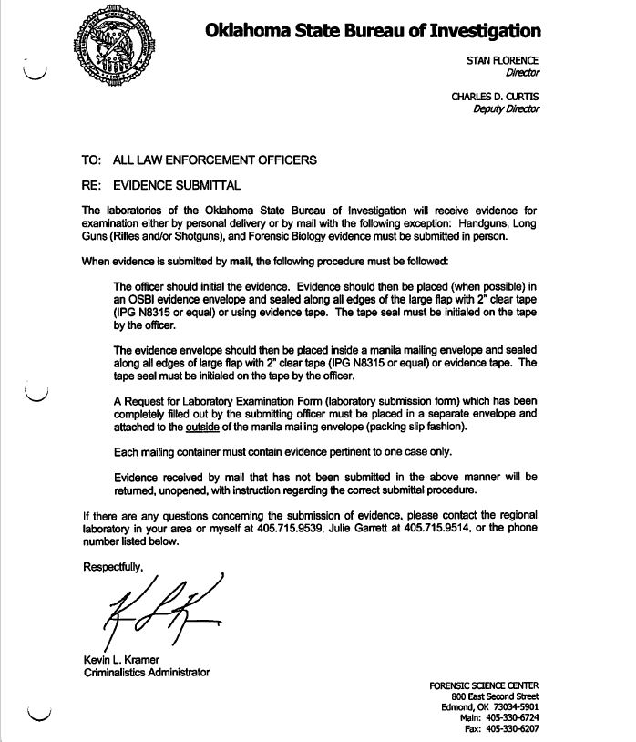
Submitting Evidence By Mail
Only one case per mailing container
Place evidence envelope inside of manila envelope or mailing container
Seal the mailing container the same as the evidence envelope, this mailing container is now part of the evidence
Complete RFLE and place in envelope taped to the outside of mailing container, similar to a packing slip
If evidence is not packaged properly it will be shipped back to the agency for proper submittal
Notes:
Honestly, mailing evidence is not recommended, and I would try to avoid it if you can.

Slide 33
Discipline-Specific Submissions
Physical Evidence: Packaging & Submitting to the OSBI Lab

Slide 34
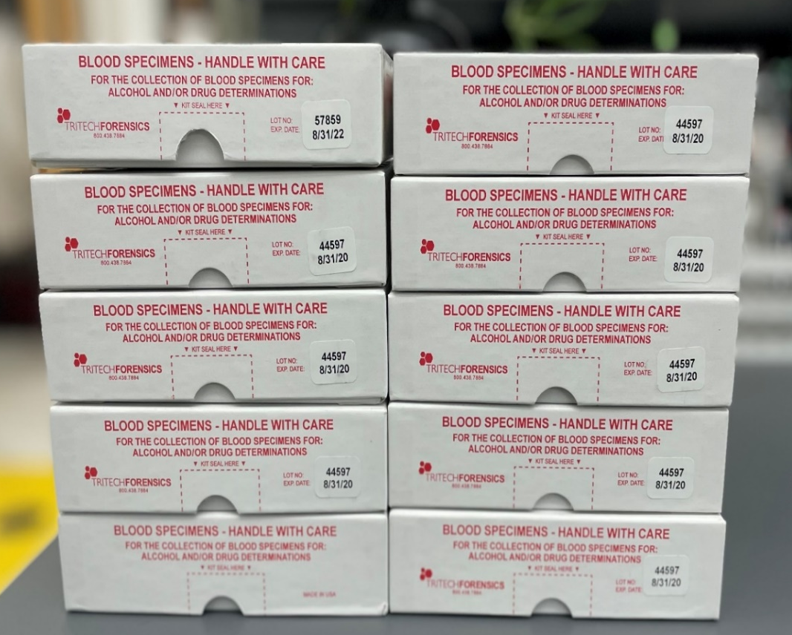
Submitting Toxicology Evidence
DUI kits can now be submitted (hand delivered) to any OSBI laboratory or regional evidence acceptance facility or they can be mailed to the OSBI FSC (Edmond)
Hand deliver all other toxicology evidence, including but not limited to DFSA kits, alcoholic content, non-vehicular homicides, etc. (everything that is not a DUI) to any OSBI laboratory or regional evidence acceptance facility
DFSA kits must be refrigerated at all times (due to the urine in the kits)
Notes:
DUI kits by mail or hand delivery – mail to FSC, and although you can hand deliver to any lab/evidence acceptance facility (except Lawton at this time due to no refrigeration available), we prefer that they are submitted directly to FSC if possible to help expedite testing. All other evidence, DFSA kits, alcoholic content, non-vehicular homicides, everything that is not a DUI, must be hand delivered to any OSBI laboratory/evidence acceptance facility, and again, we prefer that you submit these to FSC if possible; however, feel free to submit to the location most convenient for you.
Recommend refrigerating DUI kits, but the blood is in blood vials w/preservatives that make it okay to not be refrigerated (although it is recommended). DFSA kits must be refrigerated – they contain blood and urine, and the urine does not contain preservatives.
[Notes for if questions asked about refrigeration: Recommended. If it isn’t refrigerated, drugs such as olanzapine (Zyprexa) and cocaine can degrade/breakdown and therefore not be detectible. There is NO concern about alcohol production if it isn’t refrigerated because the sample comes from a living person. If the sample was from a dead person, then you do worry about it - for blood from deceased individuals, blood should be refrigerated. OSBI only tests blood from living individuals; deceased persons & toxicology testing is not under our scope.]

Slide 35
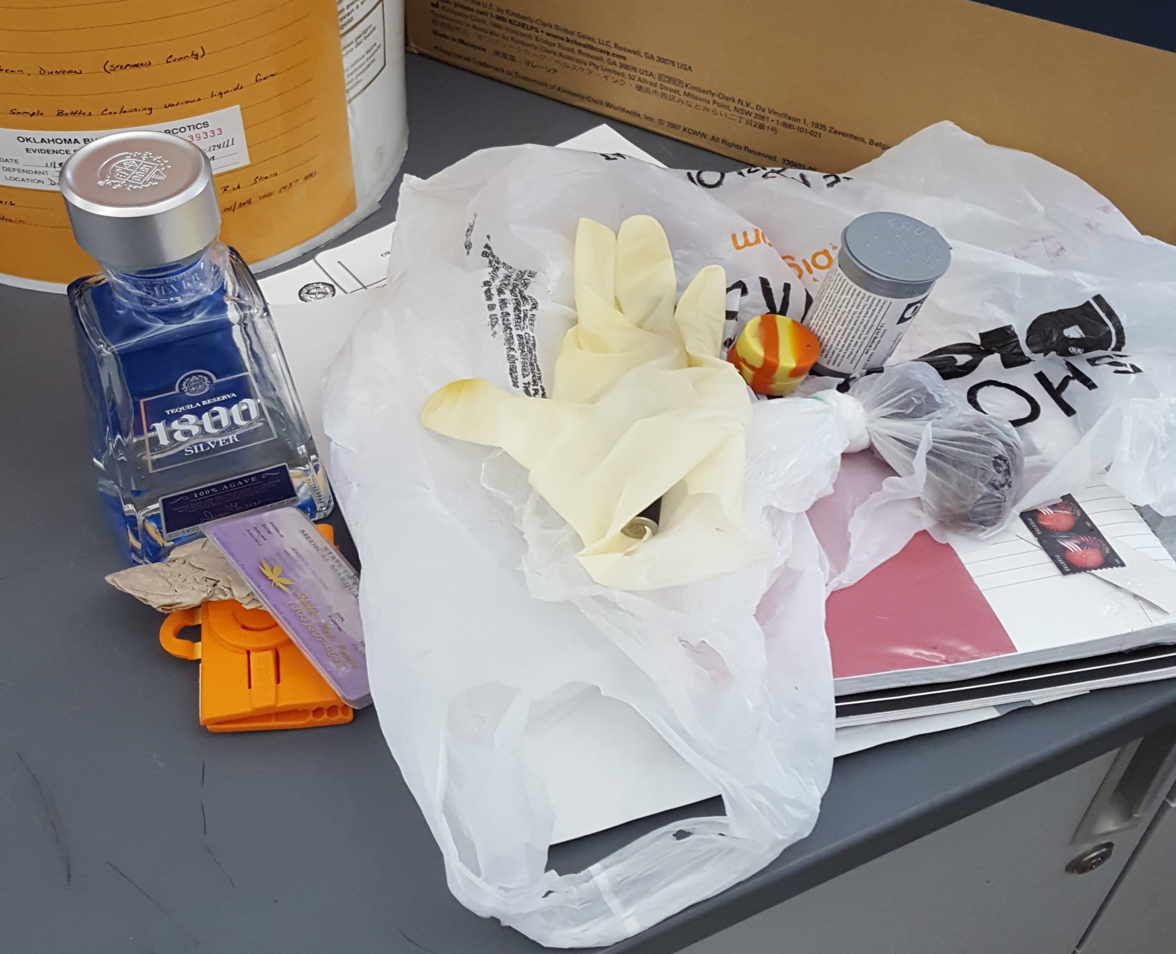
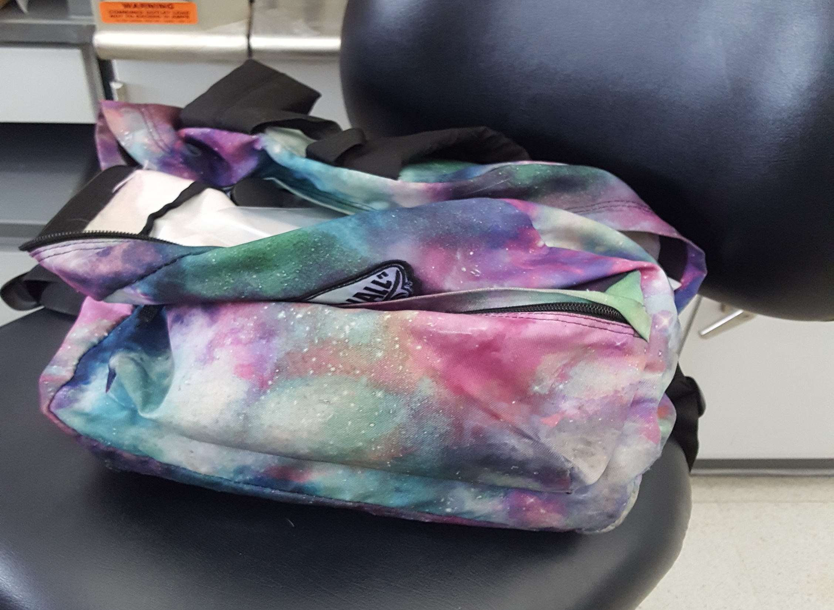
Submitting CDS (Drug) Evidence
Must be packaged separately from other property
Leave the drugs in existing container but package that appropriately
Submit only what you actually need tested
Do not submit:
Syringes
Field test kits
Receipts, rubber bands, lighters/matches, other trash
Razorblades/knives
Exception: Submittal okay if residue present but must be packaged appropriately
Marijuana with any perceptible moisture content (i.e. fresh plants) must be loosely packaged in a paper container that allows for drying or shall be dried prior to storage; fresh plants will mold in plastic
Notes:
Handle with caution (just like all other evidence)
Can leave drugs in their container and package that, e.g. pills in a pill bottle – no need to dump them out and into the package you’re submitting to OSBI
Submit only what you actually need tested, e.g.:
Plastic bag containing a Green Leafy Substance (GLS)
Gum wrapper containing a black tar substance
No syringes, unless they have admin approval; if so, package in a syringe tube.
The acid in field test kits can destroy the evidence if they leak.
Razorblades and Knifes can be submitted if they have a residue but they must be packaged in a safety tube.
Also, one thing to remember when you get lab results back in drug cases, the weights reported may differ from a weight measurement you took. You may have weighed a substance with it’s packaging; we don’t – we report net weight of the substance without any packaging. Also remember the moisture and humidity can affect weight measurements, use of calibrated scales, etc.

Slide 36
Submitting Trace Evidence
Match packaging size to evidence
Submit entire object when possible and practical
Package arson evidence in lined cans or arson bags
Collect known samples close to damage
Document location of known and unknown samples
Never submit evidence from known and unknown samples in the same packaging
Notes:
For matching size to the evidence, small items can be lost from poorly sealed envelopes; small items should be placed into a paper bindle first.
Place small samples in paper bindles and then into their own containers (envelopes)
Individually packaged known and unknown samples can then be placed in the same outer container (evidence envelope)
Lined cans for ignitable liquid/arson evidence are provided by OSBI upon request. Plastic bags and buckets can NOT be used to submit arson evidence. During ignitable liquid testing, trace analysts are looking to identify petroleum products and plastic bags and buckets are manufactured from petroleum.
Arson bags can be used for clothing and other things that won’t fit in cans, and the bags can then be heat-sealed

Slide 37
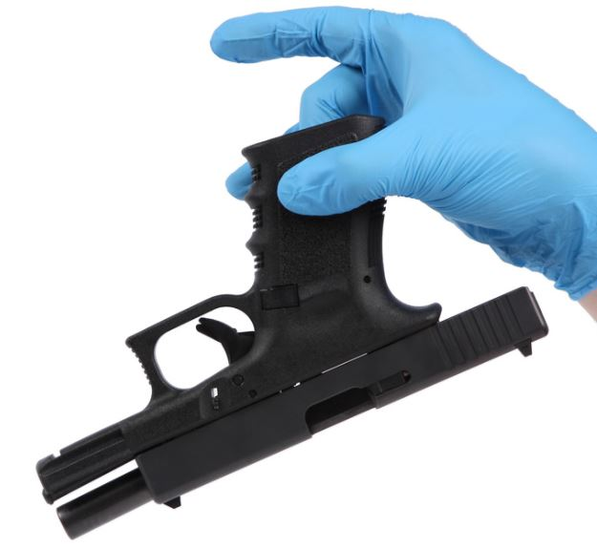
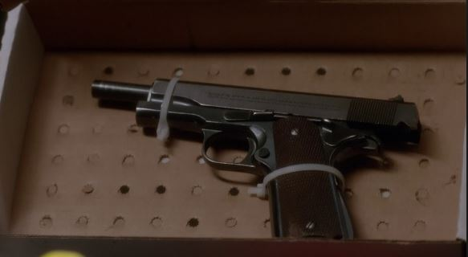
Submitting Firearms
All firearms must be submitted in person and must be unloaded
Must document on package & RFLE that gun is unloaded
Preferred packaging: cardboard gun box
If DNA is needed, do not package in plastic
Do not put anything inside the barrel that could alter or damage the weapon
If you use zip-ties, please do not thread through the barrel
Magazines should be removed from firearm and packaged with it
Ammunition should not be packaged with the firearm & should not be submitted (safety hazard)
Do not submit extra firearm accessories, such as extra magazines, holsters, cleaning gear, gun box, etc.
Properly label if biohazard is possible
Notes:
Handle firearms safely, always assuming it’s loaded & verify it’s unloaded; after it’s been rendered safe, PACKAGE IT!
Handle weapon as little as possible - If firearm needs to be fingerprinted, handle it by any surface that would likely not have fingerprints, e.g. slide serrations, textured grips, etc.
If you use ties, please leave some slack for removal; recommend using reusable ties
Do not “mummify” the firearm
If DNA analysis is needed, do NOT package weapon in plastic
Live ammunition should not be submitted or packaged with the firearm. The Firearms Lab does not want suspect live ammunition. They will not use this for test firing because they don’t know how the ammo was stored/handled previously. This can be a safety hazard.
Of note, for felon in possession cases, LEU/DNA will not analyze the evidence, but Firearms can accept the evidence for NIBIN entry

Slide 38
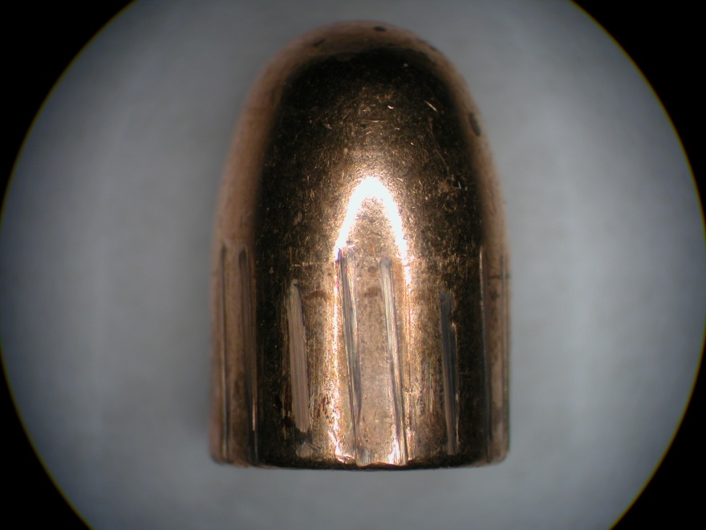
Submitting Projectiles
No metal to metal contact
Package separately
Preferred packaging: smaller containers within a larger container
Use container to document any agency item/marker numbers
Properly label if biohazard is possible

Slide 39
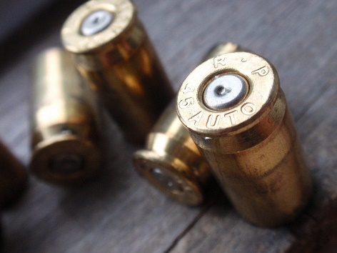
Submitting Cartridge Casings
The decision to package them separately or together is at the submitter’s discretion
If each has unique agency item/marker number, need to be packaged separately, with that information on container (do not write/scribe on the evidence)
Preferred packaging: smaller containers within a larger container
Properly label if biohazard is possible

Slide 40
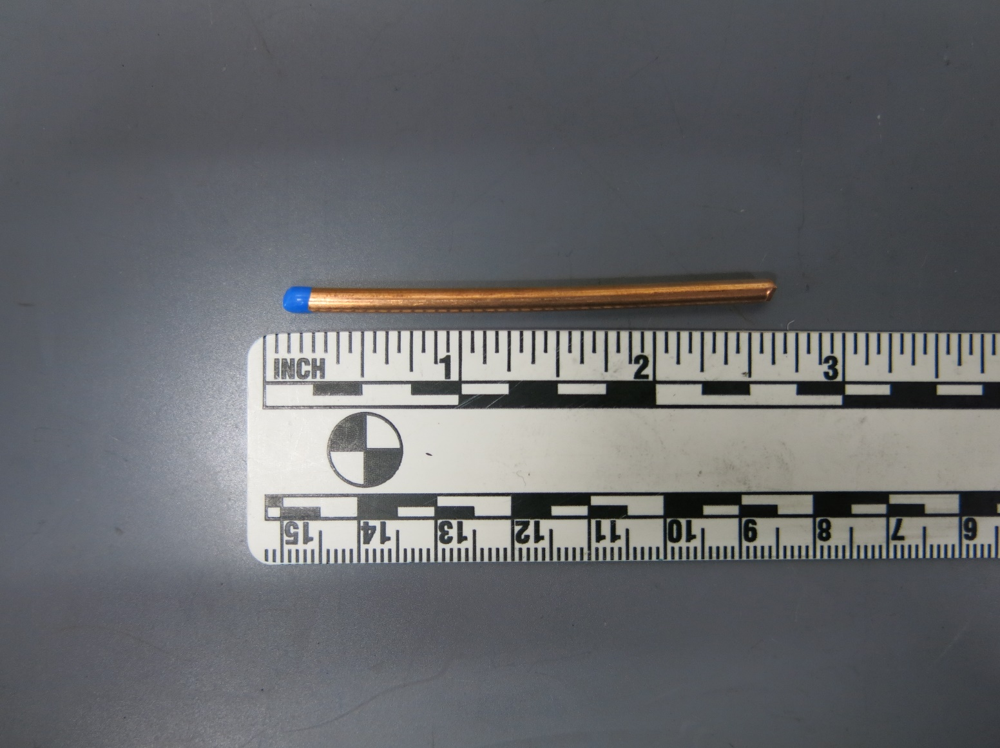
Submitting Toolmark Evidence
Tools and tool-marked items should always be protected against damage
Submit both tool & tool-marked item(s) for analysis
If evidence is cut in order to submit (e.g. wire from a wall or spool), mark the end you cut
Notes:
Damage to tool could alter the marks it leaves, and thus invalidates the comparison to the tool-marked item(s).
Reminder: cannot do unknown-to-unknown comparisons; MUST have a tool to compare to.
Mark end not to be compared. Sharpie or tape works! Just so there is some indication of which end to compare to the tool.

Slide 41
Submitting Evidence for Distance Determination
Submit firearm in question
Submit only victim’s/target surface clothing with bullet hole(s)
OSBI does not process suspect’s clothing for muzzle-to-target distance determination
Submit only the outer garment, if known
Submit only dried clothing
The item should be dried as flat as possible, not wadded up, as this will assist us with the chemical processing of the garment
Multiple garments/articles of clothing need to be packaged separately to prevent cross-contamination

Slide 42
Submitting Latent Prints
Digital images of latent prints or impression evidence will not be accepted by email submission and must be submitted on physical media (CD, DVD, etc.)
Exception: Digital images of impressions for the sole purpose of identification of deceased or living individuals may be submitted via email
Submit complete known impressions of all victims and suspects with evidence, if possible; this will provide the necessary comparison materials to complete your case in a more timely manner
Notes:
Each disc should be accompanied by a photo log that is properly documented; this should include:
Officer initials
Date
Description of where the photo was taken
Description of what item is shown in the photo
When you submit knowns, provide all suspect and victim information to include:
Name (to include maiden and alias)
Date of Birth
SSN
Race
Sex
It is ok if you don’t have known impressions to submit. We can pull print cards from those that we have available, and we can search suitable prints through AFIS, but the prints may remain unidentified.

Slide 43

Submitting Biological Evidence
All Forensic Biology evidence must be submitted in person
Exception: Sexual Assault Evidence Collection Kits and known buccal (cheek) swabs for DNA reference samples may be submitted via evidence locker or a delivery service
Always keep sexual assault kits separate from clothing
Never package biological evidence in plastic; always package in paper to prevent mold and contamination
Wet items must be air-dried prior to packaging
Never blow on samples to dry them
Swab or take cuttings from large items if possible
Simple cotton swabs submitted in envelopes are best for the collection of crime scene stains and known samples
Control swabs are not needed
Never touch any biological sample; it may transfer your DNA to the item
Never lick outer envelopes to seal them
Must mark all biology evidence as biohazard
Notes:
Plastic can degrade/destroy DNA
OSBI FSC has drying stalls available
SAK stays separate from clothing, which is packaged appropriately in paper bags (each bag labeled), and this usually does require multiple bags

Slide 44
Submitting Biological Evidence
Cases are “triaged” as they are submitted to determine which items are best suited for analysis based on circumstances of alleged crime; be prepared to answer questions from a biologists during submittal
Major crimes (homicides, assaults & robberies) will be discussed with the officer &/or DA to determine best items for processing at the time of submission
Property crimes (burglaries, larcenies, arsons) are limited to a maximum of 3 items (not including knowns)
Sexual assault kits (envelope 1 only) do not require consultation with a biologist; all other sexual assault evidence (kit envelope 2, clothing, bedding, etc.) require consultation with a biologist
Non-reporting and anonymous sexual assault kits are not accepted
Notes:
Why triage cases?
Allows us to work cases more efficiently
Has significantly decreased our backlogs and turnaround times
Be prepared to answer questions upon submittal of biology cases. A biologist will either come to speak with you directly or they may also call you on the phone. You’re welcome to call us first, before you come to the lab to submit evidence, and get approval for the biology submission.
SAKs are updated by OSBI in the SAK Tracking System as they are submitted to the lab and after return to the submitting agency. SAK envelope #2 does require consultation with a biologist.

Slide 45
Submitting Biological Evidence
All biology submittals must have the RFLE and an accompanying incident report that describes what happened and from where items were collected
Helps us determine your best evidence
Helps us determine if a piece of evidence is CODIS eligible or not
Speeds up analysis (fewer phone calls for info)
Notes:
Summary of the incident
What evidence was collected
Where was the evidence collected
“At the crime scene” does not count
Need more detail such as “On wall by body”
Why might the evidence contain suspect DNA
“Victim does not smoke” if a cigarette butt is collected
“Item does not belong to victim” if a clothing item is submitted

Slide 46
Submitting Biological Evidence
All DNA requests must be submitted with known reference samples; this must include samples from the victim, suspect(s) [if possible] and exclusionary knowns, as needed
Known DNA reference samples must be labeled with who they are collected from in item descriptions (not just “DNA swabs” or “known swabs”)
Known/reference samples do not need to be labeled or packaged separately for whatever side of the mouth they are collected from
Do not use OSBI Offender Collection Kits (CODIS kits) for known DNA reference sample collection
Notes:
Buccal/oral swabs

Slide 47
Expediting Analysis
Physical Evidence: Packaging & Submitting to the OSBI Lab

Slide 48
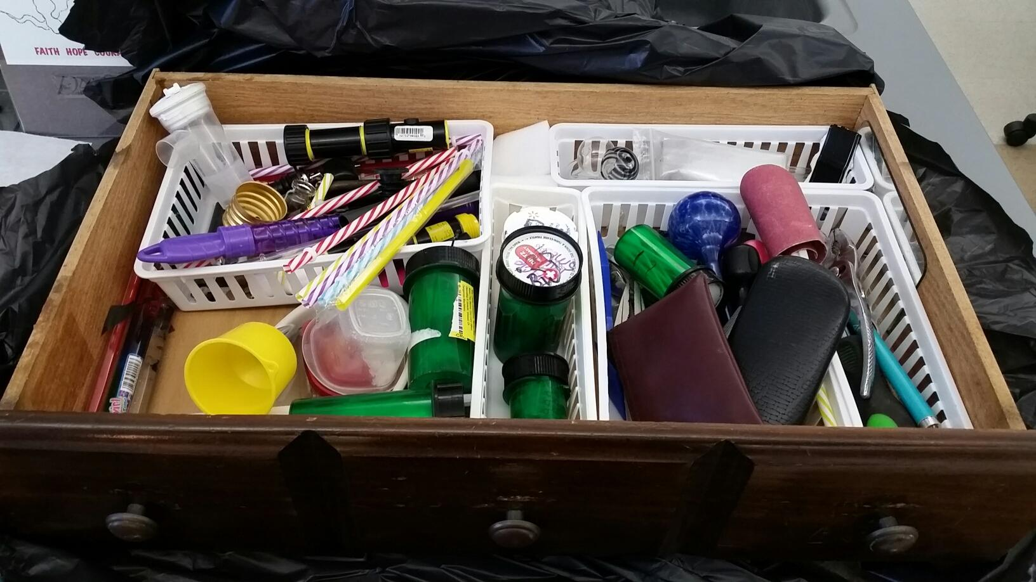
Things That Slow Down Lab Analysis
Discrepancies
Extra items (not analyzed)
Packaging
Safety issues
Notes:
If there are extra or missing items, such as drug counts and weights that do not match, we cannot work those items until we contact the submitting officer and resolve the discrepancies
This is good practice, but also required by our policy and accreditation requirements (ISO 17025 7.4.3 and CSD QM 7.4.3).
This can take a significant amount of time, since many officer’s work at night.
In 2021, we had 4248 items submitted in Drugs that we did not analyze.
These were items that we cannot test such as trash, were duplicate items not necessary for the charges, or items with residue when weighable drugs had been submitted.
We still need to verify these items with the submittal form, inventory them, sometimes obtain a weight. This takes time.
It slows us down if items are packaged in multiple layers, excessively taped, or placed ill-fitting containers.
In addition when hazardous items such as syringes, field test kits, or broken glass are submitted, we must make these items safe by providing a sharps container, heat sealed bag, provide bubble wrap, or appropriate outer containers.

Slide 49
How to Expedite Analysis
Appropriately label all evidence on outer containers with enough detail to determine who or where item(s) was/were collected from
Include direct contact information of the requesting officer on RFLE, e.g. if officer works night shift, provide e-mail in addition to phone number
Separate and submit evidence needing different types of analysis in different packages where possible, e.g. unknown substance for drugs in one container, clothing for biology in another container, etc.
Submit evidence in a timely manner to allow plenty of time for analysis prior to court dates (2 to 3 months is preferred)
Make sure all appropriate evidence is submitted prior to requesting us to “rush” your case
Notes:
If you have a case that has a firearm for Firearms, clothing for Biology, fingerprints for Latents, and drugs, package all of these thing separately so that they can go to each of the different units at the same time rather than having to send everything to one unit, one-by-one, preventing other units from being able to work the case because they’re waiting on the evidence.
Note, multiple drugs can be in the same outer package as long as they are each in their own separate packages inside
Sexual assault kits – kit stays separate from clothing which is packaged appropriately in paper bags, make sure each bag is labeled (usually require multiple bags)
Do not package items collected from suspect with items collected from victim or crime scene.
Do not package known DNA samples (suspect, victim, elimination knowns) in the same packages as the crime scene evidence.

Slide 50
Communication
Notify us when the status of a case changes
New case information
Court dates
Rush/expedite
Analysis is no longer needed
Communication is key!
Notes:
Do NOT package known DNA samples (suspect, victim, elimination knowns) in the same packages as the crime scene evidence.
Do not package items collected from suspect with items collected from victim or crime scene.
Sexual assault kits – kit stays separate from clothing which is packaged appropriately in paper bags, make sure each bag is labeled (usually require multiple bags)

Slide 51
Destruction
Physical Evidence: Packaging & Submitting to the OSBI Lab

Slide 52
Destruction
Per Title 63 Oklahoma Statutes, Sections 2-507 and 2-505(B) the OSBI is required to destroy all drugs and drug paraphernalia
Once evidence is no longer needed for court or investigation purposes, evidence can be submitted for destruction
Complete OSBI Destruction Form
Sign and date the bottom
Notes:
So, generally, as case the enters our lab system will be returned to the submitting agency, after court proceedings/legalities are done, then the evidence can be returned back to OSBI for destruction
Can combine multiple cases on 1 form
If case has previously been to OSBI, you can reference the container # (letter) and we will have the contents in our records
OSBI does take syringes for drug destruction purposes only

Slide 53
Destruction
OSBI does not take any of the following for destruction:
Alcohol
Biological evidence
Ammunition or fireworks
Cell phones or electronics
Batteries
Car tags
Notes:
How to destroy alcohol? This is up to you and your department’s policy. It does not have to come to us for destruction. We recommend photographing/videoing as it’s disposed

Slide 54
Summary & Resources
Physical Evidence: Packaging & Submitting to the OSBI Lab

Slide 55
Summary
Proper evidence handling ensures evidence integrity/preservation, chain of custody & safety
General and discipline-specific proper evidence packaging and submission encompasses:
Proper containers, labeling & seals
OSBI Evidence Acceptance Policy
OSBI Request for Laboratory Examination (RFLE) (lab submission form)
OSBI laboratories/facilities & hours of operation
Ways to submit to OSBI (in-person, evidence lockers, mail)
You can assist in expediting analysis
OSBI destroys all drugs and drug paraphernalia

Slide 56
Resources
https://osbi.ok.gov/forensic-services/quality-system-overview
Facilities & Available Services, OSBI CSD QMA 4.1
Evidence Acceptance Requirements, OSBI CSD QMA 2
Evidence Packaging & Sealing Requirements, OSBI CSD QMA3
Service Limitations, OSBI CSD QMA 4.2
Alternate Service Providers, OSBI CSD QMA 5
Request for Laboratory Examination (RFLE) form (laboratory submittal form), OSBI CSD QPA 5.1
Destruction form, OSBI CSD QPA 7.1
“Syringes No Longer Accepted” customer notification
“Evidence Description Accuracy” customer notification
“Submittal of Sexual Assault Evidence Collection Kits” customer notification
OSBI Laboratory Reports Online registration form
OSBI CSD Laboratory Kit & Supply Request form
OSBI Forensic Laboratory Customer Service Survey
Notes:
ALL OF THESE ARE ONLINE: OSBI website > “Evidence Submission” tab
Use Chrome or Firefox browsers; do not use Internet Explorer

Slide 57
Resources
OSBI Physical Evidence Unit
Christa Rhodes, Supervisor Christa.Rhodes@osbi.ok.gov (918) 456-0653
Notes:
For any questions, feel free to call the lab.

Slide 58
Thank You
For comments and/or recommendations for improvement regarding lab services, contact:
Janice Joslin, Director of Criminalistics Services Division
Janice.Joslin@osbi.ok.gov
(405) 715-9554
For comments and/or recommendations to improve this presentation, contact:
Danielle Ross-Carr, Administrator, Criminalistics Services Division
Danielle.Carr@osbi.ok.gov
(405) 715-9559
Notes:
For any comments or recommendations for improvement regarding the content of this presentation, please contact Danielle Ross Carr.

Slide 59
History
Revision 0, September 8, 2022: Initial/original presentation
Revision 1, December 1, 2022: Removed all references to Digital Evidence Unit (due to transfer from CSD to Investigative Division) and reworded the “Submitting Toxicology Evidence” slide and notes to clarify that toxicology evidence, including DUI kits, can be submitted to any OSBI laboratory/evidence acceptance facility
Revision 2, April 3, 2023: Updated names of OSBI Evidence Facilities, added slide 36 under CSD, updated info on “Thank You” slide
Revision 3, July 25, 2023: Removed NWRL from lab locations
Revision 4, August 9, 2023: Updated to OSBI brand/color, removed slide 36
Revision 5, February 7, 2024: removed evidence manual from slide 56; removed Enid reference from slide 31.
Revision 6, July 1, 2024: updated personnel.

