Slide 1

Welcome!

Slide 2
Plan Year 2026 Open Enrollment
Benefits partner training
Employee Benefits Department​
Human Capital Management

Slide 3
Vision plan presentations

Slide 4
All vision plans
Coverage for exams, lenses, frames, contact lenses and more
Designated provider networks
Limited coverage for services by non-network providers

Slide 5




Vision plans

Slide 6







Year-round vision benefits with
Primary Vision Care Services
Oklahoma owned and operated
www..pvcs-usa.com
888-357-6912
email@pvcs-usa.com
2518 W Gore Blvd., Lawton, OK

Slide 7
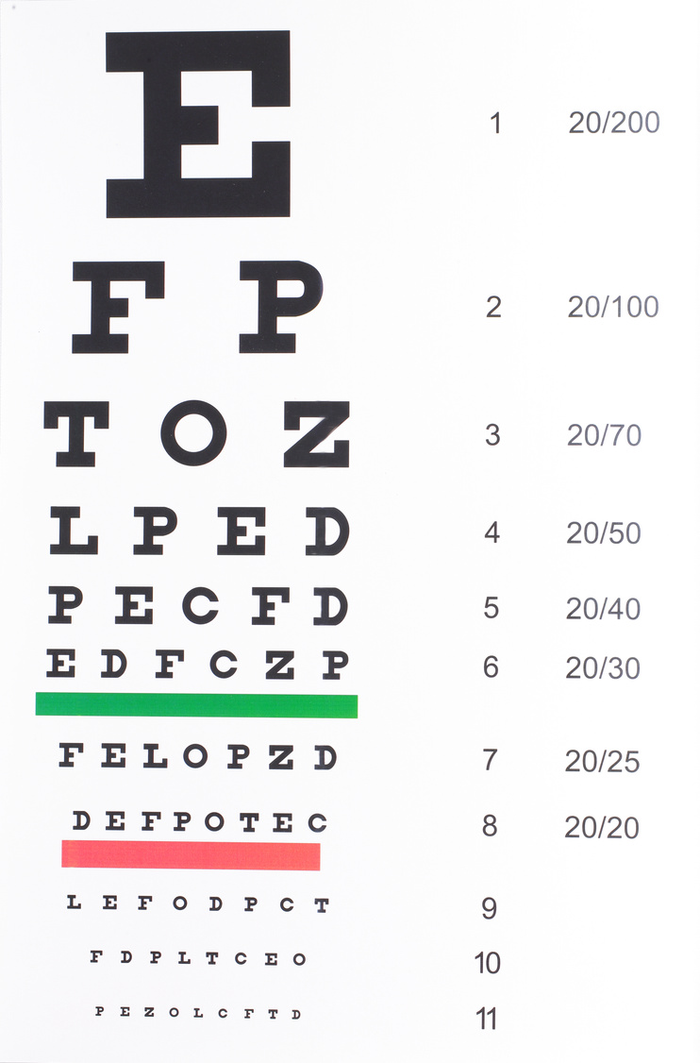

PVCS offers one simple, easy to understand plan with year-round vision benefits
Exams are covered in full and not limited to once per year.
All materials at wholesale cost. This includes frames, lenses, lens options, and contact lenses.
There is a $50 copay for the initial soft contact lens fitting.
Members are eligible for both prescription glasses and contacts in the same plan year.

Slide 8

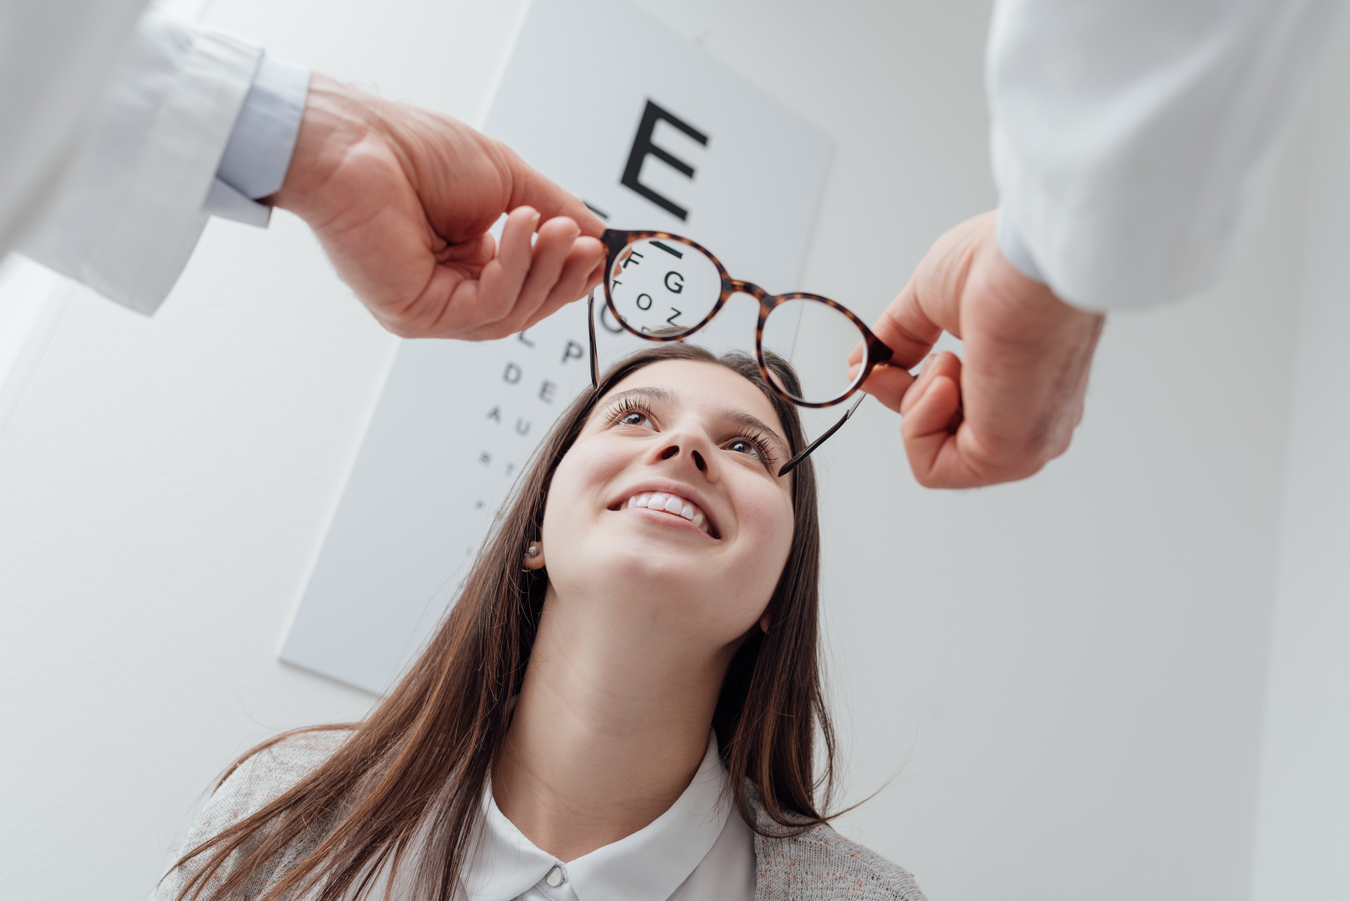


PVCS Providers
Over 300 provider locations statewide. All PVCS providers are independent optometrists and ophthalmologists that dispense glasses and contacts in their offices.
Visit our website for a complete listing of PVCS providers using the Find a Doctor tab.
www.pvcs-usa.com

Slide 9

Network Benefits
No ID Card Required
Simply select a PVCS provider and identify yourself as a PVCS member
Eye exams are covered at 100% and not limited to once per year
Members are eligible for glasses and contacts in the same plan year
Members are allowed as many pairs of prescription glasses as wanted or needed at the wholesale benefit
Prescription glasses and contact lenses are provided at wholesale cost
Non-network benefit reimbursement up to $40 for an eye exam and up to
$60 for prescription glasses or contact lenses in lieu of network benefits.

Slide 10


Lasik Vision Providers
PVCS members interested in Lasik vision correction can save up to $1,000 using nJoy Vision in Oklahoma City and the Oklahoma Medical Eye Group In Tulsa.

Slide 11


Questions
Call our live answer customer service 888-357-6912
Email us at email@pvcs-usa.com
The difference is clear...
Visit our website at www.pvcs-usa.com

Slide 12

State of Oklahoma 2026 Option Period
Vision Benefits Presentation

Slide 13

An overview of your vision benefits
Offers flexibility and choice
In-network benefits available through network eye care professionals or go out-of-network and be reimbursed at your plan's out-of-network rates.
Find an in-network eye care professional at superiorvision.com. Call your eye doctor to verify network participation.
Obtain a vision exam with either an MD or OD.
Use different eye care professionals for exam and for eyewear.
No claim forms or vouchers required for in-network services.
Personalized ID card in the mail and in the app (not required, but recommended for convenience when visiting an eye care professional).

Slide 14
Your in-network vision benefits
In-network benefit | Member copays
Routine eye exam (one per calendar year) Ophthalmologist (MD) or Optometrist (OD) | $10
Frames & lenses (one pair lenses per calendar year) Standard lenses (single vision, bifocal, trifocal and standard progressive lenses) | $25
Contact lens fitting (one per calendar year) | $25
In-network benefit | Member allowances
Frames (one per calendar year) | $150 retail allowance
Contact lenses (one allowance per calendar year) Elective Medically necessary | $150 retail allowance Covered

Slide 15
Your out-of-network vision benefits
Out-of-network benefit | Member reimbursement
Routine eye exam (one per calendar year) Ophthalmologist (MD) or Optometrist (OD) | $34, less $10 copay (MD) $26, less $10 copay (OD)
Eyeglass lenses (one pair lenses per calendar year) Standard lenses (single vision, bifocal, trifocal) | $26, less $25 copay (Single) $39, less $25 copay (Bifocal) $49, less $25 copay (Trifocal) $39, less $25 copay (Standard Progressive Lens)
Contact lens fitting (one per calendar year) | Not Covered
Out-of-network benefit | Member reimbursement
Frames (one per calendar year) | $81, less $25 copay
Contact lenses (one allowance per calendar year) Elective Medically necessary | $100 $210

Slide 16










Our network is built to support our members
We’ve got them covered
70% of consumers get eye exams from independent eye care professionals.
The Superior National network
We manage one of the largest eye care professional networks in the country with the following network access available in the State of Oklahoma:
Access points: 469
Unique locations: 249
Unique eye care professionals: 353
6 Online retailers *new Warby Parker & Targetopitcal.com
The network includes 50 of the top 50 national retailers
The size of our network gives members the ultimate choice: any frame and a wide selection of lenses for every vision correction need.

Slide 17

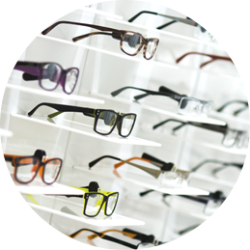
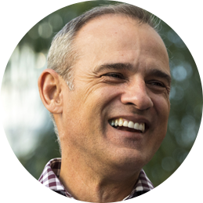
You can also get value-added discounts
Discounts on covered eyewear
20% for amounts over the frame or contact lens allowances, lens add-ons, and other prescription materials on first pair of glasses
10% off retail for specialty contact lens fit
Discounts on non-covered eyewear
30% on extra pairs of eyeglasses
30% off additional exams
20% for lens options on extra eyeglasses
20% off additional contact lenses
10% for additional, disposable contacts
$39 max out-of-pocket for retinal imaging
LASIK discounts
Members can see low prices (typically under $1,000 per eye) on LASIK procedures administered by QualSight.
*Out-of-pocket costs may vary based upon plan design.

Slide 18

Have questions?
Join us online or give us a call
Website: superiorvision.com
Phone: 1 (844) 549-2603
Live support:
Monday – Friday: 8AM – 9PM CST
Saturday: 10AM – 4:30PM CST
Benefit information
Eligibility status
Claims information
Eye care professional listings
Assistance with issues and special requests
We have answers!

Slide 19
MetLife Vision benefits are underwritten by Metropolitan Life Insurance Company, New York, NY. Certain claims and network administration services are provided through Superior Vision Services, Inc. (“Superior Vision”), a Delaware corporation. Superior Vision is part of the MetLife family of companies. Like most group benefit programs, benefit programs offered by MetLife and its affiliates contain certain exclusions, exceptions, reductions, limitations, waiting periods and terms for keeping them in force. Please contact MetLife or your plan administrator for costs and complete details.
SVS-MKG20-0293v001 PPT 06/2020

Slide 20



STATE OPTION PERIOD
Plan Year 2026

Slide 21


Oklahoma Owned & Operated

Slide 22


An Excellent Choice
Affordable
Local
Trusted

Slide 23


Local Benefits
Tax Dollars Stay Local to The State of Oklahoma
Customer Service Right Here In Oklahoma
Community Outreach

Slide 24
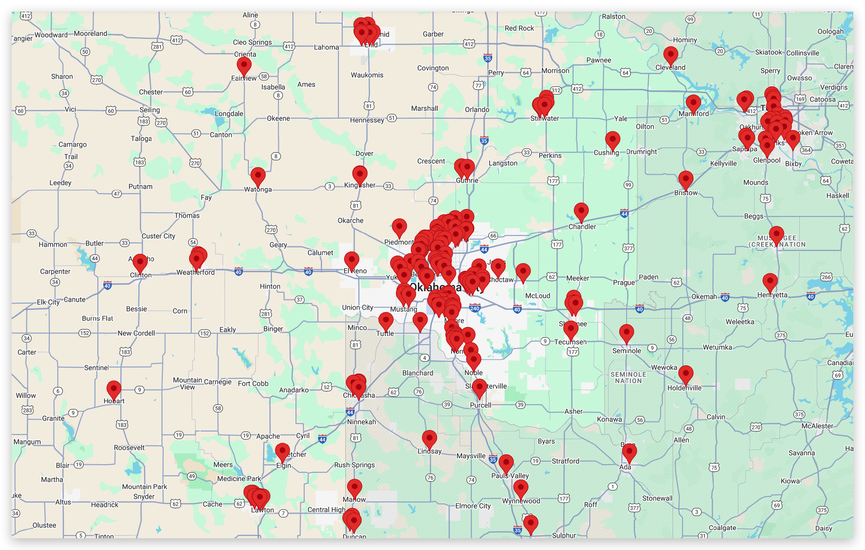
One of The Largest Networks in Oklahoma!

Slide 25

National Coverage
Local Focus

Slide 26
Reduce Out-of-Pocket Expenses
Simple
Affordable
Flexble
Transparent

Slide 27
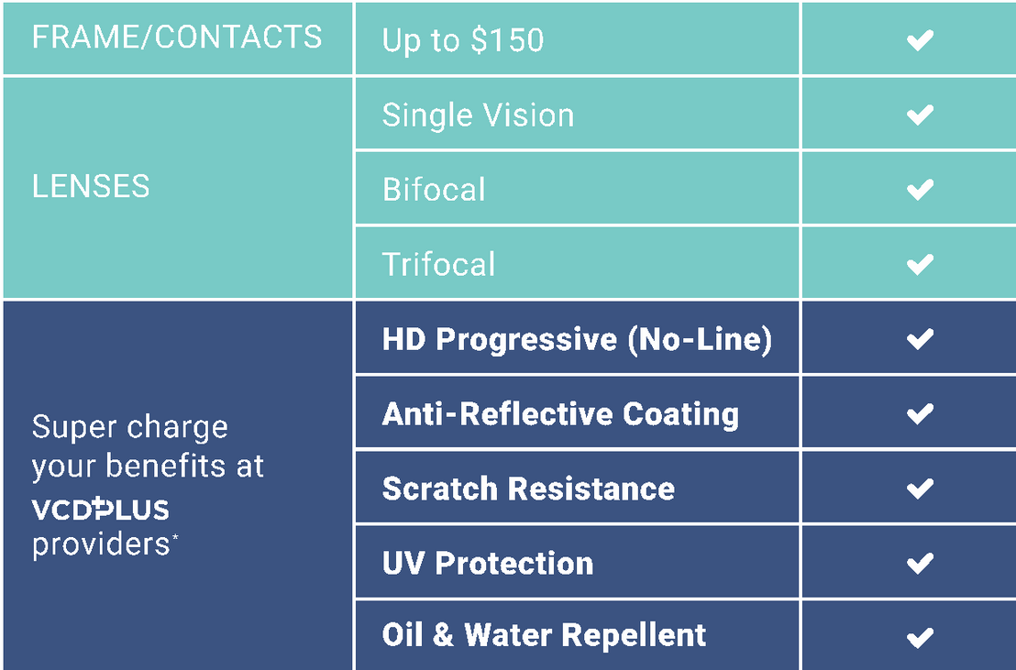
GREAT BENEFITS, PLUS FREE OPTIONS
Freedom to use your materials allowance the way you want!
Popular Options:
No Additional Cost!

Slide 28
AN EXCELLENT CHOICE
THANK YOU!
Vision Care Direct of Oklahoma
https://okstate.vision
(855) 918-2020

Slide 29
It’s Time to Enroll
Get to Know Your VSP Vision Benefits

Slide 30




Great Eye Care with a Hefty Side of Savings
Vision Care is Essential
Savings that Really Stack Up
Thousands of In-Network Choices
Founded by Doctors, Focused on You

Slide 31
See Why Eye Care Is Essential to Overall Health and Wellness
Did you know an eye exam is the only non-invasive way to view blood vessels in your body?
Signs of more than
270 health conditions can be detected during an eye exam*.
Your eye doctor can be the first to detect signs of certain conditions, like diabetes**.
*Full Picture of Eye Health, American Optometric Association, 2020

Slide 32
Your VSP Plan Snapshot
Frequency
Copays
Allowances
$10 WellVision Exam®
$25 Glasses
$60 Contact lens exam
$20 Essential Medical Eye Care
$39 Retinal Imaging
$170 frame + $50 allowance for featured frames
$120 Contacts (instead of glasses)
Exam: Every calendar year
Frame: Every calendar year
Lenses: Every calendar year
Lenses
Lens Enhancements
Fully covered single vision, lined bifocal, lined trifocal lenses, and impact resistant lenses for children
Fully covered standard progressives and UV protection
Impact- resistant lenses for dependent children
Average savings of 30% on other lens enhancements

Slide 33










The Choice is Yours
It’s easy to choose the care that’s right for you.
VSP gives you thousands of in-network choices, including private practice doctors, regional and national optical chains, or Eyeconic, the VSP preferred online eyewear store.
Private Practice locations
Retail
locations
Online at Eyeconic®
Participating Retail Chains like these ̶
and more
*Visionworks, Eyeconic, and Eyemart Express family of stores are VSP-affiliated companies.

Slide 34
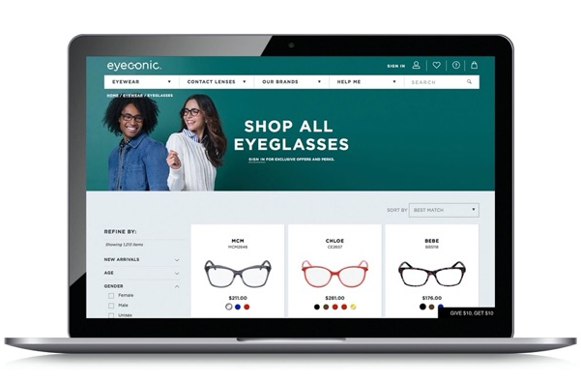
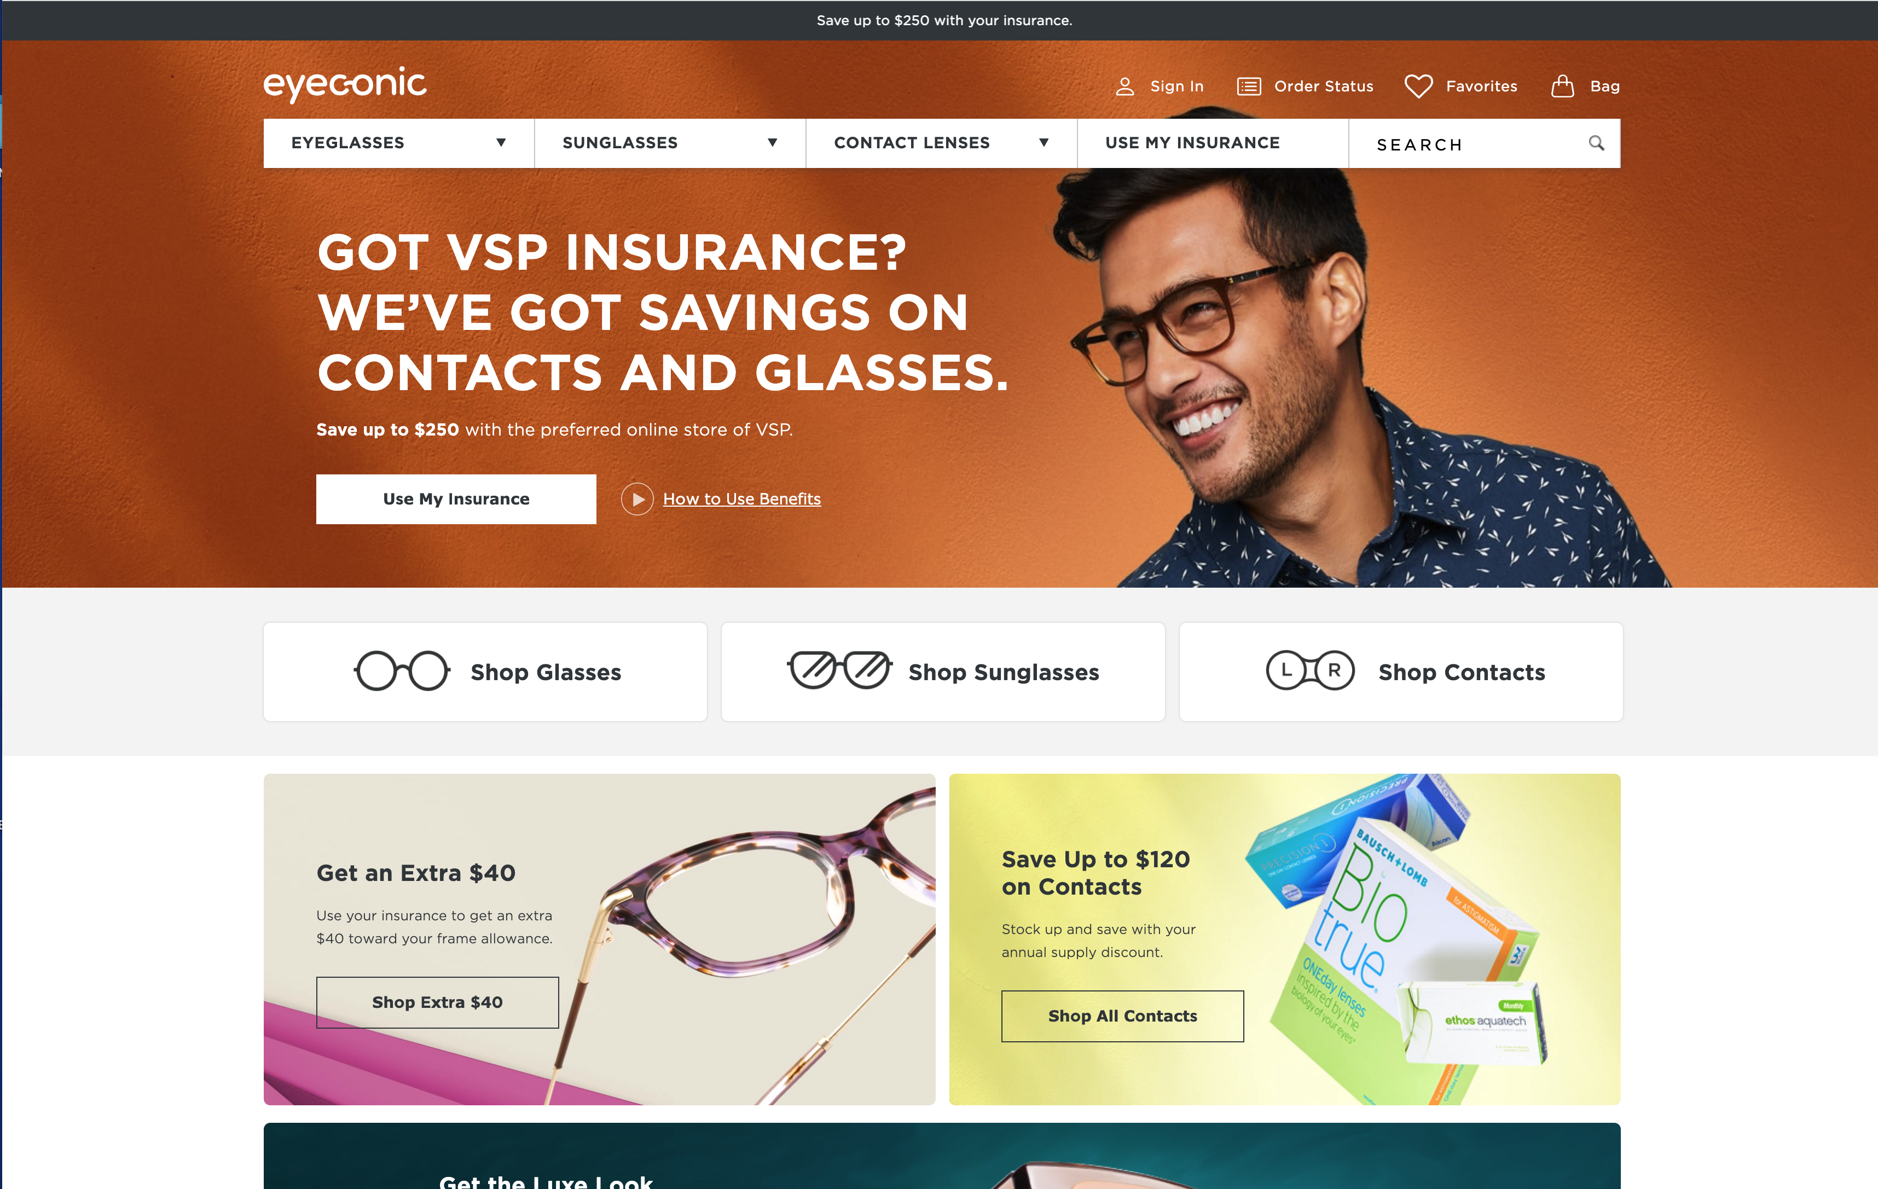

Eyewear Shopping Online at Eyeconic®
Eyeconic ® is the in-network, online eyewear store for VSP® members. You’ll get:
Over 60 brands of glasses, contacts, and sunglasses
Virtual Try-On
Free shipping and returns*
Get 20% off eyewear just for being a VSP member
Specialty sizes that fit your needs
Find your product, customize your order, and we do the rest. Start saving at eyeconic.com today.
*Terms and conditions apply. Visit eyeconic.com/faqs for more details

Slide 35
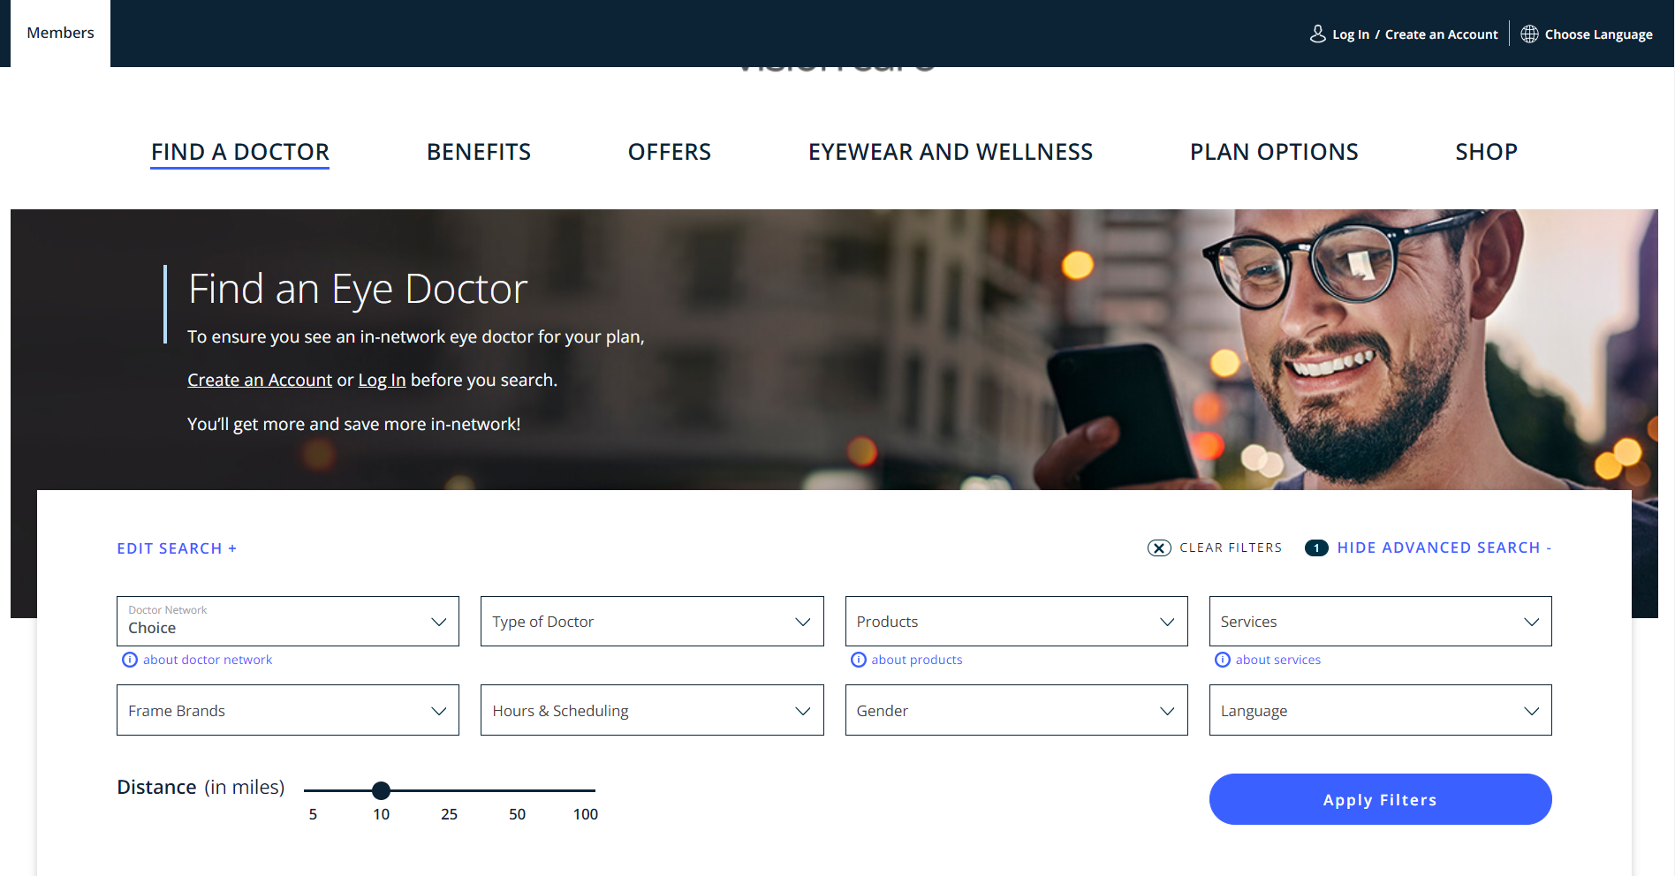
The Right Doctor for You
Using the Find a Doctor tool on vsp.com is easy
Visit vsp.com/eye-doctor (or navigate from vsp.com home page)
Enter the preferences that are
meaningful to you like:
Location
Gender
Language
Frame brands
Specialty
Services
Hours & Scheduling
A sliding distance bar makes finding a match nearby easy. You can even opt to view locations on a map.

Slide 36

Using Your Benefit is Easy
Once you’ve enrolled…
Create an account at vsp.com and review your personalized benefit information
Find a VSP in-network doctor by visiting your member account, going to vsp.com or calling 800.877.7195
Simply tell your eye doctor’s office that you have VSP–and we’ll take care of the rest

Slide 37

Enroll Today!
VSP helps you see well and be well with the coverage and quality care you deserve.
Visit vsp.com or call 800.877.7195
©2025 Vision Service Plan. All rights reserved. VSP, Eyeconic, Eyeconic.com, and WellVision Exam are registered trademarks, and VSP Premier Edge is a trademark of Vision Service Plan.

