Slide 1

Welcome!

Slide 2
Plan Year 2026
Open Enrollment
Benefits partner training
Employee Benefits Department​
Human Capital Management

Slide 3
Health plan presentations

Slide 4





Health plans

Slide 5

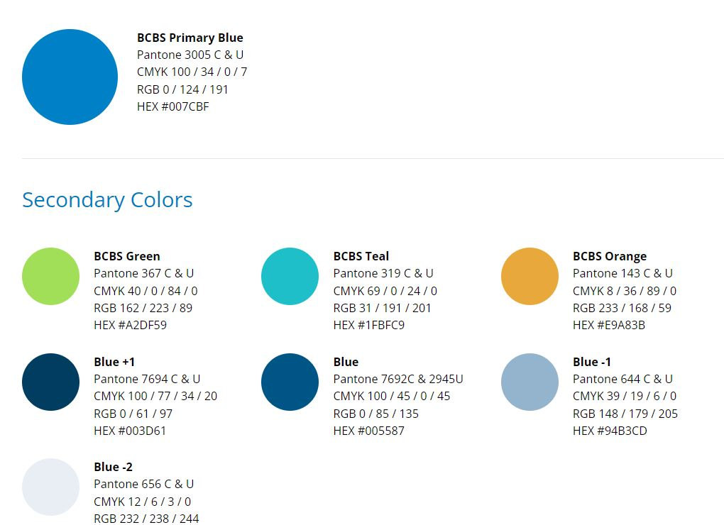



BlueLincs HMOSM
The right fit for your health care needs
www.bcbsok.com/state
Blue Cross and Blue Shield of Oklahoma, a division of Health Care Service Corporation,
a Mutual Legal Reserve Company, an Independent Licensee of the Blue Cross and Blue Shield Association.

Slide 6



The Right Care, in the Right Place,
at the Right Price.
ACCESS TO
HEALTH CARE
SAVING YOU MONEY
No deductible
$0
Low copay for primary doctor visits
One of the most affordable HMO options
Largest HMO network in the state
No referrals required within the network
24/7 Nurseline & Virtual Visits

Slide 7


Providers Where You Are
In-network providers in every county in Oklahoma
St. Francis
Ascension St. Johns
Hillcrest
Integris Health
Mercy
St. Anthony
OSU Health Center
Lakeside Womens
McBride Orthopedic
OU Medical Center
Oklahoma Heart Center
Norman Regional
McAlester Regional
Wagoner Health
Northeastern
Rural Wellness
Indian Health Care
Cleveland Hospital
116 in-network hospitals

Slide 8

Your Wellness = Our Priority
WELLNESS COACHING
FITNESS PROGRAM
Professionally certified coaches help employees with nutrition, physical activity, stress management, tobacco cessation, improving blood pressure, improving cholesterol, weight loss and weight maintenance.
The Fitness Program is a flexible membership program that gives your employees access to a nationwide network of thousands of fitness locations as well as digital options.
Well onTarget® Member Wellness Portal
Fitness and Nutrition Tracking
BluePointsSM
Health Assessment
Self-Management Programs
Preventive Care Reminders

Slide 9

Contact Us
bcbsok.com/state
Find a doctor or hospital
Prescription drug coverage
Log into Blue Access for Members
Customer Service
855-609-5684
24 hours a day
7 days a week

Slide 10
2026 Active & Pre-Medicare Benefits
Serving State, Education and Local Government members for over 30 consecutive years!
state.ccok.com

Slide 11



Exciting Changes for 2026!
New Medical & Prescription Drug Plan
Reduced Premiums
Lowest Cost HMO Plan for 2026!
Expanded Service Area
Additional Urgent Care Providers
New Pharmacy Benefit Manager (PBM) Navitus Health Solutions

Slide 12

Medical & Prescription Drug Benefits
Medical
Prescription
Tier 2 Preferred Brand: $40
Value Added Benefits
No PCP Referrals
Tier 3 Non-Preferred: $70
Select Generics ($0 Copay)
IP Hospital: $400/day (max $2,000)
30-day supply
Costco
Walgreens
90-day supply
OP Hospital: $350
Deductible: $0
Mail-Order Vendors
ER Copay: $300
2 copays for 3 months supply
PCP: $25
Specialist: $50
Lab/X-ray: $0*
Complex Imaging: $200*
Retail or Mail Order
Tier 1 Preferred Generic: $15
Tier 4 Specialty: $300
24-Hour Nurse Line ($0 Copay)
Family OOP: $10,000*
Individual OOP: $4,000
Urgent/Emergent While Traveling
Vision Screening ($0 Copay)
24/7 Online Virtual Visits
Urgent Care: $50
*Lowest of all HMO Plans
Bold indicates a change

Slide 13





New Pharmacy Benefit Manager (PBM)
New ID cards will be issued for all CommunityCare members.
Broad pharmacy network
Formulary reference guide

Slide 14
CommunityCare Network (59 Hospital Locations)
Ascension St. John (7 locations)
Bailey Medical Center
Cedar Ridge Hospital
Cleveland Area Hospital
Community Hospital
Community Hospital North
Creek Nation Community Hospital
Drumright Regional Hospital
Hillcrest Hospital (6 locations)
Integris (12 locations)
Lakeside Women’s Hospital
McAlester Regional
Mercy Hospital (3 locations)
Muscogee Creek Nation
NHS Sequoyah
NHS Tahlequah
Norman Regional (2 locations)
Northwest Surgical Hospital
Ok Center for Ortho & Multi Specialty Surgery
Oklahoma Heart Hospital
Oklahoma Heart Hospital South
OSU Medical Center
Pawhuska Hospital
Rolling Hills Hospital
Rural Wellness (Fairfax)
Saint Francis (4 locations)
Stillwater Medical (3 locations)
Tulsa Spine & Specialty Hospital
Wagoner Community Hospital
  New providers:
  Tulsa Pediatric Urgent Care
  MedWise Urgent Care (11 locations)

Slide 15
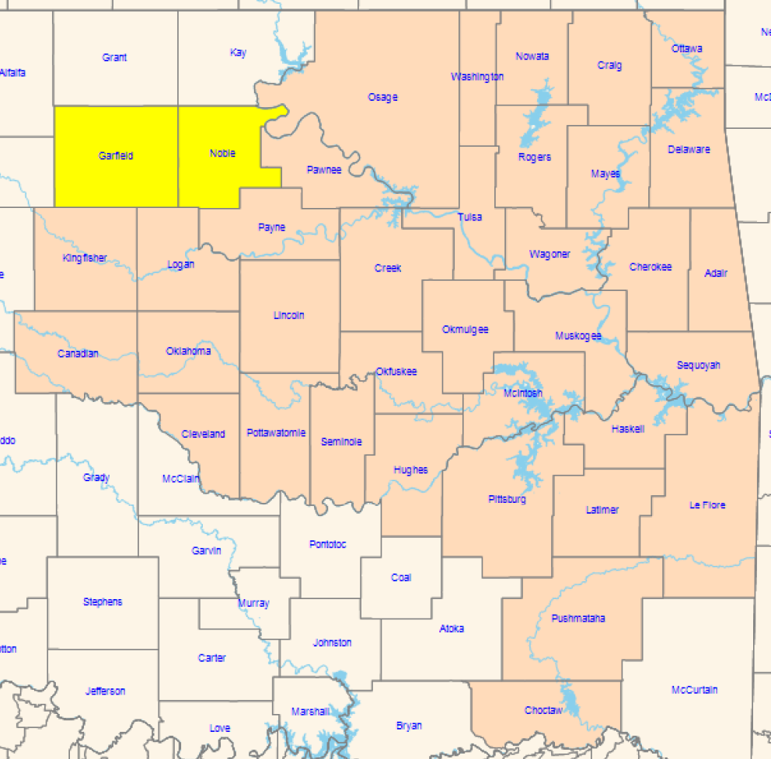
Expanding CommunityCare Service Area
Expanding CommunityCare Service Area
Garfield & Noble were added for a total of 37 counties.
Visit state.ccok.com to verify providers in your area.
Contact Customer Service for additional assistance.

Slide 16
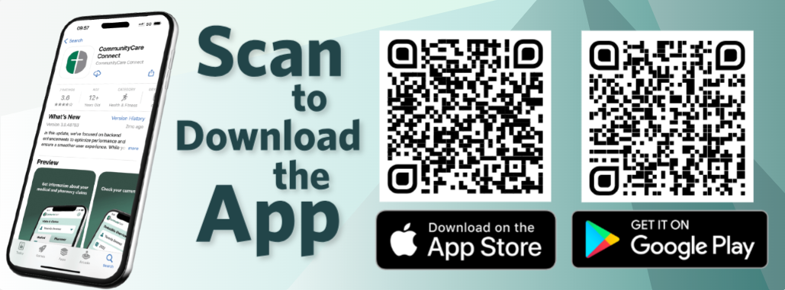
Access to Information
Mobile App
Member Portal
Access your digital ID card
Benefits and out-of-pocket summary
Claims and EOB information
Provider directory and other tools
myccok.com
    (same login as mobile app)
Price Estimator
Tax Documents
Health Risk Assessment (HRA)
Frequently Asked Questions

Slide 17







Customer Service:
918-594-5242 or 800-777-4890
M - F (8 a.m. – 6 p.m.)
Pharmacy Help Desk:
877-293-8628
Answered 24/7
24-Hour Nurse Line:
918-594-5242 or 800-777-4890
(Press option #5)
Custom Website:
state.ccok.com
Where Care means more.

Slide 18

STATE OF OKLAHOMA
Education & Government Employees Plan
January 1-December 31, 2026
STP26
MLGMH26-ST

Slide 19
Choose a plan that puts its MEMBERS FIRST!
21
continuous years of serving State of Oklahoma employees and educators!

Slide 20
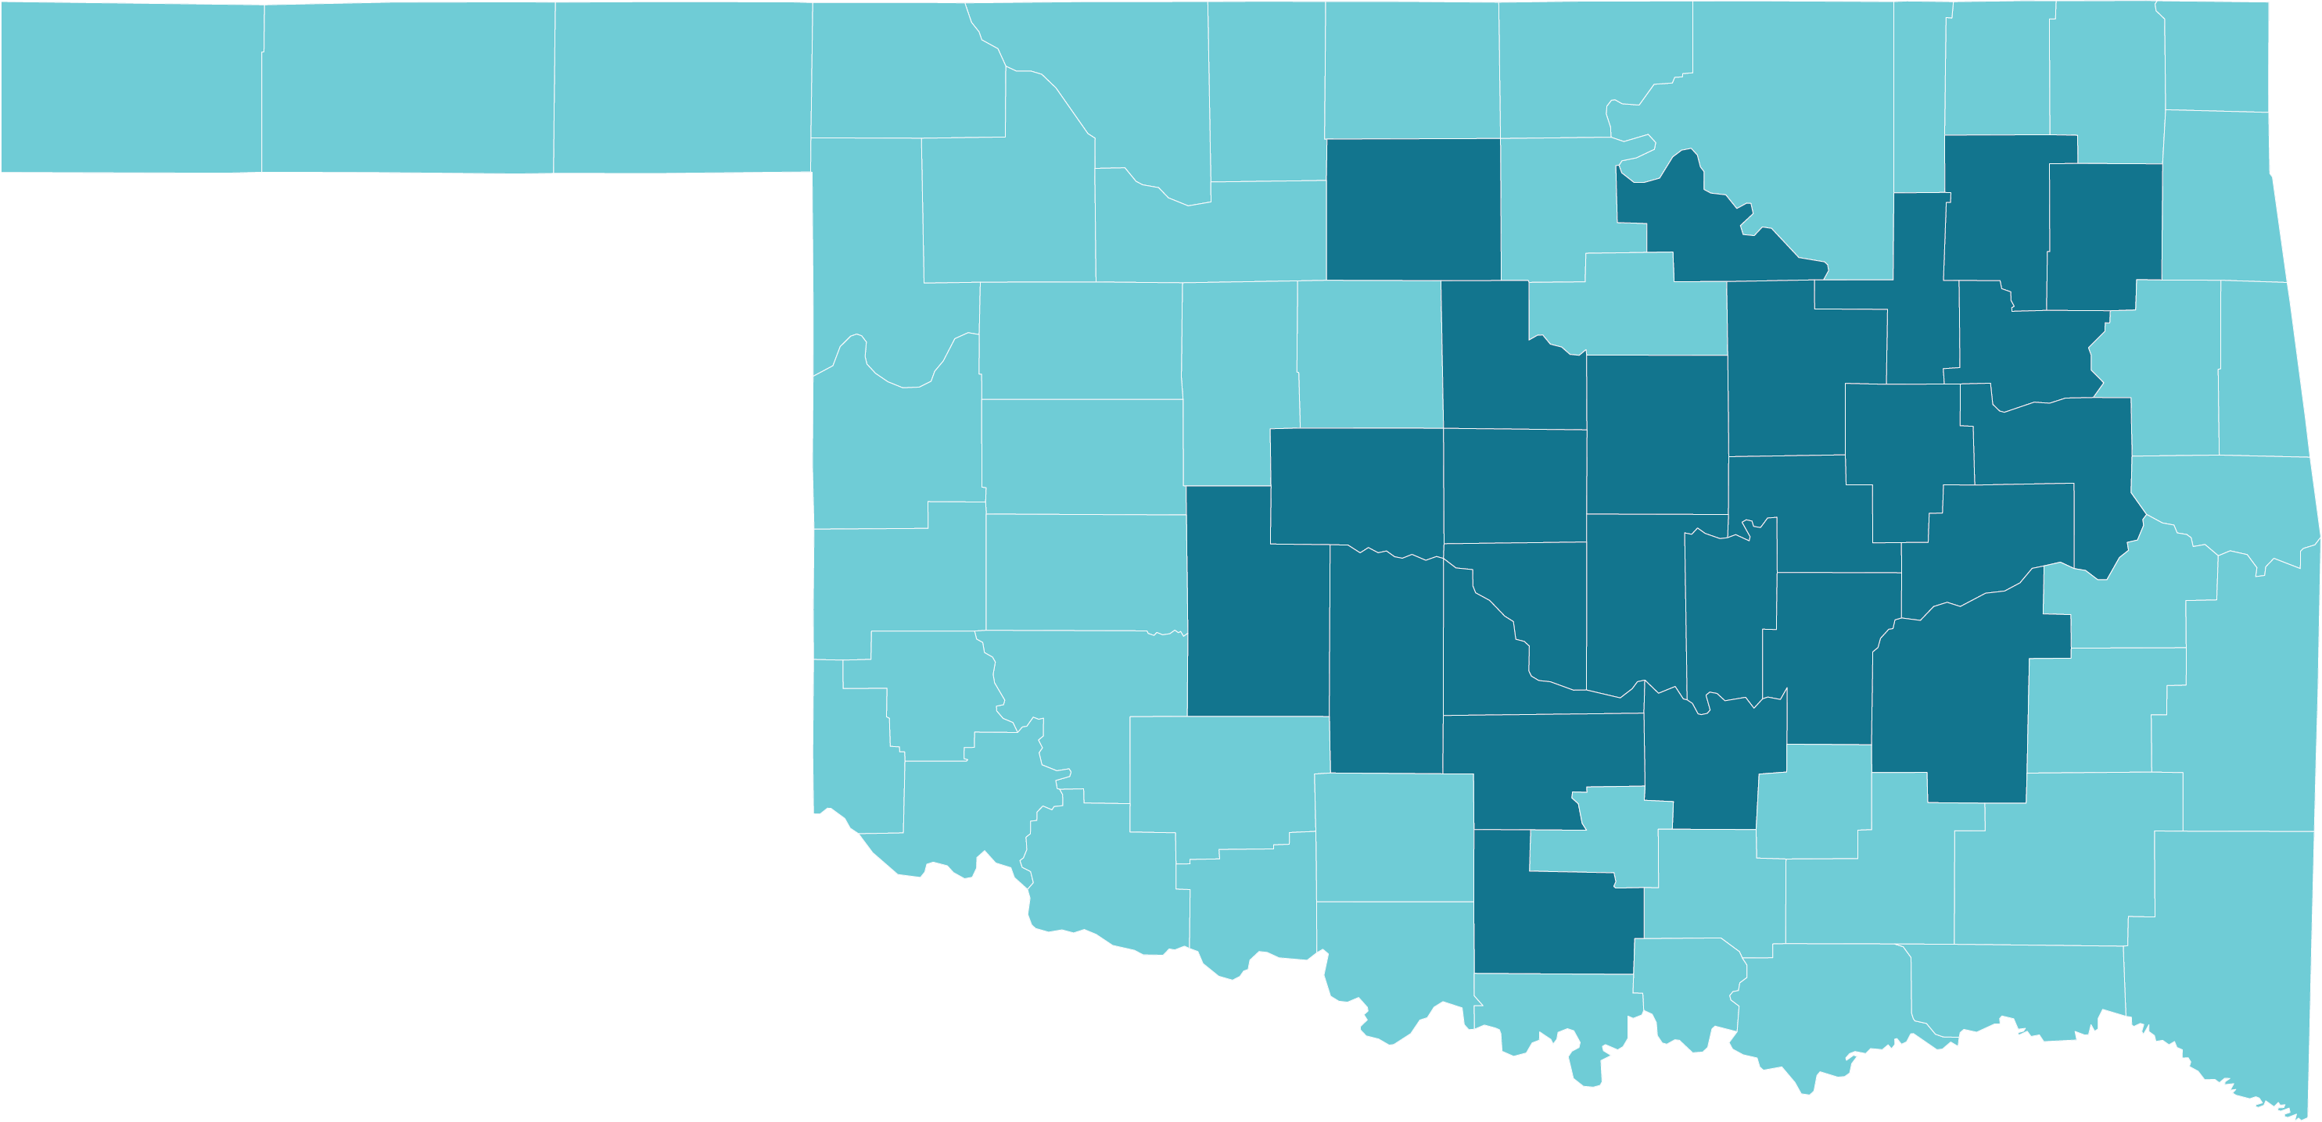
ELIGIBILITY & SERVICE AREA
26 COUNTY SERVICE AREA
Must be a permanent resident in our service area
Must be a current State of Oklahoma employee and/or educator

Slide 21








2026 State of Oklahoma Employees and Educators
Key Plan Benefits
Benefit | Copay
Primary Care Physician Visit | $0 copay for unlimited visits
Specialist Visits | $50 copay
X-Rays & Labs | $10 copay
Physical Therapy | $35 copay
Urgent Care | $25 copay
Specialty Scans | $250 copay preferred facility $750 copay non-preferred facility
Outpatient Surgery | $300 copay preferred facility $800 copay non-preferred facility
Inpatient Hospital | $300 copay per day $900 maximum copay per admission
Out-of-network care is not covered except for emergency or urgent care situations.

Slide 22



STAY AHEAD of whatever life throws!
$0 copay for Unlimited Primary Care Physician Visits
$500 Maternity
Delivery Copay
$20 Tier 1 Generics
for a 30-day supply

Slide 23
THOUSANDS OF PROVIDERS in our provider network
Tulsa Area
Harvard Family Physicians
Utica Park Clinic Physician Group
Hillcrest Medical Center
Hillcrest South Hospital
Hillcrest Hospital Claremore
Hillcrest Hospital Pryor
Tulsa Spine & Specialty Hospital
Oklahoma Heart Institute
Oklahoma Surgical Hospital
OSU Medical Center
OSU Physicians
Bailey Medical Center, Owasso
Oklahoma Spine and Brain Institute
McAlester Regional Health Center
Oklahoma City Area
Centennial Health
Mercy Hospital
Mercy Primary Clinics
Integris Baptist Medical Center
Integris Baptist Medical Center Portland Avenue
Integris Health Edmond
Integris Southwest Medical Center
Integris Primary and Specialty Care Clinics
Oklahoma Heart Hospitals (North & South)
Bone & Joint at St. Anthony
St. Anthony Hospital
Variety Care Clinic
Lakeside Women’s Center of Oklahoma
This is not a full list of providers. Other providers are available in our network. The provider network may change at any time. You will receive notice when necessary. To see if your local provider or hospital is in network, visit www.GlobalHealth.com or call Customer Care at 1-877-280-5600 (TTY: 711) 9:00 AM – 5:00 PM, Monday-Friday

Slide 24
Connect with us!
1-877-280-5600 (TTY: 711)
www.GlobalHealth.com/Oklahoma/MyStatePlan
v

Slide 25

5219

Slide 26

WHY CHOOSE HEALTHCHOICE?
Five flexible health plan choices offer a variety of options to best fit the needs of you and your family.
PPO plans.
Large medical provider and pharmacy networks.
Network and non-network benefits.
Self-referrals to a specialist.
Free and easy mobile benefit app.

Slide 27

WHICH PLAN IS RIGHT FOR YOU AND YOUR FAMILY?
Tobacco-free plans
FLEXIBILITY Enjoy the flexible use of your health plan. | BUDGET-FRIENDLY Offers first-dollar coverage. Ideal for those with minimal health care needs. | SAVINGS Lower your premium to maximize your savings.
  HealthChoice High
  Option 1
  HealthChoice Basic
  Option 2
  HealthChoice HDHP
  Option 3
    Copays for office visits.
    Lowest deductible and out-of-pocket maximum.
    Alternative plan for tobacco users.
    HealthChoice pays first $500 of covered medical expenses.
    No copays for network services.
    Alternative plan for tobacco users.
    Lowest premiums available.
    Copays for network services after deductible.
    Use with a health
    savings account
    (HSA) for tax
    advantages.

Slide 28

ALTERNATIVE HEALTHCHOICE PLANS
Tobacco Users
HealthChoice High Alternative Option 1 | HealthChoice Basic Alternative Option 2 | HealthChoice HDHP Option 3
    Calendar year deductible $1,000 Ind./$2,750 family.
    Lowest deductible and out-of-pocket maximum.
    Network calendar year out-of-pocket maximum $3,550 Ind./$8,400 family.
    Premium is the same as HealthChoice High.
    HealthChoice pays first $250 of covered medical expenses.
    Calendar year deductible $1,250 Ind./$1,750 family.
    No office copays for network services.
    Premium is the same as HealthChoice Basic plan.
    Plan features and premiums are the same as Tobacco-Free HDHP plan.

Slide 29
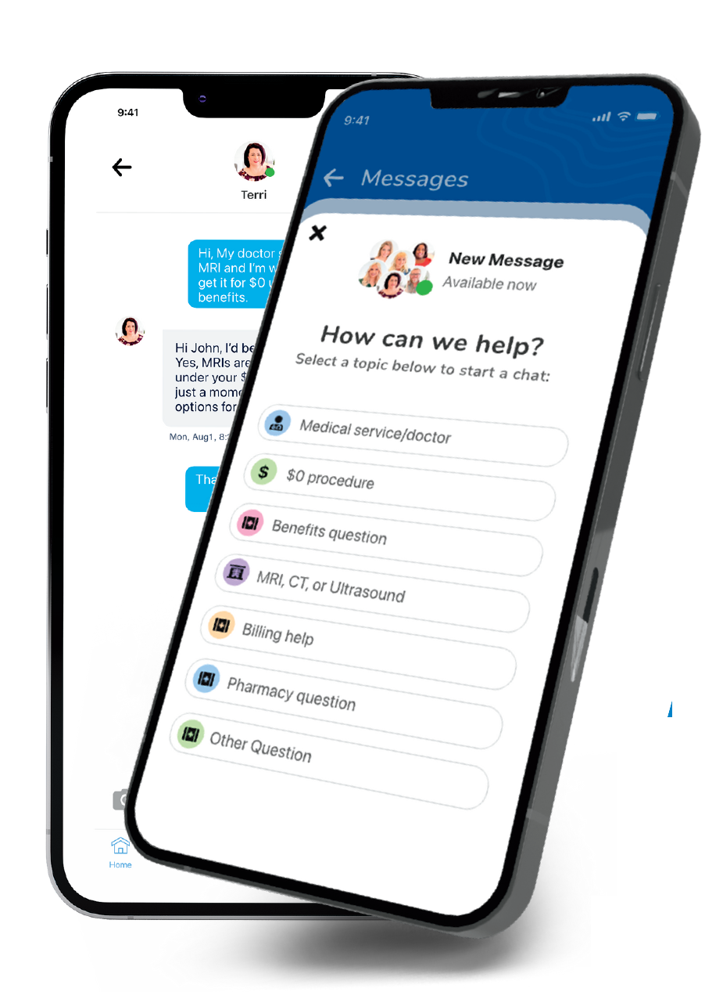

HEALTHCHOICE APP
Save time, money and frustration with an app that has it all!
Chat with a Care Guide – Guides are available 24/7 and can help guide you to care, answer benefit questions and even help make appointments!
Save Money – Access $0* medical care including MRIs, CT scans, ultrasounds, surgeries, and much more.
Access:
  Claims and EOBs.
  Insurance cards.
  Find network providers.
  Access SwiftMD – Telemedicine.
  Check deductible and out-of-pocket maximum amounts and more!
Meet Your Care Guides
*HDHP members must first meet their deductible.
Search HealthChoice in your app store and download

Slide 30
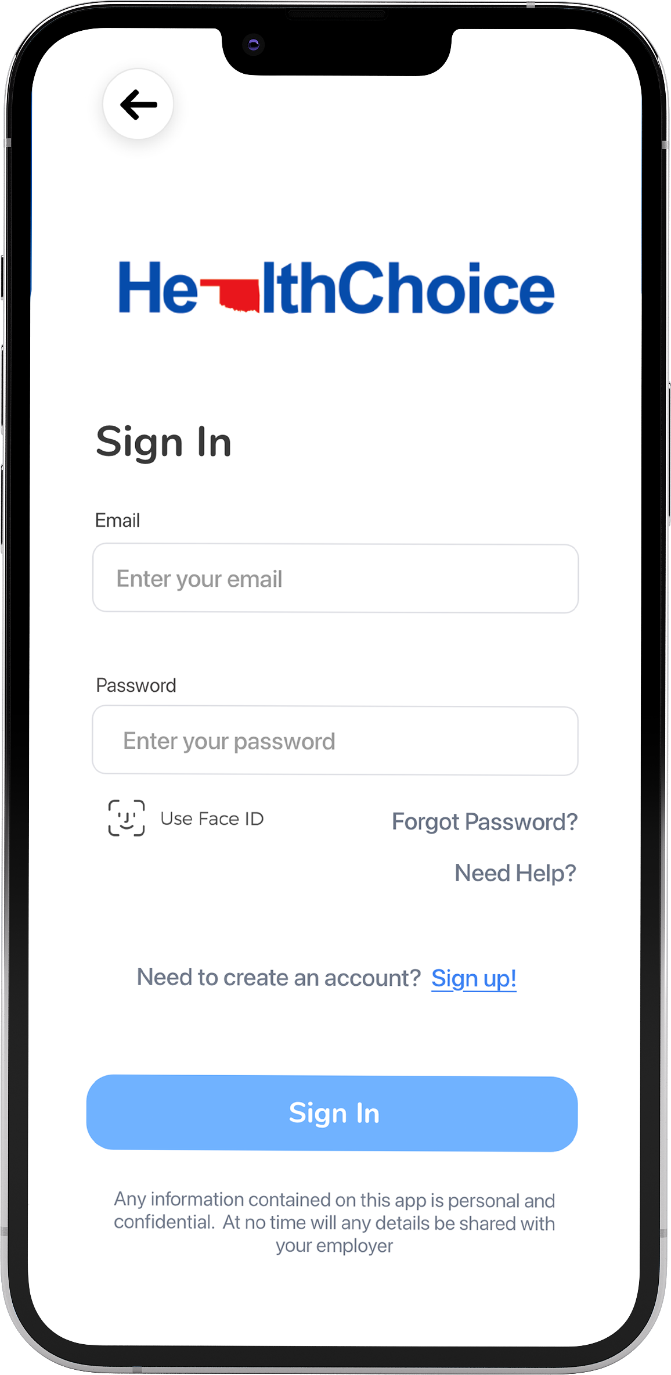
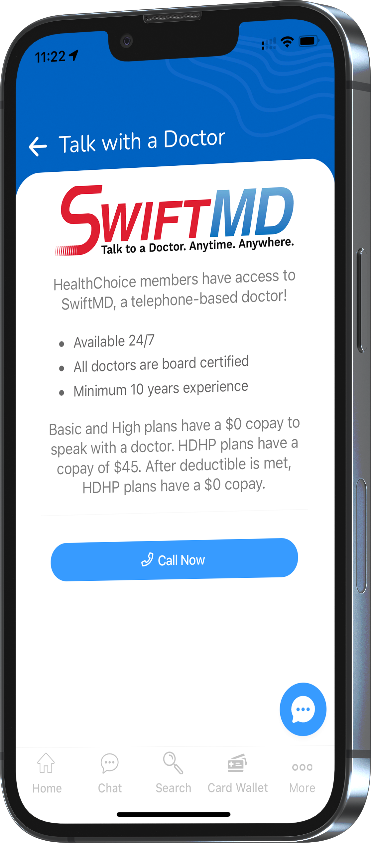
Telemedicine – SwiftMD
Available 24/7 with no limit on visits.
Board-certified physicians.
$0 cost for all HealthChoice plans.
Swift MD.com.
Passcode HCOK20.
Access SwiftMD through the HealthChoice App!

Slide 31
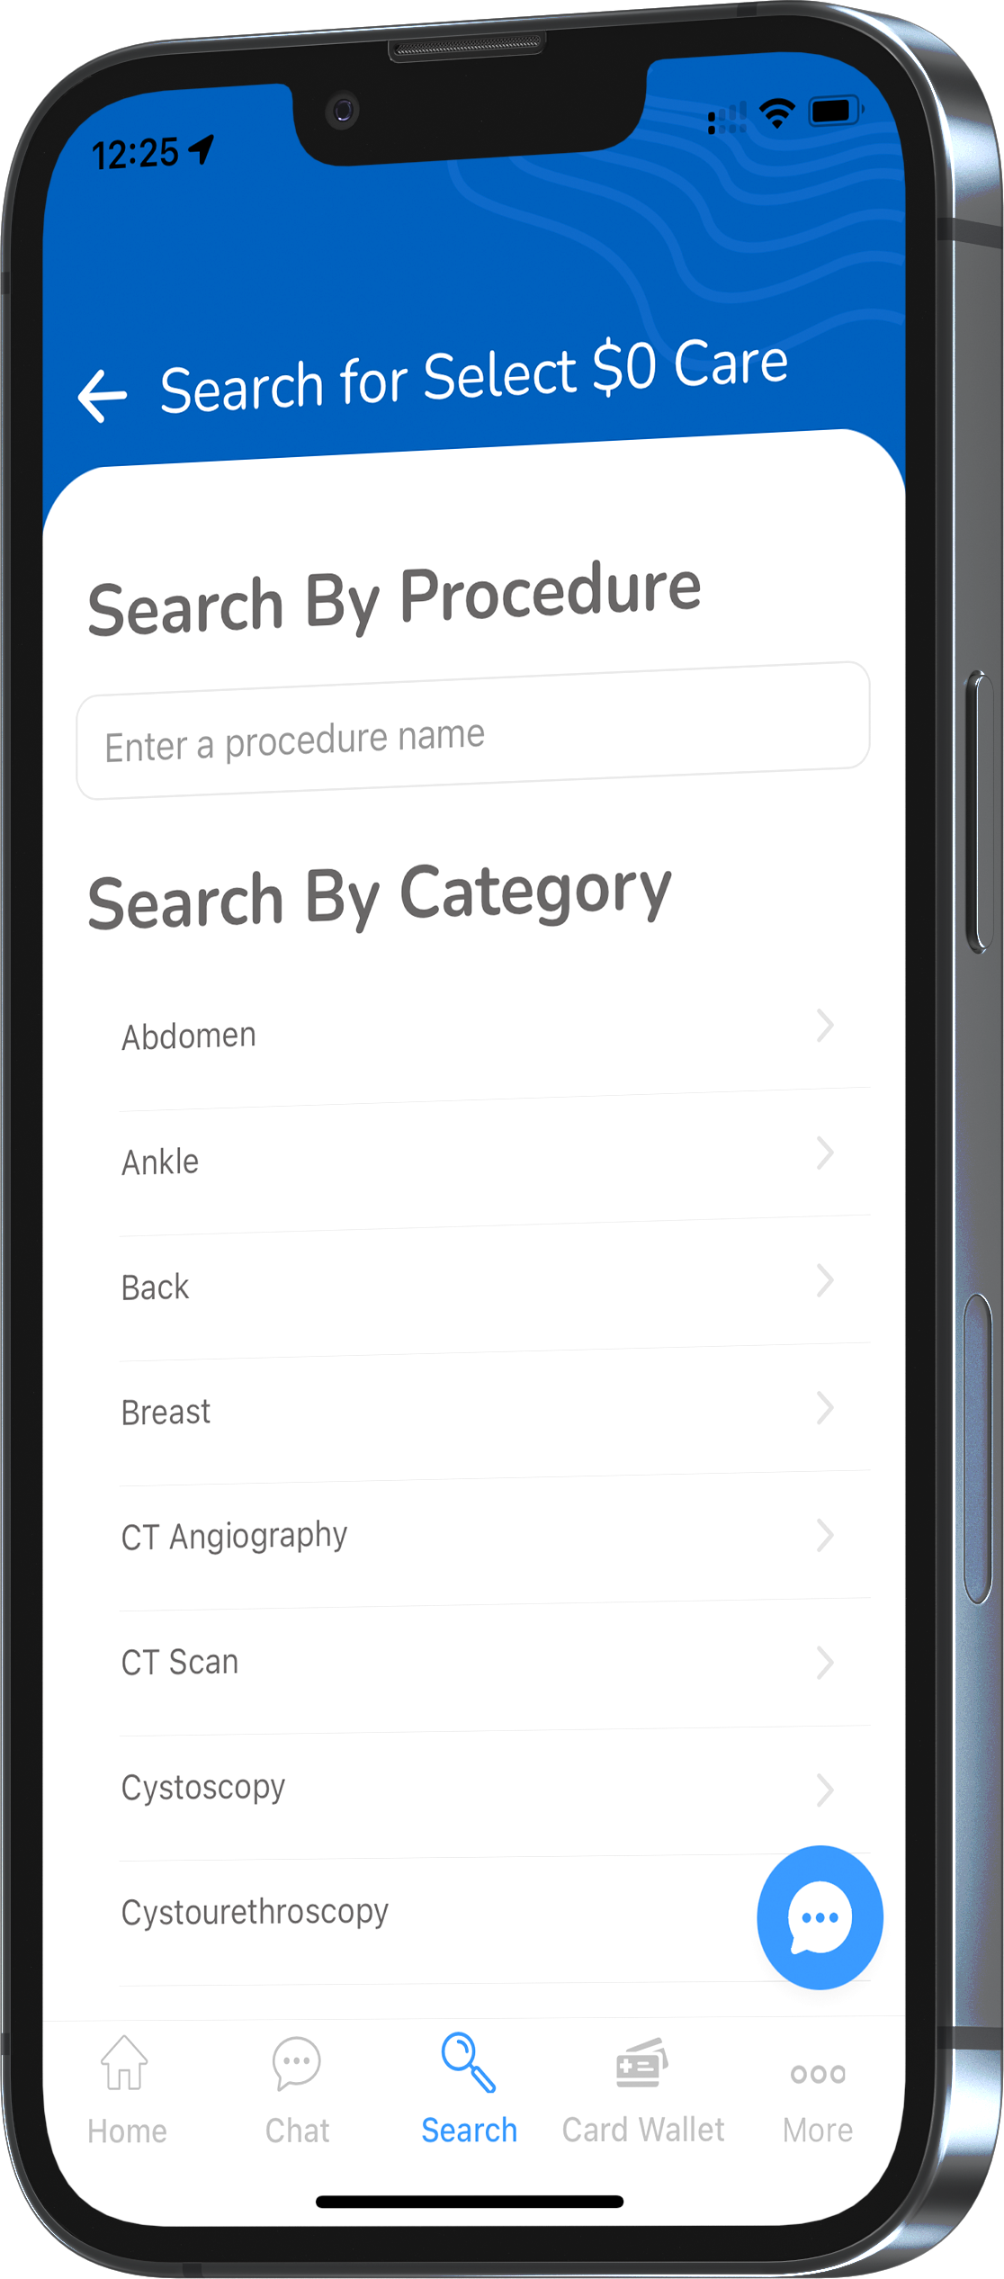
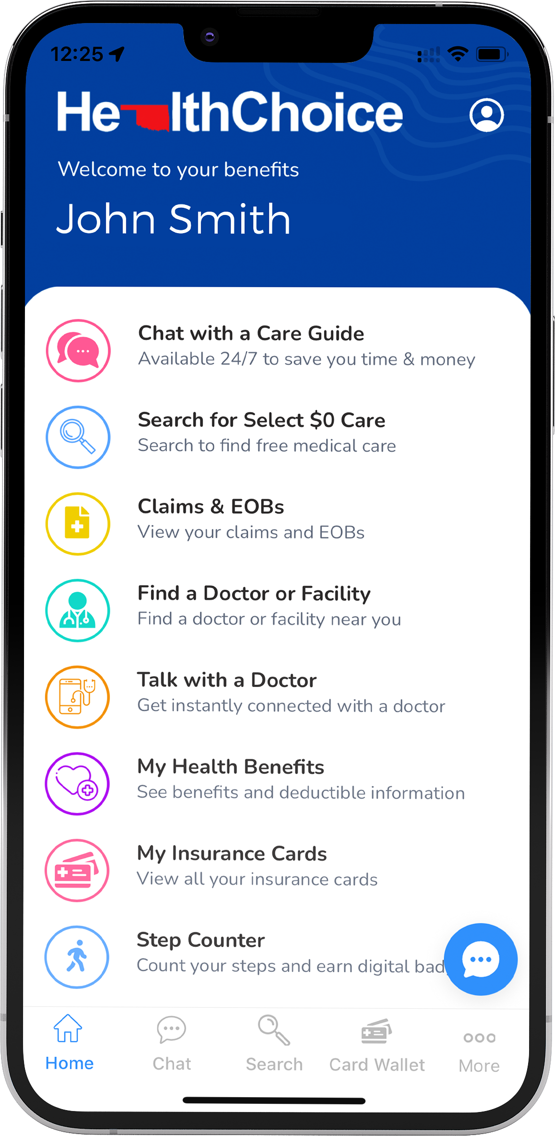
$0 Select Program – all plans
    Select services and procedures are covered at 100% of the bundled allowable.
    Select services include:
      MRI scans.
      CT scans.
      Ultrasounds.
      Some surgeries and more!
    No age limit or limits on the number of procedures.
    Incentive payments.
    HDHP members must meet their deductible first.
Accessible through the HealthChoice app!

Slide 32

Pharmacy benefits – all plans
    30- and 90-day supply.
    Generic, Preferred, Non-Preferred, and Specialty copays.
    High and Basic: $100 pharmacy deductible per individual before pharmacy copays apply.
    HDHP: $1,750 medical and pharmacy deductible combined per individual/$3,500 per family must be met before pharmacy copays apply.

Slide 33

CARE Programs
  CARE programs – all members
    Maternity CARE
      One-on-one calls with an OB/GYN nurse.
      Ongoing support for those who are pregnant.
      Receive health resources and answers about body changes and baby’s growth.

Slide 34

CARE Programs
  CARE programs – all members
    Ongoing Condition CARE
      Personalized guidance – diabetes, high blood pressure, heart disease, asthma or other serious health conditions.
      CARE professionals help participants manage symptoms of depression.

Slide 35
CARE Programs
  CARE programs – all members
    Wellness CARE
      Focuses on personal health.
      Wellness coordinators provide support and resources.
      Provides education and motivation for focusing on healthy behaviors.
      Interactive opportunities to learn about fitness, nutrition, stress management and lifelong habits.

Slide 36

Tobacco-free attestation
Attestation must be completed by Dec. 31, 2025.
Applies only to returning HealthChoice High and Basic plan members.
HDHP members are not required to complete the attestation. However, if you wish to enroll in the High or Basic plan for Jan. 1, you will need to complete the attestation.
If you are in the process of quitting tobacco, you must be tobacco free for 90 days prior to attesting.
Tobacco users still qualify for the High or Basic plan if you:
    Provide a letter from your physician.
  Failure to complete will result in being moved to HealthChoice High Alternative or Basic Alternative plan Jan. 1.

Slide 37

HealthChoiceOK.com
  Log in now to:
  View your Things-to-do, a personalized benefit to-do list.
  Check your benefits and see what’s covered.
  Check what you owe and how much you’ve paid.
  Find a doctor in your network.
  Learn about medical conditions and your treatment options.

Slide 38

RESOURCES
  HealthChoiceOK.com
  Health Insurance Handbook
  Provider Search page
  HealthChoice member Portal
  HealthChoice Benefits App
  EGID Member Services
  405-717-8780 or 800-752-9475
HealthChoice Customer Care
  800-323-4314
  TTY 711

