Slide 1

Welcome!

Slide 2
Plan Year 2026 Open Enrollment
Benefits partner training
Employee Benefits Department​
Human Capital Management

Slide 3
Dental plan presentations

Slide 4
All dental plans
Preventive care
Basic care
Major care
Orthodontic care

Slide 5





BlueCare Dental
The right fit for your health care needs
Blue Cross and Blue Shield of Oklahoma, a Division of Health Care Service Corporation, a Mutual Legal Reserve Company, an Independent Licensee of the Blue Cross and Blue Shield Association

Slide 6







BlueCare Dental Benefits — Simplified
SAVING YOU MONEY
ACCESS TO HEALTH CARE
Affordable plan options to fit your budget
Discounts throughout the network
Cost comparison tool to shop for dental services
Large Dental network across the whole country
Choose BlueLincs HMO to have all dental and medical info together
Dental Wellness Center: online resource tool

Slide 7


NO COPAY - PREVENTIVE CARE
Cleanings and Routine Oral Exams
Full-Mouth and Bitewing X-Rays
Sealants
Space Maintainers
Topical Fluoride Application
DEDUCTIBLE*
HIGH PLAN
LOW PLAN
Individual
$25
$50
Family
$75
$150
ANNUAL MAX
HIGH PLAN
LOW PLAN
Per Individual
$2,500
$1,500
*Deductible only applies to Basic Care and Major Care category services.

Slide 8
HIGH PLAN
LOW PLAN
BASIC CARE*
Amalgam and Composite Fillings
Cleaning, Scaling, and Root Planing
Emergency (Palliative) Treatments
Endodontic and Periodontal Services
Extractions and Oral Surgery
Topical Fluoride Application
15% In-Network
30% Out-of-Network
Copay
HIGH PLAN
LOW PLAN
MAJOR CARE*
Bridges, Dentures
Crowns, Inlays, and Onlays
Implants
Reline, Rebase, Recementaions, and Repairs
40% In-Network
50% Out-of-Network
Copay
50% In-Network
50% Out-of-Network
Copay
HIGH PLAN
LOW PLAN
ORTHODONTIA*
Coverage for dependent children to age 19
No waiting period
Lifetime Maximum Benefit
50% COPAY
$5,000 LIFETIME
$1,500 LIFETIME
*Deductible applies to these services.

Slide 9



Contact Us
bcbsok.com/state
Customer Service
• Find a dentist
• Prescription drug coverage
• Log into Blue Access for Members
• 855-609-5684
• 24 hours a day
• 7 days a week
Blue Cross and Blue Shield of Oklahoma, a Division of Health Care Service Corporation, a Mutual Legal Reserve Company, an Independent Licensee of the Blue Cross and Blue Shield Association

Slide 10


YOUR CIGNA DENTAL BENEFITS
Plan year: January 1, 2026 –
December 31, 2026
Offered by Cigna Health and Life Insurance Company, Connecticut General Life Insurance Company, or their affiliates.
862420 b

Slide 11

Welcome to Cigna!
When it comes to
your health,
we’re in this
together.

Slide 12
A plan where one dentist coordinates your care within a network that provides general and specialty dental care
You choose a primary care dentist in the DHMO network where you can receive all your care
By using dentists in the DHMO network you may pay less than you would with other types of dental plans
You pay an office visit fee and the charge listed on your Patient Charge Schedule
There is no out-of-network coverage (except in emergencies)
There are no deductibles and no annual dollar maximums
Cigna Dental Care® Dental Health Maintenance Organization (DHMO*)

Slide 13


Prepaid Plan (DHMO)
Coverage with no deductibles or waiting periods
Examples of covered services
Preventive care, such as cleanings and exams, at no added or low cost
Additional cleanings, fluoride, and fluoride varnish available for a copay
Temporomandibular joint (TMJ) diagnosis
General anesthesia/IV sedation when medically necessary
Coverage for brush biopsy, a noninvasive diagnostic procedure for detecting oral cancer
Coverage for teeth whitening (take-home bleaching gel with trays) and athletic mouth guards
No age limit on sealants
Coverage for advanced procedures like crowns and bridges over implants
Second opinions covered
Emergency care
Orthodontic coverage for children AND adults
Notes:
Each member of your family can choose their own network dentist. This is important when, for example, your child is away at school or your spouse needs to find a dentist near work.
Second opinions are covered. Just call Customer Service and they’ll help you make the arrangements.
If you’re in pain and need immediate care, call Customer Service for the name of a nearby network dentist. If an emergency occurs after business hours or a network dentist isn’t available, or you are out of the area, you can use any dentist. Cigna Dental will reimburse up to [$50] of your costs, less applicable patient charges. Or, according to the group agreement/member booklet, e.g., Texas and Pennsylvania have no $ limit.
General Anesthesia/IV sedation is covered when medically necessary and performed by a participating oral surgeon or periodontist.

Slide 14
Your coverage
 | Prepaid Plan- LOW | Prepaid Plan- HIGH
Annual deductible | No deductible | No deductible
Lifetime maximum | None | None
Calendar-year maximum | None | None
Office Visit Fee | $5 | $0
PERCENTAGE YOUR PLAN PAYS
Copay Examples
Preventive care Example: Routine cleaning (two per calendar year) | $0 | $0
Basic restorative Example: Dental Filling- one surface | $23 | $0
Major restorative Example: Root canal, Anterior | $375 | $210
Orthodontia Example: Child/Adult Orthodontia (24-month Treatment) | $2,472 Child $3,384 Adult | $2,040 Child $2,376 Adult
Implants Surgical placement of implant | $1,215 | $1,025

Slide 15

Cigna Dental Oral Health Integration Program®
Available at no added cost to Cigna dental plan members
Pays out-of-pocket costs for specific dental services* if you:
Have a medical condition that can be affected by gum disease or tooth decay
Are currently being treated by a doctor for this condition
Eligible conditions: Heart disease, stroke, diabetes, pregnancy, chronic kidney disease, organ transplants, head and neck cancer radiation
Discounts on prescription mouthwash, gels and toothpaste*
Enroll at myCigna.com or call the phone number on back of your Cigna ID card
Want to know more? Visit myCigna.com or call 800.Cigna24 anytime.
* Discounts available through Cigna Home Delivery Pharmacy only. This is a discount, and NOT insurance. If you have other insurance coverage, you should first confirm
pricing/availability through your insurance carrier as it may result in a lower cost to you.
Notes:
You do not need to meet your plan’s deductible to receive reimbursement for these
services. However, any reimbursement you receive will apply to and is subject to your
plan’s annual maximum

Slide 16

myCigna is your Cigna – Dental
Your personalized Cigna website
Register on myCigna.com in a couple of minutes
Log in anytime to access information, tools and resources
What you can do on myCigna
Take an interactive quiz to measure your risk for cavities, gum disease or oral cancer*
Search for dentists by specialty, procedure, location and language
Check balances, monitor services and manage your dental plan
Use easy tools to estimate costs for over 400 common dental procedures
* These tools are for informational purposes only and should not be used for self-diagnosis. Always see your dentist for appropriate care recommendations and treatment.

Slide 17
We’re here 24/7/365
i
By phone – 800.244.6224
Call anytime day or night for live customer service
Ask for a Spanish-speaking representative or speak with us in your preferred language – interpreter service is available in over 200 languages
Get help finding a dental office
Check your eligibility
Download the myCigna Mobile App for easy access on the go!
myCigna – online or through the mobile app
Review your plan information and check a claim status
Find network dentists
Print temporary ID cards
Change your DHMO dental office
View year-to-date dental costs and estimate approximate costs prior to treatment
Take oral health assessments that you can share with your dentist

Slide 18
THANK YOU FOR YOUR TIME!

Slide 19
Appendix A
Minnesota Residents: When enrolling in a DHMO plan, you must visit your selected network dentist in order for the charges on the Patient Charge Schedule to apply. You may also visit other dentists that participate in our network or you may visit dentists outside the Cigna Dental Care network. If you do, the fees listed on the Patient Charge Schedule will not apply. You will be responsible for the dentist’s usual fee. We will pay 50% of the value of your network benefit for those services. You’ll pay less if you visit your selected Cigna Dental Care network dentist. Call Customer Service for more information.
Oklahoma Residents: DHMO for Oklahoma is an Employer Group Pre-Paid Dental Plan. You may also visit dentists outside the Cigna Dental Care network. If you do, the fees listed on the Patient Charge Schedule will not apply. You will be responsible for the dentist’s usual fee. We pay non-network dentists the same amount we’d pay network dentists for covered services. You’ll pay less if you visit a network dentist in the Cigna Dental Care network. Call Customer Service for more information.
DHMO for residents of Minnesota and Oklahoma

Slide 20


2026 Dental Benefits Options for State, Education & Local Government Employees
DDOK has proudly served State of Oklahoma employees and their families for more than 20 years!

Slide 21



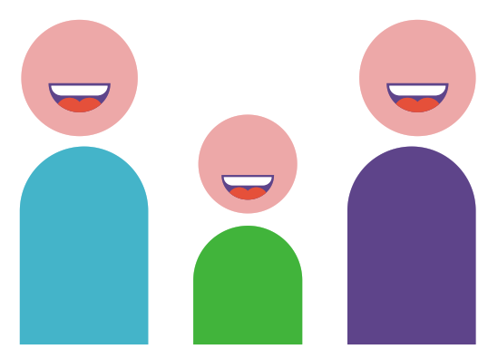

We Deliver a Superior Customer Experience
DDOK does not deny coverage due to pre-existing conditions
No waiting periods before you can begin receiving treatment
Our coverage includes replacement of a missing tooth, even if it was lost prior to your DDOK coverage
99%
Plan options for State employees include
orthodontic coverage for adults and children.
We allow benefits for comprehensive orthodontic cases, even if treatment was started prior to DDOK coverage
Overall member satisfaction rating – and percentage of inquiries (calls) resolved during initial contact

Slide 22
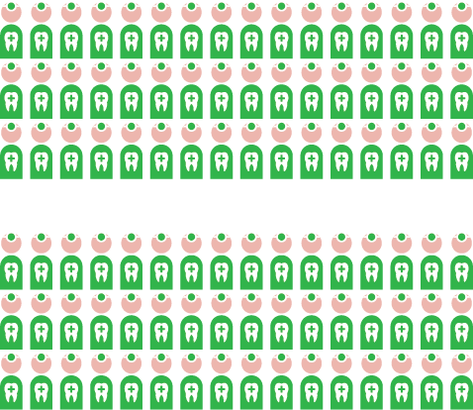

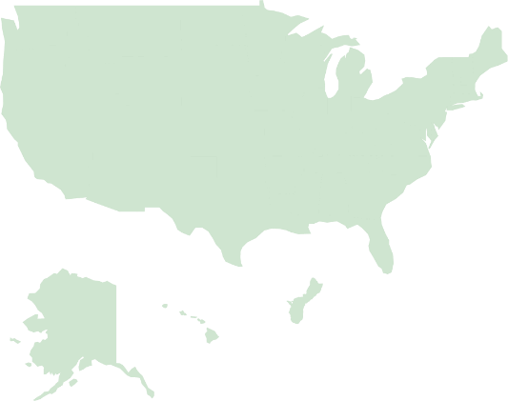
We Deliver the Largest Network of Dentists
Oklahoma’s Largest Dental Network
Our unmatched network strength means
your dentist likely participates with Delta Dental –
ask if your dentist is a Delta Dental PPO provider
to enjoy maximum savings!
Just over 1,900 dentists practice in the state, and nearly 1,100 of those dentists participate in Delta Dental’s PPO network.
Nationwide
Access

Slide 23
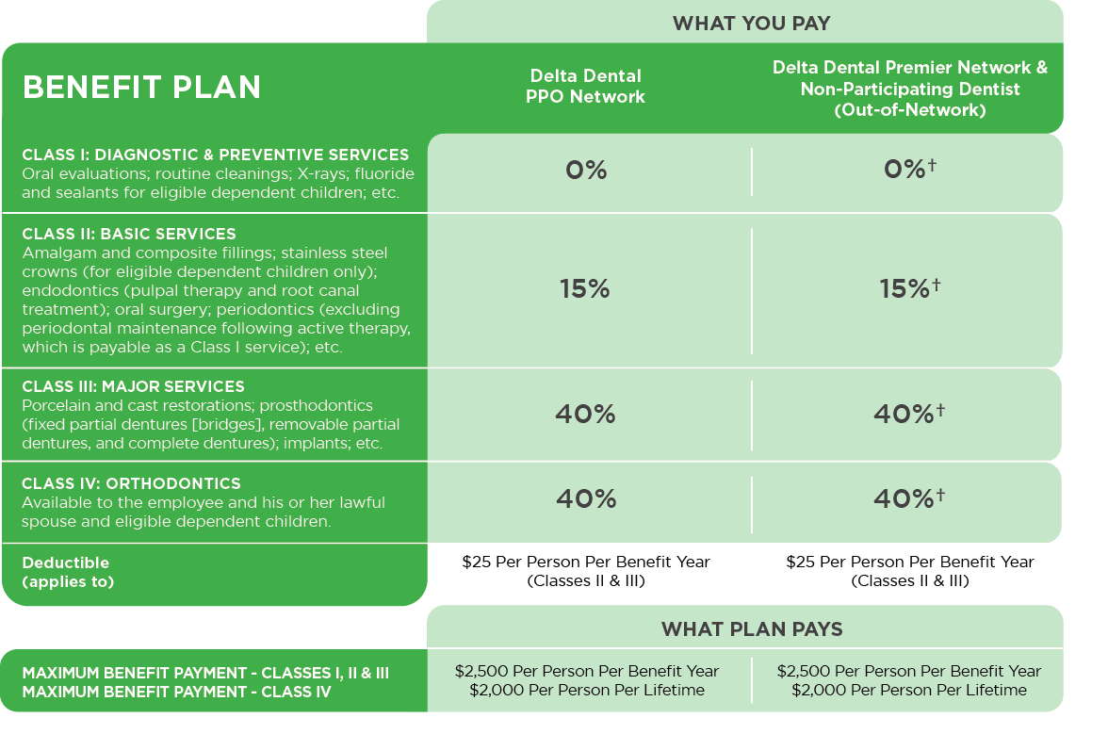
Option 1: Delta Dental PPO**
†If you receive treatment from a Delta Dental Premier provider, you will be responsible for the difference between the PPO allowable and Premier allowable amounts. If you are treated by a dentist who does not participate with Delta Dental (out-of-network), you will be responsible for the difference between the dentist charge and the PPO allowable amount.
**Dependents eligible To age 26

Slide 24
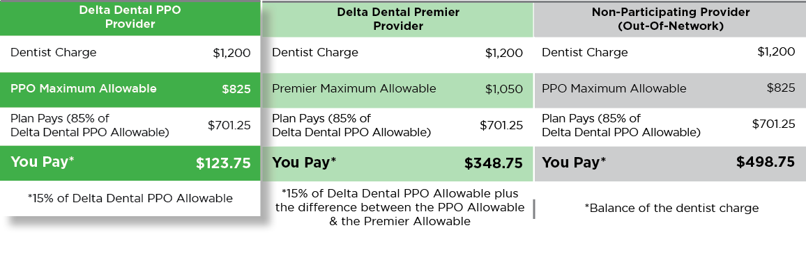
Option 1: Delta Dental PPO
This plan option provides access to both the Delta Dental PPO and the Delta Dental Premier networks. Subscribers of this plan are welcome to receive treatment from the licensed dentist of their choice, but will have lower out-of-pocket expenses when they visit a Delta Dental PPO participating dentist.
Example
Payment of a covered Class II dental service**
**Assumes deductible is satisfied

Slide 25
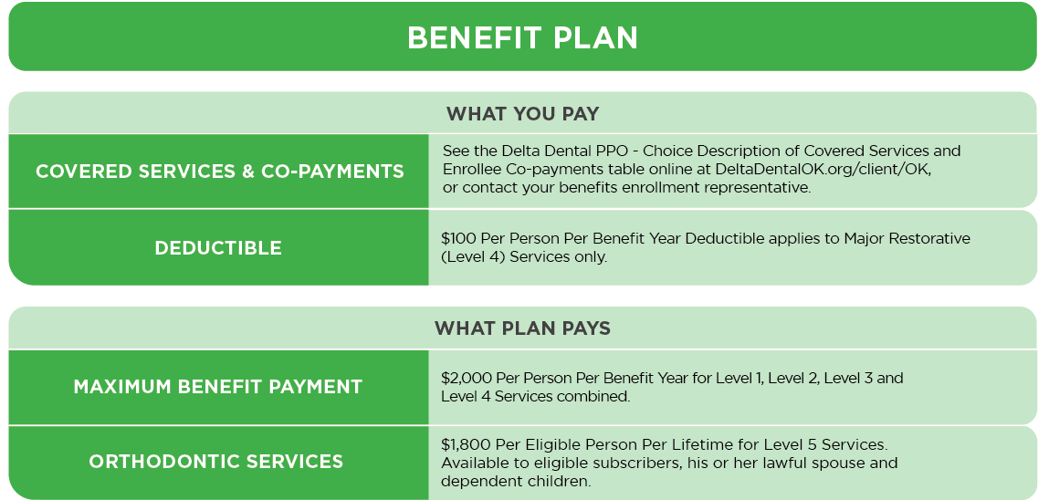
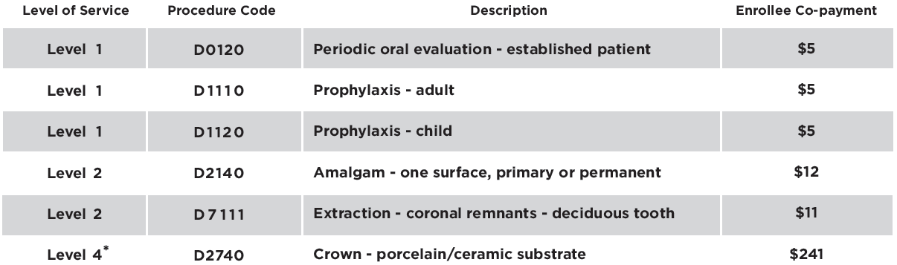
Option 2: Delta Dental PPO – Choice**
Members who select this low-cost program have access to the Delta Dental PPO network and will be responsible for the amounts reflected in the Delta Dental PPO – Choice Description of Covered Services and Enrollee Co-payments table along with any deductible. Their out-of-pocket expenses will be lower if they use a Delta Dental PPO provider.
Examples of Covered Services & enrollee Co-payments
*Assumes deductible is satisfied
**Dependents eligible To age 26

Slide 26

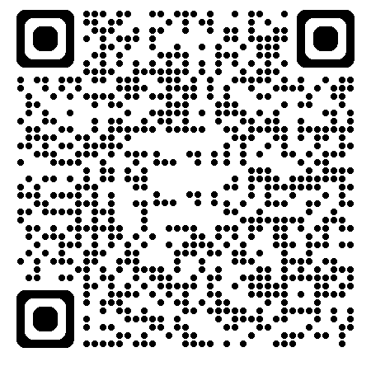
Visit Our Custom Website for State Employees
To learn more about the plans and services available to you with Oklahoma’s leading dental benefits provider, please scan the QR code to visit DeltaDentalOK.org/client/OK
Review Plan Information
Search for Participating Dentists
Access Monthly Health Tip
Learn Answers to FAQs
Register for Spotlight to access:
an electronic ID card
plan information, including Explanation of Benefits (EOBs)
secure messaging with our Customer Service team
claim status and history, and more!
Visit DeltaDentalOK.org/client/OK today!

Slide 27

We would welcome the opportunity to serve you and your family in 2026.
Please do not hesitate to contact us with any questions.
Live Answer Customer Service
Monday – Thursday, 7:00 a.m. – 6:00 p.m.
Friday, 7:00 a.m. – 5:00 p.m.
405-607-2100 (OKC Metro) 800-522-0188 (Toll Free)
DeltaDentalOK.org/client/OK

Slide 28

Dental Plan
WE LOVE TO MAKE
YOU SMILE!
HealthChoiceOK.com
5206

Slide 29

WHY CHOOSE HEALTHCHOICE DENTAL?
Network and non-network benefits available.
Network providers file your claims for you.
No limit on orthodontic benefit for members under age 19.
$2,500 calendar year maximum benefit per person for preventive, basic and major services.

Slide 30

Preventive Services
Network and non-network covered at 100% of allowable amounts.
Cleanings and topical fluoride treatments; two per calendar year.
Bitewing X-rays; two per calendar year.
Full mouth X-rays; one every 36 months.

Slide 31

Basic Restorative Services
Extractions, including wisdom teeth.
Oral surgeries, including general anesthesia.
Root canals and crown repairs.
$25 per individual/$75 per family calendar year deductible.
Plan pays 85% of allowable amounts when using a network provider.

Slide 32

Major Restorative Services
Initial placement of full or partial removable dentures.
Dental implant approved by FDA.
Inlays, onlays and crown restorations.
$25 per individual/$75 per family calendar year deductible.
Plan pays 60% of allowable amounts when using a network provider.

Slide 33

Orthodontic Services
No lifetime maximum.
No calendar year deductible.
Orthodontic services for members under age 19.
Orthodontic services for treatment of TMD at any age.*
12-month waiting period applies to new enrollees to the plan.
Plan pays 50% of allowable charges.
*If diagnosed with TMD, certification may be required.

Slide 34
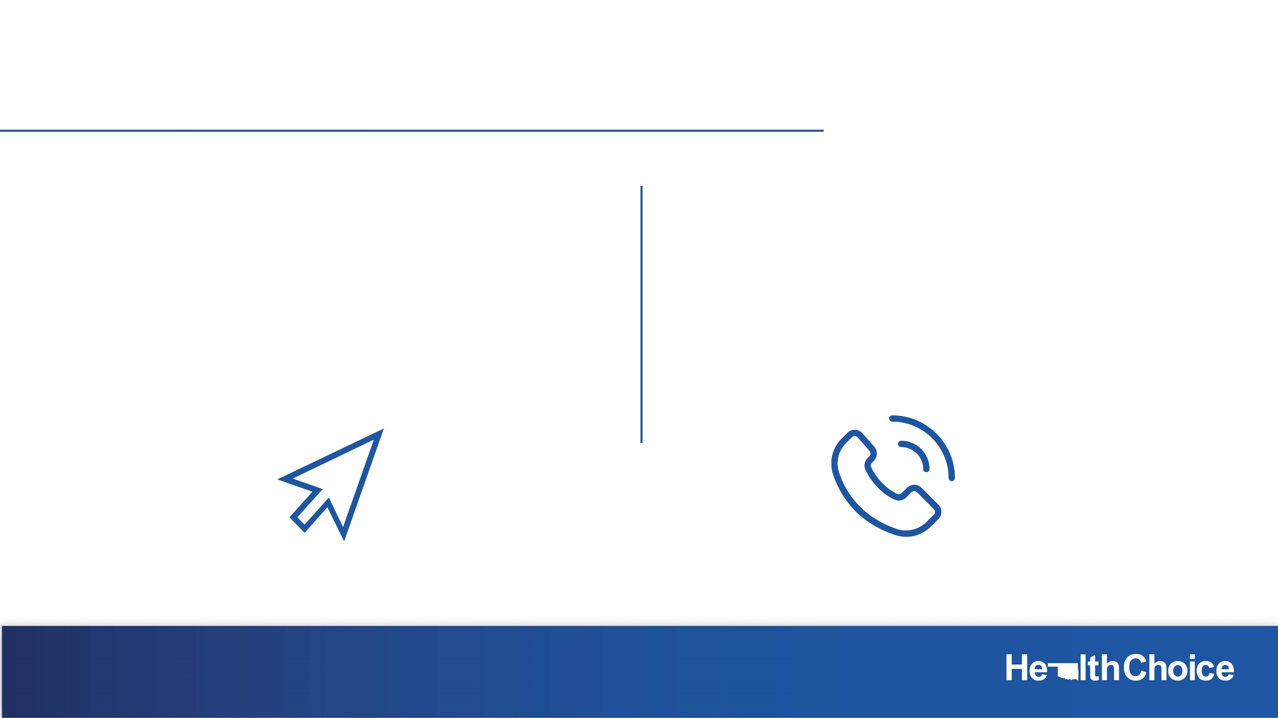
Resources
HealthChoiceOK.com
Dental handbook.
Provider Search page.
EGID Member Services
405-717-8780 or 800-752-9475
HealthChoice Customer Care
800-323-4314
TTY 711

Slide 35

Dental Insurance
Prepared for: State of Oklahoma
Dental Insurance Preferred Dentist Program (PPO)

Slide 36

What is Dental Insurance
Reduce your out-of-pocket costs for dental check-ups and procedures
Key Features
Little to no out-of-pocket costs for cleanings, X-rays, and exams in-network.^{D1}
Average savings of 35-50% on dentist list prices.^{D2}
Your dentist usually handles claims – which means less paperwork for you
Understand the types of procedures
Different plans pay different percentages for these procedures.
Preventive Care — cleanings, X-rays and exams
Basic Care — fillings and extractions
Major Care — bridges, crowns and dentures
Orthodontic Care

Slide 37
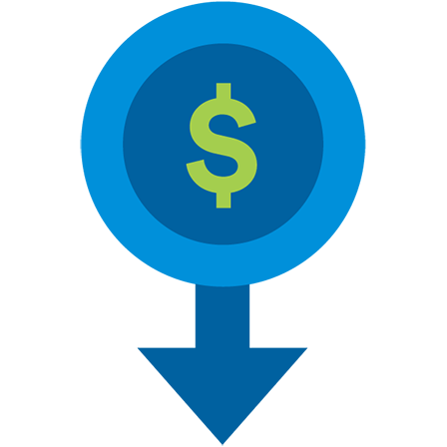
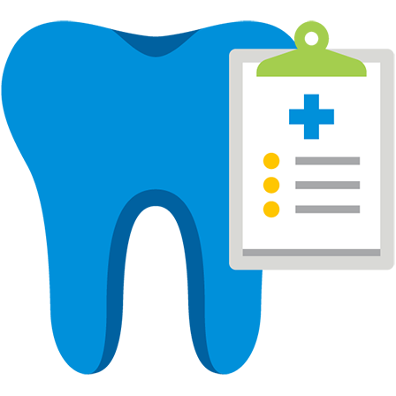


Why are dental benefits so important?
A plan that offers savings, choice and anywhere, anytime service¹
Negotiated fees typically 35% to 50% less than the average charges in the same area^{D2}
Explore our large network of carefully selected, participating dentists with flexibility to go to any dentist in- or out-of-network
With MetLife's International Dental Travel Assistance Program, access dentists in more than 200 countries^{D3}
Easy access to pre-treatment estimates, real-time claims processing and 24-hour customer service
High cost of certain dental treatments
Benefit of preventive care
Connection between oral health and overall health

Slide 38
MetLife Dental Plans
PDP PLUS Network
High Classic MAC |  | Low Classic MAC
In-network dentists: percentage of negotiated fee^{D4} | Out-of-network dentists: Maximum Allowable Charge^{D5} | In-network dentists: percentage of negotiated fee^{D4} | Out-of-network dentists: Maximum Allowable Charge^{D5}
Services Provided
Type A: Preventive | 100% | 100% | 100% | 100%
Type B: Basic | 85% | 85% | 70% | 70%
Type C: Major | 60% | 60% | 50% | 50%
Type D: Orthodontia | 60% | 60% | 50% | 50%
Annual deductible For type: B and C services | $25 individual/ $75 family | $25 individual/ $75 family | $50 individual/ $150 family | $50 individual/ $150 family
Annual benefits maximum excluding orthodontia | $5000 per person | $5000 per person | $1,500 per person | $1,500 per person
Orthodontia lifetime benefits maximum | $5000 Lifetime maximum Adults/Children | $5000 Lifetime maximum Adults/Children | $2000 Lifetime maximum Adults/Children | $2000 Lifetime maximum Adults/Children
Child(ren)’s eligibility for dental coverage is from birth up to age 26.

Slide 39




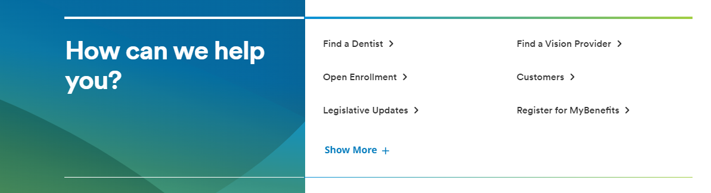
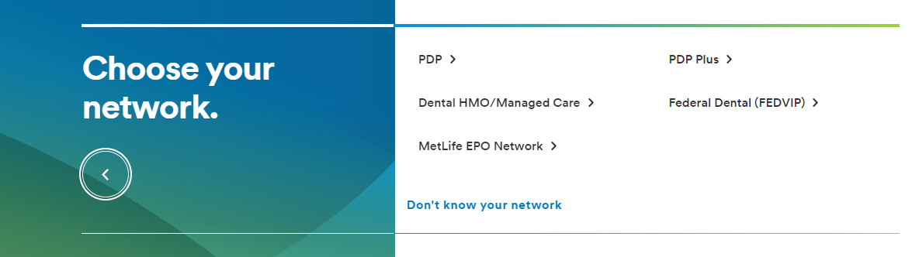
Find a Dental Provider
With MetLife Dental insurance, you can choose from thousands of general dentists and specialists nationwide. You can find the names, addresses, languages spoken and phone numbers of participating dentists by searching our online Find a Dentist directory.
Step 1: Go to metlife.com
Step 2: Select “Find a Dentist” next to “How can we help you?"
Step 3: Select “PDP Plus” next to “Choose your network.”
Enter your Zip, City or State and select the “Find a Dentist” button. You will then be prompted to select your plan from the list. The plan name is located in your Schedule of Benefits.

Slide 40
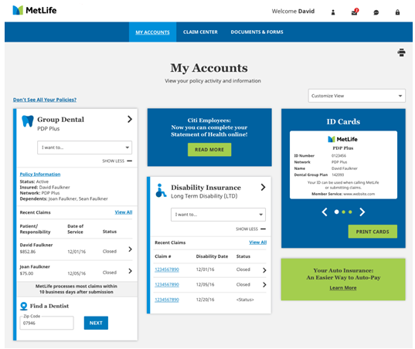

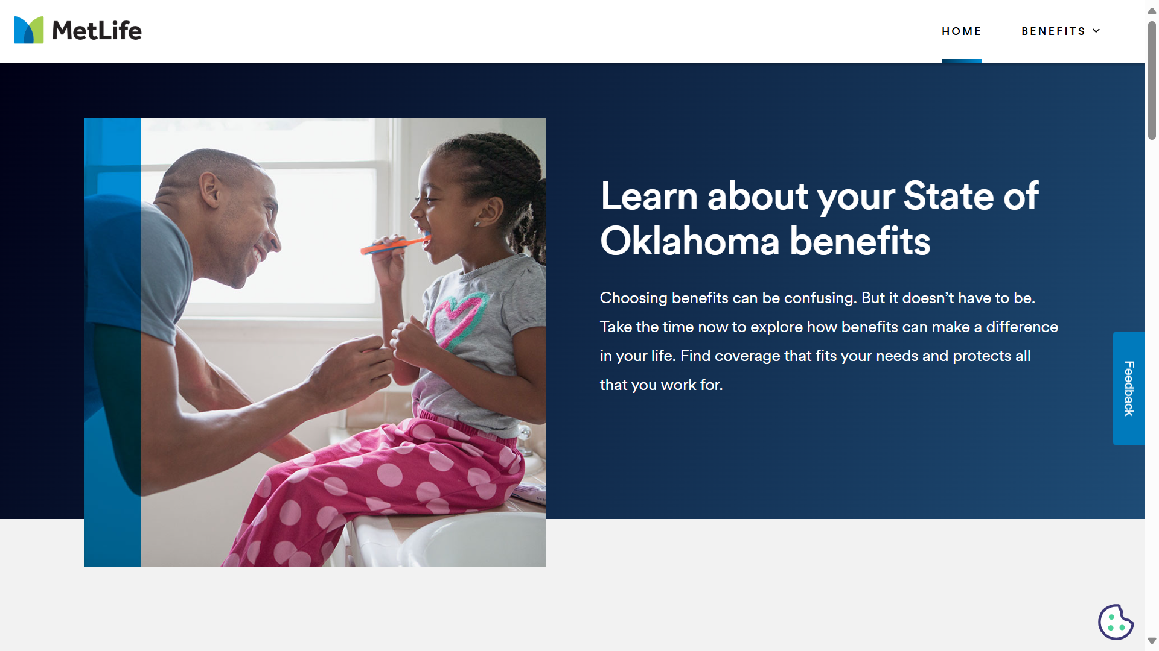
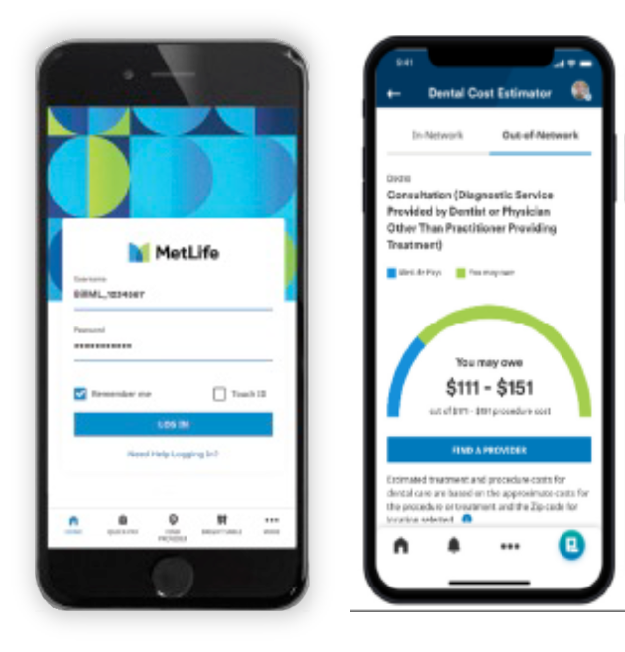


Questions? Need help or more info.?
With MyBenefits you can...
View enrollment status
Check recent claims and status
Print ID cards
Find essential forms
Access educational tools
Register with MyBenefits today! www.metlife.com/mybenefits
Call:
1-855-676-9443
Mondays - Fridays, 8 a.m. – 8 p.m., ET Saturdays - Sundays, 10 a.m. – 7 p.m., ET
Visit: www.metlife.com/info/oklahoma/
Download “MetLife US” at the App Store or Google Play. Log in with your MyBenefits information to access these features.*

Slide 41


Helping you make smarter choices
Oral Health Education made easy
Dentist Education & Communication
Patient Education & Communication
Visit MetLife’s Oral Health Library¹⁵
www.oralfitnesslibrary.com

Slide 42
Thank you.
Notes:
Thank you all for your time and I will be happy to answer any questions you may have.

Slide 43
Appendix
Notes:
Thank you all for your time and I will be happy to answer any questions you may have.

Slide 44

Dental Insurance
Footnotes and disclosures
* May be subject to any plan cost sharing such as benefits maximums.
D1. Like most group benefit programs, benefit programs offered by MetLife and its affiliates contain certain exclusions, exceptions, reductions, limitations, waiting periods and terms for keeping them in force. Please contact MetLife or your plan administrator for costs and complete details.
D2. Certain providers may participate with MetLife through an agreement that MetLife has with a vendor. Providers available through a vendor are subject to the vendor’s credentialing process and requirements, not MetLife’s. If you should have any questions, contact MetLife Customer Service.
D3. A pre-treatment estimate is only an estimate. The actual amount that MetLife will pay is determined when a claim is submitted, and is subject to any co-payments, deductibles, cost sharing and benefits maximums
D4. Negotiated fees refer to the fees that in-network dentists have agreed to accept as payment in full for covered services, subject to any deductibles, copayments, cost sharing and benefit maximums. Negotiated fees are subject to change.
D5. Reimbursement for out-of-network services is based on the lesser of the dentist’s actual fee or the Maximum Allowable Charge (MAC). Maximum Allowable Charge: The out-of-network Maximum Allowable Charge is equal to the in-network negotiated fee.
D6. Based on internal analysis by MetLife.
D7. R&C fee refers to the Reasonable and Customary (R&C) charge, which is based on the lowest of 1) the dentist’s actual charge, 2) the dentist’s usual charge for the same or similar services or 3) the usual charge of most dentists in the same geographic area for the same or similar services as determined by MetLife.
D8. Please see plan details for out-of-network benefits.
D9. MetLife PDP Copay plans are only available to groups with 1,000 or more eligible employees. Copay plans are not available for insured cases in Texas, including plans sitused in Texas or covering Texas residents. Copay plans are also not available for insured cases in Connecticut.
D10. Certain Limitations apply to some services; please review your Schedule of Benefits for full details.
D11. In California, orthodontic and pedodontic specialty services require pre-approval. Your selected participating dentist will contact SafeGuard for pre-approval. Once approved, your dentist will contact you with the name of a participating specialist.
Metropolitan Life Insurance Company, New York, NY
© 2025 MetLife Services and Solutions, LLC

Slide 45
Dental Insurance
Footnotes and disclosures
Product Disclaimers
Like most group benefit programs, benefit programs offered by MetLife and its affiliates contain certain exclusions, exceptions, waiting periods, reductions of benefits, limitations and terms for keeping them in force. Please contact MetLife for complete details.]
Group dental insurance policies featuring the Preferred Dentist Program are underwritten by Metropolitan Life Insurance Company, New York, NY 10166.
Metropolitan Life Insurance Company, New York, NY © 2025 MetLife Services and Solutions, LLC

Slide 46

YOUR BENEFITS FROM SUN LIFE Discover new ways to protect what you love
Janet Ruggiano
Benefits Counselor, Sun Life
PY 2026

Slide 47

Sun Life Dental
Dental insurance can help lower your out-of-pocket expenses so you and your family can maintain healthy smiles – and better overall health, too.
Deductible: $30 per person per calendar year
Annual maximum: $1750 per person per calendar year – Preventive, Basic and Major Services
Orthodontia Services: $1500 Lifetime Maximum per child to age 19
Freedom to choose dentists both in and out of the network
Periodontal disease can lead to receding gums, loss of teeth, and can increase the risk of other health problems such as heart disease and diabetes.¹
1. https://www.mayoclinic.org/diseases-conditions/periodontitis/symptoms-causes/syc-20354473 (accessed 08/23)

Slide 48

Coinsurance for Covered Services
Procedure | In Network | Out of Network
Preventive – Type 1 | 100% | 100%
Basic – Type 2 | 85% | 70%
Major – Type 3 | 60% | 50%
Orthodontia – Type 4 | 60% | 50%
These are the percentages your plan pays of the provider’s fee (after any applicable deductible has been satisfied).

Slide 49

Network dentists can save you* $$
Example | Network Dentist | Non-Network Dentist
Average charge for crown** | $1,278 | $1,278
Minus network discount | 30% | NA
Actual fee | $894 | $1,278
Network Dentist 60%; Non-Network 50% | $536 | $639
Claimant pays | $358 | $639
You could save $281 by going to a network dentist!
*This example is for illustrative purposes only. Cost of dental procedures may differ depending on location or dental provider. Savings may also differ in cases when deductibles apply or if the dentist’s discount differs from 30%
**2023 Fair Health data. Figures have been rounded to the nearest dollar.

Slide 50

Lifetime of Smiles®
Your plan includes:
Brush biopsies for early detection of oral cancer
Genetic testing to help identify individuals at genetic risk for gum disease
Periochips to control bacteria and reduce the size of periodontal pockets
Four cleanings per year to help prevent gum disease (coverage up to 4 periodontal cleanings in a 12-month period)^{1,2}
Tooth-colored fillings for back teeth
NEW!! Preventive Rewards: you can get up to $1,250 added to your annual maximum for the next year. The amount added is based on your paid claims for preventive services during the prior year.
1. Dental prophylaxis cleaning is limited to 1 time in any 6-month period and periodontal maintenance procedure is limited to 1 in any 3-month period. Total number of combined dental prophylaxis cleanings and periodontal maintenance procedures cannot exceed 4 in a 12-month period. 2. Classification of services varies by plan design.

Slide 51
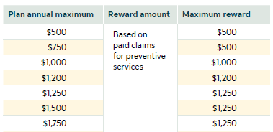
Your Sun Life Dental Plan now includes Preventive Rewards
How does Preventive Rewards work?
You have a $1,750 annual maximum benefit plus Preventive Rewards on your plan. When a dental member has paid claims for preventive services in a year, they can rollover the amount of those paid claims, up to $1,250, for future years. They can get additional rewards each year until they hit $1,250. This rewards dental members for getting preventive treatments while increasing their annual maximum dollars for future treatments.
Notes:
Options for bullet #1
[Preventive Max Waiver® which allows covered dental expenses for preventive services to not apply to the annual maximum]
[Preventive Rewards so you can get up to $<PREVENTIVE REWARDS ACCOUNT MAXIMUM> added to your annual maximum for the next year. The amount added is based on your paid claims for preventive services during the prior year.]
[RollMax which allows you to roll over a portion of your unused annual maximum for use the next year. When you have paid claims less than $<ROLLMAX ROLLOVER LIMIT> on dental services in a year, you can rollover $<ROLLMAX ROLLOVER AMOUNT> to next year. You can rollover unused dollars up to $<ROLLMAX ACCOUNT MAXIMUM> total over multiple years.]
[Brite Solutions® which covers tooth-colored porcelain crowns on posterior teeth and bleaching is covered at 50% coinsurance with a $500 separate lifetime maximum.]

Slide 52

How to find a dentist
Visit www.sunlife.com/findadentist
Select the network listed on your ID Card
Enter your search criteria and a list of participating dentists will be provided
Call customer service at 800-442-7742 for assistance in locating a network dentist
Access it from the Dental Health Center at www.sunlife.com/dentalhealthcenter
Is your Dentist not in our network? Use the Provider nomination card if your dentist is not in our network of dentists.

Slide 53

You’ve built a great life. Protect it.
Enroll in your Sun Life benefits during your Open Enrollment
Notes:
You’ve built a great life. Protect it.
REMINDER: Sign up when life insurance is first offered so you won’t have to answer medical questions and provide proof of good health.

