Slide 1

Mission Possible
An update on Oklahoma’s State Health Information Exchange
Prepared for the Health Information Technology Advisory Board
December 16, 2020

Slide 2
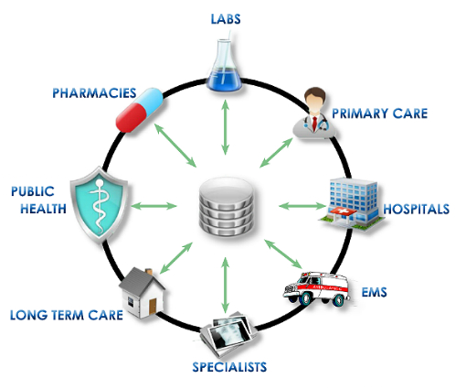
Our mission, that we’ve already chosen to accept . . .
to allow health information to flow seamlessly to and from authorized healthcare organizations and individuals in Oklahoma
to meet the needs of end users by enabling access to secure, accurate data available at the right time and place, for the right purposes.

Slide 3
Why is this mission important?
Short answer is better health outcomes
Long answer is an ROI from health system efficiency, improved care coordination, transparency, accountability and facilitating value-based reimbursement
Oh . . . And CMS is willing to provide enhanced federal funds in order to help providers achieve meaningful use
Notes:
MIPS, replaced SGR

Slide 4
Plan of attack
Leverage enhanced federal funds to implement
Deploy a public-private partnership model
  State is far too late to the game to “build” platform
  Go to the market to procure software, service and support
Public portion of strategy is to provide oversight, governance and strategy
  State has many options when deciding how best to serve this role
Notes:
Under direction from the Governor and through the spending power of the legislature, Oklahoma is leveraging available Medicaid funding to establish and implement a functioning HIE.
Mention governance- something we have to do, not something we ought to do

Slide 5
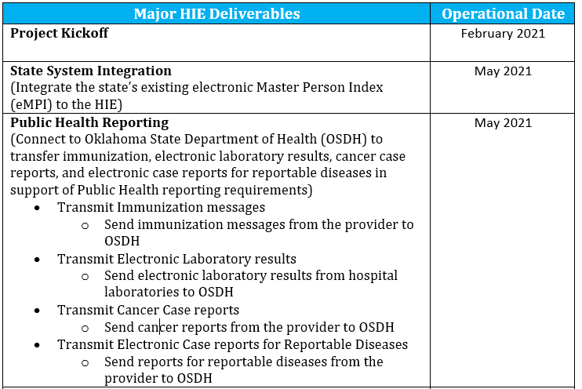

Slide 6
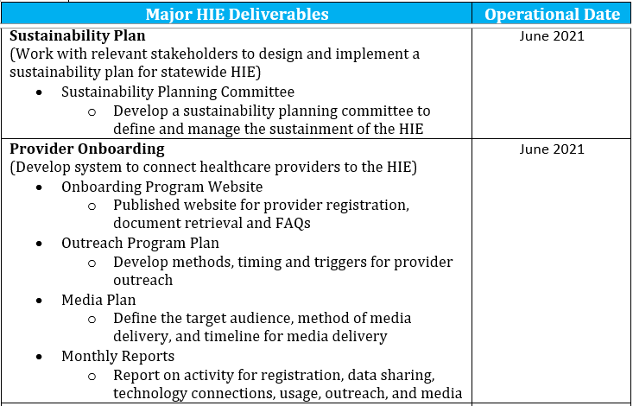

Slide 7
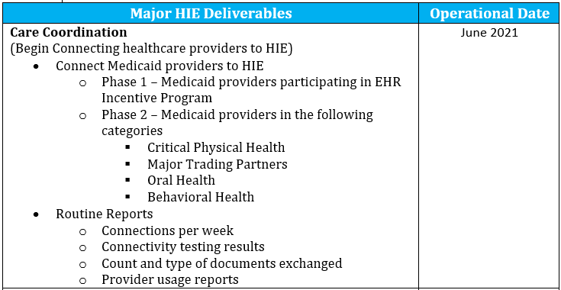

Slide 8
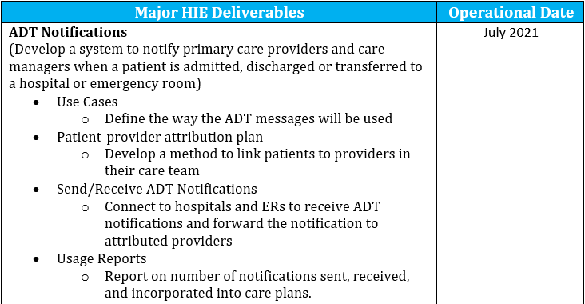

Slide 9
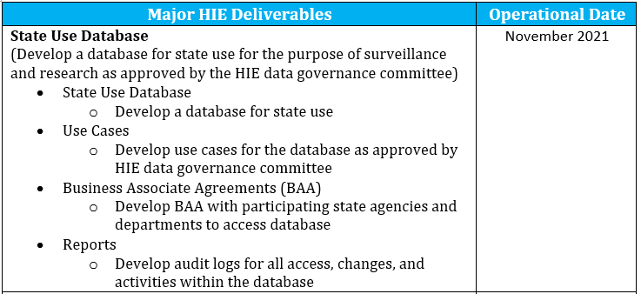

Slide 10
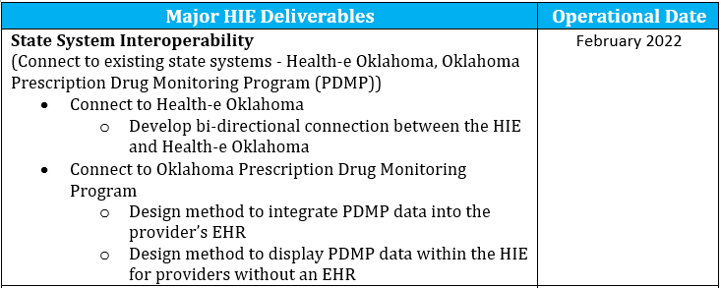

Slide 11
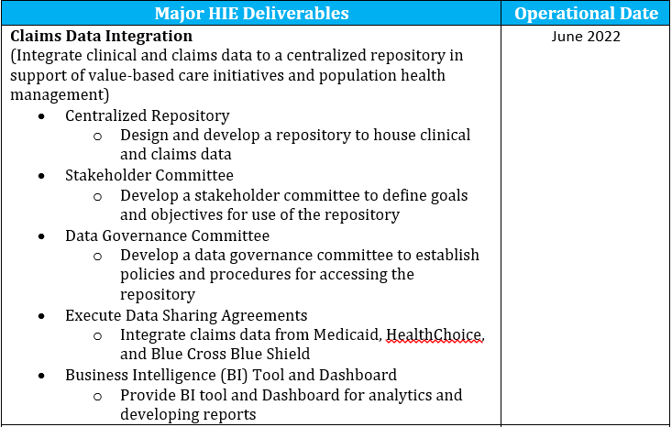

Slide 12
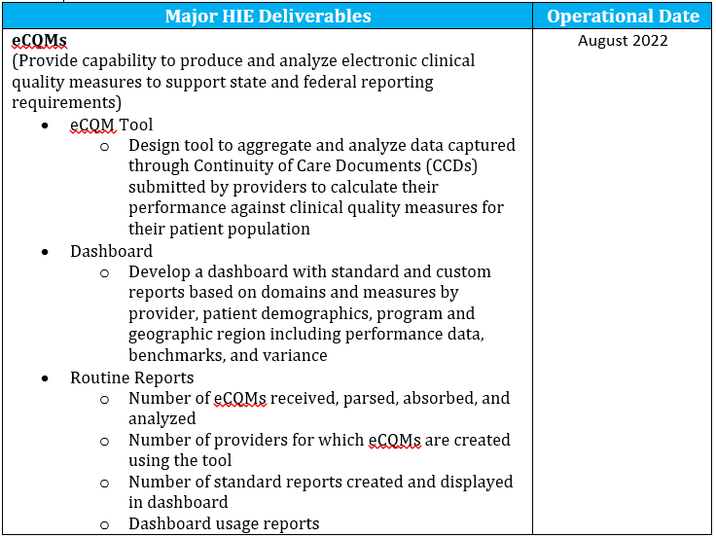

Slide 13
What’s next?
Award RFP and receive CMS contractual approval
Multi-agency (behind the scenes) work during implementation
  OHCA, OSDH, OBNDD, ODMHSAS, OMES
Educational (virtual) road show
Outstanding decisions that have to made
  Governance
    Inside
    Outside
  Sustainability
  Statutory authority
Notes:
Are we a

Slide 14




Carter Kimble
Executive Director
Office of the State HIE
Carter.Kimble@okhca.org
4345 N. Lincoln Blvd.
Oklahoma City, OK 73105
okhca.org
mysoonercare.org
Agency: 405-522-7300
Helpline: 800-987-7767

