Slide 1
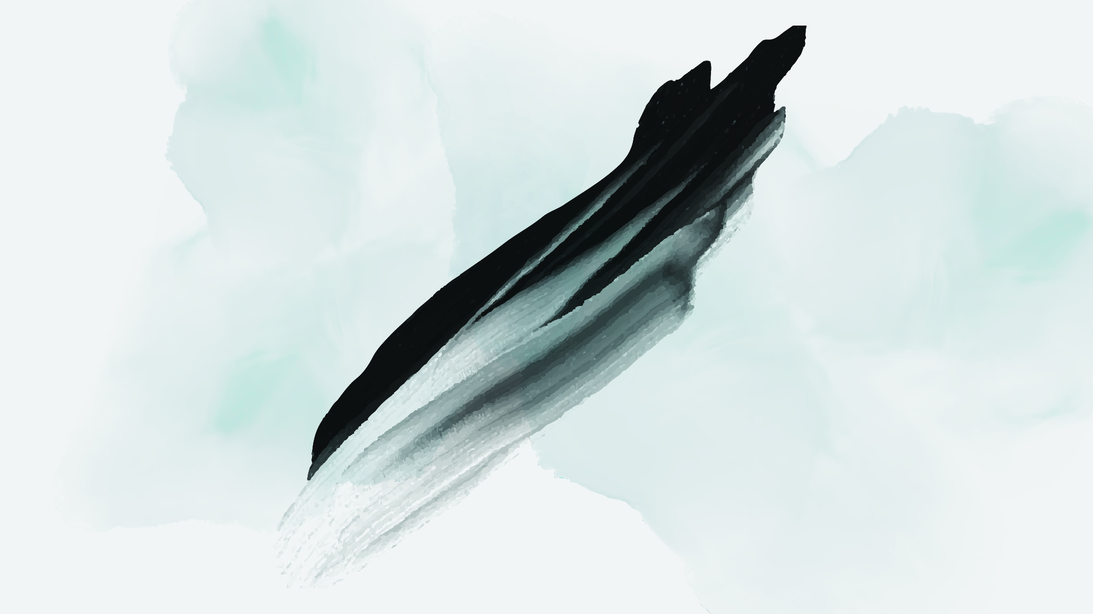
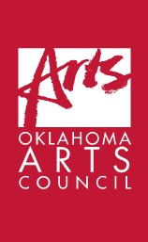

Slide 2

April 2021
State Capitol Preservation Commission
Capitol AIPP Projects for Consideration
First Floor:
Wilma Mankiller (1945-2010)
Second Floor:
Choctaw Code Talkers of WWI
Cultural Treasure Doc Tate Nevaquaya (1932-1996)

Slide 3
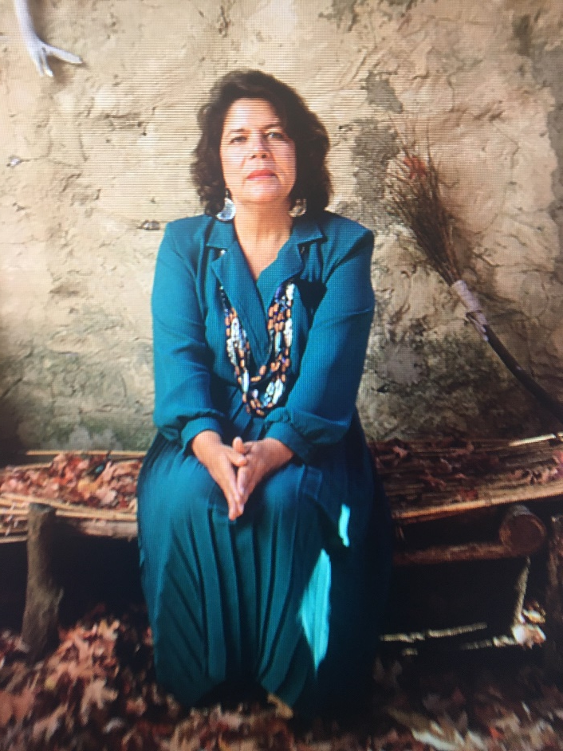
First Floor, Grand Staircase Landing.
Wilma Mankiller
Elected Deputy Principal Chief of the Cherokee Nation of Oklahoma in 1983.
Appointed Principal Chief of the Cherokee Nation of Oklahoma in 1983.
Ms. Magazine Woman of the Year in 1987.
First woman elected Principal Chief of the Cherokee Nation of Oklahoma, 1987.
Tenure focused on education, job training and healthcare.
A National advocate for strengthening the self-governance capacity of Native Nations.
International example of the importance and effectiveness of women as political leaders.

Slide 4
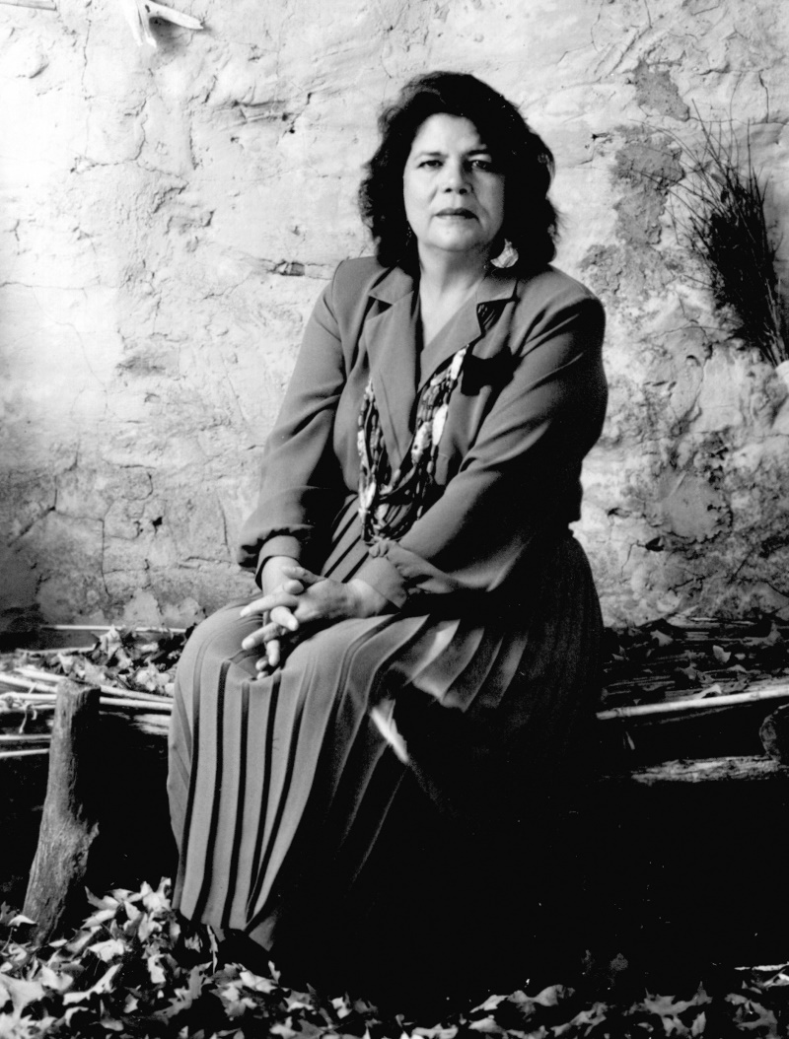
Budget for Wilma Mankiller Portrait
Artwork 15,000
Honoraria, 6 @ 1,000 6,000
Gold leafed frame 2,800
Installation 200
Signage 400
Subtotal $24,400

Slide 5
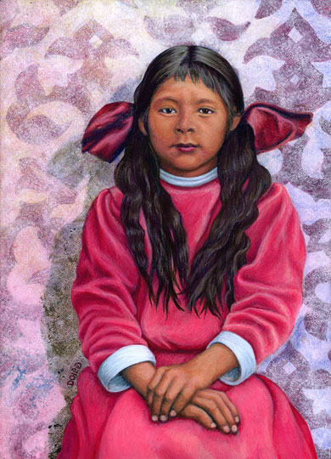
Possible Artist:
America Meredith
(Cherokee Nation)
BFA, University of Oklahoma.
MFA, San Francisco Art Institute.
Visiting Artist Fellow; National Museum of the American Indian.
Numerous Awards and Exhibitions.
Curator.
Publisher: First American Art.

Slide 6
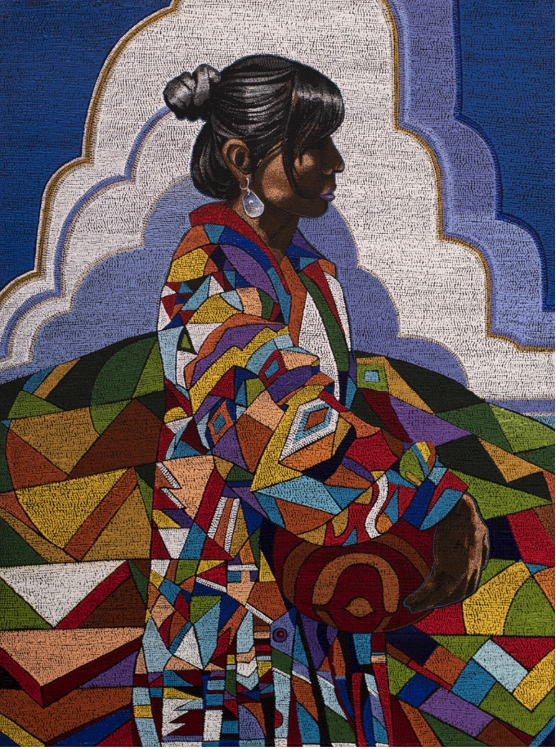
Possible Artist:
Starr Hardridge
(Muscogee (Creek))
BFA, Savanah College of Art & Design.
Nadia Verdon Atelier of Decorative Arts, Penne D’Agenais, France.
Nationwide Group and solo exhibits.
Numerous awards and distinctions.

Slide 7
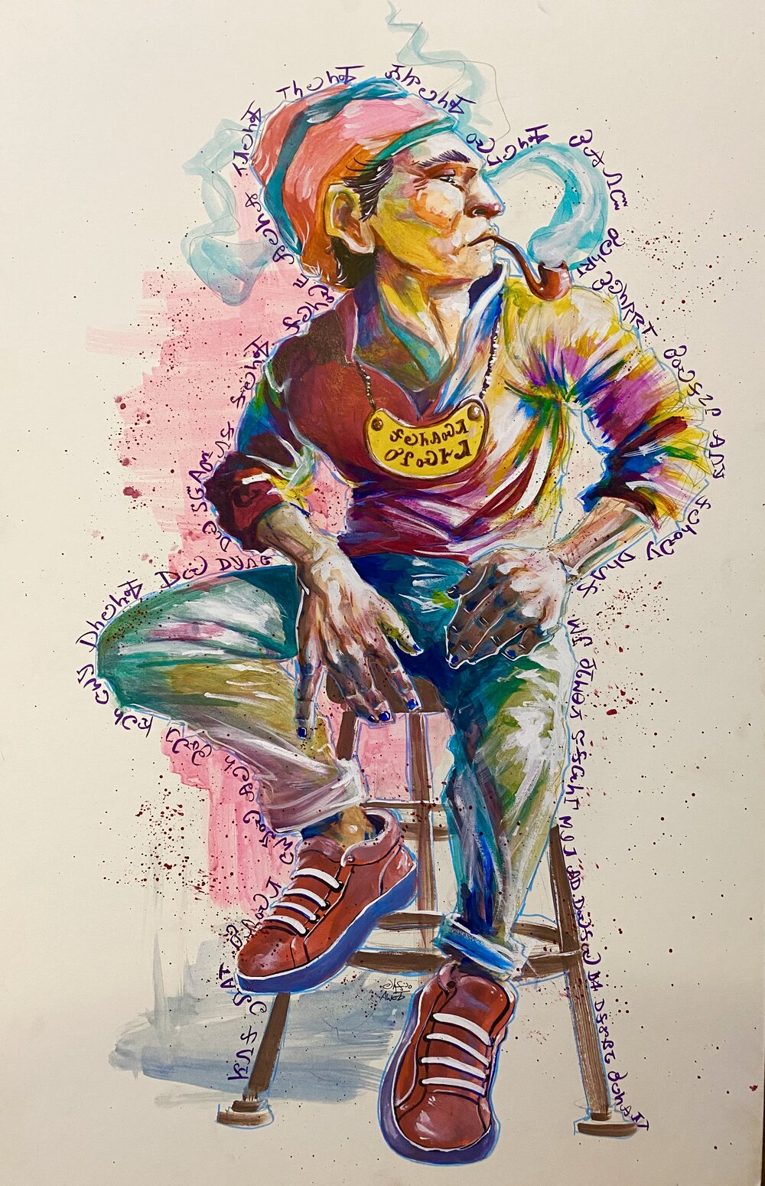
Possible Artist:
Roy Boney
(Cherokee Nation)
BFA, Oklahoma State University.
MFA, University of Arkansas.
Filmmaker & Animation Artist.
Graphic Novelist.
Widely exhibited in the US and Internationally.
Numerous awards and distinctions.

Slide 8
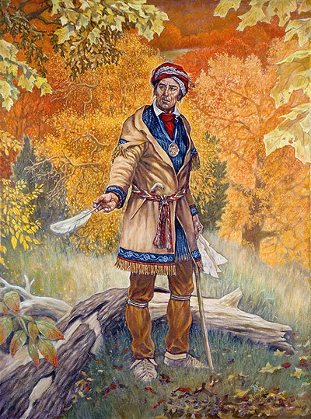
Possible Artist:
Daniel Horsechief
(Cherokee Nation / Pawnee)
BA, Bacone College, Muskogee, OK.
AA, Institute of American Indian Arts, Santa Fe, NM.
Numerous awards and prizes for sculpture & Painting.
Commissions from NE State University and the Cherokee Nation.
Widely exhibited.

Slide 9
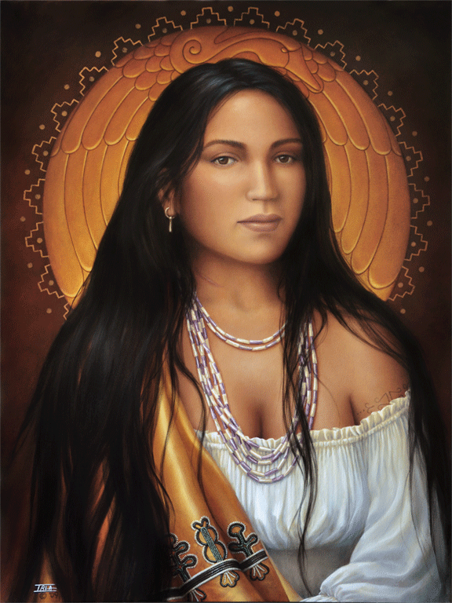
Possible Artist:
Sharon Irla
(Cherokee Nation)
Founding member, Southeastern Indian Artists Association.
Exhibiting since 2003.
Successful fashion designer.
Many awards in competitive art exhibitions.
Widely exhibited and collected.

Slide 10
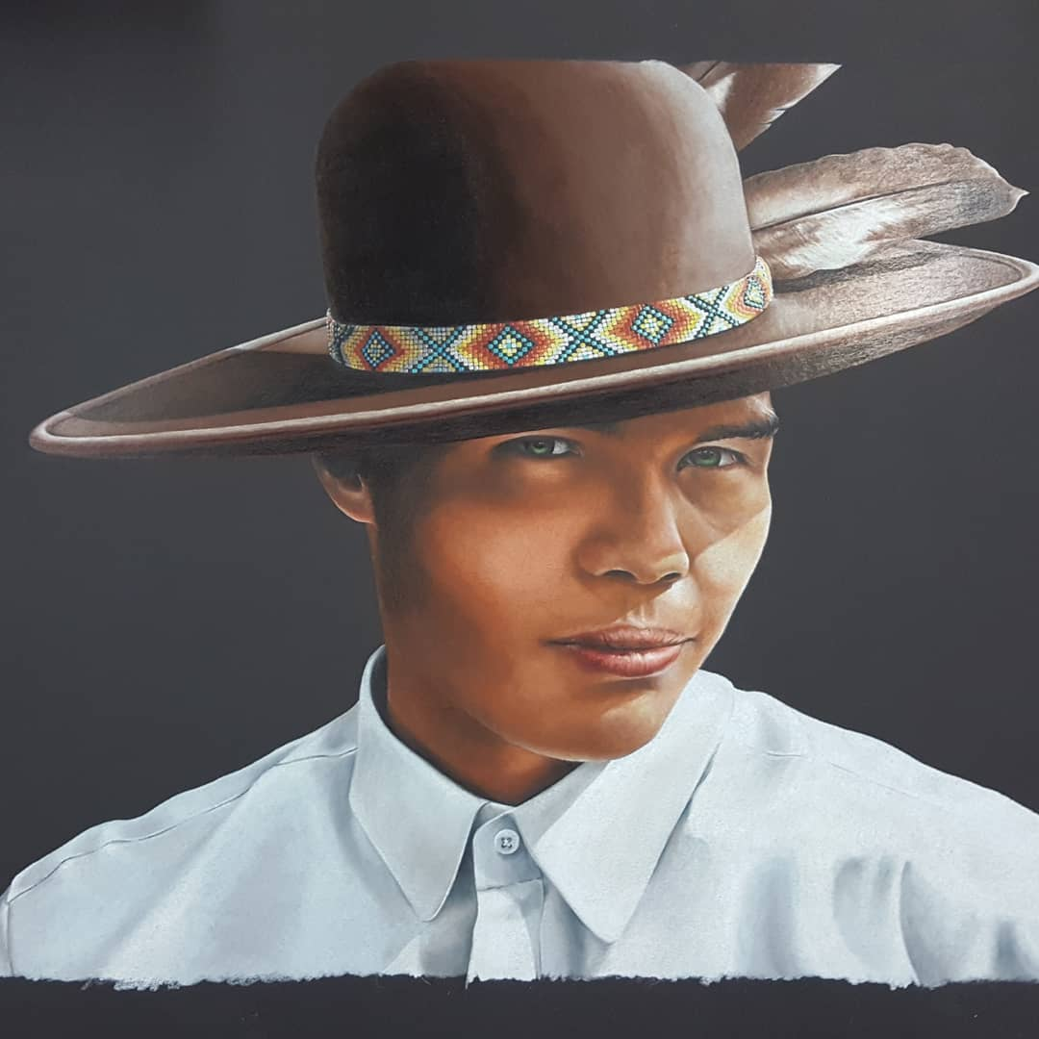
Possible Artist:
Bryan Waytula
(Cherokee Nation)
BFA, University of Oklahoma.
Published author and illustrator.
Award winning, multi-disciplinary artist.
Widely exhibited across the US.

Slide 11
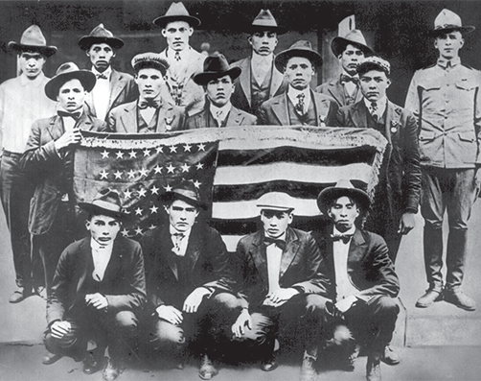
2nd Floor
Supreme Court Hallway
“Hall of Heroes”
Commemorating Oklahoma’s veterans
New Painting:
Choctaw Code Talkers of WWI
Artist: TBD
Selection Process: RFP

Slide 12
Choctaw Code Talkers Budget
Artwork 15,000
Honoraria: 3@1000 3,000
Gold leafed frame 2,800
Installation 200
Signage 400
Subtotal $21,400

Slide 13
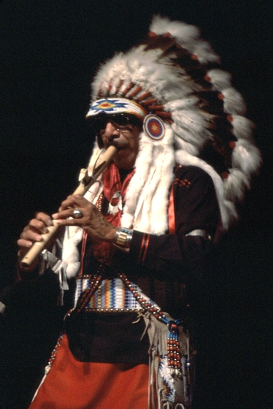
2nd Floor
Oklahoma Cultural Treasures
  New Portrait:
  Doc Tate Nevaquaya
  (Comanche, 1932-1996)
  Internationally acclaimed composer and musician.
  Noted visual artist.
  National Heritage Fellow of the NEA.
  Named an Oklahoma Cultural Treasure in 1995.

Slide 14
Doc Tate Nevaquaya Budget
Artwork 10,000
Gold leafed frame 2,800
Installation 200
Signage 400
Subtotal $13,400

Slide 15
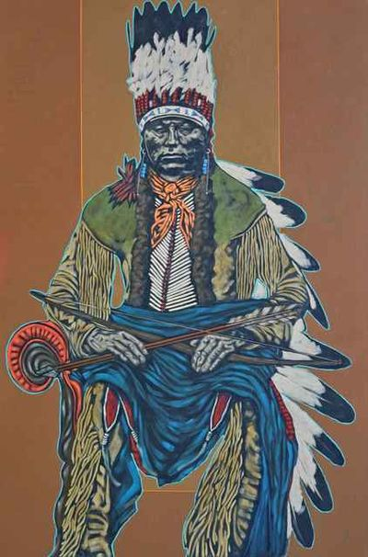
Artist:
Nocona Burgess
(Comanche)
BFA, University of Science & Arts,
Chickasha, OK.
M.Ed., University of New Mexico.
Widely published award-winning artist.
Internationally exhibited.
Permanent Collections:
National Museum of the American Indian.
Museum of Indian Arts and Culture.
Comanche National Museum.
Bristol Museum, Bristol England.

Slide 16
Motion

Slide 17
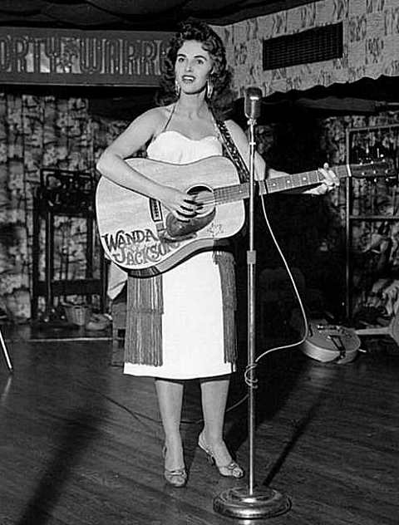
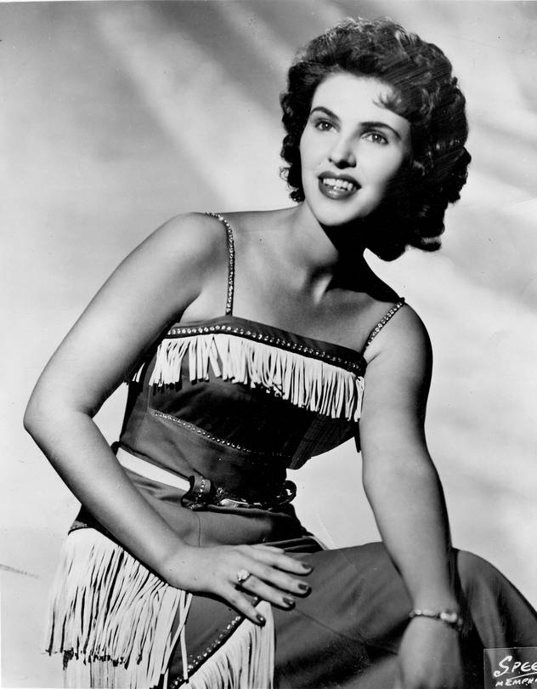
April 2021
State Capitol Preservation Commission
New portrait commission proposal:
Oklahoma Cultural Treasure
Wanda Jackson
Brought by:
The Friends and Family
of Wanda Jackson

Slide 18
The Queen of Rockabilly
Throughout her life, Wanda Jackson has been not only a model for successive generations of female performers, but an ambassador for her home state of Oklahoma all over the world. Her long and illustrious career as pioneer and innovator in American music has earned her not only the title “Queen of Rockabilly” and induction into the Rock & Roll Hall of Fame, but that of Oklahoma Cultural Treasure. She has undoubtedly earned a place on the walls of the Oklahoma State Capitol representing the best of what Oklahoma has to offer the world.
Painting specifications: Oil on linen, approximately 40” x 30”
Enclosed in a custom-made gold-leafed wooden frame.
Installed with other Cultural Treasures on the 2nd floor, Spring 2022.

Slide 19
Motion

