Slide 1

State Budget Outlook
Multiyear Trend Analysis
John Gilbert
OMES Budget and Revenue Analyst
Nov. 1, 2020
Notes:
Hello, my name is Charlotte Clear and I am a Workforce Planning Specialist with the Office of Management and Enterprise Services. Our department provides guidance to state agencies to ensure long-term talent readiness. Our mission is to assist state agencies in analyzing the current workforce, determining future workforce needs and implementing solutions so that agencies will have an effective workforce to meet future demands.
Thank you for joining me today. During this presentation, we will discuss the succession planning initiative for the State of Oklahoma.

Slide 2

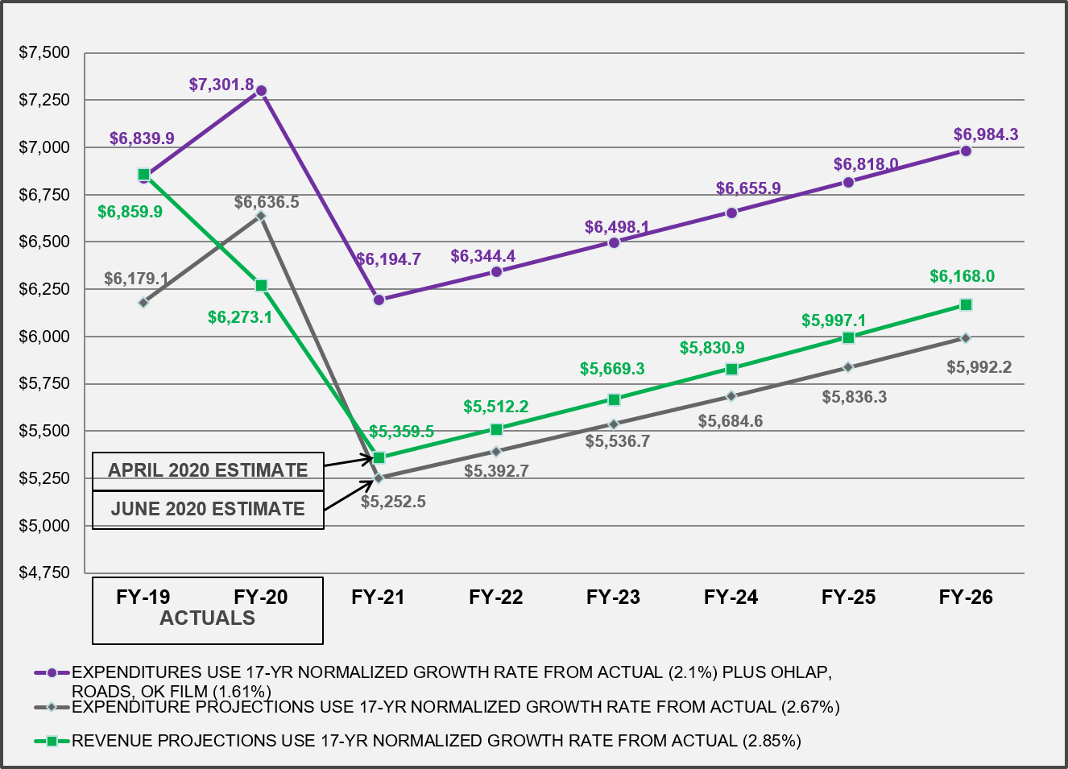
General revenue fund trends
Revenue vs. expenditures (in millions)

Slide 3
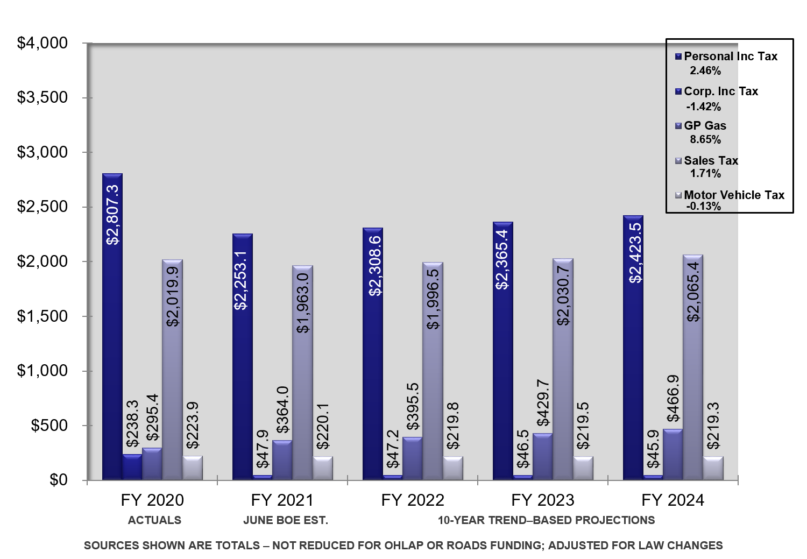
General revenue fund sources
Trend-based projections (in millions)

Slide 4
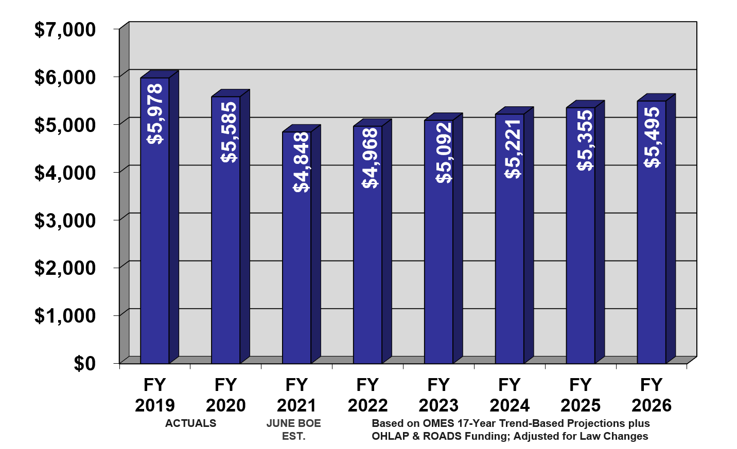
General revenue growth
Five major sources (in millions, with % of change from prior year)
Total growth: Personal income tax, Corporate income tax, Gross production gas, Sales tax, Motor vehicle tax

Slide 5
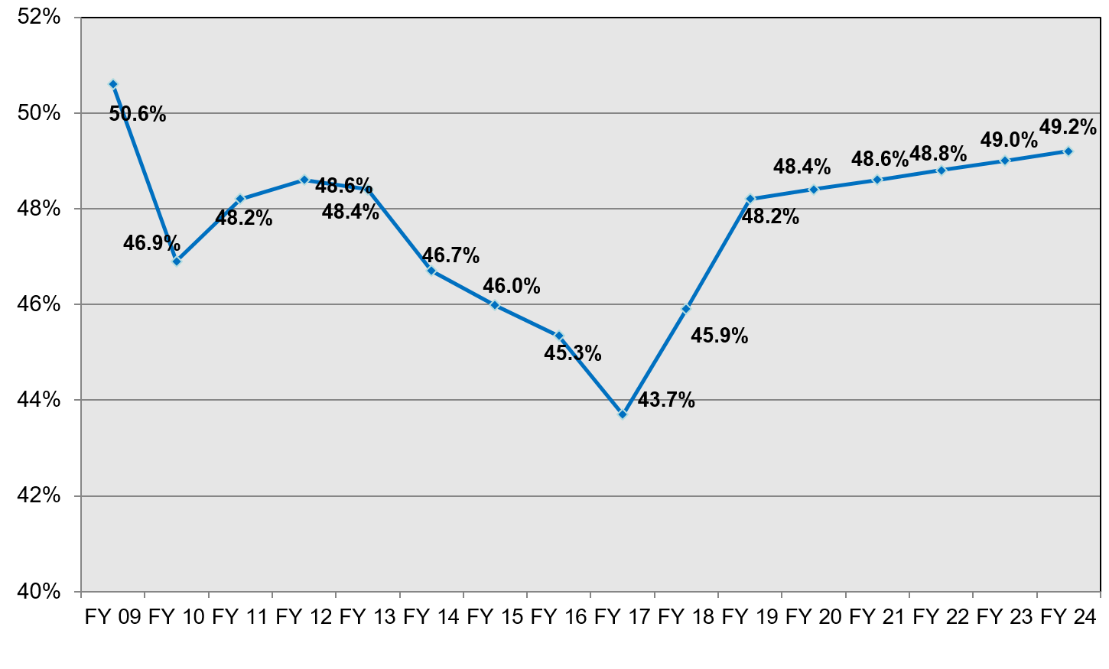
Projections of GRF as a percentage of total tax collections
ACTUALS
PROJECTIONS
PROJECTIONS USE AVERAGE RATES OF CHANGE CALCULATED FOR TOTAL APPORTIONED AND GRF COLLECTIONS FROM PRIOR 12 YEARS

