Slide 1


Advanced Planning Document Process
Adolph Maren
April 24, 2019

Slide 2
ACRONYM
HIE APD Phases
Concept development
Develop draft HIE APD and budget
Develop draft contracts, amendments and RFPs from all entities
Internal state reviews of HIE APD, budget and contracts, amendments and RFPs (OHCA, OSDH, MyHealth, OMES)
Submission of APD and all supporting documents to CMS
Approval of APD and draft supporting documents
Release of RFPs
Submit final supporting documents to CMS
Maintenance of APD

Slide 3
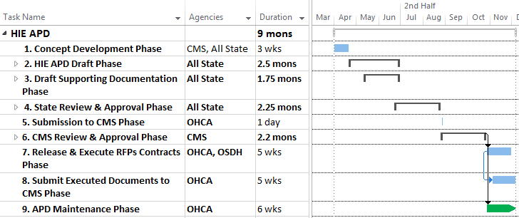
Sample Schedule
DETAILED
Note: All State = OHCA, OSDH, MyHealth

Slide 4
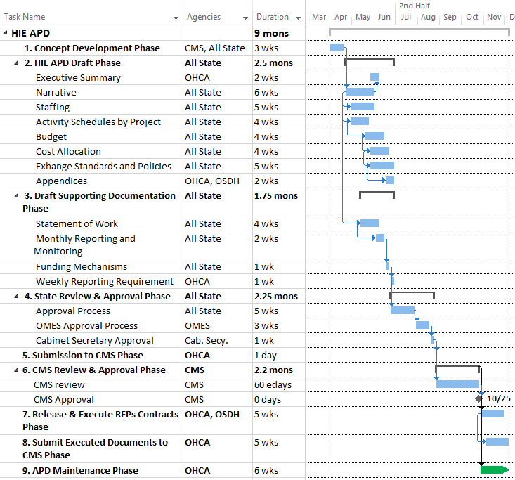
Note: All State = OHCA, OSDH, MyHealth

Slide 5
1. Concept Development
Obtain concept approval from CMS for HIE Plan
  Contact CMS Lead ☑ 3/28/19
  Provide brief HIE concept document ☑ 4/3/19
  CMS sets up teleconference with appropriate participants
  Participate in teleconference with CMS in order to provide any requested detail.
  Modify HIE concept document and resubmit to CMS if requested

Slide 6
2. HIE APD Draft
HIE APD executive summary:
  Requested amounts by FFYs
  Date of CMS approval of previous APD with amounts by FFYs
  Date of last State Medicaid HIT Plan (SMHP) approval and/or expected timing of next update
Notes:
HIE APD Guide from CMS available for email upon request

Slide 7
2. HIE APD Draft, cont.
  HIE APD narrative to include:
    HIE approach
    Risks and risk mitigation
    Impact on providers’ ability to meet Meaningful Use (MU) and it’s relevance to public health
    Role of state government/governance
    Exchange standards and policies
    Summary of transition plans from design to ongoing operations
    Sustainability plan
    Key milestones

Slide 8
2. HIE APD Draft, cont.
Proposed activity schedule
    Detailed list of activities/projects including:
      Start date
      Completion date
      Current status
Proposed budget by FFY
    Federal, state and total cost
    Also budget each FFY by quarter
Notes:
Due to complexity, Proposed Activity Schedules could be 10-20 pages

Slide 9
2. HIE APD Draft, cont.
Cost allocation plan, if applicable
  Method of calculating Medicaid percentage based on projected benefits to state’s Medicaid Program
  Proportional investments by other payers
  Cost allocation methodology and data sources by activity and funding stream
Assurances, security, interface requirements
  Description of the exchange standards and policies
  Required affirmations of state’s compliance with federal regulations

Slide 10
2. HIE APD Draft Phase, cont.
  Appendix A – Medicaid Management Information
  System (MMIS) costs and allocation, if
  applicable
  Appendix B – Provider Incentive Payments (N/A)
  Appendix C – Grants (N/A)
  Appendix D – HIE Checklist
  Appendix E – Table of alignment with seven
  standards and conditions

Slide 11
3. Draft Supporting Documentation
Drafts of contracts, amendments and RFPs with entities such as OSDH, MyHealth, and other contractors to include:
    Statement of work
    System requirements
    Regulations
    Monthly reporting and monitoring
    Funding/payment mechanism/cost allocation
    Weekly reporting requirements
    Auditing and IV and V requirements

Slide 12
4. State Reviews
  State entities required to review and approve HIE APD, contracts, amendments and RFPs expected to include:
    OHCA
      Finance
      Legal
      Business Enterprises
      Executive Staff
    OSDH & MyHealth
    OMES
    Oklahoma Cabinet Secretary
STAFFING

Slide 13
4. State Review Details
  OHCA and OMES positions to approve HIE APD, contracts, amendments and RFPs:
    OHCA Finance
      Contracts Development Coordinator
      Contracts Development Manager
      Purchasing & Contracts Development Director
      Director of Financial Accountability & Compliance
      Budget & Fiscal Planning Director
      General Accounting Director
      Sr. Director General Accounting/Budget & Fiscal Planning
      Chief Financial Officer

Slide 14
4. State Review Details, cont.
  OHCA Legal
      Deputy General Counsel and others as assigned
  OHCA Business Enterprises
      Chief of Business Enterprises
      Director of Electronic Health Operations
      HIT Grant Program Manager
      HIT Grant Resource Manager
  OHCA Executive
      Chief Executive Officer
      Chief Operating Officer/Deputy State Medicaid Director
OSDH, MyHealth & OMES
Cabinet Secretary

Slide 15
Internal Process Development
  Monitoring, control and invoicing process for contracts
    Weekly activity reports provided to:
      Director of Electronic Health Operations
      HIT Grant Resource Manager
    Annual auditing, as required
    IV&V, as required
    Monthly invoicing
      Submitted to OHCA Finance as prescribed in contract
      Approved by various OHCA staff levels
      State share to be invoiced by OHCA to entity, if applicable
      Reimbursement to be made by entity to OHCA

Slide 16
9. APD Maintenance
  Monitoring, control and invoicing process for contracts
    Weekly activity reports provided to:
      Director of Electronic Health Operations
      HIT Grant Resource Manager
    Annual auditing, as required
    IV&V, as required
Notes:
State share must be either state appropriations or certified public funds such as local taxes (42 CFR, Section 433.51)

Slide 17
9. APD Maintenance, cont.
    Monthly invoicing
      Submitted to OHCA Finance as prescribed in contract
      Approved by various OHCA staff levels
      State share to be invoiced by OHCA to entity, if applicable
      Reimbursement to be made by entity to OHCA
  HIE APD to be updated/resubmitted annually with all previous requirements
Notes:
State share must be either state appropriations or certified public funds such as local taxes (42 CFR, Section 433.51)

Slide 18
Acronyms
BACK @
APD Advanced Planning Document
CMS Centers for Medicare and Medicaid Services
HIE Health Information Exchange
HIT Health Information Technology
IV&V Independent Verification and Validation
OHCA Oklahoma Health Care Authority
OMES Oklahoma Management Enterprise Services
OSDH Oklahoma State Department of Health
MMIS Medicaid Management Information System
MU Meaningful Use
RFP Request for Proposal
SMHP State Medicaid HIT Plan

Slide 19

Questions?

Slide 20
Contact Information
Adolph Maren Jr.
Director of Electronic Health Operations
Oklahoma Health Care Authority
4345 N. Lincoln Blvd. | Oklahoma City, OK 73105
P: (405) 522-7915 | F: (405) 530-7298
adolph.maren@okhca.org

