Slide 1
Transforming University Teaching Clinics to the Patient-Centered Medical Home
F. Daniel Duffy, MD, MACP
Dean
Oklahoma Health Care Authority Retreat
August 27, 2010

Slide 2
Plan for Presentation
Patient Centered Medical Home
OU School of Community Medicine Vision
Practice Transformation
Lessons Learned

Slide 3
Oklahoma is the only state where the death rate has gotten worse…..
Some Factors
Economic downturn→ healthy people and jobs left Oklahoma
Poverty remained
Heart Disease – (Diabetes)
Cancer
Access to Care
Obesity
Age-adjusted
Death Rates
Past 25 Years

Slide 4
Real Health Disparities
NORTH TULSA
Shorter Life Expectancy
14 Year difference
in Life Expectancy
Across Tulsa County
SOUTH TULSA
Longer Life Expectancy

Slide 5
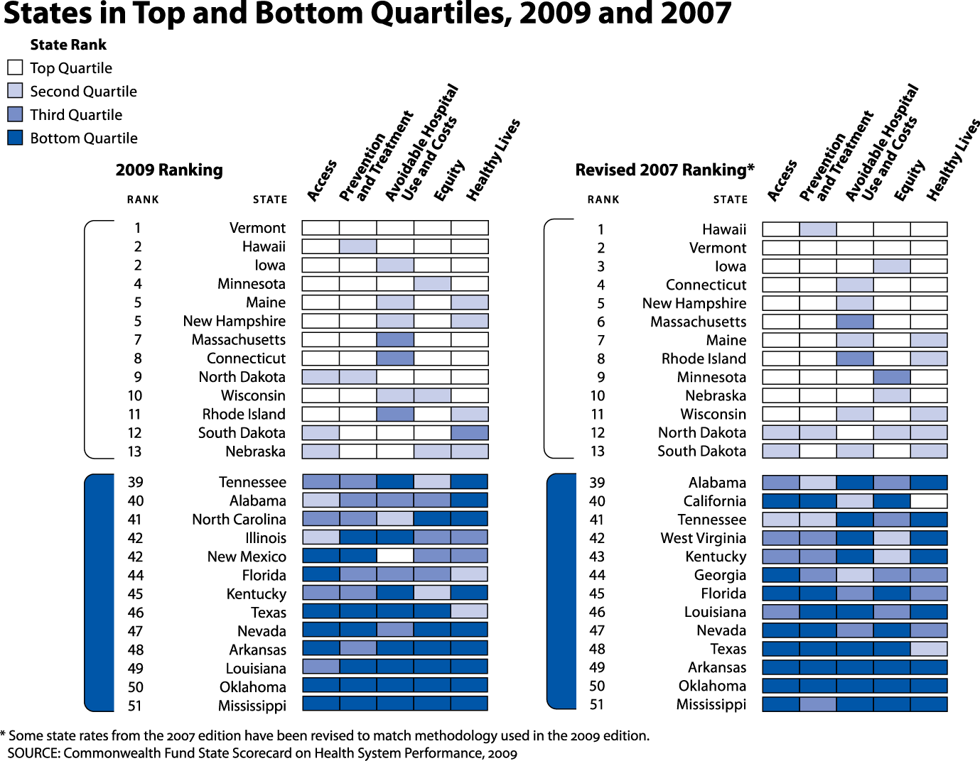

Slide 6
What is the problem?
We have
high quality doctors and hospitals.
an extensive network of safety net clinics
an active and engaged philanthropic community
But . . .
We have a fragmented healthcare system
Payment is tied to seeing more patients in person
Patients see doctors in separate health systems
Safety net clinics are out of main stream

Slide 7
Patient Centered Medical Home the Answer?
National Movement in Health Care Reform
Melds streams of practice innovation:
Primary Care core elements
Relationship-centered care principles
Information Technology
Care Coordination
Chronic Care Model
Payment Reform for primary care
Nutling PA, et al. Initial Lessons From the First National Demonstration Project on Practice Transformation to a Patient-Centered Medical Home ANNALS OF FAMILY MEDICINE; WWW.ANNFAMMED.ORG VOL. 7, NO. 3 MAY/JUNE 2009

Slide 8
The PCMH Movement
An engine for reform in health care delivery, reimbursement, and primary care.
Demonstration projects in payment reform in numerous states supported by professional organizations, major employers, insurers, Medicare, state governments, not-for-profit foundations, and Medicaid.
Nutling PA, et al. Initial Lessons From the First National Demonstration Project on Practice Transformation to a Patient-Centered Medical Home ANNALS OF FAMILY MEDICINE; WWW.ANNFAMMED.ORG VOL. 7, NO. 3 MAY/JUNE 2009

Slide 9
A Network of Patient-Centered Medical Homes will improve the health of Tulsans
Our Vision

Slide 10
OHCA lit a burning platform

Slide 11
Patient-Centered Medical Home Project – 6 months!
Transform the OU Physicians Tulsa into the PCMH model of care for teaching, research, and patient care
Notes:
Presenter: Dr. Clancy
This is our first quarterly PCMH meeting of the year.
The purpose of the meeting is to acknowledge and celebrate our successes, keep momentum with the project, address project risks, issues, and questions, and plan for the upcoming quarter and the remainder of the year.

Slide 12

Patient Centered Medical Home
Sounds nice– but what is it really?
Patient Centered Medical Home
Patient Centered Medical Home
Patient Centered Medical Home
Patient Centered Medical Home
Patient Centered Medical Home
Patient Centered Medical Home
$ Payment $ $ Model $
Care Coordination and Health Information Exchange
Notes:
Soft concept– falls on its own
I (OHCA) need a healthcare delivery system that can accomplish those things– I need you to do a better job of working together

Slide 13
PCMH NCQA Elements
Physician Leadership & Expertise in Quality Innovation
Patient Data Tracking (Registry)
Evidence-Based Standardized Care (Clinician Reminders)
E-Prescribing
Proactive Care Management (Non-Physician Staff)
Test Tracking
Self-Care Support (Non-Physician Staff)
Referral Tracking
Access & Continuity of Care (Communication - Appointments)
EMR

Slide 14
TODAY’S CARE
MEDICAL HOME CARE
My patients are those who make appointments to see me
Our patients are those who are registered in our medical home
Patients’ chief complaints or reasons for visit determines care
We systematically assess all our patients’ health needs to plan care
Care is determined by today’s problem and time available today
Care is determined by a proactive plan to meet patient needs without visits
Care varies by scheduled time and memory or skill of the doctor
Care is standardized according to evidence-based guidelines
Patients are responsible for coordinating their own care
A prepared team of professionals coordinates all patients’ care
I know I deliver high quality care because I’m well trained
We measure our quality and make rapid changes to improve it
Acute care is delivered in the next available appointment and walk-ins
Acute care is delivered by open access and non-visit contacts
It’s up to the patient to tell us what happened to them
We track tests & consultations, and follow-up after ED & hospital
Clinic operations center on meeting the doctor’s needs
A multidisciplinary team works at the top of our licenses to serve patients

Slide 15
Medical Home Teamwork
New roles and responsibilities
Everyone functions at the top of their license
New teamwork roles for students and residents
New work flow
Team meetings for planning and improvement
Continuous training, learning, and improvement
Non-visit “touches” deliver pro-active, planned, coordinated, and integrated care
Data driven work – not visit-driven work
New Approach to quality and safety
Eliminate re-work
Eliminate duplicated effort
Eliminate work-a-rounds

Slide 16
Connectivity Tools
Electronic Medical Record
Reminders, work flow integrated plan, available everywhere
Patient Portal
Call center, electronic web, cell phones, conference calls
Service Portal
Doctor portal for consultation and referral tracking
Lab, X-ray and Prescription Portal
Network Data Warehouse (Registry)
Care management: prevention & high risk patients
Quality measurement and reporting.
Payer Portal

Slide 17
MEDICAL HOME CARE
OU’S TRANSFORMATION
Our patients are those who are registered in our medical home
Medical Home Member Agreement
We systematically assess all our patients’ health needs to plan care
Annual Health Needs Assessment
Care is determined by a proactive plan to meet patient needs without visits
Registry: Proactive Plan/Reminders
Care is standardized according to evidence-based guidelines
EMR templates – Practice Policies
A prepared team of professionals coordinates all patients’ care
Team meetings – Role expansion
We measure our quality and make rapid changes to improve it
Quality reports – Lean-six sigma
Acute care is delivered by open access and non-visit contacts
Today slots – In-/Out-bound Phone
We track tests & consultations, and follow-up after ED & hospital
E-Lab track, Doc2Doc, High Users
A multidisciplinary team works at the top of our licenses to serve patients
Docs, Nurses, SW, Pharm D

Slide 18
OHCA Specifics – Tier 1 PCMH
Primary care & Prevention services
Immunizations
Organized clinical data
Medication lists
Administration functions for billing
Tracks & Follow-up tests/x-rays with patient
Tracks referrals until completed
PCP continuity & specialist coordination

Slide 19
OHCA Specifics – Tier 2
Accepts electronic data from Health Care Authority
24/7 voice contact, triage, on-call professional
Extended hours
Use PCMH agreement with patients
Use OCHA data for proactive planning services
Continuity of care for acute visits
Behavior health and substance abuse screening
Use variety of forms of communication with patients
Tracks care received in ER/Hosp/Others – use case management registry

Slide 20
OHCA Specifics – Tier 3
Health care team led by a primary care physician
Medication reconciliation
Use health assessment tools to identify patients’ needs
Personalized screening process
Evidence based prevention/chronic care guidelines
Measure performance & quality improvement action
Use Sooner Care management program
Trains staff in care management roles
Document patient self-care support
Available at least 4 after-hours per week
Integrated care plan for patient co-management
Interactive web-based patient portal

Slide 21
What does Tier 1 need to get to Tier3?
Care management support
Tools for care coordination
Social services
Help getting patients into specialty care
Practice optimization help
EMR implementation help
View of big picture
Data and analytics

Slide 22

Birth of a Health Access Network
Choose 3 organizations in the state to provide extra services to networks of doctors
Reduce costs
Improve access to specialty services
Enhance coordination of care
Improve the health status of communities
Reduce health disparities in communities
Pay the networks an additional fee for all patients in their networks

Slide 23
The Sooner Health Access Network
Care management:
working with PCMH’s to improve patient health at a population level
Secure communication:
Between providers and patients
Advanced health care analytics:
Data to support intelligent care delivery
Care coordination:
“flight control” for patients who see multiple doctors and hospitals

Slide 24
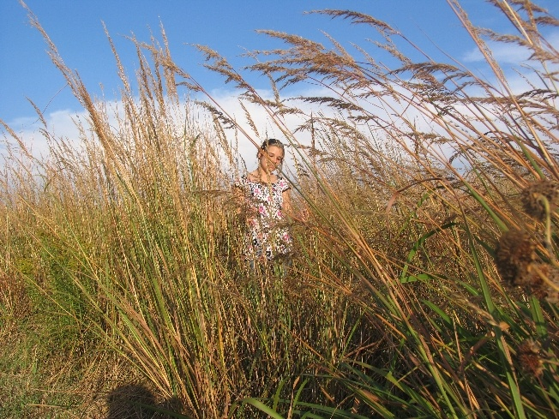
Lost in the tall grass

Slide 25
Lesions from National PCMH Pilots
Becoming a PCMH Requires Transformation
Epic whole-practice re-imagination and redesign.
Transformation is a Developmental Process
Transformation is a Local Process
Requires Personal Transformation of Physicians
Technology is Not Plug and Play
Change Fatigue is a Serious Concern
Nutling PA, et al. Initial Lessons From the First National Demonstration Project on Practice Transformation to a Patient-Centered Medical Home ANNALS OF FAMILY MEDICINE; WWW.ANNFAMMED.ORG VOL. 7, NO. 3 MAY/JUNE 2009

Slide 26
Learning Organization
Transformation means becoming a learning organization to co-create an emergent future rather than to learn how to build something already known.
Learning organizations challenge the conventional expert model that expects consultants to come with external expertise and simply fix problems.
Nutling PA, et al. Initial Lessons From the First National Demonstration Project on Practice Transformation to a Patient-Centered Medical Home ANNALS OF FAMILY MEDICINE; WWW.ANNFAMMED.ORG VOL. 7, NO. 3 MAY/JUNE 2009

Slide 27
What have we learned?
We can be a “learning organization”
We have not, but can, document our work processes to know what we do
Front-line input to clinical and business procedures is essential!
Every good idea has unintended consequences
Changing work means people changing and using technology

Slide 28
Leadership Keeps Vision
Competing leadership signals
External priorities
Change is human – not technological
Supporting pain of transformation
Appreciation
Repeated clear message: “We can do this! We must do this!”
Excitement about the emerging future

Slide 29
Questions, Comments, Feedback
Notes:
Presenter: Dr. Duffy

