Slide 1

Insure
Oklahoma
May 2025

Slide 2

Disclaimer
Insure Oklahoma policy is subject to change without notice.
The information included is current as of May 1, 2025.
Current program information can be found on our website at InsureOklahoma.org.

Slide 3

What you will learn
Background
How it Works
Employers
Employees
Employee Enrollment
Renewals
Questions
College Students
Spouses & Children

Slide 4
BACKGROUND OF INSURE OKLAHOMA

Slide 5
WHY WAS INSURE OKLAHOMA CREATED?
In April 2004, Senate Bill 1546 authorized OHCA to develop a program assisting employees of small businesses.
In November 2004, the Oklahoma Health Care Initiative created the funding mechanism to make a program like this possible.
Oklahoma voters passed SQ713 which increased the sales tax on tobacco products. A portion of the revenues were designated to fund the new health program.

Slide 6
WHAT IS INSURE OKLAHOMA?
An innovative program created to bridge the gap in health care coverage for low-income working adults.
Under the Employer-Sponsored Insurance (ESI) program, premium costs are shared by the State (60%), the Employer (25%) and the Employee (15%).

Slide 7
How does INSURE OKLAHOMA work?

Slide 8

What is Employer-sponsored insurance?
Qualified Employee
Qualified Employer
Qualified Benefit Plan
Notes:
What makes up ESI, there are 3 parts:
Qualified employer
Located in Oklahoma
250 or fewer employees and 500 or fewer employees for non-profit employers
Employers must apply and offer a qualified benefit plan(QBP)
Qualified benefit plan
OHCA approved plan from a public carrier called a qualified benefit plan(QBP)
Employer/Small business agrees to purchase for employees
Qualified employee
Ages 19-64
Must live in Oklahoma
Meet income guidelines 200% Federal Poverty Level (FPL)
Must work the eligible hours set by their employer
No Medicaid or Medicare

Slide 9
ESI Contributions
*Employers are not required to contribute to dependent(s) premiums
Notes:
-employees pay 3% of HH income or 15%, which ever is less
-employers pay 25%
-IO pays 60% or more

Slide 10
Qualified employers

Slide 11




How does an employer qualify?
Located in Oklahoma
250 or fewer employees (for-profit) or 500 or fewer employees (not-for-profit)
Apply for or already offer qualified benefit plan (QBP) with the 1st of the month billing
Willing to pay 25% of employee premium

Slide 12

What is a qualified Benefit Plan?
Must cover hospital, lab, physician, X-ray and pharmacy services
Maximum out-of-pocket: $3,000
Maximum office visit copay: $50
Maximum pharmacy deductible: $500
Must be through an Insure Oklahoma contracted carrier

Slide 13
Who are Contracted Carriers?
Advantage Health Plans – MEWA, Financial Institutions Only
Aetna Health, Inc.
Allied National Companies (AAIC)
BlueCross BlueShield
Community
Care
Coventry Health and Life Insurance Company
Municipal Health Solutions, LLC
Oklahoma State Medical Association
United Health Care

Slide 14

How does an employer Apply?
Apply online at InsureOklahoma.org.
Paper application (also available for download on the website).
Coverage begins the 1st of the month after approval.

Slide 15

documents
Business or Federal Employer Identification Number (FEIN)
Business demographic information
Staff listing (with Social Security numbers)
EFT information for subsidy payments
Rate Sheet and SBC from carrier
Sign employer agreement

Slide 16
employer renewal
Employer renewals happen automatically every 12 months.
Insure Oklahoma may request documentation for verification, if necessary, such as payroll reports or OESC documentation.
Employer must submit new two-page employer application if they change benefit plans and include rates and SBC.
Employer is responsible for sending in renewal rates every year if they stay on the same plan.

Slide 17
Qualified employees and dependents

Slide 18
Criteria
Ages
19-64
Must be employed with a qualified employer
Must live in Oklahoma
Meet
income guidelines between 138% & 200% of Federal Poverty Level (FPL)
Must work the eligible hours set by their employer
Must not qualify for
or be on Medicaid or Medicare

Slide 19

spouses
Ages 19-64
Must live in Oklahoma
If employed, must be part time if a large employer (over 250 employees)
Must meet income guidelines (between 138% and 200% of Federal Poverty Level)
Must not qualify for or be on Medicaid or Medicare

Slide 20

children
Ages 0-18
Must not qualify for SoonerCare
If child qualifies for SoonerCare, can have other coverage but IO will not subsidize
Must not qualify for or be on Medicare

Slide 21
Qualified COLLEGE STUDENTS

Slide 22

Who qualifies?
Ages 19-22
Must attend an accredited Oklahoma college
Full time status
Must supply a current signed FAFSA and current class schedule
All household income counts
Notes:
-FAFSA Free Application for Federal Student Aid

Slide 23
Qualified College Student
The college student must be deemed a dependent of their parents(s) according to the Free Application for Federal Student Aide (FAFSA) program.
The family household income must meet the income guidelines for Insure Oklahoma.
Insure Oklahoma will subsidize 85% of the premium for the college student covered under the parent’s insurance plan.

Slide 24
Employee renewals
Employee's will need to renew their application
every 11 months.
Any changes in the household need to be reported
or updated within 10 days of the change.
Insure Oklahoma may request documentation for verification if necessary.
.

Slide 25
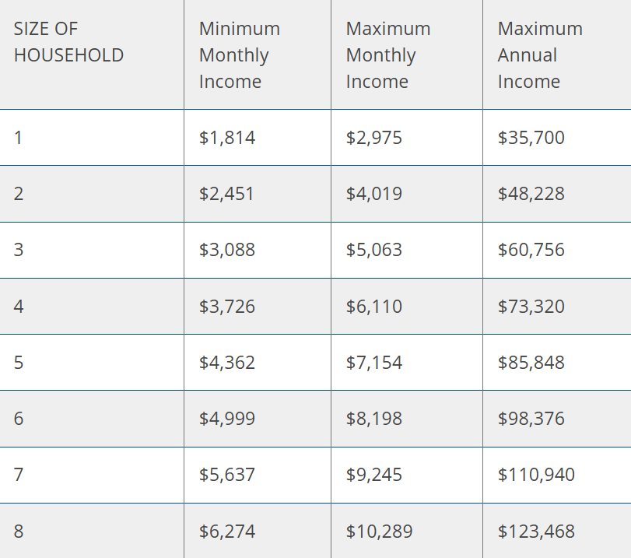
INSURE OKLAHOMA INCOME GUIDELINES
4/1/2025

Slide 26

Insure Oklahoma Helpline: 888-365-3742
Helpline Hours: Monday to Friday 8 a.m.-5 p.m. CST
(Closed on Thursdays 8 a.m.-10:30 a.m.)
Email: Insureok@okhca.org
Website: InsureOklahoma.org

