Slide 1




WELCOME
May 29, 2024
We will begin shortly.
Please mute yourself.
Save questions until end of presentation:
  Use the chat feature.
  Raise your hand.

Slide 2
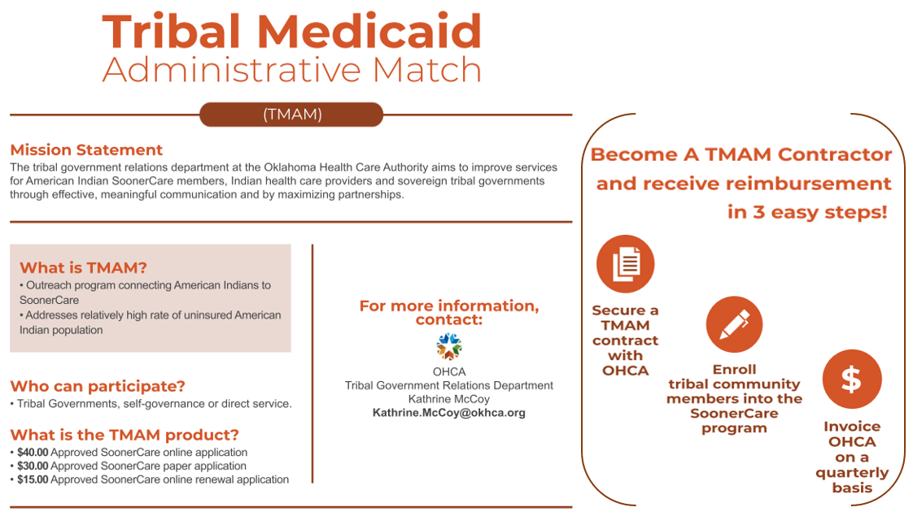
WELCOME
May 29, 2024
We will begin shortly.
Please mute yourself.
Save questions until end of presentation:
  Use the chat feature.
  Raise your hand.

Slide 3


WELCOME
May 29, 2024
We will begin shortly.
Please mute yourself.
Save questions until end of presentation:
  Use the chat feature.
  Raise your hand.

Slide 4

WELCOME
May 29, 2024
We will begin shortly.
Please mute yourself.
Save questions until end of presentation:
  Use the chat feature.
  Raise your hand.

Slide 5


WELCOME
May 29, 2024
We will begin shortly.
Please mute yourself.
Save questions until end of presentation:
  Use the chat feature.
  Raise your hand.

Slide 6

WELCOME
May 29, 2024
We will begin shortly.
Please mute yourself.
Save questions until end of presentation:
  Use the chat feature.
  Raise your hand.

Slide 7
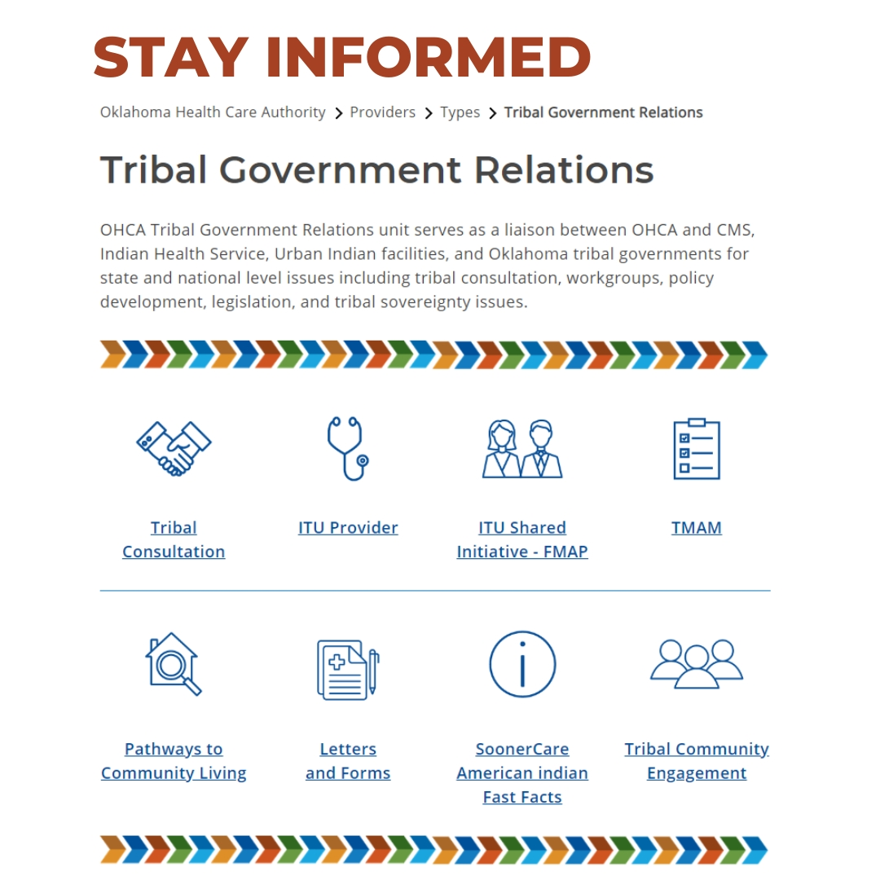
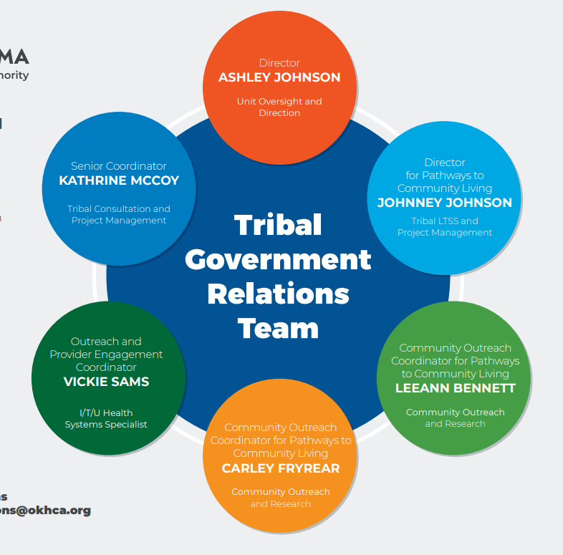
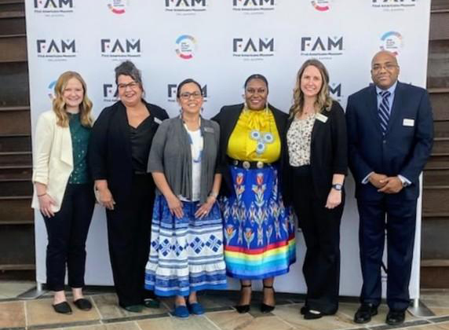
WELCOME
May 29, 2024
We will begin shortly.
Please mute yourself.
Save questions until end of presentation:
  Use the chat feature.
  Raise your hand.

Slide 8
DISCLAIMER
This presentation was compiled by the OHCA Tribal Government Relations Department.
The information contained within this presentation is intended as a reference only and is current as of May 2024. Content is subject to change.
    Stay current with up-to-date information on the OHCA website: Oklahoma.gov/ohca/tribal-relations.
8 | OKLAHOMA HEALTH CARE AUTHORITY

Slide 9
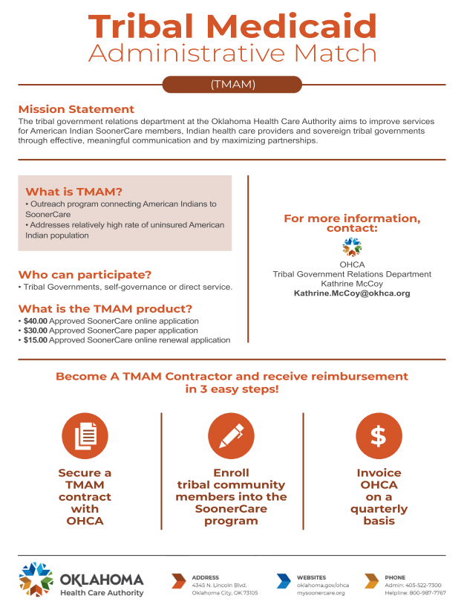
AGENDA
SoonerCare 101
Tribal Government Relations
TMAM
  Program
  Participation Requirements
  Product
  Required Documentation
  Invoice Submissions
  Verification of Invoice
  State Share Bill Back
  Benefits
  Reminders
  Connect
  Questions
9 | OKLAHOMA HEALTH CARE AUTHORITY
9| OKLAHOMA HEALTH CARE AUTHORITY

Slide 10
SOONERCARE 101

Slide 11
SOONERCARE 101
What is SoonerCare?
  SoonerCare (Oklahoma Medicaid, Title XIX) is a health coverage program jointly funded by the federal and state government.
  This program covers medical expenses for certain groups of people who have limited income and resources.
  The Oklahoma Health Care Authority is the state agency that administers the program.
11 | OKLAHOMA HEALTH CARE AUTHORITY
11| OKLAHOMA HEALTH CARE AUTHORITY

Slide 12

SOONERCARE 101
Who Qualifies for SoonerCare?
Reside in Oklahoma
Be a U.S. citizen or qualified alien
Meet financial income and resources standards
12 | OKLAHOMA HEALTH CARE AUTHORITY
12| OKLAHOMA HEALTH CARE AUTHORITY
This Photo by Unknown Author is licensed under CC BY-SA

Slide 13

SOONERCARE 101
Who is Eligible for SoonerCare?
Adults with children under 19
Children under 19 and pregnant women
Adults, not eligible for Medicare, ages 19-64
Individuals ages 65 and older
Individuals who are blind or who have disabilities
13 | OKLAHOMA HEALTH CARE AUTHORITY
13| OKLAHOMA HEALTH CARE AUTHORITY

Slide 14
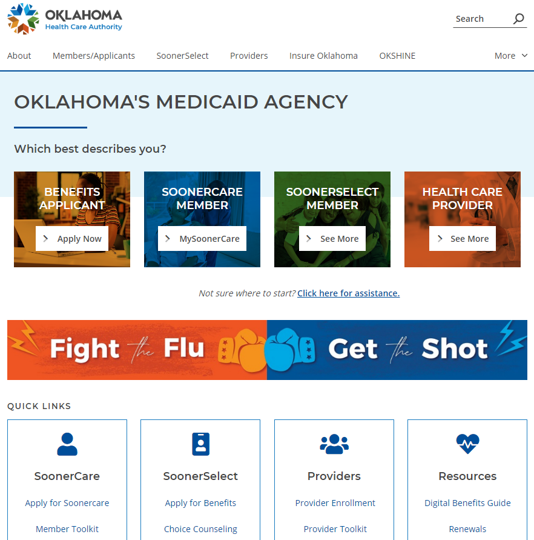
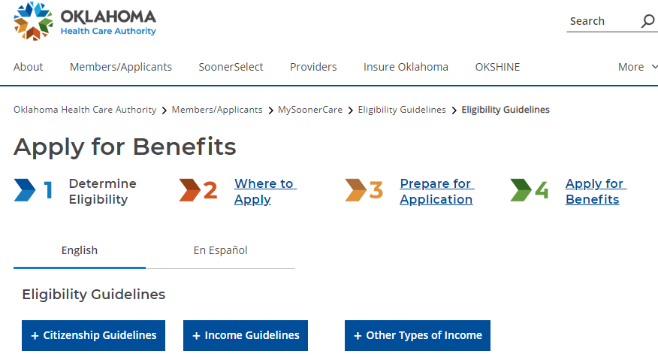
SOONERCARE 101
For a full list of eligibility guidelines, please visit our website.
14 | OKLAHOMA HEALTH CARE AUTHORITY
14| OKLAHOMA HEALTH CARE AUTHORITY

Slide 15
TRIBAL GOVERNMENT RELATIONS

Slide 16

TRIBAL GOVERNMENT RELATIONS
MISSION:
To create and promote collaborative relationships among the Oklahoma Health Care Authority, tribal health care stakeholders, sovereign tribal governments, federal agencies and nontraditional partners through meaningful communication. We strive to maximize partnerships to achieve shared goals and improve the health outcomes of Oklahomans.
16| OKLAHOMA HEALTH CARE AUTHORITY
16| OKLAHOMA HEALTH CARE AUTHORITY

Slide 17


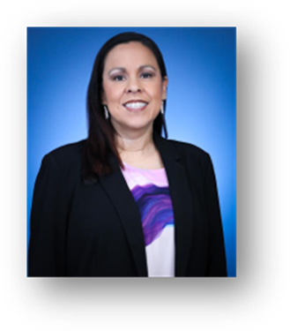
TRIBAL GOVERNMENT RELATIONS
PURPOSE AND FUNCTION:
Agency Subject Matter Expertise
  Informed on national tribal health care trends and issues.
Tribal Consultation
  Proposed Rule, State Plan, Waiver and Rate Amendments.
Tribal Health Network Support
  Onsite or virtual trainings.
Community Engagement
  Partner support at tribal health fairs and events.
Ashley Johnson
Director
Vickie Sams
Outreach & Provider
Engagement Coordinator
Kathrine McCoy
Senior Coordinator
17| OKLAHOMA HEALTH CARE AUTHORITY
17| OKLAHOMA HEALTH CARE AUTHORITY

Slide 18
TMAM
(TRIBAL MEDICAID
ADMINISTRATIVE MATCH)

Slide 19
TMAM PROGRAM
What is OK TMAM?
The Tribal Medicaid Administrative Match Program (TMAM) is a targeted initiative that seeks to address the relatively high rates of uninsured American Indians/Alaskan Natives (AI/AN). The program is designed to provide reimbursement to tribal enrollment partners who process new and renewed applications for SoonerCare members. The primary objective of TMAM is to reduce the number of uninsured American Indians/Alaskan Natives (AI/AN) individuals and improve access to health care services.
19 | OKLAHOMA HEALTH CARE AUTHORITY

Slide 20
TMAM PARTICIPATION REQUIREMENTS — Contractor
What is a tribal contractor?
It is a tribal organization carrying out health programs of the Indian Health Services (IHS), including health services which are eligible for reimbursement by Medicaid, under a contract or compact entered into between the tribal organization and the IHS pursuant to the Indian Self-Determination and Education Assistance Act (ISDEAA), P.L.93-638.
20 | OKLAHOMA HEALTH CARE AUTHORITY

Slide 21
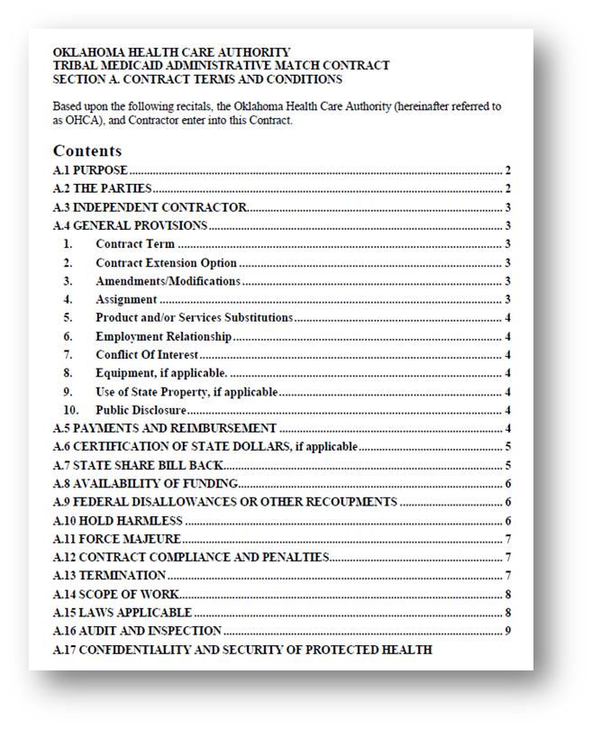
TMAM PARTICIPATION REQUIREMENTS — Contract
Signed contract between Oklahoma Health Care Authority (OHCA) and tribal contractor.
Contract shall begin on last date on which both parties has signed and expire on June 30, 2024, with an option to renew for one additional year.
21 | OKLAHOMA HEALTH CARE AUTHORITY

Slide 22
TMAM PRODUCT
What is the OK TMAM product?
Once a tribe has an approved OK TMAM contract, they are eligible to receive payment for the following:
  $40 Approved SoonerCare online application
  $30 Approved SoonerCare paper application
  $15 Approved SoonerCare online renewal application
  The application is located at MySoonerCare.org. There is no contract needed to access the website application.
22 | OKLAHOMA HEALTH CARE AUTHORITY

Slide 23
TMAM PRODUCT
APPROVED ONLINE APPLICATIONS (OA)
  You can submit applications through Home View.
    Visit OHCA’s public website at MySoonerCare.org.
  You can submit applications through Agency View if you are a contracted partner.
    Only an approved agency-view contracted partner may access a secure agency portal and input a new application or retrieve an existing saved or previously submitted application.
  Health Insurance Marketplace (HIM) application(s) resulting in a SoonerCare approval for an individual or family shall also be claimed for OK TMAM.
23 | OKLAHOMA HEALTH CARE AUTHORITY

Slide 24
TMAM PRODUCT
  APPROVED PAPER APPLICATIONS (PA)
  Paper applications are located at MySoonerCare.org.
  Although paper applications are accepted, OHCA strongly encourages OK TMAM contractors to utilize the online application system.
  APPROVED ONLINE RENEWAL (RNWL)
  SoonerCare renewal applications will only be accepted online.
  The individual had SoonerCare coverage within the last 30 days.
24 | OKLAHOMA HEALTH CARE AUTHORITY

Slide 25

TMAM PRODUCT
NEW APPLICATIONS
  Individual has NOT had SoonerCare coverage within the last 30 days.
  Individual moving from one program to another with a separate application.
  Individuals being added to an existing application (e.g., newborns).
RENEWAL
  Individual had SoonerCare coverage within the last 30 days.
  Individual moving from one program to another with the same application.
25 | OKLAHOMA HEALTH CARE AUTHORITY

Slide 26
TMAM REQUIRED DOCUMENTATION
Attachment A
PDF Invoice With Correct Dollar Amounts
ATTACHMENT B
Excel Worksheet With Required Fields Completed
26 | OKLAHOMA HEALTH CARE AUTHORITY

Slide 27
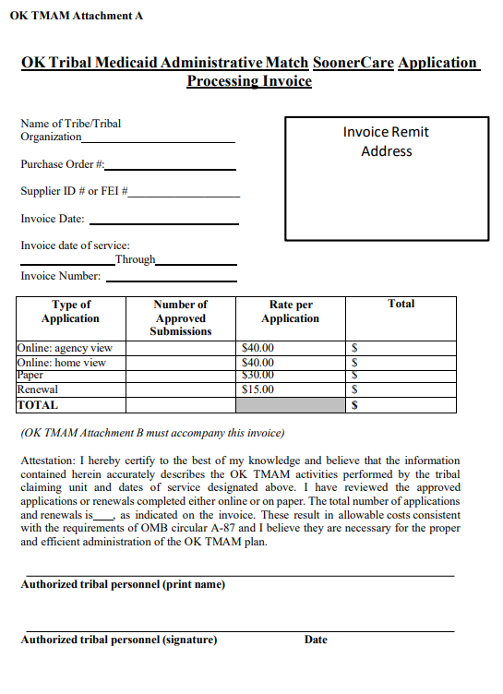
TMAM REQUIRED DOCUMENTATION
ATTACHMENT A
Submit a proper invoice for services rendered.
Fill in all lines and boxes.
List the Number of Approved Submissions and enter the Total Dollar Amount.
Print, Sign, Date and submit Attachment A (invoice PDF) via email to Contracts@okhca.org.
Modified or altered invoices will not be accepted!
27 | OKLAHOMA HEALTH CARE AUTHORITY

Slide 28
TMAM REQUIRED DOCUMENTATION
ATTACHMENT A
One SoonerCare application can cover multiple household members, but OHCA will only pay for one application per household.
Invoice with correct dollar amounts.
Invoice numbers cannot be the same as a previously submitted invoice number.
  Example of correct invoice numbering by the contractor: 2023-3, 2023-4, 2024-1, 2024-2
Fiscal year begins July 1.
28 | OKLAHOMA HEALTH CARE AUTHORITY

Slide 29
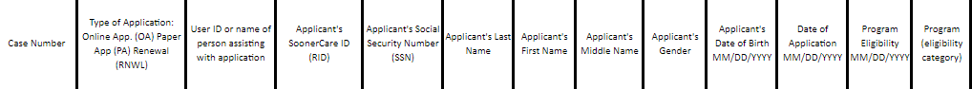
TMAM REQUIRED DOCUMENTATION
ATTACHMENT B
Request a secure link from kathrine.mccoy@okhca.org. Upon receipt of the secure and encrypted email, insert Attachment B (Excel sheet) and send.
Other formats NOT accepted include PDF, Word, Outlook, JPEG, GIF.
All fields must be populated in the correct format, or the submission may be deemed invalid. Transposed numbers, typos and other errors will render the entry invalid.
29 | OKLAHOMA HEALTH CARE AUTHORITY

Slide 30
TMAM REQUIRED DOCUMENTATION
ATTACHMENT B
Attachment B is located on the OHCA Tribal Relations webpage: oklahoma.gov/ohca/tribal-relations.
Only one Attachment B is accepted per invoice per quarter claimed.
Modified or altered formats of Attachment B will not be accepted.
Do not leave any blank fields, as they could result in nonpayment.
Hint: Lock Excel sheet while using; unlock when sending to OHCA.
30 | OKLAHOMA HEALTH CARE AUTHORITY

Slide 31
TMAM INVOICE SUBMISSIONS
When submitting TMAM invoice:
Only one invoice (Attachment A - PDF) per tribe will be accepted by OHCA each quarter.
No opportunity to correct invoice once received by OHCA.
Application dates need to be within the quarter claimed.
Invoices submitted to OHCA more than 90 days past the last day of claiming quarter will not be accepted and will be returned as invalid.
Email invoice (Attachment A - PDF) to Contracts@okhca.org.
31 | OKLAHOMA HEALTH CARE AUTHORITY

Slide 32

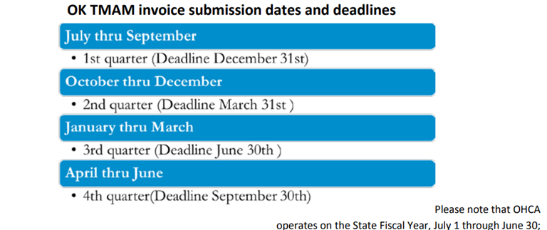
TMAM INVOICE SUBMISSIONS
INVOICE SUBMISSION DATES and DEADLINES
32 | OKLAHOMA HEALTH CARE AUTHORITY

Slide 33
TMAM VERIFICATION OF INVOICE
OHCA will verify all new or renewed applications.
Applications that are not verifiable by OHCA will result in a deduction from the claimed amount on the invoice.
The dollar amount stated from OHCA is accurate and final.
To accept the final invoice amount, please reply to our secure email with the exact phrase, “I approve the invoice amount for $$$$.”
33 | OKLAHOMA HEALTH CARE AUTHORITY

Slide 34
STATE SHARE BILL BACK
OHCA’S Finance Department will bill the tribal contractor quarterly for the state share; 25% of total payment received.
Payment must be received by OHCA within 30 days. If the state share funds are not paid within 30 days, then OHCA will pay no further invoices until the state share funds have been received.
If the TMAM point of contact changes, contractor must notify OHCA immediately.
Note: All emails containing PHI must be sent securely.
34 | OKLAHOMA HEALTH CARE AUTHORITY

Slide 35
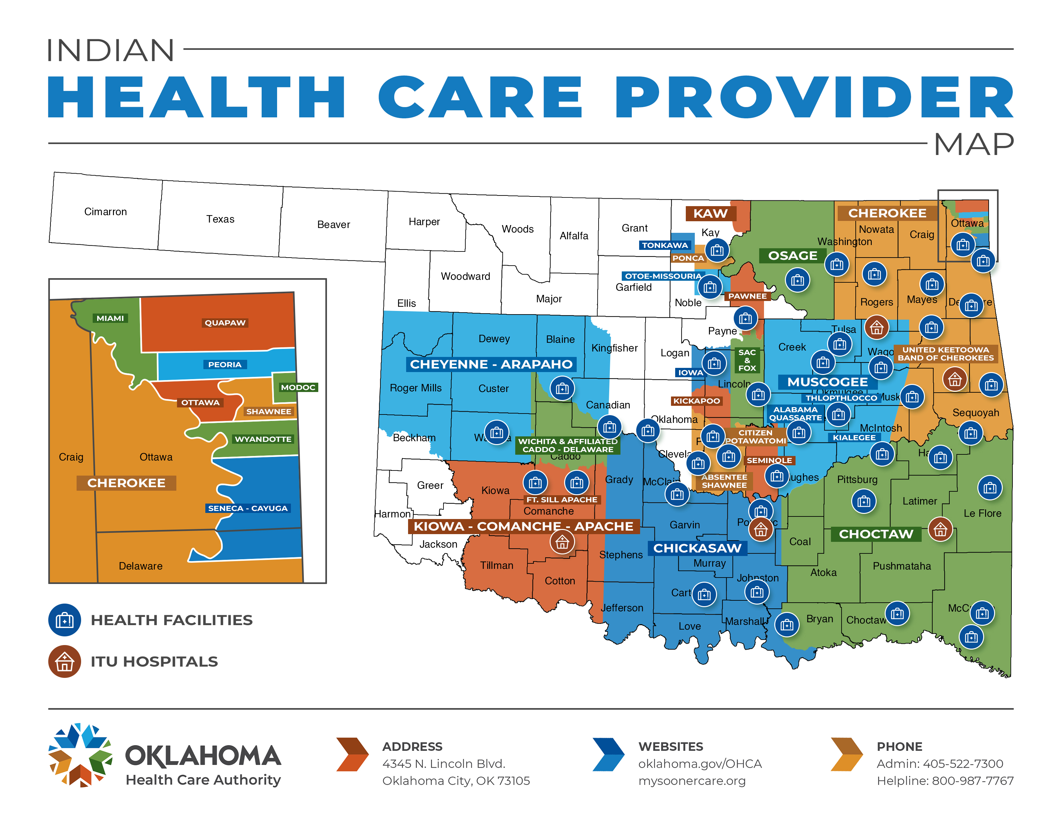
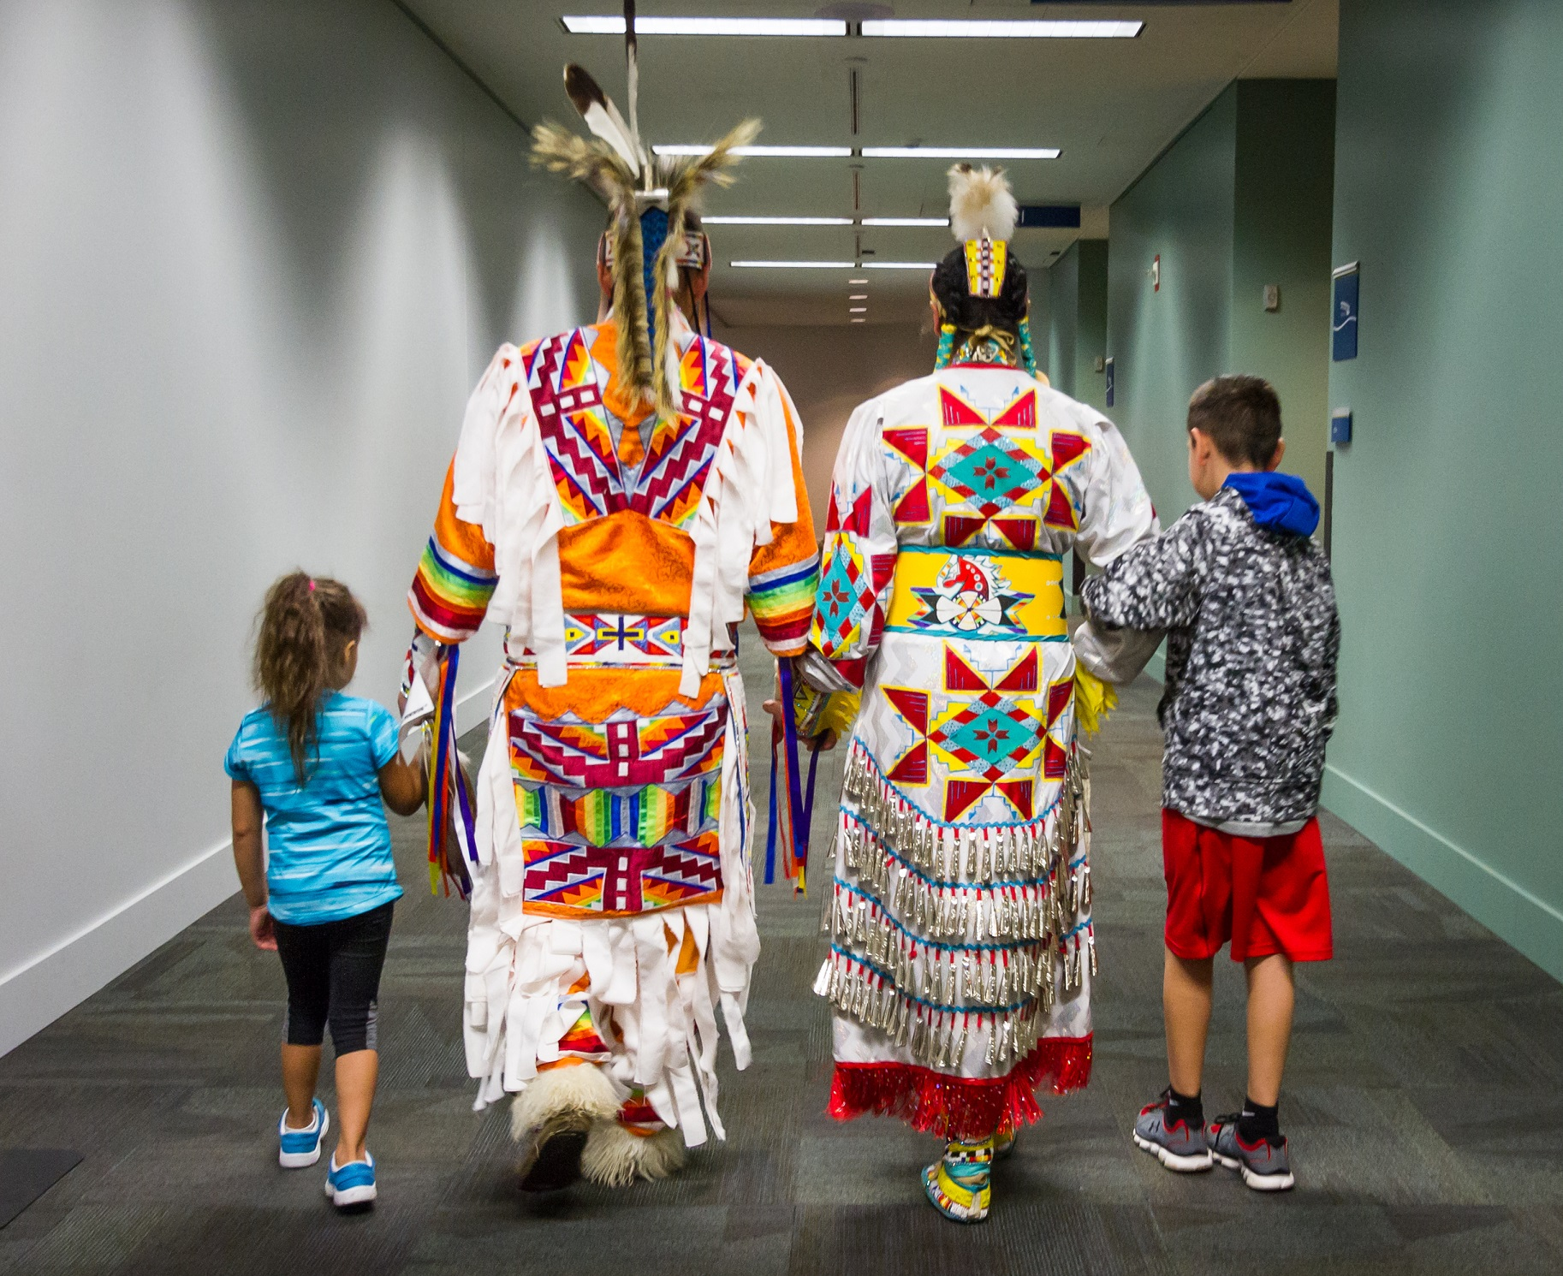
TMAM BENEFITS
Pour those dollars right back into your health system.
35 | OKLAHOMA HEALTH CARE AUTHORITY

Slide 36

TMAM REMINDERS
Tribe must notify OHCA regarding any TMAM staff changes.
Submit Attachment A (invoice PDF) to Contracts@okhca.org.
Request a secure link from kathrine.mccoy@okhca.org. Upon receipt of the secure and encrypted email, insert Attachment B (excel sheet) and send.
Invoice to include application dates within the quarter claimed.
One SoonerCare application can cover multiple household members, but OHCA will only pay for one application per household.
TMAM resources are available at: oklahoma.gov/ohca/tribal-relations.
36 | OKLAHOMA HEALTH CARE AUTHORITY
36| OKLAHOMA HEALTH CARE AUTHORITY

Slide 37

TMAM CONNECT
Can your tribe benefit from additional revenue?
Let's discuss the next steps in becoming a TMAM partner.
Connect with me: kathrine.mccoy@okhca.org
37 | OKLAHOMA HEALTH CARE AUTHORITY
37| OKLAHOMA HEALTH CARE AUTHORITY

Slide 38

QUESTIONS
38 | OKLAHOMA HEALTH CARE AUTHORITY

Slide 39




Ashley Johnson, Tribal Relations Director
Ashley.Johnson@okhca.org
Kathrine McCoy, Tribal Government Relations Senior Coordinator
Kathrine.Mccoy@okhca.org
Vickie Sams, Tribal Government Relations Outreach and Provider Engagement Coordinator
Vickie.Sams@okhca.org
https://oklahoma.gov/ohca.html
4345 N. Lincoln Blvd.
Oklahoma City, OK 73105
oklahoma.gov/ohca
MySoonerCare.org
Agency: 405-522-7300
Helpline: 800-987-7767
39 | OKLAHOMA HEALTH CARE AUTHORITY

Slide 40
THANK YOU

