Slide 1

Soonerselect dental
Getting Started and Preparedness for Day One
January 2024

Slide 2
disclaimer
SoonerCare policy is subject to change.
The information included in this presentation is current as of January 2024.
Current information can be found on the OHCA public website: www.Oklahoma.gov/ohca.

Slide 3
Class Description
This class will provide you with the tools you need to be successful during the transition and implementation of the SoonerSelect dental program.
Recommended audience: All SoonerCare dental providers and staff.

Slide 4
Agenda
What providers need to know:
  Provider checklist
  Contracting information
  Contact information
  Tribal Provider information
  Verification of member eligibility and dental plan
  Prior authorizations
  Claims
  Continuity of care
  Assistance for members with transition to SoonerSelect
Resources
Questions

Slide 5
Provider checklist

Slide 6
Provider checklist
To continue serving all SoonerCare members who transition to SoonerSelect, providers should complete the following as soon as possible prior to go-live:
Review & execute contracts with either or both SoonerSelect dental plans, which are DentaQuest and LIBERTY Dental.
Review DentaQuest’s and LIBERTY Dental’s benefits and extra benefits.
Review your provider information with each SoonerSelect dental plan for accuracy. Submit changes to the dental plan if information is incorrect or inaccurate.
Review “Day 1: SoonerSelect Dental Program Provider Quick Reference Guide” for information to know on the first day of SoonerSelect dental program launch.
Encourage their patients enrolled in SoonerSelect dental to select a Primary Care Dentist (PCD) by contacting their dental plan.

Slide 7
Contracting information

Slide 8
Contracting information
OHCA encourages all dental providers to contract with both DentaQuest and LIBERTY Dental to continue serving all SoonerCare members who transition to SoonerSelect.
Contact the dental plans for more information on provider contracting.
DentaQuest Provider Network Development: 855-873-1283 | DentaQuest.com | NetworkDevelopment@DentaQuest.com
LIBERTY Dental Provider Network Development: 888-902-0342 | LibertyDentalPlan.com | okprinquiries@libertydentalplan.com

Slide 9
Contact information

Slide 10
Contact information
It is important that all provider contact information is accurate for SoonerSelect dental members. Providers should confirm that their contact information, practice and affiliation is correctly listed with DentaQuest and LIBERTY Dental prior to February 1, 2024.
Incorrect or missing information may impact a member’s ability to choose you as their PCD or find you for services. Please review your information directly with each dental plan.
DentaQuest: 833-479-1007 | DentaQuest.com | DentaQuest Provider Portal
LIBERTY Dental: 888-902-0342 | LibertyDentalPlan.com | LIBERTY Dental Plan Provider Portal

Slide 11
tribAL PROVIDER INFORMATION

Slide 12
Tribal provider information
OHCA will reimburse claims for services provided by Indian Health Care Providers (IHCPs). IHCPs should submit all claims directly to OHCA for reimbursement for SoonerSelect dental members.
For more information, please contact the OHCA Tribal Government Relations team at: TribalGovernmentRelations@okhca.org.

Slide 13
Verification of member eligibility and dental plan

Slide 14
verification
OHCA offers two methods of confirming member eligibility and dental plan – the online provider portal and the OHCA Provider Helpline.
On the provider portal, providers will be able to identify that a member is enrolled in SoonerSelect dental by looking under the Coverage Section. SoonerDental indicates SoonerSelect dental.
Temporarily, the SoonerSelect dental plan assignments for members will not be visible online. OHCA is diligently working to update our secure provider portal eligibility screen so that providers may verify member eligibility information electronically. OHCA will notify providers when this information is available via global message. Providers can also call the OHCA Provider Helpline at 800-522-0114, option 1 to verify member eligibility and dental plan assignment.

Slide 15
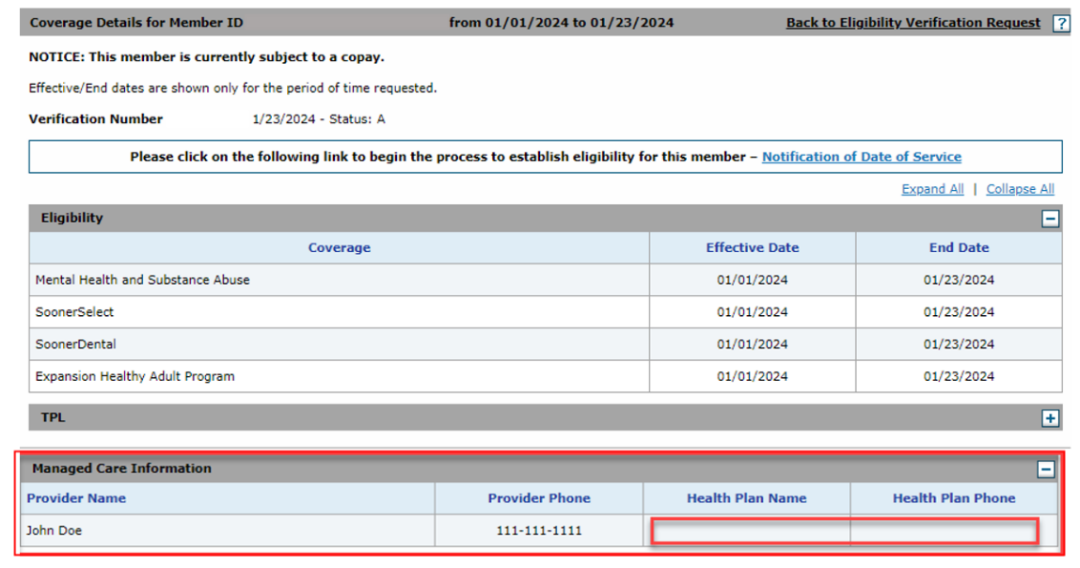

Slide 16
Id cards
Providers may ask the member for their dental plan ID card, which will display the dental plan in which the member is enrolled. Examples of SoonerSelect dental member ID cards are below. If the member does not have their ID card, members can log onto the MySoonerCare.org member portal to see their dental plan assignment.

Slide 17
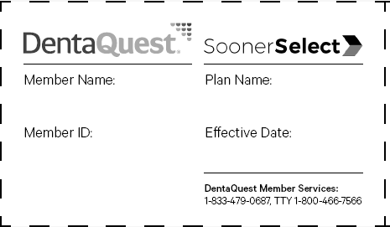
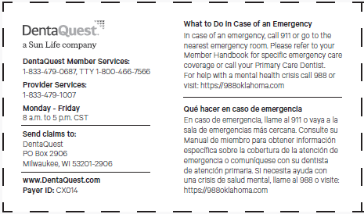
Dentaquest example member id card

Slide 18
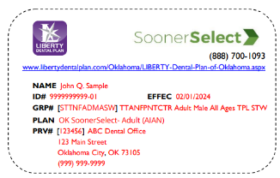
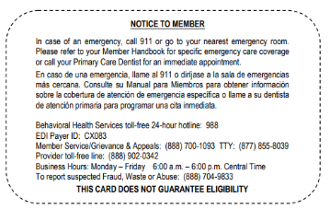
Liberty DENTAL example member id card

Slide 19
Prior authorizations

Slide 20
Prior authorizations
Members will have a 90-day period to ensure continuity of care where any services with a prior authorization (PA) under SoonerCare will be honored. DentaQuest and LIBERTY Dental Plan will process PAs through their internal processes and secure provider portals. Please directly contact the dental plans for training needs or questions on PAs.
DentaQuest: 833-479-1007 | DentaQuest.com | DentaQuest Provider Portal
LIBERTY Dental: 888-902-0342 | LibertyDentalPlan.com | LIBERTY Dental Plan Provider Portal

Slide 21
claims

Slide 22
claims
DentaQuest and LIBERTY Dental will process claims through their internal processes and secure provider portals. Please directly contact the dental plans for training needs or questions on claims.
DentaQuest: 833-479-1007 | DentaQuest.com | DentaQuest Provider Portal
LIBERTY Dental: 888=902-0342 | LibertyDentalPlan.com | LIBERTY Dental Plan Provider Portal

Slide 23
Continuity of care

Slide 24
Continuity of care
If a patient is a SoonerSelect Dental member and the provider is not currently contracted with the member’s SoonerSelect dental plan, the provider must:
Notify the member that they can only provide services for up to 90 calendar days.
Follow the dental plan’s guidelines and procedures for out-of-network care during the 90-day period.
Note that payments to dental providers that have not yet contracted with dental plans will be made at the current Medicaid fee schedule rate.
For questions specific to each SoonerSelect Dental plan, please contact the plan directly. For general SoonerSelect provider questions, providers may contact the OHCA Provider Helpline at 800-522-0114.

Slide 25
Assistance for members with transition to soonerselect

Slide 26
Assistance for members
All members had an opportunity to pick a SoonerSelect dental plan. Members who did not make an active selection were assigned a dental plan.
Members have 90 calendar days (until May 1, 2024) if they wish to change dental plans. Providers cannot select or change a SoonerSelect dental plan on behalf of a member.
Members should log on to MySoonerCare.org to change their dental plan or contact the OHCA Member Choice Counseling Hotline at 800-987-7767, Option 5.
Members will have a 90-day period to ensure continuity of care where any services with a prior authorization (PA) under SoonerCare will be honored.

Slide 27
Assistance for members
Members may ask providers questions about SoonerSelect dental. Members can contact their dental plan directly with any questions about their services, their PCD, in-network providers, PAs, or care management.
DentaQuest: 833-479-0687| DentaQuest.com
LIBERTY Dental Plan: 888-700-1093 | LibertyDentalPlan.com

Slide 28
resources

Slide 29
resources
DentaQuest Provider Phone Number: 833-479-1007
DentaQuest Provider Email: NetworkDevelopment@DentaQuest.com
LIBERTY Dental Provider Phone Number: 888-902-3042
LIBERTY Dental Provider Email: okprinquiries@libertydentalplan.com
OHCA Provider Helpline: 800-522-0114
OHCA Website: SoonerSelect Dental Plans
OHCA Member Helpline: 800-987-7767

Slide 30
Questions?

Slide 31




GET IN TOUCH
4345 N. Lincoln Blvd.
Oklahoma City, OK 73105
oklahoma.gov/ohca
MySoonerCare.org
Agency: 405-522-7300
Helpline: 800-987-7767

