Slide 1
soonercare hospice coverage
June 2024

Slide 2
Class description
This class will provide an in-depth look at hospice benefits for children and adults. Attendees will learn more about the policy, procedures and submitting claims.
Recommended Audience:
Providers and billing staff who provider services and submit claims.

Slide 3
disclaimer
SoonerCare policy is subject to change.
The information included in this presentation is current as of June 2024.
Stay informed with current information found on the OHCA public website at oklahoma.gov/ohca.

Slide 4
agenda
Hospice Coverage
  Adults with Healthy Adult Program (HAP)
  Adults with Medicare
  Advantage Waiver
  Children
Eligibility
Prior Authorization
Claims Submission
Resources
Questions

Slide 5
Hospice Coverage

Slide 6
Adults – Healthy adult program
Adults whose eligibility is Healthy Adult Program (HAP).
Does not include TXIX adults.
Ages 19-64.
Prior authorization is required.
Expansion adults residing in long-term care (LTC) facilities, including nursing facilities (NF) and Intermediate Care Facilities for individuals with Intellectual Disabilities (ICF/IID), may receive hospice services. NF and ICF/IID room and board per diem rates are reimbursed to the in-home hospice provider at a rate equal to 95% of the facility's per diem rate. Hospice providers are responsible for passing the room and board payment through to the NF or ICF/IID. This will not apply if the member has Medicare.

Slide 7
Adults with medicare
Claim is billed to Medicare or Medicare replacement plan as the primary payer.
SoonerCare is a secondary payer when a crossover claim is billed to SoonerCare.
SoonerCare prior authorization requirements do not apply to crossover claims.

Slide 8
Adults with advantage waiver
Members must have eligibility for Advantage Waiver.
Prior authorization is required.
Prior authorization is completed by the member’s Advantage case manager.
Oklahoma Human Services: 405-522-5050.

Slide 9
children
Ages 0-20 years old.
Prior authorization is required.

Slide 10
eligibility

Slide 11
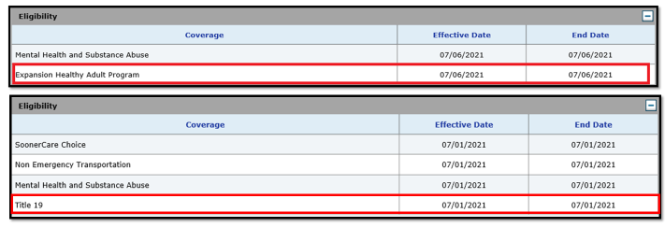
Soonercare eligibility

Slide 12
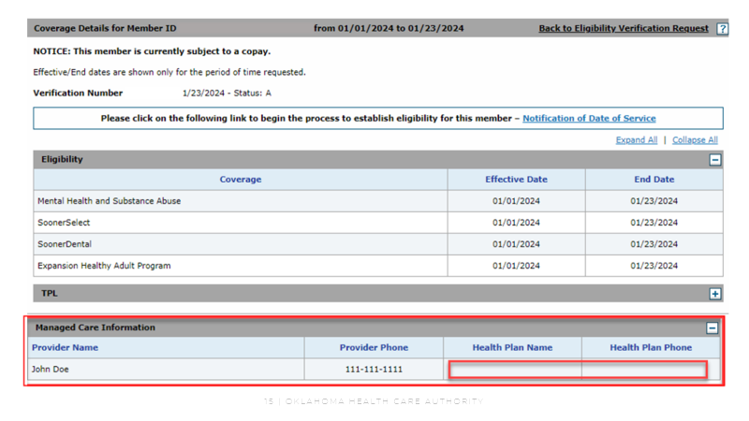
Soonerselect eligibility
SoonerSelect members are managed by our partners: Aetna Better Health of Oklahoma, Humana Healthy Horizons in Oklahoma and Oklahoma Complete Health. Please contact the member’s plan directly for assistance.

Slide 13
Prior authorization

Slide 14
Prior authorization
Prior Authorization Requirements TXIX children and HAP:
  Revenue code: 651 Routine Hospice Care
  Revenue code: 652 Continuous Home Care
  Revenue Code: 655 Inpatient Respite Care
  Revenue Code 656 General Inpatient Care
  Service Intensity Add-On

Slide 15
Claims submission

Slide 16
Claims submission
TXIX children and adults with HAP: The claim type is an institutional home health claim. It will be billed with revenue codes.
Adults with Advantage Waiver: The claim type is a professional claim and billed with procedure code S9126.
Adults with Medicare: The claim type is a crossover claim of the same type billed to Medicare.

Slide 17
resources

Slide 18
Helpful telephone numbers
OHCA Call Center
800-522-0114 or 405-522-6205, option 1
Internet Helpdesk
800-522-0114 or 405-522-6205, option 2, 1
EDI Helpdesk
800-522-0114 or 405-522-6205, option 2, 2

Slide 19
Training materials
Provider Training:
  Upcoming webinar trainings
  Previous training materials
  Recorded webinars
  How-to videos
  Resources
Visit oklahoma.gov/ohca/providers/provider-training

Slide 20
Training resources
Provider education specialists:
  Education specialists provide education and training as needed for providers either virtually or telephonically.
  Requests for assistance should be emailed to:
    SoonerCareEducation@okhca.org.
    Requests should include the provider's name and ID, contact information and a brief description of what assistance is needed.
For immediate claims or policy assistance, please contact the OHCA provider helpline at 800-522-0114.

Slide 21
Questions?

Slide 22




GET IN TOUCH
4345 N. Lincoln Blvd.
Oklahoma City, OK 73105
oklahoma.gov/ohca
MySoonerCare.org
Agency: 405-522-7300
Helpline: 800-987-7767

