Slide 1
Pay for Performance Training manual 2023

Slide 2
Objectives
Quality Measures
Data Collection and Submission
Program Audit
Facility Survey
Quality Assurance Team

Slide 3
Quality Measures

Slide 4
Quality Measures
PERCENTAGE OF LONG-STAY RESIDENTS WHO LOSE TOO MUCH WEIGHT
N029.02
PERCENTAGE OF LONG-STAY RESIDENTS WHO RECEIVED AN ANTIPSYCHOTIC MEDICATION
N031.03
PERCENTAGE OF LONG-STAY RESIDENTS WITH HIGH RISK/ UNSTAGEABLE PRESSURE ULCERS
N015.03
PERCENTAGE OF LONG-STAY RESIDENTS WITH A URINARY TRACT INFECTION
N024.02

Slide 5
Quality Measures
Earn payment.
Meet or exceed national average.
5% relative improvement each quarter from baseline or better.
Four equally weighted CMS Long-Stay Quality Measures.
Minimum of $1.25 per Medicaid patient per day for each qualifying metric.
Facilities with deficiency of 1 or greater in the program are disqualified from receiving an award for that quarter and following quarters until the facility comes into compliance.
Facility deficiency tags can be viewed here https://surveys.health.ok.gov/.

Slide 6
Quality Measures
EXAMPLE: FACILITY ACTUAL QM PERFORMANCE
QUARTER | Q1 | Q2 | Q3 | Q4
BASELINE | 12.75% | 12.75% | 12.75% | 12.75%
NATIONAL AVG. BENCHMARK | 10.50% | 10.50% | 10.50% | 10.50%
IMPROVEMENT TARGET (5%) | 12.11% | 11.48% | 10.84% | 10.20%
FACILITY ACTUAL QM SCORE | 14.65% | 11.15% | 9.54% | 10.45%
OUTCOME | Failed | Achieved | Achieved | Achieved

Slide 7
Data Collection and Submission

Slide 8
Submission deadlines
Facilities enter the facility adjusted percent score from the CASPER MDS 3.0 facility level quality measure report for each of the four quality measures.
Facilities upload the CASPER MDS 3.0 facility level quality measure report for each of the four quality measures.
DATA COLLECTION PERIOD | SUBMISSION DEADLINE 5:00pm | PAYMENT 4th Wednesday of the month
October, November and December | Jan. 30 | Feb.
January, February and March | Apr. 30 | May
April, May and June | Jul. 30 | Aug.
July, August and September | Oct. 30 | Nov.
If submission deadline date falls on a weekend or holiday, submission will be due the next business day at 5 pm.
Notes:
January-March: Apr 30th falls on Sunday/next business day is Monday, May 1st
April-June: July 30th falls on Sunday/next business day is Monday, July 31st

Slide 9
Update profile page

Slide 10
PFP/QOC Provider Portal - step 1
Baselines and
National Average
Training
and FAQ’s
Add additional e-mails by separating with a comma

Slide 11
Provider Portal - step 2

Slide 12
Provider Portal - step 3

Slide 13
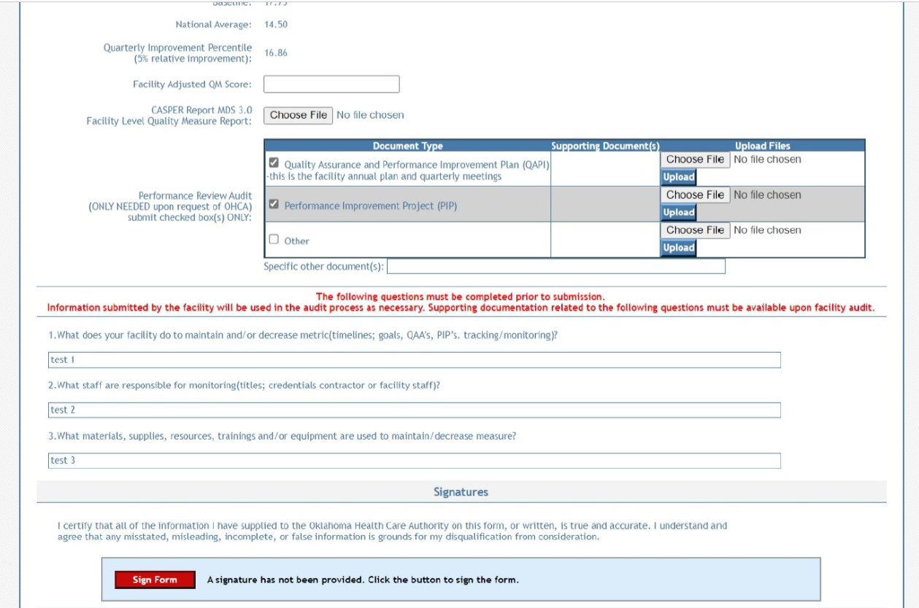
Provider Portal - step 4
Notes:
Facilities will only need to provide supporting documentation if selected for an audit. Tentative Roll Out July 1.

Slide 14
CASPER retrieval
Facilities go into their CASPER reports and run their MDS CASPER 3.0 Facility Level QM reports for the appropriate quarter.

Slide 15
CASPER form
Assistance with obtaining CASPER report:
Oklahoma State Department of Health.
Quality Improvement and Evaluation Service helpdesk.
405-271-5278.

Slide 16
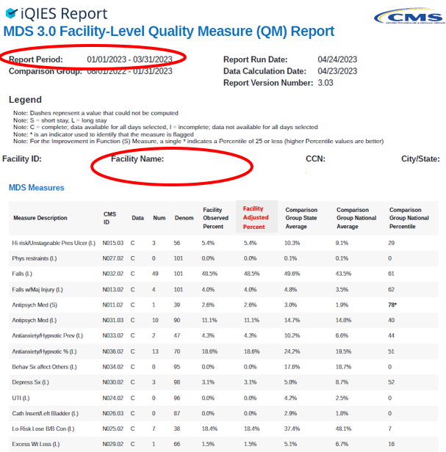
CASPER form
Assistance with obtaining CASPER report:
Oklahoma State Department of Health.
Quality Improvement and Evaluation Service helpdesk.
405-271-5278.

Slide 17
program audit

Slide 18
program audit
The quality assurance (QA) team conducts weekly program audits of participating facilities. Audits are conducted based on random, standard revisit; state survey; third-party request.
Desk audit - Facilities submit requested documentation via the PFP/QOC provider portal prior to the quarterly program metric due dates.
Virtual/teleconference audit - Facilities are contacted via email and phone by the QA audit team. Facilities are required to submit required documentation electronically the same day.
On-site audit - Facility documentation is reviewed in person. Facilities provide requested information same day to the on-site QA team.

Slide 19
Program audit (cont.)
Audits are conducted within 15 business days of documentation receipt.
Facilities are provided 15 business days to submit additional documentation requests or provide a Corrective Action Plan to the QA team.
A summary of audit findings will be provided to the facility 15 business days after the facility audit is finalized.
Requested documentation that is not received under the standard policy of the PFP program, agency rule Oklahoma Administrative Code (OAC) 317:30-5-136.1. Pay-for-Performance (PFP) program, have the potential to forfeit reimbursement dollars.
Notes:
*I feel that this slide needs changes regarding the audit process.

Slide 20
desk audit
Facility documentation is requested quarterly with the PFP quality metric submission(s).
Performance Review Audit box is checked in PFP/QOC provider portal if your facility is selected for a desk audit (refer to slide 13).
Facilities will NOT be able to submit their quarterly reports if they have been chosen for audit and do not provide document uploads.
Notes:
desk review and notified by the e-mail(s) listed on the PFP/QOC Provider Portal.
within fifteen business days of desk review completion.

Slide 21
Desk audit (cont.)
Documentation requirement(s):
Quality Assurance and Performance Improvement Plan with most recent date of review or revision.
Quality Assessment and Assurance Committee meeting notes with attendee page including signatures and titles.
Program Improvement Projects for the requested reporting period.
The above are requirements at F520 483.75.
Other documents as requested.
Notes:
Changed the wording on this

Slide 22
Virtual/teleconference Audit
The QA auditor contacts the facility 9 a.m. the day of the audit to request same-day document submission.
The QA auditor sends a follow-up email to the facility with requirements.
The Staff & Resident Assessment Form must be submitted by 12:30 p.m. the same day to ltcqualityassurance@okhca.org to conduct Staff & Resident Surveys.
The facility must submit requested documentation by 3 p.m. same day to ltcqualityassurance@okhca.org.
Notes:
Changed this to reflect current process.

Slide 23
Virtual/Teleconference audit (cont.)
Documentation requirement(s):
Quality Assurance and Performance Improvement Plan with most recent date of review or revision.
Quality Assessment and Assurance Committee meeting notes with attendee page including signatures and titles.
Program Improvement Projects for the requested reporting period.
The above are requirements at F520 483.75.
Staff & Resident Assessment Form.
Notes:
Changed the wording on this

Slide 24
On-site audit
QA audit team contacts the facility the same day of upcoming on-site audit.
QA audit team requests the facility establish a contact person throughout the audit.
QA team tours facility.
QA manager visits with administrative staff.
QA audit team conducts surveys with employees and residents.
Documentation reviewed on-site.

Slide 25
Educated and/or trained on PFP.
Participate in quarterly/monthly meetings to discuss quality in the nursing home.
Feel there is adequate staff to provide direct care to residents.
Satisfied with the compensation received at this facility.
Satisfied with the benefits (health insurance, retirement, paid trainings, self-schedule, etc.) this facility provides.
EMPLOYEE
SURVEY
All job levels are included in anonymous assessments. Must be employed a minimal of 90 days.
Notes:
PFP-Most staff is not aware PFP program and metrics. Once staff was educated on program they did respond addressing or focusing on those metrics
Education QAPI and PIPs and how staff can play a role
more than half of the staff stated they do some type of quality improvement project to address different quality measures
CPM-Most staff stated they do not participate in CPM with the residents but are aware of CPM being held at least every quarter or significant changes with resident
Alzheimer/Dementia Training-Most staff receives training
Training would be beneficial to all staff levels (never know when staff will interact with a resident with Alzheimer/Dementia.
Resident population will change and better prepare staff to address behaviors
IP-Most staff knew that there was an IP on staff that worked at least part-time
Pay Increase/Adequate Half of the staff stated they have not received a pay increase since Oct 2019. Most staff feel that they are not paid adequately for the work that they do although they work in the homes because they truly care about the residents. Half of the staff reflected longevity and career ladder opportunities

Slide 26
On-site audit (cont.)
Documentation requirement(s):
Quality Assurance and Performance Improvement Plan with most recent date of review or revision.
Quality Assessment and Assurance Committee meeting notes with attendee page including signatures and titles.
Program Improvement Projects for the requested reporting period.
The above are requirements at F520 483.75.
Staff & Resident Assessment Form.
Notes:
Changed the wording on this

Slide 27
Facility Survey

Slide 28
Survey form
Form is fillable or you can print and fill out.

Slide 29
Resident had a recent UTI, WL, use of antipsychotic med, pressure ulcer.
Included in the decisions made related to my care.
Staff treats me with dignity and respect.
Staff responds in a reasonable time when I ask for help or push the call bell in my room.
Satisfied with the meal options and quality of food provided at this nursing home.
RESIDENT
SURVEY
Inclusive to residents at the facility 90-plus days with a BIMS score of 13-15 (intact/borderline) and residents with BIMS 8-12 (moderate impairment).
Notes:
Residents don’t know DR name, low attendance at resident care plan meetings although residents did state they could ask to be seen by doctor on days that they are present at the home. Most Residents stated they do have telehealth visits during COVID
Most residents do not know if they have had a care plan meeting although most residents felt they could voice concerns and preferences
Wellbeing-
most residents stated that steps were taken when health issues became prevalent
most residents were happy with the care they received in the home
most resident felt sad to not be able to partake in any activities or be able to go to places due to COVID although they did state that staff contacts family and friends through phone to talk or video chat
PNA-most residents are unaware of increase and several have even asked about the stimulus payment
Ombudsman-many residents do not know what an “Ombudsman” is and how they can support/advocate for the residents. Half of the residents stated speaking to someone that provided support although did not know them by the name of “Ombudsman”

Slide 30
Quality Assurance Team

Slide 31
Quality Assurance Team
QA Manager
Jennifer Wynn:
Jennifer.Wynn@okhca.org
QA Senior Research Analyst
Tyisha Antwine
Tyisha.Antwine@okhca.org
QA Senior Research Analyst
Irene Sanderson
Irene.Sanderson@okhca.org
Program Analyst II
vacant
Program Analyst II
vacant
Quality Assurance email
ltcqualityassurance@okhca.org

Slide 32
GET IN TOUCH
4345 N. Lincoln Blvd.
Oklahoma City, OK 73105
okhca.org
MySoonerCare.org
Agency: 405-522-7300
Helpline: 800-987-7767

