Slide 1
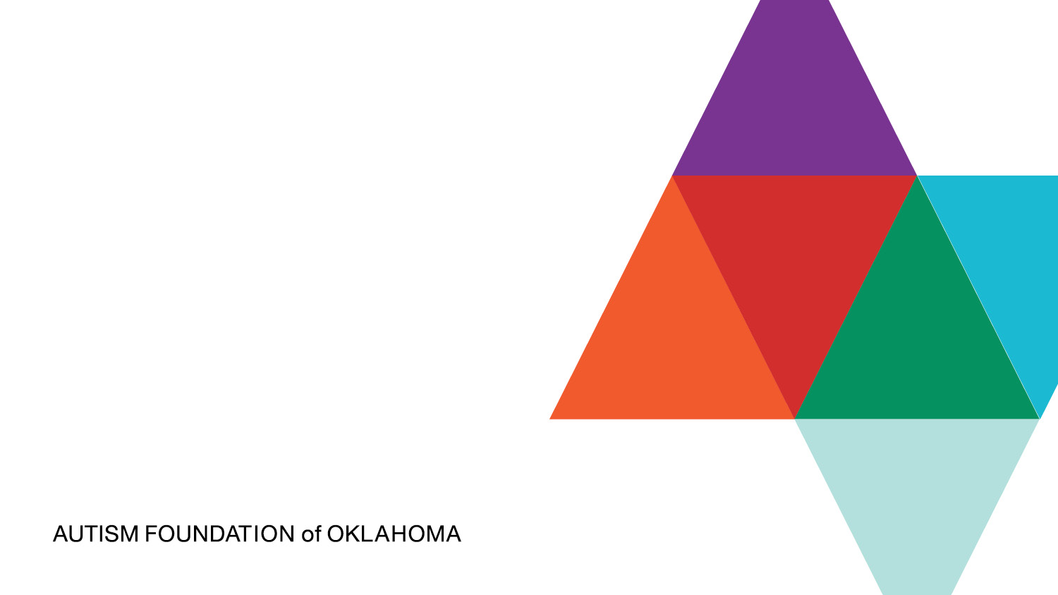

Workplace Neurodiversity
Module I: Autism, I/DD, & Neurodiversity 101
Inclusion in the Workplace

Slide 2

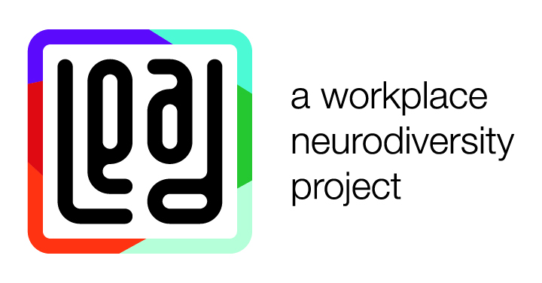

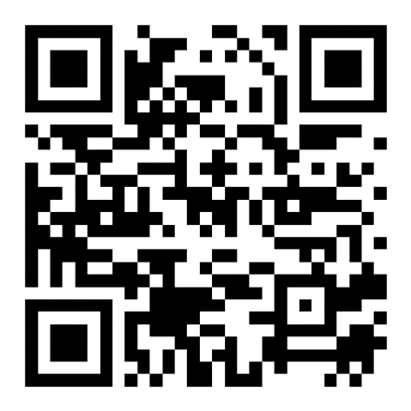
Speaker Introduction
Kyle Britt, MA, CAS
Workforce Development Project Coordinator
kbritt@autismfoundationok.org
(405) 474-7937
Notes:
Presenters can be edited with photos, titles and introductions as needed.

Slide 3

AFO Program Areas
Advocacy & Awareness
Early Childhood Development
Health Equity
Public Safety
Social Inclusion
Workforce Development
Our mission is to improve the lives of Oklahomans with autism and their families.
Notes:
Advocacy & Awareness - AFO advocates for policies and programs in support of individuals with autism and their families at the state and local level. AFO also hosts Autism Advocacy Day at the Oklahoma State Capitol every April for hundreds of individuals, family members and providers from all across the state.
AFO also has a Resource Coordinator available by phone M-F from 8 am- 5 pm daily help connect families and providers with autism resources.
Early Childhood Development - AFO provides training to Oklahoma's childcare providers to better support children with autism with an overall goal of increasing quality childcare services for Oklahoma children with autism and developmental delays. AFO currently has a grant from Oklahoma Partnerships for School Readiness to train every OKDHS- certified childcare facility in the state by the end of 2024.
Health Equity- AFO currently provides autism training and sensory kits to public, private, and tribal nation healthcare workers all across the state through a partnership with the Oklahoma State Department of Health. By the end of 2023, we had trained all 77 country health departments in the state and 5 tribes.
Public Safety- AFO provides community events that give drivers and passengers with autism the opportunity to practice safe traffic stops. We also offer autism education and sensory kits to local police, firefighters, and EMTs to help them better assist Oklahomans with autism and special needs. AFO also advocates for public policy measures to increase the safety of autistic Oklahomans.
Social Inclusion- AFO is committed to the inclusion and belonging of autistic Oklahomans. We providing social opportunities each month in OKC and Tulsa to help foster new relationships and decrease social isolation. We also provide sensory kits and training to many of Oklahoma’s favorite family and tourist destinations throughout the state. Throughout the year, we host and co-host numerous social inclusion opportunities that we post to our social media.
Workforce Development - Through a partnership with the Developmental Disabilities Council of Oklahoma, AFO provides training and business solutions to Oklahoma employers committed to diversity and equity. Our LEAD training aims to provide more employment opportunities for autistic individuals and decrease the overall unemployment of those we serve. We also added a new training last year to help businesses serve autistic clients and customers better called Autism-Friendly Business. This training offers practical tools and a certification for businesses to promote.

Slide 4

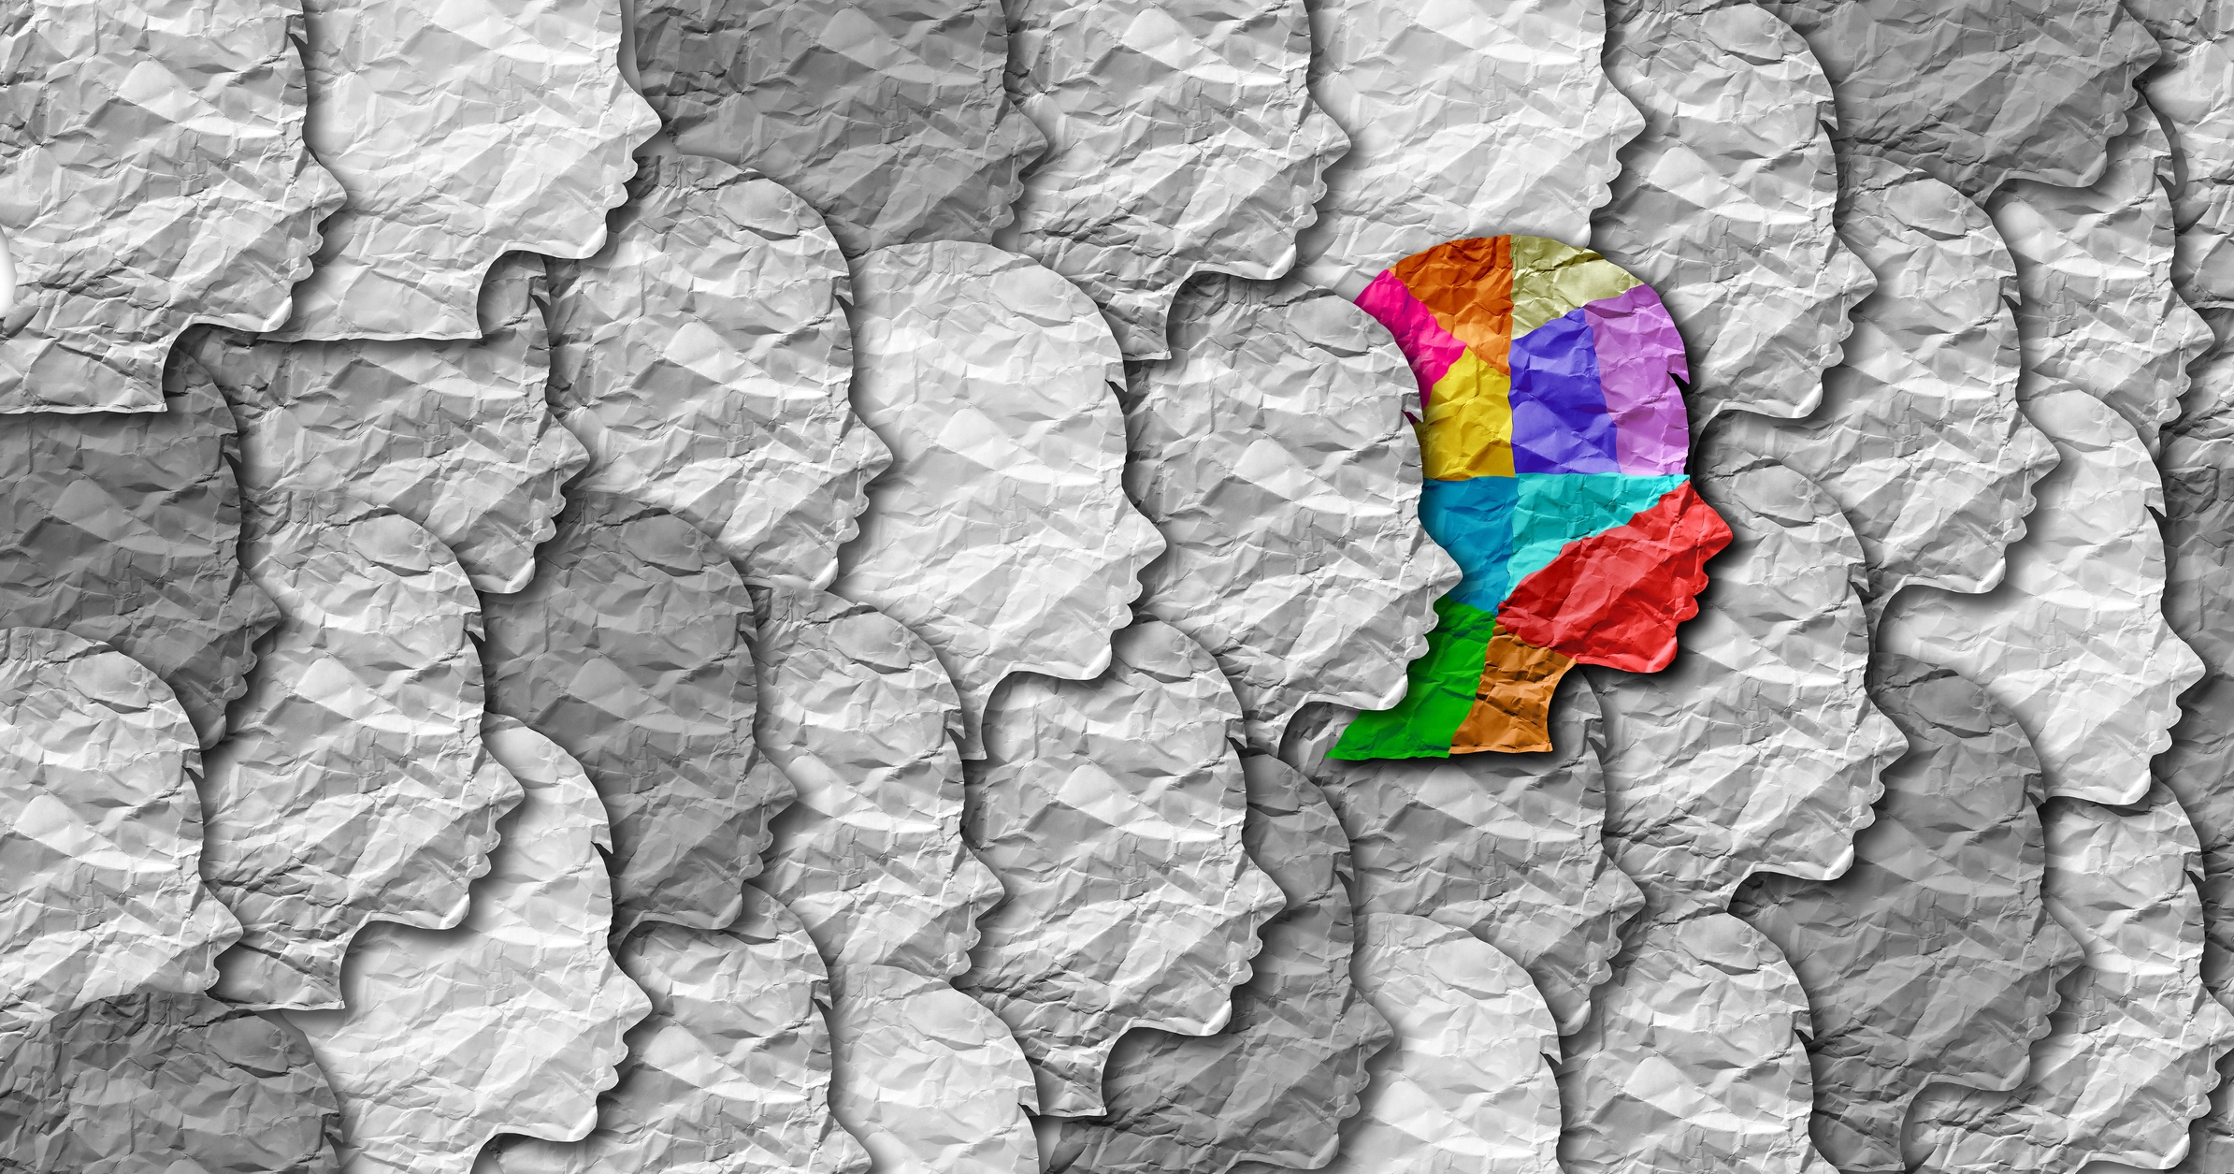
Module I
Definitions
Autism & I/DD History
Demographics
Characteristics
Neurodiversity
Discrimination

Slide 5

What is Autism?
Autism spectrum disorder (ASD) is a developmental disability caused by differences in the brain.
People with ASD often have problems with social communication and interaction and restricted or repetitive behaviors or interests.
People with ASD may also have different ways of learning, moving, or paying attention.
It is important to note that some people without ASD might also have some of these symptoms. But for people with ASD, these characteristics can make life very challenging.
Source: CDC
Notes:
People with ASD have problems understanding social reciprocity, beginning and maintaining relationships and grasping nonverbal communicative behaviors. They also exhibit behavioral patterns that might include repetitive motor movements, inflexibility to routines, fixated interests, problems with sensory input (hypersensitive or hyposensitive to sound, touch, etc.), or unusual interest in the sensory aspects of the environment.

Slide 6
Evolving Autism & I/DD Demographics
CDC now says autism affects 1 in 36 children in the U.S.
According to the CDC, about 6.5 million adults in the United States have I/DD.
An estimated 50,000 people on the autism spectrum graduate high school in the U.S. each year.
Thirty-five percent of young adults with autism have never held a job or received postgraduate education after leaving high school.
Only 44% of adults with I/DD are employed; this compares to 83% of adults without I/DD.
An estimated 50-75% of people on the autism spectrum experience periods of long-term unemployment.
Twenty-eight percent of adults with I/DD have never had a job.
Source: CDC, Drexel University

Slide 7
Characteristics of Autistic Adults
Common signs of autism in adults include:
finding it hard to understand what others are thinking or feeling
getting very anxious about social situations
finding it hard to make friends or prefer to be on your own
Seeming blunt, rude, or not interested in others without meaning to
finding it hard to say how they feel
taking things very literally – for example, they may not understand sarcasm or phrases like "break a leg"
having the same routine every day and getting very anxious if it changes
Notes:
not understanding social "rules", such as not talking over people
avoiding eye contact
getting too close to other people, or getting very upset if someone touches or gets too close to you
noticing small details, patterns, smells or sounds that others do not
having a very keen interest in certain subjects or activities
liking to plan things carefully before doing them

Slide 8
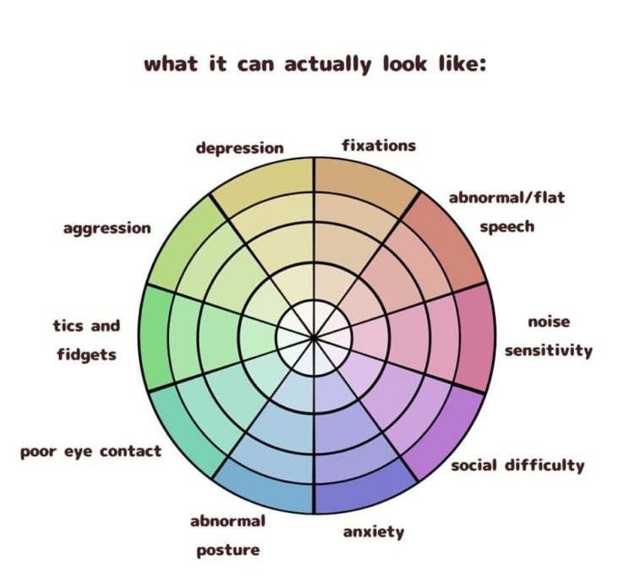
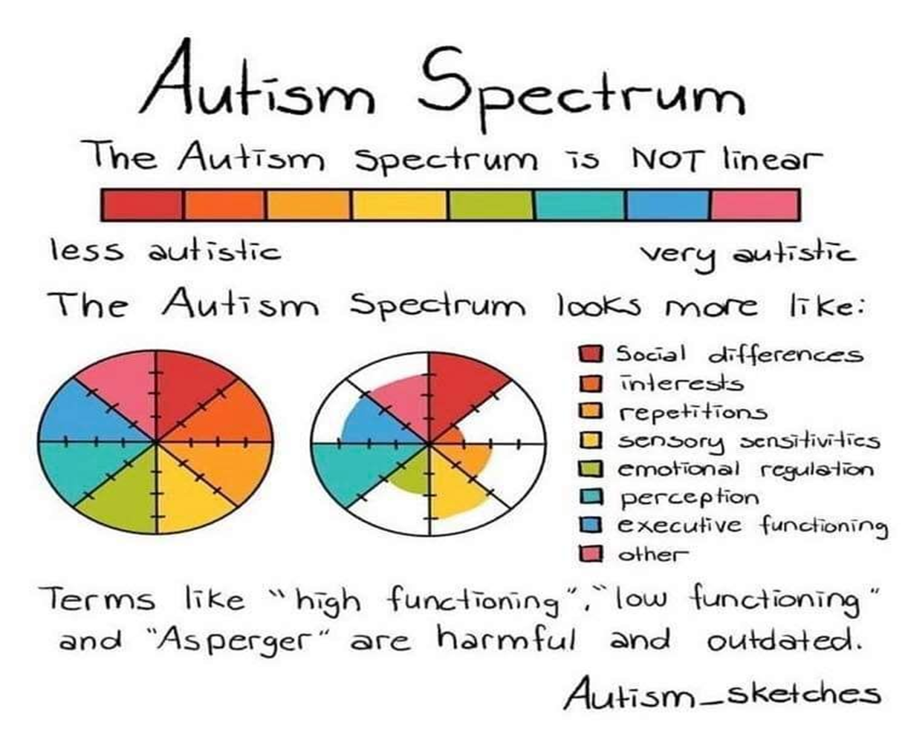
Notes:
Just like every person, every Autistic person is unique and has different abilities, interests, and challenges. Each Autistic person will experience their Autism differently, including in the way they communicate, socialize, and interpret sensory stimuli. Whether a person is autistic or not, all of us have skills and challenges, and areas where we need more (or less!) support. This is as true for Autistic people as it is for non-autistic people, and each Autistic person is an individual with their own profile of skills and challenges.
For some, eye contact might be easy; for others, it might be deeply uncomfortable.
Some autistic individuals may experience a high degree of sensitivity to crowds or noisy environments, while others might thrive in a busy atmosphere.
Some may engage in special interests, throwing themselves into research and collecting information or items relevant to their interest; others simply may not.
This also helps both autistic individuals and those around them understand a person’s unique needs better. Someone considered high-functioning may not need as much support; however, when we look at that person’s wheel, we may see they don’t struggle in social situations (something others commonly but erroneously equate to “less autistic”). Still, they may have significant difficulties with executive function, ranging from problems like hygiene to difficulty switching tasks. This person is no more or less autistic than any other autistic person—they just need support in some areas more than others.

Slide 9
Three Levels of Autism
Level 1: Requiring support
A person with level 1 autism requires the least amount of support.
Level 1 social communication characteristics may include:
trouble understanding or complying with social conventions
the appearance of disinterest in social interactions
some emotional or sensory dysregulation
Level 1 restricted interests and repetitive behavior traits can be:
a need for additional personal organization strategies
behavioral rigidity and inflexibility
stress during transitions
attention span differences
perseveration (focusing on something longer than is helpful)
Source: Psych Central, 2022
Notes:
Level 1: Requiring Support
These individuals usually have challenges with executive functioning and daily social interactions. They often need help with transitions, planning and organization, and time management.
Difficulty interpreting social cues and body language can hamper friendships. Sometimes they need help interpreting figurative language, jokes, and sarcasm. These individuals often fall between the cracks because their need for support is not always obvious.

Slide 10
Three Levels of Autism
Level 2: Requiring substantial support
An autistic person who meets the level 2 criteria in either category has similar characteristics as those in level 1 but to a greater extent.
Social communication traits at level 2 may include:
using fewer words or noticeably different speech
missing nonverbal communication cues like facial expressions
exhibiting atypical social behavior, like not responding or walking away during a conversation
Restricted interests and repetitive behavior traits at level 2 might resemble:
a high interest in specific topics
noticeable distress when dealing with change or disruption
Source: Psych Central, 2022
Notes:
Level 2: Requiring Substantial Support
Individuals at this level have more profound challenges with language and social communication. Conversation is often repetitive and more basic. Their interests tend to be more narrow, which can limit more meaningful interactions.
They can be more resistant to changes in routine, which can provoke anxiety and stressful responses.

Slide 11
Three Levels of Autism
Level 3: Requiring very substantial support
An autistic person assessed as level 3 in either social communication or restricted/repetitive behaviors will need the most support and seem noticeably different at a young age.
Level 3 social communication means the person may:
be nonspeaking or have echolalia (repeating words or phrases they hear)
prefer solitary activities
interact with others only to meet an immediate need
seem unable to share imaginative play with peers
demonstrate a limited interest in friendships
If they are at level 3 for restricted/repetitive behaviors, they might:
engage in repetitive physical behaviors like rocking, blinking, or spinning in circles
express extreme distress when asked to switch tasks or focus
Source: Psych Central, 2022
Notes:
Level 3: Requiring Very Substantial Support
These individuals are usually identified by more significant language and communication challenges. They may seem more preoccupied with their preferred behaviors and interests, which they often choose to focus on over social interactions.
Changes in routine can be extremely challenging. With proper support, these students can learn emotional flexibility and how to interact more meaningfully with others.

Slide 12
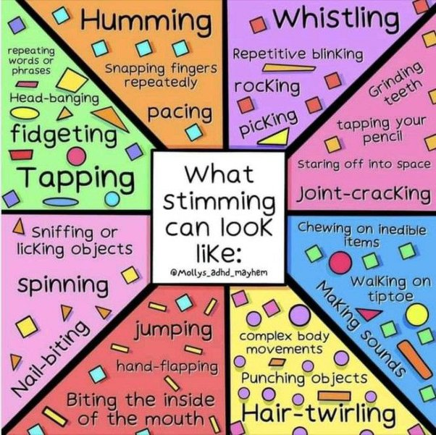
Stimming:
Repetitive or unusual movements or noises.
Stimming seems to help some autistic individuals manage emotions and cope with overwhelming situations.
Notes:
What is “Stimming” We all do it.
Common stimming behaviors include:
biting your fingernails
twirling your hair around your fingers
cracking your knuckles or other joints
drumming your fingers
tapping your pencil
jiggling your foot
Whistling
While stimming in neurotypical people is often anxiety-related, in neurodivergent people, it can have a few other sources as well. Stimming helps regulate stress, anxiety, boredom, fear, emotional overwhelm, physical overwhelm, sensory overload, and even express happiness and joy!

Slide 13

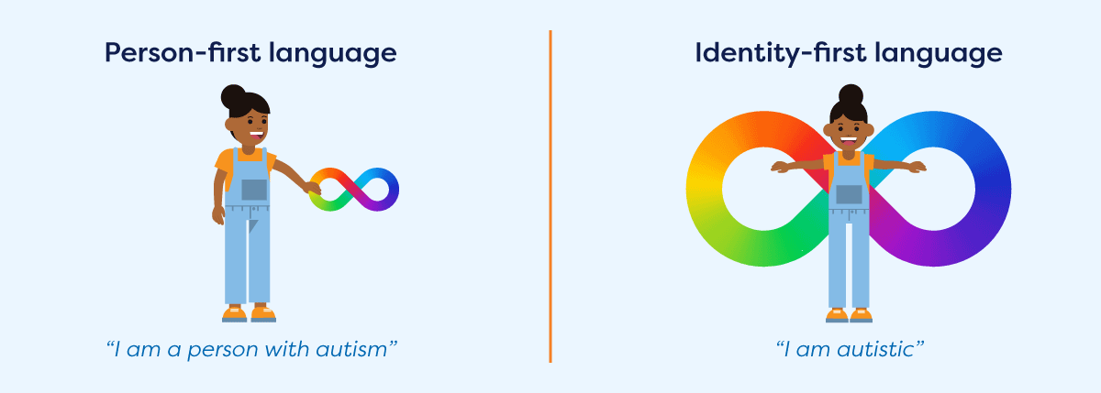
Person First vs. Identity First Language
Notes:
Person-first language emphasizes the person before the disability, for example, “person who is blind” or “people with spinal cord injuries.”
Identity first language puts the disability first in the description, e.g., “disabled” or “autistic.”
Person-first or identify-first language is equally appropriate depending on personal preference. When in doubt, ask the person which they prefer.
How a person chooses to self-identify is up to them, and they should not be corrected or admonished if they choose not to use person-first language.
It is important to note that while person-first language is often used in more formal writing, many people with disabilities, particularly younger people, are choosing to use identity-first language. At AFO, we use person-first and identity-first language interchangeably in our outward communication until a preference is made known.
Again, when in doubt, just ask.

Slide 14

What is I/DD?
Intellectual disabilities are disorders that involve difficulties in intellectual functioning and adaptive behavior and begin before the age of 18. Intellectual functioning involves mental tasks such as learning, reasoning, problem-solving, and so on. It is assessed using an IQ test and is measured in terms of mild, moderate, or severe.
Adaptive behavior includes conceptual, social, and practical skills. People who struggle with adaptive behavior may show difficulties with literacy, money management, schedules and time, interpersonal relationships, daily personal care activities, and more.
Source: Social Innovations Journal
Notes:
Developmental disability is a broad term that encompasses intellectual disabilities and other lifelong disabilities that begin in childhood before age 18. Developmental disabilities affect intellectual functioning, physical functioning, or both [3]. Examples include Down syndrome, Autism Spectrum Disorder, cerebral palsy, Fragile X Syndrome, and more [4]. Someone with a developmental disability may or may not also have an intellectual disability. Some developmental disabilities may be diagnosed before or shortly after birth, and others may not be diagnosed until later in childhood. Developmental monitoring and screening by a pediatrician can assess whether or not your child is reaching developmental milestones as expected.

Slide 15
I/DD History
The Institutional Model Period
Model came to the United States from Germany in 1848
Physicians would recommend institutional living to parents of children with I/DD.
The Kennedy Era & the Introduction to Community-Based Care
In the 1960s, John Kennedy comprised a group of clinical experts and advocates, calling it the President’s Commission on Mental Retardation.
200,000 individuals were living in institutions, and the group recommended they close
Kennedy and his successors engineered a way to supplement the state funding of state institutions with Medicaid dollars. This was the start of the Intermediate Care Facilities/Mental Retardation* (ICF/MR) program.
Source: Social Innovations Journal
Notes:
The commission reviewed literature, held hearings to gather the input from others, and toured other countries to learn about alternatives to the United States institutional model. They returned from the Scandinavian countries particularly impressed because these countries did not rely on the institutional model. They encouraged and supported families to keep their children at home and they rejected the notion that people should be segregated on the basis of intellectual ability.
The study revealed individuals were happier in the community, they were able to exercise choice, and their families were equally satisfied.

Slide 16
Characteristics of Adults with I/DD
Delay in learning development
May have difficulty with reading or speaking
May struggle to understand social cues
May have issues with memory recall
May struggle to perform routine tasks such as showering, dressing, etc..
May struggle with problem-solving
May struggle to understand consequences
May not have behavior consistent with their age
May have difficulty regulating or expressing emotions
Sources: Special Olympics
Notes:
It is important to consider that these characteristics will not apply to every individual with I/DD.

Slide 17
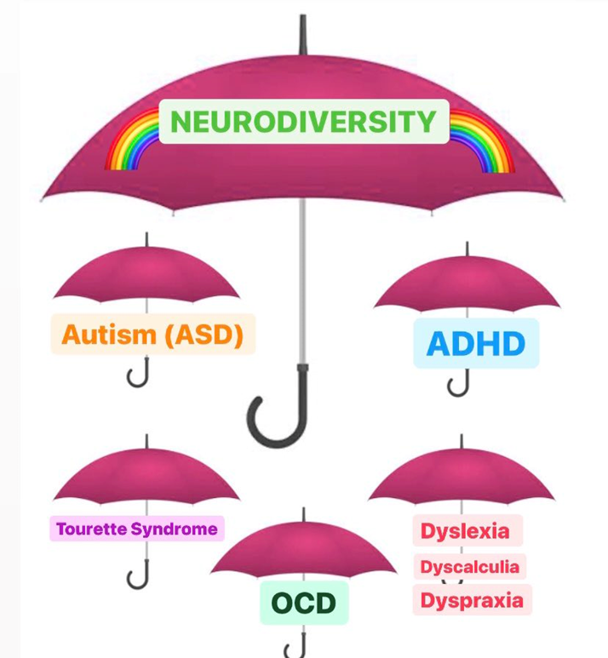
What is Neurodiversity?
Umbrella term for Autism Spectrum Disorder, ADHD, Dyslexia, Dyspraxia, and other learning disabilities
Judy Singer, a sociologist who has autism, started using the term "neurodiversity" in the late 1990s.
Refers to the concept that certain developmental disorders are normal variations in the brain. And people who have these features also have certain strengths.
Ex.- people with ADHD may have trouble with time management but often show high levels of passion, drive, and creative thinking.
Source: WebMD
Notes:
The neurodiversity movement emerged during the 1990s, aiming to increase the acceptance and inclusion of all people while embracing neurological differences. Judy Singer, an Australian sociologist, coined the term neurodiversity to promote equality and inclusion of "neurological minorities."
The word neurodiversity refers to the diversity of all people, but it is often used in the context of autism spectrum disorder (ASD), as well as other neurological or developmental conditions such as ADHD or learning disabilities.
What is the most common type of neurodiversity?
Among adults, dyslexia is the most common type of neurodivergent condition. Approximately 10% of adults are diagnosed with dyslexia.
Around 4-5% of the population has attention deficit hyperactivity disorder (ADHD).
A further 1-2% of people has an autism spectrum disorder (ASD). Together, those three syndromes constitute around 70 percent of all neurodevelopmental disorder diagnoses. Neurodivergent conditions include ADHD, dyslexia, dyspraxia, personality disorders, and bipolar disorder.
While it is primarily a social justice movement, neurodiversity research and education are increasingly important in how educators and clinicians view and address certain disabilities and neurological conditions. Through online platforms, more and more autistic people were able to connect and form a self-advocacy movement.

Slide 18
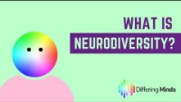

Slide 19
Neurodivergent & Neurotypical
The term “neurodivergent” describes people whose brain differences affect how their brain works. That means they have different strengths and challenges from people whose brains don’t have those differences.
Neurodivergent isn’t a medical term. Instead, it’s a way to describe people using words other than “normal” and “abnormal.” That’s important because there’s no single definition of “normal” for how the human brain works.
The word for people who aren’t neurodivergent is “neurotypical.” That means their strengths and challenges aren't affected by any kind of difference that changes how their brains work.
Source: Cleveland Clinic
Notes:
Is being neurodivergent a disability?
Some neurodivergent people struggle because of systems or processes that don’t give them a chance to show off their strengths or that create new or more intense challenges for them.
Example #1: Many people who are neurodivergent struggle in social situations, which can make it hard to find work because they struggle during job interviews. However, they can still get the job if the hiring process emphasizes their abilities, such as screening potential hires with a skills test. Once on the job, their attention to detail means they’re an outstanding accountant or record-keeper because they can easily process data that others might find more tedious.
Example #2: Some who are neurodivergent struggle in noisy environments or situations. That means a busy classsroom can feel overwhelming to them. However, a pair of noise-canceling headphones might give them the quiet they need to continue their work.
In both examples, accommodations helped the person overcome their particular struggle. For someone with a disability, an accommodation is a way to accept that they’re different or have challenges, and then give them a tool or a way to succeed. For the people who are neurodivergent in the examples above, the accommodations were the hiring process and the headphones.

Slide 20
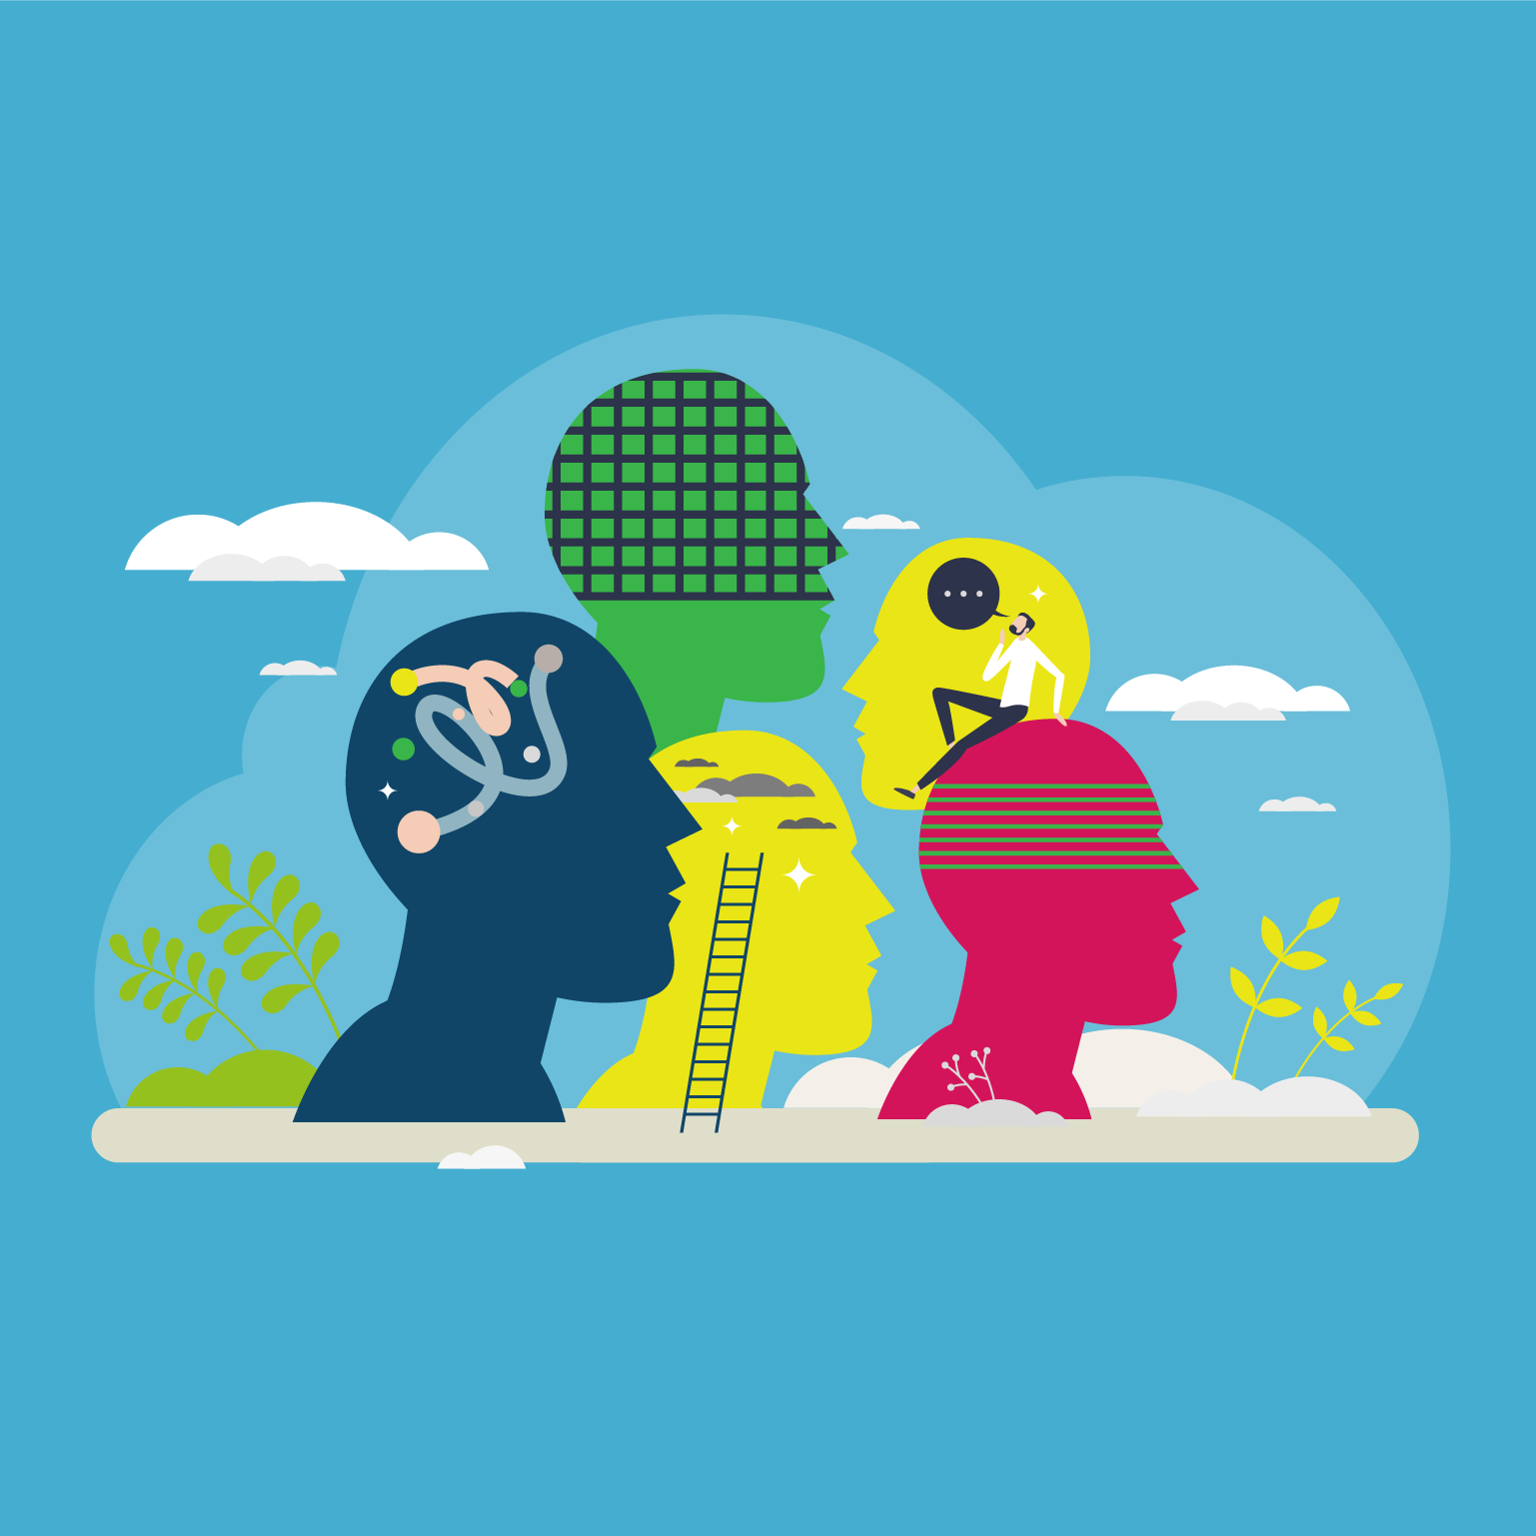
Neurodiverse Communication
How autistic people on the spectrum communicate is as varied as the experience of autism itself.
Communication is the exchange of information including ideas, needs, desires and feelings. Communication can also be made in written form and includes reading and writing.
Notes:
Autistic people and those with I/DD process differently which can make it difficult to communicate the same ways others do or perceive as “acceptable.” It does not mean they cannot communicate; it’s just done differently.
Some people on the autism spectrum might find it hard to hold a conversation, or even start one. They can also have difficulty understanding facial expressions and inferring communicative intent based on context.
Communication also includes the understanding and use of non-verbal communicative behaviors (eg. eye-contact, and body language, physical gestures).

Slide 21
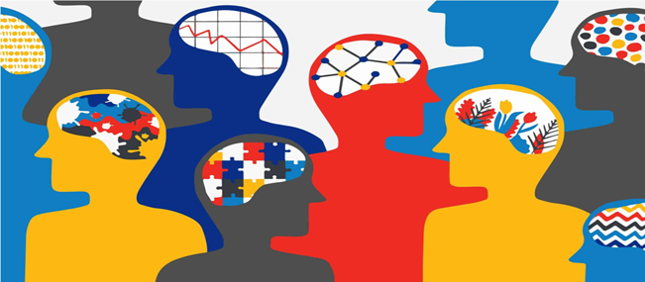
Communication
Sensory processing issues account for a lot of the communication difficulties.
There are two main types:
Hyposensitivity is when an individual has a muted response to sensory information. For example, being unaware of body sensations, not able to feel hunger.
Hypersensitivity is when an individual has an over-sensitivity to sensory information. For example, loud noises and bright lights may significantly bother these individuals.
Notes:
Having unique sensitivities to certain types of sensory input can create challenges in everyday situations like school, work or community settings. For someone who is hypersensitive, it can take a lot of effort to spend all day under LED or fluorescent lights, navigate a crowded space or process conversations in rooms with background noise. This can be incredibly physically and emotionally draining and can leave the person feeling too exhausted to do other important tasks.
Understanding and accommodating sensory issues can ease discomfort and increase opportunities for autistic people to learn, socialize, communicate and participate in the community. Accommodations might mean modifying the environment, using tools and strategies, or creating new habits or routines. Since sensory needs depend on the environment, accommodations may need to be adapted for each setting.

Slide 22
Communication Tips
be clear and concise
pause between words and phrases to give the person time to process what you’ve said, and to give them a chance to think of a response
don’t use too many questions
use less non-verbal communication (eg eye contact, facial expressions, gestures, body language)
be aware of the environment (noisy/crowded) that you are in. Sensory differences may be affecting how much someone can process.
Source: National Autistic Society
Notes:
An autistic person may find it difficult to filter out the less important information. If there is too much information, it can lead to ‘overload’, where no further information can be processed. To help with that or to avoid that, here are some tips.

Slide 23

Disability Stigma
Stigma - a mark of disgrace associated with a particular circumstance, quality, or person.
Likely Reasons for Stigma:
Lack of education
Lack of awareness
Nature and complications of autism
Unpredictable behavior
Source: Autism Parenting
Notes:
A lack of education and awareness are probably the top reasons behind stigma. Those with mental disabilities, cognitive disorders and developmental disabilities are probably also stigmatized due to the nature and complications of their conditions. Certain symptoms like unexpected (in a neurotypical view), unpredictable behavior or violence could also lead to mental illness stigma

Slide 24

Debunking Common Stereotypes
Individuals with autism…
are aggressive.
become obsessed with certain things.
are really smart.
are unintelligent.
cannot communicate.
look different.
don’t have emotions.
can’t have relationships.
Source: Autism Learning Partners
Notes:
Individuals with autism can experience outbursts just like any individual can. Like most individuals, these outbursts are often a result of a trigger (anxiety, stress, loud noises, physical contact).
This does have a small amount of truth to it, in that individuals with autism can have intense interests. However, this does not apply to every individual with autism, and just as importantly, it isn’t unique to individuals with autism.
You may have heard the dated label ‘high’ or ‘low’ functioning used to describe an individual with autism. Individuals simply fall within a range, or spectrum, of autism.
Individuals with autism have a wide range of intelligence, just like any other individual. Autism is also diagnosed in highly intelligent individuals and does not directly affect an individual’s intelligence.
Autism doesn’t limit a person’s ability to speak, but it can be more challenging for people with autism to communicate or express themselves in traditional ways.
Autism in no way affects an individual’s physical appearance. In reality, it can be challenging for individuals to identify because autism specifies how someone’s brain works, not how they look.
Sometimes, an individual with autism may display their emotions differently than one might expect, but this does not mean they are emotionless. Emotional intelligence and communication of emotions are traits that any individual can improve upon throughout their lifetime, whether or not they have autism.
Individuals with autism often have difficulty communicating and reading social cues, so relationships can be more challenging. With support, successfully interpreting social cues accurately and communicating effectively, individuals with autism can have meaningful relationships.

Slide 25
Avoiding Ableism
Examples of Ableism:
Able-bodied people using facilities that are made for disabled people, such as parking spaces or bathrooms.
Asking a disabled person what is “wrong” with them.
Assuming that a disabled person’s diagnosis tells you everything you need to know about them.
Telling a disabled person they don’t look disabled, or that you don’t “see” their disability.
Assuming disabled people do not engage with ‘normal’ parts of society, such as work or relationships, and seeing them as “inspirational” if they do so.
Source: Web MD
Notes:
Ableism refers to discrimination based on disability. It is centered on the idea that non-disabled people are more valuable to society than disabled people. It suggests that society puts a higher value on people with typical abilities.
Ableism assumes that people with disabilities need to be “fixed.” Like other forms of prejudice, ableism creates unfair and harmful stereotypes about specific groups of people.

Slide 26
Practice Inclusion: End the Use of the R-Word
The R-word and its variations is a form of hate speech. While was originally introduced as a medical term in 1961 for people with intellectual disabilities, in the decades since, the R-word has become an insult used all too common in everyday language.
Those who use the R-word often do so with little regard for the pain it causes people with intellectual disabilities—and the exclusion it perpetuates in our society.
Source: Special Olympics
Notes:
The R-word, also known as the R-slur, is a hurtful term that remains prevalent throughout social media, according to a Kantar Social Listening study. The research shows that when social media users are posting about people with intellectual disabilities, 7 in every 10 of those posts are negative, and 6 in 10 contain a slur.
In 2010, President Barack Obama signed “Rosa’s Law,” which changed “mental retardation” to “intellectual disability” in U.S. federal law. Inspired by 9-year-old Rosa Marcellino, the law was a key milestone to promoting inclusive, people-first language.
Spreading the R-word continues to hurt people with intellectual disabilities—and whether intended or not, is a form of bullying. Eliminating this word is a step toward respect for all.

Slide 27
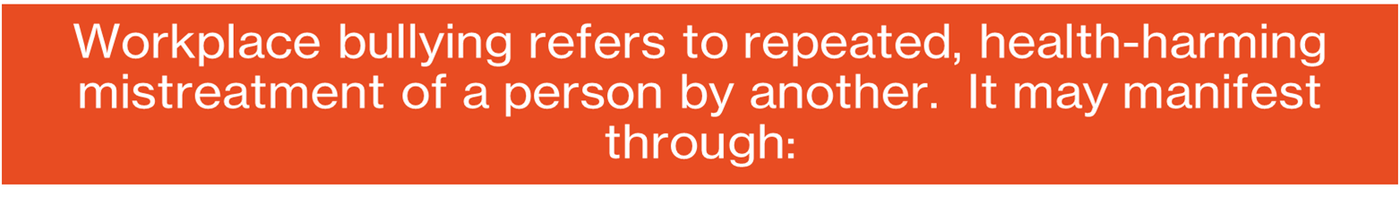



Bullying & Discrimination
Humiliation
Intimidation
Defamation
Sabotage
Isolation
Source: Northeast ADA Center
Notes:
In the Yang-Tan Institute’s NIDILRR-funded Work-Life Balance and Disability study, 23% of participants indicated that they had experienced harassment or discrimination in the past year. They described these situations as “bullying” or “harassment” (Cook, 2016):
• Being yelled at by supervisors and coworkers, often in front of other employees;
• Being denied professional development and promotional opportunities;
• Being excluded from information sharing at work;
• Being excluded from workplace and after-work socializing;
• Being excluded from employee recognition;
• Being forced to publicly disclose their disability; and
• Being pushed toward taking an early retirement or constructive discharge by the perpetrators’ making the work environment so intolerable that a reasonable person would not be able to stay.

Slide 28
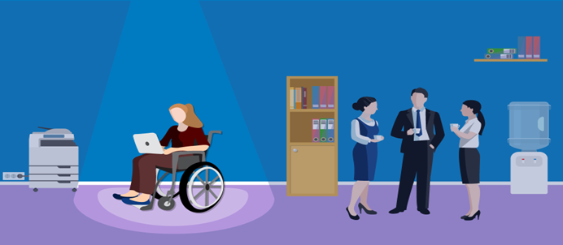
Examples of Disability Discrimination in the Workplace
Firing someone due to a disability
Discrimination due to past disability
Failing to accommodate an employee’s disability
Discrimination by perception
Harassing someone with a disability
Declining a job offer to someone due to a family member’s disability
Notes:
If an employer doesn’t hire a qualified applicant due to a disability, decides to reassign the employee to a lesser role, or fire him or her because of a disability, it would be in violation of the law.
If a worker has overcome cancer but is not given a promotion or a job offer due to the risk of a relapse, that is discrimination, and it is against the law.
Employers are required by law to make reasonable accommodations for disabled employees as long as it isn’t financially impossible or extremely difficult. Reasonable accommodation can be as simple as making alterations to the layout of the furniture in the lounge or providing additional equipment to assist an employee with their work.
Even if a worker is not disabled but is discriminated against because he or she is believed to have a disability, it’s still against the law.
Bullying, nicknames, inappropriate questions and unwanted jokes are all forms of disability harassment.
If an employee is married to a disabled spouse and is passed over for promotion because the decision maker believes that the employee cannot devote the adequate time to the job due to the disabled family member, that is considered disability discrimination and it is against the law.

Slide 29
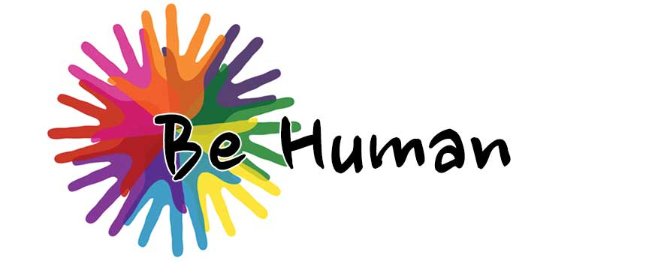

Slide 30

Notes:
ONLY IF ASKED ABOUT SEXUALITY IN RESPONSE TO THE VIDEO
Research shows that the majority of autistic adults (70% of autistic males and 76% of autistic females) engage in sexual activity—although they do so to a lesser degree than their non-autistic peers (89% of both non-autistic males and females report engaging in sexual activity). In contrast to previous findings, the results also found that there were no differences in likelihood of ever contracting an STI, or the age at which participants first engaged in sexual activity, between autistic and non-autistic individuals.
In addition, the study found that autistic adults and adolescents are approximately eight times more likely to identify as asexual and ‘other’ sexuality than their non-autistic peers. And there were sex differences in sexual orientation: autistic males are 3.5 times more likely to identify as bisexual than non-autistic males, whereas autistic females are three times more likely to identify as homosexual than non-autistic females.
When comparing autistic females and males directly, autistic females were more likely to be sexually active; more likely to identify as asexual, bisexual, and ‘other’ sexuality; and were less likely to identify as heterosexual.
Source: University of Cambridge (https://www.cam.ac.uk/research/news/autistic-individuals-are-more-likely-to-be-lgbtq).

Slide 31
Employer Fears & Misconceptions
What are some fears and misconceptions employers may have about hiring someone with a disability?

Slide 32
Employer Fears & Misconceptions
Autistic or I/DD individuals are prone to absenteeism and unreliability.
Hiring managers doubt skills of autistic or I/DD individuals despite application and interviews.
Autistic individuals cannot work in a competitive environment, but instead require a tailored, more sheltered workplace.
Individuals with autism or I/DD will increase the organizations disability insurance rates.
Autistic or I/DD individuals will embarrass the organization when interacting with the public.
Coworkers will resent changes, disruptions, or needed flexibility to their own duties as a result of an autistic or I/DD worker.
Source: Sage Journals – Hiring Agents’ Beliefs: A Barrier to Employment of Autistics
Notes:
There are many myths and misconceptions surrounding autistic people in the workplace and they can be quite harmful.
The destructive impact of fears and misconceptions about autistic people in the workplace can be felt anywhere from being misunderstood by colleagues, to being discriminated against in hiring and advancement processes, to being unemployed for months or even years at a time despite holding all relevant experience, qualifications and attitudes. Imagine how you might feel if the success of your career or even your ability to simply generate income and participate in society could be at best, negatively impacted, or at worst, taken away from you because of how other people feel about the way your brain is wired.

Slide 33
Interviewing Neurodiverse Individuals
Decrease the number of interviewers.
Provide a quiet space for conducting the interviews to reduce distractions.
Offer phone-based interviews
Share interview questions in advance of the interview.
Decrease reliance on figurative expressions, such as metaphors and idioms
Adjust your rate of speech as appropriate.

Slide 34
Interviewing Neurodiverse Individuals
Modify interview questions.
Inform the candidate if they are talking too much.
Consider use of a second-chance interview.
Consider evaluating candidates’ abilities in alternative ways.
Provide clear expectations on next steps.

Slide 35
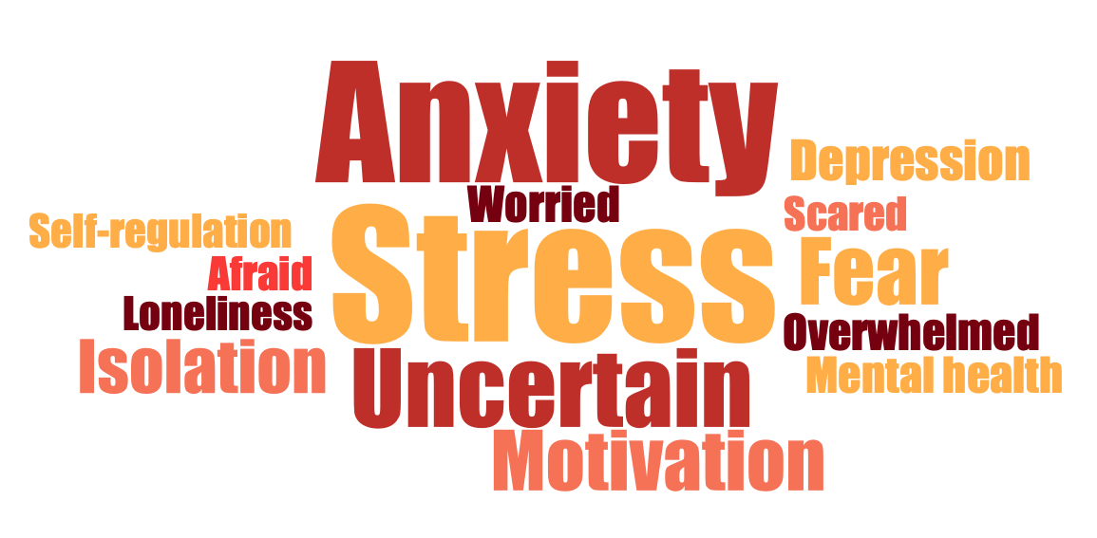
Self-Disclosure
An individual with a disability does not have to disclose to their employer unless an accommodation is needed.
This is a source of anxiety for many individuals with autism.
Individuals with ASD & I/DD fear:
lowered expectations
being treated differently
stigma
increased monitoring

Slide 36
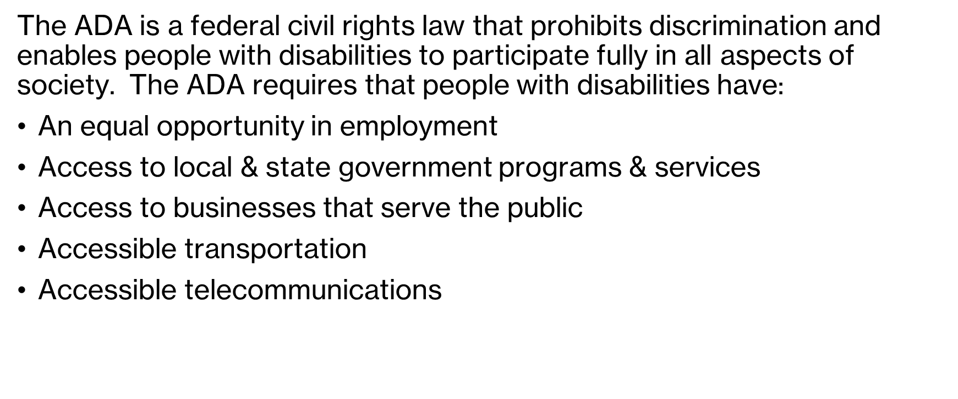
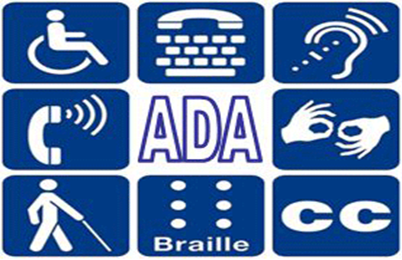
Americans with Disabilities Act (ADA)
Notes:
Disability rights are civil rights. The purpose of the ADA is to make sure that people with disabilities have the same rights and opportunities as everyone else to fully participate in aspects of society.

Slide 37

ADA Responsibilities as an Employer
The ADA makes it unlawful to discriminate in all employment practices such as:
Recruitment
Pay
Hiring & firing
Promotion
Job assignments
Training
Leave
Lay-offs
Benefits
All other employment-related activities
The ADA prohibits an employer from retaliating against an applicant or employee for asserting his rights under the ADA.
Source: US Equal Employment Opportunity Commission
Notes:
It is also unlawful for an employer to retaliate against an individual for asserting their rights under the ADA. The Act also protects you if you are a victim of discrimination because of your family, business, social or other relationship or association with an individual with a disability.

Slide 38

ADA Responsibilities as an Employer
The ADA requires reasonable accommodations as they relate to 3 aspects of employment:
ensuring equal opportunity in the application process;
enabling a qualified individual with a disability to perform the essential functions of a job; and
making it possible for an employee with a disability to enjoy equal benefits and privileges of employment.
Under the ADA, individuals do not have to disclose a disability until an accommodation is needed.
Source: U.S. Dept of Labor: Office of Disability Employment Policy
Notes:
Reasonable accommodations should not be viewed as “special treatment” and they often benefit all employees. For example, facility enhancements such as ramps, accessible restrooms, and ergonomic workstations benefit more than just employees with disabilities. Examples of reasonable accommodations include making existing facilities accessible; job restructuring; part-time or modified work schedules; acquiring or modifying equipment; changing tests, training materials, or policies; and providing qualified readers or interpreters.
Many job accommodations cost very little and often involve minor changes to a work environment, schedule or work-related technologies

Slide 39
Leading the Way…
Many companies, from large corporations to small businesses, have developed successful neurodiversity hiring initiatives that are helping to improve their bottom lines and increase the employment rates of people with disabilities.
Source: Employer Assistance & Resource Network on Disability Inclusion
Notes:
The benefits of hiring autistic workers
Studies show that companies that hire autistic employees maintain a better work environment and generate better results in less time. Here are a few more benefits:
Innovation at the workplace: Businesses must innovate and adapt to thrive in the market. Hiring a diverse group of people, including autistic people will help companies put their best foot forward.
Access to a larger talent pool: Businesses gain access to a larger pool of talented and skilled individuals.
Enhanced productivity: After working with neurodiverse employees, managers learn to avoid abstract language, use shorter and crisp sentences, and give more specific instructions that benefit everyone.

Slide 40
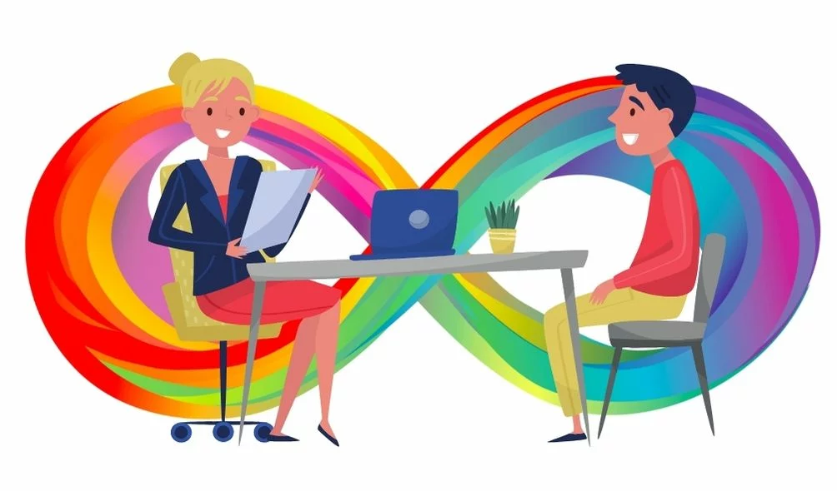
Capital One – Autism at Work began in 2009 and is an internship program aimed at bringing young people on the autism spectrum to work at the company.
Ford Motor Company – FordWorks began in 2016 and its goal is hiring and supporting autistic employees. FordWorks partnered with the Autism Alliance of Michigan, which sent staff to Ford to shadow jobs and determine which would be suitable for the particular strengths of employees with autism and to help address any issues that might arise.
Microsoft – Neurodiversity Hiring Program started in 2015 and candidates are given an initial technical skills assessment, and after that a phone screening and then an invitation-only, week-long campus event to determine if a candidate’s skills and workability match with the company’s needs. New hires have onboarding support, including job coaches and Microsoft mentors.
Source: Employer Assistance & Resource Network on Disability Inclusion

Slide 41
Neurodiversity as an Advantage
Problem-Solving - Neurodiverse employees may bring new perspectives to an organization’s efforts to create and recognize value.
Job Retention - According to Training Industry, employers who have opened their doors to a neurodiverse workforce have found that autistic employees have a retention rate upward of 90%.
Workplace Culture - Hiring and including a neurodiverse workforce can drastically improve the culture of a work environment. A recent survey conducted by Microsoft rated a positive work environment as one of the top five most important aspects that employees look for in a job.
Source: Forbes – Five Benefits to Hiring a Neurodiverse Workforce
Notes:
Neurodiversity recognizes the differences, not deficits, of neurodivergent individuals. A major advantage that neurodivergent employees bring to a workforce is how they receive, process, and interpret information differently. These differences may lead to viewing and solving problems in unconventional ways. This difference in thinking and processing could also lead to new approaches and possibilities that other employees may overlook. Neurodiversity offers a competitive advantage to employers who recognize the benefits of diversity in the workplace. If every employee thinks and processes information in the same way then we are likely to miss out on opportunities to bring creative solutions into our organizations.
Neurodiverse people tend to be quite loyal to their employers and are more likely to stay in a job long term. Provided the working environment is supportive, accepting and inclusive, your neurodiverse hire will likely stick around.
The success of neurodiversity inclusion is twofold: the value neurodiverse employees provide the company and the value the company can provide neurodiverse employees.

Slide 42
Neurodiversity as an Advantage
Boosting Company Image - When a brand has a strong purpose, consumers are four times more likely to trust the company, and six times more likely to defend the company from criticism.
Professionalism - Many autistic people flourish in a structured environment, where they are expected to follow rules and abide by a routine.
Access to Larger Talent Pool - In a competitive market, employers can’t afford to overlook the large pool of qualified, capable, neurodivergent individuals who sometimes get lost in the hiring process.
Source: Forbes – Five Benefits to Hiring a Neurodiverse Workforce
Notes:
By valuing diversity and opening your business's doors to a neurodiverse population, you can simultaneously boost your company image and make your workplace more appealing to incoming applicants.
Being more intentional about creating an inclusive recruiting and retention plan helps build an environment where everyone can thrive.
Developing policies that support the well-being of any employee supports all employees. When you support neurodiversity at work, you make it easier for everyone to ask for the support they need.

Slide 43
Benefits of Hiring Neurodiverse & I/DD Employees
Fosters diversity of thought, different approaches to work, innovation, and creativity
Inclusion and integration of neurodivergent professionals can also boost team morale. (Deloitte Insights, 2022).
62% of adults with ID employed in a competitive setting have been at their current job for 3 years or more
Research suggests that teams with neurodivergent professionals in some roles can be 30% more effective than those without them.
Favorable public opinion of a business
Legal compliance
81% of adults with ID employed in a sheltered setting have been at their current job for 3 years or more.
Source: The Minds Journal & Special Olympics
Notes:
Great minds do not always think alike. We’re all made up of different perspectives, life experiences and various ways of looking at and processing the world around us.
Having a neurodiverse workforce has proven crucial for both the business and employees alike.
Adults on the autism spectrum face high unemployment rates, although many would be eager and able to use their talents to the benefit of someone’s business. Unfortunately, many employers aren’t willing to give them a chance due to their preconceived notions about autism, creating a loss for both the employee and the employer
As society continues to move forward, diversity and inclusion will continue to be major themes. Furthermore, the biggest problems of our time will require an acceptance that great minds are everywhere, and they’re probably not all thinking alike.

Slide 44


Questions??

Slide 45
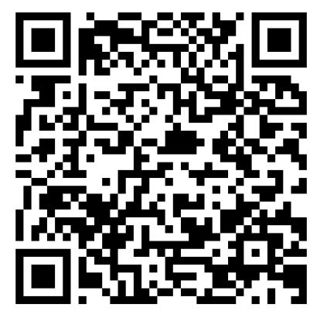
Post Training Survey

Slide 46

E-mail: kbritt@autismfoundationok.org
Phone: (405) 474-7937
Kyle Britt, MA, CAS
Workforce Development Coordinator

Slide 47
Resources
National Autism Center
WebMD
Texas Health & Human Services
Special Olympics
Social Innovations Journal
US National Institutes of Health (NIH)
UK National Health System (NHS)
Cleveland Clinic
Drexel University

Slide 48
Resources
Employer Assistance & Resource Network on Disability Inclusion
U.S. Dept of Labor: Office of Disability Employment Policy
Autism Parenting
Autism Learning Partners
Northeast ADA Center
Baldwin & Vernon Law Firm
U.S. Equal Employment Opportunity Commission
Together We Rock!
Special Olympics

Slide 49

Training Sponsored By:

