Slide 1
Tips for Using Program Support Materials

Slide 2
Use the Program Resources
FEMA uses these materials in the review process.
Panelists from across the nation review applications using the same criteria.
Program Support Materials are released to assist in understanding what the reviewers are looking for in the application.

Slide 3
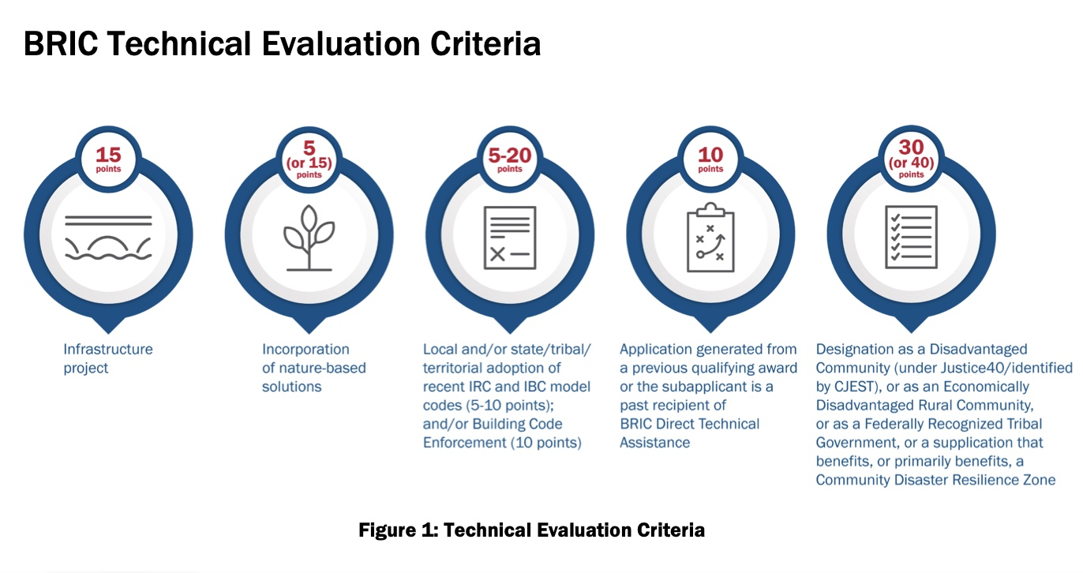
Self Score the Community and Application
Notes:
What about 5-20, or 40 or 40?

Slide 4
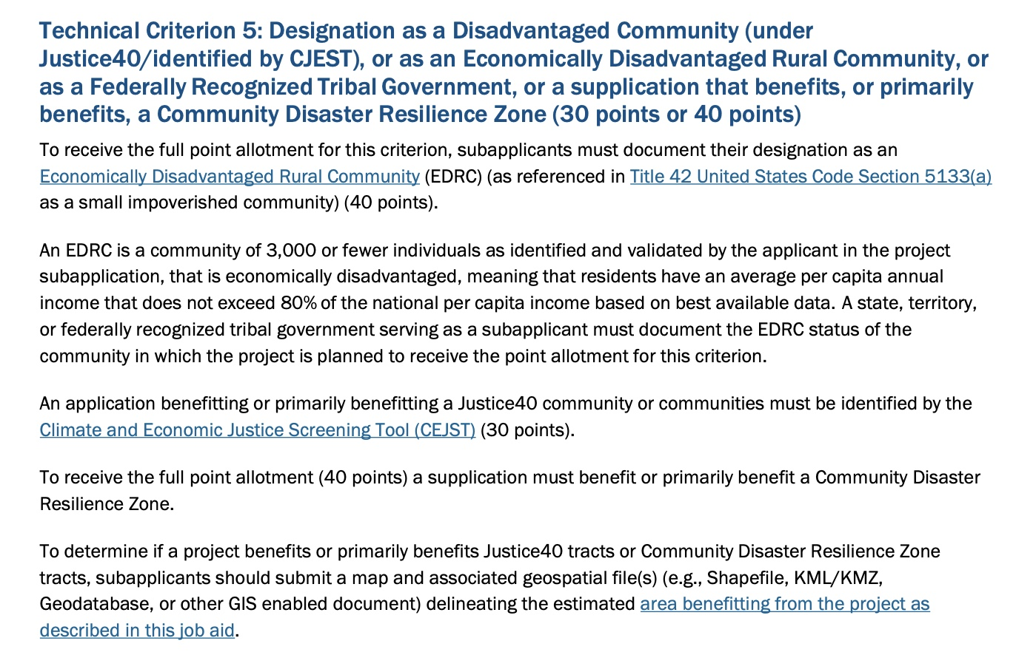
No Points, Some Points, Max Points?

Slide 5
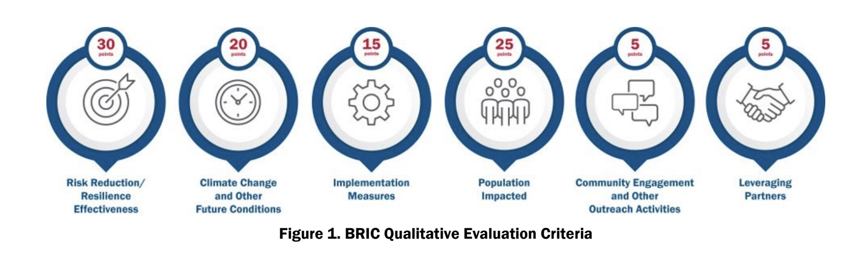
Qualitative Criteria
Notes:
Subjective

Slide 6
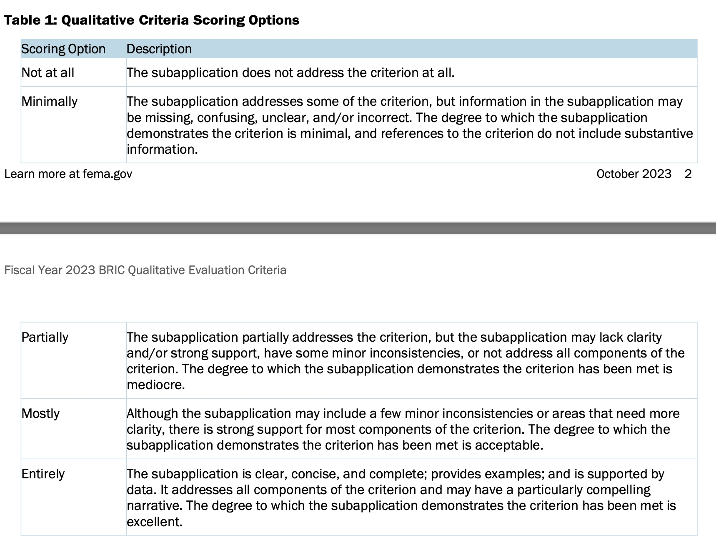

Slide 7
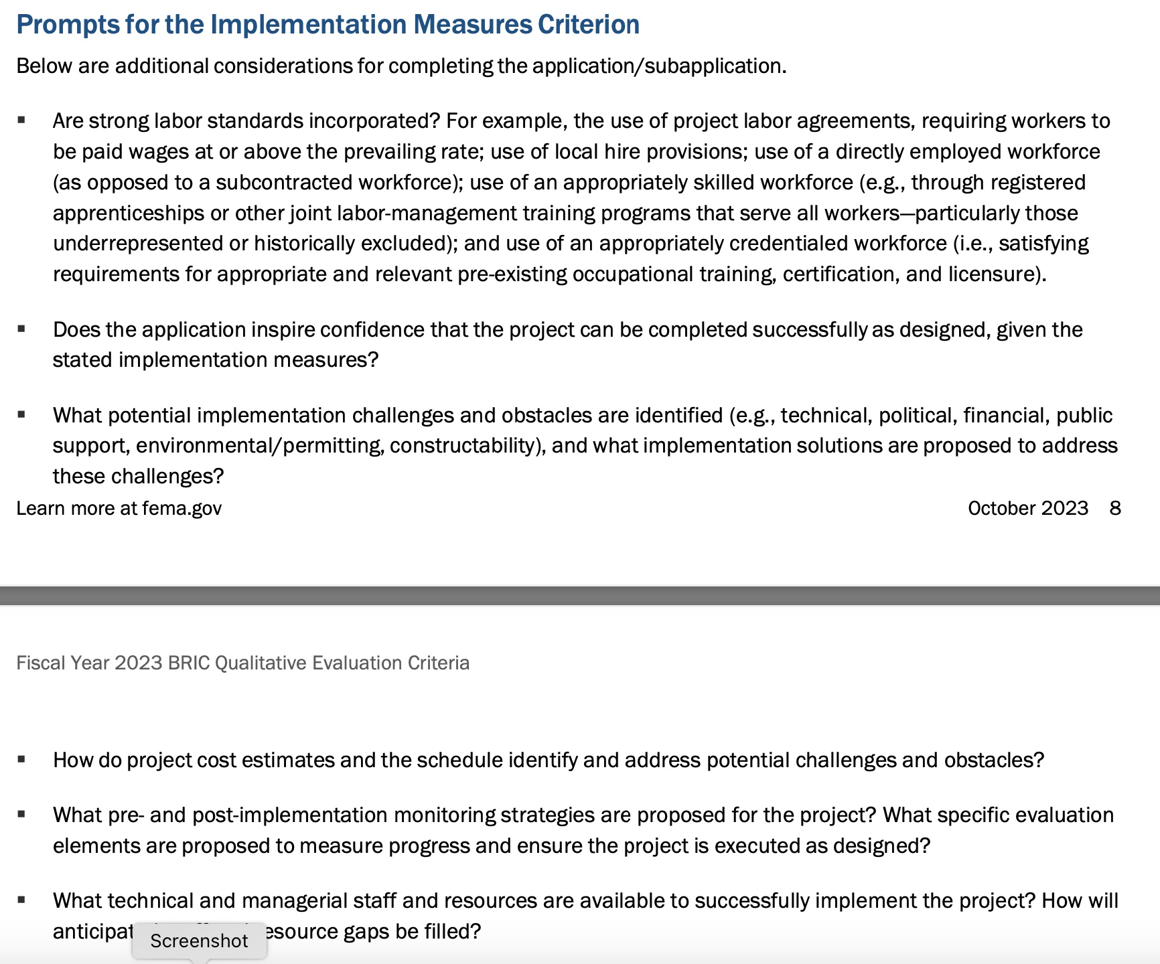
Answer the Prompts in the Program Support Material
Notes:
Consider developing an attachment to the application that is well formatted, uses key words from the prompts as headers, and answers all questions in the program support material prompts.
Develop a crosswalk for the reviewer to show where each item was met.
Well organized applications do much better

Slide 8
In any FEMA Hazard Mitigation Assistance Program
The state and FEMA are here to help!
Use the resources FEMA provides.
Refer to the FEMA Hazard Mitigation Assistance Program and Policy Guide.
Do your research and ask lots of questions.

Slide 9
Michael D’Arcy, Resilience Division Manager michael.darcy@oem.ok.gov
Questions?

