Slide 1
Flood Mitigation Assistance (FMA) and Building Resilient Infrastructure and Communities (BRIC) Eligibility and Completeness Overview
Hazard Mitigation Assistance Grants | August 13, 2024
Notes:
Good afternoon and welcome to today's Hazard Mitigation Assistance Non-Disaster Grants webinar.
We know, natural disasters are a global challenge, and their impact is felt by communities across the United States and around the world. From devastating floods and wildfires to destructive hurricanes and earthquakes, these events can result in immeasurable loss of life, property, and infrastructure. As we confront the increasingly unpredictable forces of nature, it is our collective responsibility to work towards a safer and more resilient future.
This webinar will focus on subapplication completeness and cost effectiveness, based on the Notice of Funding Opportunity from last season, as the new NOFOs are not out for BRIC and FMA.

Slide 2
Application Development Best Practices
Do
Don’t
Use clear and consistent naming conventions for attachments
Provide supporting documentation
Consider project scoping or phasing for larger complex projects
Match project or activities with program and Notice of Funding Opportunity (NOFO) priorities
Include inaccurate information
Forget to attach key documents
Provide unclear descriptions of the intended level of protection
Fail to connect natural hazards to the project
Notes:
There are certain things you do and don't do for a subapplication to be better suited for our program funding.
This slide shows some of the Do's and Don'ts that are most important, such as: using clear language – as reviewers, we don't necessarily know your acronyms, know your processes, or some of the more technical language. So be sure that anyone can understand what you are saying.
Also make sure you provide all the required documentation – you can find that in the NOFO and in our Hazard Mitigation Assistance Guidance.
If you don't have enough information about the project yet, consider a project scoping option or possibly phasing the project. How much info you know, depends on which option you would choose.
Make sure your project matches the funding opportunity you are applying to.
Don’t give inaccurate information, don't forget to attach key documents (as that could cause your subapplication to be rejected. Make sure all descriptions are clear, and you connect your project to a natural hazard and risk reduction.

Slide 3
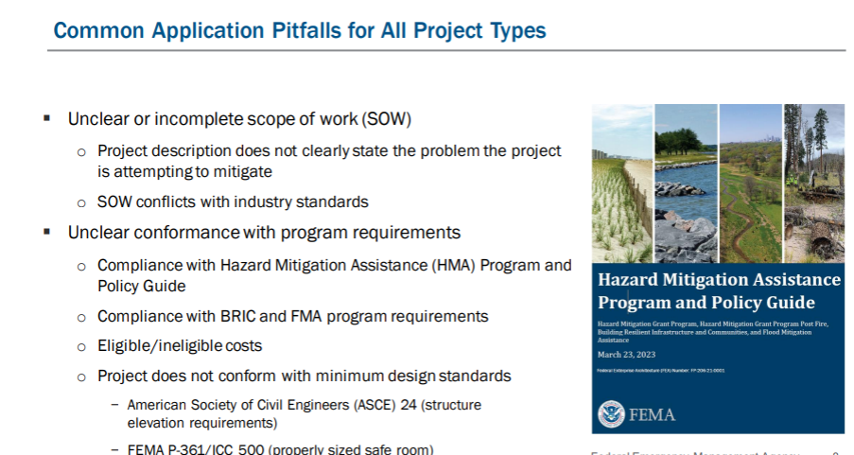

Notes:
If your Scope of Work doesn't tell us what you are doing and how, we will not understand your project.
In addition, if your scope of work has ineligible items in it, those will need to be taken out or reworked – which takes time away from awarding your project.
Your project will also need to be in compliance with all program requirements and design standards, or it may be unable to be selected for further consideration.

Slide 4
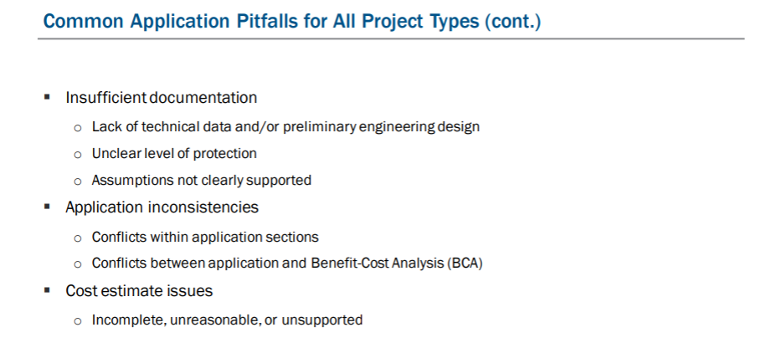
Notes:
You can see some of the other pitfall here on this slide – missing documentation can cause your project to not be selected, inconsistencies can cause delays in review, and cost estimate issues can be problematic.

Slide 5
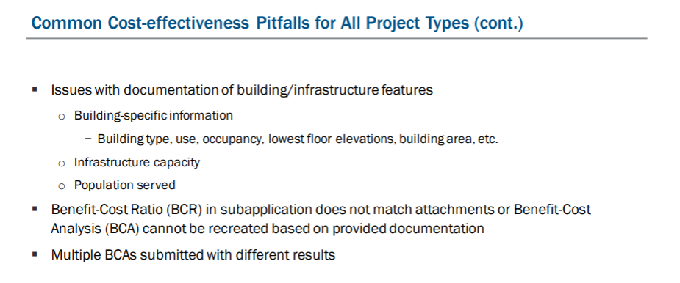
Notes:
If your project requires a benefit-cost analysis, documentation for all entries is required. Failure to provide documentation can be a reason for a project to not be selected.
You can see some of the documentation needs on this slide, including building information, population served, etc.

Slide 6
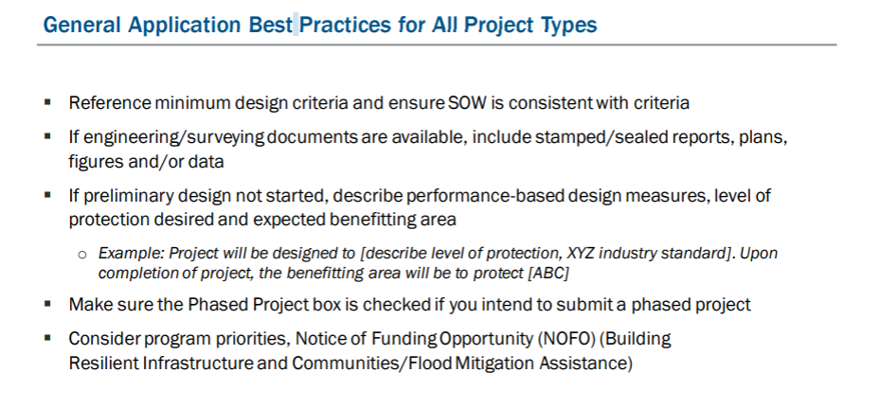
Notes:
As far as best practices, here are some suggestions on how to make your subapplication more complete.
Be sure to reference minimum design criteria, preliminary design, and level of protection – as well as the population to be protected.
If you will be phasing the project, be sure to click the Phased Project box in FEMA GO.

Slide 7
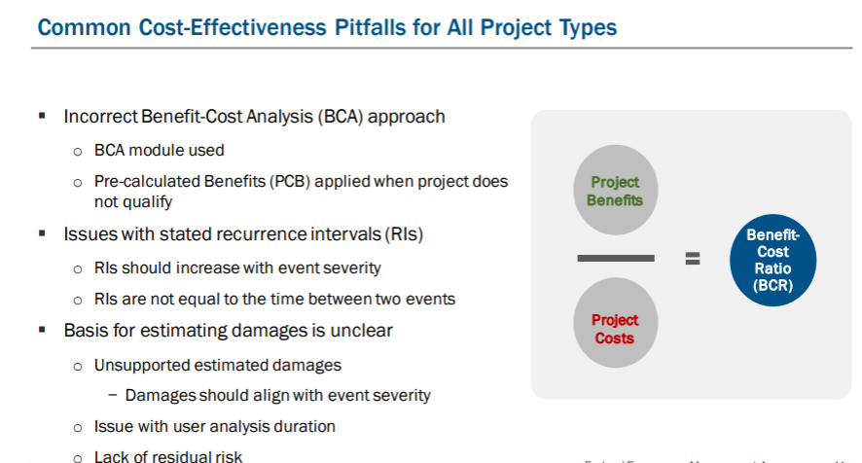

Slide 8
Benefit-Cost Analysis (BCA)
FEMA requires all hazard mitigation projects to be cost-effective. Applicants and subapplicants may use one of three standard approaches:
Streamlined Determination Method:
  For projects with a total cost of less than $1,000,000, the subapplicant may provide a narrative that includes qualitative and quantitative data demonstrating the benefits and cost-effectiveness of the project.
  Pre-calculated benefits are available for some project types, including acquisitions, elevations, wind retrofits, tornado safe rooms, hospital generators, and post-wildfire mitigation.
  Applicants and subapplicants may still opt to use a BCA to show cost-effectiveness of a project.
Notes:
FEMA requires all hazard mitigation projects to be cost-effective.
Applicants and subapplicants may use one of three standard approaches:
Streamlined Determination Method:
For projects with a total cost of less than $1,000,000, the subapplicant may provide a narrative that includes qualitative and quantitative data demonstrating the benefits and cost-effectiveness of the project.
Pre-calculated benefits are available for some project types, including acquisitions, elevations, wind retrofits, tornado safe rooms, hospital generators, and post-wildfire mitigation.
Or utilize Benefit Cost Analysis tools to show cost-effectiveness of a project.

Slide 9
Benefit-Cost Analysis (BCA) (Cont.)
Assistance:
  FEMA will review hazard mitigation project subapplications during the pre-award process that are competitive and otherwise eligible for selection.
    For BRIC, a BCA or Benefit-Cost Ratio (BCR) of at least 1.0 is not required at time of application for Federally Recognized Tribes, Economically Disadvantaged Rural Communities, and projects primarily benefitting Community Disaster Resilience Zones.
    For FMA, Federally Recognized Tribes, small and improvised communities and communities in Community Disaster Resilience Zones can submit subapplications without completing a BCA.
Discount Rate Adjustment:
  If a streamlined cost-effectiveness determination method does not apply, a BCA is required to validate cost-effectiveness. FEMA has established a set discount rate of 3% to be used in a BCA for hazard mitigation projects for the FY 2023 BRIC and FMA cycles.
Notes:
Assistance:
FEMA will review hazard mitigation project subapplications during the pre-award process that are competitive and otherwise eligible for selection.
For BRIC, a BCA or Benefit-Cost Ratio (BCR) of at least 1.0 is not required at time of application for Federally Recognized Tribes, Economically Disadvantaged Rural Communities, and projects primarily benefitting Community Disaster Resilience Zones.
For FMA, Federally Recognized Tribes, small and improvised communities and communities in Community Disaster Resilience Zones can submit subapplications without completing a BCA.
Discount Rate Adjustment:
If a streamlined cost-effectiveness determination method does not apply, a BCA is required to validate cost-effectiveness. FEMA has established a discount rate of 3% to be used in a Benefit Cost Analysis for hazard mitigation projects for the FY 2023 BRIC and FMA cycles.

Slide 10
Helplines
General questions about the BRIC and FMA programs can be directed to:
  For Applicants: FEMA Regional Offices at www.fema.gov/about/contact.
  For Subapplicants: State Hazard Mitigation Officers at www.fema.gov/state-hazard-mitigation-officers.
  For immediate assistance, you may also contact the HMA Helpline: 1-866-222-3580
For technical assistance with the FEMA GO system, contact the FEMA GO Helpline:
  femago@fema.dhs.gov
  1-877-611-4700 (Monday through Friday, 8:00 AM – 6:00 PM ET.)
For questions about cost-effectiveness and FEMA’s Benefit-Cost Analysis software, contact the BC Helpline:
  BCHelpline@fema.dhs.gov
  1-855-540-6744
For questions about the National Environmental Policy Act (NEPA) or Environmental and Historic Preservation (EHP) requirements, contact the EHP Helpline:
  FEMA-EHPHELPLINE@fema.dhs.gov
  1-866-222-3580
For questions about FEMA's Building Science publications, contact: FEMA-BuildingScienceHelp@fema.dhs.gov
For questions about FEMA's Safe Room publications, contact: Saferoomp@fema.dhs.gov
Notes:
Please note the various ways to get help and more information on this slide.
General questions from subapplicants can be directed to the State office and if the State has questions they can contact their FEMA POC.
Technical assistance with FEMA GO is also available at the FEMA GO helpline.
For help with cost-effectiveness and BCA, you can contact the BCA Helpline.
For environmental questions, there is an EHP Helpline.
And then you can see an email address for building sciences and safe rooms.

Slide 11


