Slide 1
Stakeholder Meeting
I-35 Bridges over the Oklahoma River
I-35 & I-40 Dallas Junction Interchange
JP30444 (06)

Slide 2
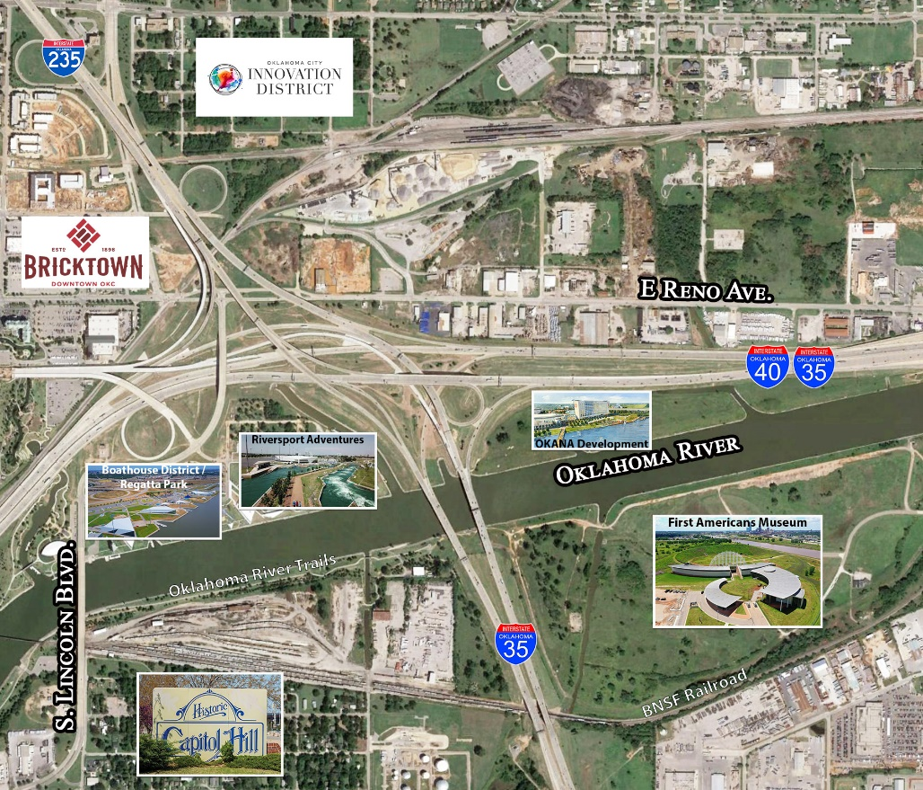
Project History
Beginning in 2016, a study was commissioned to address increased traffic on I-35 (projected at 210,000 AADT in 2030) and how to accomplish additional capacity for the river crossing.
The original idea was to add two new parallel bridges for I-35 to have two continuous lanes through the interchange.
In 2018, ODOT constructed an interim project to include additional lanes on those movements, but had not addressed capacity for the full river crossing.

Slide 3
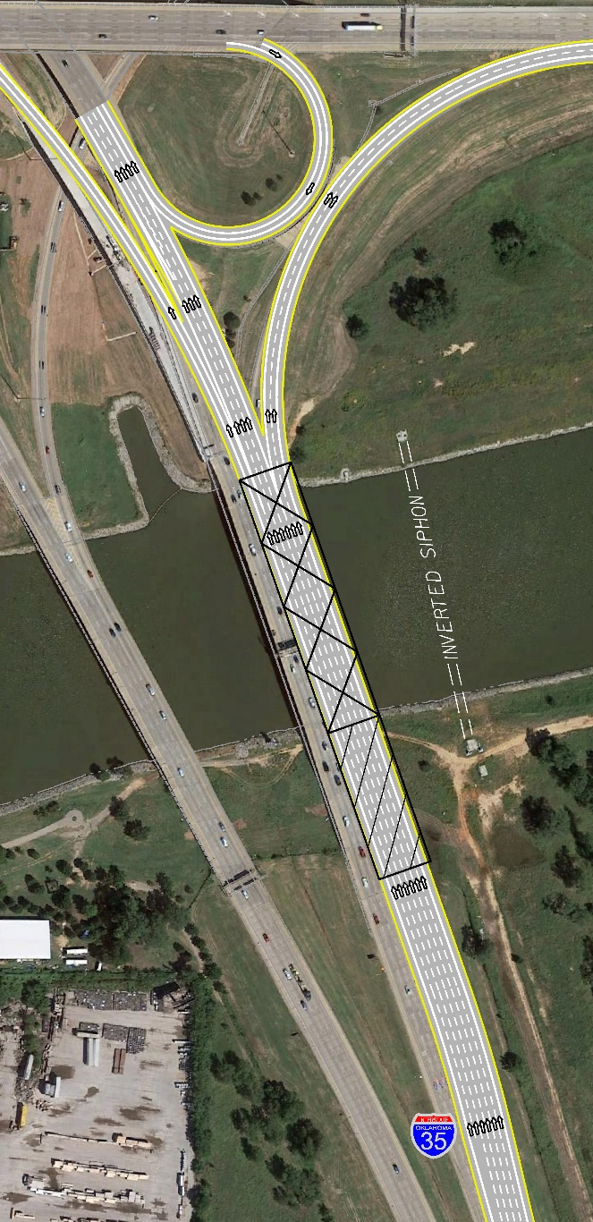
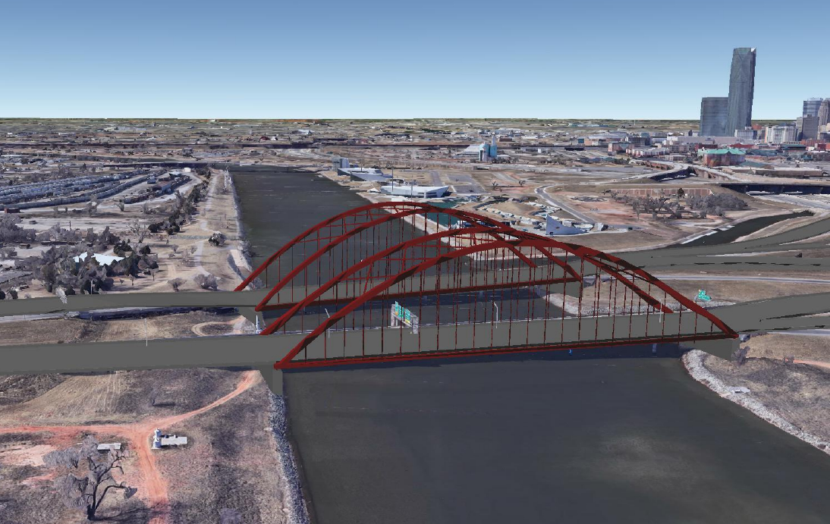
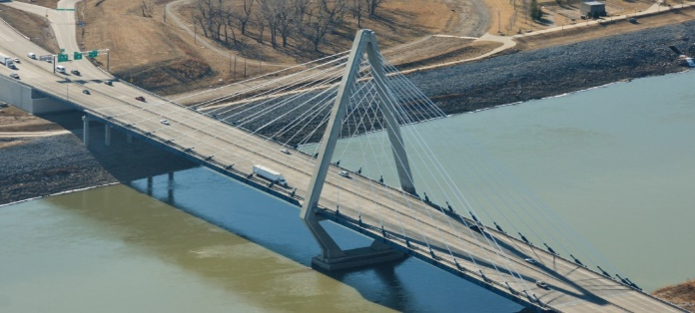
ODOT Study
ODOT’s Study Reviewed the Following Options:
Adding parallel bridges (Option 1)
Replacing existing structures with single pier, traditional beam (Option 2)
Replacing existing structures with no pier, traditional beam (Option 3)
Replacing existing structures with no pier utilizing a long span structure (tied arch or cable stay) (Option 4)

Slide 4
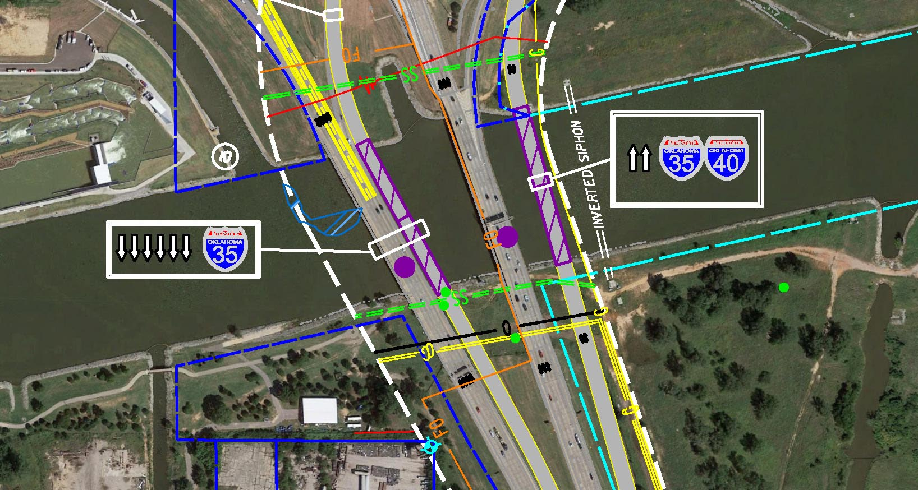
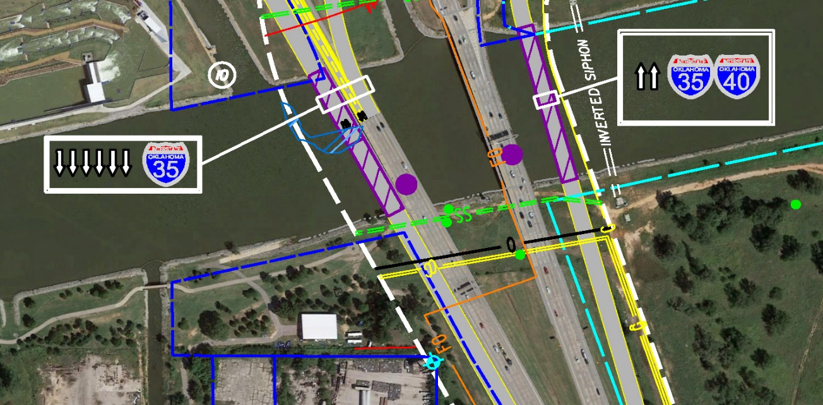
Option 1 – Plan View
Requires Future Replacement/Rehabilitation of Existing I-35 Mainline Bridges
Increases Difficulty of Replacing SB Mainline Bridge in the Future
Long-Term Maintenance on Four Bridges
Concept 1
Concept 2

Slide 5
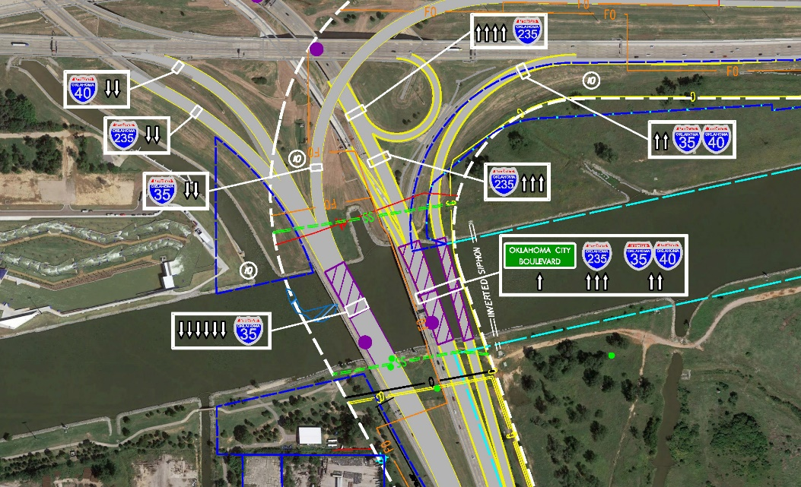
Option 2 – Plan View
Option 2 – Traditional Bridge with Pier in the Water
Traditional Beam
Minimize Impact to the
Interchange
Concept 3.1
Concept 3.2

Slide 6
Option 2 – Profile View

Slide 7
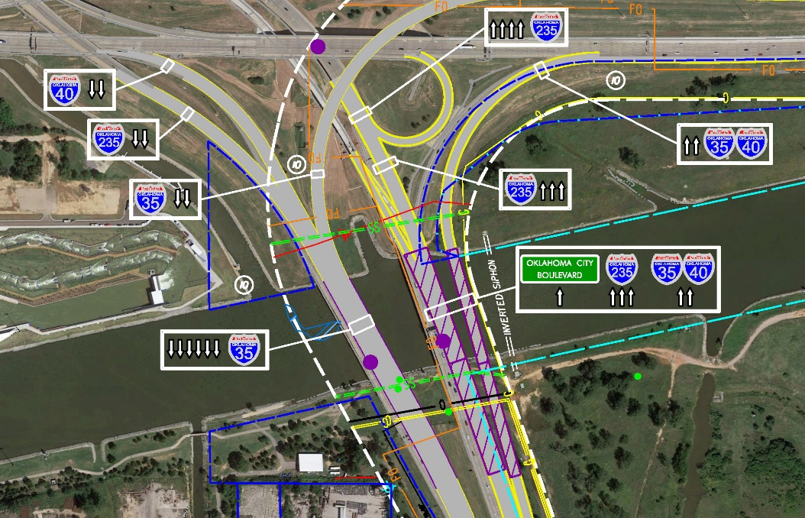
Option 3 – Plan View
Option 3 - Traditional Bridge with No Piers in the Water would require:
Very Large Beams
20+’ Tall Beams
Difficult Construction
Higher Construction Cost
Significant Impacts to All Roadways Involved with the Interchange
Concept 3.2

Slide 8
Option 3 – Profile View Matching Grade

Slide 9
Option 3 – Profile View Raised Grade

Slide 10
Option 4 – Plan View

Slide 11
Option 4 – Tied Arch

Slide 12
Option 4 – Cable Stay

Slide 13
Mainline Bridge Cost Estimates
 | Adding Parallel Bridges with Rehabilitation to Existing Structure (Multiple Piers Remain) | Replacing Existing Structure - Traditional Beam Bridge - 1 Pier in Water | Replacing Existing Structure - Traditional Beam Bridge - No Pier in Water | Tied Arch Bridge - No Piers in Water | Cable Stayed Bridge - No Piers in Water
 | OPTION 1 | OPTION 2 | OPTION 3 | OPTION 4 | OPTION 4
NB Bridge & Approach Units | $18.7 M | $14.2 M | $33.5 M | $70.0 M | $112.1 M
SB Bridge & Approach Units | $18.1 M | $13.5 M | $31.9 M | $66.4 M | $110.8 M
TOTAL COST | $36.8 M | $28.7 M | $65.4 M | $136.4 M | $222.9 M
Based on Construction Year 2025 on cost/sq ft of Bridge Deck Area
Costs shown are for Bridge Structures Only, Do not include adjacent Roadway impacts

Slide 14
Decision Matrix
 | Adding Parallel Bridges with Rehabilitation to Existing Structure (Multiple Piers Remain) | Replacing Existing Structure - Traditional Beam Bridge - 1 Pier in Water | Replacing Existing Structure - Traditional Beam Bridge - No Pier in Water | Tied Arch Bridge - No Piers in Water | Cable Stayed Bridge - No Piers in Water
 | OPTION 1 | OPTION 2 | OPTION 3 | OPTION 4 | OPTION 4
Capacity | 6 Lanes | 6 Lanes | 6 Lanes | 6 Lanes | 6 Lanes
Piers In Waterway | Multiple (match existing) | Single | No Pier | No Pier | No Pier
TOTAL COST | $36.8 M | $28.7 M | $65.4 M | $136.4 M | $222.9 M
Constructability Constraints | Constructable | Constructable | Severe Constructability Issues | Limited I-35 Closure | Extensive I-35 Closure
Bridge Maintenance | Traditional | Traditional | Traditional | Somewhat Complex | Complex

Slide 15
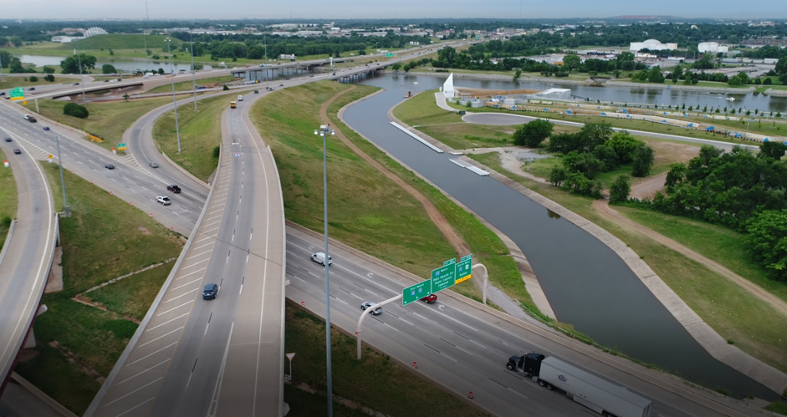
Next Steps
Stakeholder Engagement
Finalize Traffic Operational Analysis
Determine Impacts to ROW & Utilities
Finalize Costs
Finalize & Submit Study
Concept Selection
Begin Construction Plans

Slide 16
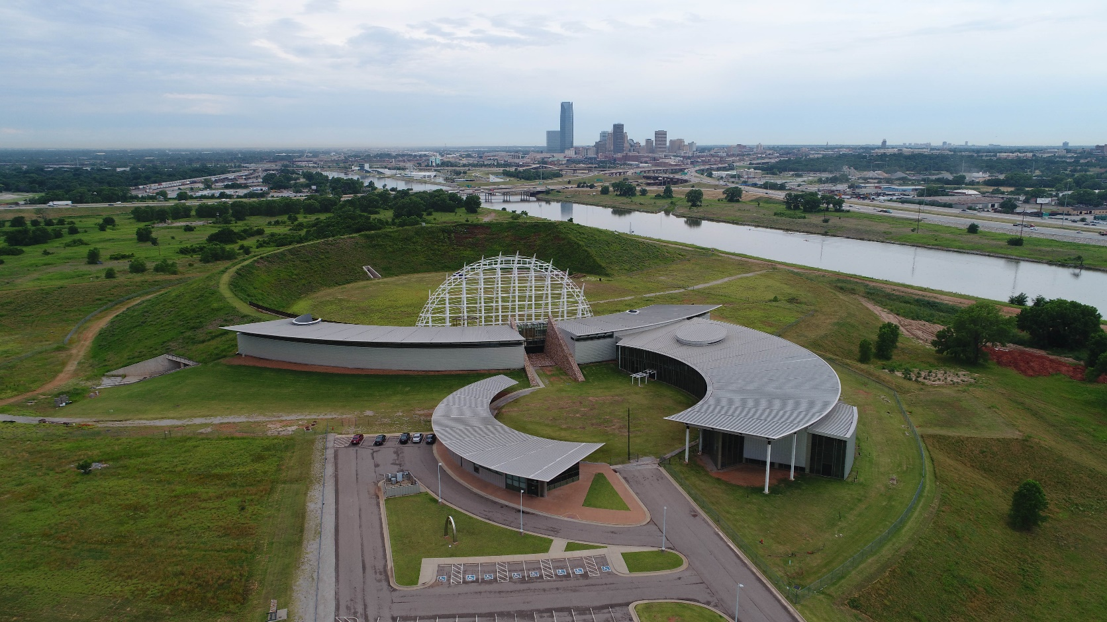
General Questions & Comments
Please feel free to ask any general questions or comments regarding the information presented?

