Slide 1
What Happens After Disadvantaged Business Enterprise (DBE) Certification
Oklahoma Department of Transportation/Civil Rights Division
Notes:
Introduction

Slide 2
About Us
ODOT makes all certification decisions for the participation in the DBE Program.
Makes all certification decisions on behalf Oklahoma U.S. DOT recipients
Maintain directory of current certified firms online.
“One-Stop Shopping” for certifications.
Oklahoma has elected to have one Unified Certification Program for the state of Oklahoma. The certification agency is ODOT.

Slide 3
Our Promise
Discrimination Clause
The Oklahoma Department of Transportation (ODOT) ensures that no person or groups of persons shall, on the grounds of race, color, sex, religion, national origin, age, disability, retaliation or genetic information, be excluded from participation in, be denied the benefits of, or be otherwise subjected to discrimination under any and all programs, services, or activities administered by ODOT, its recipients, sub-recipients, and contractors. To request an accommodation please contact the ADA Coordinator at 405-521-4140 or the Oklahoma Relay Service at 1-800-722-0353. If you have any ADA or Title VI questions email ODOT-ada-titlevi@odot.org.

Slide 4
What Does Happen
After DBE/ACDBE Certification?
Annual Renewals
Interstate Certifications
Changes
Expansions

Slide 5
Annual Recertifications
Online Application

Slide 6
Gathering Required Documents
Annual Recertifications
First of all gather all your documents
No Change Affidavit (NCA)
Must be the most current form
Can be downloaded From CRCC
Most Current Federal Tax Return

Slide 7
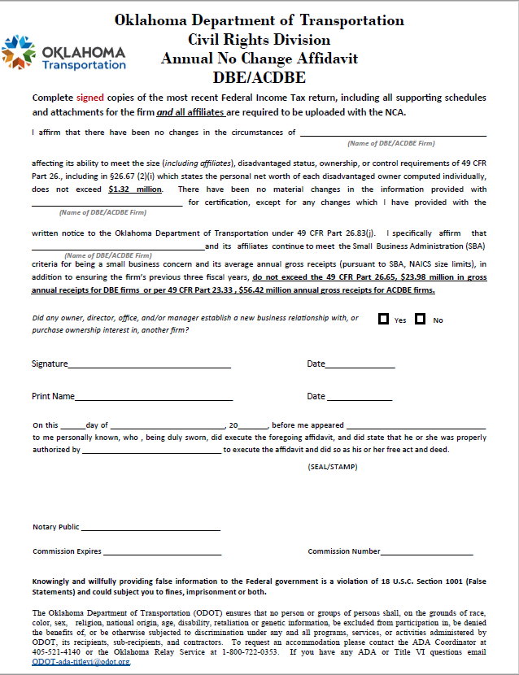
No Change Affidavit (NCA)
Fill out the firm’s name in three (3) places.
Make sure to put a check mark on “Yes” or “No”.
Sign and date.
Print and date.
Must be notarized.

Slide 8
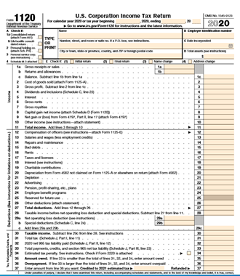
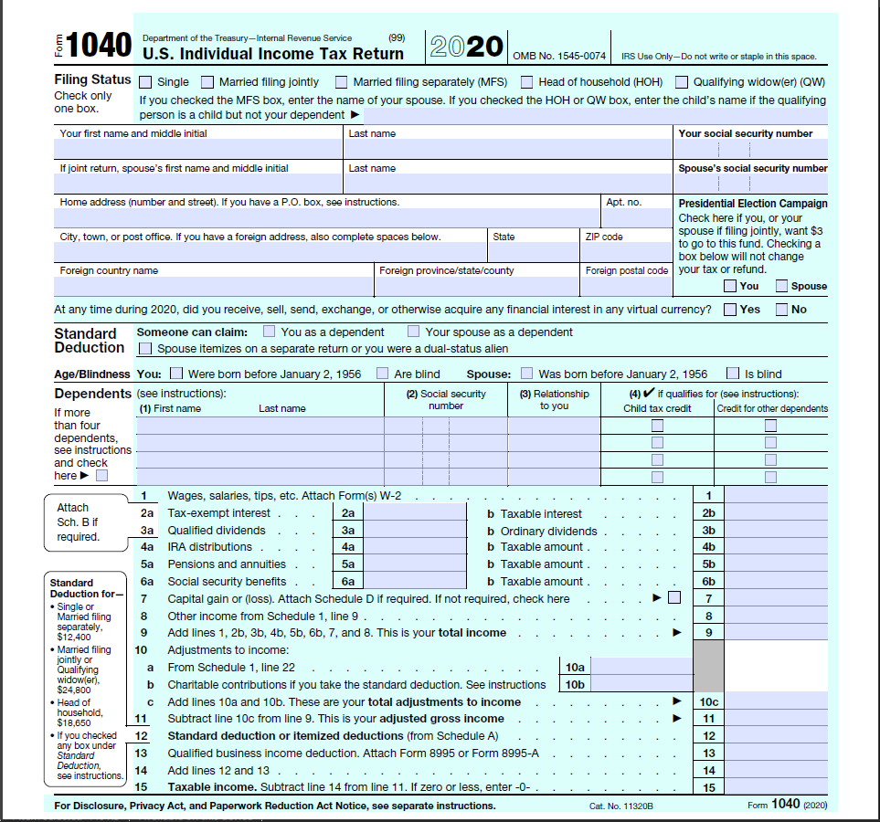
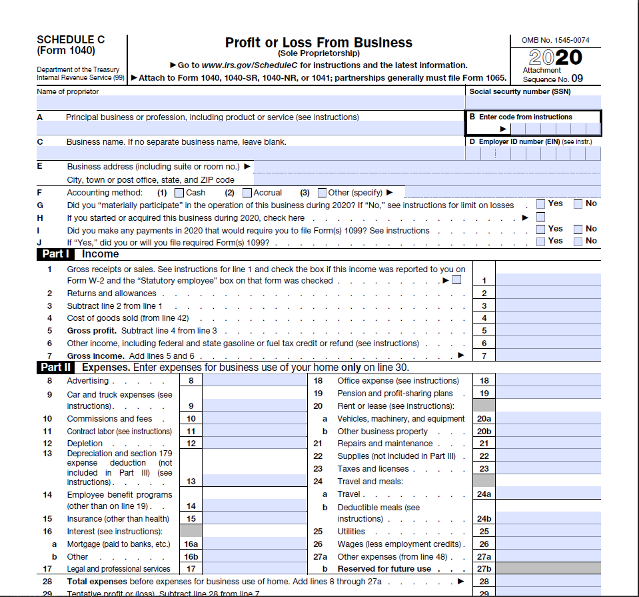
Federal Tax Return
Tax Returns
Most current year or Extension Request
Last previous year Tax Return (if extension was filed the previous year)
Must be signed
All schedules included (Schedule C/Profit and Loss for Individual Tax Returns)
Three years (average gross receipts)
Changes in January 6, 2022
Five (5) most current years

Slide 9
Civil Rights Certification and Compliance System (CRCC)
Online Annual Recertification Application

Slide 10
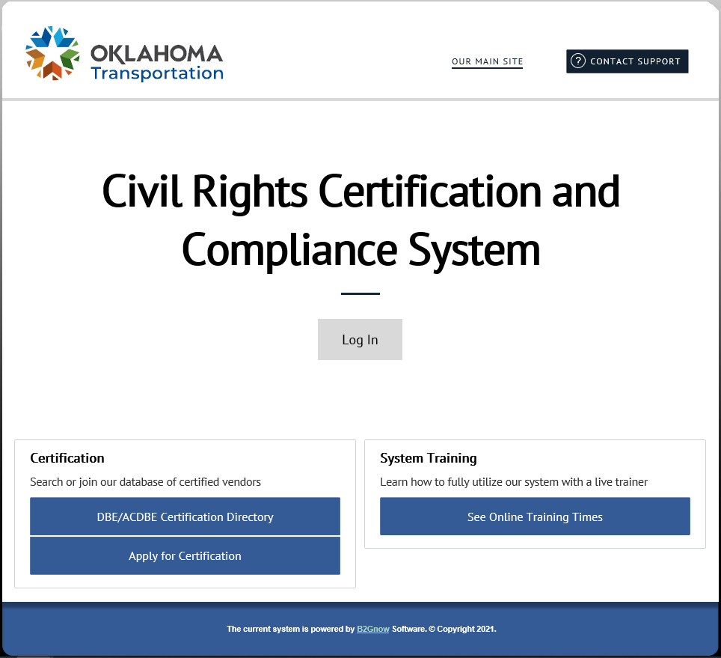
Civil Rights Certification and Compliance System (CRCC)
Online Renewal Applications
Online Applications Only
Website https://okdot.gob2g.com/
Online Training
Log into your profile

Slide 11
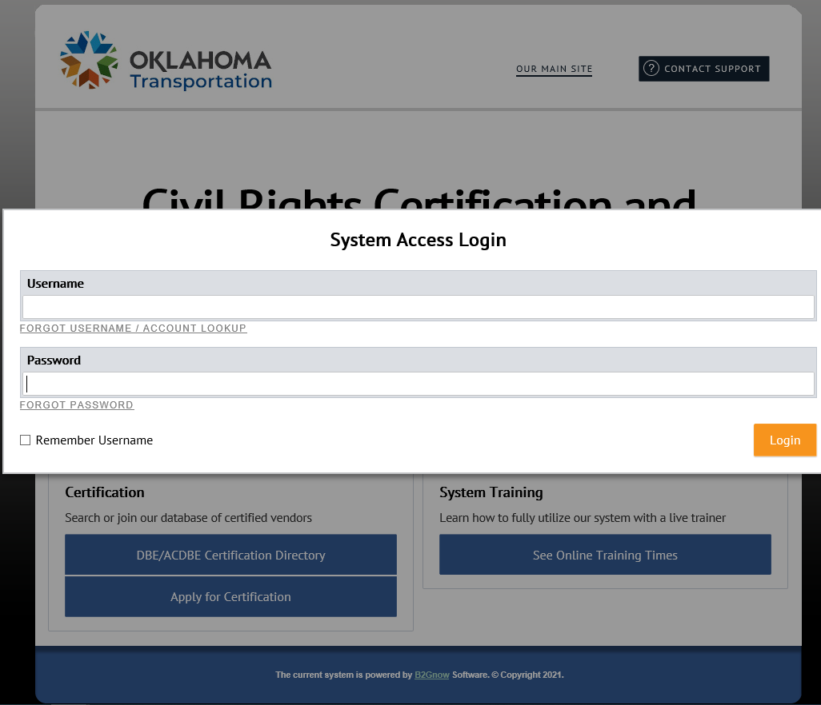
Civil Rights Certification and Compliance System (CRCC)
Online Renewals
Username
Forgot Username/Account Lookup
Password
Forgot Password
Remember Username
Login

Slide 12
Civil Rights Certification and Compliance System (CRCC)
Online Annual Renewals
Dashboard
Status
Active
Pending
Renewing
Certification Center
Active Certifications
ACDBE
DBE
Click on Renew/Apply for Certification

Slide 13
Civil Rights Certification and Compliance System (CRCC)
Annual Renewals
Select an Option
Your firm is currently certified by ODOT.
Your firm is seeking certification.
You would choice Your firm is currently certified by ODOT.

Slide 14
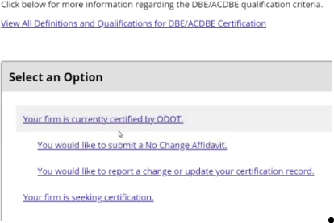
Civil Rights Certification and Compliance System (CRCC)
Annual Renewals
Select an Option
Your firm is currently certified by ODOT.
You would like to submit a No Change Affidavit.
You would like to report a change or update your certification record.
You would choice the You would like to submit a No Change Affidavit.

Slide 15
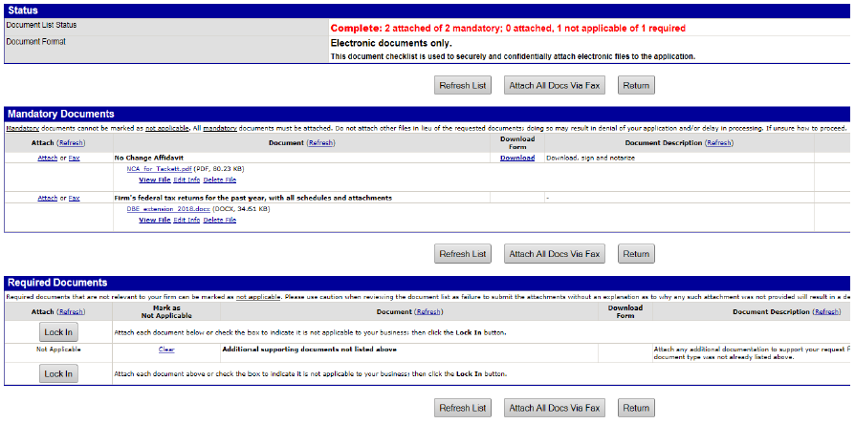
Civil Rights Certification and Compliance System (CRCC)
Online Applications
Click Attach to upload your “NCA” form.
You can download the most current form on this screen.
Make sure the NCA is completely filled out, signed, and notarized.
Next you will attach your Firm’s Federal Tax Return.
If you file an extension the previous year, make sure to include both the previous and current tax returns.
In the “Required Documents” section, you can click on “Clear” and then on “Lock In” if you have no additional documents to attach.
Once all documents are attached click on “Return”.

Slide 16
Large image
Approval Process

Slide 17
Civil Rights Certification and Compliance System (CRCC)
Application Review
Review Documents
Completeness
Eligibility
Q & A
Missing Documents
Questions
On-Site Review
No On-Site Review is Required
Unless there has been changes made or an expansion is needed.

Slide 18
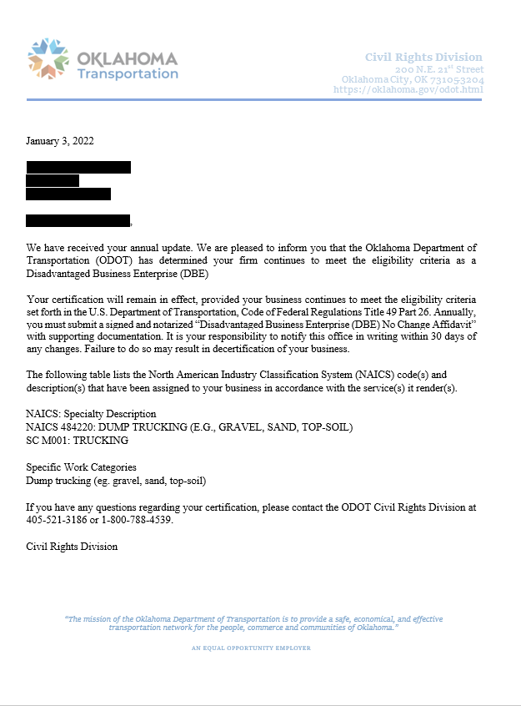
Civil Rights Certification and Compliance System (CRCC)
Approval
Approval Letter
DBE/ACDBE Directory
Must be submitted on or before the due date
Annual Recertification (Every year)
No Change Affidavit (NCA)
Most Current Federal Tax Return

Slide 19
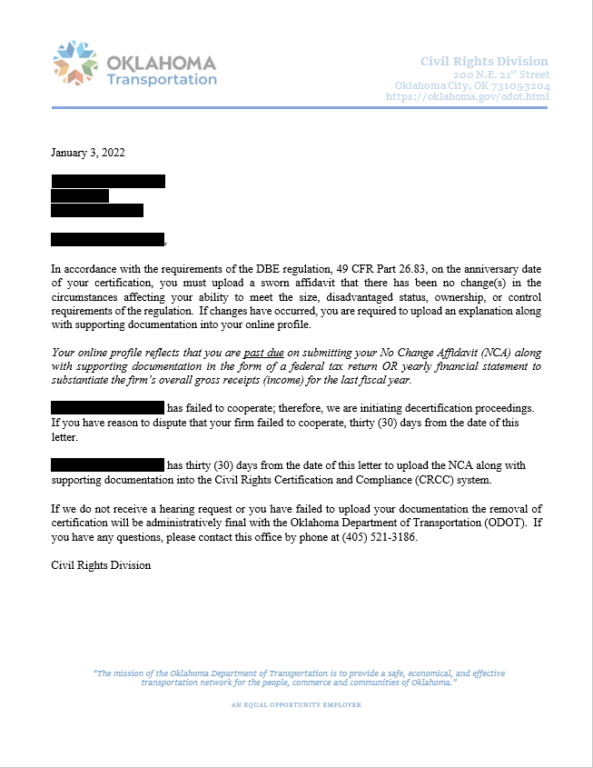
Civil Rights Certification and Compliance System (CRCC)
Decertifications
Reasons for Decertification
Failure to Submit a Annual Renewal Application
Failure to Comply for Requested Documents
No Longer Eligible
Decertification Letter
Appeal with ODOT (30 days)
Appeal with USDOT (90 days)

Slide 20
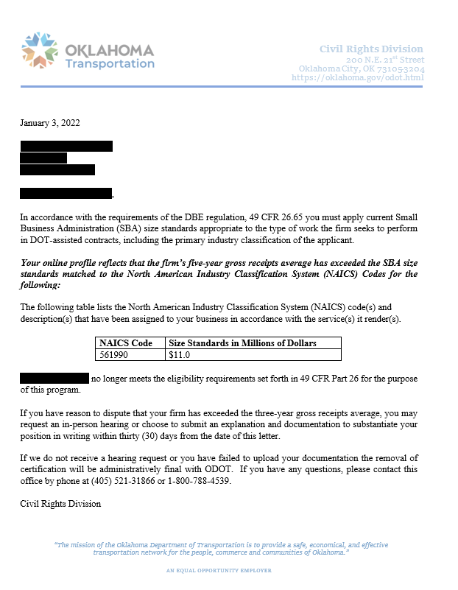
Civil Rights Certification and Compliance System (CRCC)
Graduations
Company’s Success
Graduations
Exceeded Gross Receipts for NAICS
Graduation Letter
Appeal with ODOT
Appeal with USDOT

Slide 21
Interstate Certification
Application Process

Slide 22
Civil Rights Certification and Compliance System (CRCC)
How to Get Certified in Another State (State B)
ODOT’s Involvement (State A)
There are two options:
49 CFR 26.85 (b) – State B will accept State A’s certification without further procedures
49 CFR 26.85 (c) – State B will not accept State A’s certification
49 CFR 26.85 (b)
ODOT will not have to do anything
State B will verified thru our Directory that you are currently certified
49 CFR 26.85 (c)
ODOT will provide the On-Site Review to State B
Must be certified in home state first
Applying with another state
Upload Approval Letter from ODOT
Upload copy of Initial Application
Upload copy of documents provided to ODOT
No On-Site Review

Slide 23
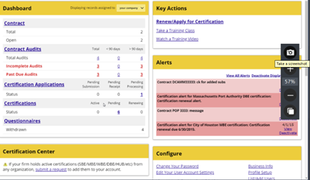
Civil Rights Certification and Compliance System (CRCC)
Interstate Certification
Dashboard
Status
Active
Pending
Renewing
Certification Center
Active Certifications
ACDBE
DBE
Click on Renew/Apply for Certification

Slide 24
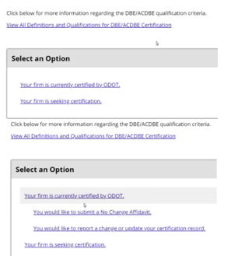
Civil Rights Certification and Compliance System (CRCC)
Interstate Certification
Select an Option
Your firm is currently certified by ODOT.
Your firm is seeking certification.
You would choice Your firm is currently certified by ODOT.
Your firm is currently certified by ODOT.
You would like to submit a No Change Affidavit.
You would like to report a change or update your certification record.
Your firm is seeking certification.
You would choice Your firm is seeking certification.

Slide 25
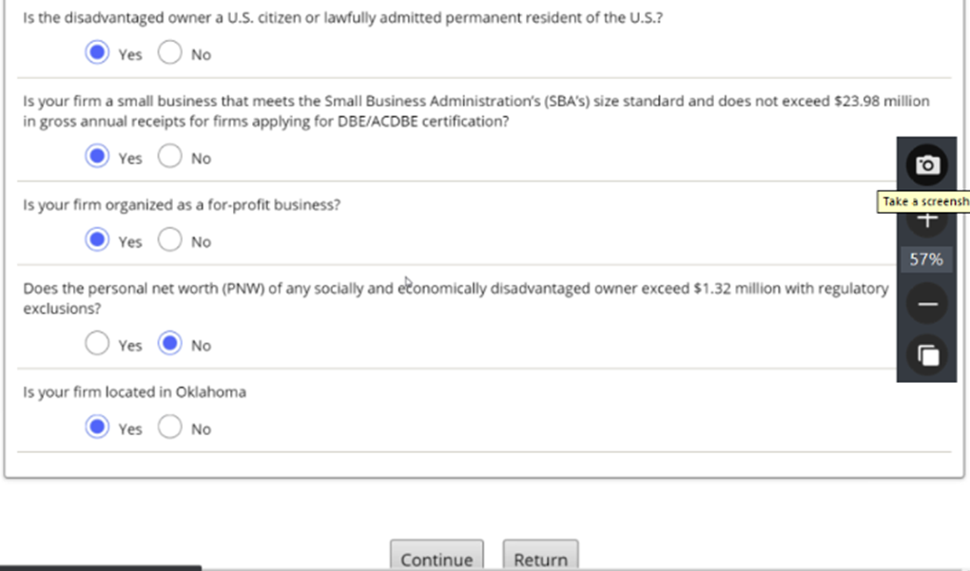
Civil Rights Certification and Compliance System (CRCC)
Interstate Certification
Eligibility
At least 51% owned by a socially and economically disadvantaged individual(s) who also controls it.
Disadvantage owner must be US citizen or lawfully admitted permanent resident of the US.
Firm must meet the Small Business Administration’s (SBA’s):
Size standards
Not exceed $23.98 million in gross receipts
Firm is organized as a for-profit business.
Your firm is located in Oklahoma.
Click on the Yes or No buttons for each of the questions.
Click on Return

Slide 26
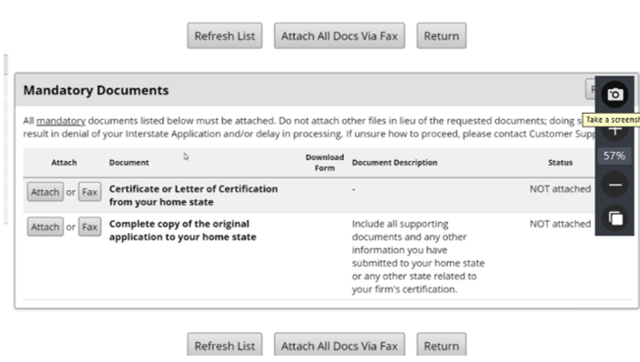
Civil Rights Certification and Compliance System (CRCC)
Interstate Certification
Attached Documents
Certificate or Letter of Certification from your home state
Complete copy of the original application to your home state
Include all documents submitted to your home state
Include all documents submitted to other states related to your firm’s certification.
Certificate or Letter of Certifications from other states
Make sure Status shows Attached
Click on Return

Slide 27
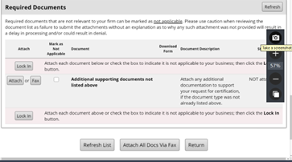
Civil Rights Certification and Compliance System (CRCC)
Interstate Certification
Attached Documents
Attach any additional supporting documents that were not listed above.
Click on Lock In to attach the documents or click in the box to mark not applicable. Then click on Lock In.
Click on Return

Slide 28
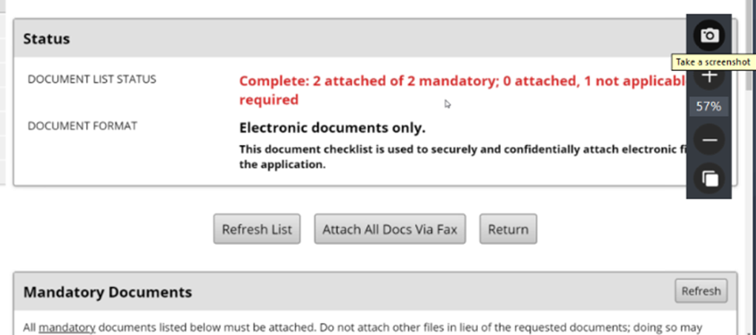
Civil Rights Certification and Compliance System (CRCC)
Interstate Certification
Required documents must be attached or the not applicable box clicked.
Mandatory documents must be attached (other documents in lieu of the requested documents).
Delays the certification process
Denial
Click on Return

Slide 29
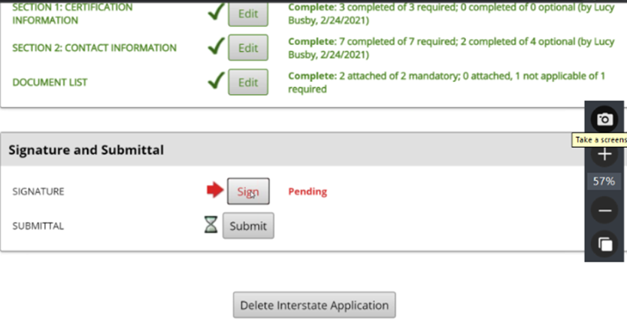
Civil Rights Certification and Compliance System (CRCC)
Interstate Certification
Application is complete
Pending Signature
Click on Sign

Slide 30
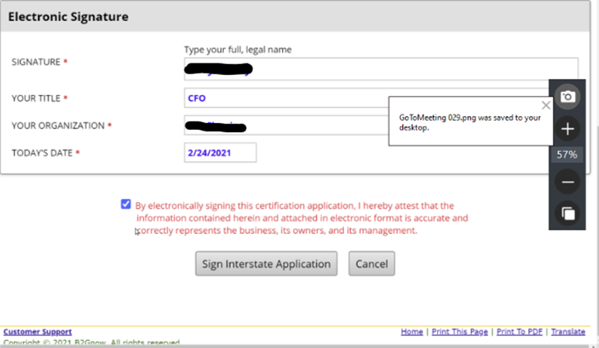
Civil Rights Certification and Compliance System (CRCC)
Interstate Certification
Type your name
Type your title
Type your organization’s name
Enter today's date
Click the box
Click Sign Interstate Application

Slide 31
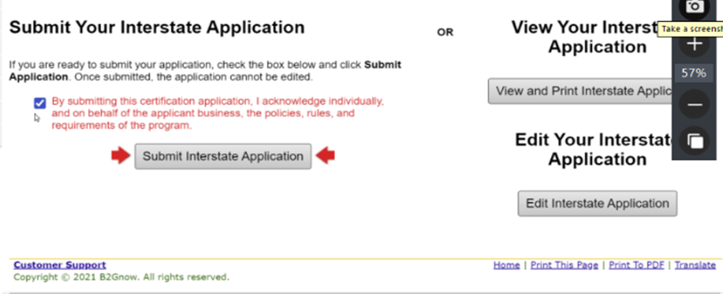
Civil Rights Certification and Compliance System (CRCC)
Interstate Certification
View Your Interstate Application
Recommended
Once submitted it cannot be edited
Edit Your Interstate Application
If needed only
Submitting your Interstate Application
If you’re ready check the box
Click on Submit Interstate Application

Slide 32
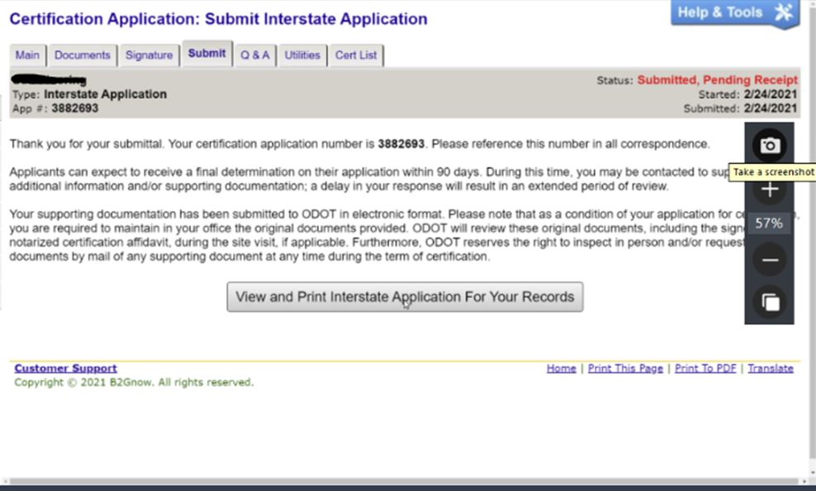
Civil Rights Certification and Compliance System (CRCC)
Interstate Certification
Submitting your Interstate Application
Certification Application Number
90 Days
Additional Information and/or Documents Needed
Extended Period of Review
View and Print Interstate Application for Your Records
Recommended
Easier for future Interstate Applications

Slide 33
Changes and Expansions
Online Application Process

Slide 34
Civil Rights Certification and Compliance System (CRCC)
Changes
Expansions
Log into your account
Click on “Renew/Apply for Certification”
Click on “Your Firm is currently certified by ODOT”
Click on “You would like to report a change or update your certification record.”
Click on “Submit Change Request”
Only Business Name/DBA Name
Address, Email, Phone, and Fax
Change in Ownership
Fill out form
Upload any applicable documents
Click on “Review”
Click on “Save”
Log into your account
Click on “Renew/Apply for Certification”
Click on “Your Firm is currently certified by ODOT”
Click on “You would like to report a change or update your certification record.”
Click on “Submit Expansion Request”
Fill out form
Upload any applicable documents
Click on “Review”
Click on “Save”

Slide 35
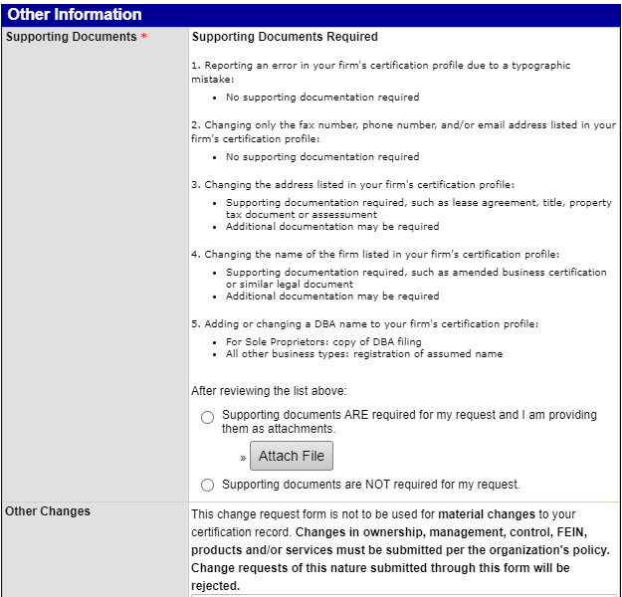
Civil Rights Certification and Compliance System (CRCC)
Changes and Expansions
No Documents Required
Error due to typographic mistakes
Changes in fax number, phone number, and/or email address
Documents Required
Change of address
Adding or changing DBA name
Sole Proprietors/Copy of DBA Filing
All other/Registration
Changes in ownership, management, control, FEIN, products and/or services must be submitted thru an expansion.
Request of this nature submit as a change instead of an expansion will be rejected.

Slide 36
Questions

Slide 37
DBE Reviewers
Sandra Ramos
405.812.8470
sramos@odot.org
Jessica Patterson
405.318.1425
jpatterson@odot.org
https://okdot.gob2g.com/

