Slide 1
SUICIDE PREVENTION IN
PRIMARY CARE
https://ZeroSuicide.edc.org

Slide 3
Suicide can be prevented in Primary Care
Suicide is the 10th leading cause of death in the U.S.
Of those dying by suicide, approximately 45% will have seen their primary care provider within the month before their death, while only 20% will have seen a mental health professional in that period.
Over 38% of individuals have made a healthcare visit (eg., primary care, emergency department, specialty care, etc) within the week before their suicide attempt and 95% have had a health care visit within the preceding year.
Adult patients report that they expect their physician to ask about lifestyle factors that could impact their health and are open to advice.
Reducing Access to Lethal Means
Limiting access to medications and chemicals and removing or locking up firearms and other weapons are important actions to keep patients safe.
Many suicide attempts occur with little planning during a short-term crisis.
90% of attempters who survive do NOT go on to die by suicide later.
Access to firearms is a risk factor for suicide. Reducing access to lethal means saves lives.
Notes:
Suicide takes more lives in the U.S. than homicide, war and natural disasters combined.
Just like there are warning signs and risk factors for other health crises like cardiac arrest, we can learn the warning signs and risk factors that can help us to prevent people from dying by suicide.
As with other health issues, time can be a critical and life saving measure. Typically, a life can be saved if you allow time for the person’s suicide risk to subside or to get through that period of distress, and to get mental health help. To prevent suicide, we need to identify persons who may be suicidal as well as take an active role in connecting them to help before they take action to end their lives.
The most important thing you can put between a suicidal person and their way of ending their life is TIME.
Research shows that by temporarily reducing a suicidal person’s access to lethal means, we give suicidal individuals time – time for the intense suicidal risk to diminish and time for someone to intervene with mental health support and resources.
For the majority of people who experience a suicidal crisis, if unable to access their chosen method even temporarily, they are unlikely to engage in another action to end their lives.
Luoma JB, Martin CE, Pearson JL. Contact with mental health and primary care providers before suicide: a review of the evidence. Am J Psychiatry. 2002;159:909–916. [PMC free article] [PubMed] [Google Scholar]
Ahmedani, B. K., Stewart, C., Simon, G. E., Lynch, F., Lu, C. Y., Waitzfelder, B. E., ... & Hunkeler, E. M. (2015). Racial/ethnic differences in healthcare visits made prior to suicide attempt across the United States. Medical care, 53(5), 430.
Mann, J. J., Apter, A., Bertolote, J., Beautrais, A., Currier, D., Haas, A., ... & Mehlum, L. (2005). Suicide prevention strategies: A systematic review. Jama, 294(16), 2064–2074. Retrieved from http://www.daveneefoundation.org/wp-content/uploads/Suicide-Prevention-…
Zalsman, G., Hawton, K., Wasserman, D., van Heeringen, K., Arensman, E., Sarchiapone, M., ... & Purebl, G. (2016). Suicide prevention strategies revisited: 10-year systematic review. The Lancet Psychiatry, 3(7), 646–659. Retrieved from http://www.thelancet.com/journals/lanpsy/article/PIIS2215-0366(16)30030…

Slide 4
Zero Suicide Mission & Principles
Mission
QI model designed for system-wide transformation
Transform the way health systems care for people with suicidal urges
Culture change to a “Zero-based” mindset
Foundational Principles
Core Values—the belief and commitment that suicide can be eliminated in a population under care by improving service access and quality and through practicing continuous quality improvement.
Systems Management—taking systematic steps across systems of care to create a culture that no longer finds suicide acceptable, setting aggressive but achievable goals to eliminate suicide attempts and deaths, and organizing service delivery and support accordingly.
Evidence-Based Clinical Care Practices—adopting practices that research shows reduce suicide deaths and behaviors and that are delivered through the entire system of care and that emphasize productive patient-staff interactions.

Slide 5
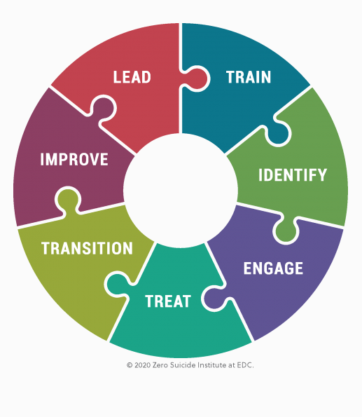
Zero Suicide Elements
Lead system-wide culture change committed to reducing suicides
Train a competent, confident, and caring workforce
Identify patients with suicide risk via comprehensive screenings
Engage all individuals at-risk of suicide using a suicide care management plan
Treat suicidal thoughts and behaviors using evidence-based treatments
Transition individuals through care with warm hand-offs and supportive contacts
Improve policies and procedures through a continuous quality improvement plan

Slide 6
Core Element: Lead
System-wide commitment
Establish implementation team
Schedule regular meetings
Leaders at all levels serve as champions
Authority for developing and changing guidelines
Continuous QI to ensure fidelity
Assist with training and maintaining culture of Zero Suicide
Assess elements of safer suicide care currently in place
Adopt a comprehensive suicide care approach and develop policy
Establish positions responsible for ensuring fidelity to the model

Slide 7
Core Element: Train
Staff require skills and confidence to provide excellent care
All employees receive training appropriate to their role
Ensure that training contains the following elements:
The fundamentals of the organization’s Zero Suicide philosophy
Policies and protocols relevant to the staff member’s role and responsibilities
Basic, research-informed training on suicide identification for all staff
Additional training to all clinical staff to ensure a basic level of skill in assessing, managing, and treatment planning for patients at risk of suicide, including safety planning and reduction of access to lethal means
Advanced training to deepen skills and increase confidence and effectiveness
Train new staff and provide refresher training at least every 3 years

Slide 8
Core Element: Identify
Screening for Suicide Risk
Policies and procedures clearly describe screening patients for suicide risk, including:
The frequency of screening
Documenting risk screenings
Screening and identification workflows
How staff will be alerted when their patients screen positive for suicide risk
Completion of full risk formulation for patients screening positive for suicide risk
Further assessment to establish severity of suicide risk https://cssrs.columbia.edu/
A written policy and procedure specifies that patients are provided timely access to clinically trained staff after screening positive for suicide risk.
A standardized screening measure is used by all staff.
Staff receives formal training on suicide screening and documentation.

Slide 9
Core Element: Engage
All individuals identified to be at risk of suicide are engaged in a pathway to care during the appointment.
Safety Planning
Brief and in the patient’s own words
Involve patient’s family/supports as full partners in the collaborative process
Include a plan for lethal means safety
Be in the patient’s possession when they leave the appointment
Be updated whenever warranted
Intervention is documented in the patient EHR.
Counseling on Access to Means (CALM) is an online training offered free of charge by the Suicide Prevention Resource Center. Recommended that all clinical—and in some cases non-clinical—staff members complete.

Slide 10
Core Element: Treat
Clients with suicide risk are treated in the least restrictive setting possible.
Evidence-based interventions include interventions and treatment that are designed to target suicide risk directly.
Safety Planning is a list of coping strategies and sources of support developed by a clinician in collaboration with the patient
Reducing access to lethal means
Teaching brief problem-solving and coping skills
Enhancing social support and identifying emergency contacts
Using motivational enhancement to increase likelihood of engagement in further treatment
Brown_StanleySafetyPlanTemplate.pdf (suicidepreventionlifeline.org)

Slide 11
Core Element: Transition
Care transitions are high-risk times for patients.
Bridge transitions: primary care → behavioral health care → primary care
The burden lies on the provider to develop systems to ensure that patients make and keep appointments.
Address suicide risk at every visit and handoff in the primary care setting.
Policies provide guidance for successful care transitions and specify the contacts and supports needed throughout the process.
Track/manage the patient’s pathway to care through follow-up and supportive contacts.
Notes:
Bickley, H., Hunt, I. M., Windfuhr, K., Shaw, J., Appleby, L., & Kapur, N. (2013). Suicide within two weeks of discharge from psychiatric inpatient care: A case-control study. Psychiatric Services, 64(7), 653–659. Retrieved from http://ps.psychiatryonline.org/doi/abs/10.1176/appi.ps.201200026

Slide 12
Policies for Safe Care Transitions
Develop internal written policies and procedures for safe care transitions:
When the patient is referred to a provider or service both within or outside of your organization
When the patient transitions to another organization or provider in the community
When the patient terminates services, either independently or in agreement with the care provider
When the patient repeatedly misses appointments
Following a patient’s contact with crisis services
At discharge from an ED or a psychiatric hospital
Train staff on policies and procedures for safe care transitions.
Ensure that patients receive education about the model of care and the rationale for treatment as they move from one clinician to another, or from one agency/setting to another.
Monitor to ensure that care transitions are documented and flagged for action in an electronic health record or a paper record.

Slide 13
Creating Smooth Care Transitions
Establish safety plan with patient and provide copy before referral
Ensure the patient has spoken by phone with the new provider
Call/send relevant patient information in advance of the appointment
Contact the patient within 24–48 hours after they have transitioned to the next care provider and document the contact
Caring contacts are follow-ups that show support, promote connection, and increase collaboration.
In-person, phone calls, text messages, postcards, and e-mail messages

Slide 14
Core Element: Improve
Determine how closely the elements of the model are being followed.
Check on quality.
Help identify opportunities for improvement.
Provide feedback regularly to senior leadership and staff on progress toward patient-care goals in conjunction with the systems, policy, and patient care practice changes being made in the organization’s Zero Suicide approach.

Slide 15
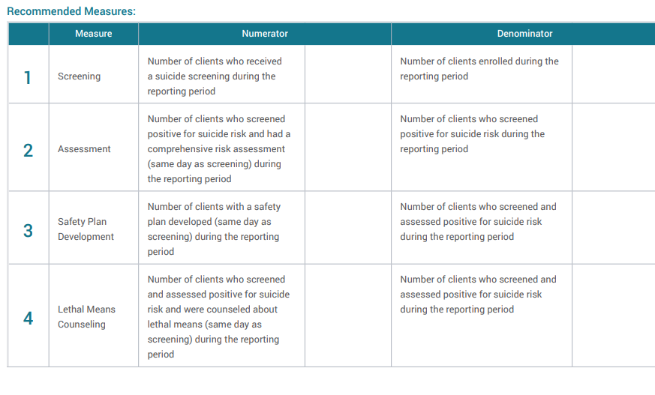
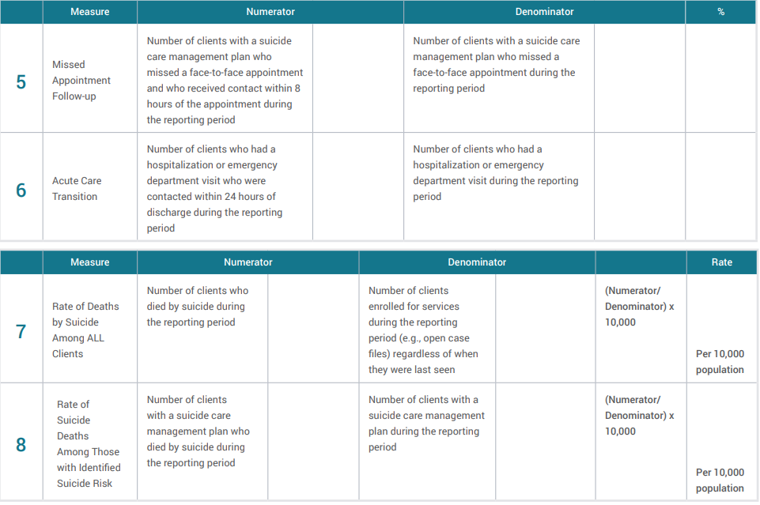
ZS Data Elements Worksheet.TS_.pdf (edc.org)

Slide 16
Chickasaw Nation DHS Implementation
Suicide Care Workflow
All patients receive PHQ with further C-SSRS assessment for positive screens.
If positive screen, assess for level of suicide risk:
Low risk- Create a collaborative safety plan as part of identified process
Moderate risk- Use clinical judgment of life context and screening scores to assess whether patient can be safe utilizing safety plan and support system or would be best treated in an inpatient facility.
High Risk- Plan with the family for patient to be admitted to inpatient, complete safety plan. Coordinate transport unless clinician’s judgment determines patient can leave with family member.
Safety Planning using Stanley Brown tool. Allows the patient to identify positive coping strategies, members of their support system, and important contact information for those whom the patient can call on if needed.
Follow-up: Before the patient leaves the facility, create a follow-up appointment/phone call. Utilize administrative staff to identify no-shows and track those at the highest risk so they can be contacted. Encourage patients to complete our Heartline contact consent form. Heartline is an outside hotline that assists with patient follow-up. It is of great importance to make these follow up appointments for the patient before they leave so they experience little to no gap in services, including medication refills. Prior to our Zero Suicide implementation, patients who received inpatient care did not receive standardized follow-up contact post-discharge, and at times our care processes would end when the patient left our facility. Now, for patients who are referred to inpatient care we have created a unique discharge form that includes their follow up information and upcoming appointments.
Chickasaw Nation Departments of Health and Family Services | Zero Suicide (edc.org)

Slide 17
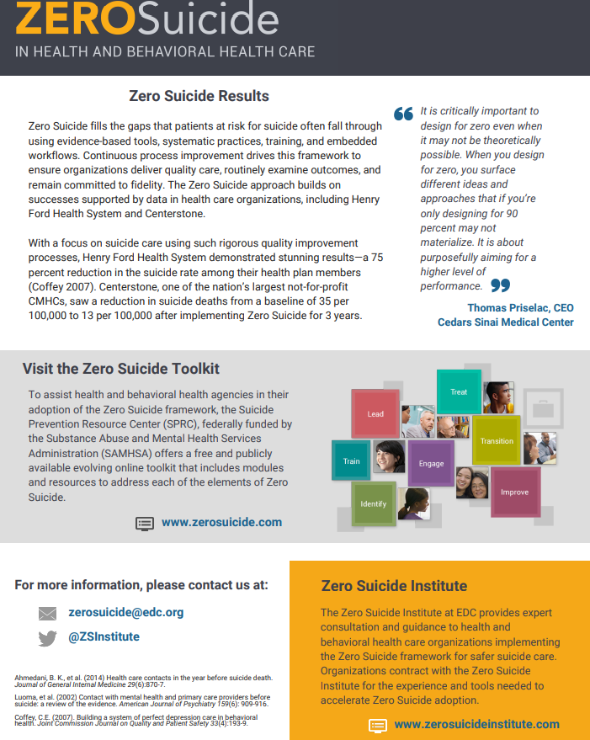
https://zerosuicide.edc.org/sites/default/files/Transforming%20Systems.pdf

Slide 18
Resources
Zero Suicide
Zero Suicide Institute
Zero Suicide 2-page overview document
Zero Suicide Toolkit
Zero Suicide --Suicide Safer Care Guide for Primary Care Providers
Suicide Prevention Toolkit for Primary Care Practices | Suicide Prevention Resource Center
Zero Suicide Data Elements Worksheet
Zero Suicide Organizational Self-Study
Counseling on Access to Lethal Means
Health Care | National Action Alliance for Suicide Prevention
The Columbia (C-SSRS)
Brown_StanleySafetyPlanTemplate.pdf (suicidepreventionlifeline.org)
Notes:
https://zerosuicide.edc.org/
https://zerosuicideinstitute.com/
https://zerosuicide.edc.org/sites/default/files/Transforming%20Systems.pdf
https://zerosuicide.edc.org/toolkit/zero-suicide-toolkitsm
https://www.sprc.org/settings/primary-care/toolkit
https://zerosuicide.edc.org/sites/default/files/suicidesafercareguideforprimarycareproviders.pdf
https://zerosuicide.edc.org/sites/default/files/ZS%20Data%20Elements%20Worksheet.TS_.pdf
https://zerosuicide.edc.org/sites/default/files/2021-12/ZS-Org-SelfStudy-2021-v2.pdf
https://zerosuicide.edc.org/resources/trainings-courses/CALM-course
https://theactionalliance.org/healthcare
https://cssrs.columbia.edu/
https://suicidepreventionlifeline.org/wp-content/uploads/2016/08/Brown_StanleySafetyPlanTemplate.pdf

