Slide 1
Environmental Strategies Overview
Jeremy T. Goldbach, LMSW
June 8, 2011

Slide 2
Learning Objectives
After participation in this workshop, participants will be able to :
Define environmental strategies
Describe how to use the Strategic Prevention Framework (SPF) to select appropriate environmental strategies
Identify environmental strategies that may be a good fit in their own communities

Slide 3
Notes:
Icebreaker – the following slides show risk and protective factors that surround youth. Ultimately creating a “community” and justifying the need for comprehensive prevention services.

Slide 6
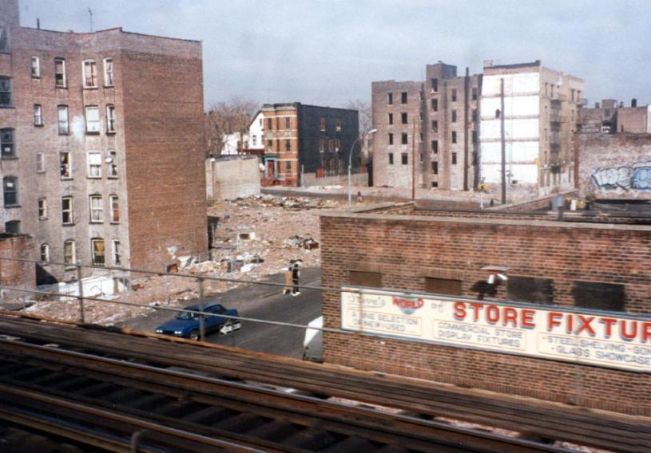

Slide 10
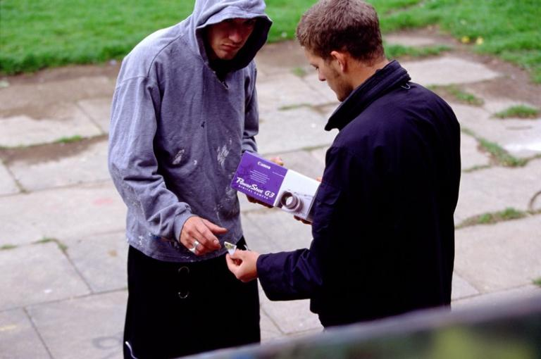

Slide 11
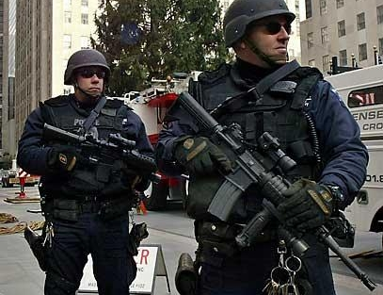

Slide 12
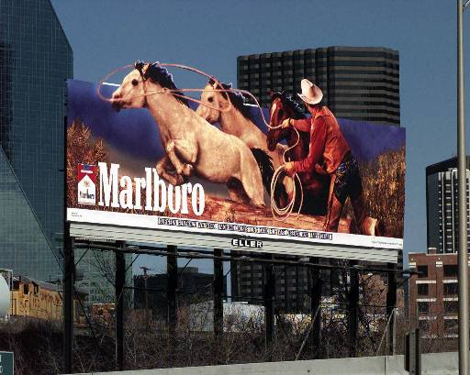

Slide 13
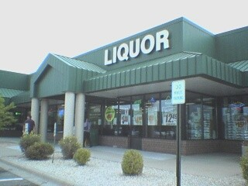
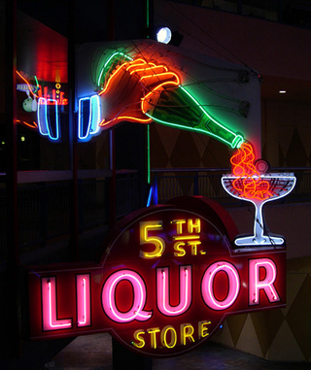
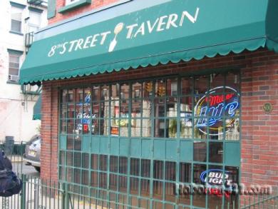

Slide 17
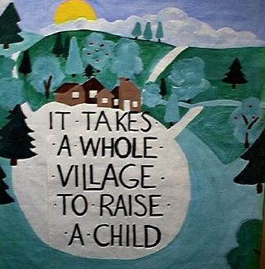
What’s the point?!

Slide 18
So Why Environmental Strategies?
A significant portion of youth in the United States (age 12 to 17) have used alcohol and other drugs.
Rates of binge drinking (five or more drinks) in underage youth is a concern, with large increases between 7th grade (1.6% of 12 and 13 year olds) and high school graduation (34.7% of 18 to 20 year olds).
Economically, the costs of alcohol use and its related consequences in U.S. communities add up to more than $235 billion annually (Rehm, et al, 2009).
(NSDUH, 2009; Rehm et al. 2009)

Slide 19
Continued
Addressing alcohol abuse through only one strategy (such as a single direct service prevention intervention only) is less effective than taking a broader approach that includes the larger community.
multi-component strategies promote a systemic approach to solving issues recognizing that individuals operate within, and are affected by, an “environment”.
(Hawley, 1950; Rousseau & House, 1994; Stokols, 1996).

Slide 20
Breaking it Down
What are Environmental Strategies?
Making flowers bloom?
Ending Wars?
Getting rid of pollution?
NO…well, not for us anyway!

Slide 21
Environmental Strategies
Technically speaking…
Strategies that address policies, norms, expectations, regulations and enforcement within a shared environment with others in a community. Such strategies tend to: have greater reach (affecting more individuals) and less strength (intensity per individual); (2) be longer in duration; and (3) show more rapid results. – quoted from the 2004 RAND Getting to Outcomes.

Slide 22
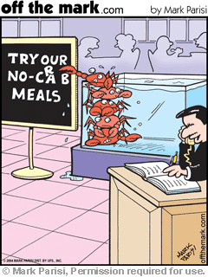
Team Work!
Discuss successes you’ve
had in using environmental
strategies
Discuss barriers/struggles
in using environmental
strategies
Draft a “working definition”
of environmental strategies

Slide 23
Environmental Strategies
Less technically speaking:
Are policies and practices (customs, habits, etc) that change the context & norms where we live and work, and limits access to a substance, and can prevent harmful behaviors.

Slide 24
Environmental Strategies
Environmental Strategies focus on the following 4 areas:
Access & Availability;
Policy & its Enforcement;
Community Norms; and
Media Messages.

Slide 25
Environmental Factors
Policies/Regulations/Laws
Availability
Norms
Adapted from: http://captus.samhsa.gov/southwest/resources/documents/envchangetheory.pdf

Slide 26
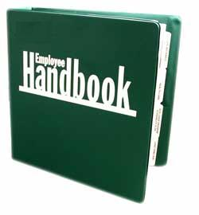
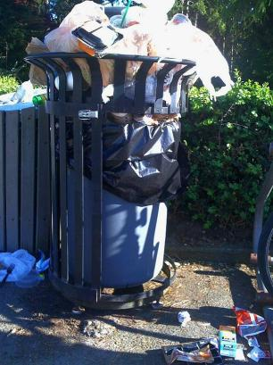
Policies/Regulations/Laws
They control availability, support norms, and specify sanctions for violations

Slide 27
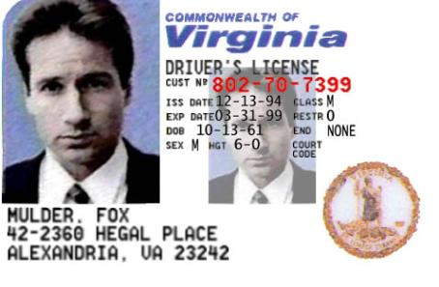
Availability
Is the amount of time, energy, and money that must be expended to obtain a substance (alcohol, tobacco, drugs). The more resources (harder) it takes to get the substance the less availability (access).

Slide 28
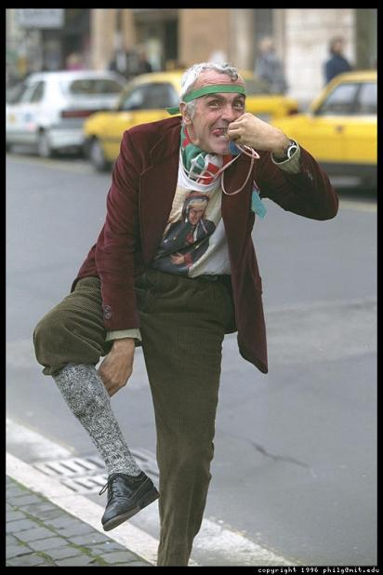
Norms
The rightness or wrongness,
the acceptability or
unacceptability, and/or
deviance of specific
behaviors for a specific
group of individuals
Notes:
Jeremy

Slide 29
But how do we know what to do?
The Strategic Prevention Framework (SPF)
SAMHSA/CSAP Supported
Based on a Public Health Approach
Cholera – John Snow
An iterative process designed to reduce of the negative consequences of substance abuse problem
A framework that identifies the major needs and then selects a strategy to target these needs

Slide 30
The SPF Framework
Assessment
Profile population needs, resources, and readiness to address needs and gaps
Evaluation
Sustainability &
Cultural Competence
Capacity
Monitor, evaluate, sustain, and improve or replace those that fail
Mobilize and/or build capacity to address needs
Implement evidence-based prevention programs and activities
Develop a Comprehensive Strategic Plan
Implementation
Planning

Slide 31
Why Use the SPF?
Effective capacity building process
Required by SAMHSA and used by many others
Gives a roadmap based on research, data, and evidence
Decisions can be evaluated through data-driven measurement

Slide 32
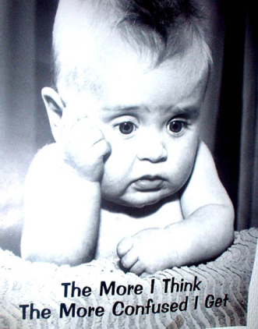
Step 1: Needs Assessments
Why do we assess?
To guide the prevention effort
To provide information about
the target population and their
corresponding substance abuse
problem

Slide 33
Intervening Variables
The “But Why Here?”
Retail Access?
Low Enforcement?
Social Access?
Perceived Risk?
Social Norms?
Alcohol Promotion?
Pricing?

Slide 34
Step 1: Outputs
Milestones | Products
Epidemiological Workgroup forms, and begins to collect and analyze data | Data Report with clear, concise data-driven problem statement
Identification of target area and population | Data sources for ongoing assessment
Assessment of readiness and barriers to success | Gap analysis

Slide 35
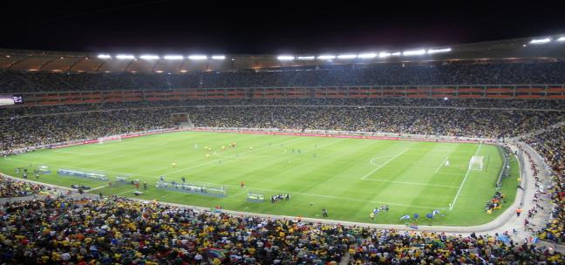
Step 2: Capacity Building
To find out what we already
have and what we need
Different types of capacity
(fiscal, physical, staff, etc)
- So we don’t duplicate efforts or pick much-needed but unachievable strategies

Slide 36
Step 2: Outputs
Milestones | Products
Creation of partnerships | Capacity Report with quarterly updates
Training and Technical Assistance (T/A) provided in targeted areas | Directory of key stakeholders, leaders, and service providers
Meetings w/ key stakeholders | Memorandums of Understanding (MOU) w/ stakeholders

Slide 37
Step 3: Planning
What kind of planning is done?
Identifying the most powerful factors (intervening variables) contributing to the target behavior
Investigating appropriate evidence-based strategies to match population’s needs
Planning expected outcomes (both short and long-term)

Slide 38
Step 3: Outputs
Milestones | Products
Writing goals, objectives, and performance targets | Logic Model
Drafting Strategic Plan | Preliminary Action Plan
Creation of Evaluation Plan | Evaluation Plan

Slide 39
Step 4: Implementation
What do we do?
Develop Action Plan for implementing the Strategic Plan
Take Fidelity of Implementation into account
Write detailed Evaluation Plan that includes process and outcome measurements

Slide 40
Step 4: Outputs
Milestones | Products
Developing and implementing Action Plan | Action Plan
Gathering information about EBIs (evidence-based interventions) | Identification and selection of EBIs
Creating Evaluation Plan and measures | Evaluation Plan and Performance Measures

Slide 41
Step 5: Evaluate
What do we evaluate?
The effectiveness of the selected evidence-based program, policy, or practice (EBP)
How?
By collecting required outcome data
Recommendations made for quality improvement

Slide 42
Step 5: Outputs
Milestones | Products
Collaboration with Evaluation team
Data collection and review of EBP effectiveness | Evaluation Report
Recommendations for Quality Improvement | Quality Improvement recommendations

Slide 43
Sustainability and Cultural Competence
What are we sustaining, the prevention programs or the prevention effort?
Why is cultural competence important?
How do we create prevention systems with culturally responsive behaviors, attitudes, and practices?

Slide 44
And…..BREAK!

Slide 45
Break Out!
As a group, read the case study
Complete the Logic Model sections:
Problem
But Why? (Intervening variables)
But Why Here? (description)
Strategies
STOP at “Activities”

Slide 46
Types of Environmental Strategies
What are the 5 types (broad categories) of Environmental Strategies?
Policy
Enforcement
Education
Communication
Collaborations
Adapted from http://captus.samhsa.gov/northeast/resources/prevention_materials/strengthening_families.cfm#collaboration

Slide 47
Policy
Examples
minimum age to buy
taxes
underage drinking laws
driving while intoxicated (DWI) laws
restrictions on advertising and billboard placement
restrictions on smoking in public places or private entities
open container laws
limits on the location, density, and hours of operation of liquor stores
rules governing the use and placement of cigarette vending machines

Slide 48
Enforcement
Policies without enforcement = no change
Sobriety checkpoints
Compliance checks
Steps detailed in policy for non-compliance
Publicize laws and penalties
Increase building inspections
Post signs to notify about surveillance (in stores on roadways, etc)
Citizen patrols

Slide 49
Education
Need to educate people on policies, penalties, proper procedures
Retail seller trainings – owners, managers, cashiers. (off premise)
Retail server trainings – bartenders, wait staff, owners. (on premise)
Curriculum targeting entire populations.
Education also occurs under communications, see later slide.

Slide 50
Communication
Social Marketing
Media Advocacy
Counter-marketing
Media Literacy
Social Norms Campaigns

Slide 51
Collaborations
People working together professionally or casually with a shared goal. Examples:
Businesses unite to prohibit smoking
Share resources and reduce duplication
Reclaim public spaces (parks, vacant lots, etc) by picking up trash, planting gardens, and spending time in the areas to discourage others
Work with schools to keep substances off school grounds

Slide 52
Selecting the Right Environmental Strategy
How do you know which type of environmental strategy is best for your state or community?
What do you need to know to decide which is best?
Can you do just one or should you do more than just one?

Slide 53
Evidence-Based Environmental Strategies
Responsible Beverage Service
Compliance Checks
Happy Hour Restrictions
Reducing Outlet Density
Sobriety check points
Graduated drivers license laws
Social Host Laws
Keg Registration
Restriction of alcohol sales at public events
Increasing taxes on Alcohol
Other Policy Changes?

Slide 54
Break Out!
Discuss the best strategies and short, intermediate and long-term goals related to those strategies
Report back to the group on what you’ve decided is best for your community

Slide 55
Discussion
What is one thing your organization is doing well already, and you’re proud to report?
What is one thing that you will take home to integrate into your prevention planning?
Other Questions or Comments?

Slide 56
Evaluation and Close
Jeremy Goldbach, LMSW
Associate
CSAP’s CAPT Southwest Resource Team
swpc@ou.edu
405-325-1454
Please complete the CAPT Evaluation Forms and Attendance Sheets

