Slide 1
HIV & AIDS
HIV Education Training (HET) (oklahoma.gov)
Notes:
Title Slide
Visit the link.

Slide 2
HIV: True or False?
I'm HIV-positive, now my life is OVER.
I CAN get HIV by being around people who are HIV-positive.
I would NOT be able to tell if my partner or I were HIV-positive.
I CAN get HIV from mosquitoes.
I'm straight and don't inject drugs, so I CANNOT get HIV.
I CAN get HIV from oral sex.
My partner and I are both HIV-positive, so there is NO NEED to use condoms.
Oklahoma State Department of Health | HIV 101 | 2023
Notes:
1. I'm HIV-positive, now my life is over. FALSE
In the early years of the epidemic, the death rate from AIDS was extremely high. But today, ART (antiretroviral drugs) allow People Living With HIV/AIDS (PLWH) to live longer, normal, and productive lives.
2. I can get HIV by being around people who are HIV-positive. FALSE
HIV is only passed through five bodily fluids: blood, semen, rectal fluids, vaginal fluids or breast milk.
HIV cannot be spread through saliva, tears, sweat, or urine (kissing, sharing cups/utensils, water fountains, etc.)
Small traits of HIV are found in saliva, but it is not enough to cause infection unless one of the five fluids are also present (blood, semen, rectal fluids, vaginal fluids or breast milk). Two liters of saliva with HIV for it to be transmitted.
3. I would not be able to tell if I or my partner was HIV positive. TRUE
You can be HIV-positive and not have any symptoms for years. The only way for you or your partner to know if you're HIV-positive is to get tested.
4. I can get HIV from Mosquitoes. FALSE
From pubmed.ncbi.nlm.nih.gov, because HIV is spread through blood, HIV lives for only a short time inside an insect not long enough to reproduce in the mosquito’s gut or and invade the salivary gland. Does not spread HIV.
Several studies, however, show no evidence to support this -- even in areas with lots of mosquitoes and cases of HIV. When insects bite, they do not inject the blood of the person or animal they have last bitten. Also,
5. I'm straight and don't inject drugs, so I cannot get HIV. FALSE
Most men do become HIV-positive through sexual contact with other men. However, about 16% of men and 78% of women become HIV-positive through heterosexual contact.
HIV is spread mostly through unprotected sexual contact and does not discriminate against anyone. It is not who you are, but your behaviors which put you at risk of contracting HIV. Regardless of your personality or sexuality, you will be at risk if you don't take protective measures.
6. I can get HIV from oral sex. TRUE
It's true that oral sex is least likely/less risky than some other types of sexual contact. But you can get HIV by having oral sex with either a man or a woman who is HIV-positive. Always use some type of barrier (ex: latex or nitrile) during oral sex.
7. My partner and I are both HIV positive, so there is no need to use a condom. FALSE
There are also two types of HIV: HIV-1 and HIV-2 and both are retroviruses.
Worldwide, the predominant virus is HIV-1, and generally when people refer to HIV, they will be referring to HIV-1.
See aidsmap.com and Avert.org for details about There are different Strains/Groups of HIV 1: M , N, O, P AND Group M sub-types: A, B, C, D, F, G, H, J, K. B subtype is The Most Common in the US. Worldwide, the most common HIV subtype is C. If a condom is not used during sexual contact, HIV-positive partners may exchange different types or strains of HIV. This can lead to re-infection, which will make the treatment of HIV more difficult. The new HIV strain may become more resistant to the current treatment or cause the current treatment option to be ineffective.
HIV-2 has eight Stains/Groups with subtype A and B considered epidemic. HIV-2 is less easily transmitted, and the period between initial infection and illness is longer in the case of HIV-2. The uncommon HIV-2 type is concentrated in West Africa and is rarely found anywhere else. Also, the treatment for HIV-1 is different than it is for HIV-2. (http://www.avert.org/hiv-types.htm)

Slide 3

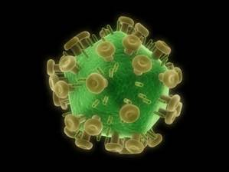
What is HIV?
Human Immunodeficiency Virus
A virus spread through body fluids and affects specific cells of the immune system, called CD4 cells or T cells.
A virus that kills the CD4 cells (T cells) damaging the immune system.
A virus that replicates inside the human body, so it must invade a healthy cell in the body to survive.
Oklahoma State Department of Health | HIV 101 | 2023
Notes:
NAME: The word HIV is a type of abbreviation known as initialism. It’s pronounced as initials.
“H” stands for human. HIV is a retrovirus meaning it cannot reproduce outside of the human body. To cause infection, HIV must be able to reproduce and survive in a human host.
“I” is for Immunodeficiency which refers to an unhealthy immune system. The immune system is the body’s natural defense against infections and diseases.
“V” is for virus. A disease or condition caused by a virus. The common cold and flu are examples of virus. All virus can be treated, but there is no cure. HIV does not go away.
HIV is the virus that causes AIDS
HIV attacks/hijacks the immune system, which protects the body from infection.
HIV invades the CD4 or T Cells (white blood cells). These cells help the body fight all diseases.
HIV destroys the CD4 cell by taking over the cell and using it to make copies of HIV or replicate itself.
This process continues until a person living with HIV has no CD4 left, unless they get and stay on medication.

Slide 4
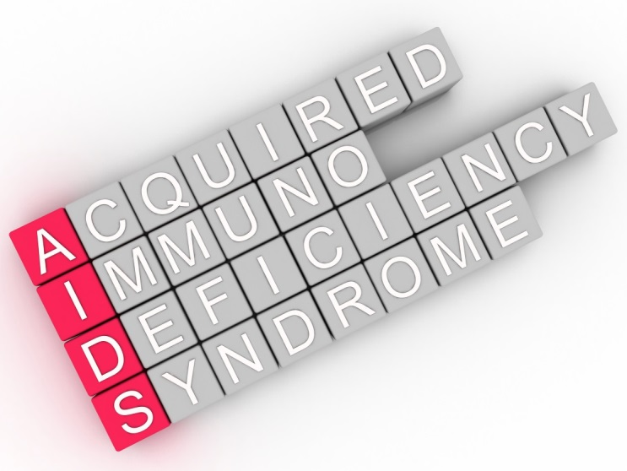
What is AIDS?
Positive HIV Test
+
Very low CD4 count (<200 cell/mm³ )
OR
presence of specific cancers or opportunistic infections
=
AIDS
AIDS occurs in the late stages of the HIV infection process.
Once diagnosed, the body has a hard time fighting diseases and certain cancers.
NO cure for AIDS, but there is treatment.
Oklahoma State Department of Health | HIV 101 | 2023
Notes:
Name: The word AIDS is a type of abbreviation known as an acronym. It’s pronounced like a word.
“A” is Acquired. HIV does not run-in families like diabetes and heart disease (not hereditary). Outside of perinatal (mother to baby) transmission, HIV enters the body through some external method.
“I’ is Immuno and represents the body’s immune system that works to protect the body from infection.
“D” is Deficiency and refers to a defect in the immune system causing it to not function properly.
“S” is Syndrome and is a group of signs and symptoms that occur together and characterize a particular abnormality or condition.
1st bullet point: AIDS occurs when a person living with HIV is not on medication or is not taking it correctly and is towards the end of the disease process, or end of their life.
2nd bullet point: Immune system is weakened, leaving the body vulnerable to diseases and cancers it would normally be able to fight. These are called Opportunistic Infections.
Diagnosis explanation:
Only a medical doctor can diagnose someone with AIDS. For example, when a person takes a test for HIV, the test searches for HIV antibodies and/or antigens.
A positive result means the person has HIV or is HIV positive. It is not a diagnosis of AIDS. For an AIDS diagnosis, two things must be present: a positive HIV test and presence of an indicator disease and/or a CD4/T cell count of less than 200 cell/mm³ (cubic mm) of blood.
*If questions asked about Opportunistic Infections, specific cancers or infections*
Pneumocystis jiroveci, formerly called carinii, pneumonia
Candidiasis of bronchi, esophagus, trachea or lungs
Cervical cancer that is invasive
Coccidioidomycosis that has spread
Cryptococcosis that is affecting the body outside the lungs
Cryptosporidiosis affecting the intestines and lasting more than a month
Cytomegalovirus disease outside of the liver, spleen or lymph nodes
Cytomegalovirus retinitis that occurs with vision loss
Encephalopathy that is HIV-related
Herpes simplex including ulcers lasting more than a month or bronchitis, pneumonitis or esophagitis
Histoplasmosis that has spread
Isosporiasis affecting the intestines and lasting more than a month
Kaposi's sarcoma
Lymphoma that is Burkitt type, immunoblastic or that is primary and affects the brain or central nervous system
Mycobacterium avium complex or disease caused by M kansasii
Mycobacterium tuberculosis in or outside the lungs
Other species of mycobacterium that has spread
Pneumonia that is recurrent
Progressive multifocal leukoencephalopathy
Salmonella septicemia that is recurrent
Toxoplasmosis of the brain, also called encephalitis
Wasting syndrome caused by HIV infection

Slide 5
People-First Language
UN AIDS
Terminology
Guidelines
https://www.unaids.org/sites/default/files/media_asset/2015_terminology_guidelines_en.pdf
Oklahoma State Department of Health | HIV 101 | 2023
Notes:
Work toward eliminating Stigma by educating about words:
“A word can be correct, but that doesn’t make it nice. I am living with HIV, not an HIV-infected person. I am NOT an infection!” Mina, a teen living with HIV
(HIVE online 13 Jan 2016).
Stigma: It’s a set of negative and often unfair beliefs that a society or group of people have about something such as HIV.

Slide 6
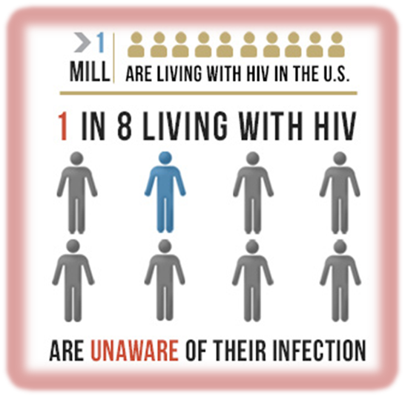
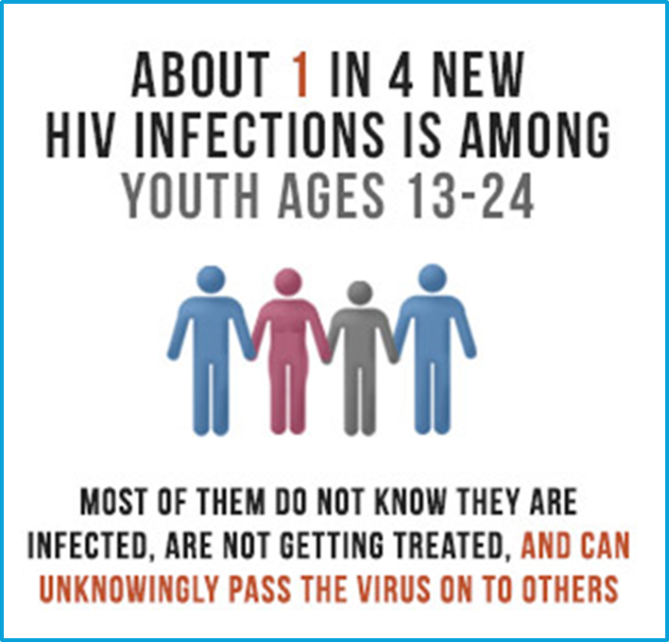
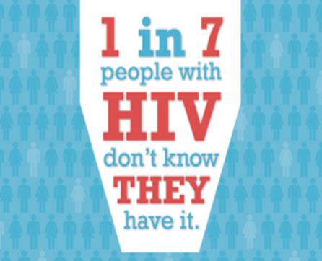
Why is This Important?
In the U.S.
30,635 people diagnosed with HIV (2020).
17,032 people diagnosed with AIDS (2018).
Oklahoma State Department of Health | HIV 101 | 2023
Notes:
Number of people living with HIV: 1.2 million
Percent of people with HIV who don’t know it: 13%
Percent of people with HIV virally suppressed: 57%
Among all those living with HIV, 1 in 7 (14.3%) are unaware of their infection.
An estimated 44.9% of persons aged 13-24 years are unaware of their HIV status (whether they are positive or negative)
IN OKLAHOMA: Year-end 2017: 302 newly diagnosed HIV cases (6,163 currently living with HIV).
IN OKLAHOMA: Year-end 2020: 345 newly diagnosed HIV cases (7158 currently living with HIV).
21.5% (n=74) were classified as late testers
AIDS diagnosed within 3 months of HIV diagnosis
At the end of December 2020, 7158 people were living with HIV/AIDS in Oklahoma.
46.4% (3324) had been diagnosed with AIDS.
2020: 30,635
2019: 34,800
2018: 36,400

Slide 7
Diagnoses of HIV Cases,
by Age
United States, 2020
N=30,635
Oklahoma, 2020
N=345
<1%
Oklahoma State Department of Health
| HIV 101 | 2023
Age 65 over
Notes:
2022 Note: Among all HIV-positive youth aged 15-24, only know they have HIV!
2020 Diagnosed with HIV (all ages) in United States and 6 dependent territories: 30,635
< 13 : ?% (?)
13-14: .039%, (12)
15-19: 4.1% ( 1,256)
20-24: 15.9% (4,867)
25-29: 19.9% (6,103)
30-34: 17.1% (5,233)
35-39: 11.25% (3,445)
40-44: 8.3% (2,540)
45-49: 6.8% (2,094)
50-54: 6.2% (1,883)
55-59: 5.2% (1,599)
60-64: 2.9% (901)
≥ 65 : 2.3% (702)
2018 Note: Among all HIV-positive youth aged 15-24, only 1 in 2 know they have HIV!
2019 Diagnosed with HIV (all ages) in United States : 34,800
2018 Diagnosed with HIV (all ages) in United States and 6 dependent territories: 37,968
< 13 : 0.22% (87)
13-14: 0.2%, (20)
15-19: 4.53% (1,719)
20-24: 16.20% (6,152)
25-29: 20.46% (7,768)
30-34: 15.07% (5,723)
35-39: 11.19% (4,250)
40-44: 7.97% (3,025)
45-49: 7.54% (2,861)
50-54: 6.66% (2,528)
55-59: 4.94% (1,877)
60-64: 2.79% (1,058)
≥ 65 : 2.37% (900)
2020 Diagnosed with HIV (all ages) in Oklahoma: 345
≤ 12 : < 1% (1)
13-14: 0% (0)
15-24: 22.9% (79)
25-34: 33% (118)
35-44: 23.8% (82)
45-54: 11.6% (40)
55-64: 5.8% (22)
≥ 65 : <1% (7)
2019 Diagnosed with HIV (all ages) in Oklahoma: 326
≤ 12 : < 1% (1)
13-14: 0% (0)
15-24: 23.6% (77)
25-34: 36.2% (118)
35-44: 18.4% (60)
45-54: 14.7% (48)
55-64: 5.8% (19)
≥ 60 : <1% (3)
2017 Diagnosed with HIV (all ages) in Oklahoma:
≤ 12 : < 1%
13-19: 2.65% (8)
20-29: 37.75% (114)
30-39: 26.16% (79)
40-49: 15.23% (46)
50-59: 12.91% (39)
≥ 60 : 5.30% (16)
2016 Diagnosed with HIV (all ages) in Oklahoma:
≤ 12 : 0.3%
13-19: 3.1%
20-29: 40.7%
30-39: 23.4%
40-49: 19.7%
50-59: 9.2%
≥ 60 : 3.7%
2015 Diagnosed with HIV (all ages) in United States:
≤ 14 : 0.37%
15-19: 4.30%
20-24: 17.93%
25-29: 19.01%
30-34: 13.76%
35-39: 10.61%
40-44: 8.65%
45-49: 8.36%
50-54: 7.62%
55-59: 4.70%
60-64: 2.52%
≥ 65 : 2.17%

Slide 8
Diagnoses of HIV Cases, by Transmission
United States, 2020
N=30,635
Oklahoma, 2020
N=345
Oklahoma State Department of Health
| HIV 101 | 2023
Notes:
Note: % of cases are transmitted strictly by sexual contact
IN OKLAHOMA: “Other/Unknown” includes “No Identified Risk/No Reported Risk (NIR/NRR)”
2020 Diagnosed with HIV infection (all ages) in the United States:
67.8% (20,758) - Male-to-male sexual contact
3.9% (1,198) - IDU: males
4.5% (857) - IDU: females
3.6% (1,109) - Male-to-male sexual contact & IDU
6.7% (2,051) - Heterosexual contact: males
14.9% (4,575) - Heterosexual contact: females
0.28% (87) - Other (perinatal, hemophilia, blood transfusion, and NIR/NRR)
2020 IN OKLAHOMA: Diagnosed with HIV infection (all ages)
57.7% (199) - MSM
7.3% (25) - IDU (males and females)
5.8% (20) - MSM & IDU
2.3% (7.9) - Heterosexual contact (male and female)
<1% (1) - Perinatal
27% (93) - NIR/NRR
2019 IN OKLAHOMA: Diagnosed with HIV infection (all ages)
52.5% (171) - MSM
8.6% (28) - IDU (males and females)
7.7% (25) - MSM & IDU
5.2% (17) - Heterosexual contact (male and female)
<1% (1) - Perinatal
25.8% (84) - NIR/NRR
2018 Diagnosed with HIV infection (all ages) in the United States:
64.97% (24,933) - Male-to-male sexual contact
3.71% (1,434) - IDU: males
2.78% (1,058) - IDU: females
3.58% (1,372) - Male-to-male sexual contact & IDU
7.49% (2,916) - Heterosexual contact: males
15.84% (6,092) - Heterosexual contact: females
0.43% (162) - Other (perinatal, hemophilia, blood transfusion, and NIR/NRR)
2017 Diagnosed with HIV infection (all ages) in Oklahoma:
53.0% (160) - MSM
6.6% (20) - IDU (males and females)
8.9% (27) - MSM & IDU
7.0% (21) - Heterosexual contact (male and female)
<1% - Perinatal
24.5% 74) - NIR/NRR
2016 Diagnosed with HIV infection (all ages) in Oklahoma:
53.9% - MSM
5.4% - IDU (males and females)
8.8% - MSM & IDU
23.7% - Heterosexual contact (male and female)
0.3% - Perinatal
7.8% - NIR/NRR
Note: 93% of cases are transmitted strictly by sexual contact
2015 Diagnosed with HIV infection (all ages) in the United States:
66.75% - Male-to-male sexual contact
3.57% - IDU: males
2.48% - IDU: females
3.04% - Male-to-male sexual contact & IDU
7.46% - Heterosexual contact: males
16.17% - Heterosexual contact: females
0.52% - Other (perinatal, hemophilia, blood transfusion, and NIR/NRR)

Slide 9
Diagnoses of HIV Cases, by Race/Ethnicity
United States, 2019
N=36,801
Oklahoma, 2020
N=345
9%, OK
3%, OK
7%, OK
11%, OK
6%, OK
64%, OK
Oklahoma State Department of Health
| HIV 101 | 2023
Notes:
Note: HIV does not discriminate, but there are disparities, or groups who are impacted more than others.
NOTE: When looking at numbers like this it is important to know that just because a group has a larger percentage or number it does not mean they are more impacted. (See OK information for details.)
NOTE Explanation: In Oklahoma, it looks like Whites are most impacted by HIV. This is not the case.
Look at the percentage by race who were diagnosed with HIV. Now look to the right of those descriptions to see the percentage that race is of Oklahoma’s total population.
When the percentage of the race with the disease is larger than the percentage of the population in the given area, Oklahoma for instance, that is who is most impacted, or disproportionately impacted.
2020 IN OKLAHOMA: Diagnosed with HIV infection (all ages)
42% (145) - White 64%
24% (83) - Black/African American 7%
15% (52) - Hispanic/Latino 11%
8% (28) - American Indian/Alaskan Native 9%
1% (4) - Asian/Pacific Islander 3%
10% (35) - Multiple Races 6%
2019 Diagnosed with HIV infection (all ages) in United States:
42% (15,340) - Black/African American
25% (9,018) - White
29% (10,502) - Hispanic/Latino
2% (743) - Asian/Pacific Islander
1% (210) - American Indian/Alaskan Native
2% (918) - Multiple Races
2019 IN OKLAHOMA: Diagnosed with HIV infection (all ages)
39.6% - White 65%
28.5% (84) - Black/African American 7.8%
14.1% (53) - Hispanic/Latino 11.1%
6.1% (28) - American Indian/Alaskan Native 9.4%
1.5% (2) - Asian/Pacific Islander 2.6%
10.1% (11) - Multiple Races 6.3%
2018 Diagnosed with HIV infection (all ages) in United States:
42.29% (16,055) - Black/African American
25.22% (9,575) - White
27.01% (10,255) - Hispanic/Latino
2.50% (948) - Asian/Pacific Islander
0.49% (186) - American Indian/Alaskan Native
2.50% (949) - Multiple Races
2017 Diagnosed with HIV infection (all ages) in Oklahoma:
41.06% (124) - White
27.81% (84) - Black/African American
17.55% (53) - Hispanic/Latino
9.27% (28) - American Indian/Alaskan Native
0.66% (2) - Asian/Pacific Islander
3.64% (11) - Multiple Races
2016 Diagnosed with HIV infection (all ages) in Oklahoma:
47.8% White
26.1% Black/African American
12.9% Hispanic/Latino
8.1% American Indian/Alaskan Native
1.4% Asian/Pacific Islander
3.7% Multiple Races
2015 Diagnosed with HIV infection (all ages) in United States:
44.72% Black/African American
26.60% White
23.51% Hispanic/Latino
2.62% Asian/Pacific Islander
0.53% American Indian/Alaskan Native
2.03% Multiple Races

Slide 10


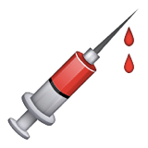

How is HIV Spread?
HIV is passed from person to person
through the exchange of body fluids.
THREE Ways:
        Unprotected sex (anal, vaginal, or oral) with People Living With HIV (PLWH)
        Blood to blood contact
        Exposure to HIV before or during birth or through breastfeeding
Oklahoma State Department of Health | HIV 101 | 2023
Notes:
Sex
Anal sex is the highest of sexual transmission of HIV. This is due to lack of elasticity and a thinner lining of the anus. Also, the concentration of HIV is higher is rectal fluids than it is in semen.
Both men and women can have anal sex.
Having anal sex may prevent pregnancy; however, it does put a person at risk for HIV and other STIs.
Vaginal sex is the second highest of sexual transmission of HIV.
Oral sex carries the least risk of sexual transmission of HIV.
NOTE: It is important that young people know that Oral and Anal Sex ARE FORMS OF SEX. Many do not count these as forms of sex, yet the risk is still present for HIV and other STIs.
2. Blood Contact
Sharing needles falls under blood-to-blood transmission because when someone inserts a needle into his or her veins, small amounts of blood is drawn into the syringe. When that same needle/syringe is used by another person, the blood is mixed. “Shooting up” any drug or sharing “works” (the spoon, cotton ball, or any other items used while injecting and sharing the drug) puts people at risk of contracting HIV and Hepatitis C.
Before the blood supply was tested for HIV (tested in 1985), people contracted HIV through blood transfusions or other blood products. Today the risk of contracting HIV through blood products is 1 in 1.5 million.
Open wound to open wound. This could occur, for example, during a contact sport, such as soccer, football, baseball, softball, basketball, or any sport where an open wound has occurred. Thus, the reason for removing the injured person from play, until the wound can be cleaned and covered.
3. Mother-to-Child –
HIV can be spread from a HIV-positive woman to her child during pregnancy, childbirth (labor and delivery), or breastfeeding. It is the most common way newborns contract HIV.
Pregnant women living with HIV take medicine during pregnancy and childbirth to reduce the risk of mother-to-child transmission of HIV. In some situations, a woman with HIV may have a scheduled cesarean delivery (C-section) to prevent mother-to-child transmission of HIV.
Babies born to women living with HIV receive HIV medicine for 6 weeks after birth. The HIV medicine reduces the risk of infection from any HIV that that may have entered a baby’s body during childbirth.
Because HIV can be transmitted in breast milk, women living with HIV should not breastfeed their babies. Baby formula is a safe and healthy alternative to breast milk.
The CDC (Centers for Disease Control and Prevention) recommends that all pregnant women get tested for HIV as early as possible in each pregnancy.

Slide 11

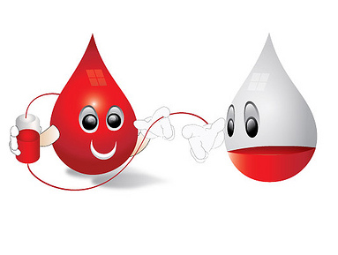
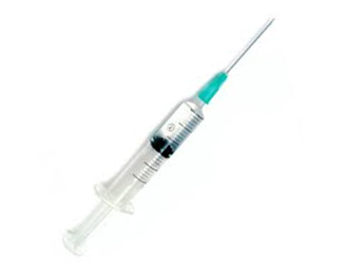
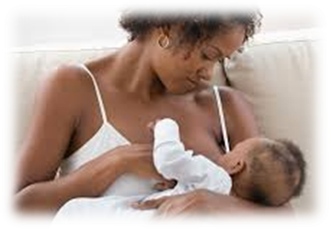
What Fluids Can Transmit HIV?
Blood
Rectal fluids
Semen
Vaginal fluids
Breast Milk
Oklahoma State Department of Health | HIV 101 | 2023
Notes:
Five Fluids
Blood
Rectal fluids: mucus that lines the rectum.
Semen (ejaculate/cum & pre-ejaculate/pre-cum): is the substance that is released from the penis following sexual orgasm. Pre-cum is the liquid that seeps out of the penis before ejaculation occurs. There are lower concentrations of HIV in pre-cum, making transmission less likely, but still possible.
Vaginal fluids: combination of fluid and cells continually shed from the vagina. Normal vaginal discharge helps keep vaginal tissues healthy, provide lubrication and protect against infection and irritation.
Breast milk can infect the baby following birth. This is especially an issue in other countries such as Africa who have communities who depend solely on breast milk to nourish their children.
NOTE: There is not enough virus to transmit HIV in: saliva, sweat, tears, urine, feces.

Slide 12
How does HIV Enter the Body?
Mouth Nose Eyes
Vagina Penis Anus
Open Skin
Oklahoma State Department of Health | HIV 101 | 2023
Notes:
These body fluids (blood, rectal fluids, vaginal fluids, semen, breast milk) must come-into-contact with a mucus membrane or damaged tissue or be directly injected into your bloodstream (by a needle or syringe) for transmission to possibly occur.
Mucus membranes are the soft, moist areas just inside openings to your body. They can be found in the eyes (the conjunctiva is clear and covers the eyeball), nose, ears, vagina, anus, mouth or the opening at the tip of the penis (the urethra).

Slide 13
Symptoms of HIV
Many people who have HIV have NO symptoms
at all for 10 years or more.
    It is estimated 158,500 (13%) people in U.S. have HIV,
    but do not know it.
    Symptoms vary from person to person. Some people who have HIV report having flu-like symptoms 2-4 weeks
    after exposure.
Oklahoma State Department of Health | HIV 101 | 2023
Notes:
The only way to know if you have contracted HIV is to be tested. You cannot rely on symptoms to know if you have HIV.
Flu-like symptoms: (often described as “the worst flu ever”) can last anywhere from a few days to several weeks after exposure.
Just because you have these symptoms doesn’t mean you have HIV. These symptoms could be caused from other infections, such as COVID-19.
Fever
Enlarged lymph nodes
Sore throat
Rash

Slide 14
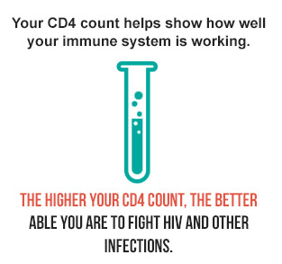
Viral Load & CD4 Count
CD4 (T4) Count
Number of white blood cells in the blood
Viral Load
Amount of HIV in the blood
Oklahoma State Department of Health | HIV 101 | 2023
Notes:
CD4 Count:
CD4 cells or T-cells-type of white blood cells that play a major role in protecting your body from infection. They send signals to activate your body’s immune response when they detect “intruders,” like viruses or bacteria.
A CD4 count is a lab test that measures the number of CD4 cells in a sample of your blood.
Your CD4 count helps show you how well your immune system is working. The higher your CD4 count, the more likely you successfully fight HIV and other infections.
A normal CD4 count is from 500 to 1,500 cells/mm3 of blood (for adults or adolescents).
A very low CD4 count (less than 200 cells/mm3) is one of the ways to determine whether a person living with HIV has progressed to AIDS.
Viral Load:
Measures amount of HIV RNA in blood (RNA is ribonucleic acid, a protein).
This measurement is thought to be more accurate than a CD4 count, to decide where a person is in the disease process.
The term “viral load” refers to the amount of HIV in a sample of your blood. When your viral load is high, you have more HIV in your body, and that means your immune system is not fighting HIV well, and the more likely you are to spread the HIV virus.
There is really no such thing as a “normal” viral load. People who do not have HIV have no viral load at all, so there’s no “Normal” range for reference.
A viral load test helps provide information on your health status and how well antiretroviral therapy (ART – treatment with HIV medicines) is controlling the virus.
The goal of ART is to move your viral load down, ideally to undetectable levels. In general, your viral load will be declared "undetectable" if it is under 40 to 75 copies in a sample of your blood. This number depends on the lab and the equipment they use to analyze your sample.
Having an “undetectable” viral load doesn’t mean that the virus is completely gone from your body, it is simply below what a lab test can find. If you stop taking the medication the viral load will increase.
Someone with an Undetectable viral load still has HIV and needs to stay on medication to remain healthy.
NOTE: Having an undetectable viral load also means a person cannot transmit HIV to another person sexually. This is another form of prevention called Treatment as Prevention.

Slide 15

Window Period
The period of time after someone may have been exposed to HIV, but before a test can detect it (up to three months).
IMMEDIATELY INFECTIOUS
Oklahoma State Department of Health | HIV 101 | 2023
Notes:
Window period:
The period after exposure to HIV, but before a test can find the virus.
Someone with HIV who is currently in the window period, is IMMEDIATELY infectious, or able to transmit HIV.
Can be from approximately 9 days to 3-6 months, depending on the type of HIV test used and the person's body.
The immune system usually takes 3 to 8 weeks to make antibodies against HIV, but tests differ in how early they can detect the virus.
97% of people will develop antibodies in the first 3 months after getting the HIV virus.
In very rare cases, it can take up to 6 months to develop antibodies to HIV.
NOTE: If you get a negative HIV test result 3 months after your exposure or earlier, it is recommended you retest in another 3 months.
Most rapid HIV tests test for antibodies only, so this is a 3-month window period. (Will explain further on the next slide)
Clinical Tests that test for both antibodies AND antigens may be able to reduce the window period to 3 weeks.
RNA HIV testing reduces the window period to about 10 days.
NO MATTER THE TYPE OF TEST USED, IF SOMEONE IS IN THE WINDOW-PERIOD, THEY MUST RETEST TO GET AN ACCURATE PICTURE OF THEIR HIV STATUS!!!

Slide 16
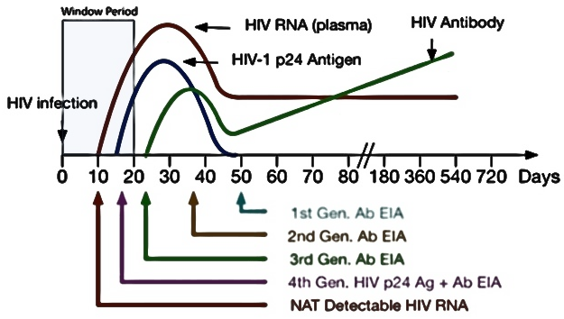
What is the Window Period ?
Oklahoma State Department of Health | HIV 101 | 2023
Notes:
WINDOW PERIOD: Free Image from www.grepmed.com
The period after exposure to HIV, but before a test can find the virus.
Someone with HIV who is currently in the window period, is IMMEDIATELY infectious, or able to transmit HIV.
Can be from approximately 9 days to 3 to 6 months, depending on the type of HIV test used and the person's body.
The immune system usually takes 3 to 8 weeks to make antibodies against HIV, but tests differ in how early they successfully detect the virus.
97% of people will develop antibodies in the first 3 months after getting the HIV virus.
In very rare cases, it can take up to 6 months to develop antibodies to HIV.
NOTE: If you get a negative HIV test result 3 months after your exposure or earlier, it is recommended you retest in another 3 months.
NOTE:
Most rapid tests test for antibodies only, so this is a normally 3-month window period.
Tests that test for both antibodies AND antigens may be able to reduce the window period to 3 weeks.
RNA HIV testing reduces the window period to approximately 10 days.
NO MATTER THE TYPE OF TEST USED, IF SOMEONE IS IN THE WINDOW-PERIOD THEY SHOULD RETEST TO GET ANPICTURE OF THEIR HIV STATUS.

Slide 17
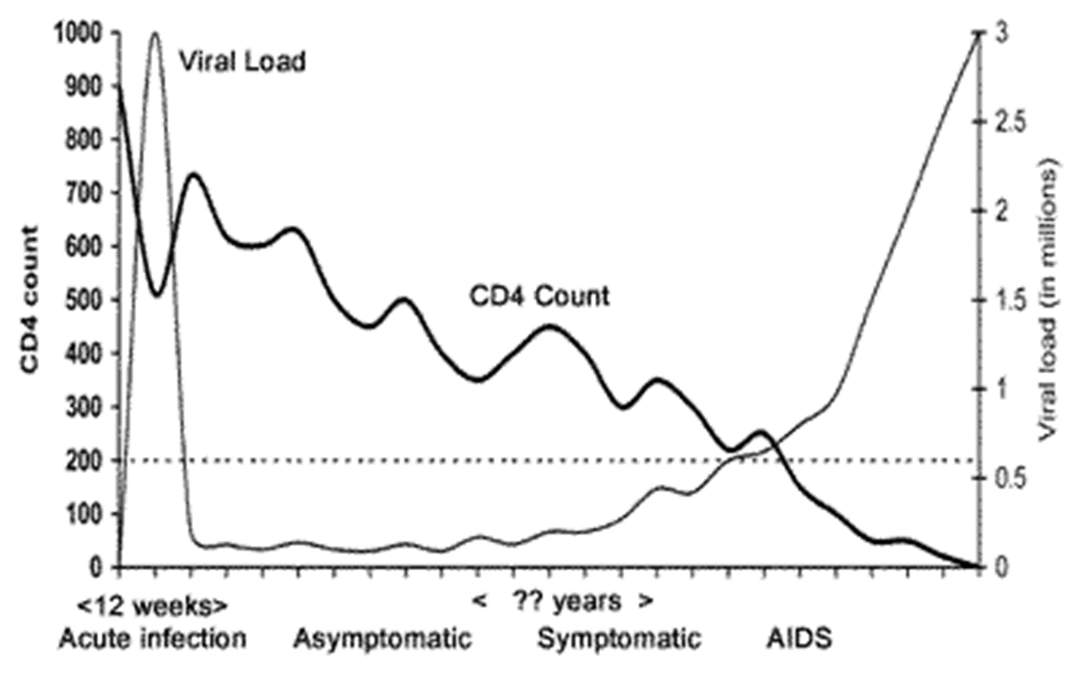
Viral Load & CD4 Count Graph
AIDS
Oklahoma State Department of Health | HIV 101 | 2023
Notes:
Remember how we said, ‘Someone with HIV who is currently in the window period, is IMMEDIATELY infectious, or able to transmit HIV’.
Look at the upper left of the graph at the viral load. Look at how high it is and then look at the bottom left of the graph for the time period of infection onset. This is the very beginning of the HIV infection process.
Now, look at the graph and see how the viral load and CD4 change over time. This would be an example of the impact on the body if a person was not on medicine.

Slide 18
What does a HIV Test Mean?
Positive
+
Negative
-
HIV antibody found.
Have the virus and can pass to others.
Need to begin treatment immediately.
No HIV antibody found.
May not have HIV (consider the window period).
Retest in three months.
Oklahoma State Department of Health | HIV 101 | 2023

Slide 19
Opportunistic Infections (OIs)
People with healthy immune systems can be exposed to certain viruses and have no reaction.
HOWEVER
PLWH can face serious threats
from the same viruses.
Opportunistic Infections (OIs) are infections that occur more frequently and are more severe in individuals with weakened immune systems including people living with HIV.
Oklahoma State Department of Health | HIV 101 | 2023
Notes:
OIs are signs of a declining immune system.
Most life-threatening OIs occur when your CD4 count is below 200 cells/mm3.
IMPORTANT: OIs are the cause of death for people living with HIV, not AIDS or HIV.
One of the goals of HIV treatment is to lower the risk of getting OIs, by keeping the viral load low and the CD4 count high.
OIs can occur all over the body and can be relatively localized (meaning they affect only one part of the body) or systemic/disseminated (spread to other parts of the body and other body systems). OIs are signs of a declining immune system.
Most life-threatening OIs occur when your CD4 count is below 200 cells/mm3.
IMPORTANT: OIs are the cause of death for people living with HIV, not AIDS or HIV.
One of the goals of HIV treatment is to lower the risk of getting OIs, by keeping the viral load low and the CD4 count high.
OIs can occur all over the body and can be relatively localized (meaning they affect only one part of the body) or systemic/disseminated (spread to other parts of the body and other body systems).
When or If you become susceptible to OIs is often related to your CD4 count.
When or If you become susceptible to OIs is often related to your CD4 count.
*If questions are asked regarding specific OIs*
500 cells/mm³ to 200 cells/mm³ OPPORTUNISTIC INFECTIONS
Candidiasis (Thrush)
This is a fungal infection that is normally seen in patients with CD4 counts in this range. It is treatable with antifungal medications. A trained provider can usually diagnose thrush with a visual examination.
Kaposi’s Sarcoma (KS)
KS is caused by Human Herpes Virus-8. Before the introduction of antiretroviral therapy, as many as 1 in 5 patients with AIDS had KS. It can cause lesions on the body and in the mouth. In addition, this virus can affect internal organs and disseminate to other parts of the body without any external signs. Treatment plans can include chemotherapy to shrink the lesions, as well as antiretroviral therapy to increase CD4 cell count. A diagnosis is typically made by inspecting a lesion and performing a direct biopsy on it.
Oral Symptoms include:
White patches on gums, tongue or lining of the mouth
Pain in the mouth or throat
Difficulty Swallowing
Loss of Appetite
Vaginal Symptoms Include:
Vaginal Irritation
Itching
Burning
Thick, white discharge
Signs and Symptoms of KS can include:
Appearance of a purplish lesion on skin
Appearance of a purplish lesion in the mouth
Occasionally gastrointestinal complaints with disseminated KS
200 cells/mm³ to 100 cells/mm³ OPPORTUNISTIC INFECTIONS
Pnuemocystis Jirovecii (Carinii) Pneumonia (PCP)
PCP is a fungal infection and is the OI that most often causes death in patients with HIV. It is treatable with antibiotic therapy and close monitoring. If necessary, prophylaxis is available for patients who are at risk for PCP, but who are not ready to start antiretroviral medication. Diagnosing PCP usually involves a hospital stay to ensure proper testing and treatment without complications.
Histoplasmosis and Coccidioidomycosis
These are fungal infections that are found in many regions of the United States. They often present as severe, disseminated illnesses in patients with low CD4 counts. Diagnosis consists of blood tests and evaluation for possible exposures related to geographical areas.
Progressive Multifocal Leukoencephalopathy (PML)
PML is a severe neurological condition that is caused by the JC virus and typically occurs in patients with CD4 counts below 200. While there is no definitive treatment for this disease, it has been shown to be responsive to antiretroviral therapy. In some cases, the disease resolves without any treatment.
Signs and Symptoms of PCP can include:
Shortness of Breath
Fever
Dry Cough
Chest Pain
Signs and Symptoms of Histoplasmosis and Coccidioidomycosis can include:
Fever
Fatigue
Weight Loss
Cough
Chest pain
Shortness of Breath
Headache
Signs and Symptoms of PML can include:
Dementia
Seizures
Difficulty Speaking
Confusion
Difficulty walking
100 cells/mm³ to 50 cells/mm³
OPPORTUNISTIC INFECTIONS
Toxoplasmosis
Toxoplasmosis is caused by the parasite Toxoplasma gondii that can cause encephalitis and neurological disease in patients with low CD4 counts. The parasite is carried by cats, birds, and other animals and is also found in soil contaminated by cat feces and in meat, particularly pork. Toxoplasmosis is treatable with aggressive therapy, and prophylaxis is recommended for patients with low CD4 counts (usually less than 200). Diagnosis of this condition often requires imaging studies (CT or MRI) of the brain and a blood test.
Cryptosporidiosis
Cryptosporidiosis is a diarrheal disease caused by the protozoa Cryptosporidium, and it can become chronic for people with low CD4 counts. Symptoms include abdominal cramps and severe chronic diarrhea. Infection with this parasite can occur through: swallowing water that has been contaminated with fecal material (in swimming pools, lakes, or public water supplies); eating uncooked food (like oysters) that are infected; or by person-to-person transmission, including changing diapers or exposure to feces during sexual contact. Treatment and antiretroviral therapy are important.
Cryptococcal Infection or Cryptococcosis
Cryptococcal infection is caused by a fungus that typically enters the body through the lungs and can spread to the brain, causing cryptococcal meningitis. In some cases, it can also affect the skin, skeletal system, and urinary tract. This can be a very deadly infection if not caught and properly treated with antifungal medication. Although this infection is found primarily in the central nervous system, it can disseminate to other parts of the body, especially when a person has a CD4 count of less than 50. SYMPTOMS
Signs and Symptoms of Toxoplasmosis can include:
Headache
Confusion
Motor Weakness
Fever
Seizures
Signs and Symptoms of Cryptosporidiosis can include:
Chronic Watery Diarrhea
Stomach cramps
Weight loss
Nausea
Vomiting
Signs and Symptoms of Cryptococcal Meningitis include:
Fever
Fatigue
Headache
Neck Stiffness
Some patients can have memory loss or mood changes
50-100 Cells/mm³
OPPORTUNISTIC INFECTIONS
Cytomegalovirus (CMV)
CMV is an extremely common virus that is present in all parts of the world. It is estimated that a majority of the population have had CMV by the time they are 40 years-old. CMV can be transmitted by saliva, blood, semen and other body fluids. It can cause mild illnesses when first contracted and many people may never have symptoms. However, it does not leave the body when someone has CMV. In patients with HIV and low CD4 counts it can cause infections in the eye and gastrointestinal system.
SYMPTOMS
Signs and Symptoms of CMV:
Sore Throat
Swollen Glands
Fatigue
Fevers
In people with low CD4 counts it can cause:
Blurred vision (if there is CMV infection is in the eye)
Painful Swallowing
Diarrhea
Abdominal Pain
Less than 50 Cells/mm³
OPPORTUNISTIC INFECTIONS
Mycobaterium Aviam Complex (MAC)
MAC is a type of bacteria that can be found in soil, water, and many places in the environment. These bacteria can cause disease in people with HIV and CD4 Counts less that 50. The bacteria can infect the lungs or the intestines, or in some cases, can become “disseminated”. This means that it can spread to the blood stream and other parts of the body. If this occurs, it can be a life threatening infection. If a persons CD4 count is below 50, then medications are available to prevent this infection from occurring.
SYMPTOMS
Signs and Symptoms of MAC:
Fevers
Night sweats
Abdominal Pain
Fatigue
Diarrhea

Slide 20
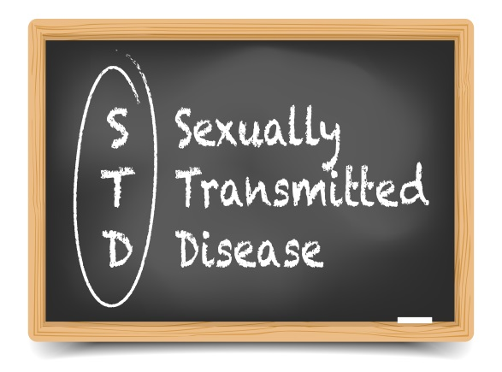
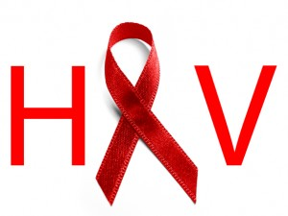
STIs & HIV
The presence of a STI increases the probability of
Acquiring HIV & Transmitting HIV.
WHY?
Compromised immune system
Additional STIs
Irritation/inflammation of mucus membranes
Oklahoma State Department of Health | HIV 101 | 2023
Notes:
Having a Sexually Transmitted Infection (STI) can increase a person's risk of contracting HIV, if the STI causes open sores or breaks in the skin (e.g., syphilis, herpes, chancre [shan-ker]) or causes inflammation and irritation of the skin/area (e.g., chlamydia, gonorrhea).
WHY?
Compromised immune system:
Another reason why the STI and HIV relationship exists is when one acquires a STI, it compromises the immune system by weakening it.
The body is left susceptible and it is easier to get another STI/HIV.
This also true in reverse. If a PLWH has HIV, they are more likely to contract another STI.
Additional STIs:
If a Person Living With HIV (PLWH) has another STI, they are three to five times more likely than other PLWHs to transmit HIV through sexual contact.
Irritation and inflammation of mucus membranes:
STIs causing irritation and inflammation of the mucus membrane make it easier for HIV to enter the body during sexual contact.

Slide 21

HIV Treatment
Newly Diagnosed? START TREATMENT!
TREATMENT BENEFITS
your own health
and the
health of others
Because of better treatments, PLWH are now living longer and with a better quality of life than ever before.
Oklahoma State Department of Health | HIV 101 | 2023
Notes:
Treatment benefits explanation:
Your own health: Lowering the level of virus in the body - live longer, healthier life
The health of others: Reduces the risk of transmitting HIV to others
Lifespan:
Average lifespan of someone diagnosed with HIV at age 20 who takes medication regularly is 71 years of age.
Average lifespan of someone diagnosed with HIV at age 20 and does NOT take medication is 32 years of age.
Average lifespan for someone who does not have HIV is 79.
*In case asked about specific details of treatment*
Many different names for HIV drugs:
"The Cocktail“
Antiretrovirals (ARVs)
Highly Active Antiretroviral Therapy (HAART or ART)
5 different “classes” of HIV drugs.
Each class of drug attacks the virus at different points in its life cycle—so if you are taking HIV meds, you will generally take 3 different antiretroviral drugs from 2 different classes.
Taking more than one drug also protects you against HIV drug resistance. When HIV reproduces, it can make copies of itself that are imperfect—and these mutations may not respond to the drugs you take to control your HIV.
Nucleoside/Nucleotide Reverse Transcriptase Inhibitors (NRTIs): Sometimes called "nukes." These drugs block HIV’s ability to use a special type of enzyme (reverse transcriptase) to correctly build new genetic material (DNA) that the virus needs to make copies of itself.
Non-Nucleoside Reverse Transcriptase Inhibitors (NNRTIs): These are called "non-nukes." They work in a very similar way to "nukes." Non-nukes also block the enzyme, reverse transcriptase, and prevent HIV from making copies of its own DNA. But unlike the nukes (which work on the genetic material ), non-nukes act directly on the enzyme itself to prevent it from functioning correctly.
Protease Inhibitors (PIs): When HIV replicates inside your cells, it creates long strands of its own genetic material. These long strands have to be cut into shorter strands in order for HIV to create more copies of itself. The enzyme that acts to cut up these long strands is called protease. Protease inhibitors (stoppers) block this enzyme and prevent those long strands of genetic material from being cut up into functional pieces.
Entry/Fusion Inhibitors: These medications work to block the virus from ever entering your cells in the first place. HIV needs a way to attach and bond to your CD4 cells, and it does that through special structures on cells called receptor sites. Receptor sites are found on both HIV and CD4 cells (they are found on other types of cells too). Fusion inhibitors can target those sites on either HIV or CD4 cells and prevent HIV from "docking" into your healthy cells.
Integrase Inhibitors: HIV uses your cells’ genetic material to make its own DNA (a process called reverse transcription). Once that happens, the virus has to integrate its genetic material into the genetic material of your cells. This is accomplished by an enzyme called integrase. Integrase inhibitors block this enzyme and prevent the virus from adding its DNA into the DNA in your CD4 cells. Preventing this process prevents the virus from replicating and making new viruses.
Fixed-dose combinations: These are not a separate class of HIV medications but combinations of the above classes and a great advancement in HIV medicine. They include antiretrovirals which are combinations of 2 or more medications from one or more different classes. These antiretrovirals are combined into one single pill with specific fixed doses of these medicines.
The word “prophylaxis” means “to prevent or control the spread of an infection or disease.”

Slide 22
Treatment as Prevention
PLWH with an Undetectable viral load Cannot Transmit HIV to others!
However, Medication CAN be:
Expensive $379,668 Lifetime (60% discount)
($597,300 undiscounted)
Complicated may take multiple pills at different times of the day
Toxic negative side effects may occur
Ineffective not all strains respond the same
Oklahoma State Department of Health | HIV 101 | 2023
Notes:
Expensive:
Cost of HIV treatment is high (especially without health insurance).
$30,000 is generally how much one would spend on a new car. Would you rather spend money on HIV treatment or buy a new car?
“Lifetime” means that $597,300/year 2015/NIH is how much money someone living with HIV would spend over the course of their whole life on treatment.
Complicated:
Sticking to an HIV regimen can be difficult and there may be multiple medications to take. (When to take it, what to take, how many to take, etc.)
Poor adherence—not taking HIV medicines every day and exactly as prescribed—can lead to drug resistance and treatment failure.
Toxic: side effects from HIV medicine -
drug interactions between different HIV medicines
interactions between HIV medicines and other medicines a person may be taking.
Side effects from HIV medicines can vary depending on the medicine and the person taking the medicine. Different people taking the same HIV medicine can have very different side effects.
Ineffective:
Drug resistance-When HIV multiplies in the body, the virus sometimes mutates (changes form) and makes variations of itself.
Variations of HIV that develop while a person is taking HIV medicines can lead to drug-resistant strains of HIV.
HIV medicines that previously controlled a person’s HIV are not effective against the new, drug-resistant HIV. In other words, the person’s HIV continues to find a way to survive.
NOTE: Remember…. Not all strains of HIV respond to the same medications.

Slide 23

U=U
UNDETECTABLE = UNTRANSMITTABLE
Launched in 2016 by PLWH.
Promotes control of HIV by preventing HIV transmission and reducing stigma towards PLWH.
PLWH and taking ART are considered undetectable when levels of virus in the body are too low to detect, by lab tests.*
As long as people stick to their treatment and are consistently monitored, PLWH are unable to transmit virus to others, after 6 months of viral suppression, through sex.
*The person still has HIV.
Oklahoma State Department of Health | HIV 101 | 2023
Notes:
HIV medication:
Called antiretroviral therapy (ART).
If taken as prescribed, ART reduces the amount of HIV in the body (viral load) to a very low level.
This keeps the immune system working, prevents illness and results in viral suppression.
Viral suppression is defined as having less than 200 copies of HIV/milliliter of blood.
IMPORTANT TO SHARE:
The Risk of HIV Transmission with an Undetectable viral load by transmission category:
Sex (oral, anal, or vaginal)- Effectively no risk.
Pregnancy, labor, and delivery - <1%
Sharing syringes or other drug injection equipment (works)- Unknown, but likely reduced risk
Breastfeeding- Substantially reduces, but does not eliminate risk (current recommendations in the U.S. are mothers with HIV should NOT breastfeed their infants)

Slide 24

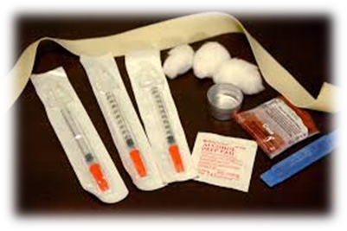
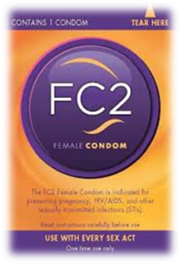

Reducing the Risk
NO RISK
Abstinence from Sex
Abstinence from Injection Drugs
Mutual Monogamy w/STI Negative Partner
REDUCED RISK
Protected Sex “Correctly and Consistently”
Fewer Sexual Partners
Never Sharing Needles or “Works”
Regular HIV/STI Testing
Oklahoma State Department of Health | HIV 101 | 2023
Notes:
No Risk
Abstinence (sex): Not having any sexual contact. Someone can choose to abstain even if they have had sex before (are not a virgin). Abstinence can be chosen for any period of time (a day, a week, a month, a year, etc.)
Abstinence (drugs): Not using injection drugs.
Mutual Monogamy-When you and your sex partner are both STI/HIV free (have been tested), and you ONLY have sex with each other.
Reduced Risk
Protected Sex
Use a new condom (male, now called external, or female, now called internal, condom) CORRECTLY for every act of vaginal, anal and oral sex throughout the entire sex act (from start to finish).
Before any genital contact, put the condom on the tip of the erect penis with the rolled side out. (looks like a sombrero)
If the condom does not have a reservoir tip, pinch the tip enough to leave a half-inch space for semen to collect. Holding the tip, unroll the condom all the way to the base of the erect penis. (guiding any air bubble out)
After ejaculation and before the penis gets soft, grip the rim of the condom (at the base of the penis) and carefully withdraw the penis. Then gently pull the condom off the penis, making sure semen doesn't spill out.
Tie a knot on the open end of the condom and throw it in the trash. DO NOT FLUSH CONDOMS!
If you feel the condom break at any point during sexual activity, stop immediately, withdraw, remove the broken condom, and put on a new condom.
OTHER FORMS OF BIRTH CONTROL DO NOT PROTECT AGAINST HIV/AIDS OR ANY OTHER STIs! (is not a barrier)
Suggestion:
Sock video if condom application (w/ penis model) demonstration is not allowed.
https://www.youtube.com/watch?v=06kT9yfj7QE
Fewer sexual partners: The less number of people someone has sex with, the less chance of being exposed. If you have sex with 3 people, reduce that number to 2 people.
IF APPROPRIATE AUDIENCE:
Not sharing needles/”works”:
Works- the spoon, cotton ball, needle, syringe, etc. used while injecting and sharing the drugs.
Equipment used to inject drugs/steroids are NOT made to be reused.
The steps below are not 100% safe; but they can reduce the risk of HIV and HCV infection.
Only perform these steps if a new, sterile needle and syringe is not available. New sterile needles and syringes are safer than bleach-cleaned needles.
Clean used needles and syringes immediately following use and again just before the needle and syringe is re-used.
1. PRE-WASH:
Wash out the needle and syringe by flushing (at least 3 times) with clean water.
Use fresh water each time. After each time the needle and syringe is flushed, dispose of the water.
Shake and tap the syringe while it is filled with water.
By flushing the needle and syringe, you are potentially reducing the amount of blood in the syringe.
2. WASH:
Draw bleach into the syringe through the needle.
Completely fill the syringe, at least 3 times, with full strength bleach.
Use fresh bleach every time.
After each time the needle and syringe is flushed with bleach, dispose of the bleach.
Let the bleach stay in the syringe for at least 30 seconds.
Shake and tap the syringe while it is filled with bleach.
3. RINSE:
Draw clean water into the syringe through the needle. (Best is sterile saline)
Completely fill the syringe at least 3 times with clean water (sterile saline, if possible).
Use fresh water each time.
Shake and tap the syringe while it is filled with water.
Notes:
Bleach should not be diluted.
Sterile saline is the best water to use. (i.e. contacts lens saline solution)
Taking the syringe apart may improve cleaning.
Do not share other items such as cooker or cotton swabs.
Regular HIV/STI Testing
HIV:
Everyone aged 13 to 64 should get tested at least one time by their healthcare provider, regardless of their risk factors.
People who have occasional exposure to HIV risks should be tested at least once a year.
People who are at high risk for HIV should get tested every 3 to 6 months.
All pregnant women should be tested during the 1st trimester of pregnancy.
If at high risk for HIV: again in the 3rd trimester.
STIs:
Syphilis:
Are pregnant
Are a man who has sex with men
Exchange sex for money, drugs or other life needs
You have HIV or another STI
You’ve had sex with someone who tested positive for syphilis
http://healthfinder.gov/HealthTopics/Category/health-conditions-and-diseases/hiv-and-other-STIs/syphilis-testing-questions-for-the-doctor
Chlamydia & Gonorrhea:
For women:
If you are age 24 or younger and having sex, get tested once every year.
If you are age 25 or older, get tested if you have more than one sex partner or a new sex partner.
If you have had sex with someone who tested positive for chlamydia or gonorrhea.
For men:
Talk with a doctor about getting tested if you have had sex with someone who tested positive for chlamydia or gonorrhea.

Slide 25
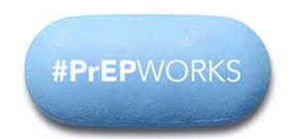
PrEP
Pre-Exposure Prophylaxis (PrEP): daily medicine can prevent HIV from making copies of itself in the body.
PrEP is only prescribed for people who are HIV-negative and
who are at ongoing substantial risk of getting HIV.
PrEP reduces the risk of getting HIV when taken consistently:
  by about 99% through sex
  at least 74% among People Who Inject Drugs (PWID)
Oklahoma State Department of Health | HIV 101 | 2023
Notes:
Pre-exposure prophylaxis (PrEP):
PrEP is a way for people who don’t have HIV to prevent getting HIV by taking a pill every day.
If you take PrEP and are exposed to HIV through sex or injection drug use, the medication works to keep the virus from taking hold in your body.
PrEP is not for everyone.
CDC recommends PrEP be considered for people who are HIV-negative and at substantial risk for HIV.
Substantial Risk:
Having an HIV-positive partner
Having multiple sex partners
Had a STI in the last 6 months
History of inconsistent condom use
Known to share needles/”works” (addiction)
Have used multiple courses of PEP, or Post-Exposure Prophylaxis
Truvada is approved for use by all people of risk for HIV through sex or injection drug use.
Descovy is approved for use by people of risk for HIV through sex, EXCEPT for people assigned female at birth (born with female genitalia) who are at risk of getting HIV through vaginal sex.

Slide 26
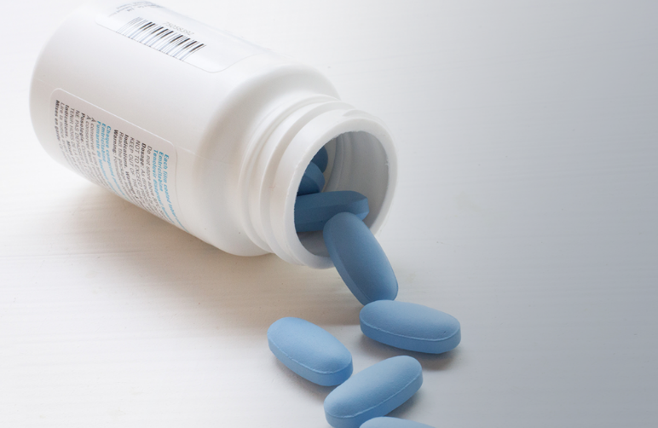
PEP
Post-Exposure Prophylaxis (PEP): a 28-day regimen of HIV medicine, started within 72 hours, of possible exposure to HIV to prevent the virus from making copies of itself in the body.
PEP is only prescribed for HIV-negative individuals who believe they were exposed to HIV, such as, during sex, shared needles (works), or were sexually assaulted.
PEP is effective in preventing HIV, but not 100%.
  Every time use condoms.
  Always use safe injection practices.
Oklahoma State Department of Health | HIV 101 | 2023
Notes:
Post-exposure prophylaxis (PEP):
PEP is a way for people who may have had an exposure to HIV, and have tested negative for HIV, to reduce the risk of getting HIV.
PEP must be started within 72hrs (3days) following the possible exposure to HIV and is taken for 28 days.
PEP is effective in preventing HIV; however, it is not 100%. Condoms should always be used with sex partners and practice safe injection practices.
PEP is only used in emergency situations and should not be used for long term use. If someone has repeated use of PEP, they need to speak with their healthcare provide about beginning PrEP.

Slide 27
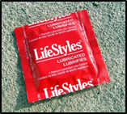

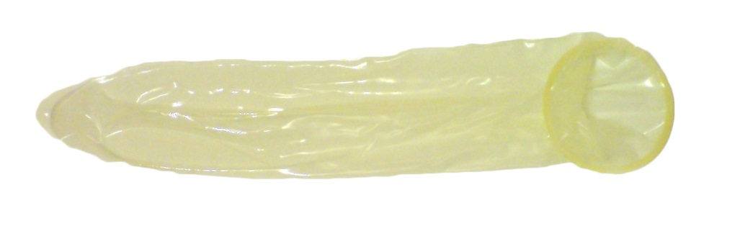
External (Male) Condoms
More than 98% effective when used
correctly and consistently
Latex: Most common and effective
Non-Latex: Polyurethane, Polyisoprene
Natural Membrane: Lambskin (NOT protect against HIV and STIs)
Oklahoma State Department of Health | HIV 101 | 2023
Notes:
Different Kinds:
Latex - a type of rubber (slightly more reliable)
Polyurethane - made from a type of plastic. Thinner/more expensive/slightly less flexible than latex. The best alternative for people who are allergic to latex.
Polyisoprene - synthetic rubber
Lambskin - made from the digestive tract (intestines) of sheep. Doesn’t protect against HIV and STIs (can pass through the tiny holes/pores in the condom). Pores are small enough to keep sperm out.
Where to get external condoms:
Most pharmacies/drugstores
Most supermarkets
Convenience stores/gas stations
Health clinics, including local County Health Departments
Family planning/sexual health centers
Vending machines in public restrooms
Some bars
Online
Condom Distribution through Sexual Health & Harm Reduction Service

Slide 28
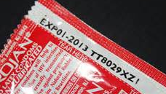
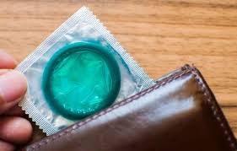
Incorrect External Condom Use 1
DO NOT:
Reuse a condom.
Use expired condoms.
Unroll the condom before putting it on the penis.
Leave condoms in hot or extreme cold places (wallet, car, etc.).
Oklahoma State Department of Health | HIV 101 | 2023
Notes:
4-year study on HIV & condoms:
245 couples – one partner HIV+ and one HIV-
123 used a condom “correctly and consistently”
0 cases of HIV transmission
Note: Communication is key.
If keeping an erection while putting a condom on is challenging (very common problem).
Try new things with condom application so using a condom is not dreaded.
Make putting on the condom a part of foreplay and/or have your partner put the condom on for you, etc.

Slide 29

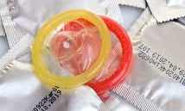

Incorrect External Condom Use 2
DO NOT:
Use oil-based products (oils, hand lotion or Vaseline) as lubricants with latex condoms.
Use your fingernails, scissors or teeth to open the wrapper.
Use more than one condom at a time, including an internal AND external condom (‘double wrapping’).
Oklahoma State Department of Health | HIV 101 | 2023
Notes:
4-year study on HIV & condoms:
245 couples – one partner HIV+ and one HIV-
123 used a condom “correctly and consistently”
0 cases of HIV transmission
Note: Communication is key.
If keeping an erection while putting a condom on is challenging (very common problem).
Try new things with condom application so using a condom is not dreaded.
Make putting on the condom a part of foreplay and/or have your partner put the condom on for you, etc.

Slide 30
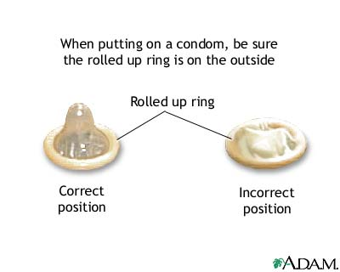
Correct External Condom Use
DO:
Keep condoms in a cool, dry place.
Put condom on an erect/hard penis before genital contact.
Hold the condom in place at the base of the penis before withdrawing (pulling out) after sex.
Throw the condom away after it has been used in the trash.
Use lubrication of Water-based or Silicone and apply as often as needed to reduce potential tears in the condom.
Oklahoma State Department of Health | HIV 101 | 2023

Slide 31
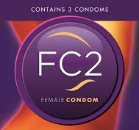
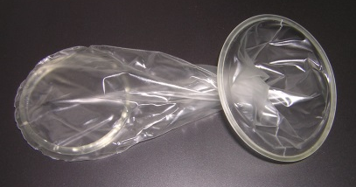
Internal (Female) Condom
Worn inside the vagina or anus
Thicker, more tear-resistant
Always latex-free
Wider opening covers more of the external area
Oklahoma State Department of Health | HIV 101 | 2023
Notes:
Internal (Female) Condoms:
A pouch used during vaginal or anal intercourse to prevent pregnancy and reduce the risk of STIs (collects pre-cum and semen when a man ejaculates).
It has flexible polyurethane rings at each end. Before intercourse it is inserted into the vagina or anus.
The ring at the closed end holds the pouch inside the vagina.
For anal sex, remove this interior ring, if you so choose.
The ring at the open end stays outside the vaginal/anal opening during intercourse.
Note: Internal condoms may be worn for up to 8 hours before intercourse.
To insert an internal condom into the vagina:
1. Put lubricant on the outside of the closed end.
2. Find a comfortable position. You can stand with one foot on a chair, sit on the edge of a chair, lie down, or squat.
3. Squeeze together the sides of the inner ring at the closed end of the condom and insert it into the vagina like a tampon.
4. Push the inner ring into the vagina as far as it can go — it will rest against the cervix. If you are unable to place it against the cervix, your partner may be able to help.
5. Pull out your fingers and let the outer ring hang about an inch outside the vaginal opening.
To insert an internal condom into the anus/rectum:
1. Remove the inner ring and place the condom on the penis.
2. Put plenty of lubricant on the outside of the condom.
3. After insertion, ensure the outer ring hangs about an inch outside the anal opening.
4. Ensure the penis and/or the inside of the condom is well lubricated to prevent the condom from moving.
To remove an internal condom:
1. Squeeze and twist the outer ring to keep semen inside the pouch.
2. Gently pull it out of the vagina or anus.
3. Throw it away in trash. Do not flush it down the toilet.
When used correctly all of the time, internal condoms are 95% effective.
Where to get internal condoms:
Possibly online at https://fc2.us.com/how-to-find/
Community Based Organizations or Health Centers
Sexual Health and Harm Reduction Service

Slide 32


Dental Dams
Thin, square pieces of latex
Used for oral sex (NOT on a penis)
Could make your own dental dam (from a condom, latex glove, or non-microwavable plastic wrap)
Oklahoma State Department of Health | HIV 101 | 2023
Notes:
Dental Dams:
Dental dams are small, thin, square pieces of latex that are used for oral-vaginal or oral-anal sex.
They get their name from their use in dental procedures.
Dental dams prevent STIs during oral sex by keeping vaginal and anal fluids that may contain bacteria and viruses away from the mouth.
They come in a variety of sizes and flavors.
When using the dental dam, be sure to ONLY use One side. Don't flip the dam over for another round because you will expose yourself to the very fluids you're trying to avoid.
Do not re-use a dam on another body part (e.g. from anus to vulva or vice-versa) because you can transfer bacteria or viruses from one body area to another.
Do not re-use a dam for another act of oral sex later either. Dental Dams are for one-time use only.
Note:
If you don’t have a dental dam you can make one out of an external or internal condom, latex glove, or non-microwavable plastic wrap.
To make a dental dam out of a condom, simply cut off the tip and cut down one side.
To make a dental dam out of a latex glove, cut off the finger and cut down one side.
If using plastic wrap, it is important that it be non-microwavable because the pores in microwaveable plastic wrap are large enough to allow viruses and bacteria to pass through.
Where to buy dental dams:
Some drugstores
Sexual health centers
Online
Adult Stores (18+)

Slide 33
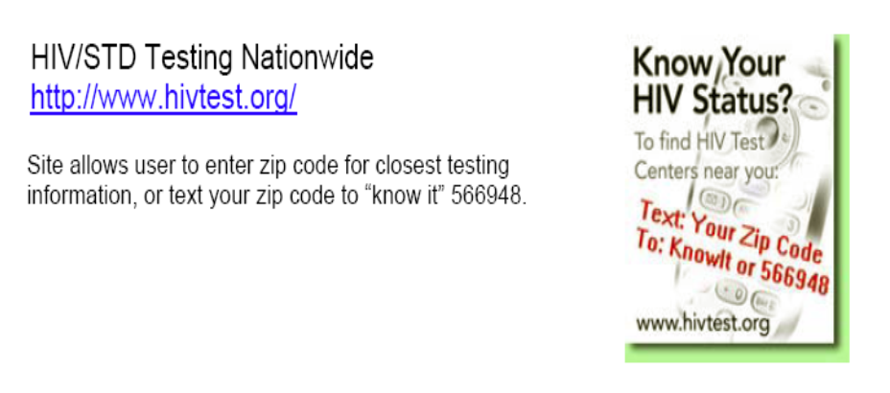
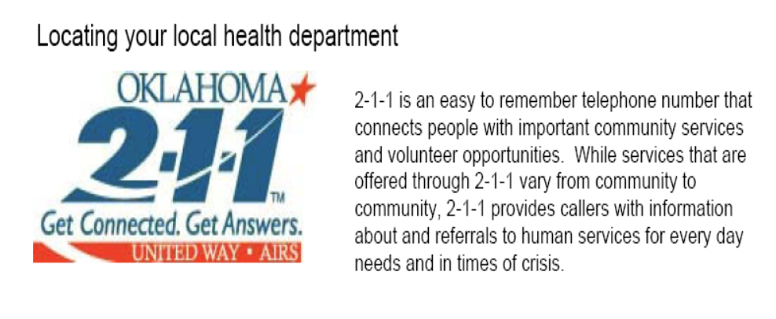
Where to Get Tested?
https://gettested.cdc.gov
www.stdcheck.com
Community-Based Organizations
Local
Health Departments
www.health.ok.gov
Oklahoma State Department of Health | HIV 101 | 2023

Slide 34
Resources
www.cdc.gov
www.hiv.gov
www.healthfinder.gov
www.plannedparenthood.org
www.stophiv.org
www.iwannaknow.org
Oklahoma HIV/AIDS Hotline:
1-800-535-2437
Oklahoma State Department of Health | HIV 101 | 2023
Notes:
NOTE: It is important you use truthful and reliable resources when searching for health information.
Government health sites like CDC, or health departments are always a good place to start.

Slide 35

Questions?
HIV & AIDS
HIV & AIDS
Oklahoma State Department of Health | HIV 101 | 2023

