Slide 1


Don’t Let HIV Be Your Endgame
Level 3,
Testing & Treatment
This training contains HIV/STD prevention education text and images prepared for middle school and high school students in accordance with the Oklahoma State Mandate 70-11-103.3 and may not be appropriate for all audiences.
Notes:
Slide 1: Don’t Let HIV Be Your Endgame: Level 3, Testing & Treatment
Presentation Shutterstock Images are purchased and not for general distribution or use other than in this presentation, https://www.shutterstock.com/home.
Image: Long Tail Red Ribbon, shutterstock_162472193.jpg.
Slide Audio
Welcome to Don’t Let HIV Be Your Endgame: Level 3, Testing & Treatment.
This training is the third level of a three-level free Oklahoma State Department of Health (OSDH) online HIV prevention education series for Oklahoma middle school and high school students.
The titles of the three levels of this series:
Level 1, The Virus.
Level 2, Person to Person.
Level 3, Testing & Treatment.

Slide 2


Tutorial
Hi, I’m Nurse Toni,
Your
Virtual Assistant.
Please select the
Audio Button
At the
Bottom of the slide
To hear me speak.
Select Me
to download the
Script.
Notes:
Slide 2: Tutorial
Image: Nurse Toni. Standing using left thumbs-up sign tan skin calm face female human with medium-length dark wavy hair, dark-brown eyes, reddish lips, wearing blue colored short-sleeve v-neck top and pant scrubs with medical professional white soft sole shoes, CDC.
Image: Red Ribbon Wall Paper, shutterstock_231442243.jpg.
.
Slide Audio
Hi, I’m Nurse Toni, your virtual assistant. Please select the audio button on the slide to hear me speak.
At this point in game mode, aware of possible consequences of not following safer is better, if you are questioning your HIV status, it’s critical to get tested.
If you test positive for HIV, you’ll need treatment information to champion against HIV.
The entire course is narrated and the Tutorial is located in the Transcript.
Select my image on this slide to open to the Transcript for a free download.
On all other slides, select the Script button in the top right bar to return to this slide to select my image on this slide to open to the Transcript for a free download.

Slide 3
Navigate
Course
Content
Link &
References
Transcript
Previous Slide
Play Audio
Next Slide
Last Slide
Home
Close
Notes:
Slide 3: Navigate
Image: None
Slide Audio
There are a few buttons to select:
The top bar includes navigation buttons.
The bottom bar includes six action buttons.

Slide 4
Menu Select each section title to navigate this course.
Introduction
Title, Tutorial, Navigate, Menu, Content, Objectives
1
Objective 1
Testing: Who, Where, What
7
Objective 2
Test Results: Nonreactive, Reactive, PrEP, PEP
11
Objective 3
Treatment, U=U
17
Summary
Champion, Survey
20
Resources
Images, References, Instructional,
Citation & Developer
22
Notes:
Slide 4: Menu
Image: None
Slide Audio
Selecting any section title on this Menu, moves you throughout the presentation.

Slide 5
Content
HIV testing
HIV test results plus PrEP and PEP
Treatment including U=U
GET TESTED
Notes:
Slide 5: Content
Image: None
Slide Audio
In this level, you will cover content:
HIV testing.
HIV test results plus PrEP and PEP.
Treatment including U=U.

Slide 6

Objectives Select Audio and then each checkmark.
At this 3rd level, you will be able to
✓
Describe HIV testing.
✓
Discuss HIV test results plus PrEP and PEP.
✓
Recognize the importance of HIV treatment.
Notes:
Slide 6: Objectives
Image: Purple pencil making checkmark in circle, shutterstock_2695943264.jpg.
Image: Red Ribbon Tree, shutterstock_109766453.jpg.
Slide Audio
For the 3rd Level, Testing and Treatment, the objectives provide you the game plan:
Describe HIV testing.
Discuss HIV test results plus PrEP and PEP.
Recognize the importance of HIV treatment.

Slide 7
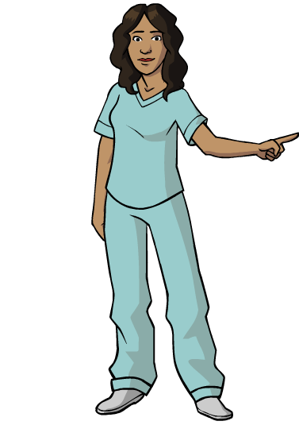
HIV Testing
To reach your
first goal
in Level 3,
Testing & Treatment,
you will learn to
describe HIV testing.
Notes:
Slide 7: HIV Testing
Image: Female human wearing scrubs pointing left with left hand, CDC.
Image: Red Ribbon Wall Paper, shutterstock_231442243.jpg.
Slide Audio
This is why you Get Tested.
You begin by reviewing risk reduction, safer is better, from Level 2, Person to Person:
Condom protected sex
Never share needles or drug equipment.
Regular HIV/STD testing.
1. CDC, “CDC Fact Sheet: Information for Teens and Young Adults: Staying Healthy and Preventing STDs,” Last modified December 2017, https://www.cdc.gov/std/life-stages-populations/stdfact-teens.html.
The only way to know for sure whether you have HIV is to Get Tested (GT).
The CDC recommends Get Tested at least once if you’re between the ages of 13-64 years old.
If you’re pregnant, Get Tested.
2. CDC, “HIV Testing,” Last modified December 3, 2019, https://www.cdc.gov/hiv/basics/testing.html.
Get Tested each year if you’re at higher risk:
Have unprotected sex.
Are a guy who has sex with other guys.
Use or share needles or drug equipmtne to inject drugs.
Have sex with a PLWH.
3. “How to Get Tested for HIV,” Teen Health from Nemours, Reviewed by: Krishna Wood White, MD, MPH October 2018, https://kidshealth.org/en/teens/hiv-tests.html .
Get Tested every 3 to 6 months if you’re a sexually active gay man or bisexual man (MSM).
4. CDC, “HIV Testing,” Last modified December 3, 2019, https://www.cdc.gov/hiv/basics/testing.html.
Safer is better. Knowing your HIV status keeps you and others safer.

Slide 8
Where Can You Get Tested?
www.211Oklahoma.org Text 211OK to 898211 including
“HIV Testing, their Age, Gender, and Zip code”
Call 1-800-CDC-INFO (232-4636)
https://gettested.cdc.gov
Text your ZIP code to KNOW IT (566948)
Notes:
Slide 8: Where can you Get Tested?
Image: None
Slide Audio
To Get Tested, you have options:
Your health care provider
Medical clinics
Community health centers
Hospitals
Substance abuse programs
Home testing kit (pharmacy or online)
5. CDC, “HIV Testing,” Last modified December 3, 2019, https://www.cdc.gov/hiv/basics/testing.html.
You can find free testing sites near you using local sources:
Use the website: www.211Oklahoma.org including “HIV Testing, your Age, Gender, and Zip code”
Text 211OK to 898211
6. “211 Oklahoma,” Accessed September 13, 2019, https://www.211oklahoma.org/
See the HIV/STD/HEPATITIS Testing Location at the OSDH site: hivstd.health.ok.gov then select Resources HIV/STD/HEPATITIS.
7. OSDH, “HIV/STD/HEPATITIS Testing Locations,” Accessed September 13, 2019, hivstd.health.ok.gov then select Resources HIV/STD/HEPATITIS.
Information from the CDC about testing sites is available:
Call 1-800-CDC-INFO (232-4636)
Website: https://gettested.cdc.gov
Text your ZIP code to KNOW IT (566948)
8. CDC, “Get Tested,” Accessed September 13, 2019, https://gettested.cdc.gov.

Slide 9

What to Expect?
Rapid HIV Test
Notes:
Slide 9: What to Expect?
Image: Health Care, shutterstock_1136296697.jpg.
Slide Audio
When you’re at the health care site, it’s a standard appointment:
You have a 30 minute individual session where they provide you HIV and other STD information.
They’ll discuss your risk factors.
Provide you with condoms.
Run the Rapid HIV Test using a finger-stick blood sample. Several test are available to detect HIV, but this provides faster results.
You’ll wait for your test results.
9. CDC, “HIV Testing,” Last modified December 3, 2019, https://www.cdc.gov/hiv/basics/testing.html.

Slide 10

Goal #1 What have you learned?
Describe HIV testing.
Select Audio,
Then each question mark to reveal an answer.
Get Tested
each year if Unprotected Sex
30 minute
Appointment
at health care site
Rapid HIV
Test with
finger-stick
Text
211OK to
898211
Get Tested
if Pregnant
Notes:
Slide 10: Goal #1, What have you learned?
Image: Free, Question mark in black square, gograph.com, https://www.google.com/search?tbm=isch&sa=1&ei=9db-W4uEB4rytAWzwY_IBw&q=+question+mark+in+black+square#imgrc=exgUJ7Yyv0ZnSM:&spf=1543600283346
Slide Audio
Glad you’ve been paying attention.
Follow the instructions, then move to the next slide for your 2nd goal.
Describe HIV testing.

Slide 11
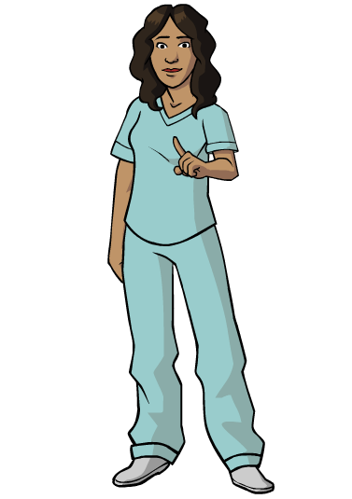
Test Results
For your
second goal,
you will learn
to discuss
HIV test results.
Notes:
Slide 11: Test Results
Image: Female Human in scrubs left hand pointing finger forward, CDC.
Image: Red Ribbon Wall Paper, shutterstock_231442243.jpg.
.
Slide Audio
Maybe you’re wondering what are “test results”?
This means to understand the difference between HIV-nonreactive and HIV-reactive.

Slide 12


Nonreactive HIV Status
PrEP
PrEP
Notes:
Slide 12: Nonreactive HIV Status
Image: HIV-AIDS Awareness campaign featuring an African couple embracing in an AIDS ribbon, with the slogan Wear and Care, shutterstock_205076476. jpg.
Image: By Brian A Jackson, Months and dates shown on a calendar whilst turning the pages, shutterstock_116458489.jpg.
Slide Audio
If you’re nonreactive, you’re status is HIV-negative for not today but for 12 weeks ago. It takes 12 weeks for your body to develop and display antibodies in your blood to HIV.
Continue to take safer protected actions to prevent HIV:
Condoms “Correctly and Consistently”.
PrEP to prevent HIV if you’re at high risk.
10. CDC, “HIV Prep,” Last modified December 3, 2019, https://www.cdc.gov/hiv/basics/prep.html.
No test can detect HIV immediately after you’ve contracted it.
The Rapid HIV test can only detect what happened 12 weeks ago.
If your Rapid HIV test result is HIV-negative today, and you’ve used safer protected actions to prevent HIV in the past 12 weeks known as the window period, you’re probably HIV-negative. To confirm, you’ll have another Rapid HIV test in 12 weeks.
Make you next appointment in 12 weeks from today before you leave.
Also, your HIV test results reveal only your HIV status and not your partner’s.
Consider getting tested together.
11. CDC, “HIV Testing,” Last modified December 3, 2019, https://www.cdc.gov/hiv/basics/testing.html.

Slide 13

Reactive HIV Status
JSI Health Communication Portifolio-John Snow, Inc.
Notes:
Slide 13: Reactive HIV Status
Image: Free, Positive Spin Campaign-JSI Health Communication Portfolio-John Snow, Inc.,CDC.gov, https://healthcommunication.jsi.com/work/.
Slide Audio
When your test result is a reactive HIV status, a follow-up test can be done during the same appointment.
If the follow-up test is reactive, it means you are HIV-positive and a person living with HIV.
You’ll be linked to care to start medical care and begin treatment as soon as you’re diagnosed with HIV by a doctor.
Continue to take safer protected actions to prevent the spread of HIV by using condoms “correctly and consistently”.
12. CDC, “HIV Testing,” Last modified December 3, 2019, https://www.cdc.gov/hiv/basics/testing.html.

Slide 14
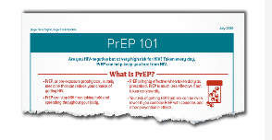
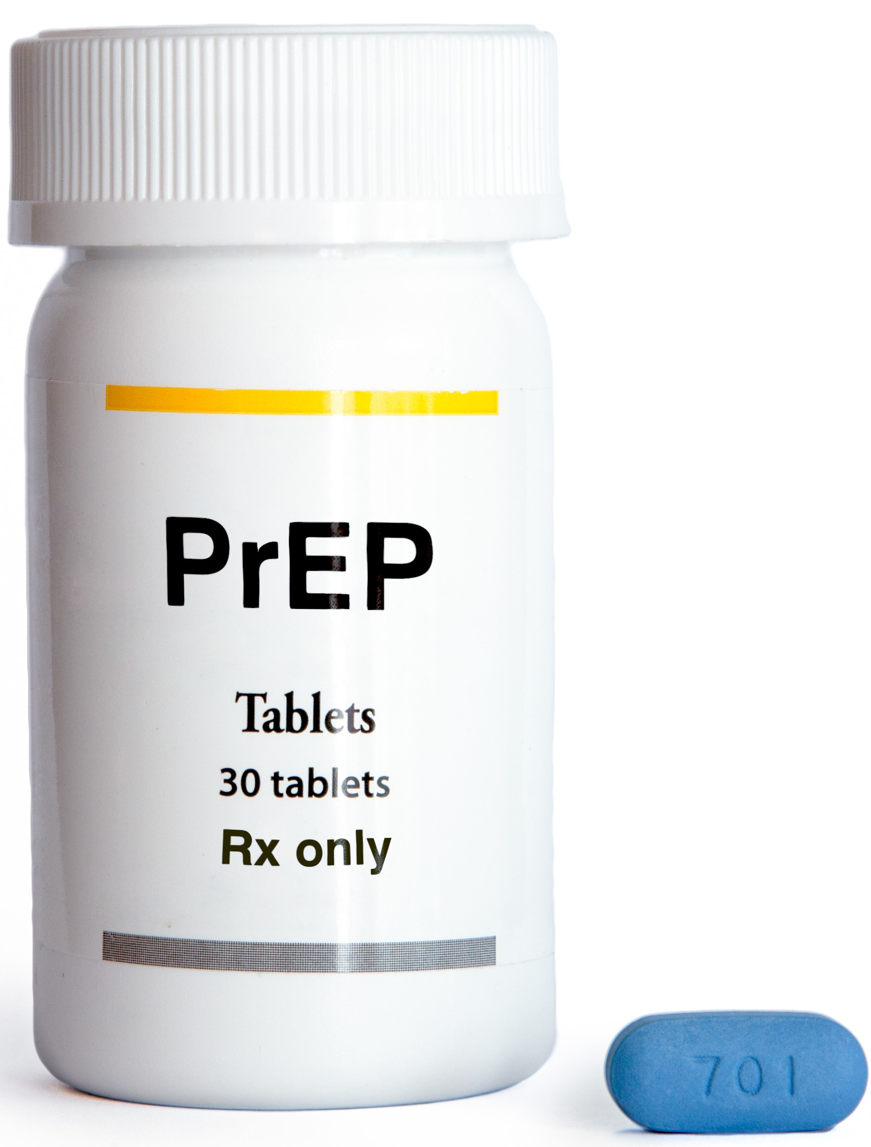
PrEP
Start Talking.
Stop HIV.
Safer is Better.
Start Talking.
Stop HIV.
Notes:
Slide 14: PrEP
Image: Free, CDC, “PrEP 101,” https://www.cdc.gov/hiv/basics/prep.html.
Image: By Ulric Giezendanner, Pre Exposure Prophylaxis (PrEP), shutterstock_ 291104606.jpg.
Slide Audio
The letters PrEP are an acronym (pronounced as a word):
Pr - means Pre. This is prior or before an event that increases your contact with infection.
E - is for Exposure. A condition resulting in a situation of risk and unprotected to invasion and infection from bacteria, viruses and parasites.
P - identifies it as a Prophylaxis. It involves a chemical or physical barrier to protect health and prevent spread of infection.
PrEP, brand name Truvada, is a very effective prescription required to be taken daily when people are at very high risk of contracting HIV such as in a sexual relationship with a person living with HIV.
13. “PrEP (Pre-Exposure Prophylaxis),” TeenHealth from Nemours, Reviewed by: Robyn R. Miller, MD, Date reviewed: January 2019, https://kidshealth.org/en/teens/prep.html.
14. CDC, “HIV Testing,” Last modified December 3, 2019, https://www.cdc.gov/hiv/basics/testing.html.
15. CDC, “HIV PrEP”, Last modified December 3, 2019, https://www.cdc.gov/hiv/basics/prep.html.

Slide 15

PEP
72 hr
Notes:
Slide 15: PEP
Image: By Gaus Alex, Loading Clock Interface (24fps). 10 second loading clock wipe for interfaces. Animated in and out transition with alpha channel, shutterstock_ 603628520.jpg.
Slide Audio
The letters PEP are an acronym (pronounced as a word):
P - means Post. This is after an event that increases your contact with infection.
E - is for Exposure. A condition resulting in a situation of risk and unprotected to invasion and infection from bacteria, viruses and parasites..
P - identifies it as a Prophylaxis. It involves a chemical or physical barrier to protect health and prevent spread of infection.
PEP is used within 72 hours after being potentially exposed to HIV infection.
It’s prescribed by your health care provider or emergency room doctor.
16. CDC, “HIV Testing,” Last modified December 3, 2019, https://www.cdc.gov/hiv/basics/testing.html.
17. CDC, “HIV PEP,” Last modified Reviewed August 6 2019, https://www.cdc.gov/hiv/basics/pep.html.

Slide 16
Goal #2 What have you learned?
Discuss HIV test results.
Nonreactive
Select Audio,
Then each question mark section
to reveal an answer.
Rapid HIV test
Reactive
Link to care
Window Period
Notes:
Slide 16: Goal #2 What have you learned?
Image: None
Slide Audio
Knowledge check then to the next slide for your 3rd goal.
Discuss HIV test results?

Slide 17

HIV Treatment
With your
final
goal, you
recognize the
importance of
treatment.
Notes:
Slide 17: HIV Treatment
Image: Female human wearing scrubs hands at shoulder questioning, CDC.
Image: Red Ribbon Wall Paper, shutterstock_231442243.jpg.
Slide Audio
Your third and last objective is to recognize the importance of treatment.
ART prevents HIV from making copies of itself in your cells.
Most PLWH on daily prescribed ART see a viral load drop to an undetectable level in six months or less.
After 7 to 12 months of treatment and with a consistent undetectable viral load, transmitting HIV is effectively zero.
Based on research, when ART stops, your viral load rebounds and the risk of transmitting HIV returns.
Viral suppressed PLWH regularly have testing of their viral load every three-four months.
“Blips” which are random increases in the viral load with a return to undetectable levels do occur.
18. NIH NIAID Now, “10 Things to Know About HIV Suppression”, Last modified Nov 14, 2017, https://www.niaid.nih.gov/news-events/10-things-know-about-hiv-suppression.
19. CDC, “HIV, Newly Diagnosed with HIV,” Last modified August 6, 2019, https://www.cdc.gov/hiv/basics/livingwithhiv/newly-diagnosed.html.

Slide 18
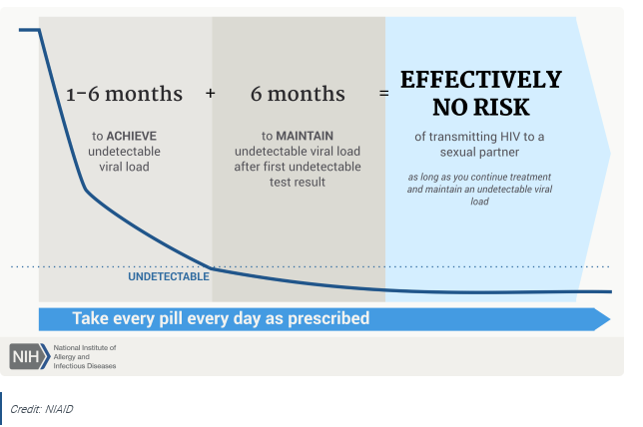
U = U
Notes:
Slide 18: U = U
Image: Free, Credit NIAID, NIH, Take Every Pill Every Day As Prescribed,10 Things Know About HIV Suppression, https://www.niaid.nih.gov/news-events/10-things-know-about-hiv-suppression.
Slide Audio
Consistent treatment with ART effectively results in viral suppression.
When your viral load is undetectable, you have no risk of transmitting HIV to an HIV-negative sex partner.
No risk of transmitting HIV is known as untransmittable.
A cure for HIV doesn’t exist, but ART used as prescribed, minimizes your viral load to an undetectable viral load.
Undetectable is having less than 200 copies of HIV per milliliter of blood.
When a test can’t detect the viral load, it’s undetectable and untransmittable known as U = U.
20. NIH NIAID Now, “10 Things to Know About HIV Suppression”, Last modified Nov 14, 2017, https://www.niaid.nih.gov/news-events/10-things-know-about-hiv-suppression.
21. CDC, “HIV, Newly Diagnosed with HIV,” Last modified August 6, 2019, https://www.cdc.gov/hiv/basics/livingwithhiv/newly-diagnosed.html.
22. RW Eisinger, CW Dieffenbach, AS Fauci, “HIV Viral Load and Transmissibility of HIV Infections: Undetectable Equals Untransmittable,” Journal of the American Medical Association DOI: 10.1001/jama.2018.21167 (February 5, 2019).
23. HIV.gov, “The Science is Clear: With HIV Undetectable Equals Untransmittable, NIAID Newroom, Last modified January 16, 2019, https://www.hiv.gov/blog/science-clear-hiv-undetectable-equals-Untransmittable.

Slide 19
Goal #3 What have you learned?
What is U = U?
Select Audio,
Then each question mark to reveal an answer.
?
?
When viral load is undetectable,
you have no risk
of transmitting HIV.
?
?
?
Notes:
Slide 19: Goal #3 What have you learned?
Image: None
Slide Audio
Final question.
What is U = U?

Slide 20
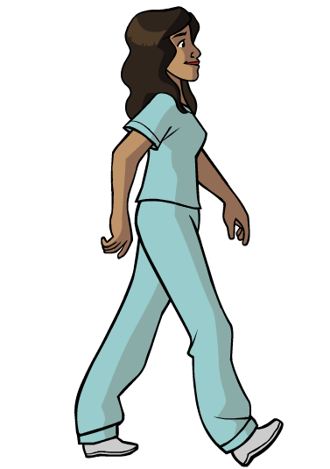
You’ve Championed This Campaign!
Thank you for being here.
Next, view:
Don’t Let HIV Be
Your Endgame
Level 3,
Testing and Treatment.
But first, select the next slide.
Notes:
Slide 20: You’ve Championed This Campaign!
Image: Female human wearing scrubs hands and arms at side turned left profile both arms from her side appears walking toward your right, CDC.
Image: Red Ribbon Wall Paper, shutterstock_231442243.jpg.
Slide Audio
Glad you joined me for Don’t Let HIV Be Your Endgame: Level 3, Testing & Treatment.
This concludes our three parts of our HIV prevention education series and our time together.
But first, see the next slide. Thanks for being here.

Slide 21
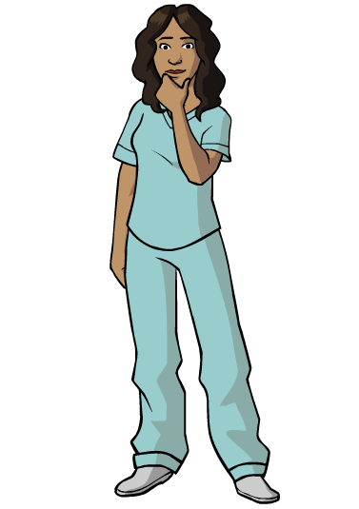
Reasons for Survey
Please take a minute.
Your opinion is valuable.
You improve this course.
You’ve completed Level 3, Testing & Treatment, of this course. Please close the course file and return to the course details page in TRAIN. Select the Mark Completed Button.
The course will update and an Evaluation Button will appear. Select the Evaluation Button to begin the Evaluation.
Notes:
Slide 21: Reasons for Survey
Image: Female human wearing scrubs standing with left hand raised holding chin elbow bent, right arm hanging, CDC.
Image: Red Ribbon Wall Paper, shutterstock_231442243.jpg.
Slide Audio
Yes, your opinion matters.
Can you do this for me?
Please take some time to answer the evaluation questions.
Your feedback is important to me and future learners. Thanks.

Slide 22
Resources 1
Slide 1 Image: Red Ribbon, shutterstock_162472193.jpg
Slide 2 Image: Female Human, scrubs, thumb-up, CDC.
Slide 2 Image: Red Ribbon Wallpaper, shutterstock_231442243.jpg.
Slide 6 Image: Purple pencil making checkmark in circle, shutterstock_2695943264.jpg.
Slide 6 Image: Red Ribbon Tree, shutterstock_109766453.jpg.
Slide 7 Image: : Red Ribbon Wallpaper, shutterstock_231442243.jpg.
Slide 7 Image: Female Human wearing scrubs pointing left, CDC.
Slide 7 CDC, CDC Fact Sheet: Information for Teens and Young Adults: Staying Healthy and Preventing STDs:.
Slide 7 CDC, HIV Testing.
Slide 7 How to Get Tested for HIV, Teen Health from Nemours.
Notes:
Slide 22: Resources 1
Image: None
Slide Audio
This slide provides information about references, links and images used.

Slide 23
Resources 2
Slide 8 CDC, HIV Testing.
Slide 8 211 Oklahoma
Slide 8 OSDH, HIV/STD/HEPATITIS Testing Locations , select Resources HIV/STD/HEPATITIS.
Slide 8 CDC, Get Tested.
Slide 9 Image: Health Care, shutterstock_1136296697.jpg.
Slide 9 CDC, HIV Testing.
Slide 10 Image: Question mark in black square (Free), gograph.com .
Slide 11 Image: Female Human in scrubs left hand pointing forward, CDC.
Slide 11 Image: Red Ribbon Wallpaper, shutterstock_231442243.jpg.
Slide 12 Image: HIV-AIDS awareness couple embracing AIDS ribbon, shutterstock_205076476. jpg.
Slide 12 Image: By Brian A Jackson, Months dates calendar turning pages, shutterstock_116458489.jpg.
Slide 12 CDC, HIV PrEP
Slide 12 CDC, HIV Testing.
Notes:
Slide 23: Resources 2
Image: None
Slide Audio
This slide provides information about references, links and images used.

Slide 24
Resources 3
Slide 13 Image: Positive Spin Campaign-JSI Health Communication Portfolio-John Snow, Inc.,CDC.gov.
Slide 13 CDC, HIV Testing.
Slide 14 Image: CDC, PrEP 101,
Slide 14 Image: By Ulric Giezendanner, Pre Exposure Prophylaxis (PrEP), shutterstock_ 291104606.jpg.
Slide 14 PrEP (Pre-Exposure Prophylaxis), TeenHealth from Nemours.
Slide 14 CDC, HIV Testing.
Slide 14 CDC, HIV PrEP.
Slide 15 Image: By Gaus Alex, Loading Clock Interface (24fps), shutterstock_ 603628520.jpg.
Slide 15 CDC, HIV Testing.
Slide 15 CDC, HIV PEP.
Slide 17 Image: Female Human wearing scrubs hands at shoulder questioning, CDC.
Slide 17 Image: Red Ribbon Wallpaper, shutterstock_231442243.jpg.
Notes:
Slide 24: Resources 3
Image: None
Slide Audio
This slide provides information about references, links and images used.

Slide 25
Resources 4
Slide 17 Every Day As Prescribed, 10 Things to Know About HIV Suppression, NIH, Credit NIAID.
Slide 17 CDC, HIV Newly Diagnosed.
Slide 18 Image: Take Every Pill.
Slide 18 Every Day As Prescribed, 10 Things to Know About HIV Suppression, NIH, Credit NIAID.
Slide 18 CDC, HIV Newly Diagnosed.
Slide 18 The Science is Clear: With HIV Undetectable Equals Untransmittable.
Slide 18 HIV Viral Load and Transmissibility of HIV Infections: Undetectable Equals Untransmittable.
Slide 20 Image: Red Ribbon Wallpaper, shutterstock
_231442243.jpg.
Slide 20 Image: Female Human wearing scrubs hands and arms at side turned left profile appears walking toward your right, CDC.
Notes:
Slide 25: Resources 4
Image: None
Slide Audio
This slide provides information about references, links and images used.

Slide 26
Resources 5
Slide 21 Image: Female Human wearing scrubs standing with left hand raised to chin, CDC.
Slide 21 Image: Red Ribbon Wallpaper, shutterstock_231442243.jpg.
Slides 28: CDC TRAIN, Citation & Developer.
Notes:
Slide 26: Resources 5
Image: None
Slide Audio
This slide provides information about references, links and images used.

Slide 27
Instructional Resources
Shutterstock
Presentation Shutterstock Images are purchased and not for general distribution or use other than in this presentation.
CDC’s E-learning Essentials
Chicago Manual of Style 17th Edition
Guidance on Disclaimers for CDC Scientific Publications and Presentations
HHS 508 Guidance: PDF Checklists
HHS 508 Guidance: PDF File 508 Checklist (WCAG 2.0 Refresh)
HHS 508 Guidance: PowerPoint Document 508 Checklist
Web Content Accessibility Guidelines (WCAG 2.0) Overview
Authoring Tool: Windows OS 10, Microsoft 2016 PowerPoint
Notes:
Slide 27: Instructional Resources
Image: None
Slide Audio
This slide provides information about references, links and images used.

Slide 28
Citation & Developer
This course is in the public domain and may be used and reprinted without permission, except for purchased Shutterstock images.
A citation as to source, however, is appreciated.
Centers for Disease Control and Prevention (CDC). Don’t Let HIV Be Your Endgame: Level 2, Person to Person. [ID: 1081990]. Atlanta, GA: US Department of Health and Human Services, CDC; 2018. Available from CDC TRAIN
Designer/Developer:
Virginia (Toni) Hovda, M.Ed.
Training Specialist II
HIV/STD Service
Oklahoma State Department of Health
1000 NE 10th Street
Oklahoma City, OK 73117-1299
Office: 405.271.9444
Notes:
Slide 28: Citation & Developer
Image: None
Slide Audio
This slide provides information about references, links and images used.

