Slide 1


Don’t Let HIV Be Your Endgame
Level 2,
Person to Person
This training contains HIV/STD prevention education text and images prepared for middle school and high school students in accordance with the Oklahoma State Mandate 70-11-103.3 and may not be appropriate for all audiences.
Notes:
Slide 1: Don’t Let HIV Be Your Endgame: Level 2, Person to Person
Presentation Shutterstock Images are purchased and not for general distribution or use other than in this presentation, https://www.shutterstock.com/home.
Image: Long Tail Red Ribbon, shutterstock_162472193. jpg.
Slide Audio
Welcome to Don’t Let HIV Be Your Endgame: Level 2, Person to Person.
This training is the second level of a three-level free Oklahoma State Department of Health (OSDH) online HIV prevention education series for Oklahoma middle school and high school students.
The titles of the three levels of this series:
Level 1, The Virus.
Level 2, Person to Person.
Level 3, Testing & Treatment.

Slide 2


Tutorial
Hi, I’m Nurse Toni,
Your
Virtual Assistant.
Please select the
Audio Button
At the
Bottom of the slide
To hear me speak.
Select Me
to download the
Script.
Notes:
Slide 2: Tutorial
Image: Nurse Toni. Standing using left thumbs-up sign tan skin calm face female human with medium-length dark wavy hair, dark-brown eyes, reddish lips, wearing blue colored short-sleeve v-neck top and pant scrubs with medical professional white soft sole shoes, CDC.
Image: Red Ribbon Wallpaper, shutterstock_231442243.jpg.
.
Slide Audio
Hi, I’m Toni, your virtual assistant. Please select the audio button on the slide to hear me speak.
Now that you know about stealth HIV, you need risk and transmission information to champion against this virus.
I’m glad you’ve joined me to battle HIV.
This course is narrated and the Tutorial is located in the Transcript.
Select my image on this slide to open to the Transcript for a free download.
On all other slides, select the Script button in the top right bar to return to this slide to select my image on this slide to open to the Transcript for a free download.
Remember: What’s your HIV endgame? You have a choice.

Slide 3
Navigation
Course
Content
Link &
References
Transcript
Previous Slide
Play Audio
Next Slide
Last Slide
Home
Close
Notes:
Slide 3: Navigation
Image: None
Slide Audio
View the buttons to select:
The top bar includes navigation buttons.
The bottom bar includes six action buttons.

Slide 4

Menu Select each listed item to navigate this course.
Title
Tutorial
Navigation
Content
Objectives
How HIV Spreads
Body Fluids
Reduce Risks
To Continue
Survey
Notes:
Slide 4: Menu
Image: Red Ribbon Awareness, shutterstock_55902637.jpg.
Slide Audio
Selecting any button on this Course Menu moves you throughout the presentation.

Slide 5


Content
How HIV Spreads
Body Fluids
Reduce Risks
Notes:
Slide 5: Content
Image: Free, World AIDS Day #WAD2018, HIV.gov, https://www.hiv.gov/events/awareness-days/world-aids-day.
Image: Free, Red Ribbon Awareness AIDS/HIV, pixabay , https://pixabay.com/en/red-ribbon-awareness-aids-hiv-913305/.
Slide Audio
In this level, you will cover content:
HIV spread from person to person.
Body fluids involved.
You can reduce your risks.

Slide 6

Objectives Select Audio and then each checkmark.
At this 2nd level, you will be able to
✓
Identify how HIV is spread.
✓
List body fluids that transmit HIV.
✓
Explain ways to
reduce risk of
HIV exposure.
Notes:
Slide 6: Objectives
Image: Purple pencil making checkmark in circle, shutterstock_2695943264.jpg.
Slide Audio
For the 2nd Level, Person to Person, objectives provide you the game plan:
Identify your enemy, HIV, and prevent it’s spread.
List possible positive HIV body fluids that transmit HIV.
Explain ways to reduce your risk of HIV exposure and win the endgame.

Slide 7

How HIV Spreads
To reach
your first goal
in Level 2,
Person to Person,
You
will learn to
identify how
HIV is spread.
Notes:
Slide 7: How HIV Spreads
Image: Female human wearing scrubs pointing left with left hand, CDC.
Image: Red Ribbon Wallpaper, shutterstock_231442243.jpg.
Slide Audio
You begin by discovering how HIV spreads from person to person.

Slide 8
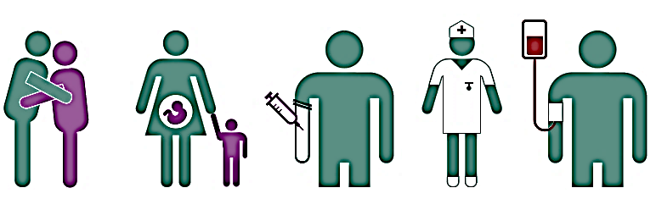
How is HIV Spread?
.
You Can Get HIV By
Unprotected
Sex
Pregnancy,
Childbirth &
Breastfeeding
Injecting Drugs
Working
in Healthcare
Blood Transfusions & Organ/Tissue Transplants
Notes:
Slide 8: How is HIV Spread?
Image: Free, How do you get HIV? Unprotected sex, etc., AVERT, https://www.google.com/search?q=You+Can+Get+HIV+By&source=lnms&tbm=isch&sa=X&ved=0ahUKEwjSnaHx0_zeAhVFXawKHXjmBq4Q_AUIDigB&biw=1680&bih=901#imgrc=rNw7yaVKqROaTM:&spf=1543599410277
Slide Audio
It spreads in several ways:
Through mucous membranes during unprotected sex. Mucous membranes are soft, moist areas just inside the openings to your body.
From Mother’s blood to child during pregnancy, childbirth or breastfeeding after the child is born.
During blood transfer when injecting drugs and sharing needles, syringes and other drug equipment.
Sometimes when working in healthcare, if a medical worker doesn’t wear the proper personal protective equipment like gloves, they could contract the virus from positive HIV body fluids.
By blood transfusion and organ/tissue transplants. But, the US blood supply has been tested for HIV since 1985 reducing the risk of exposure to the virus.
1. Center for Disease Control and Prevention (CDC), “HIV Transmission: How is HIV passed from one person to another?”, Last modified August 6, 2019, https://www.cdc.gov/hiv/basics/transmission.html.
2. HIV.gov, “How is HIV Transmitted?”, Accessed May 15, 2017, https://www.hiv.gov/hiv-basics/overview/about-hiv-and-aids/how-is-hiv-transmitted.

Slide 9
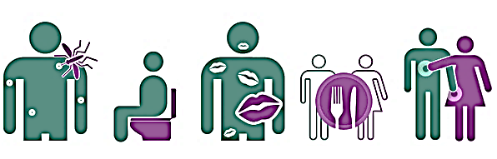
How is HIV Not Spread?
HIV Is Not Transmitted By
Insect Bites
Toilet Seats
Kissing
Sharing
Cutlery
Touching
Notes:
Slide 9: How is HIV NOT Spread?
Image: Free, HIV is Not Transmitted by Insect bites, etc., Chatham Social Health Council, https://www.google.com/search?q=You+Can+Get+HIV+By&source=lnms&tbm=isch&sa=X&ved=0ahUKEwjSnaHx0_zeAhVFXawKHXjmBq4Q_AUIDigB&biw=1680&bih=901#imgrc=Eyk1DEFIElV0OM:&spf=1543607082796.
Slide Audio
No, you don’t contract HIV from these items pictured on this slide:
Insect bites
Toilet seats
Kissing
Sharing dishes, drinking glasses, cups, spoons, forks
Touching
3. Center for Disease Control and Prevention (CDC), “HIV Transmission: How is HIV passed from one person to another?”, Last modified August 6, 2019, https://www.cdc.gov/hiv/basics/transmission.html.
4. HIV.gov, “How is HIV Transmitted?”, Accessed May 15, 2017, https://www.hiv.gov/hiv-basics/overview/about-hiv-and-aids/how-is-hiv-transmitted.

Slide 10

Goal #1 What have you learned?
Can you identify
5 Ways HIV is Spread?
Select Audio,
Then each question mark to reveal an answer.
Unprotected Sex
Injecting Drugs
Healthcare
Worker
Pregnancy, childbirth and breastfeeding
Blood Transfusions & Organ/Tissue Transplants
Notes:
Slide 10: Goal #1 What have you learned?
Image: free, Question mark in black square, gograph.com, https://www.google.com/search?tbm=isch&sa=1&ei=9db-W4uEB4rytAWzwY_IBw&q=+question+mark+in+black+square#imgrc=exgUJ7Yyv0ZnSM:&spf=1543600283346
Slide Audio
Glad you’ve been paying attention.
Follow the instructions, then move to the next slide for your 2nd goal.
Can you identify 5 ways HIV is spread?

Slide 11

Body Fluids and HIV
For your
second goal,
You
need to know
which
Body Fluids
transmit HIV.
Notes:
Slide 11: Body Fluids and HIV
Image: Female Human in scrubs left hand pointing finger forward, CDC.
Image: Red Ribbon Wallpaper, shutterstock_231442243.jpg.
Slide Audio
Maybe you’re wondering what are body fluids?
Well, these are liquid or fluid because of all the water in your living body.
There are lots of them and now you need to learn which body fluids can transmit HIV.
5. “Body fluid”, Your Dictionary, Accessed November 7, 2018, http://www.yourdictionary.com/body-fluid.

Slide 12
Which Body Fluids Can Transmit HIV?
Rectal Fluids
Semen and Pre-seminal Fluids
Vaginal Fluids
Blood
Breast Milk
Notes:
Slide 12: Which Body Fluids Can Transmit HIV?
Image: None
Slide Audio
HIV-1 is passed from person to person through mucous membranes by only specific body fluids. Like the list shows, the body fluids that can transmit HIV:
Rectal Fluids.
Semen and pre-seminal fluid.
Vaginal Fluids.
Blood.
Breast milk.
6. Center for Disease Control and Prevention (CDC), “HIV Transmission: How is HIV passed from one person to another?”, Last modified August 6, 2019, https://www.cdc.gov/hiv/basics/transmission.html.
7. HIV.gov, “How is HIV Transmitted?”, Accessed May 15, 2017, https://www.hiv.gov/hiv-basics/overview/about-hiv-and-aids/how-is-hiv-transmitted.

Slide 13
Body Fluids Not Transmit HIV
(unless contains HIV detected blood)
Saliva
Sweat
Tears
Urine
Feces
Notes:
Slide 13: Body Fluids Not Transmit HIV
No Image
Slide Audio
Some body fluids, if not mixed with HIV detected blood, do Not harbor and spread HIV. Recognize these body fluids involved:
Saliva.
Sweat.
Tears.
Urine.
Feces.
8. Center for Disease Control and Prevention (CDC), “HIV Transmission: How is HIV passed from one person to another?”, Last modified August 6, 2019, https://www.cdc.gov/hiv/basics/transmission.html.
9. HIV.gov, “How is HIV Transmitted?”, Accessed May 15, 2017, https://www.hiv.gov/hiv-basics/overview/about-hiv-and-aids/how-is-hiv-transmitted.

Slide 14
Goal #2 What have you learned?
Which body fluids
Can transmit HIV?
Rectal Fluids
Semen &
Pre-seminal
Fluids
Select Audio,
Then each question mark section
to reveal an answer.
Vaginal
Fluids
Blood
Breast Milk
Notes:
Slide 14: Goal #2 What have you learned?
Image: None
Slide Audio
Knowledge check then to the next slide for your 3rd goal.
What are the body fluids that transmit HIV?

Slide 15

Your HIV Risks
.
With your final goal, you might be wondering,
“How can I
reduce my risks of
HIV exposure?”
Notes:
Slide 15: Your HIV Risks
Image: Female human wearing scrubs hands at shoulder questioning, CDC.
Image: Red Ribbon Wallpaper, shutterstock_231442243.jpg.
Slide Audio
This third and last objective is a life-game changer.
You’ve learned HIV spreads from person to person and which body fluids transmit HIV, so reducing your risks of HIV exposure is a good idea. Safer is better.
Exactly how do you reduce your risk of HIV exposure?

Slide 16

Consent: It’s Your Body
Tea and Consent, Australian
Copyright ©2015 Emmeline May and Blue Seat Studios
Notes:
Slide 16: Consent: It’s your body
Image: Female human wearing scrubs pointing left with left hand, CDC.
Image: Red Ribbon Wallpaper, shutterstock_231442243.jpg.
Slide Audio
10. For no profit, educational use purpose only, non-commercial use: Video must have copyright information displayed below video, with a live link to original: https://vimeo.com/128105683. No alteration to the video may be made, other than translation. Copyright ©2015 Emmeline May (rockstardinosaurpirateprincess.com) and Blue Seat Studios,
Queensland Sexual Assault Network used with permission (Australian Version - Female Voice Over: Olivia Weeks). “Consent It’s Simple As Tea.” September 18, 2017, YouTube video, 2:54 minutes.
https://www.youtube.com/watch?v=_607HC5OYdU.

Slide 17
The ABC’s of HIV
Abstinence or
Buy
Condoms
Notes:
Slide 17: The ABC’s of HIV
Image: None
Slide Audio
Your answer is Abstinence or Buy Condoms. Safer is better.
Your mind and body are developing and maturing into an adult. It’s your future and you have choices.
So what’s abstinence?

Slide 18

A is For Abstinence
I Abstain Game Over
Not
Doing No Way
It Road Closed
Notes:
Slide 18: A is For Abstinence
Image: Free, Red No sex text sign, medium.com, https://www.google.com/search?tbm=isch&sa=1&ei=bdn-W-zvGtH0swXCz5zgBg&q=free,+Red+No+Sex+Sign,+&oq=free,+Red+No+Sex+Sign,+&gs_l=img.3..35i39.19637.19637..21581...0.0..0.72.72.1......1....1..gws-wiz-img.lrKMy9zGQtM#imgrc=shTzDXsK4DTbJM:&spf=1543428484080
Slide Audio
Abstinence is not just a word, but a healthy life-style choice you make every day. This is what it means:
Not having any kind of sex with a partner now or for a certain amount of time for your own reasons.
Also, abstinence is deciding not to continue having sex. It’s not too late to choose to stop having sex.
11. CDC, “HIV Prevention: Is abstinence the only100% effective HIV prevention option?”, Last modified December 2, 2019, https://www.cdc.gov/hiv/basics/prevention.html.
12. HIV.gov, XOXO: Put Your #BestDefense Into Play, Office of Women’s Health, U.S. Dept. of Health and Human Services, Last modified May 7, 2016, https://www.hiv.gov/blog/xoxo-put-your-bestdefense-into-play,.)

Slide 19
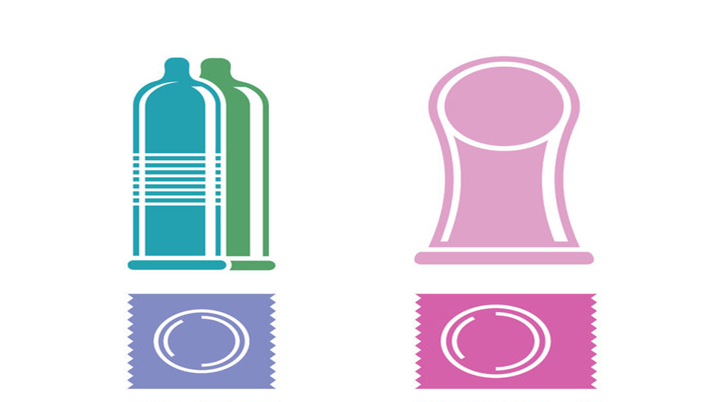
Condoms
External
Condom
Internal
Condom
Notes:
Slide 19: Condoms
Image: Free, Male and female condoms, uerria.witclub.info, https://www.google.com/search?q=https://lh3.googleusercontent.com/5-nzTDMPdClMTQyRtPi5ZzWN4y4C75fNprV32xKu4l5IzXewxBEBMtJcWcHvGFwJzw-CAU1S0QFZjdN4tzbj%3Ds750)&tbm=isch&source=iu&ictx=1&fir=1uvu9kcI72CRdM:,FS33Y-L5s4ayMM,_&usg=AI4_-kTfnH7xJfeYDILxHAwV-kFXAvHKng&sa=X&ved=2ahUKEwiD3qqE8vfeAhVCKa0KHVhyCD0Q9QEwAHoECAMQBA#imgrc=1uvu9kcI72CRdM:
Slide Audio
If you are sexually active, using condoms can protect you from HIV and other sexually transmitted diseases (STDs).
Safer is better.
13. CDC, 2017 Sexually Transmitted Disease Surveillance: STDs in Adolescents and Young Adults: Public Health Impact, Last modified October 15, 2018, https://www.cdc.gov/std/stats16/adolescents.html.

Slide 20
Goal #3 What have you learned?
What is Abstinence?
Select Audio,
Then each question mark to reveal an answer.
?
?
Abstinence is not having sex or
deciding not to continue having sex.
It’s not too late to decide
to stop having sex.
?
?
?
Notes:
Slide 20: Goal #3 What have you learned?
Image: None
Slide Audio
Final question.
What is abstinence?

Slide 21
Select Your Button To Continue
For Grade 7 through Grade 9
For Grade 10 through Grade 12
Notes:
Slide 21: Select Your Button To Continue
Image: None
Slide Audio
Select your specific button to continue.

Slide 22
ABC and “D” for Discovery
Who?
What?
Where?
When?
Why?
How?
Notes:
Slide 22: ABC and “D” for Discovery
Image: None
Slide Audio
What are the questions you always ask to discover answers?
Who?
If you’re not abstinent, then You and your sex partner.
If mixing alcohol and/or recreational drugs with sex, you are more likely to take greater risks.
The only way to know for sure if you have HIV or other STDs is to Get Tested.
14. CDC, “CDC Fact Sheet: Information for Teens and Young Adults: Staying Healthy and Preventing STDs,” Last modified December 2017, https://www.cdc.gov/std/life-stages-populations/stdfact-teens.html.
What?
Reducing risks of contracting HIV using condoms.
What is a condom?
A condom is a flexible, stretchable, thin bag.
Birth control methods, other than abstinence and condoms, do not effectively
prevent the transmission of HIV and other STDs.
15. US Department Veteran Affair, “HIV/AIDS Birth Control and HIV,” Last modified May 28, 2019, https://www.hiv.va.gov/patient/daily/sex/birth-control.asp.
Where?
Buy external condoms at drugstores, pharmacies, grocery stores or online.
Buy internal condoms online.
When?
Condoms are very effective at reducing risk for getting or transmitting HIV if you use them the right way every time.
Why?
Using condoms when you have sex can help protect you from HIV.
16. CDC, “Condom Effectiveness,” Last modified August 12, 2016, https://www.cdc.gov/condomeffectiveness/.
How?
Let’s talk about that.

Slide 23
External Condoms
Is external contraceptive effective ?
Select the checkmark.
Yes
✓
External condoms are
very effective at reducing risk
for getting or transmitting HIV
if you use them the right way
every time you have sex.
Notes:
Slide 23: External Condoms
Image: None
Slide Audio
How perfect are external condoms?
Although we’re talking about HIV, consistently and correctly used external condoms are 98% effective at preventing pregnancy.
But people aren’t perfect, so in real life, external condoms are about 85% effective.
This percentage means about 15 out of 100 people who use external condoms as their only birth control method will get pregnant each year.
17. “How effective are condoms?”, Planned Parenthood, Accessed August 22, 2018,
https://www.plannedparenthood.org/learn/birth-control/condom/how-effective-are-condoms.
External Condoms are not perfect, but much better than nothing. So, are external condoms all alike?

Slide 24

Types
HIV Protection No HIV Protection
Latex Lambskin
Vegan Latex
Polyurethane
X
23
Notes:
Slide 24: Types of External Condoms
Image: Row of male condoms, shutterstock_74723128.jpg.
Slide Audio
There are different kinds of external condoms.

Slide 25
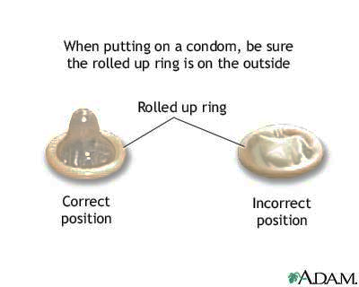
External Condom Use Do
Every Time
Storage
New Not Expired
All the Time
Wrap
Trash
Right-Side-Up
Notes:
Slide 25: External Condom Use Do
Image: Free, Male condom rolled up ring condom application, University of Maryland Medical System, https://www.google.com/search?tbm=isch&sa=1&ei=T_f-W4umBI20sQXyy4yYCg&q=male+condom+rolled+up+ring+condom+&oq=male+condom+rolled+up+ring+condom+&gs_l=img.3...206656.210455..211810...0.0..0.87.247.3......2....1j2..gws-wiz-img.....0..0j0i7i30.JHwM2BSQFTE#imgrc=3zB7O8JMlkrxDM:&spf=1543436322715
Slide Audio
If you use condoms to reach your goal of reducing your risk of getting or transmitting HIV, use a new condom the correct way every time.
18. CDC, “Condom Effectiveness: Male Condoms,” Last modified July 6, 2016, https://www.cdc.gov/condomeffectiveness/male-condom-use.html.

Slide 26
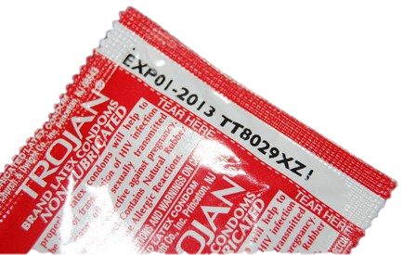
External Condom Use Do Not Use Expired
DN Open with fingernails, scissors or teeth
DN Apply more than one at a time.
DN Use defective.
DN Unroll before.
DN Reuse. New each use.
DN Flush. Wrap and trash.
Notes:
Slide 26: External Condom Use Do NOT
Image: Free, Condom with expiration date, Condom Depot, https://www.google.com/search?tbm=isch&sa=1&ei=I_j-W_rqOpG0tQWT5IvwAg&q=condom+expiration+date&oq=+condom&gs_l=img.1.1.35i39l2j0l6j0i67j0.299188.299188..302800...0.0..0.166.166.0j1......1....1..gws-wiz-img.Tceg7hb8oAU#imgrc=fdg7aUDLJrEhyM:&spf=1543436627703
Slide Audio:
There’s always the wrong way so don’t misuse condoms.
19. CDC, “Condom Effectiveness: Male Condoms,” Last modified July 6, 2016, https://www.cdc.gov/condomeffectiveness/male-condom-use.html.

Slide 27
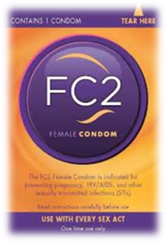
Internal Condom
More Durable
Latex-free
Worn Inside
Notes:
Slide 27: Internal Condom
Image: FC2 package, FC2 Internal Condom-US.com.
Slide Audio
The FC2 internal condom is the only one available in the United States:
Near perfect use is 95% effective at preventing pregnancy and protecting from HIV exposure. But among women who may not always use it correctly, 21 out of 100 will become pregnant.
Only use the internal or the external condom, not both together.
20. “Female Condom: How Effective Are They?,” BirthControl.com, Accessed September 10, 2018, https://www.birthcontrol.com/options/female-condom/.
21. CDC, “Condom Effectiveness: Female Condoms,” Last modified November 18, 2016,
https://www.cdc.gov/condomeffectiveness/male-condom-use.html,

Slide 28
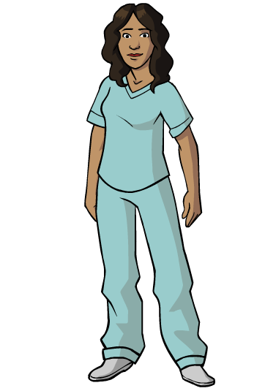
Consider the HIV Risk
No Risk
Abstinence
No Sex
No Drugs
No Alcohol
Abstinence from Sex
Abstinence from Injection Drugs
Abstinence from Sex
Abstinence from Injection Drugs
Reduced Risk
Use Condoms
Correctly & Consistently
Fewer Sexual Partners
Never Share Needles
HIV/STD Testing
Notes:
Slide 28: Consider the HIV Risk
Image: Female human wearing scrubs hands and arms at side, CDC.
Image: Red Ribbon Wallpaper, shutterstock_231442243.jpg.
Slide Audio
What’s your decision? How will you reduce your risk to get or transmit HIV? What is your endgame? Safer is better. Choices you make:
NO RISK
Abstinence from Sex.
REDUCED RISK
Condom Protected Sex “Correctly and Consistently”.
Never Sharing Needles or drug equipment.
Regular HIV/STD Testing.
22. CDC, “CDC Fact Sheet: Information for Teens and Young Adults: Staying Healthy and Preventing STDs,” December 2017,
https://www.cdc.gov/std/life-stages-populations/stdfact-teens.html.
If questions, talk with a trusted adult like your parents, grandparents, family, teacher or school nurse. Don’t Let HIV Be Your Endgame. Each day, be a champion and choose to eliminate HIV from your life.

Slide 29
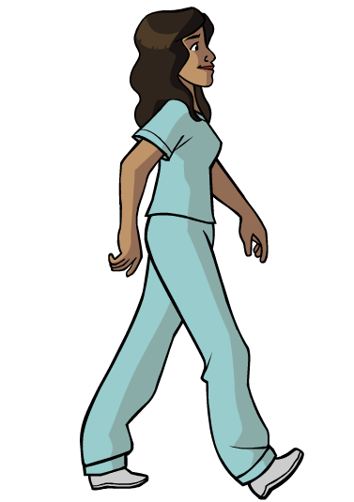
You’ve Championed This Campaign!
Thank you for being here.
Next, view:
Don’t Let HIV Be
Your Endgame
Level 3,
Testing & Treatment.
But first, select the next slide.
Notes:
Slide 29: You’ve Championed This Campaign!
Image: Female human wearing scrubs hands and arms at side turned left profile both arms from her side appears walking toward your right, CDC.
Image: Red Ribbon Wallpaper, shutterstock_231442243.jpg.
Slide Audio
Glad you joined me for Don’t Let HIV Be Your Endgame: Level 2, Person to Person.
Now, come with me for more objectives continuing the HIV series in game mode Level 3, Testing and Treatment.
But first, see the next slide.
Thanks for being here.

Slide 30

Reasons for Survey
Please take a minute.
Your opinion is valuable.
You improve this course.
You’ve completed Level 2, Person to Person, of this course. Please close the course file and return to the course details page in TRAIN. Select the Mark Completed Button.
The course will update and an Evaluation Button will appear. Select the Evaluation Button to begin the Evaluation.
Notes:
Slide 30: Reasons for Survey
Image: Female human wearing scrubs standing with left hand raised holding chin elbow bent, right arm hanging, CDC
Image: Red Ribbon Wallpaper, shutterstock_231442243.jpg.
Slide Audio
Yes, your opinion matters.
Can you do this for me?
Please take some time to answer the evaluation questions.
Your feedback is important to me and future learners. Thanks.

Slide 31
Resources 1
Slide 1 Image: Red Ribbon, shutterstock_162472193.jpg.
Slide 2 Image: Female Human, scrubs, thumb-up, CDC.
Slide 2 Image: Red Ribbon Wallpaper, shutterstock_231442243.jpg.
Slide 4 Image: Red Ribbon Awareness, shutterstock_55902637.jpg
Slide 5 Image: World AIDS Day #WAD2018 (Free), HIV.gov .
Slide 5 Image: Red Ribbon (Free), pixabay.com .
Slide 6 Image: Purple pencil with checkmark in circle, shutterstock_2695943264.jpg.
Slide 7 Image: Female Human wearing scrubs pointing left, CDC.
Slide 7 Image: Red Ribbon Wallpaper, shutterstock_231442243.jpg.
Slide 8 Image: How do you get HIV? Unprotected sex, etc. (Free), Avert .
Slide 8: CDC, HIV Transmission: How is HIV passed from one person to another?
Notes:
Slide 31: Resources 1
Image: None
Slide Audio
This slide provides information about references, links and images used.

Slide 32
Resources 2
Slide 8: HIV.gov, How is HIV Transmitted?
Slide 9: CDC, HIV Transmission: How is HIV passed from one person to another?
Slide 9: HIV.gov, How is HIV Transmitted?
Slide 9 Image: HIV is not Transmit by Insect bites, etc. (Free), Chatham Social Health Council
Slide 10 Image: Question mark in black square (Free), gograph.com
Slide 11 Image: Female Human in scrubs left hand pointing forward, CDC.
Slide 11 Image: Red Ribbon Wallpaper, shutterstock_231442243.jpg.
Slide 11: Your Dictionary: Body fluids
Slide 12: CDC, HIV Transmission: How is HIV passed from one person to another?
Slide 12: HIV.gov, How is HIV Transmitted?
Notes:
Slide 32: Resources 2
Image: None
Slide Audio
This slide provides information about references, links and images used.

Slide 33
Resources 3
Slide 13 CDC, HIV Transmission: How is HIV passed from one person to another?
Slide 13: HIV.gov, How is HIV Transmitted?
Slide 15 Image: Female Human wearing scrubs hands at shoulder questioning, CDC.
Slide 15 Image: Red Ribbon Wallpaper, shutterstock_231442243.jpg.
Slide 16 Video: Tea and Consent, Vimeo. Tea and Consent, Australian
Slide 18 Image: Celibacy Red No Sex Sign (Free), Clker.com
Slide 18 CDC, HIV Prevention: Is abstinence the only100% effective HIV prevention option?
Slide 18 HIV.gov, XOXO: Put Your #BestDefense Into Play .
Slide 19 Image: Male and female condom (Free), uerria.witclub.info .
Slide 19 CDC, 2016 Sexually Transmitted Disease Surveillance: STDs in Adolescents and Young Adults: Public Health Impact .
Notes:
Slide 33: Resources 3
Image: None
Slide Audio
This slide provides information about references, links and images used.

Slide 34
Resources 4
Slide 22 CDC, CDC Fact Sheet: Information for Teens and Young Adults: Staying Healthy and Preventing STDs.
Slide 22 US Department Veteran Affair, HIV/AIDS Birth Control and HIV
Slide 22 CDC, Condom Effectiveness .
Slide 23 Planned Parenthood, How effective are condoms?
Slide 24 Image: Row of male condoms, shutterstock_74723128.jpg.
.
Slide 25 Image: Male ringed condom (Free), University of Maryland Medical System .
Slide 25: CDC, Condom Effectiveness: Male Condoms .
Slide 26 Image: Condom expiration date (Free), Condom Depot .
Slide 26: CDC, Condom Effectiveness: Male Condoms.
Slide 27 Image: FC2 package (Free).
Slide 27 BirthControl.com, Female Condom: How Effective Are They?
Notes:
Slide 34: Resources 4
Image: None
Slide Audio
This slide provides information about references, links and images used.

Slide 35
Resources 5
Slide 27 CDC, Condom Effectiveness: Female Condoms .
Slide 28 Image: Female Human wearing scrubs hands and arms at side, CDC.
Slide 28 Image: Red Ribbon Wallpaper, shutterstock_231442243.jpg
Slide 28 CDC, CDC Fact Sheet: Information for Teens and Young Adults: Staying Healthy and Preventing STDs .
Slide 29 Image:RedRibbon Wallpaper, shutterstock_231442243.jpg.
Slide 29 Image: Female Human wearing scrubs hands and arms at side turned left profile appears walking toward your right, CDC.
Slide 30 Image: Female Human wearing scrubs standing with left hand raised to chin, CDC.
Slide 30 Image: Red Ribbon Wallpaper, shutterstock_231442243.jpg.
Slides 36: CDC TRAIN, Citation & Developer.
Notes:
Slide 35: Resources 4
Image: None
Slide Audio
This slide provides information about references, links and images used.

Slide 36
Instructional Resources
Shutterstock
Presentation Shutterstock Images are purchased and not for general distribution or use other than in this presentation.
CDC’s E-learning Essentials
Chicago Manual of Style 17th Edition
Guidance on Disclaimers for CDC Scientific Publications and Presentations
HHS 508 Guidance: PDF Checklists
HHS 508 Guidance: PDF File 508 Checklist (WCAG 2.0 Refresh)
HHS 508 Guidance: PowerPoint Document 508 Checklist
Web Content Accessibility Guidelines (WCAG 2.0) Overview
Authoring Tool: Windows OS 10, Microsoft 2016 PowerPoint
Notes:
Slide 36: Instructional Resources
Image: None
Slide Audio
This slide provides information about references, links and images used.

Slide 37
Citation & Developer
This course is in the public domain and may be used and reprinted without permission, except for purchased Shutterstock images.
A citation as to source, however, is appreciated.
Centers for Disease Control and Prevention (CDC). Don’t Let HIV Be Your Endgame: Level 2, Person to Person. [ID: 1081990]. Atlanta, GA: US Department of Health and Human Services, CDC; 2018. Available from CDC TRAIN
Designer/Developer:
Virginia (Toni) Hovda, M.Ed.
Training Specialist II
HIV/STD Service
Oklahoma State Department of Health
1000 NE 10th Street
Oklahoma City, OK 73117-1299
Office: 405.271.9444
Notes:
Slide 37: Citation & Developer
Image: None
Slide Audio
This slide provides information about references, links and images used.
21. CDC, “CDC TRAIN,” Accessed December 13, 2019, https://www.train.org/cdctrain/access-denied

