Slide 1
Immunization Service Provider Call October 2023 Please place your name, and provider in the chat.
Notes:
Good afternoon, welcome everyone. If you have not yet, please be sure to place yours and your provider name in the chat. Let’s go ahead and get started. My name is Rishu Garg and I am the Adul Immunization Coordinator for the immunization program here at OSDH. Thank you for joining us today, especially on a Friday before a holiday weekend ☺ We will try to be good stewards of your time today.

Slide 2
Agenda
State Data / COVID Administration Guidance
COVID-19 Vaccine Ordering Update
Vaccine Storage and Handling
Vaccine Ordering & Distribution
OSIIS Updates
Guest Speaker
Lauren Speer, BSN, RN.
Immunization and Communicable Disease Nurse Consultant, Nursing Services
Flu and RSV
Looking Forward
Notes:
Today we are going to go over state data and administration guides and give you updates on vaccine ordering, distribution, and OSIIS. Then later in the call we’re going to hear from Dr. Pai with information on Monkey Pox. So, with that let’s jump.

Slide 3
COVID-19 Vaccine State Data & Administration Guidance
Rishu Garg, Adult Vaccine Coordinator

Slide 4
COVID-19 Vaccinations in Oklahoma – Federal and State (as of 5/10/2023)
2,961,991
people have received at least 1 dose* of the COVID-19 vaccine
1,005,893
people have received a 3rd dose^ or booster dose^^ of the COVID-19 vaccine
485,399
people have received the bivalent booster dose of the COVID-19 vaccine
2,399,774
people are fully vaccinated** with the COVID-19 vaccine
Across Oklahoma, a total of 6,773,461 COVID-19 vaccine doses have been administered since 12/14/2020
*Refers to eligible individuals receiving Pfizer and Moderna COVID-19 vaccines and/or receiving single shot of J&J/Janssen Vaccine; **Refers to eligible individuals (ages 5 years+) fully vaccinated after receiving either Pfizer and/or Moderna COVID-19 vaccines (both doses) and/or receiving single shot of J&J/Janssen Vaccine; ^3rd dose (Pfizer or Moderna) for individuals moderately to severely immunocompromised to be received at least 28 days after a second dose; ^^Booster dose for individuals 65+ or certain other adults at high risk of severe COVID-19 to be received at least six months after completion of the primary mRNA vaccine series or two months after receiving single dose of J&J/Janssen vaccine.
Not for public distribution, data intended for internal planning purposes.
Data Source: CDC COVID Data Tracker – Tiberius Database. Data as of: May 10, 2023.

Slide 5
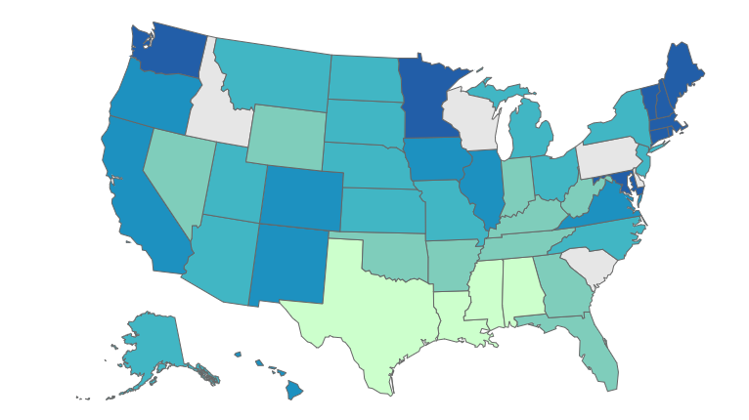
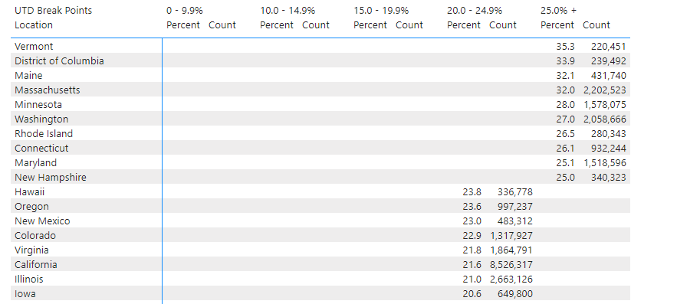
Percent of the Total Population Who Are Up to Date with COVID-19 Vaccines, (CDC)
Oklahoma: 12.5% of Population
493,059
Female: 13.6% Male: 11.3%

Slide 6
Updated (2023-2024 Formula) Interim Clinical Considerations for Use of COVID-19 Vaccines
Summary of recent changes (last updated September 15, 2023)
Recommendations for use of the 2023–­2024 formulations of Moderna COVID-19 Vaccine and Pfizer-BioNTech COVID-19 Vaccine:
Everyone ages 5 years and older is recommended to receive 1 dose of updated (2023–­2024 Formula) mRNA COVID-19 vaccine
Children ages 6 months–4 years
Initial vaccination: should receive either 2 doses of updated (2023­–2024 Formula) Moderna or 3 doses of updated (2023–­2024 Formula) Pfizer-BioNTech COVID-19 vaccine
Received previous mRNA doses: need 1 or 2 doses of updated (2023–­2024 Formula) Moderna or updated (2023­–­2024 Formula) Pfizer-BioNTech COVID-19 vaccine, depending on the number of prior doses
People who are moderately or severely immunocompromised
Initial vaccination: should receive a 3-dose series of updated (2023–­2024 Formula) Moderna or updated (2023–­2024 Formula) Pfizer-BioNTech COVID-19 vaccine
Received previous mRNA doses: need 1 or 2 doses of updated (2023­–2024 Formula) Moderna or updated (2023–­2024 Formula) Pfizer-BioNTech COVID-19 vaccine, depending on the number of prior doses
May receive 1 or more additional updated (2023–­­2024 Formula) mRNA COVID-19 vaccine doses
Bivalent mRNA COVID-19 vaccines and Original Monovalent Novavax vaccines are no longer recommended in the United States
Updated guidance for COVID-19 vaccination and myocarditis or pericarditis
Updated guidance for COVID-19 vaccination and Multisystem Inflammatory Syndrome (MIS) in children (MIS-C) and in adults (MIS-A)
Reorganization and consolidation of sections on contraindications and precautions, including allergic reactions to COVID-19 vaccines
Reference Materials
Interim COVID-19 Immunization Schedule (Updated 9/22/2023)
COVID-19 Vaccination Recommendations Infographic (Updated 9/20/2023)
COVID-19 Vaccination Recommendations Infographic (Immunocompromised) (Updated 9/20/2023)
COVID-19 Vaccine Product Information (Updated 9/25/2023)
CDC Clinical Considerations
Notes:
https://www.cdc.gov/vaccines/covid-19/downloads/COVID19-vaccination-recommendations-most-people.pdf
https://www.cdc.gov/vaccines/covid-19/clinical-considerations/interim-considerations-us.html?ACSTrackingID=USCDC_2120-DM104004&ACSTrackingLabel=Updated%20Guidance%3A%20Interim%20Clinical%20Considerations%20for%20Use%20of%20COVID-19%20Vaccines&deliveryName=USCDC_2120-DM104004

Slide 7
FDA Updated Novavax COVID-19 Vaccine (2023-2024 Formula) Authorization as of October 5th, 2023
On October 3, 2023, the FDA amended the EUA of Novavax COVID-19 vaccine to include the 2023-2024 formula.
The Novavax COVID-19 Vaccine, Adjuvanted, a monovalent vaccine, has been updated to include the spike protein from the SARS-CoV-2 Omicron variant lineage XBB.1.5 (2023-2024 formula).
Novavax COVID-19 Vaccine, Adjuvanted (2023-2024 Formula) is authorized for use in individuals 12 years of age and older.
The updated authorization details are available on the FDA website.
We will share updated clinical and operational guidance and ordering details as it becomes available.
The Novavax COVID-19 Vaccine, Adjuvanted (Original monovalent) is no longer authorized.
As part of the FDA’s actions, the Novavax COVID-19 Original Monovalent Vaccine is no longer authorized for use in the United States. To minimize the risk of vaccine administration errors, providers should:
Remove all Original monovalent Novavax COVID-19 vaccines from storage units immediately, even if they are not expired.
Once all inventory is fully accounted for, zero out all original monovalent Novavax COVID-19 vaccines from your clinic's available vaccine inventory on hand in OSIIS.
Dispose of all original monovalent Novavax COVID-19 vaccine vials in accordance with local, state, and federal regulations.
Report all disposed inventory as wastage.
Novavax COVID-19 Vaccine, Adjuvanted (2023-2024 Formula) Fact Sheet

Slide 8
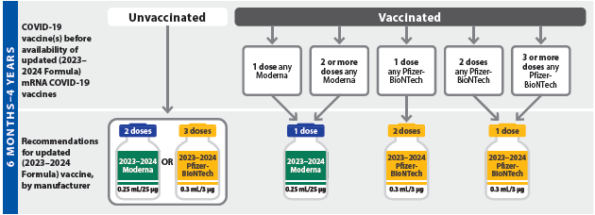
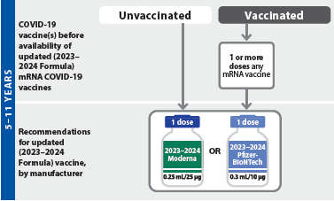
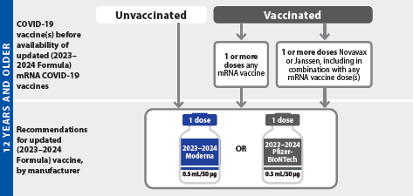
Recommended updated (2023–2024 Formula) mRNA COVID-19 vaccines for people who are NOT moderately or severely immunocompromised*†

Slide 9
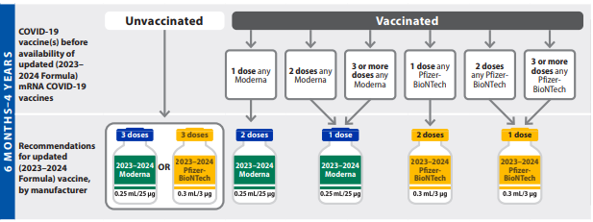
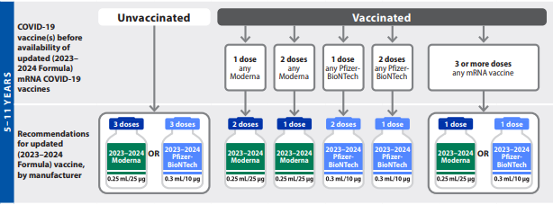
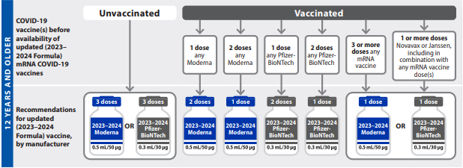
Recommended updated (2023–2024 Formula) mRNA COVID-19 vaccines for people who ARE moderately or severely immunocompromised*†
‡The FDA EUA provides that children who transition from age 4 years to age 5 years during the Pfizer-BioNTech vaccination series complete the 3-dose series with updated (2023–2024 Formula) Pfizer-BioNTech COVID-19 Vaccine for ages 6 months–4 years, 0.3 mL/3 ug (yellow cap; yellow label).
The FDA EUA provides that children who transition from age 4 years to age 5 years during the Moderna vaccination series complete the 2-dose series; there is no dosage change.
The COVID-19 vaccination schedule for people who are moderately or severely immunocompromised is detailed in Table 2.
Notes:
‡The FDA EUA provides that children who transition from age 4 years to age 5 years during the Pfizer-BioNTech vaccination series complete the 3-dose series with updated (2023–2024 Formula) Pfizer-BioNTech COVID-19 Vaccine for ages 6 months–4 years, 0.3 mL/3 ug (yellow cap; yellow label). The FDA EUA provides that children who transition from age 4 years to age 5 years during the Moderna vaccination series complete the 2-dose series; there is no dosage change.

Slide 10
Updated COVID-19 (2023-2024) Vaccine Formulations
Two types of COVID-19 vaccines are available for use in the United States:
mRNA vaccines
Moderna COVID-19 Vaccine (2023–2024 Formula) is authorized for children ages 6 months–11 years; SPIKEVAX is the licensed Moderna product for people ages 12 years and older. These vaccines are hereafter referred to as updated (2023–2024 Formula) Moderna COVID-19 Vaccine.
Pfizer-BioNTech COVID-19 Vaccine (2023–2024 Formula) is authorized for children ages 6 months–11 years; COMIRNATY is the licensed Pfizer-BioNTech product for people ages 12 years and older. These vaccines are hereafter referred to as updated (2023–2024 Formula) Pfizer-BioNTech COVID-19 Vaccine.
Protein subunit vaccine
Novavax COVID-19 Vaccine, Adjuvanted (2023-2024 Formula) is authorized for use in individuals 12 years of age and older.
COVID-19 vaccine composition
Moderna and Pfizer-BioNTech COVID-19 vaccines: The 2023–2024 formulation has been updated to a monovalent vaccine based on the Omicron XBB.1.5 sublineage of SARS-CoV-2. The bivalent formulation (Original and Omicron BA.4/BA.5) should no longer be used.
Novavax COVID-19 Vaccine: the 2023-2024 formulation has been updated to include the spike protein from the SARS-CoV-2 Omicron variant lineage XBB.1.5. The Original Monovalent formulation should no longer be used.
COVID-19 vaccine-specific package inserts and FDA fact sheets’ and U.S. COVID-19 Vaccine Product Information
can be consulted for a full list of ingredients and information on the conditions of use, storage and handling, preparation, and administration procedures.
Notes:
https://www.fda.gov/emergency-preparedness-and-response/coronavirus-disease-2019-covid-19/covid-19-vaccines

Slide 11
COMIRNATY and Pfizer-BioNtech (2023-2024) Covid-19 Vaccines
Pfizer Vaccines - At a Glance - CDC
COMIRNATY Package Insert
EUA Fact Sheet Pfizer-BioNtech COVID-19 Vaccine 6m-11yrs

Slide 12
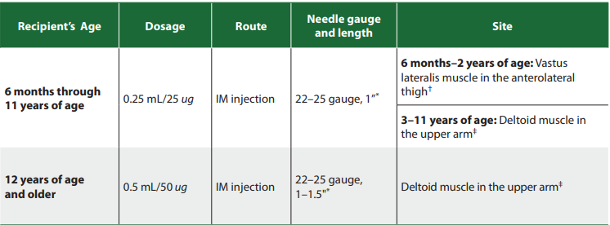
SPIKEVAX Moderna COVID-19 Vaccine (2023-2024) Formulations
Additional Guidance: Moderna COVID-10 Vaccine | FDA | Spikevax | FDA | Moderna Vaccines | Modernaatx.com
Updated 2023-2024 Moderna Covid Vaccines At a Glance - CDC
Notes:
fine

Slide 13
Novavax
Co-Administration
Expiration dates can be obtained using the Novavax Expiry Date Checker
Notes:
Novavax COVID-19 Vaccine
Adolescents ages 12–17 years: A 2-dose primary series and 1 age-appropriate bivalent mRNA booster dose is recommended. For the primary series, the first and second doses are separated by 3 weeks. The bivalent mRNA booster dose is administered at least 2 months after completion of the primary series. Currently, the bivalent Pfizer-BioNTech booster dose is authorized for adolescents in this age group who receive a Novavax primary series.
Novavax COVID-19 Vaccine
Adults ages 18 years and older: A 2-dose primary series and 1 bivalent mRNA booster dose (Moderna or Pfizer-BioNTech) is recommended. The primary series doses are separated by 3 weeks and the bivalent mRNA booster dose is administered at least 2 months after completion of the primary series.
https://us.novavaxcovidvaccine.com/hcp

Slide 14
Timing, spacing, age transitions
4-Day grace period
Doses administered up to 4 days before the minimum interval or age, known as the 4-day grace period, are considered valid. If a dose is administered prior to the 4-day grace period, see Appendix B. Doses administered at any time after the recommended interval are valid.
Transitioning from a younger to older age group
In general, CDC recommends that people receive the age-appropriate vaccine product and dosage based on their age on the day of vaccination (Table 1 and Table 2).
If a person moves to an older age group between vaccine doses, they should receive the vaccine product and dosage for the older age group for all subsequent doses with one exception:
The FDA EUA provides that children who transition from age 4 years to age 5 years during the Pfizer-BioNTech COVID-19 vaccination series complete the 3-dose series with updated (2023–2024 Formula) Pfizer-BioNTech COVID-19 Vaccine for ages 6 months–4 years, 0.3 mL/3 ug (yellow cap; yellow label).
In addition, the FDA EUA provides that children who transition from age 4 years to age 5 years during the Moderna vaccination series complete the 2-dose series; there is no dosage change.

Slide 15
Interchangeability of COVID-19 vaccines
Children ages 6 months–4 years should receive all doses of COVID-19 vaccine from the same manufacturer; this includes children who are moderately or severely immunocompromised and those who are not. People ages 5 years and older who are moderately or severely immunocompromised should receive a 3-dose initial vaccination series using vaccines from the same manufacturer.
In the following exceptional situations, a different age-appropriate COVID-19 vaccine may be administered:
Same vaccine not available
Previous dose unknown
Person would otherwise not complete the vaccination series
Person starts but unable to complete a vaccination series with the same COVID-19 vaccine due to a contraindication
A Vaccine Adverse Event Reporting System (VAERS) report is not indicated for these exceptional situations.
For people who receive 1 Moderna and 1 Pfizer-BioNTech vaccine dose, complete the initial vaccination series as follows:
Children ages 6 months–4 years who are not moderately or severely immunocompromised should follow a 3-dose schedule. A third dose of either updated (2023–2024 Formula) Moderna vaccine or updated (2023–2024 Formula) Pfizer-BioNTech vaccine should be administered at least 8 weeks after the second dose.
People ages 6 months and older who are moderately or severely immunocompromised should follow the recommended 3-dose schedule. A third dose of either updated (2023–2024 Formula) Moderna vaccine or updated (2023–2024 Formula) Pfizer-BioNTech vaccine should be administered as follows:
Ages 6 months–4 years: at least 8 weeks after the second dose
Ages 5 years and older: at least 4 weeks after the second dose
The COVID vaccination schedules for People who are not moderately or severely immunocompromised and People who are moderately or severely immunocompromised should be consulted for age-specific information; see Appendix B for recommended actions following interchangeability-related COVID-19 vaccine administration errors or deviations.

Slide 16
Bridge Access Program for COVID-19 Vaccines and Treatments
Provide access to only COVID-19 vaccines and treatments for eligible populations, under and uninsured individuals 19 years of age and older
The program is temporary, beginning in Fall of 2023 and scheduled to end on Dec 31st, 2024
Almost 25-30 million uninsured and underinsured adults are qualified to participate in the program
Limited doses of COVID-19 vaccines available to state immunization awardees, local health departments (LHDs) and associated clinics, eligible FQHCs, Rural Health Centers, and Indian Health Service and Tribal Providers.
Participating Pharmacies: CVS, Walgreen's and e-True North
Request for further information: bridgeaccess@health.ok.gov

Slide 17
COVID- 19 Vaccine Ordering Updates
Margaret Archer, MPH, and Muhammad Khalil, BSM
Covid-19 Vaccine Ordering Team

Slide 18
COVID-19 Vaccines available in OSIIS
OSIIS offers 5 COVID-19 vaccine formulations across all age groups.
Updates to the ordering process
When placing orders for COMIRNATY (Pfizer) 12+ and Spikevax (Moderna) 12+, be sure to select the appropriate intent (ADULT or PED). This will determine the funding source used to purchase the vaccine.
Providers no longer have the option to opt-out of receiving ancillary kits.
Providers can no longer request dose amounts less than the minimum dose requirements for direct shipment.
As a reminder, please remember to regularly check the OSIIS homepage for news updates related to COVID-19 Vaccines.
Notes:
-The COVID 19 Vaccine ordering process in OSIIS has not changed substantially, but there are few minor changes
-As a first bullet point word for word, “more information on this will be provided later on in the presentation.
Please note that you can no longer opt out of receiving ancillary kits for any of the vaccine formulations, and
Providers can no longer request dose amounts that are less than the minimum dose requirement for direct shipment.

Slide 19
COVID-19 Vaccines available in OSIIS
CVX | Name on OSIIS ordering page | NDC | Manufacturer | Doses per Package
308 | Pfizer-BT 2023-2024 (10 x 3 dose vials) 6m-4yrs | 59267-4315-02 | PFIZER, INC. | 30
309 | COMIRNATY 2023-2024 (10 x 0.3mL vials) 12+ yrs | 00069-2362-10 | PFIZER, INC. | 10
310 | Pfizer-BT 2023-2024 (10 x 0.3mL sdv vials) 5-11 yr | 59267-4331-02 | PFIZER, INC. | 10
311 | Moderna 2023-2024 (10 x 0.25mL sdv vials) 6m-11y | 80777-0287-92 | MODERNA | 10
312 | Spikevax 2023-2024 (10 x 0.5mL sdv vials) 12+ yrs | 80777-0102-95 | MODERNA | 10
The updated Novavax COVID-19 Vaccine, Adjuvanted (2023-2024 Formula), will be available in OSIIS once the allocation is received.
Notes:
These are the 5 Vaccine formulations avaliable to order in OSIIS,
They are Grouped by CVX code and reflect the way the vaccines are listed on the COVID-19 Order form in OSIIS.
I'll give everyone a minute to review this,
Today’s presentation slides will be shared so the information in this table will be readily available for reference when needed.
If anyone has any questions or concerns, please feel free to reach out to me directly. Thank you!

Slide 20
COVID-19 Vaccine for Children Ordering in OSIIS
COVID-19 Vaccines that are ordered with Pediatric intent are funded by the Vaccines for Children Program (VFC).
Please ensure that these vaccines are administered only to VFC-eligible children.
More information about VFC eligibility can be found here: CDC VFC Program Eligibility
Notes:
Read first bullet point, th

Slide 21
Vaccine Storage and Handling
Sonja Claborn LPN,
Immunization Field Consultant

Slide 22
Best Practices for Inventory Management
To reduce waste, providers should be aware of vaccines in their inventory that are nearing expiration dates and prioritize their administration.
Providers should enroll in the CDC Code Management Service to access the most up-to-date Expiration Information for all Vaccines.
Vaccine Lot Number and Expiration Date Webpage
Click the "Register" button in the upper right-hand corner to complete the registration form to request access.
Moderna, Novavax, and Pfizer Vaccine Expiration Lookup & Reference Information:
Moderna Vial Expiration Data Look Up Tool
Pfizer-BioNTech Covid-19 Lot Expiry Tool
Novavax Expiry Date Checker Tool
Notes:
Inventory Management – rotate stock and check expiration dates weekly. PFIZER CAN NEVER BE STORED IN A STANDARD FREEZER

Slide 23
Covid Vaccine Inventory Clean Up : Unauthorized Vaccines
As of September 13th, 2023, the bivalent Moderna and Pfizer-BioNTech COVID-19 vaccines are no longer authorized for use.
As of October 3rd, 2023, the Novavax COVID-19 Vaccine, Adjuvanted (Original monovalent) is no longer authorized.
To minimize the risk of vaccine administration errors, providers should:
Remove all bivalent mRNA and original monovalent Novavax COVID-19 vaccines from storage units immediately, even if they have not expired.
Once all inventory is fully accounted for, zero out all bivalent mRNA and original monovalent Novavax vaccines from your clinic's available vaccine inventory on hand in OSIIS.
Dispose of all bivalent mRNA and original monovalent Novavax COVID-19 vaccine vials in accordance with local, state, and federal regulations.
Report all disposed inventory as wastage in OSIIS.
Refer to the tip sheet for further guidance: COVID-19 Vaccine Cleanup -Inventory Adjustment- Report Wastage OSIIS TipSheet.docx
The table below lists COVID-19 vaccines that must be removed from your inventory.
Manufacturer | Presentation | Unit of Sale NDC
Moderna TX Inc. | MDV5; 10-pack | 80777-0282-99
Moderna TX Inc. | Ped 6m-5y; MDV2; 10pk | 80777-0283-99
Pfizer Inc. | MDV6; 10-pack | 59267-0304-02
Pfizer Inc. | SDV; 10pk | 59267-1404-02
Pfizer Inc. | Ped 5y-11y; MDV10; 10pk | 59267-0565-02
Pfizer Inc. | Ped 6m-4y; MDV10; 10pk | 59267-0609-02
Novavax | 10 x 2.5mL Multi-Dose Vial | 80631-0102-10
If you have any questions or concerns, please reach out to Margaret.Archer@health.ok.gov

Slide 24
Covid Vaccine Wastage
COVID-19 vaccines received as a part of CDC's routine programs- VFC, 317, and Bridge access program will need to be returned to McKesson once they are expired or spoiled.
Only non-viable vaccines cannot be returned to McKesson, which includes broken vials/syringes, vaccine drawn into a syringe but not administered are considered wastage.
COVID-19 vaccine program requirements include reporting wastage (unused, open, spoiled, or expired) into OSIIS. Please follow the Wastage tip sheet to report COVID-19 vaccine wastage.
After recording, the vaccine must be disposed of in accordance with Oklahoma regulations and processes to dispose of regulated medical waste.
Operational Summary for Identifying, Disposing, and Reporting COVID-19 Vaccine Wastage l CDC
Notes:
Many providers have expired covid-19 vaccines, and we would like to remind you about the wastage process for expired and spoiled vaccines.
These vaccines must be taken out of the inventory in OSIIS using VTrckS-Other reason for expired vaccines and all others (marked with green check marks) for spoiled.
Vaccines must be labeled and discarded of at the end of the day if possible.

Slide 25
Comirnaty and Pfizer-BioNTech (2023-2024) Storage and Handling
Additional guidance: CDC Vaccine Storage and Handling Toolkit | Pfizer BioNtech COVID Vaccine | FDA | Comirnaty | FDA | https://www.cvdvaccine.com/
Comirnaty Package Insert | Pfizer-BioNTech COVID-19 Vaccine (2023-2024 Formula) Fact Sheet
Notes:
Additional guidance: CDC Vaccine Storage and Handling Toolkit | Pfizer BioNtech COVID Vaccine | FDA | Comirnaty | FDA | https://www.cvdvaccine.com/

Slide 26
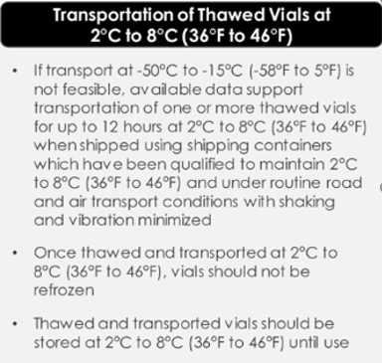
Spikevax and Moderna COVID-19 (2023-2024) Storage and Handling
Additional Guidance: SPIKEVAX Package Insert | Moderna COVID-19 Vaccine (2023-2024 Formula) Fact Sheet | Moderna HCP Letter | https://eua.modernatx.com/

Slide 27
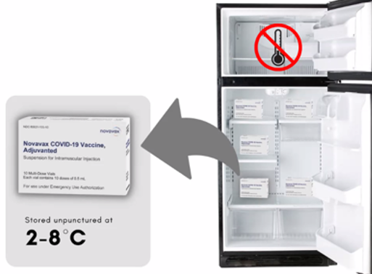
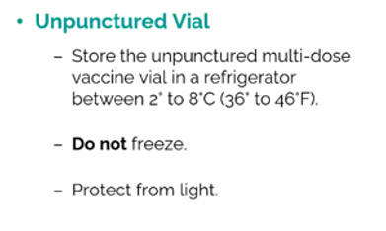
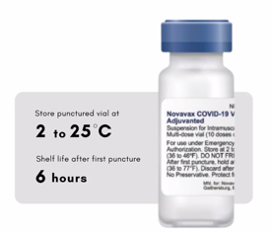
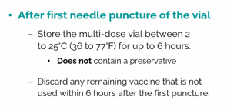
Novavax Storage and Handling
Additional Storage and Handling Information can be accessed here
Notes:
NOVAVAX is not interchangeable! Cannot be used with any other covid vaccine
NOVAVAX Store the unpunctured multi-dose vial in a refrigerator between 2° to 8°C (36° to 46°F)
NOVAVAX Storage After First Puncture of the Vaccine Vial After the first needle puncture, hold the vial between 2° to 25°C (36° to 77°F) for up to 6 hours. Discard the vial 6 hours after the first puncture
Prepare for administration • Record the date and time of the first puncture on the vial label. • Each multi-dose vial contains 10 doses of 0.5 mL each. • Do not pool excess vaccine from multiple vials. • After the first needle puncture, hold the vial between 2° to 25°C (36° to 77°F) for up to 6 hours. • Discard vial 6 hours after the first puncture
PFIZER S&H Ultra-Low-Temperature (ULT) Freezer [-90°C to -60°C (-130°F to -76°F)] 12 months‡ Home (cvdvaccine-us.com)
PFIZER Refrigerator [2°C to 8°C (35°F to 46°F)] 10 weeks
PFIZER After First Puncture [2°C to 25°C (35°F to 77°F)] 12 HOURS
StorageandHandlingQuickReference.pdf (modernatx.com)

Slide 28
Covid-19 Vaccine Inventory Clean-Up
Following the end of the Public Health Emergency (PHE) Declaration on May 11th, 2023, we are asking providers to assess their inventory reporting data and account for unrecorded doses.
Per The CDC COVID-19 Vaccination Program Agreement, providers are required to record vaccine administration in addition to the number of COVID-19 vaccine doses that were unused, spoiled, expired, or wasted. Providers are also required to dispose of expired COVID-19 vaccines in accordance with local regulations and processes regulating medical waste and report disposed vaccines as wastage.
Of note: ALL remaining monovalent mRNA vaccine formulations must be removed from inventory as they are no longer authorized.
To assess your facility’s inventory reporting data and ensure accuracy, providers must take the following actions by July 15th, 2023:
Review any unreported data and reconcile as needed.
Adjust all monovalent, unused, spoiled, expired, or wasted vaccines from inventory in OSIIS
Select “VTRCKS-Other” as the adjustment reason
Enter “wastage” in the comment text box
Zero out remaining inventory in Vaccine Finder according to previously established protocol.
Dispose of expired COVID-19 vaccine in accordance with local regulations and processes regulating medical waste.
If you have any questions or concerns, please contact the OSIIS Help Desk or reach out to Margaret.Archer@health.ok.gov and Muhammad.Khalil@health.ok.gov
The Operational Summary for Identifying, Disposing, and Reporting COVID-19 Vaccine Wastage l CDC provides information to help awardees and immunization managers identify, handle, dispose of, and report waste in COVID-19 vaccination programs.

Slide 29
Vaccine Ordering and Distribution
Teja Paruchuri, MPH
Notes:
Next topic is vaccine ordering and distribution.

Slide 30
Reconciliation
Reconciliation – every 14 days
Providers are required to reconcile their inventory once every 14 days before placing a vaccine order.
If a clinic does not reconcile COVID inventory every 14 days, they will not be able to create a vaccine order.
An informational video on COVID 19 vaccine reconciliation and ordering can be accessed at https://vimeo.com/528424790
Inventory Reconciliation
Notes:
We want to remind you that inventory reconciliation is a requirement for all providers that order covid-19 vaccines, including County Health Departments. Covid-19 inventory must be reconciled weekly. Some providers have two inventory locations – one for normal vaccines, another for covid. Providers need to make sure they reconcile not only the default inventory location, but also the covid location.

Slide 31
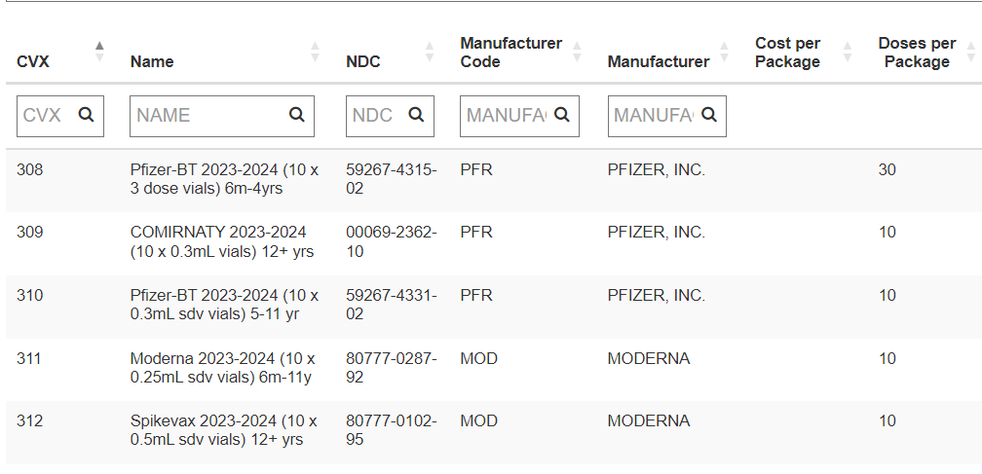
Ordering Process
Providers can create orders in OSIIS during the ordering timeframe, which is Tuesday through Monday.
COVID-19 vaccines are on allocation. Please do not order more vaccines than you can use in a 2-week period. Orders that have already been placed will be cut based on the availability of the vaccine and doses administered.
Providers will no longer be able to order less than the minimum quantity for direct shipment.
The minimum quantity is 10 doses for all formulations, except for Pfizer 6m-4yrs, which is 30 doses.

Slide 32
Ordering Process
The cut-off to create orders in OSIIS – COB on Monday's.
Orders that are submitted by Monday will be submitted to CDC for processing on Tuesdays and vaccine will be delivered by the end of the same week.
To make any changes or cancellations to orders after the deadline, providers must reach out ASAP.
To request a change, a provider should email OSDH VaccineHelp <VaccineHelp@health.ok.gov>
If provider doesn’t receive a confirmation of changes/cancellation within 24h, provider must call the OSDH Immunization Service 405.426.8580 to ensure that the order has been cancelled.
Orders will directly be shipped to the providers. (subjected to change based on the available weekly threshold amounts).
Please do not refuse any vaccine shipments.
Notes:
orders with at least min quantities or less than minimum quantities will be approved in OSIIS and will be fulfilled and delivered by CHDs depending on the available weekly threshold amounts.

Slide 33
Ordering Process
Upon delivery of vaccine, providers should complete the following steps:
Verify if the doses ordered and received are correct.
Check if the delivered vaccines are viable. If the vaccines are not viable upon receipt or if there are doses missing, report it to Immunization Service on the same day.
Immediately place vaccines into storage according to the storage guidelines.
Accept inventory in OSIIS.
Questions about orders:
OSIIS: OSIISHELP@health.ok.gov
Vaccine ordering process: VaccineHelp@health.ok.gov
Notes:
I want to highlight the importance of the 4 steps each provider needs to do when receiving vaccines from CHDs. Please don't forget about the 4th step. If you don't accept the transfer in OSIIS, CHD will not be able to reconcile their inventory and order any vaccines.
If you have any questions about orders related to OSIIS: please reach out to the OSIIS help desk at “”
For questions about the vaccine ordering process: please contact VaccineHelp@health.ok.gov
For questions about order fulfilment/deliver, please reach out to the County Health Department’s contacts. This contact information will be shared in the follow-up email.

Slide 34
Covid vaccine returns
Below is a summary of how to handle spoiled/expired/wasted COVID-19 vaccines.
COVID 19 vaccines received as part of the USG pandemic response
These vaccines cannot be returned to McKesson.
Once unauthorized, whether spoiled/expired/unused, these vaccines should be adjusted out of your inventory as wastage and properly disposed of according to state and local regulations.
Updated 2023-24 COVID 19 vaccines received as part of CDCs routine program (VFC, 317, or Bridge Access Program)
Spoiled or expired vaccines should be returned to Mckesson by creating vaccine returns in OSIIS just like any other routine vaccines.
Any nonviable vaccines that cannot be returned to McKesson are considered wastage, including open multi-dose vials where not all doses have been administered, broken vials/syringes, vaccine drawn up into a syringe but not administered, etc. These vaccines should must be adjusted out of the inventory as wastage should be properly disposed of according to state and local regulations.
Notes:
I want to highlight the importance of the 4 steps each provider needs to do when receiving vaccines from CHDs. Please don't forget about the 4th step. If you don't accept the transfer in OSIIS, CHD will not be able to reconcile their inventory and order any vaccines.
If you have any questions about orders related to OSIIS: please reach out to the OSIIS help desk at “”
For questions about the vaccine ordering process: please contact VaccineHelp@health.ok.gov
For questions about order fulfilment/deliver, please reach out to the County Health Department’s contacts. This contact information will be shared in the follow-up email.

Slide 35
OSIIS Updates
Martin Lansdale, MPH
OSIIS Data Quality Coordinator

Slide 36
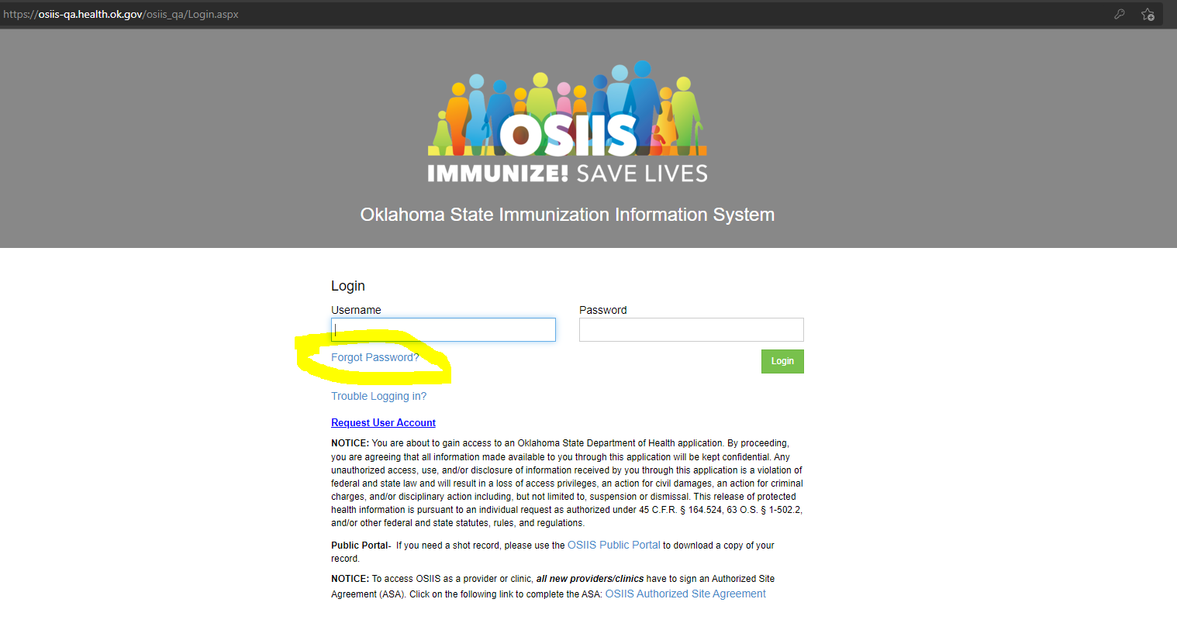
Updating Passwords in OSIIS
Notes:
Last week we received a request from CDC asking Oklahoma providers to regularly update information in VF. This must be done every day or at leaset every 72 hours. After this call, please check if your inventroy has been updated in VF.

Slide 37
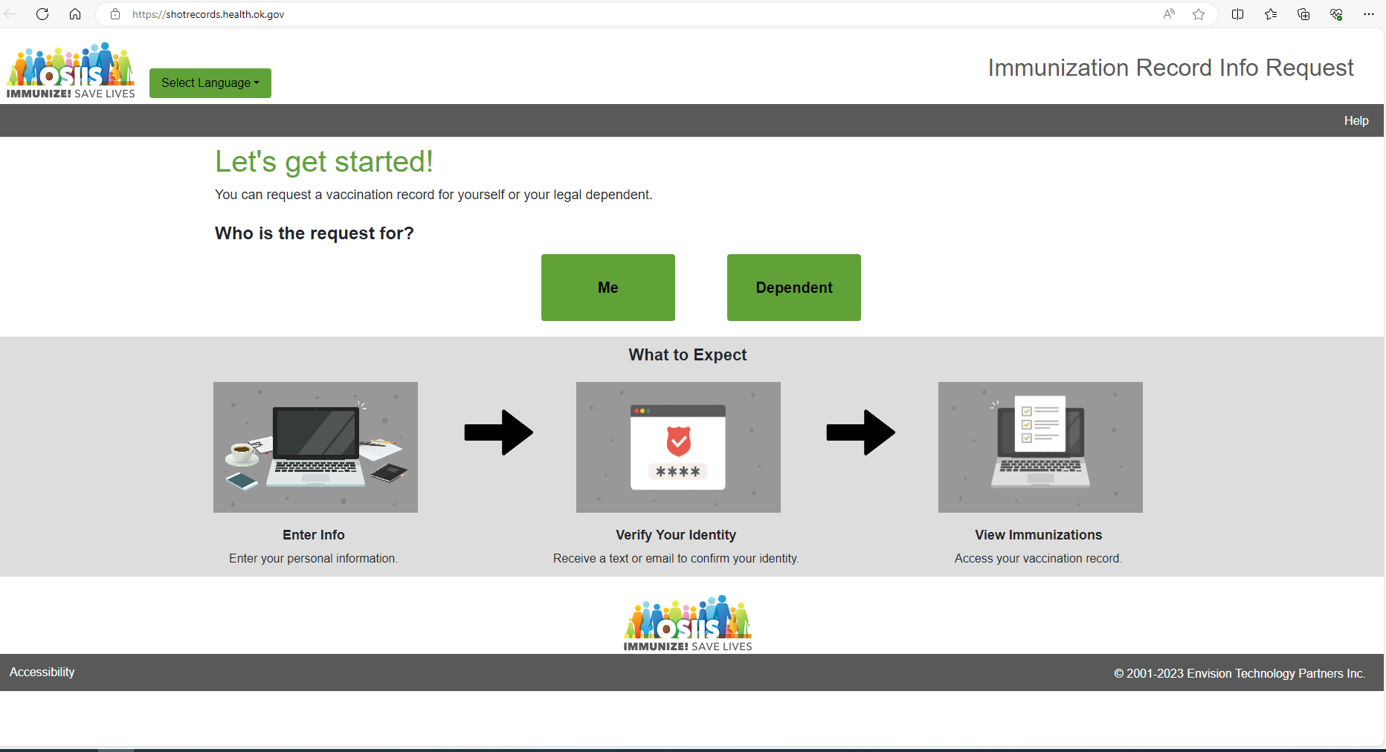
Public Portal: New Look!
Notes:
Last week we received a request from CDC asking Oklahoma providers to regularly update information in VF. This must be done every day or at leaset every 72 hours. After this call, please check if your inventroy has been updated in VF.

Slide 38
Updated Public Portal
OSIIS has a public portal that can be found at the below link and now is in English and Spanish!
https://shotrecords.health.ok.gov/
DISCLAIMER: Not all shots are recorded in OSIIS as reporting private vaccine is not required.
Patients can search and download a copy of their shot record for just COVID shots or their complete immunization history through the portal.
The public portal uses patient name, date-of-birth, email, and phone number for verification purposes (all have to be on the shot record in OSIIS or patients cannot pull their shot record).
Currently OSIIS has a high amount of missing emails/phone numbers.
Providers need to make sure to document email and phone number for the patient and add/send it to OSIIS with the shot record in order to increase the likelihood of a records match in the portal.
Notes:
Last week we received a request from CDC asking Oklahoma providers to regularly update information in VF. This must be done every day or at leaset every 72 hours. After this call, please check if your inventroy has been updated in VF.

Slide 39
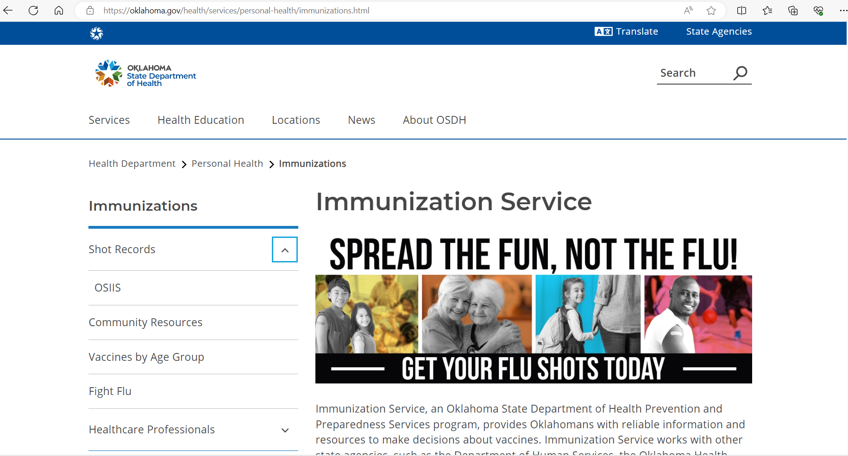
Immunization Services Website
Notes:
Last week we received a request from CDC asking Oklahoma providers to regularly update information in VF. This must be done every day or at leaset every 72 hours. After this call, please check if your inventroy has been updated in VF.

Slide 40
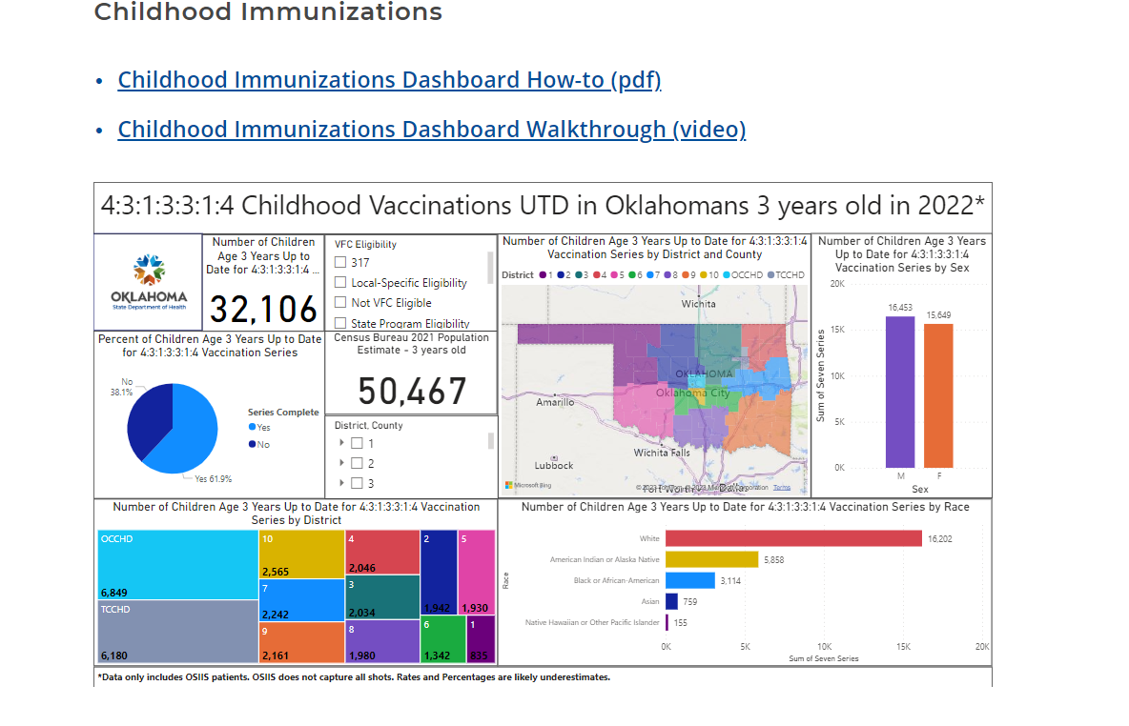
Immunization Services Website
The Immunization Services Website (Immunizations (oklahoma.gov) has been updated!
Updated website includes a link for the public portal and includes VFC program information, community resources, OSIIS, helpful hints, FAQ's, and more.
Site also now contains flu, covid, and Childhood Immunizations dashboards as well as links to Oklahoma immunization data, OSIIS data request's, tip sheets, and HL7 onboarding information.
Notes:
Last week we received a request from CDC asking Oklahoma providers to regularly update information in VF. This must be done every day or at leaset every 72 hours. After this call, please check if your inventroy has been updated in VF.

Slide 41
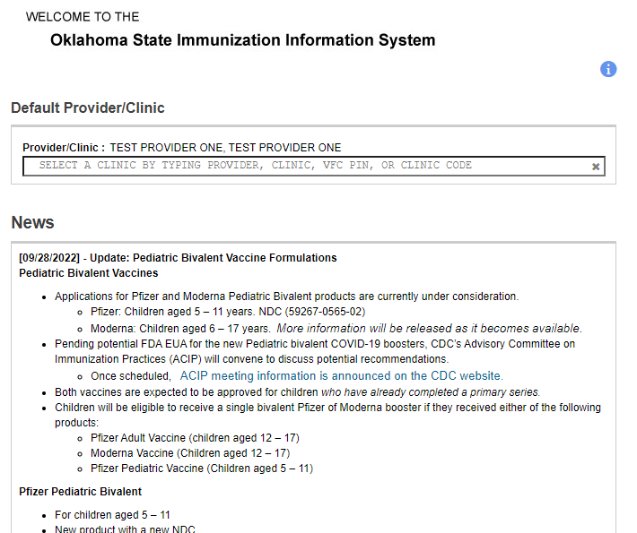
News
Notes:
Last week we received a request from CDC asking Oklahoma providers to regularly update information in VF. This must be done every day or at leaset every 72 hours. After this call, please check if your inventroy has been updated in VF.

Slide 42
Moderna Booster in OSIIS
Notes:
Last week we received a request from CDC asking Oklahoma providers to regularly update information in VF. This must be done every day or at leaset every 72 hours. After this call, please check if your inventroy has been updated in VF.

Slide 43
How To Guides
"How To" Guides
How to Turn On User Default Order Notifications
Inventory Reconciliation
How to Place a Covid-19 Vaccine Order
Immunizing a Patient for COVID
How to add an extra dose
Wastage
COVID-19 Vaccine Cleanup -Inventory Adjustment- Report Wastage OSIIS TipSheet.docx
Notes:
If you need help with any of the processes, please use our detailed "How to" guides.

Slide 44
Flu and RSV
Lauren Speer, BSN, RN.
Immunization and Communicable Disease Nurse Consultant, Nursing Services

Slide 45
It’s Influenza Season
2023 – 2024
Lauren Speer BSN, RN
Nursing Service
Immunization & Communicable Disease Nurse Consultant
Let’s get ready to fight the flu!

Slide 46
Influenza
Influenza (also known as “flu”) is a contagious respiratory illness caused by influenza viruses. It can cause mild to severe illness, and at times can lead to death.

Slide 48
Take Action to Prevent Flu
The best way to reduce your risk from seasonal flu and its potentially serious complications is to get vaccinated every year. Optimal time for flu vaccination is in October.

Slide 49
Everyday preventive actions to stop the spread of flu.
Avoid close contact with people who are sick
If you are sick, limit contact with others as much as possible to keep from infecting them.
Cover coughs and sneezes.
Cover your nose and mouth with a tissue when you cough or sneeze. Throw the tissue in the trash after you use it.
Wash your hands often with soap and water. If soap and water are not available, use an alcohol-based hand rub.
Avoid touching your eyes, nose, and mouth. Germs spread this way.
Clean and disinfect surfaces and objects that may be contaminated with viruses that cause flu.
For flu, CDC recommends that people stay home for at least 24 hours after their fever is gone except to get medical care or other necessities. Fever should be gone without the need to use a fever-reducing medicine.

Slide 51
Influenza Vaccine

Slide 52
How do flu vaccines work?
Flu vaccines cause antibodies to develop in the body two weeks after vaccination.
These antibodies provide protection against infection with circulating influenza viruses
All flu vaccines in the US are quadrivalent vaccines that is they protect against four different flu viruses: Influenza A(H1N1) virus, Influenza A(H3N2)virus and two influenza B viruses

Slide 53
Quadrivalent Flu Vaccines
Standard-dose unadjuvanted quadrivalent influenza shots that are manufactured using virus grown in eggs. These include Afluria Quadrivalent, Fluarix Quadrivalent, FluLaval Quadrivalent, and Fluzone Quadrivalent. Different influenza shots are licensed for different age groups. These four vaccines are approved for people 6 months of age and older. Most influenza shots are given in an arm muscle with a needle. One quadrivalent influenza shot (Afluria Quadrivalent) can be given either with a needle (for people aged 6 months and older) or with a jet injector (for people aged 18 through 64 years only).
A quadrivalent cell-based influenza shot (Flucelvax Quadrivalent) containing virus grown in cell culture, which is licensed for people 6 months and older. This vaccine is egg-free.
Recombinant quadrivalent influenza shot (Flublok Quadrivalent), an egg-free vaccine, approved for people 18 years and older.
A quadrivalent flu shot using an adjuvant (an ingredient that helps create a stronger immune response), Fluad Quadrivalent, approved for people 65 years of age and older.
A quadrivalent high-dose influenza vaccine Fluzone High-Dose, which contains a higher dose of antigen to help create a stronger immune response, licensed for people 65 years and older.
A live attenuated influenza vaccine (FluMist Quadrivalent), which is given intranasally. This vaccine is approved for people 2 through 49 years of age. Live attenuated influenza vaccine should not be given to people who are pregnant, immunocompromised persons, and some other groups
All people 6 months and older should get a flu vaccine which is age and health status appropriate

Slide 54
Influenza Vaccine Schedule
1 dose each influenza season for persons age 9 years or older
For children aged 6 months through 8 years, the number of doses of influenza vaccine needed for the 2023–24 influenza season is determined as follows:
Those who have previously received ≥2 total doses of trivalent or quadrivalent influenza vaccine ≥4 weeks apart before July 1, 2023, require only 1 dose for the 2023–24 season. The previous 2 doses of influenza vaccine do not need to have been received in the same season or consecutive seasons.
Those who have not previously received ≥2 doses of trivalent or quadrivalent influenza vaccine ≥4 weeks apart before July 1, 2023, or whose previous influenza vaccination history is unknown, require 2 doses for the 2023–24 season. The interval between the 2 doses should be ≥4 weeks.

Slide 55
Influenza Vaccine Schedule

Slide 56
Who Should Not Be Vaccinated
Flu Shots:
Children younger than 6 months of age are too young to get a flu shot.
People with severe, life-threatening allergies to any ingredient in a flu vaccine (other than egg proteins) should not get that vaccine. This might include gelatin, antibiotics, or other ingredients.
People who have had a severe allergic reaction to a dose of influenza vaccine
Nasal Spray Flu Vaccine:
Children younger than 2 years of age.
Adults 50 years of age and older.
People who have had a severe or life-threatening allergic reaction to any ingredient in the nasal spray vaccine (other than egg proteins).
People who have had a severe allergic reaction to any flu vaccine.
Children and adolescents 2 through 17 years of age who are receiving aspirin- or salicylate-containing medications.
People with weakened immune systems (immunosuppression) due to any cause, including (but not limited to) immunosuppression from medications, congenital or acquired immune disorders, HIV infection, or asplenia.
People who care for or are close contacts of severely immunocompromised persons who require a protected environment (or otherwise avoid contact with those persons for 7 days after getting the nasal spray vaccine).
Pregnant people.
Children 2 years through 4 years who have asthma or who have had a history of wheezing in the past 12 months.
People with cerebrospinal fluid (CSF) leaks (communication and leakage of fluid between the space surrounding the brain and the nose, throat, ear, or any other place in the head).
People with cochlear implants.
People who have recently taken influenza antiviral drugs. This depends on the specific influenza antiviral medication that was taken, and how recently the last dose was taken.

Slide 57
Vaccine Information Statement
Provide a Vaccine Information Statement (VIS)
when a vaccination is given.
to the parent or legal representative¹ of any child to whom the
provider intends to administer such vaccine, or
to any adult² to whom the provider intends to administer such
vaccine.
Record information for each VIS provided.
the edition date of the VIS distributed, and
the date the VIS was provided.
the name, address and title of the individual who administers the
vaccine,
4.the date of administration, and
5.the vaccine manufacturer and lot number of the vaccine used.

Slide 58
Can you get the flu from the flu shot?
No
The flu vaccine is inactivated and it usually takes about 2 weeks to build antibodies to help prevent the flu.

Slide 59
Respiratory Syncytial Virus (RSV)

Slide 60
RSV for infants and young children
BEYFORTUS (nirsevimab-alip)
1 dose of Nirsevimab of all infants younger than 8 months born during or entering their first RSV season.
1 dose of Nirsevimab for infant and children 8-19 months old who are at increased risk for severe RSV disease and entering their second season.
Dosing:
Less than 5 kg recommended dose is 50 mg
5 kg and greater recommended dose is 100 mg
Nirsevimab will come in a prefilled syringe.
RSV activity in the United States usually begins October 1 and concludes March 31; although there can be regional variation.
Two monoclonal antibody products – nirsevimab (Beyfortus) and palivizumab (Synagis) – can help protect babies and young children from severe disease from an RSV infection. Monoclonal antibodies are not vaccines. They provide an extra layer of defense that helps fight RSV infections and protect children from getting very sick. The protection these antibodies provide wanes over time. These products are not treatments for a child who already has RSV infection.
Can be co-administered with other immunizations.
Store refrigerated between 36°F to 46°F (2°C to 8°C). BEYFORTUS may be kept at room temperature 68°F to 77°F (20°C to 25°C) for a maximum of 8 hours.
After removal from the refrigerator, BEYFORTUS must be used within 8 hours or discarded.
Do not freeze. Do not shake.

Slide 61
RSV for infants and young children
Synagis (palivizumab)
Preparation for Administration
To reconstitute, remove the tab portion of the vial cap and clean the rubber stopper with alcohol pad.
Both vials contain an overfill to allow the withdrawal when reconstituted.
Slowly add 0.6 mL of sterile water for injection to the 50 mg vial or add 1.0 mL of sterile water for injection to the 100 mg vial.
The vial should gently be swirled for 30 seconds to avoid foaming. Do Not Shake.
Reconstituted Synagis® (palivizumab) should stand at room temperature for a minimum of 20 minutes until the solution clarifies.
Reconstituted Synagis® (palivizumab) does not contain a preservative and should be administered within 6 hours of reconstitution.
Palivizumab is limited to children under 24 months of age with certain conditions that place them at high risk for severe RSV disease. It must be given once a month during RSV season.
Palivizumab is administered at a dosage of 15mg/kg.
Prefilled syringe: 50mg/0.5 mL or 100mg/1.0 mL
Upon receipt and until reconstitution for use, Synagis® (palivizumab) should be stored between 2
and 8°C (35.6° and 46.4°F) in its original container. Do not freeze. Do not use beyond the
expiration date.

Slide 62
RSV Vaccine in Adults 60 and older
Each year in the United States, RSV leads to approximately 60,000-160,000 hospitalizations and 6,000-10,000 deaths among adults 65 years and older.
There are two RSV vaccines approved for adults 60 and older
Arexvy (RVCPreF3)
Abrysvo (RSVpreF)
Both vaccines contain a part of the RSV virus by causing an immune response that can protect you from respiratory disease if someone is infected with RSV in the future.
Clinicians should discuss RSV vaccination with adults ages 60 years and older.
When should someone get the RSV Vaccine?
For the 2023-2024 season, 60 and older with shared clinical decision making with your health care provider (anyone who provides or administers vaccines, including primary care physicians, specialists, physician assistants, nurse practitioners, registered nurses, and pharmacists) can assist the client with the decision to get the vaccine.
For other points to consider review the screening checklist for contraindications to vaccine to ensure there are no contraindications to receiving the vaccine. (e.g. severe allergic reaction to any component of the vaccine or serious neurological conditions, including Guillain-Barre Syndrome (GBS)
Oklahoma State Department of Health | RSV Vaccine | Fall 2023

Slide 63
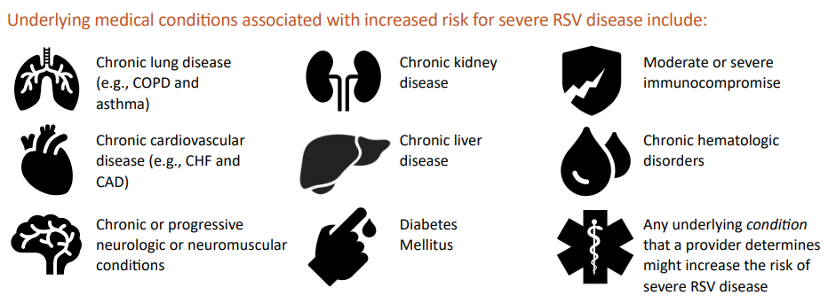
RSV Vaccine in Adults 60 and Older
Shared Clinical Decision Making-
Adults ages 60 years and older who are most likely to benefit, including those with certain chronic medical conditions associated with increased risk of severe RSV disease.
Adults with advanced age and those living in nursing homes or other long-term care facilities are also at increased risk of severe RSV disease and may benefit from RSV vaccination.
Healthcare providers should also talk to their patients about other vaccines (e.g., COVID-19, influenza) available this fall to help prevent respiratory illness.
Healthcare providers can co-administer the vaccines for which a patient is eligible in the same visit, including RSV, COVID-19, and influenza vaccines.

Slide 64
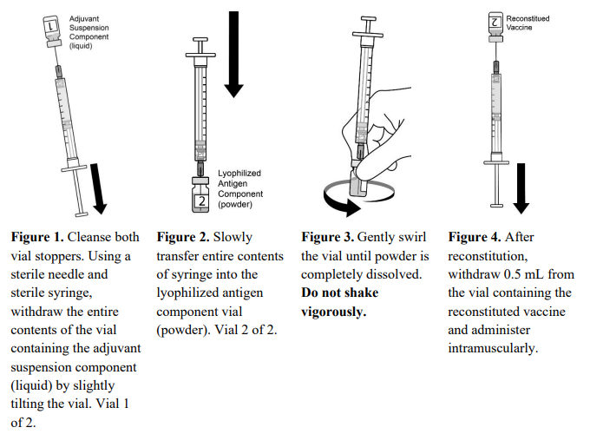
AREXVY (GSK adjuvanted RSV vaccine)
Administer a single dose of 0.5 mL intramuscularly.
Will require reconstitution:
Store refrigerated between 2°C and 8°C (36°F and 46°F). Do not freeze. Discard if the antigen component has been frozen.
After reconstitution, administer AREXVY immediately or store protected from light in the refrigerator between 2°C and 8°C (36°F to 46°F) or at room temperature up to 25°C (77°F) and use within 4 hours. Discard reconstituted vaccine if not used within 4 hours.
Commonly reported side effects are pain at the injection site, fatigue, myalgia, headache, and arthralgia.

Slide 65
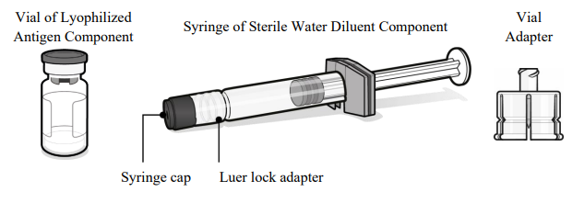
RSV Vaccine for Pregnant Women- ABRYSVO (Pfizer RSV vaccine)
ABRYSVO (used for Adults 60+ as well) is a vaccine indicated for active immunization of pregnant individuals at 32 through 36 weeks gestational age for the prevention of lower respiratory tract disease (LRTD) and severe LRTD caused by RSV in infants from birth through 6 months of age.
Administered intramuscularly 0.5 mL prefilled syringe
ABRYSVO will need to be reconstituted
Store in refrigerator at 2°C to 8°C (36°F to 46°F) in the original carton. Do not freeze.
After reconstitution, administer immediately or store at room temperature 15°C to 30°C (59°F to 86°F) and use within 4 hours. Discard reconstituted vaccine if not used within 4 hours.
Commonly reported side effects are pain at the injection site, headache, muscle pain, and nausea in pregnant women.
Commonly reported side effects are fatigue, headache, pain at the injection site, and muscle pain for adults 60+.

Slide 66
Thank you!

Slide 67
Questions?
Thank you!

Slide 68
Questions/Suggestions Looking Forward: Next Call January 5th, 2024 at 12pm

Slide 69
Resources: Medical Updates & Immunization Site Training for All Healthcare Providers led by Pfizer Vaccines US Medical Affairs
Goal: Educate providers and immunization staff personnel on the proper use of the Pfizer-BioNTech COVID-19 Vaccines
To access dates and links for upcoming training sessions, please visit*:
https://www.pfizermedicalinformation.com/en-us/medical-updates

Slide 70
Resources
Testing:
Nasopharyngeal, throat, saliva
Testing@health.ok.gov
Monoclonal Antibodies: (Amanda Cavner)
Antivirals@health.ok.gov
https://oklahoma.gov/covid19/what-you-should-know/monoclonal-antibody-therapies.html
Vaccine:
COVID-19 Vaccines | FDA
PREP Act Guidance
Interim Clinical Considerations for Use of COVID-19 Vaccines | CDC
COVID-19 Vaccination for Children | CDC
Pfizer: Home (cvdvaccine-us.com)
Moderna: What is Moderna COVID-19 Vaccine (EUA)? | How Does It Work? (modernatx.com)
Novavax: https://us.novavaxcovidvaccine.com/hcp
Notes:
Facilities can order PPE using the Big Commerce online ordering system.
If a facility needs assistance with setting up an account, please use the link, https://okppe.mybigcommerce.com/. Proceed to the "Need an Account?" page and complete the Contact Us for an account. Usually, an account is created within 24 hours.
For testing supplies and guidance, you can contact testing@health.ok.gov
There are limited quantities of NP, Throat, Saliva available
For questions regarding Monoclonal Antibody Theraputics: contact antivirals@health.ok.gov with questions about guidance or administration
There are currently 102 providers in Oklahoma, this website will take you to a map that tells you the location of the nearest provider of monoclonal antibodies is

Slide 71
Resources/Tools
OSIIS Training: https://osiis.health.ok.gov/osiis/Application/ApplicationHelp/Index
Notes:
Facilities can order PPE using the Big Commerce online ordering system.
If a facility needs assistance with setting up an account, please use the link, https://okppe.mybigcommerce.com/. Proceed to the "Need an Account?" page and complete the Contact Us for an account. Usually, an account is created within 24 hours.
For testing supplies and guidance, you can contact testing@health.ok.gov
There are limited quantities of NP, Throat, Saliva available
For questions regarding Monoclonal Antibody Therapeutics: contact antivirals@health.ok.gov with questions about guidance or administration
There are currently 102 providers in Oklahoma, this website will take you to a map that tells you the location of the nearest provider of monoclonal antibodies is

Slide 72
Vaccine Inventory Adjustment: On-Hand Expired Vaccines
When reconciling inventory, check that your facility has no expired inventory on hand.
Navigate to the Vaccine Inventory On-Hand screen by selecting:
Inventory > Vaccines > On-Hand from the left-hand menu.
Change the Status from On-Hand to Depleted/Expired
Locate the Filter tab
Locate the vaccine inventory item requiring an inventory adjustment.
Click the corresponding Action button and select Adjustment.
Complete the following required fields:
Date (enter the actual date on which the inventory was wasted)
Reason (select Vtrcks Other)
Modification (if a value does not default, select Add or Subtract to make the corresponding adjustment)
Doses Adjusted (enter the number of doses wasted for the selected reason)
Comments (Expired)
Click the Create button.
Click the On-Hand menu item to return to the Vaccine Inventory On-Hand screen where you can verify the inventory was adjusted correctly.
See attached video on Resources/Tools
Notes:
OSIIS (ok.gov)

Slide 73
QAs From Live Call
Notes:
Facilities can order PPE using the Big Commerce online ordering system.
If a facility needs assistance with setting up an account, please use the link, https://okppe.mybigcommerce.com/. Proceed to the "Need an Account?" page and complete the Contact Us for an account. Usually, an account is created within 24 hours.
For testing supplies and guidance, you can contact testing@health.ok.gov
There are limited quantities of NP, Throat, Saliva available
For questions regarding Monoclonal Antibody Theraputics: contact antivirals@health.ok.gov with questions about guidance or administration
There are currently 102 providers in Oklahoma, this website will take you to a map that tells you the location of the nearest provider of monoclonal antibodies is

