Slide 1
Preventive Health and Health Services (PHHS) Block Grant (BG)
Public Hearing Meeting
2:00 pm
May 1, 2024
Notes:
AC members and quest must sign in per the attendance sheet
Chair- person, call to order the meeting; note time of start time
Let the chair- person know the meeting can start.

Slide 2
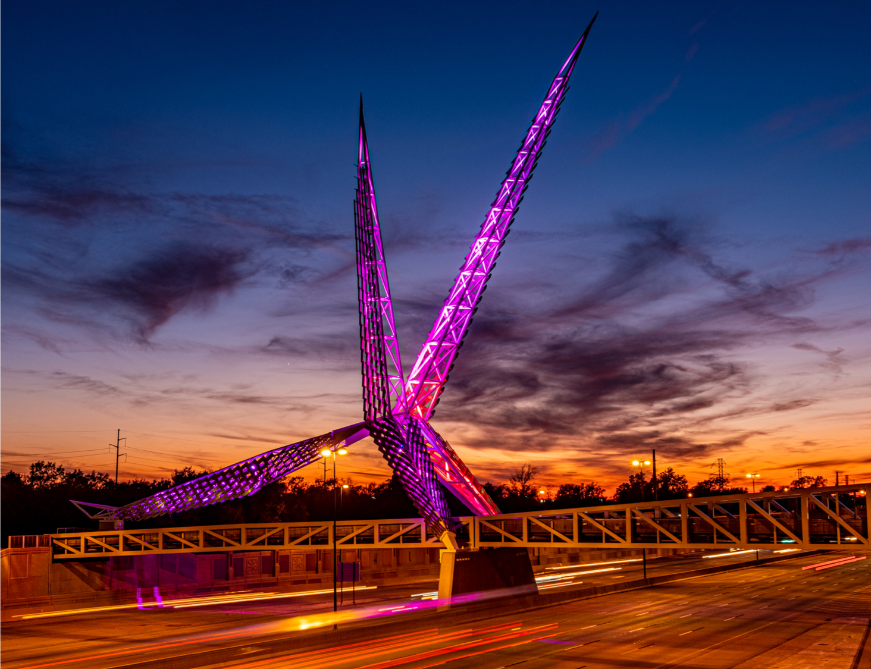
Meeting Agenda
Call to Order, Welcome and Introductions
Public Hearing -FY24 State Work Plans and Funding FY24 - FFY2025
Closing Remarks and Adjournment
Oklahoma State Department of Health | Preventive Health and Health Services Block Grant | 2024
Notes:
Welcome and thank you for your participation.
Have all guests and AC members make introductions
Today’s agency:
Public Hearing for FY24 Work plans and funding
Closing remark and adjourn the meeting

Slide 3
FY24 Work Plans - SFY2025 Proposals and Funding
Notes:
Based on the AC recommendations and the commissioner approval, the following proposals/applications will receive funding for FFY2025.
Today’s agenda will provide an overview of the FY2024 workplans and budgets.

Slide 4
Advancing Health Equity and Strengthening Minority Health
Budget: $179,995 - Maintain existing program FTEs - 3 existing staff
Other - supplies/training/IT
Healthy People 2030: Increase the proportion of adults with limited English proficiency who say their providers explain things clearly - HC/HIT‑D11
Program SMART Objective and Activity:
Objective – By 09/2025, increase health literacy among adult LEP individuals in Oklahoma by providing accessible and culturally appropriate health information.
Activity - The OMHHE will conduct listening sessions, key informant interviews, and capacity building sessions with LEP individuals and groups and provide in-person and virtual interpretations and translation services.
Notes:
Review the programs
Work plan SMART objective and activities
Budget

Slide 5
Healthy Aging and Injury Prevention
Budget: $152,343 –Enhance or expand FTEs:3 existing staff Other: supplies/travel/IT
Healthy People 2030: Reduce fall-related deaths among older adults – IVP-08
Program SMART Objective and Activity:
Objective - By 09/2025, stabilize the rate (131.2 per 100,000 in 2021) of unintentional fall-related deaths among adults 65 years and older.
Activity- 1. Engage state and community stakeholders across sectors of healthy aging to strengthen capacity to address age-related factors that increase risk on injury.
2. Conduct outreach efforts to provide injury prevention educational and programmatic information.
3. Identify opportunities to expand access to evidence-based fall prevention programming (e.g.,TCMBB, MOB, Tai Chi for Arthritis and Fall Prevention) in counties with high fall-related death and hospitalization rates.

Slide 6
Office of Communications - CHD Digital Display System
Budget: $95,000 –Start up FTEs: 0 Other: Equipment
Healthy People 2030: Health Communications, Increase the health literacy of the population — HC/HIT‑R01
Program SMART Objective and Activity:
Objective - By 09/2025, the Office of Communications will work with county health department staff to purchase, install, and implement content for digital display systems in 81 county health department lobbies.
Activity - The Office of Communications will work to develop a slide deck of at least 25 content slides with information on health department services and public health topics for the digital display system.
Notes:
Rachel Baugh

Slide 7
Suicide Prevention
Budget: $118,084 –Enhance or expand FTEs: 1 Other: Supplies/IT
Healthy People 2030: Reduce the suicide rate – MHMD 01
Program SMART Objective and Activity:
Objective - By 09/2025, implement at least one suicide harm reduction strategy across OSDH and CHDs.
Activity - The IPS will distribute firearm locks to CHDs and public interacting OSDH services.

Slide 8
Partner Inflicted Brain Injury- PIBI
Budget: $49,183 –Enhance or expand FTEs: 1 Other: Supplies/ IT/contract/travel for training
Healthy People 2030: Reduce intimate partner violence – IVP D04
Program SMART Objective and Activity:
Objective - By 09/2025, Injury Prevention staff will provide training on partner inflicted brain injury recognition and accommodations to 250 domestic violence service providers and allied professionals.
Activity - Provide training on partner inflicted brain injury recognition and accommodations at one statewide domestic violence service provider conference.

Slide 9
Sexual Assault Hotline Training, Support & Surveillance
Budget: $89,800 –Start up FTEs: 0 Other: Supplies/Contract
Healthy People 2030: Reduce contact sexual violence — IVP D0
Program SMART Objective and Activity:
Objective - By 09/2025, the Injury Prevention Service (IPS) staff will contract with an identified expert in sexual and domestic violence hotline training to provide hotline training to 130 sexual and domestic violence advocates.
Activity - 1. IPS staff and community partners will identify an expert in sexual and domestic violence hotline training to contract with for training in Oklahoma.
2. Arrange training space and support for attendees to attend one statewide training,
3. Contract with the YWCA-OKC to upgrade existing dated hotline response systems, and
4. Conduct surveillance of sexual violence through the Behavioral Risk Factor Surveillance System (BRFSS)

Slide 10
Child Passenger Safety Program-CPS
Budget: $221,386 –Maintain existing funds FTEs:0 Other: Supplies
Healthy People 2030: Reduce the proportion of deaths of car passengers who weren’t buckled in - IVP-07
Program SMART Objective and Activity:
Objective – By 09/2025, distribute an average of 300 child safety seats monthly to participating sites statewide.
Activity - The IPS will procure child safety seats and work with certified CPS technicians in the OSDH Central Office and county health departments to identify opportunities to offer free car seat checks to the general public and installations of free car/booster seats to eligible low-income families.

Slide 11
Certified Healthy Oklahoma Community and Congregation Consultation- CHO
Budget: $47,041 Start up FTEs:1 Other: Supplies/IT/travel
Healthy People 2030: Reduce the proportion of adults with obesity — NWS‑03
Program SMART Objective and Activity:
Objective - By 09/2025, Certified Healthy Oklahoma will see an increase of 20 additional applications between Certified Healthy Oklahoma Community and Congregation Sectors.
Activity - Certified Healthy Oklahoma team will partner with OSDH Communications to develop marketing materials to promote Certified Healthy Oklahoma Community and Congregation applications.

Slide 12
Chronic Disease Prevention Service (CDPS) – Community Health Screenings
Budget: $50,023 –Enhance or expand FTEs:0 Other: Supplies/Equipment
Healthy People 2030: Improve cardiovascular health in adults – HDS-01
Program SMART Objective and Activity:
Objective – By 09/2025, Chronic Disease Prevention Service will provide health screening and quality control supplies along with training and educational material to local health departments across the state to provide an additional 8,000 preventive health screenings to clients living with or at risk for heart disease and diabetes in their counties.
Activity - Create and train nurses within county health departments over utilization of a Smartsheet data collection tool to input the number and type of health and community service program referrals provided for clients receiving Cholestech LDX screenings with abnormal lab value results.
Notes:
Morgan Hamilton

Slide 13
Go NAPSACC Expansion
Budget: $47,076 –Enhance or expand FTEs: 1 Other: Supplies/ IT /travel
Healthy People 2030: Reduce the proportion of children and adolescents with obesity — NWS‑04
Program SMART Objective and Activity:
Objective - By 09/2025, an additional 25 Early Childhood Programs will be participating in Go NAPSACC.
Activity - The Early Childhood Education Consultant will conduct quarterly CECPD approved trainings. The trainings will include providing an overview of Go NAPSACC to the early childhood programs and how to implement the program evidence- based strategies. The trainings will include discussion of policies, resources, and materials to ensure a successful participation and completion of the program.

Slide 14
Healthy School Environments Technical Assistance
Budget:$39,241 –Enhance or expand FTEs: 0 Other: Supplies/ IT/travel
Healthy People 2030: Reduce the proportion of children and adolescents with obesity — NWS‑04
Program SMART Objective and Activity:
Objective - By 09/2025, Community Analysis and Linkages will partner with Healthy Schools Oklahoma to implement Painted Play-spaces at 10 schools.
Activity - Community Analysis and Linkages will partner with Healthy Schools Oklahoma to identify 10 schools to implement Painted Play-spaces and at least 5 schools will be in underserved communities.

Slide 15
Increasing Nutrition Security in County Health Departments with Statewide Partners
Budget: $80,242 –Enhance/expand FTEs: 2 Existing Other: Supplies/ IT/contract
Healthy People 2030: Reduce household food insecurity and hunger — NWS‑01
Program SMART Objective and Activity:
Objective - By 09/2025, the two state food banks will establish to 10 emergency food pantries in county health departments.
Activity - The food banks will provide training and logistical support to 10 county health department sites in preparation for an on-site food pantry.
Notes:
Lauran Larson

Slide 16
Leading Oklahoma to Prosperity through Health Communications Initiative
Budget: $5,500 –Enhance or expand FTEs: 0 Other: Lodging/travel
Healthy People 2030: Increase the health literacy of the population HC/HIT‑R01
Program SMART Objective and Activity:
Objective – By 09/2025 the OSDH communications team will host a statewide strategic planning training program.
Activity - The OSDH communications team will host a statewide training program to strategically plan for communications that will reach Oklahomans.
Notes:
Erica Rankin

Slide 17
Northeastern Oklahoma CATCH Coordinated School Health Initiative
Budget: $77,697 –Enhance or expand FTEs: 4 existing staff Other: Supplies/ IT/travel
Healthy People 2030: Increase the proportion of children who do enough aerobic physical activity PA-09
Program SMART Objective and Activity:
Objective - By 09/2025, CATCH curriculum and equipment will be purchased and training will be provided to 8 schools in District 4 in order to ensure the program is accessible to low-income elementary school aged students.
Activity - Provide a one-day training to after school program identified staff to implement CATCH program.

Slide 18
D5 Pilot Birth Certificate Waiver for Homeless
Budget: $45,000 -Start up FTEs: 0 Other: IDs and Birth Cert
Healthy People 2030: Improve Overall Well-Being - OHM-01
Program SMART Objective and Activity:
Objective - By 09/2025 a streamlined process and dedicated portal will be developed to support the pilot project.
Activity - Build dedicated portal.
Notes:
Brandi Combs

Slide 19
Fluoride Outreach Project
Budget: $22,500 –Enhance or expand FTEs: 0 Other: Supplies/travel
Healthy People 2030: Oral Conditions, Reduce the proportion of children and adolescents with lifetime tooth decay – OC01
Program SMART Objective and Activity:
Objective - By 09/2025 Staff in the Dental Health Service will provide 7500 Fluoride Varnish applications to the County Health Departments and other partners for application to the teeth of vulnerable children.
Activity - Providing fluoride varnish to internal and external partners.

Slide 20
Project Combatting Heavy Advertisement of Tobacco (CHAT) in Oklahoma
Budget: $40,000 –Enhance/expand FTEs: 0 Other: Contract
Healthy People 2030: Reduce the proportion of adolescents in grades 6 through 12 who are exposed to tobacco product marketing TU-22; Reduce current use of any tobacco products among adolescents TU-04; Reduce current use of any tobacco products by adults TU-01
Program SMART Objective and Activity:
Objective - By 09/2025, will maintain one contract with the Hudson College of Public Health to assess 320 licensed tobacco retailers in Oklahoma using surveillance tools such as the Standardized Tobacco Assessment for Retail Settings (STARS) to identify disparities and policy needs for point-of-sale advertising and retailer density relating to youth access to tobacco.
Activity - CHAT will maintain one contract with the Hudson College of Public Health to assess 320 licensed tobacco retailers in Oklahoma using surveillance tools such as the Standardized Tobacco Assessment for Retail Settings (STARS) to identify disparities and policy needs for point-of-sale advertising and retailer density relating to youth access to tobacco.
Notes:
Elizabeth Chery

Slide 21
Closing Remarks and Adjournment
Thank you!
Notes:
Chair to call the meeting to end.
Closing remarks –

