Slide 1
Preventive Health and Health Services (PHHS) Block Grant (BG)
Advisory Committee Meeting
2:00 pm
March 13, 2024
Notes:
AC members and quest must sign in per the attendance sheet
Chair person - call to order the meeting; note time of start time
Let Chair person know the meeting can start. If less than 4 board members are there, won't have a quorum. Can still have meeting if they want, but cannot vote on anything.

Slide 2
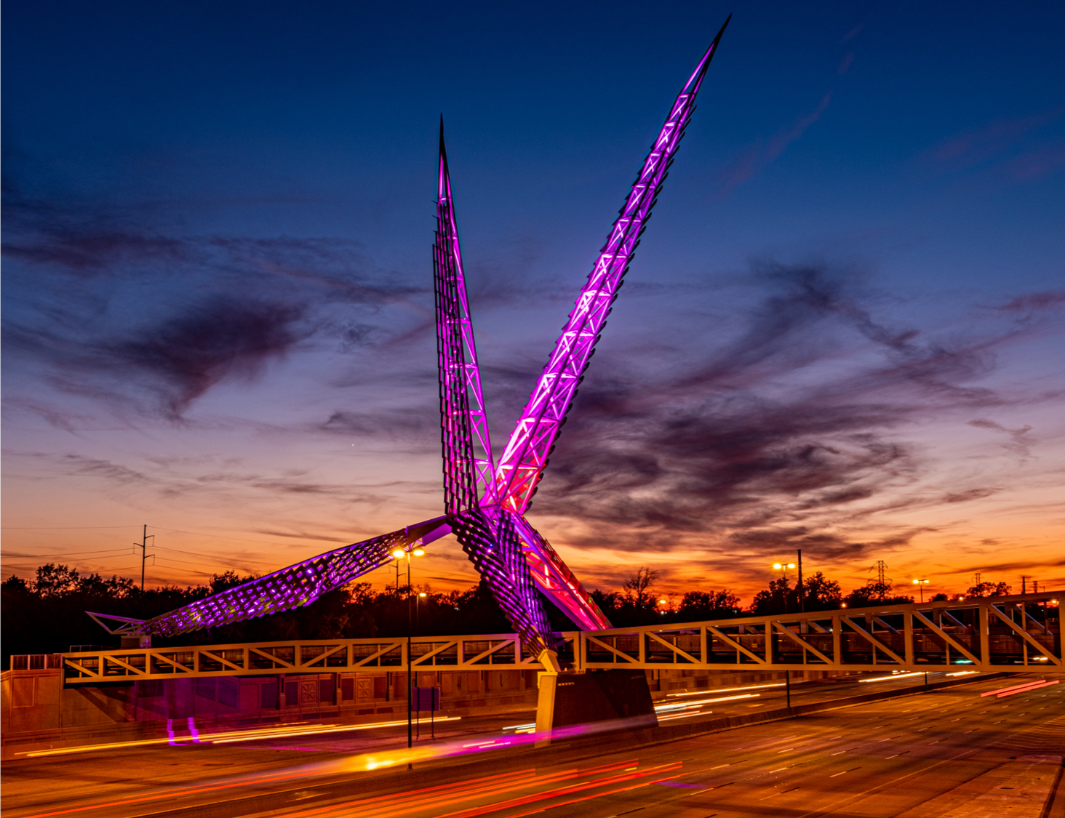
Meeting Agenda
Call to Order, Welcome and Introductions
Review and Approve of Minutes
FY23 Success stories
FY23 Program and Budget Summary Spend Down Update
Budget Revision
FY24- SFY2025 Proposal Requests and Evaluations
Closing Remarks and Adjournment
Oklahoma State Department of Health | Preventive Health and Health Services Block Grant | 2024
Notes:
Welcome and thank you for your participation.
Have all guests and AC members make introductions
Today’s agency:
Review and approve minutes for December 2023
Success stories
FY23 Workplans Update and Revision Requests
FY23 Program and Budget Spend Down Update
FY24 Proposal Requests
Closing remark and adjourn the meeting

Slide 3
Review and Approval of Meeting Minutes
Notes:
Chair will ask if there is discussion on the minutes. If not, chair will ask if there is a motion to approve minutes. Note who motions and who seconds approval. Go around the AC members and ensure each one either say 'yay' or 'nae' and note that. If there is a discussion and minutes not approved, will table to approve at next meeting and just note it. Or can motion to approve with changes.

Slide 4
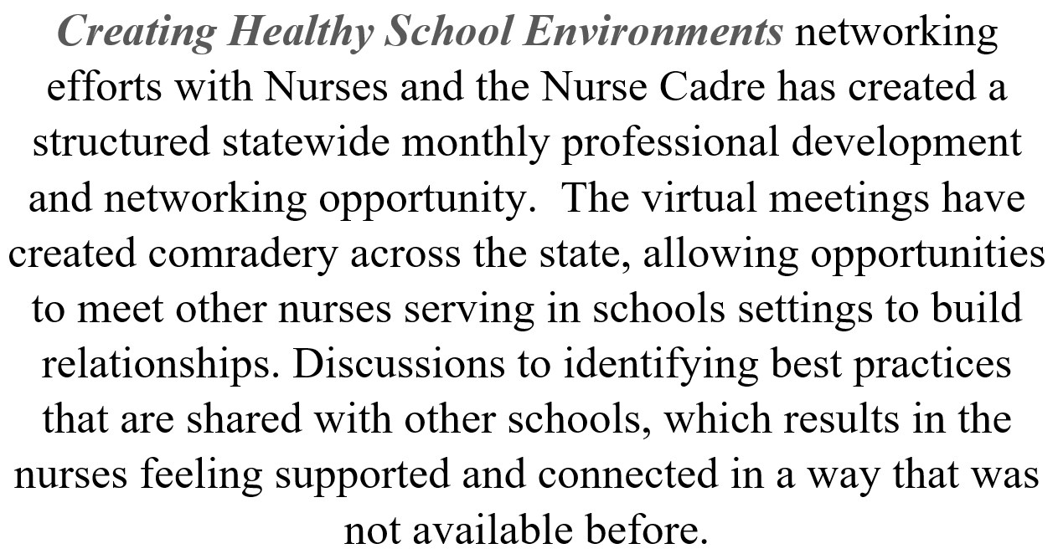
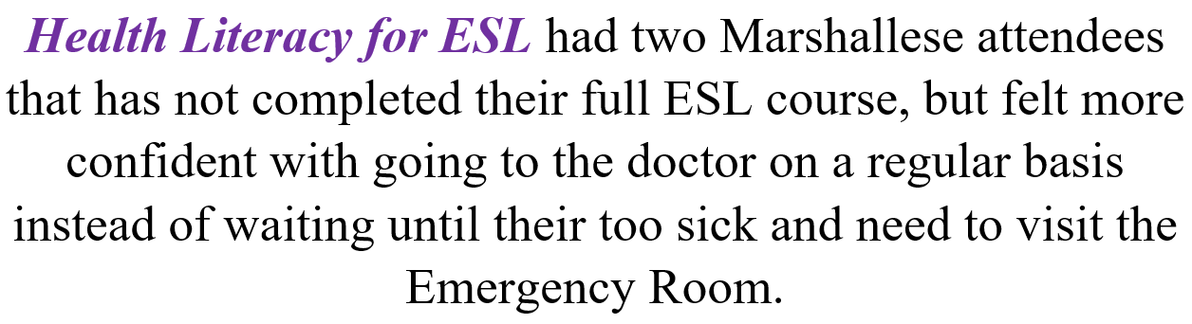
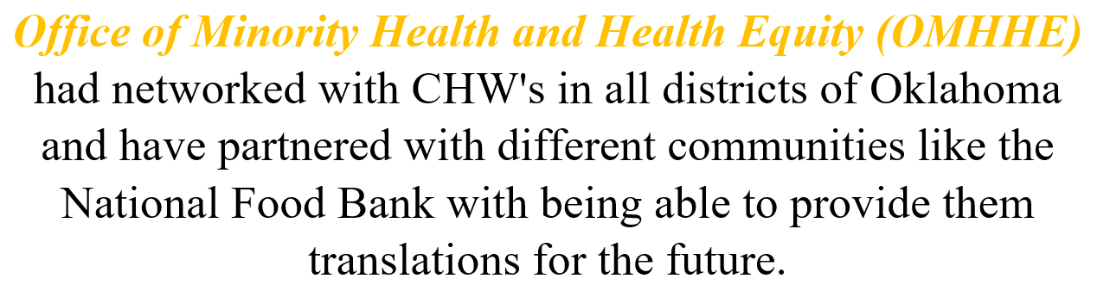
Success stories:
Notes:
Program success stories: Just to name a few

Slide 5
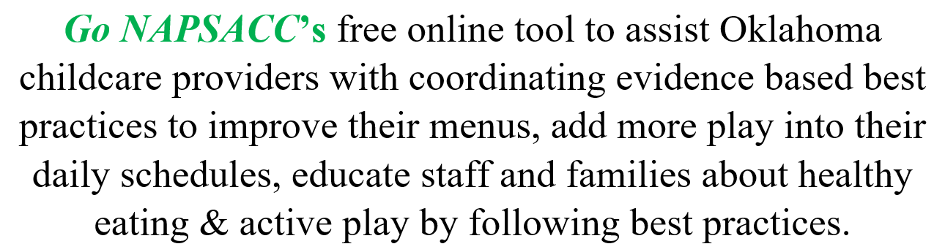
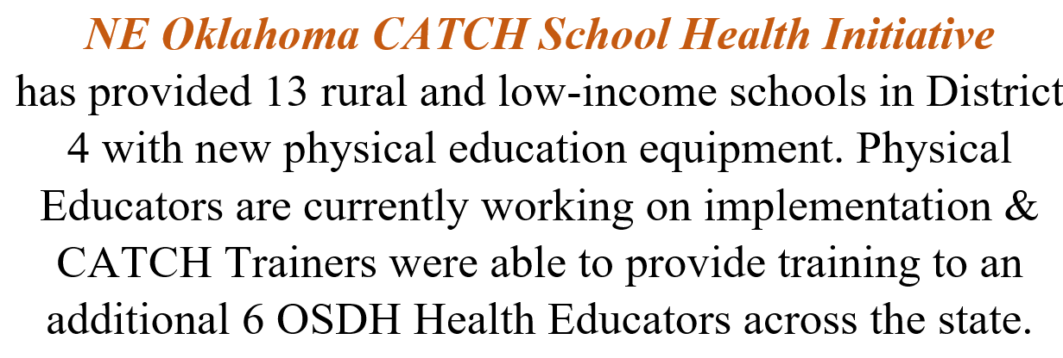

Success stories:
Notes:
APR success stories cont

Slide 6
FY24- SFY2025 Budget Summary and Revisions

Slide 7
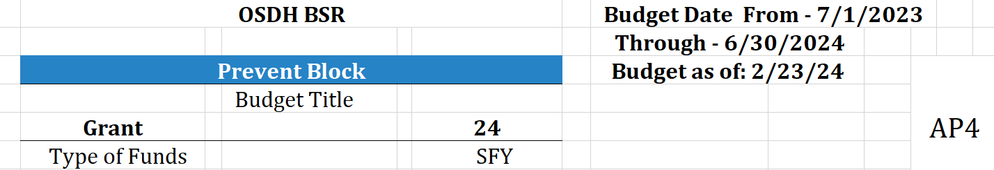
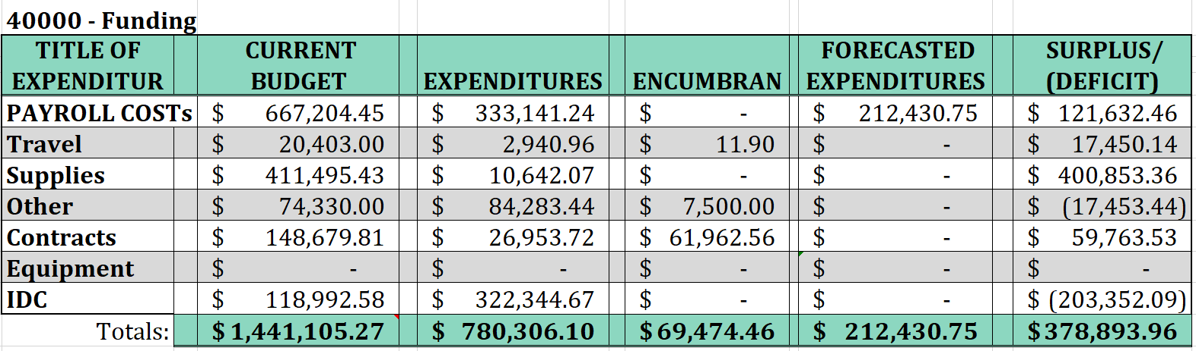
FY23 Budget Summary as of February 2024
Notes:
Total award 1,445,519.00 (surplus- $4413.73)
-Surplus of funds are due to fundings returns and/or budget revisions,
-4 months regarding per the SFY 2024 July thru June
Budget Revision:
PIBI- 12,000 for BRFSS 4-questions
Activity – Collaborate with the Center for Health Statistics to monitor the burden of domestic violence by including at least four intimate partner violence questions on BRFSS annually
Sexual Assault - $9,000 for BRFSS 3-questions
Activity – Injury Prevention Service will partner with the Center for Health Statistics to identify and pay for three questions related to sexual violence victimization for inclusion in the Oklahoma BRFSS
Program:
In lieu of cancelling these activities, could we instead use these funds toward supporting the Adverse Childhood Experiences (ACEs) questions in the Oklahoma BRFSS? As I mentioned in the APR, we have decided to shift to an alternating year rotation on the SV and DV specific questions to give space to the other questions desired by the agency. However, ACEs questions directly relate to SV and DV as well. SV and DV are actual adverse childhood experiences that are measured, as well as people who have experienced ACEs have higher rates of experiencing SV and DV in their adulthood. In all, we would just be shifting the question content a bit, as the ACEs questions contain a specific SV experience and a DV in the home experience question among other ACEs focused questions.
CDC:
Yes, the ACE BRFSS questions could be supported. This would require revisions to the current approved workplan, using the process for advisory committee approval of the changes. Some of the language for the two programs referenced, including the SMART Objective(s) are very specific. Also, if the number of questions supported across the two programs will change, this information also needs to be revised. In essence, the workplan would need to be updated to reflect the shift in direction.

Slide 8
FY24- SFY2025 Proposal Requests and Evaluations
Notes:
During the Application/Proposal meeting on Feb 22, 2024 everyone in attendance had the opportunity to get a brief overview of the PHHS BG application program goals. Per today’s slides we will review the program strategies

Slide 9
Advancing Health Equity and Strengthening Minority Health
Budget Request: $250,000 - Maintain existing program FTEs:3 existing staff Other: supplies/training/IT
Healthy People 2030: Increase the proportion of adults with limited English proficiency who say their providers explain things clearly - HC/HIT‑D11
The program will focus on Communication, Actions, and Accountability to address health equity, inclusion and equality. OMHHE will work to communicate in a way that integrate health and health equity into day-to-day communication and operations of the organization. (i.e. make it norm to mention literacy and community initiatives and health equity results during routine meeting, linking the SDoH efforts and health equity to performance improvement).The OMHHE will work with Communication to bring awareness around plain language throughout communication medians. Inclusive communication principles such as: · Using a health equity lens · Using person-first language · Avoiding unintentional blaming · Using preferred terms for populations of focus while recognizing that preferred terms may differ · Looking for ways to be more inclusive in text and images · Exploring other resources related to health equity communications The OMHHE will continue to proactively engage with LEP populations and underrepresented communities to help review, analyze and summarize information. This will also align with the Workforce grant initiatives as well as the SHIP to improve health outcomes and strengthen the workforce. October is Health Literacy Month, a time for public health and health care organizations to recommit making sure all audiences can find, understand, and benefit from information and services to make the best health-related decisions for themselves and others.
Notes:
Please refer back to the row 3 on the spreadsheet……..
row 3 program 1

Slide 10
Oklahoma Colorectal Cancer Prevention and Control Program/Comprehensive Cancer Control Program
Budget Request: $300,000 – Start up program FTEs: 0 Other: Contract
Healthy People 2030: Increase the proportion of adults who get screened for colorectal cancer – C-07
Through partnership with the Oklahoma State Department of Health County Health Departments (CHD), FIT testing kits will be provided to individuals in need. Eligibility will be determined through current CHD staff who are gathering patient information through check-in. Distribution of FIT tests will be provided through CHD providers. Once a test has been supplied, patient information will be input into the existing cloud-based data system, Med-IT, where a patient navigator will conduct follow-up reminders at timed intervals to improve completion rates. Once a test is processed and results are received, the patient navigator and/or a community health worker will contact the patient to connect them with necessary resources for additional screening and/or treatment if needed. The same eligibility requirements used by the National Colorectal Cancer Control Program will be used so that when the grant is available next the framework will be in place to continue with the program seamlessly.
Notes:
Row 4 program 2

Slide 11
Healthy Aging and Injury Prevention
Requested budget: $198,929 –Enhance or expand FTEs:3 existing staff Other: supplies/travel/IT
Healthy People 2030: Reduce fall-related deaths among older adults – IVP-08
According to the CDC, unintentional injuries are the eighth leading cause of death among adults 65 years and older. Falls are the leading cause of injury death and motor vehicle crashes (MVCs) are the second leading cause of injury death among adults 65 years and older in Oklahoma. Falls and MVCs result in the majority of traumatic brain injury (TBI)-related hospitalizations and deaths among older adults. Lower body weakness, vision problems, medications, environmental hazards, or certain chronic conditions are all factors that can lead to increased risk for falls and motor vehicle crashes. These factors are often influenced by social determinants of health, which interfere with the well-being, functional independence, and quality of life of older adults. There is a need to establish a holistic framework to aging, not only to reduce the risk of falls and MVCs among older adults, but also improve quality of life and give older adults the ability to age in the community environment of their choice.
To reduce the number of falls, motor vehicle crashes, and improve health outcomes for older adults; Injury Prevention Service (IPS) multifaceted planned approach, including:
strategically engage state & community partners across sectors to reduce unintentional injuries (falls & MVCs) among older adults and strengthen capacity to address age-related factors that increase risk of injury (cognitive & mental health)
conduct trainings & increase implementation of the evidence-based falls prevention programs Tai Chi: Moving for Better Balance (TCMBB), Matter of Balance (MOB), Tai Chi for Arthritis and Fall Prevention;
increase awareness and uptake of the driver safety program, CarFit;
develop & adapt educational materials and website content to support CDC’s Still Going Strong campaign; and
increase awareness and uptake of CDC’s STEADI (Stopping Elderly Accidents, Deaths, and Injuries) toolkit to health care providers in counties with high rates of fall-related injury and death.
Notes:
Please refer back to the row on the spreadsheet……..
Row 5 program 3

Slide 12
Northeastern Oklahoma Healthy Readers Initiative - District 4
Budget Request: $167,504 -Start up FTEs: 4 existing staff Other: Supplies/IT
Healthy People 2030: Increase the health literacy of the population — HC/HIT‑R01
Increase the proportion of children whose family read to them at least 4 days per week — EMC‑02
The Goal of the Northeastern Oklahoma Healthy Readers Initiative, is to increase the amount of rural and low-income adolescents 12 and under, in District 4, who have at least one book in the home, as well as, to increase the number of parents and caregivers who have access to information regarding the benefits of reading to your children. This initiative will address health equity, inclusion, and equality by providing books to all parents, caregivers, and children who seek Well Child visits within our clinic throughout District 4. Adolescents who utilize our services for Well Child visits will be provided a token to retrieve a book of their choosing from the book vending machine. Upon retrieval of the book, parents and caregivers will also be provided with educational information in order to supplement our goal.
Notes:
Please refer back to the row on the spreadsheet……..
row 6 program 4

Slide 13
Office of Communications - CHD Digital Display System
Budget request: $135,595 –Start up FTEs: 0 Other: Equipment
Healthy People 2030: Health Communications, Increase the health literacy of the population — HC/HIT‑R01
This program will leverage the opportunity to purchase and install a digital display monitor and software system in every county health department to deploy digital signage for clients. This digital signage can include statewide messaging, local messaging, and videos – all to engage clients on relevant, timely health information that can improve outcomes in that area and introduce a captive audience to additional services. By leveraging this strategy, CHD staff will reduce the amount of time and money spent on print materials in the lobbies which is currently the only way to ensure information is displayed in the building. Each digital TV display will be connected to a web-based software system that can be controlled via computer or mobile device anywhere at any time, drastically reducing the need for physical copies of flyers and posters, and resulting in more unified, timely messaging being deployed statewide.
Notes:
Please refer back to the row on the spreadsheet……..
row 7 program 5

Slide 14
Suicide Prevention
Budget Request: $131,337 –Enhance or expand FTEs: 1 Other: Supplies/IT
Healthy People 2030: Reduce the suicide rate – MHMD 01
The Injury Prevention Service (IPS) has collected, analyzed, and disseminated suicide data as part of the Oklahoma Violent Death Reporting System for nearly 20 years and has partnered closely with the Oklahoma Department of Mental Health and Substance Abuse Services (ODMHSAS) suicide prevention area during that time. Over the years, there have been numerous discussions regarding the development of a suicide prevention program within the IPS to complement the work of ODMHSAS and to better support the county health departments (CHDs) and other public interfacing programs at OSDH in this area. This proposal provides dedicated staff to continue building a suicide prevention program tailored to OSDH and the CHDs. The IPS will use the project period to continue to develop infrastructure in suicide prevention, determine additional modalities that are best suited to the CHDs, and build capacity among the CHDs and other public interfacing OSDH programs to implement suicide prevention strategies and best serve our clients. Currently, the IPS Suicide Prevention Coordinator is certified in evidence-based suicide prevention programs (Counseling Around Lethal Means (CALM) and Talk Saves Lives); and is preparing materials around firearm safety and the distribution of gun locks; presentations on the magnitude of the problem, prevention strategies, and resources; and training on coalition building, facilitation, and community-level prevention.
Notes:
Please refer back to the row on the spreadsheet……..
row 8 program 6

Slide 15
Partner Inflicted Brain Injury- PIBI
Budget request: $52,462 –Enhance or expand FTEs: 1 Other: Supplies/ IT/contract/travel for training
Healthy People 2030: Reduce intimate partner violence – IVP D04
The program design is to build the capacity of domestic violence service (DVS) agencies and allied partners to serve clients who have experienced PIBI. By providing training, technical assistance, and resources for DVS agencies & allied partners; the program will increase awareness of the issue and the use of appropriate accommodations for clients with this disability. IPS will 1) Maintain a contract with Ohio Domestic Violence Network (ODVN) Center on PIBI to provide technical assistance to the IPS; 2) Provide training on PIBI screening to DVS providers & allied professionals; 3) Adapt Oklahoma-centric PIBI screening & support materials for allied professionals who serve persons experiencing domestic violence; and 4) conduct listening sessions with identified populations experiencing health disparities to determine if materials and/or training should be adapted to better serve the identified population. ODVN developed CHATS screening tool for the identification of potential partner-inflicted brain injuries specifically for clients seeking services at DVS providers. This trauma-informed & evidence-based lay assessment tool and its accompanying materials provides an opportunity to “connect with survivors, identify & provide information on head injuries, and accommodate people’s needs”1. This tool offers a point of contact to educate clients regarding the potential impact of PIBI, brings awareness to the DVS provider that accommodations in the client’s plan may be necessary for success, and offers tangible next steps for both client & service provider so that the client is connected with relevant support. BRFSS questions related to experiencing intimate partner violence help inform the state of the occurrence of intimate partner violence in Okla. Support & inclusion of those questions in the OK BRFSS is the only consistent way to collect victim report data which is often different from reports to law enforcement.
Notes:
Please refer back to the row on the spreadsheet……..
row 9 program 7

Slide 16
Sexual Assault Hotline Training, Support & Surveillance
Budget request: $89,800 –Start up FTEs: 0 Other: Supplies/Contract
Healthy People 2030: Reduce contact sexual violence — IVP D0
This program is designed to build response capacity for hotline advocates responding to sexual violence hotlines and monitor the burden of sexual violence in Oklahoma. To do this, the Injury Prevention Service (IPS) will
contract with an identified expert in sexual and domestic violence hotline training,
arrange training space and support for attendees to attend one statewide training,
contract with the YWCA-OKC to upgrade existing dated hotline response systems, and 4) conduct surveillance of sexual violence through the Behavioral Risk Factor Surveillance System (BRFSS)
Notes:
Please refer back to the row on the spreadsheet……..
row 10 program 8

Slide 17
Child Passenger Safety Program
Budget Request: $299,972 –maintain existing funds FTEs:0 Other: Supplies
Healthy People 2030: Reduce the proportion of deaths of car passengers who weren’t buckled in - IVP-07
To increase child safety seat usage rates in Oklahoma and reduce crash-related injuries and deaths to child occupants, the IPS administers a comprehensive child safety seat installation and education program, which includes supporting county health department CPS technicians. The IPS receives Core State Injury Prevention funding through the Centers for Disease Control and Prevention to support a full-time CPS Project Coordinator to provide programmatic oversight. The IPS will utilize Preventive Health and Health Services Block Grant funding to procure child safety seats to ensure seats are available to eligible low-income families statewide to prevent injuries, disabilities, and death to children due to motor vehicle crashes
Notes:
Please refer back to the row on the spreadsheet……..
row 11 program 9

Slide 18
Certified Healthy Oklahoma Community and Congregation Consultation
Budget request $49,307.34 start up FTEs:1 Other: Supplies/IT/travel
Healthy People 2030: Reduce the proportion of adults with obesity — NWS‑03
The strategy of the program is to increase the number of Certified Healthy Oklahoma(CHO) community and congregation applications in the 2024 application period. Certified Healthy Oklahoma staff plan to do this through increased marketing of Certified Healthy Oklahoma with printed materials and PSAs. Additionally, Certified Healthy Oklahoma staff plan to partner with County Health Department staff to host mini summits in their communities to increase awareness of the program to entities that haven’t participated in the past and to provide additional TA to previous applicants to increase their certification level.
Notes:
Please refer back to the row on the spreadsheet……..
row 10 program 12

Slide 19
2025 Public Health Nursing Core Competency Conference
Budget Request: $225,000 –start up FTEs: 0 Other: Conference
Healthy People 2030: Increase use of core and discipline-specific competencies to drive workforce development — PHI R03
This program will be managed by Nursing Service Educator and Administrative Program Officer. Initial steps will be a needs assessment and identification of the which core competencies and discipline-specific training are needed. These competencies and trainings must align with the OSDH strategic plan related to health categories in the area of health behaviors, adverse childhood experiences and multiple chronic conditions. The two-day conference will provide training based on established parameters. An assessment of the effectiveness of the education and training will support further offerings
Notes:
Please refer back to the row on the spreadsheet……..
row 13 program 11

Slide 20
Chronic Disease Prevention Service (CDPS) – Community Health Screenings
Budget Request: $134,000 –Enhance or expand FTEs:0 Other: Supplies/Equipment
Healthy People 2030: Improve cardiovascular health in adults – HDS-01
Funds used to purchase Cholestech LDX screening & quality control supplies for county health departments to expand the number of preventive health screenings they can perform. Cholestech LDX screenings are point of care screenings measuring total cholesterol, high-density lipoprotein (HDL) cholesterol & blood sugar levels. Screening results can be provided to clients approximately five minutes after the initial blood draw. CDPS will provide screening supplies, education materials & referral resources for nurses to utilize while consulting clients over their results. Nurses performing preventive health screenings in the counties currently track their reach by how many encounters they have. Abnormal lab values are further tracked for follow up through tracking logs. This program will allow for more encounters & strengthen the nursing services resources for following up with patients. Adding this additional tracking step to current protocol to measure how many (number & type) of referrals to community health services are made as a result of the health screenings. Community health services include, but are not limited to Diabetes Prevention Program classes, Diabetes Self-Management Education and Support classes, Self-Monitored Blood Pressure programs, lifestyle change programs, and social support services to meet social determinants of health needs.
This program will strengthen the relationship between nursing services in the counties and CDPS in the Central Office, allowing for better collaboration and resource sharing.
Notes:
Please refer back to the row on the spreadsheet……..
row 14 program 12

Slide 21
Work@Health Technical Assistance
Budget Request:$50,101 –Enhance or expand FTEs:1 Other: supplies/IT/travel
Healthy People 2030: Increase the proportion of worksites that offer an employee health promotion program — ECBP‑D03
In partnership with the YMCA of Greater OKC, Community Analysis and Linkages’ Master Work@Health trainer will identify and train 10 employers in Work@Health. In partnership with the YMCA of Greater OKC, an intervention to increase physical activity in the workplace will be implemented by the worksites. Additionally, by partnering with the University of Tulsa, employees will be given the opportunity to wear wrist devices that track their movement prior to and during the intervention to see if physical activity did increase after adding a physical activity intervention in their workplace.
Notes:
Please refer back to the row on the spreadsheet……..
row 15 program 13

Slide 22
Go NAPSACC Expansion
Budget Request: $62,578 –Enhance or expand FTEs: 1 Other: Supplies/ IT /travel
Healthy People 2030: Reduce the proportion of children and adolescents with obesity — NWS‑04
The Oklahoma State Department of Health (OSDH) has adopted the Go Nutrition and Physical Activity Self-Assessment for Child Care (Go NAPSACC) online toolkit in efforts to enhance nutrition and physical activity practices in early care and education (ECE) programs in Oklahoma. The Go NAPSACC platform will provide assistance to childcare providers to improve the health of young children through education, practices, policies, and environments that support healthy eating, physical activity, and oral health. Go NAPSACC allows providers to focus on seven modules (Child Nutrition, Breastfeeding & Infant Feeding, Farm to ECE, Oral Health, Infant & Child Physical Activity, Outdoor play & Learning, Screen time) and use five steps (Assess, Plan, Take Action, Learn More, Keep It Up) to plan, prioritize, and take action to make healthy changes within their early childhood programs. OSDH will recruit other stakeholders to become GO NAPSACC consultants to increase the reach of in-depth consultation to early childcare providers to implement evidence-based strategies to increase physical activity and nutrition in their environments and statewide
Notes:
Please refer back to the row on the spreadsheet……..
row 16 program 14

Slide 23
Healthy School Environments Technical Assistance
Budget Request:$122,577 –Enhance or expand FTEs:2 existing staff Other: Supplies/ IT/travel
Healthy People 2030: Reduce the proportion of children and adolescents with obesity — NWS‑04
OSDH will provide support to schools to create healthier environments in three ways:
1. To collaborate with Healthy Schools Oklahoma to provide stencils, paint, and supplies to increase the numbers of schools with Painted Play-spaces. Painted Play-spaces takes unused concrete areas at schools and paint different physical activity exercises and games for students to use before, during, and after school.
2. Continue to collaborate with statewide partners to plan and host the Annual Institute for school staff. The Annual Institute is a one-day conference that offers breakout sessions and speakers on topics that schools identify they need more technical assistance on to implement healthy policies and practices.
3. To procure standardized evidence-based skills-based health education curriculum. County Health Department staff will use this curriculum to teach students in schools about health topics and provide opportunities to practice skills. The curriculum will align with the Oklahoma Academic Standards for Health Education. This will support an increase in healthy behaviors adopted by students that can last a lifetime.
Notes:
Please refer back to the row on the spreadsheet……..
row 15program17

Slide 24
State Obesity Prevention Plan Stakeholders Group
Budget Request: $71,999 –maintain FTEs: 4 Other: Supplies/IT
Healthy People 2030: Reduce the proportion of adults with obesity — NWS‑03
The 114 unique objectives outlined in the plan aim to take a comprehensive approach to reducing obesity. Addressing the social drivers of health requires that public health organizations work across sectors to improve health. Public-private partnerships are key in achieving some of the overarching goals of the state plan including creating social, physical, and economic environments that promote attaining the full potential for health and well-being for all. This plan pulls together Oklahoma’s over 100 organizations and agencies in an attempt to focus their efforts to make a measurable impact. The plan focuses on providing adequate access to all Oklahomans across the state and also highlights improvements to the environments in which most Oklahomans spend most of their time. This includes early care and education locations, schools, worksites, healthcare, and the communities in which people live, work, learn, and play.
Notes:
12.5 % for each FTE
Please refer back to the row on the spreadsheet……..
row 18 program 16

Slide 25
Increasing Nutrition Security in County Health Departments with Statewide Partners
Budget Request: $161,165 -Enhance or expand FTEs: 2 Existing Other: Supplies/ IT/contract
Healthy People 2030: Reduce household food insecurity and hunger — NWS‑01
Renewing contracts with the Regional Food Bank of Oklahoma and the Food Bank of Eastern Oklahoma for a third year will allow them to increase the reach of the “State Partnerships Improving Nutrition and Equity (SPINE)” intervention into 10 additional County Health Departments. Additionally, staff are overseeing a Food is Medicine technical assistance opportunity and the Oklahoma Food is Medicine Coalition. The coalition’s purpose:
To increase collaboration and eliminate duplication of efforts,
To identify approaches to scale Food is Medicine in Oklahoma,
To explore, prioritize, & pursue funding pathways such as Medicaid 1115 demonstration waivers, In Lieu of Services, value added benefits, contracting amendments,
To develop & disseminate custom outreach materials to support these efforts. Staff are also in the preparatory stage of launching a nutrition security taskforce to establish a state plan to increase nutrition security. This state plan will be developed in partnership with Hunger Free Oklahoma and include a lived experience lens.
Notes:
Please refer back to the row on the spreadsheet……..
row 19 program 17

Slide 26
Leading Oklahoma to Prosperity through Health Communications Initiative
Budget Request: $20,000 –Enhance or expand FTEs: 0 Other: Lodging/travel
Healthy People 2030: Increase the health literacy of the population HC/HIT‑R01
The communications department supports OSDH programs in addressing social determinants of health (SDoH). Many Oklahomans may have barriers from a healthy life due to the neighborhood and built environment they live, work or play in. Strategic and aligned communications between programs and county health departments through a training will allow us to better address things like the importance of how we will communicate to our target audiences about maternity care to lower the risk of maternal and infant mortality.
Notes:
Please refer back to the row on the spreadsheet……..
row20 program 18

Slide 27
Northeastern Oklahoma CATCH Coordinated School Health Initiative
Budget Request: $77,244 –Enhance or expand FTEs: 4 existing staff Other: Supplies/ IT/travel
Healthy People 2030: Increase the proportion of children who do enough aerobic physical activity PA-09
The goal of the Northeastern Oklahoma CATCH Coordinated School Health Initiative, is to increase the amount of rural and low-income middle school aged students in District 4 participating in an evidence based physical activity and exercise CATCH Kids Club program. This program is a nutrition education and physical activity program designed for elementary and middle school-aged children (grades K – 8) in an after-school or summer setting. CKC is composed of nutrition education (including snack activities) and physical activities to encourage active living & healthy eating. The CKC health program for kids offers an easy-to-use format that both children and staff enjoy and is easy to implement.
Notes:
Please refer back to the row on the spreadsheet……..
row 21 program 19

Slide 28
D5 Pilot Birth Certificate Waiver for Homeless
Budget Request: $45,000 -Start up FTEs: 0 Other: IDs and Birth Cert
Healthy People 2030: Improve Overall Well-Being - OHM-01
There are similar birth certificate waiver programs across the United States. The intent of this program is to pilot it in D5 with the intent to expand statewide. The pilot will inform need and potential impact. Through this process Vital Records will create a dedicated portal for CHWs to access when serving eligible individuals. On a monthly basis, Vital Records will send D5 an invoice for the cost of birth certificates processed through the portal. The funds from PHHSBG will be used to reimburse Vital Records. We will also continue to work with Dept of Public Safety and Service Oklahoma to create a process or system for eligible individuals to obtain the id. The birth certificate is the first hurdle. Our partner state agency is the second.
Notes:
Please refer back to the row on the spreadsheet……..
Row 22 program 20

Slide 29
Fluoride Outreach Project
Budget Request: $22,500 –Enhance or expand FTEs: 0 Other: Supplies/travel
Healthy People 2030: Oral Conditions, Reduce the proportion of children and adolescents with lifetime tooth decay – OC01
The plan is for OSDH/Dental Health to purchase 7,500 single-use 5% sodium fluoride varnish packets. We will distribute the fluoride varnish to partners who will apply the product to the teeth of children. Fluoride varnish prevents or reduces caries on primary and permanent teeth. The frequency of applications is not firmly established, however two or more applications per year is recommended by the CDC, depending on the risk of dental decay. Specific outcomes include distributing the fluoride product to partners with access to children and the ability to apply the product. We will track the number of children served and the number of applications. In addition to previous grant strategies, we will supply a toothbrush for each application of fluoride varnish. Partners will relay oral health education to parents/caregivers.
Notes:
Please refer back to the row on the spreadsheet……..
row 23 program 21

Slide 30
State and Tribal Public Health Learning Collaborative
Budget Request: $4,461–Enhance/expand FTEs: 0 Other: Travel Meeting/Conference
Healthy People 2030: Explore the impact of community health assessment and improvement planning efforts — PHI‑R09
Establish a platform for State-Tribal collaboration around public health priorities. Short-term outcomes in year one is to complete three (3) listening sessions to establish common priorities, identify potential collaborative projects and lay groundwork for future strategic alignment. The program will recruit two tribes and one tribal-serving entity for the listening sessions. Furthermore, the program will provide structure to the ongoing Cherokee Nation public health collaborative, facilitating the creation of workgroups to address key issues identified during the November 9th, 2023, retreat between Cherokee Nation and OSDH. Other than Cherokee Nation, the recruitment process will be flexible (first come, first serve or competitive) until all opportunities are filled. Listening sessions will be held within service areas of participating tribes and tribal-serving entities. Listening session facilitation trainings and resources will be offered to tribal staff and partners. A State-Tribal strategic alignment roadmap will be co-developed with Cherokee Nation and co-presented at the Tribal Public Health Conference in 2025
Notes:
Please refer back to the row on the spreadsheet……..
row 24 program 22

Slide 31
Project Combatting Heavy Advertisement of Tobacco (CHAT) in Oklahoma
Budget Request: $84,000 –Enhance/expand FTEs: 0 Other: Contract
Healthy People 2030: Reduce the proportion of adolescents in grades 6 through 12 who are exposed to tobacco product marketing TU-22; Reduce current use of any tobacco products among adolescents TU-04; Reduce current use of any tobacco products by adults TU-01
In 2017-2018, a comprehensive assessment of the tobacco retail environment across the state was completed (Project CHAT). A high density of tobacco retailers was found in many counties, and differences were observed between urban and rural counties for outside advertising of tobacco products, price promotion, and product placement. CHAT 2.0 focused on the sale of electronic cigarette products and included an audit of licensed tobacco retailers as well as brick-and-mortar vape stores. Conducted during the COVID pandemic and completed in 2021, CHAT 2.0 demonstrated widespread access to e-cigarettes and the availability of products that were not allowed by the FDA. This project will build over the results found during the past two project CHAT. The project will be conducted over a one-year period. During earlier phases of CHAT, the protocol and data collection tools were created; thus, once funding is approved, surveillance can begin almost immediately. Four strategies or deliverables will be completed. We will estimate the density of tobacco retailers statewide and by county. A random sample of tobacco retail outlets to be audited will be created. Upon completion of 160 stores, a mid-year progress report will be provided. A final report will be submitted once 320 retailers have been assessed.
Notes:
Please refer back to the row on the spreadsheet……..
row 25 program 23

Slide 32
FY24- SFY2025 Proposal and Funding Recommendations
Notes:
Proposal evaluation scores and funding
Program proposals were discussed via a TEAMs meeting in February 2024
Proposal Evaluation forms were sent via email for ranking and to be discussed today during the March’s AC meeting to identify the Block Grant awardees for FFY25.

Slide 33
2024 PHHS Block Grant Advisory Committee Dates
May 1, 2024 @ 2pm
  Public Hearing - FY24 Work Plans​
December 11, 2024 @2pm
  FY24 Update
  Final APR FY23 Update
Notes:
AC meeting dated for year 2024

Slide 34
Next steps:
Advisory Committee Meetings
  May 2024 -Public Hearing
  December 2024

Slide 35
Closing Remarks and Adjournment
Thank you!
Notes:
Chair to call the meeting to end. and note time.
Closing remarks –

