Slide 1



Regular Commission Meeting
September 10, 2026 10:00 AM
OK State Capitol, Rm. G-3

Slide 2




Call to Order
Open Meeting Act Compliance
Introductions & Announcements

Slide 3


Announcements, consideration, discussion, and possible action on the disqualification or recusal of any Commissioner or Commissioners pursuant to Ethics Rule 1.6
Consideration, discussion, and possible action on minutes for the regular meeting and executive session held August 13, 2026

Slide 4


Executive Director’s Report

Slide 5
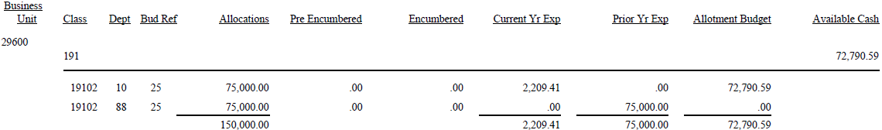
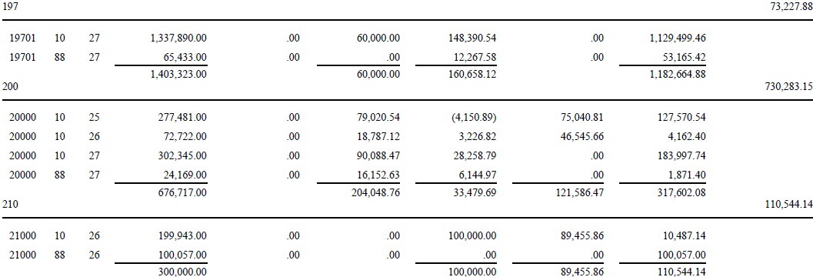
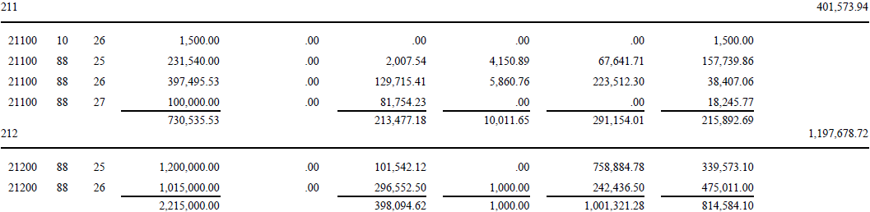

Budget As of September 2, 2026
- General Appropriations
- General Appropriations (Fiscal Year 2027)
- Revolving Fund
Executive Director’s Report
- Political Subdivisions
- Revolving Fund – Specifically for IT/Tech Related Expenses
- Guardian Replacement Fund
Grand Totals

Slide 6
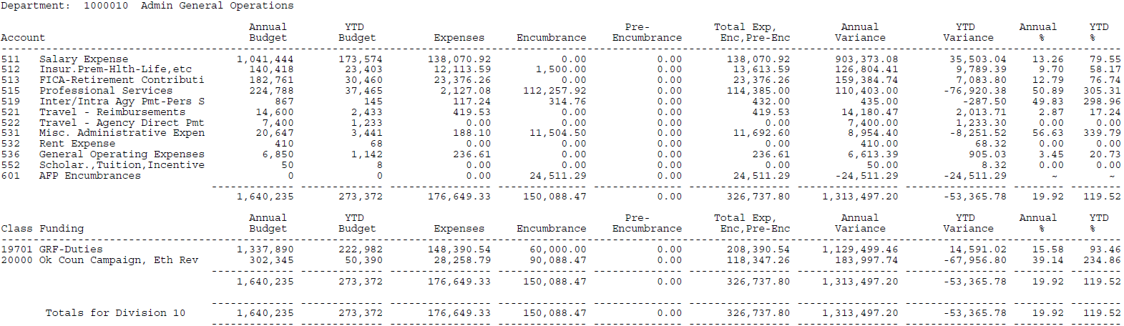
Budget As of September 2, 2026
Executive Director’s Report
General Operations

Slide 7
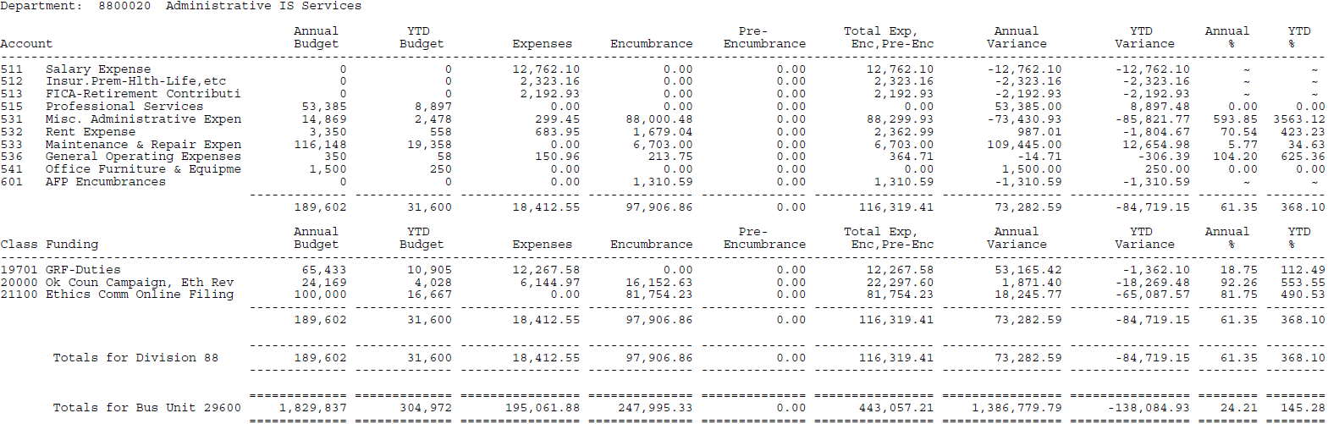
Budget As of September 2, 2026
Executive Director’s Report
IS Services

Slide 8
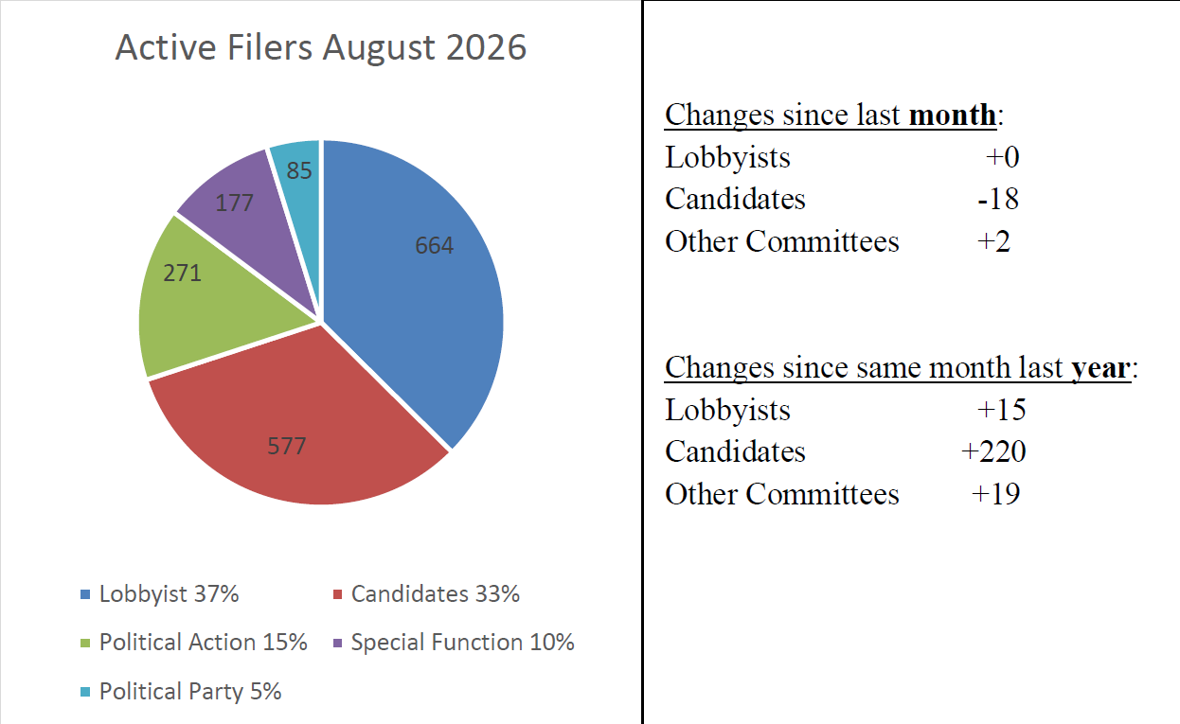
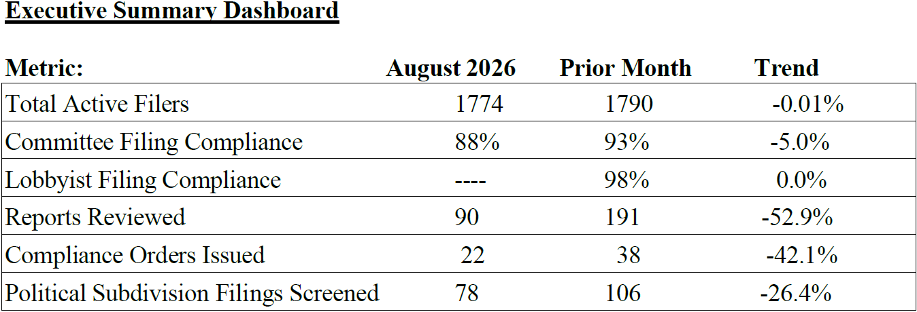
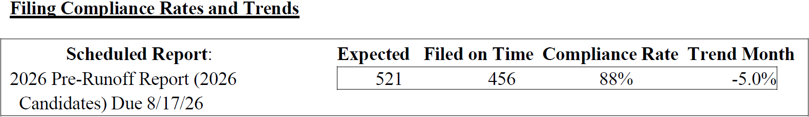
Compliance Report
THE GUARDIAN SYSTEM REGISTRANTS
Active Filers as of September 1, 2026
Executive Director’s Report
*There was only one report due date during the month of August 2026.

Slide 9
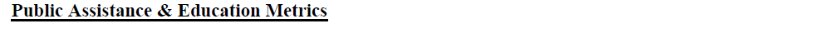
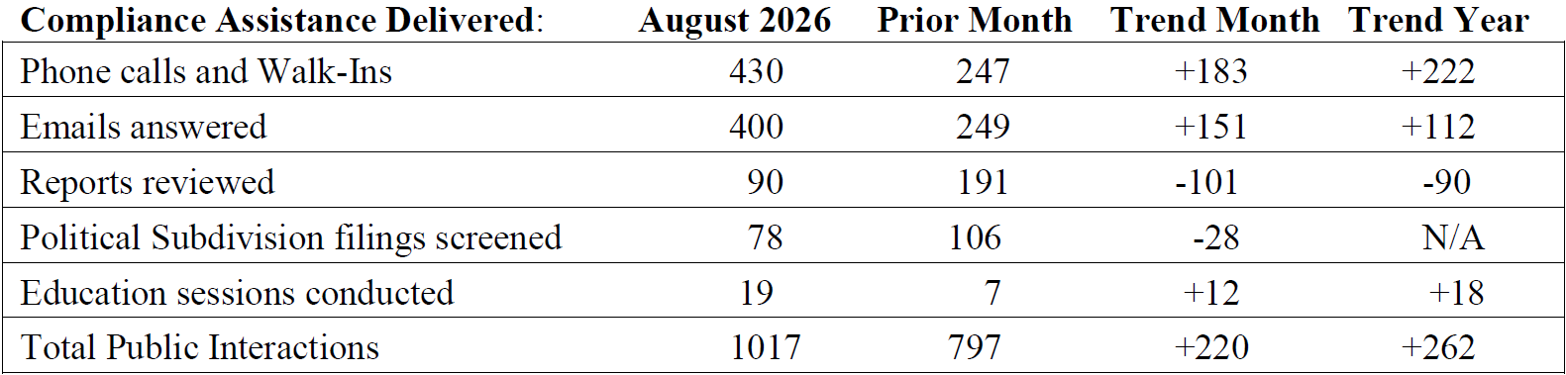
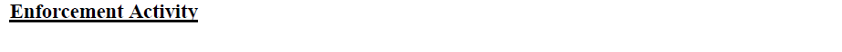
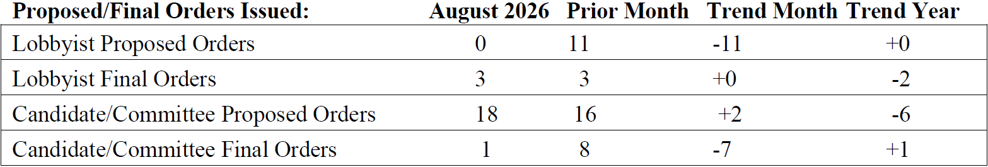
Compliance Report
Executive Director’s Report

Slide 10
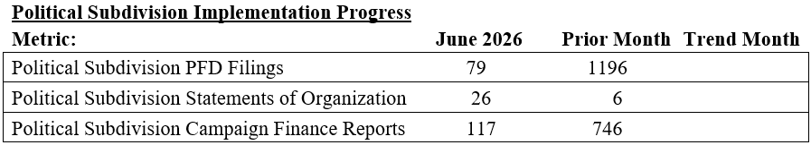
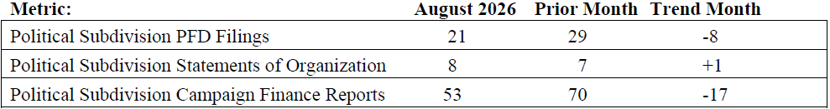
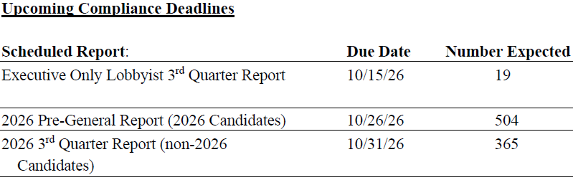
Compliance Report
Executive Director’s Report

Slide 11
Education Report
9/1/2026: Oklahoma House of Representatives Communications (Rescheduled - TBD)
9/15-17/2026: Oklahoma Municipal League Conference
9/21/2026: Government & Administrative Law Practice Section Continuing Legal Education
10/28/2026: Regents Education Program conference

Slide 12






Guardian & Political Subdivision Update
Executive Director’s Report
Conducting extensive research, system testing, and implementation planning to prepare for more than 3,500 personal financial disclosure filers from political subdivisions.
Developing clear, coordinated communications and guidance to help new filers register, navigate Guardian, and meet their filing obligations.
Preparing staff and internal processes to manage the significant increase in questions, filings, and compliance support.
Because political subdivision candidates must file personal financial disclosures—not only officeholders—those candidates will temporarily file through the Local Campaign Finance Transparency Portal until a new system is available.
Coordinating the use of Guardian and the portal to provide a workable interim process while longer-term system modernization continues.

Slide 13

Guardian & Political Subdivision Update
Technology-Assisted Campaign Finance Report Review
Project Scope
Implement an AI-Assisted Campaign Finance Review solution that analyzes filing data, identifies potential issues and exceptions, prioritizes record for human review, and provides a centralized reviewer workflow while maintaining Ethics Commissions oversight of final decisions.
Executive Director’s Report
Objectives Why we are doing this project
Reduce Manual Review
Improve Review Quality
Increase Capacity
Maintain Human Oversight
Consistent Issue Identification
Support Growing Filing Volumes
Streamline First-Pass Review
Support Trusted AI Review
Automate routine reviews
Prioritize exceptions
Focus staff on investigation
Apply business rules
Identify potential issues
Improve consistency
Process increased volume
Maintain review timelines
Scale efficiently
Staff retain final decisions
Explain flagged findings
Validate through sampling

Slide 14
Guardian & Political Subdivision Update
Technology-Assisted Campaign Finance Report Review
Timeline: Build & Test
Executive Director’s Report
Feature
Development
Target: 10/9
Execution Complete
Target: 11/6
Product Deployment
Target: 11/20
Project Complete
Target: 12/11
System Testing & Refinement
Target: 11/6
UAT
Target: 11/9-11/20
Hypercare & Transition
Target: 12/4

Slide 15

AI Regulation & the First Amendment
Political speech receives the highest level of First Amendment protection
Efforts to regulate AI-generated political communications raises competing considerations:
Election Integrity & Voter Information
  Protecting the integrity of elections
  Helping voters identify materially altered content
  Providing voters information about political communications
Freedom of Political Speech
  Avoiding government restrictions on protected political expression
  Avoiding compelled speech that unnecessarily burdens the speaker
  Protecting satire, parody and other traditional forms of political expression
Key Question:
Can transparency objectives be achieved without restricting the underlying political speech?
Executive Director’s Report
Emerging Issues: Artificial Intelligence - Constitutional Considerations

Slide 16
Disclosure Is Different From Prohibition
PROHIBITION
“You may not distribute this communication.”
*Greater First Amendment concern because government restricts the underlying political speech.
DISCLOSURE
“You may distribute this communication, but certain
information must accompany it.”
*Does not prevent the communication—but still raises First Amendment concerns because government is compelling the speaker to say something.
Supreme Court campaign-finance precedent generally provides greater constitutional latitude for disclosure and disclaimer requirements than for restrictions on political speech.
Buckley v. Valeo and Citizens United v. FEC
Executive Director’s Report
Emerging Issues: Artificial Intelligence - Constitutional Considerations
Notes:
Generally, fare much better in court than outright prohibitions

Slide 17
Buckley v. Valeo (1976) The Supreme Court struck down certain limits on political spending but upheld campaign-finance disclosure requirements, recognizing the government's interest in providing voters information about political activity.
Government has legitimate interests that can support campaign-finance disclosure.
Citizens United v. FEC (2010) The Supreme Court struck down restrictions on independent corporate political expenditures while upholding disclaimer and disclosure requirements as a less restrictive means of providing information to voters.
Even when government cannot prohibit political speech, it may still be able to require disclosure.
Neither case involved an A.I.-content label, but instead provides the constitutional foundation for considering disclosure.
Executive Director’s Report
Emerging Issues: Artificial Intelligence - Constitutional Considerations
Notes:
Generally, fare much better in court than outright prohibitions

Slide 18
California: A Constitutional Warning
California attempted to regulate materially deceptive election communications
In August 2025, a federal district court permanently enjoined enforcement of AB 2839 against the plaintiffs, concluding that the law violated the First Amendment. The court found problems including content-, viewpoint- and speaker-based discrimination and compelled speech; it concluded the law failed strict scrutiny. * Constitutional questions surrounding A.I. regulation of political speech have not yet been resolved by the U.S. Supreme Court.
The court recognized:
✓ California has a legitimate interest in election integrity.
California AB 2839 (2024): Prohibited the knowing distribution, with malice, of certain materially deceptive election communications during the 120 days before an election. The law also imposed prescribed labeling requirements for certain manipulated content and satire/parody and authorized injunctive relief and damages.
Executive Director’s Report
Emerging Issues: Artificial Intelligence - Constitutional Considerations
But concluded:
✗ The law restricted too much protected political speech.
✗ Its treatment of satire and parody raised First Amendment concerns.
✗ Its compelled labeling provisions also presented constitutional problems.
The court emphasized counter-speech and fact-checking as alternatives to censorship. Kohls v. Bonta Aug. 2025
Oklahoma takeaway: A legitimate governmental objective does not eliminate the need for narrow drafting when political speech is involved.

Slide 19
Constitutional Challenge Remains Unresolved
Minnesota:
Federal District Court → Eighth Circuit → back to District Court
The plaintiffs sought a preliminary injunction blocking enforcement. The district court denied it. On appeal, the Eighth Circuit affirmed that denial, finding no abuse of discretion. It also held that Kohls himself lacked standing based on the labeled parody he had posted. The appellate court therefore did not reach a final merits determination that Minnesota's law either does or does not violate the First Amendment.
A “deep fake” is defined here as audio, video, an image, photograph, or similar technological representation that is so realistic that a reasonable person would believe the individual actually engaged in speech or conduct that did not occur, and whose production substantially depended on technical means.
The constitutional challenge remains unresolved. (Feb 2026)
Minn. Stat. § 609.771
Use of Deep Fake Technology to Influence Election
The current law makes it a crime to disseminate a “deep fake” when the person knows or acts with reckless disregard as to whether it is a deepfake, and the dissemination:
is without the depicted person's consent;
is intended to injure a candidate or influence an election; and
occurs during specified election periods—either within 90 days before a party nominating convention or after absentee voting begins for covered elections.
Executive Director’s Report
Emerging Issues: Artificial Intelligence - Constitutional Considerations

Slide 20
Constitutional Questions for a Disclosure Model
What triggers disclosure?
Any use of A.I. - or only content that has been materially generated or altered?
What must the speaker say?
A factual statement about how the communication was created—or a characterization such as “false,” “deceptive” or “misleading”?
How burdensome is the requirement?
Size, duration, placement and requirements for different media matter.
Is the rule sufficiently clear?
A speaker should be able to determine whether the requirement applies before distributing the communication.
How are satire and parody treated?
Political satire and parody receive significant First Amendment protection.
Does the rule regulate technology—or its effect?
Should routine AI editing trigger the same requirement as a realistic fabricated video showing a candidate doing something that never occurred?
Executive Director’s Report
Emerging Issues: Artificial Intelligence - Constitutional Considerations

Slide 21
Where the Law Remains Unsettled
There is not yet a definitive Supreme Court ruling on compelled AI disclosures in political advertising.
Existing cases provide guidance, but important questions remain:
Will courts treat A.I. labels like traditional campaign-ad disclaimers?
Or will they view them as compelled statements about the content of political speech?
What governmental interest is sufficient to justify the requirement?
What level of scrutiny will apply?
How narrowly must “AI-generated” or “materially altered” content be defined?
When does a disclosure become so burdensome that it interferes with the underlying message?
Current Landscape
Most states regulating political deepfakes have selected disclosure rather than prohibition, but many of these laws are relatively new and their constitutional boundaries remain largely untested.
Executive Director’s Report
Emerging Issues: Artificial Intelligence - Constitutional Considerations

Slide 22
What This Means for Oklahoma
Considerations for Oklahoma
If Oklahoma were to consider a disclosure approach:
1. What governmental interest would the rule seek to advance?
2. What type of AI use should trigger disclosure?
3. Could the required disclosure be factual and neutral?
4. How could the rule distinguish material synthetic content from routine technological editing?
5. How should satire and parody be addressed – if at all?
6. Can the objective be accomplished without requiring the Commission to determine whether political speech is true or false?
Executive Director’s Report
Emerging Issues: Artificial Intelligence - Constitutional Considerations

Slide 23

OKLAHOMA ETHICS COMMISSION
Strategic Plan 2027–2031
THE PEOPLE’S COMMISSION
Transparent | Accessible | Fair | Effective

Slide 24

WHERE WE ARE GOING
A practical five-year framework focused on measurable improvement.
The plan focuses Commission resources on five areas while allowing annual operating plans, numeric targets and reporting schedules to be refined as baseline data becomes available.
Education & Prevention
Make compliance easier through timely, practical education.
1
Transparency & Public Trust
Make ethics information easier to find, understand and use.
2
Fair & Preventive Compliance
Improve voluntary compliance while maintaining fair enforcement.
3
Modern & Accessible Systems
Provide reliable filing, disclosure and review technology.
4
Organizational Excellence
Build the people, processes and capacity to sustain the work.
5

Slide 25
FROM STRATEGY TO IMPLEMENTATION
The five priorities set the direction.
Annual implementation planning will establish the specific targets, reporting cadence and near-term work needed to move them forward.
CLEAR OBLIGATIONS
ACCESSIBLE INFORMATION
HIGHER COMPLIANCE
FAIR & CONSISTENT ENFORCEMENT
STRONGER PUBLIC CONFIDENCE

Slide 26
THE FIVE-YEAR PATH
The priorities remain constant; the work matures over time.
2027
BUILD & DECIDE
Establish baselines and make key decisions.
2028
IMPLEMENT & EXPAND
Implement priorities and expand what works.
2029
MIDPOINT REVIEW
Measure progress and adjust where needed.
2030
ADVANCE & IMPROVE
Build on proven approaches and address emerging needs.
2031
EVALUATE & RENEW
Measure five-year change and set the next direction.

Slide 27
PRIORITIES 1–2 | PREVENTION, ACCESS & PUBLIC TRUST
EDUCATION & PREVENTION
• Annual Ethics Education Plan beginning in 2027
• Regional education and statewide partnerships
• Plain-language checklists, guides, examples, FAQs and short videos
• Compliance/Legal/Education feedback loop based on recurring issues
• Measure whether targeted education improves later compliance
TRANSPARENCY & PUBLIC TRUST
• Establish a 2027 public awareness and access baseline
• Improve high-use public information and navigation
• Expand regional Commission presence and stakeholder engagement
• Develop an Oklahoma Ethics & Transparency Summit
• Publish a concise annual performance snapshot
2031 focus: broader statewide reach, easier public access, and evidence that education changes compliance behavior.

Slide 28
PRIORITY 3 | FAIR & PREVENTIVE COMPLIANCE
Use data and consistent review to prevent problems earlier while preserving meaningful enforcement.
WHAT WE WILL DO
• Use documented risk-based review standards to focus staff attention
• Establish baselines for timely filing, recurring errors, repeat violations and resolution time
• Track diversion outcomes and subsequent compliance
• Use recurring PFD and conflict issues for proactive reminders, guidance or targeted review
• Review trends regularly to inform education, guidance, rule clarification and enforcement priorities
BY 2031, WE WANT TO SEE
• Higher timely filing rates
• Fewer repeat and recurring violations
• Effective diversion
• More issues resolved through prevention and early correction

Slide 29
PRIORITY 4 | MODERN & ACCESSIBLE SYSTEMS
The first major strategic decision comes early: determine the Commission’s long-term filing and disclosure platform.
EARLY 2027: COMPLETE TECHNOLOGY ROADMAP + RETAIN / ENHANCE / REPLACE DECISION
SYSTEM MODERNIZATION
• Use documented performance, filer/public needs, local filing requirements and lifecycle cost
• Address data portability, vendor dependence, procurement timing and implementation risk
• Maintain filing continuity and public access during any transition
• Implement, stabilize and improve the selected strategy through 2031
TECHNOLOGY-ASSISTED COMPLIANCE REVIEW
• Build on the process implemented in 2026
• Validate accuracy and strengthen quality controls and human review
• Refine review criteria and expand appropriate uses
• Use technology to increase meaningful review coverage without sacrificing accuracy

Slide 30
PRIORITY 5 | ORGANIZATIONAL EXCELLENCE
& STEWARDSHIP
Build durable internal capacity while staying ready for changing responsibilities.
WHAT WE WILL DO
• Document critical processes, ownership, backup responsibility and key controls
• Expand cross-training and succession coverage
• Use Gemba / Voice of Customer work to identify friction and service improvements
• Conduct targeted internal reviews of selected processes
• Connect staffing, budget and technology decisions to workload
• Regularly assess emerging legal, technological and operational responsibilities
BY 2031
• Stronger continuity
• Better documented processes
• Improved service delivery
• Workforce and resources able to adapt

Slide 31
SIGNATURE INITIATIVES
1
The People’s Commission
Statewide accessibility, regional engagement, understandable public information and direct connection with the people the Commission serves.
2
Annual Ethics Education Plan
A recurring, data-informed education program built around filing cycles, elections, compliance trends and stakeholder needs.
3
Early-2027 Technology Roadmap & Platform Decision
A retain / enhance / replace decision based on documented system performance, public-access needs, compliance-review capability, lifecycle cost, data portability and implementation risk.
4
Compliance → Education Feedback Loop
Identify recurring issue → educate → measure subsequent behavior → improve the response.
5
Oklahoma Ethics & Transparency Summit
A statewide forum for education, dialogue, emerging issues and stakeholder engagement.
6
2031 State of Ethics & Transparency Report
A public five-year assessment of compliance, education, transparency, accessibility, technology and Commission performance.

Slide 32
HEADLINE PERFORMANCE MEASURES
Keep the scorecard limited enough to matter: reach, performance and outcomes—not activity counts alone.
REACH
Are we reaching the people we serve?
Education reach & geographic coverage
Public/stakeholder participation
Use of public resources
PERFORMANCE
Are we doing our work effectively?
Timely filing compliance
System reliability, user experience & modernization readiness
Compliance review timeliness, coverage & assisted-review accuracy
Organizational capacity
OUTCOMES
Is our work making a difference?
Repeat violations
Recurring filing errors
Post-education compliance improvement
Public awareness & accessibility

Slide 33
Regular Commission Meeting
September 10, 2026 10:00 AM
OK State Capitol, Rm. G-3
Executive Session

Slide 34
Regular Commission Meeting
September 10, 2026 10:00 AM
OK State Capitol, Rm. G-3
Returning Soon From Executive Session

Slide 35
Regular Commission Meeting
September 10, 2026 10:00 AM
OK State Capitol, Rm. G-3

Slide 36
Possible Action Following Executive Session

Slide 37
Case No. CJ-2026-558, State of Oklahoma ex rel. Oklahoma Ethics Commission v. RFD & Associates, Inc., Oklahoma County District Court.

Slide 38
Case No. 2026-14, alleging violations of Conflicts of Interest Rule 4.

Slide 39
C-26-16

Slide 40
C-26-17

Slide 41
C-26-18

Slide 42
C-26-22

Slide 43
C-26-23

Slide 44
C-26-24

Slide 45
No Action On:
Case No. CJ-2026-558, State of Oklahoma ex rel. Oklahoma Ethics Commission v. RFD & Associates, Inc., Oklahoma County District Court.
Case No. 2026-14, alleging violations of Conflicts of Interest Rule 4.
C-26-18

Slide 46
New Business
Adjournment

Slide 47
Next Regularly Scheduled Commission Meeting
October 8, 2026 @10:00 a.m.
OK State Capitol, Rm. G-3
2026 Regularly scheduled Ethics Commission Meetings
Start Time: 10:00am Location: Oklahoma State Capitol, Rm. G-3
Thursday, January 15, 2026 Thursday, February 12, 2026 Thursday, March 12, 2026 Thursday, April 9, 2026 Thursday, May 14, 2026 Thursday, June 5, 2026 | Thursday, July 9, 2026 Thursday, August 13, 2026 Thursday, September 10, 2026 Thursday, October 8, 2026 Thursday, November 12, 2026 Thursday, December 3, 2026

