Slide 1
DEQ Electronic
Submittal Tool
(nFORM)
Registration Guide
https://applications.deq.ok.gov/nviro/nform

Slide 2
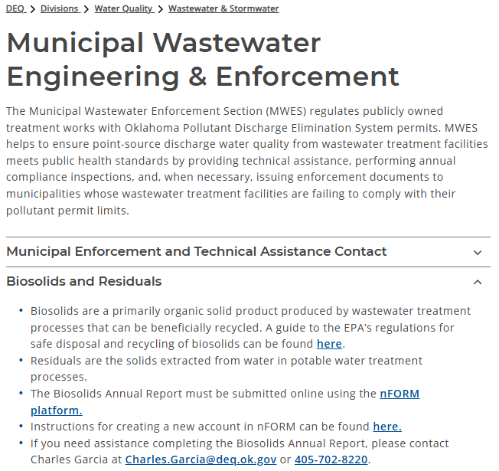
Accessing nForm
nForm can be accessed by clicking this link:
https://applications.deq.ok.gov/nviro/nform
nForm can also be accessed from the DEQ website:
https://oklahoma.gov/deq/divisions/water-quality/wastewater-stormwater/wastewater-engineering-enforcement.html

Slide 3
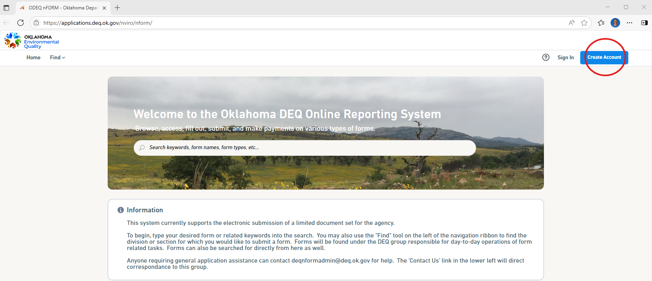
Registration
Click “Create Account” to create a new nFORM account.

Slide 4
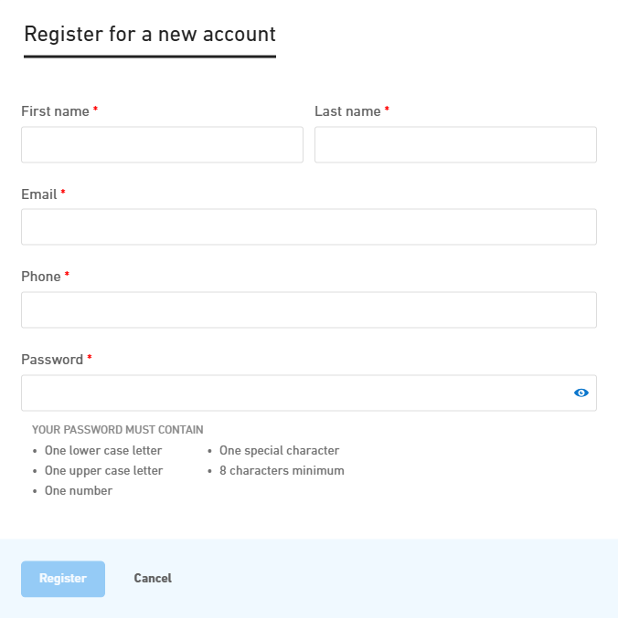
Register for a new account
Enter all required fields, then click “Register”.

Slide 5
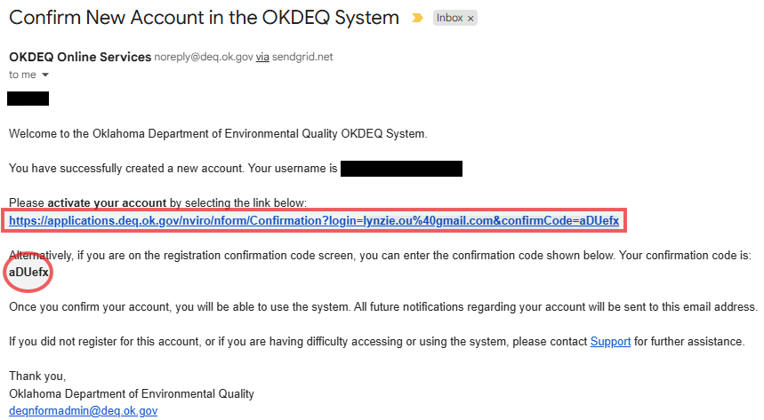
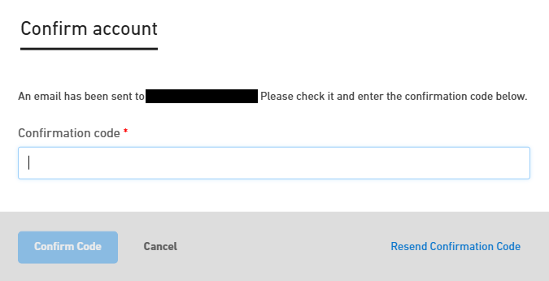
Confirm account
A confirmation e-mail will be sent to the e-mail address on file.
You may use the confirmation code, or select the link provided to activate your account.

Slide 6
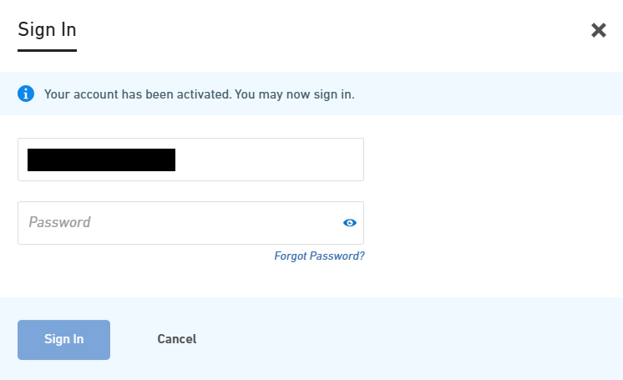
Sign In
Once your account has been activated, sign in to nFORM.

Slide 7
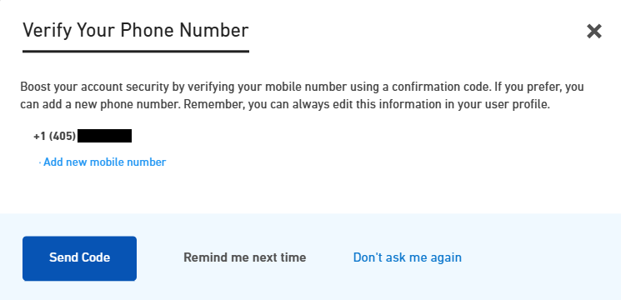
Verify your phone number
Set up two-factor authentication or click “Don’t ask me again”.

Slide 8
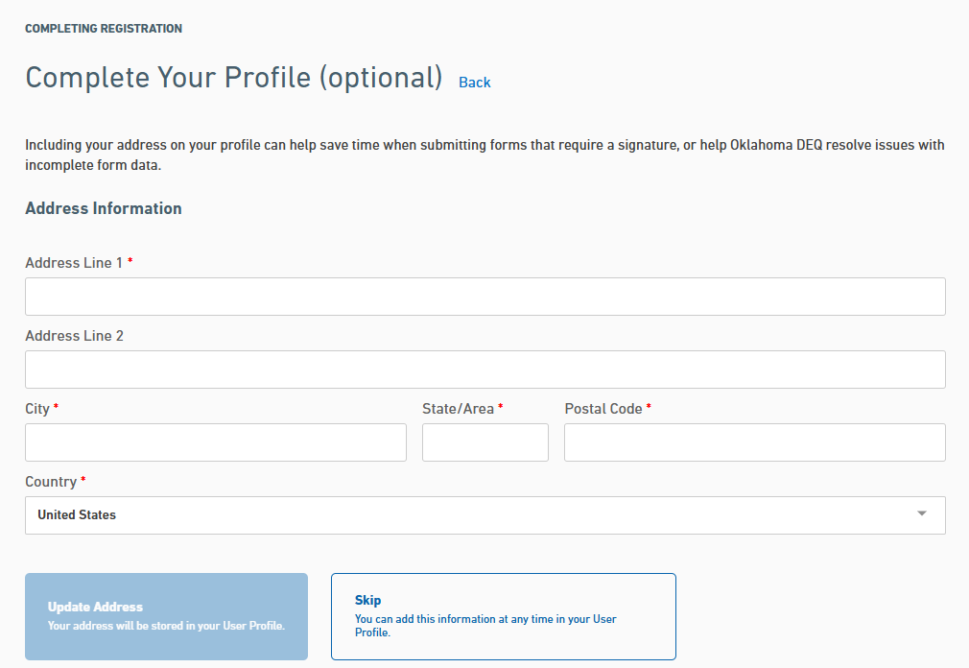
Complete Your Profile
Enter all required fields.
Click “Update Address”.

Slide 9
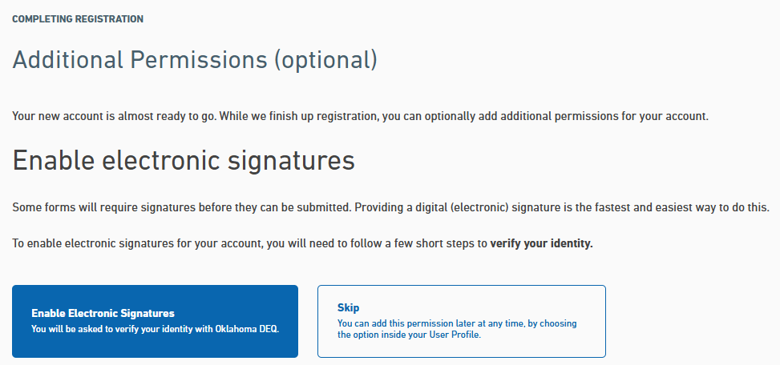
Enable Electronic Signatures
The following steps are for signatories only.
Skip to “Form Search” if you are a preparer.

Slide 10
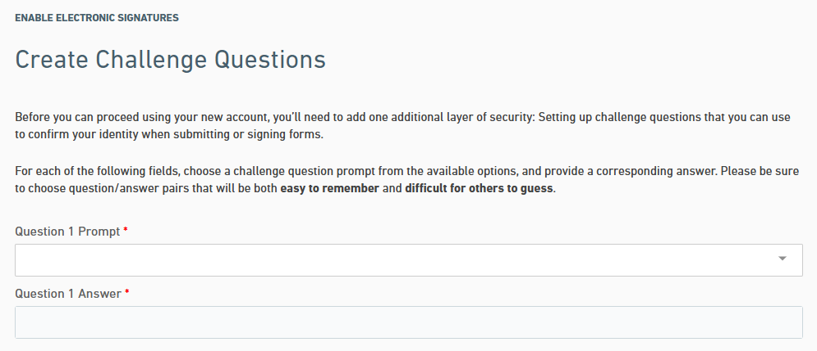
Create challenge questions
Enter all required fields.
Five questions and answers are required.

Slide 11
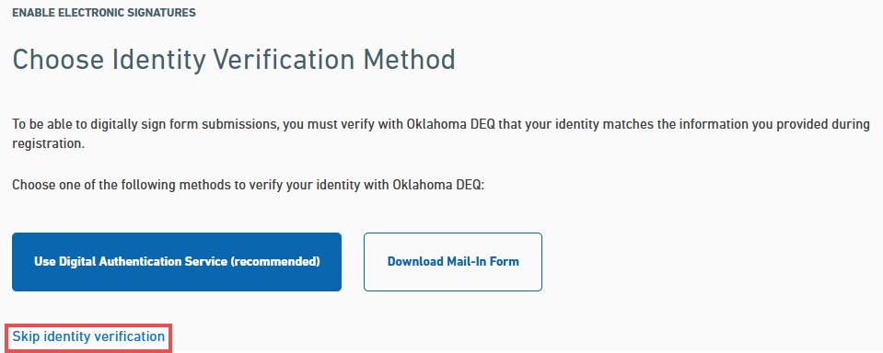
Identity Verification
Skip identity verification.
Identity verification will be completed in another step.

Slide 12
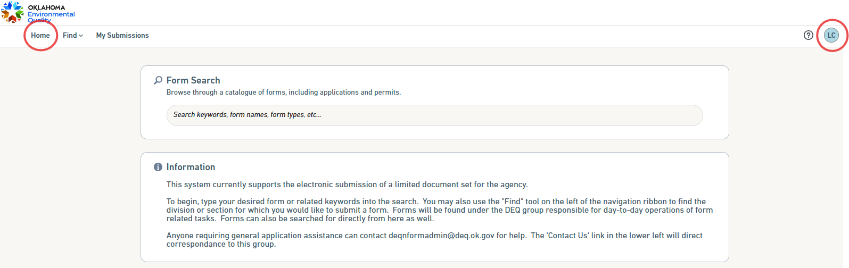
Identity Verification
Click “Home”, then your initials.
A dropdown box will appear, click “Profile”.

Slide 13
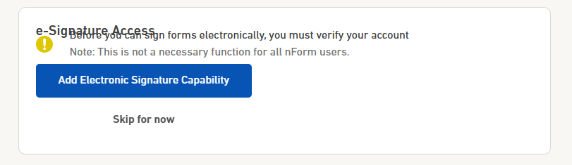
e-Signature Access
Click “Add Electronic Signature Capability”.

Slide 14
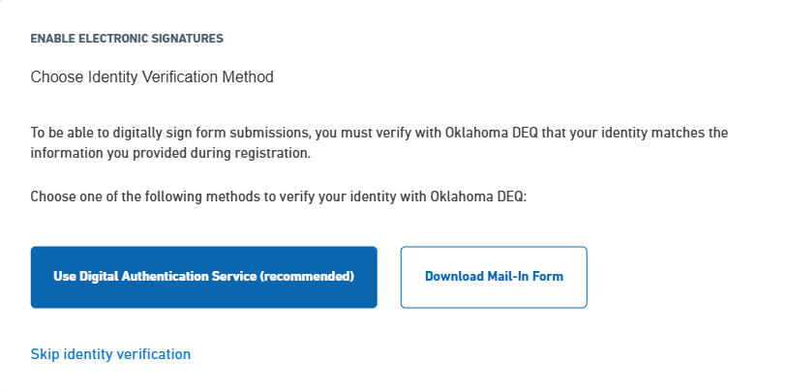
Identity Verification Method
Click “Use Digital Authentication Service (recommended)”.
A mail-in form is required if digital authentication is unsuccessful.

Slide 15
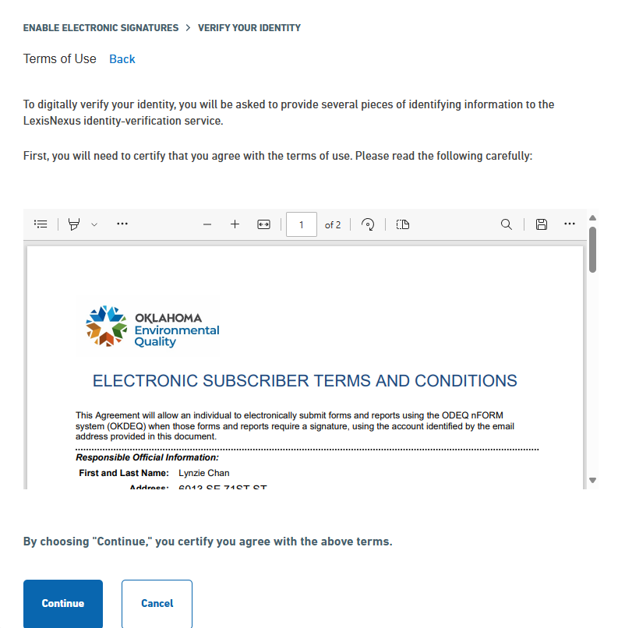
Terms of Use
Review the Terms of Use.
Click “Continue”.

Slide 16
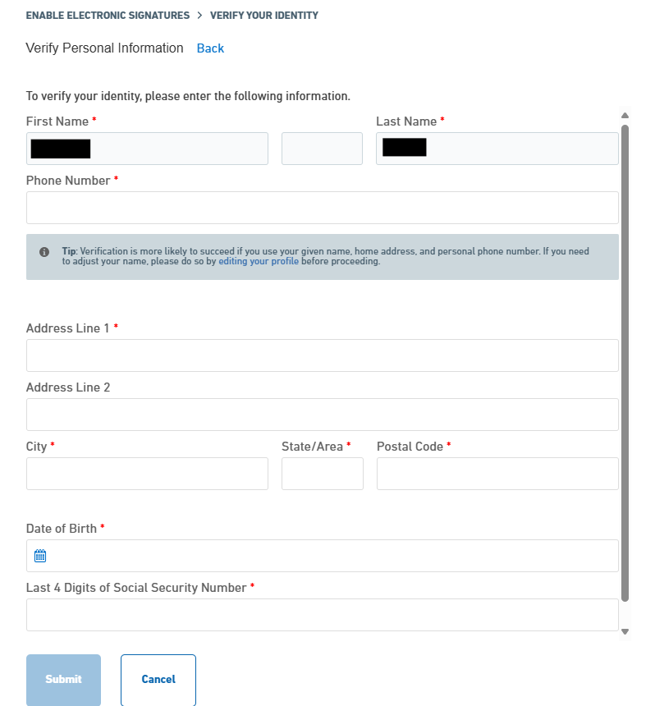
Verify Personal Information
Enter all required fields and click “Submit”.
Processing times vary, this step may take a few moments.

Slide 17
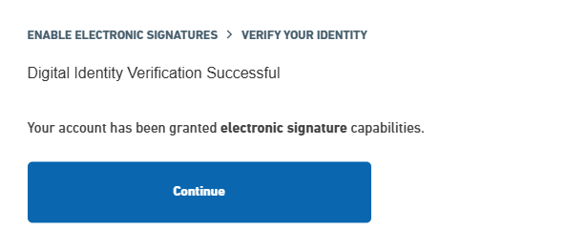
Verification Successful, Registration Complete
Click “Continue”

Slide 18
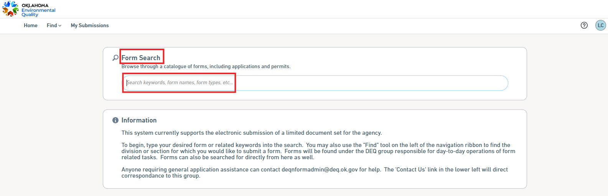
Form Search
Click “Home” then search for electronic forms via “Form Search” on the Home page.
Further instruction will be provided for completion and submission of each electronic form.

Slide 19
Need assistance or have questions? Contact us!
Call: 405-702-8100
Visit: https://oklahoma.gov/deq.html
Staff:
Charles Garcia (Biosolids) 405-702-8220
Toby Harden (Biosolids) 405-702-8109
Lynzie Chan (nFORM) 405-702-8163

