Slide 1
nFORM Preparer & Signatory Functions
https://applications.deq.ok.gov/nviro/nform

Slide 2
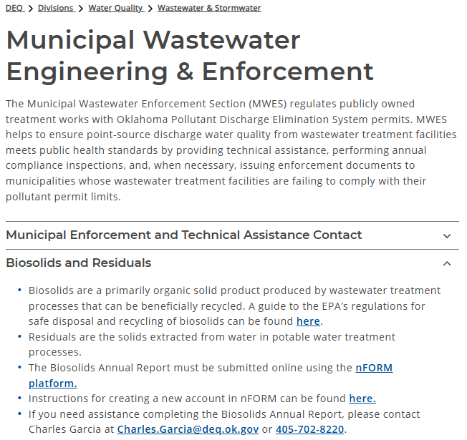
Accessing nForm
nForm can be accessed by clicking this link:
https://applications.deq.ok.gov/nviro/nform
nForm can also be accessed from the DEQ website:
https://oklahoma.gov/deq/divisions/water-quality/wastewater-stormwater/wastewater-engineering-enforcement.html

Slide 3
Preparer & Signatory Responsibilities
The preparer enters data into the form
    *There can be multiple preparers or “collaborators” for the same form
The signatory reviews, signs and submits the form
    *The signatory can also prepare/enter data into the form
    *Signatory accounts require the user to enable electronic signatures and
    complete digital identity verification

Slide 4
Sharing Preparer Access

Slide 5
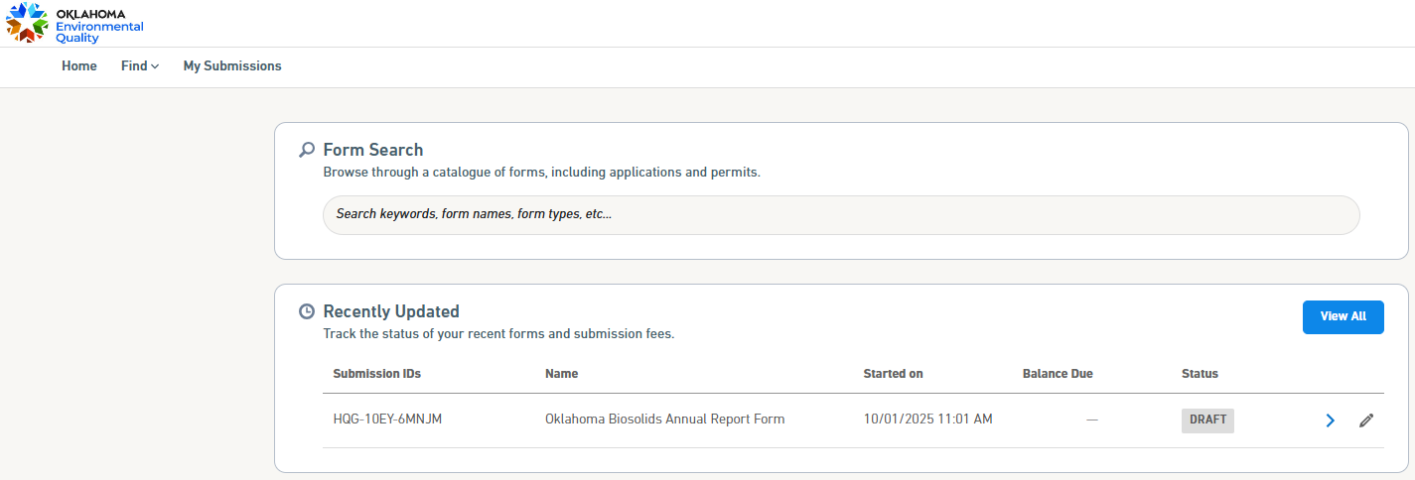
Sharing Preparer Access
After creating a new form, the user will click the blue arrow (“View Submission Overview”) next to the draft submission

Slide 6
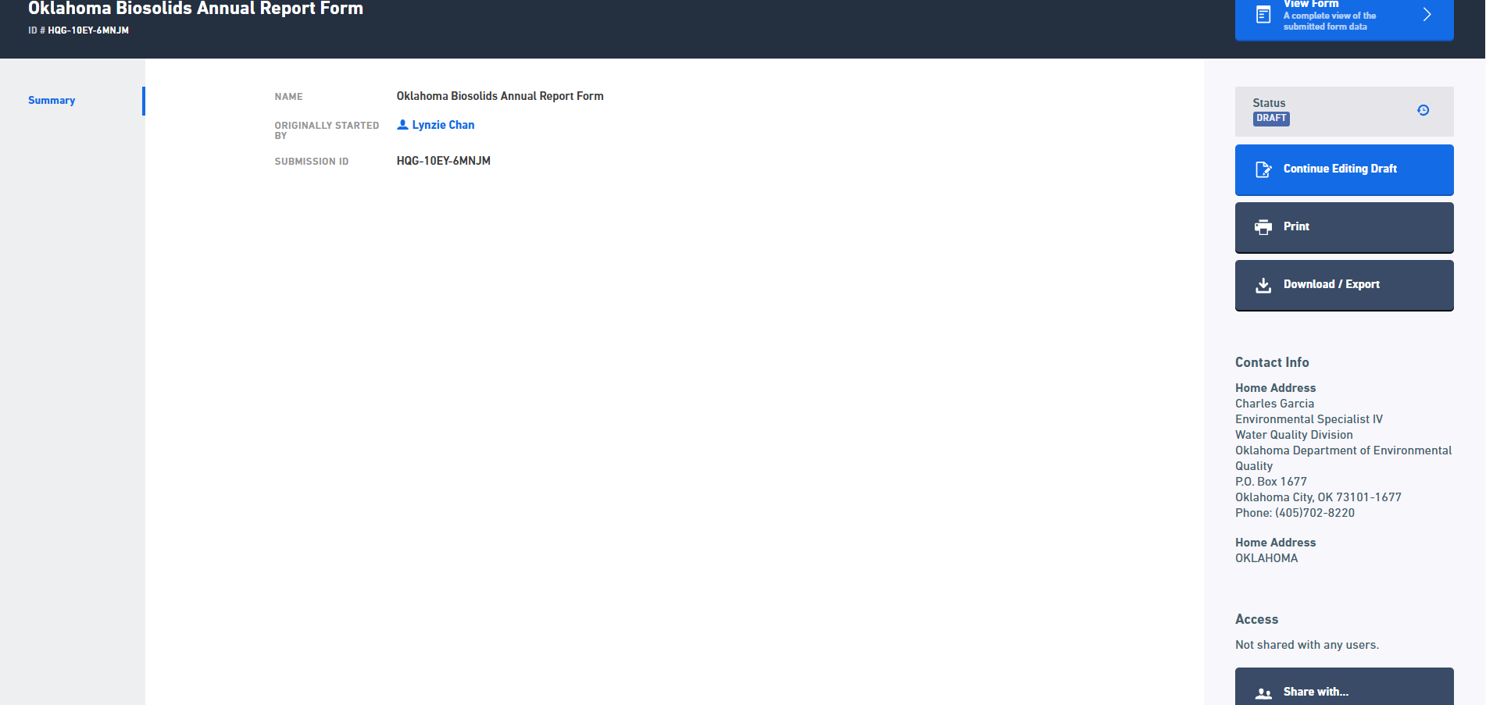
Sharing Preparer Access, cont.
The user must scroll to the bottom right of the page and click “Share With…”

Slide 7
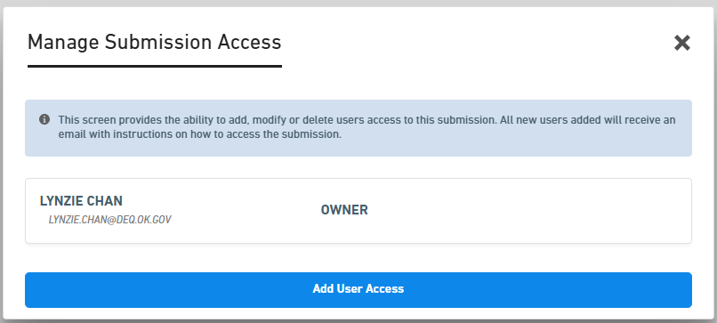
Sharing Preparer Access, cont.
Click “Add User Access”, the form originator will appear as the owner of the form
Options include:
  Viewer – View only access
  Contributor – Edit submission data
  Editor – Edit submission data and share with others

Slide 8
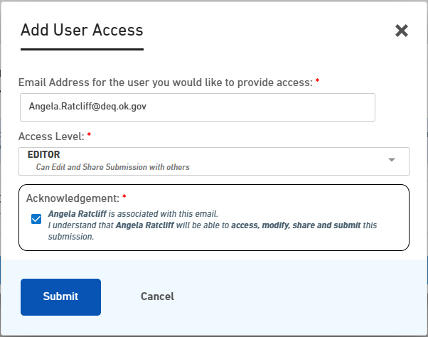
Sharing Preparer Access, cont.
Enter secondary preparer’s e-mail address
Select access level
Check the box to acknowledge and agree to the secondary preparer’s access level rights
Click “Submit”

Slide 9
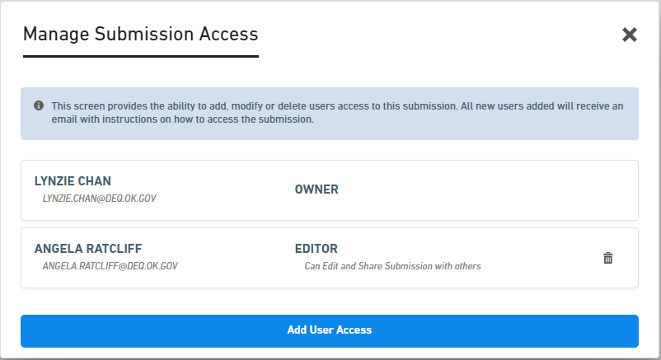
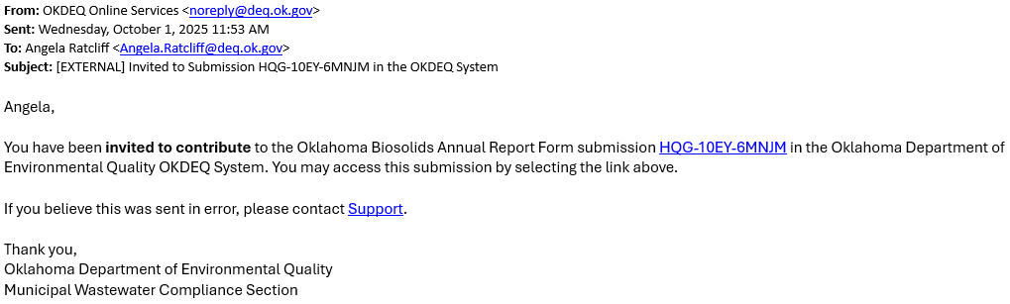
Sharing Preparer Access, cont.
“Manage Submission Access” screen confirms user access changes
The secondary preparer is sent a confirmation e-mail, including a link to the submission/form

Slide 10
Signing Options

Slide 11
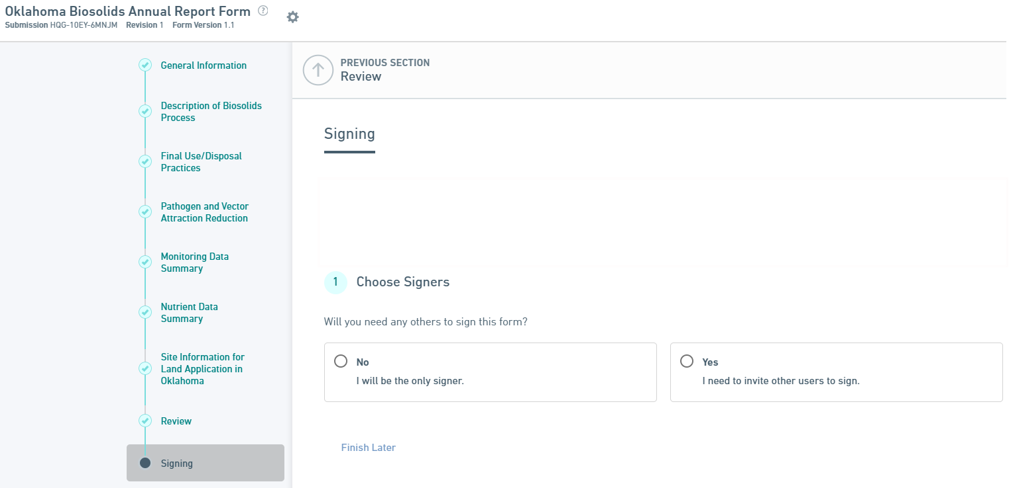
Signing and Submitting the nFORM
Once the form is complete, the “Signing” page will ask who will sign the form
If you are the signatory, click “No” and follow the prompts to submit

Slide 12
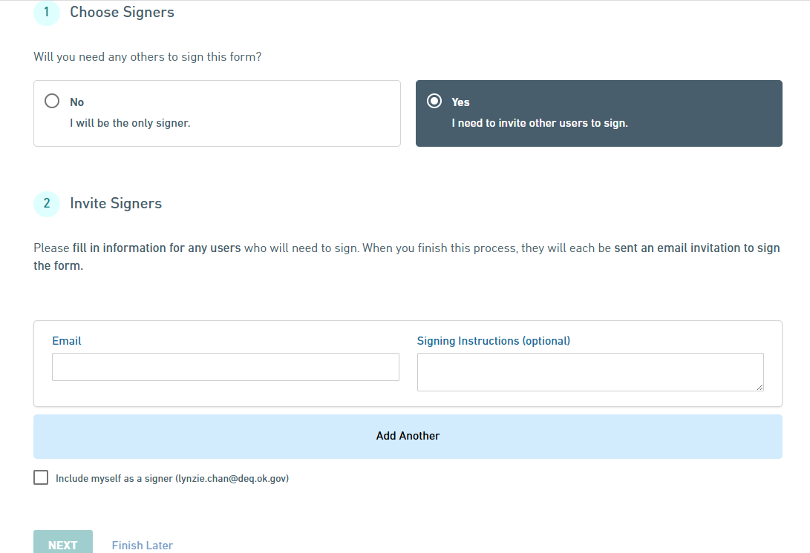
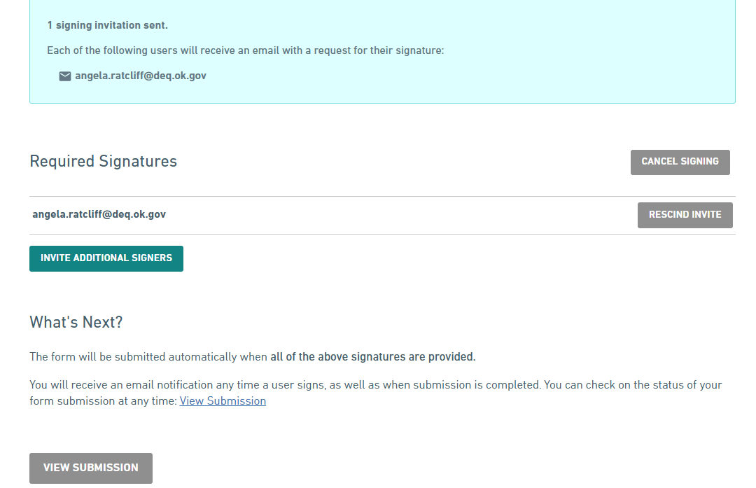
Signing and Submitting the nFORM, cont.
If you are the preparer, click “Yes” and invite a signer by entering their e-mail address and a comment or signing instructions (optional)

Slide 13
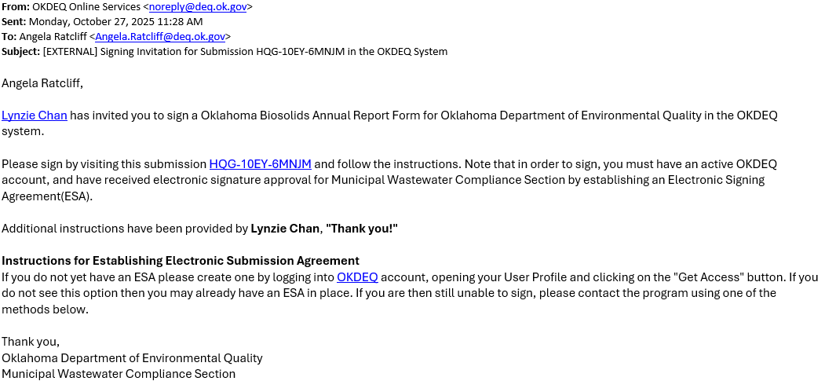
Signing and Submitting the nFORM, cont.
The signatory will receive an e-mail inviting them to sign the final report

Slide 14
Need assistance or have questions? Contact us!
Call: 405-702-8100
Visit: https://oklahoma.gov/deq.html
Staff:
Charles Garcia (Biosolids) 405-702-8220
Toby Harden (Biosolids) 405-702-8109
Lynzie Chan (nFORM) 405-702-8163

