Slide 1
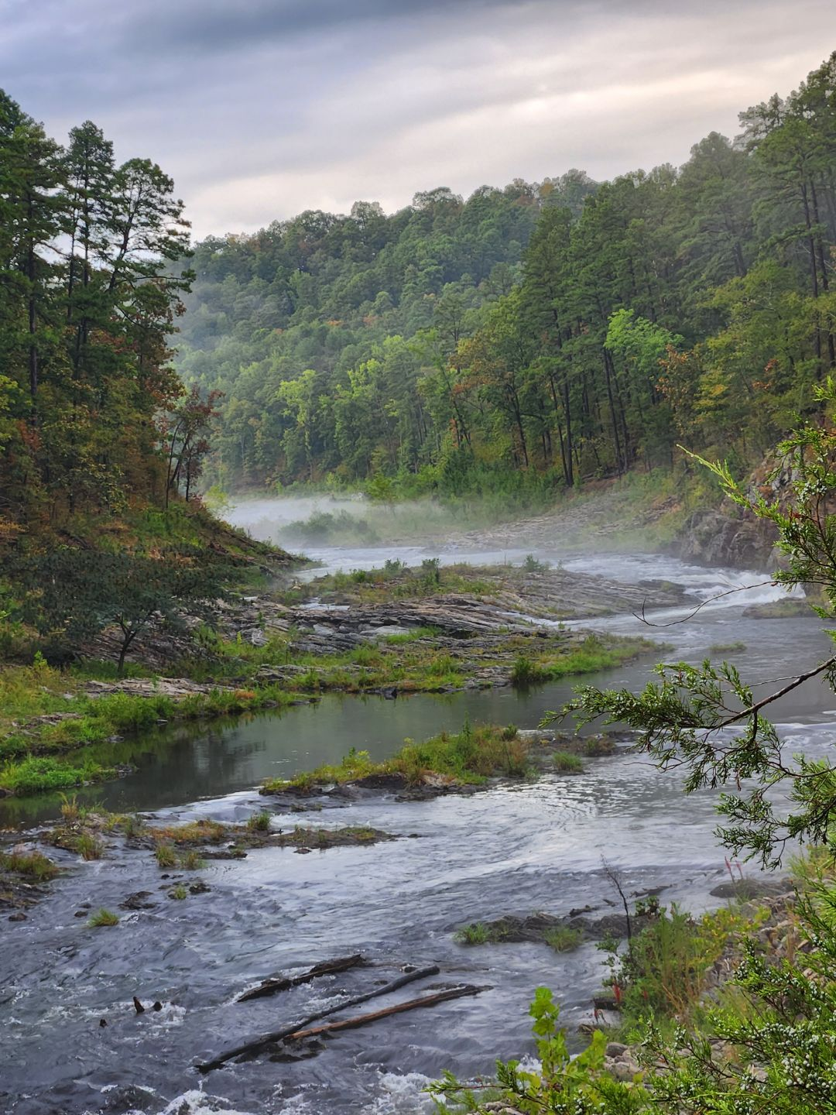
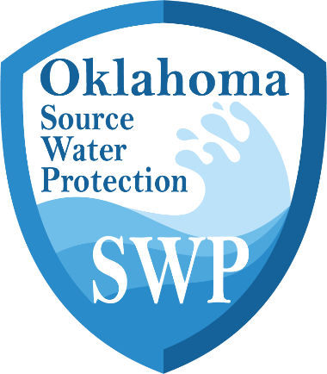
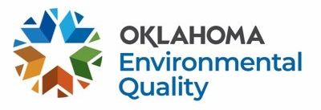
Oklahoma DEQ
Source Water Protection Program
Notes:
Hello everyone! My name is ___________ and I am part of our capacity development section. For this portion of your training, we will be discussing one of the programs that the Capacity Development group houses, and that is our Source Water Protection Program.

Slide 2
Outline
Background
Potential Sources of Contamination
SWP Practices and Projects
Benefits of SWP
SWP Funding
DEQ SWP Program
Oklahoma Source Water Collaborative
Notes:
As we move through these slides, I’ll first give you some background as to how the Source Water Protection Program came about in Oklahoma and what Source Water Protection is. We’ll then review some examples of potential sources of contamination followed by some ideas for some SWP practices and projects that could be implemented to combat those sources of contamination. Then we’ll discuss the benefits of source water protection, why you should care, and how you could maybe fund some SWP projects.
And then we will end with reviewing DEQ’s specific program, what it would entail to participate, and who the Oklahoma Source Water Collaborative includes.

Slide 3
History of DEQ Source Water Protection
1996 -
The Safe Drinking Water Act (SDWA) Amendments required every state to establish a Source Water Assessment Program
2002
2004
A Source Water Assessment was completed for every public water supply. Assessments included:
Delineation of the SWP area
Inventory of potential contaminants
Susceptibility of system
.....
2025 -
Oklahoma SWP Program redeveloped
Notes:
So first, to provide a quick history regarding the DEQ Source Water Protection Program: back in 1996, the Safe Drinking Water Act Amendments required every state to establish a Source Water Protection Program, so Oklahoma did just that. Come 2002, 2003, and 2004, DEQ had hired an external contractor to conduct assessments for every drinking water system in the state. These assessments included a delineation of the source water protection area, an inventory of the potential contaminants within that delineation, and then a calculation of the susceptibility of the system.
You'll then notice that there is a bit of a lull in the timeline until last year where the Capacity Development Section put a lot of work into revitalizing the SWP Program. Later in the presentation, we’ll take a deep dive into what the program is now composed of.

Slide 4
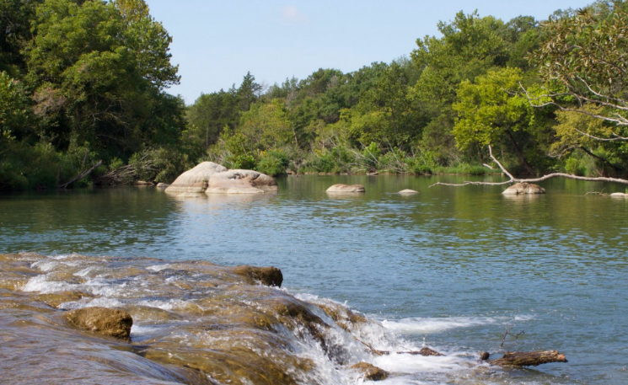
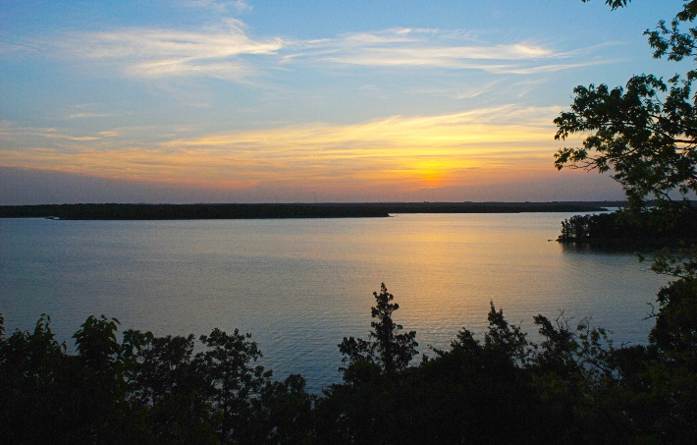
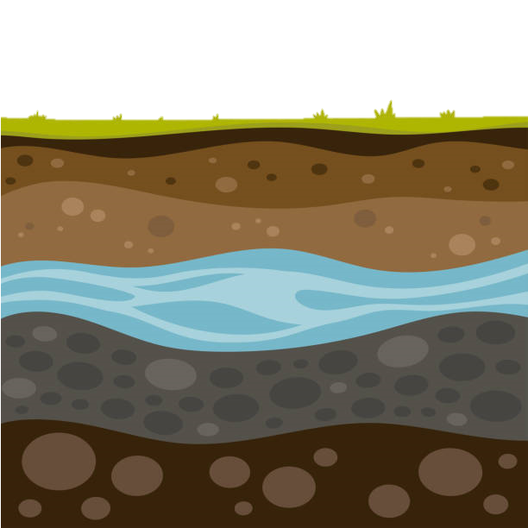
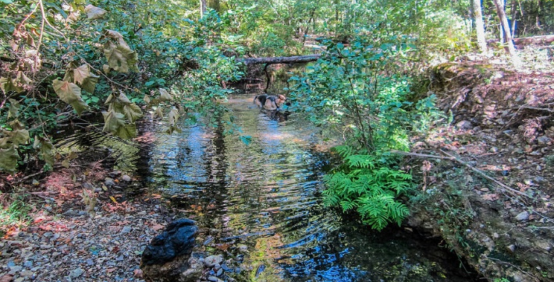
What is Source Water Protection (SWP)?
Proactive protection of water sources that provide for public drinking water supplies.
Rivers
Streams
Lakes
Reservoirs
Springs
Groundwater
Notes:
Let’s take a few steps back to the basics. So, what exactly is source water protection? SWP is defined as the proactive protection of water sources that specifically provide for public drinking water supplies. This could include anything from moving bodies of water like rivers and streams to standing bodies of water like lakes and reservoirs. Some sources could even include those that are a little less visual, such as springs and groundwater.
So how does this differ from any of the other programs that DEQ enforces? You’ll notice the keyword here is PROACTIVE. We focus so much on how we can respond to contamination of water and how we can better treat water, but we don’t tend to consider how we can proactively create better water quality right at the source.

Slide 5
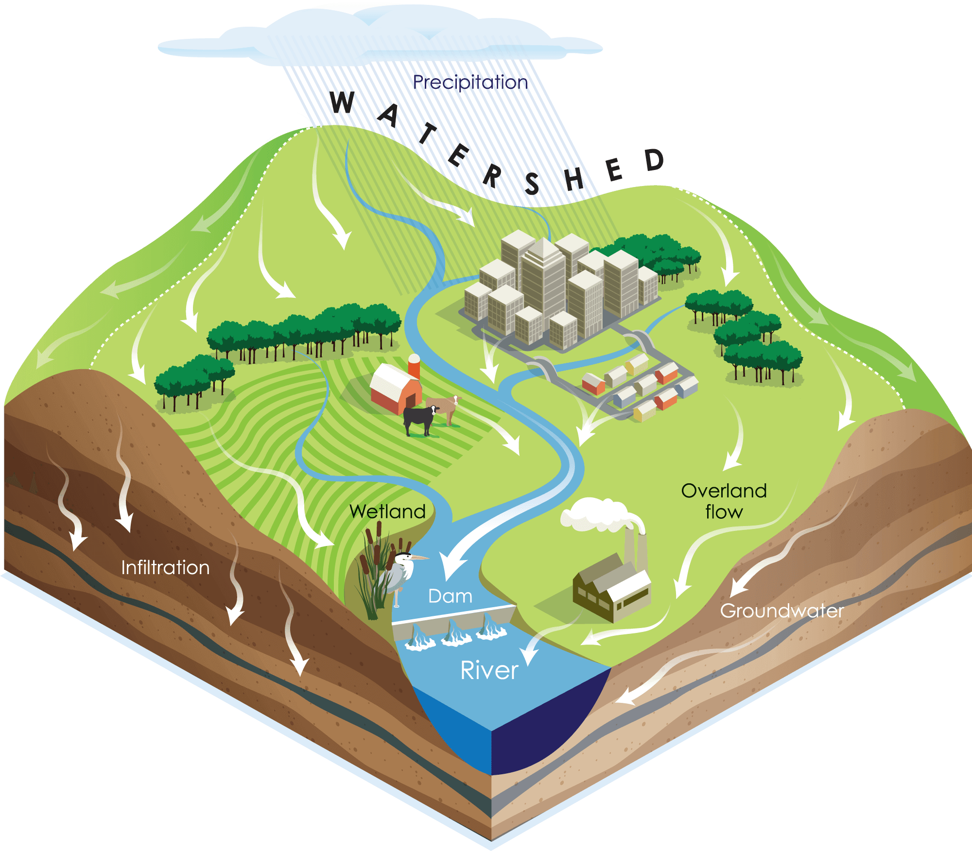
Understanding Watersheds
An area of land that drains rainfall and streams into a common outlet.
Includes surface water and groundwater.
Everything upstream effects everything downstream!
Notes:
In order to best understand source water protection, we need to understand watersheds as a whole. As many of you may know, a watershed is an area of land that drains rainfall and streams into a common outlet. As you can see in the image, we have rain falling on the higher elevation land which then moves down to lower elevations, across the surface of the earth, and it picks up all sorts of things with it - including contaminants! These contaminants are called non-point source pollution, which we will define further in a minute.
When thinking about a watershed, keep in mind the entire water cycle, which will include interactions with surface water as well as groundwater.

Slide 6
Potential Sources of Contamination
Point Sources
Non-point Sources
Individual identifiable sources that are easy to point to.
Pollutants are not originating from one single source. Occurs when precipitation moves across the land and carries contaminants.
Notes:
As I alluded to earlier, there are various forms of pollution, but they are grouped into two main categories: Point Source and Non-Point Source.
Point sources are just as they sound: these are individual and identifiable sources that are easy to point to.
Nonpoint Sources on the other-hand are much more difficult to identify and quantify. This category includes pollutants that do not originate from one single source. As we started to go over in the last slide, this occurs when precipitation moves across the land and carries contaminants with it.
Let go over some examples of each of these.

Slide 7
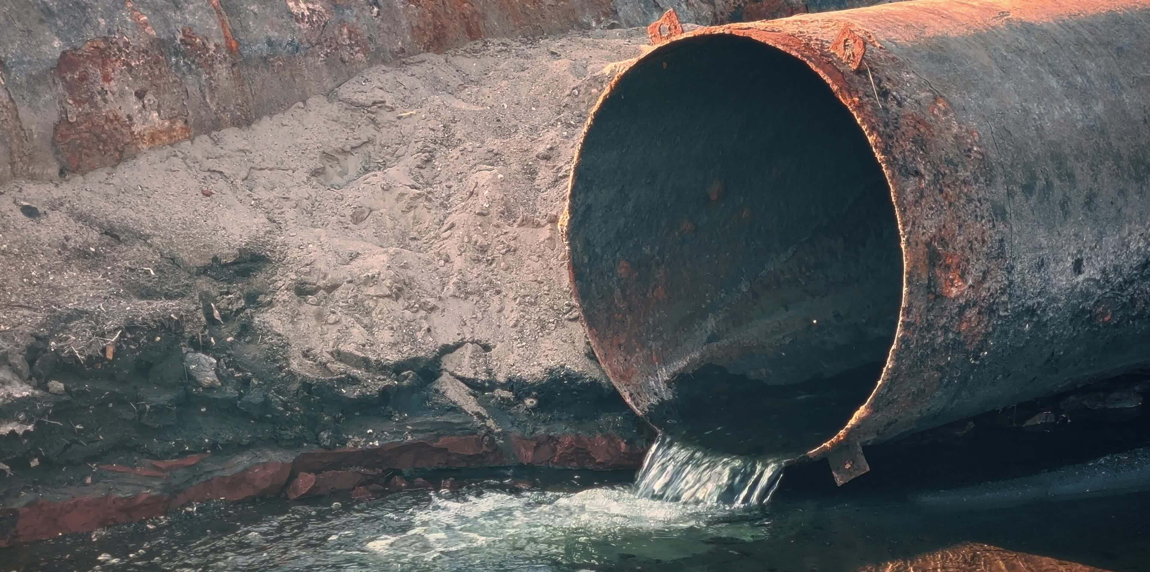
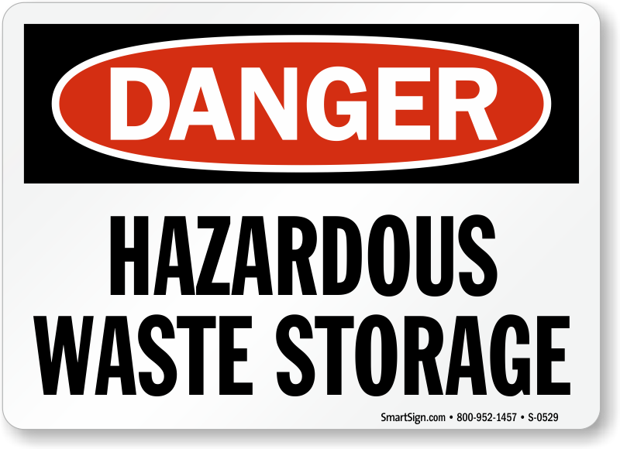
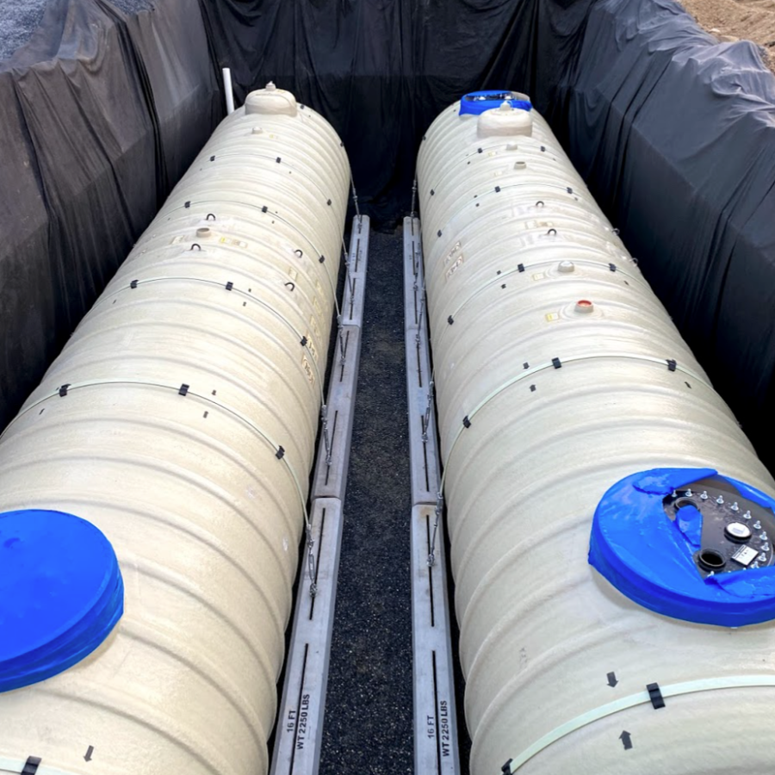
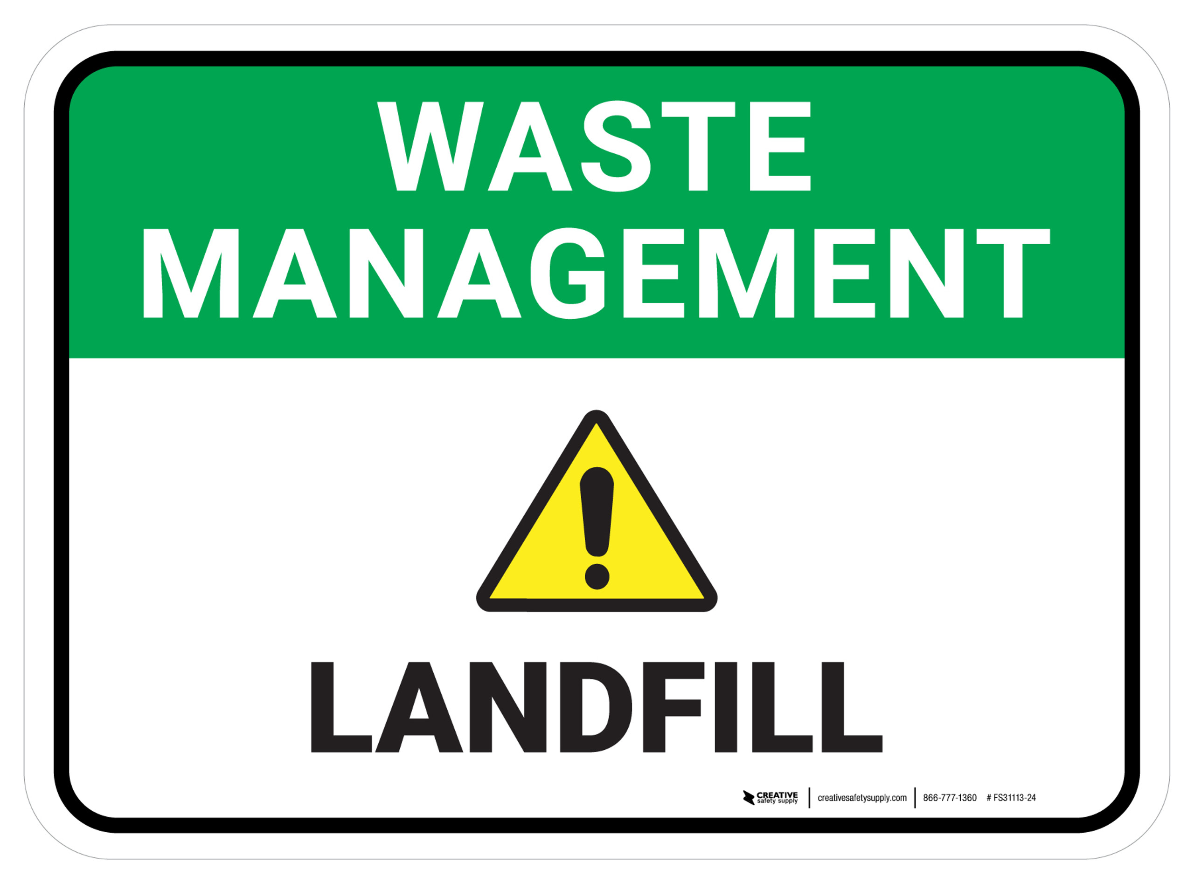
Potential Sources of Contamination
Point Sources
Concentrated Animal Feeding Operations
Underground Storage Tanks
Underground Injection Wells
Hazardous Waste Sites
Solid Waste Facilities
Oil and Gas Wells
Airports/Runways
Superfund Sites
Brownfields
Notes:
Some examples of point sources could include:
Concentrated animal feeding operations – which may have outfalls from their waste lagoons. A permitted outfall would classify these operations as a “point” source.
Underground storage tanks – which usually store petroleum products like gasoline and diesel.
Anywhere where waste is managed and permitted, such as at underground injection wells, hazardous waste sites, and solid waste facilities.
Oil and gas wells could be seen as a point source should a failure occur
Airports and runways are big ones, particularly in discussion regarding PFAS right now
And then Superfund sites and brownfields, where known contamination has previously occurred.

Slide 8
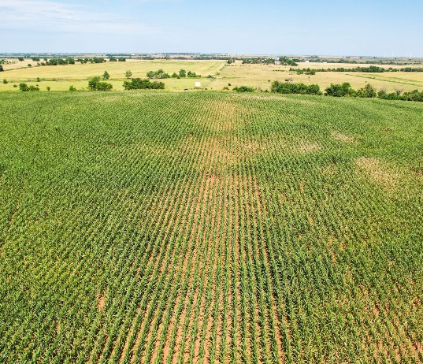
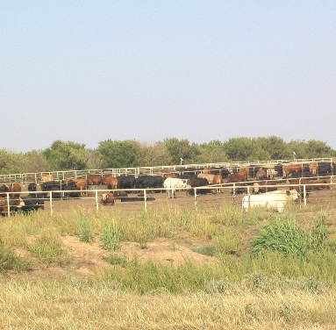
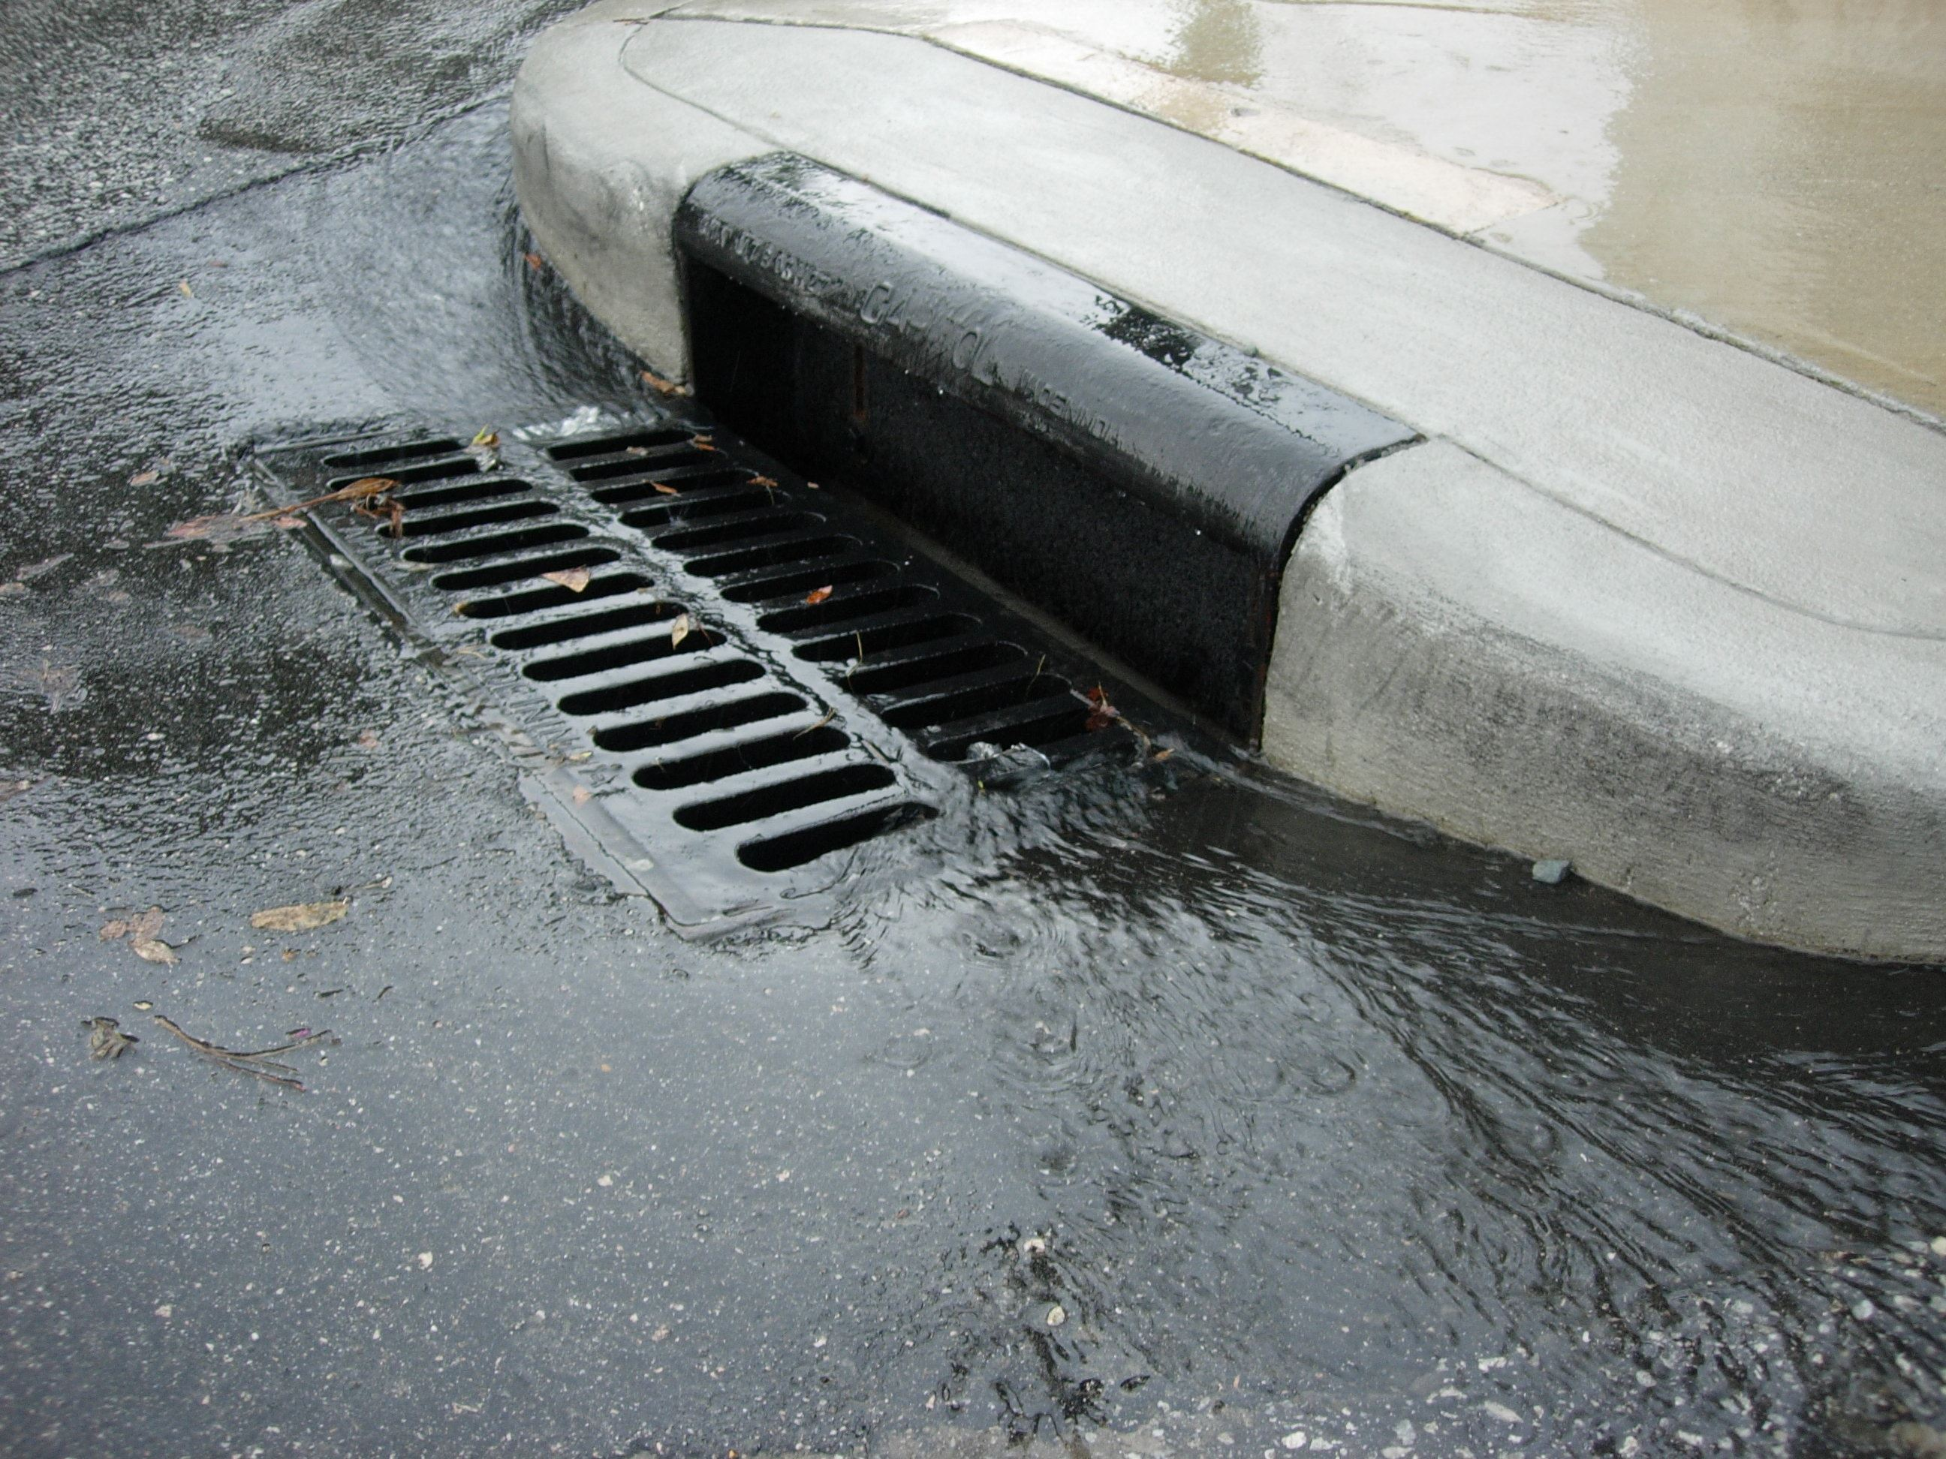
Potential Sources of Contamination
Non-point Sources
Contaminants can include:
Fertilizers, Herbicides, Insecticides
Oil and Grease
Bacteria
Nutrients
Road salts
Sediment
Notes:
On the flip side, we have the non-point sources. Since we can't label these contaminants as having come from one location, we’ll instead note the most common types of contaminants. This includes fertilizers, herbicides, and insecticides, which of course we first think of farms as being contributors of these pollutants, but we could also see these coming from suburban roads as a result of people applying these products on their lawns.
Oil and grease are common as runoff from anywhere that automobiles and machinery are present – roads, factories, driveways, gas stations, etc.
Bacteria and nutrient contributions are often tied to the keeping of livestock and farming
Road salts are self explanatory
And sediment can come from anywhere - the degradation of the banks of streams, construction sites with lots of land disturbance, the over tilling and washing away of land, and more

Slide 9
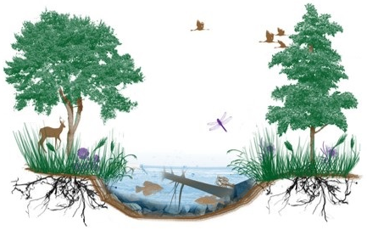
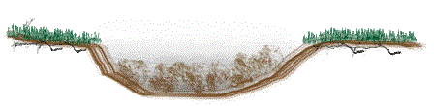
Practices and Projects for SWP
Source: Oklahoma Blue Thumb
A few examples:
Riparian area restoration
Stream bank stabilization
Benefit::
Reduce runoff of pollutants
Improvement of habitat
Reduce erosion and sedimentation
Notes:
Let's step through some examples of practices and projects that could help to protect source waters. The first *advance animation* is through the restoration of riparian areas. A riparian area is that green space that you see along the edges of a stream bank, such as in this top photo here *point to trees and grasses*. Plants act as great natural filters, so when these areas are degraded, there is less vegetation available to slow the flow of runoff and to work in the uptake and infiltration of water and contaminants. This leaves all the runoff to enter directly into the water supply.
In addition, *advance animation* restoring these areas can create major improvements to habitat. You'll see in the top photo how within the water, there is tree debris and nice shading, so fish are present! On the banks of the river, you see an increased presence of bugs, deer, and birds, who all contribute to the balance and ecology of the system. Without this provided habitat, these animals will have to find shelter and food elsewhere.
If a full riparian area restoration isn’t feasible, then even just focusing on *advance animation* stream bank stabilization will provide you a benefit that riparian area restoration would also provide. People don’t tend to think of sediment as a pollutant since its seen as natural, but when it comes to water quality, you operators know as well as I how tedious high presence of sediment can be. As you can see in the bottom photo, when large amounts of sediment enter a waterway, eventually, habitat is destroyed, benthic vegetation can be smothered, and water depths decrease. Stabilizing eroding stream banks can significantly decrease the increasing amounts of sediment that are entering your waterway(s).

Slide 10
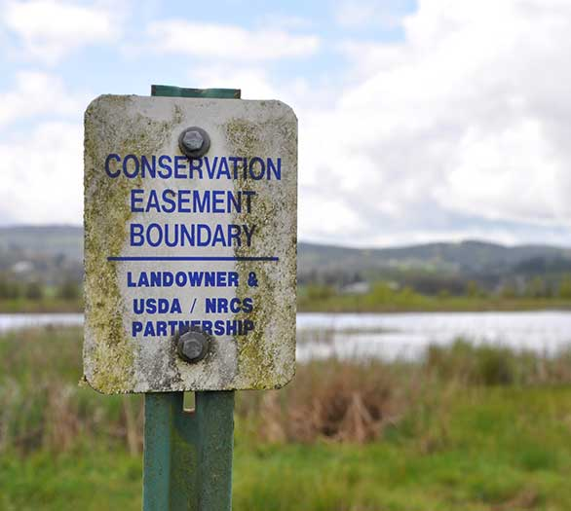
Practices and Projects for SWP
A few examples:
Riparian area restoration
Stream bank stabilization
Land protection/easements
Benefit::
Reduce pollutants near waterways
Notes:
Land protection initiatives such as through easements can be a good way to preserve the land around waterbodies and waterways. Preventing the access and conversion of land surrounding your water supply (including around wells) can reduce the risk of contaminants reaching the water. Private landowners can even receive tax breaks for the value of the land that is designated as an easement.

Slide 11
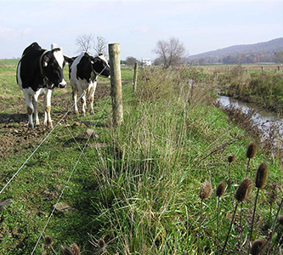
Practices and Projects for SWP
A few examples:
Riparian area restoration
Stream bank stabilization
Land protection/easements
Improved practices for agricultural and forestry activities
Benefit::
Reduce contaminants in waterways
Notes:
Working with landowners, farmers, and foresters to work on improved practices and methods can significantly help to reduce contaminants in waterways. For example, in this photo, a farmer put up fencing to keep the cattle out of the local stream. This can help to reduce the presence of E.coli and other pathogens in the water as a result of the cows directly contributing waste to the stream. Alternative water sources are then provided for the cattle.
Farmers can also consider practices such as rotational grazing, utilizing cover crops, and smarter fertilizer, herbicide, and insecticide application.

Slide 12

Practices and Projects for SWP
A few examples:
Riparian area restoration
Stream bank stabilization
Land protection/easements
Improved practices for agricultural and forestry activities
Local ordinances to limit certain activities in source water areas
Benefit::
Reduce risk of pollution
Notes:
If your utility operates under your city or township, you could look into implementing ordinances that limit certain activities or access in source water protection areas. For example, making a specific ordinance that details a more severe ramification for unapproved land disturbance within a SWP area.

Slide 13
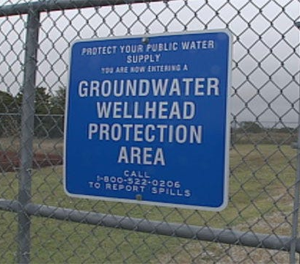
Practices and Projects for SWP
A few examples:
Riparian area restoration
Stream bank stabilization
Land protection/easements
Improved practices for agricultural and forestry activities
Local ordinances to limit certain activities in source water areas
Educating businesses and the community on pollution prevention and source water protection
Benefit::
Create awareness and reduce pollution
Notes:
There are uncountably more ideas for practices and projects out there, but one last one to leave you with, and it is arguably the most approachable, is simply education! We highly encourage you to create an organized effort to educate the businesses and people in your community regarding pollution prevention, how that ties to source water protection, and why that should matter to them.

Slide 14
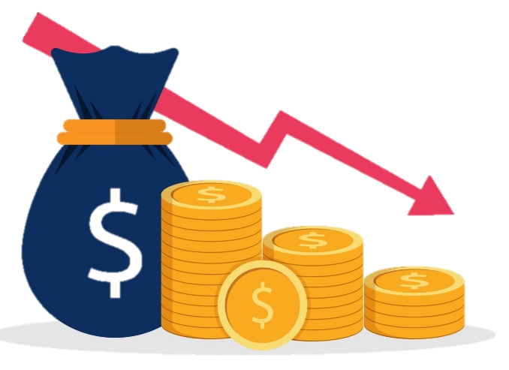
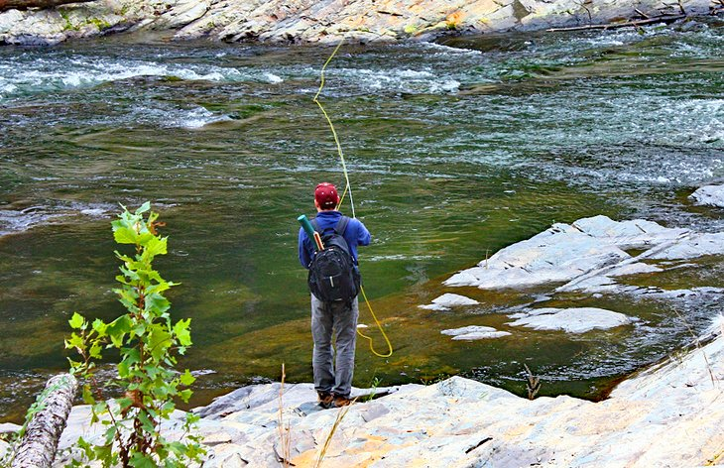
Benefits of Source Water Protection
Helps reduce treatment costs
Defer the need for complex treatment
Protects the availability and quantity of water supplies
Protecting water quality for wildlife and recreation
Notes:
When you work on educating the public, or even educating yourself on source water protection, its good to reinforce the benefits of these practices.
The cleaner we keep our water sources, the cheaper it is to treat the water, and the longer bills can remain at lower costs – both for you as the utility, but also for your customers.
Cleaner source water will also mean deferred need for complex treatment. The better the source water, the fewer treatment needs you have.
Preserving source waters also protects the availability and quantity of water supplies. As an example, the more sedimentation that occurs, the more likely it is for water levels to decrease year after year.
Lastly, I’m sure many of us really appreciate having clean water bodies and waterways for us to enjoy recreationally. The better we preserve our waters, the longer we will see thriving wildlife and the continued enjoyment of fishing, hunting, swimming, and boating, just to name a few.

Slide 15
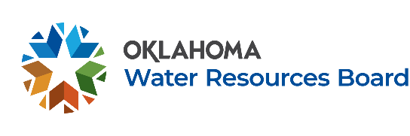
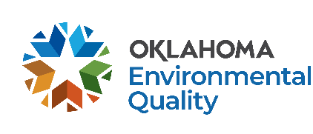
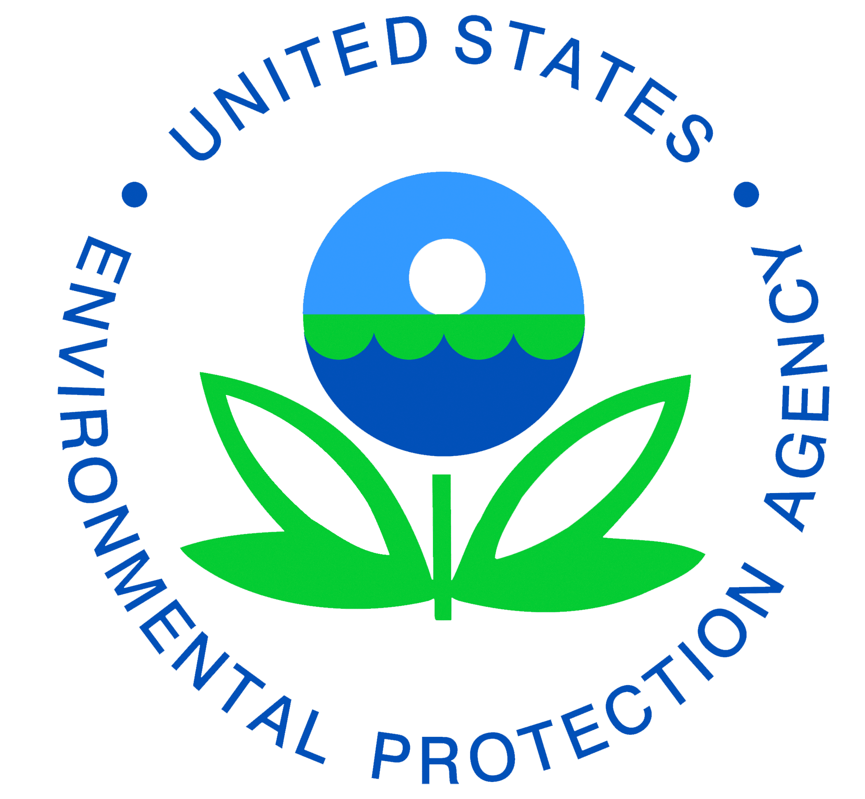



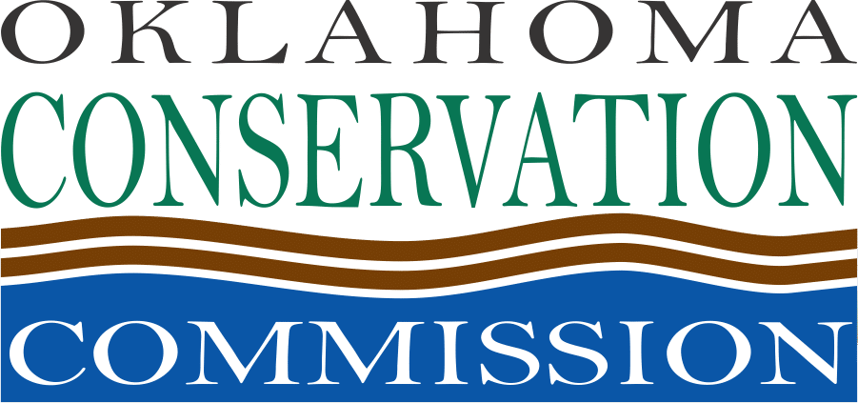
Funding for Source Water Protection
Available on a state and federal level.
Can be accessed by local governments, entities, and customers.
Specific to the kind of work to be completed.
ODEQ SWP funding handout available.
Notes:
So how do you even begin to approach these projects when we all know money usually ends up being the limiting factor? Well, there is money available out there to be specifically spent on this topic! You can find monies available on the state as well as federal level for source water protection, and depending on the funds, it can be accessed by various peoples such as local governments, entities, and individual landowners.
Many of these funds are very specific to what kind of work they will pay for, so it can take some research to determine which source of money would best fit your needs, but that’s why we at DEQ developed a SWP funding handout that can hopefully make that research process easier. To access a copy of this handout, visit the Source Water Protection page on the DEQ website, or reach out to the capacity development team and we can provide one for you.

Slide 16
Oklahoma DEQ’s
Source Water Protection Program
Notes:
Now we’ll briefly go over what participating in our Source Water Protection Program will provide for you. This program is free technical assistance provided to you as the system. Most of the technical work is done FOR YOU by DEQ, and anything we work on together will reflect greatly on your efforts as a system to your community and neighbors.

Slide 17
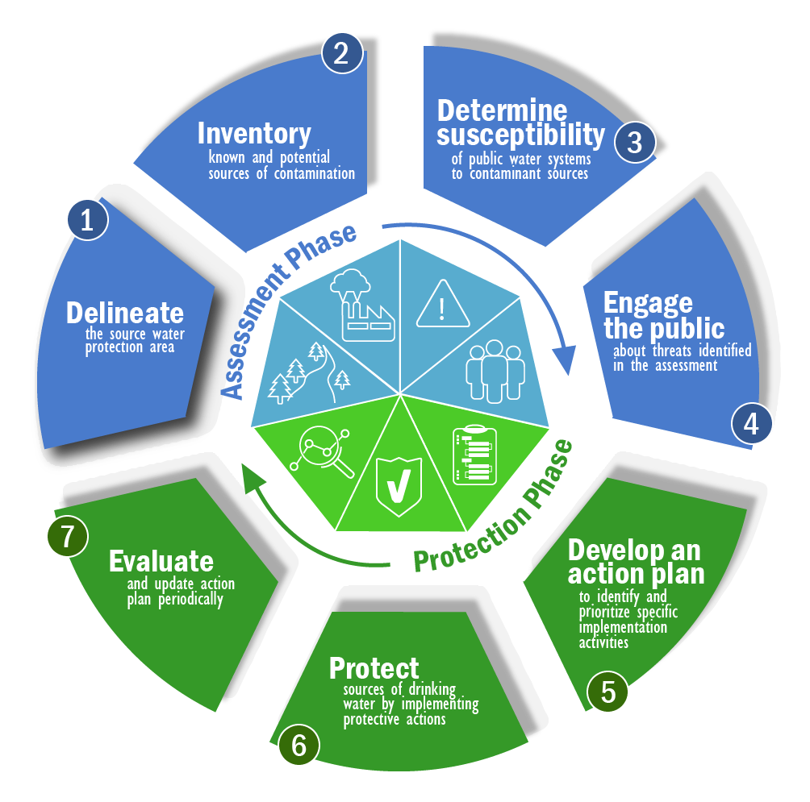
7 Components of a Source Water Protection Program
Source: EPA.gov
Notes:
The DEQ SWP program is based on EPA’s 7 components of a Source Water Protection Program. We’ll go through each of these steps in the next couple of slides, but you’ll see that there are two primary phases to a good SWP program: The Assessment Phase, and then the Protection Phase. The Assessment Phase is primarily completed by DEQ on your behalf, but with the protection phase, we pass the baton off to you to implement practices and projects in your community and at your water system. Don’t fret though, DEQ has developed numerous resources to be able to assist you in planning for a successful protection phase.

Slide 18
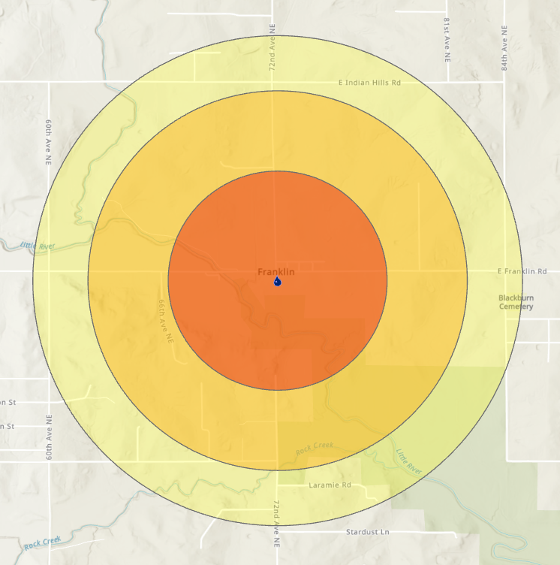
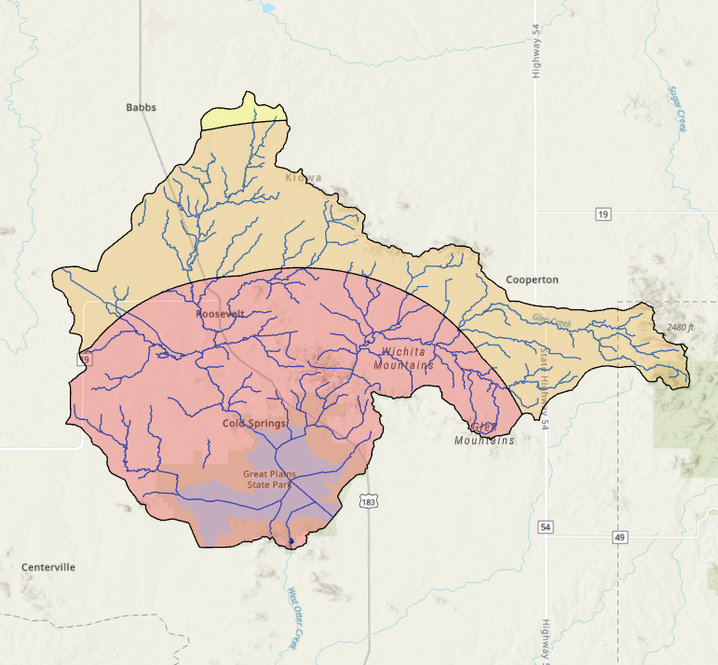
STEP 1 - Delineate
SWP Program Process
Zone C
Zone C
Zone B
Zone B
Groundwater
Calculated Fixed Radius
Zone A
Surface Water
Watershed Boundary
Zonation – Every 5 miles
Zone A
Notes:
To kick off the assessment phase, DEQ will schedule a meeting with you to gather a few details about your water system. After all the necessary details are in hand, we will begin working on your assessment!
A SWP assessment begins with a delineation phase. This delineation is of the Source Water Protection Area (SWPA) for each of your sources. These protection areas are then designated into 3 zones for easier distance visualization.
If your source is a groundwater well, then a calculated fixed radius method will be used. This will draw 3 calculated circles around your well based on certain features of your well or the soils surrounding it.
If your source is a surface water body, then a watershed-based boundary will be determined. A different zone for surface sources is established every 5 miles.

Slide 19
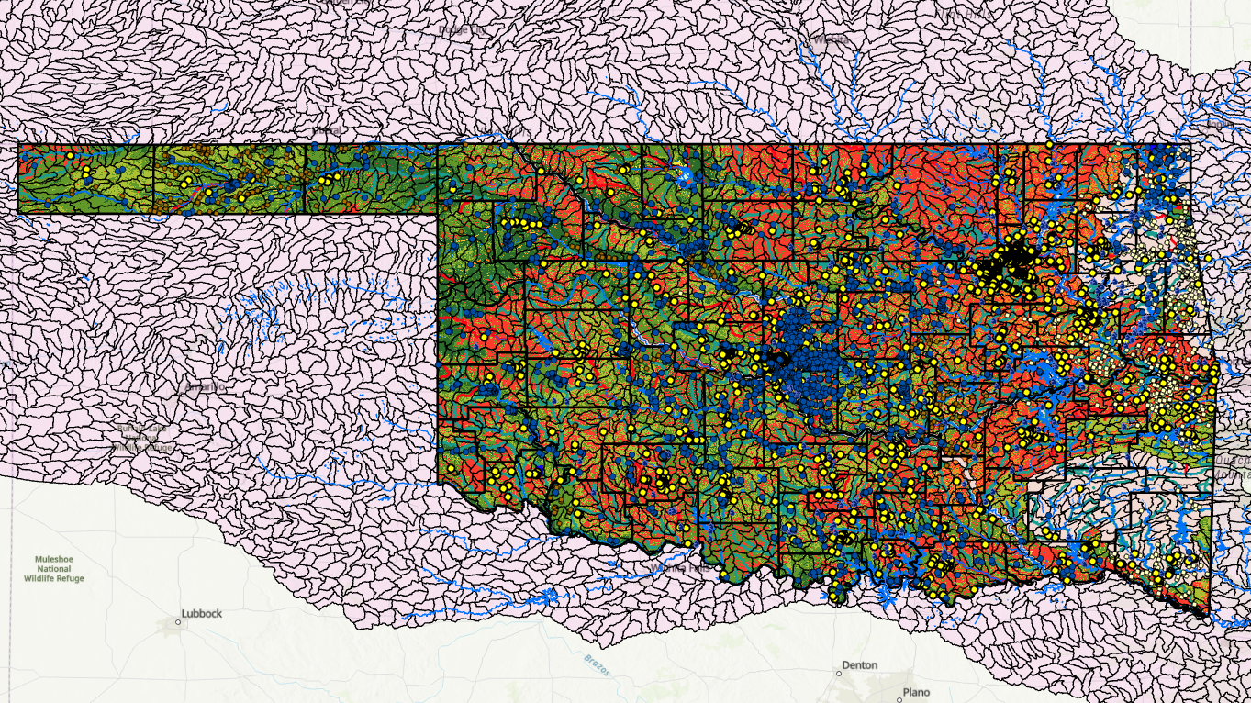
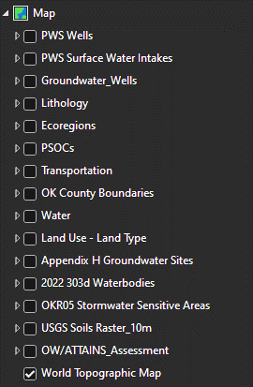
STEP 2 - Inventory
SWP Program Process
Compiled data from various sources to make a master map
Will use this map to inventory points of interest within the delineations
Notes:
With the areas that we care about now delineated, we move into the inventory step. Since we don’t have enough personnel or time to do field assessments, we have pulled data from numerous federal, state, and local resources to create a master map. We use this map to inventory all of the SWP points of interest within our source water protection areas.
*Advance slide* Here is an example of what this map looks like with only a couple of layers selected to be displayed. As you can see, it’s a lot of information to sift through.

Slide 20
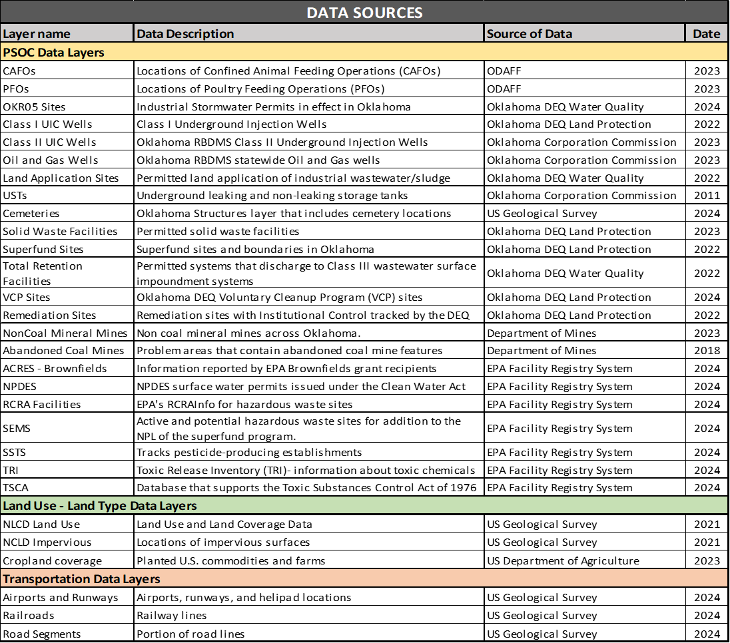
STEP 2 - Inventory
SWP Program Process
Data sources include:
Potential sources of contamination (PSOCs)
Land Uses
Transportation
Notes:
The types of features that are included in this map are potential sources of contamination, or PSOCs as we call them (which includes the locations of many POINT sources of contamination), land uses (such as if an area is a city, forest, or cropland), and transportation, which we primarily focus on the airports in this group.

Slide 21
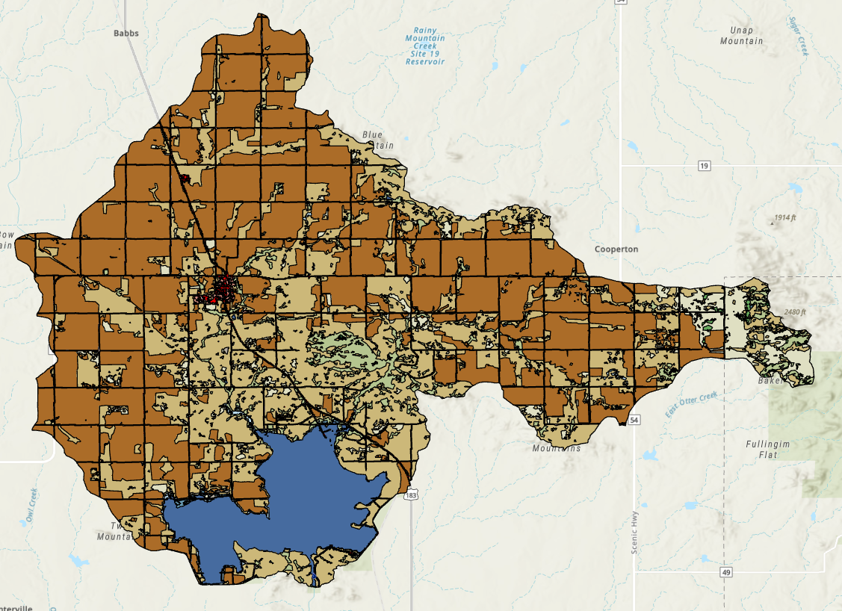
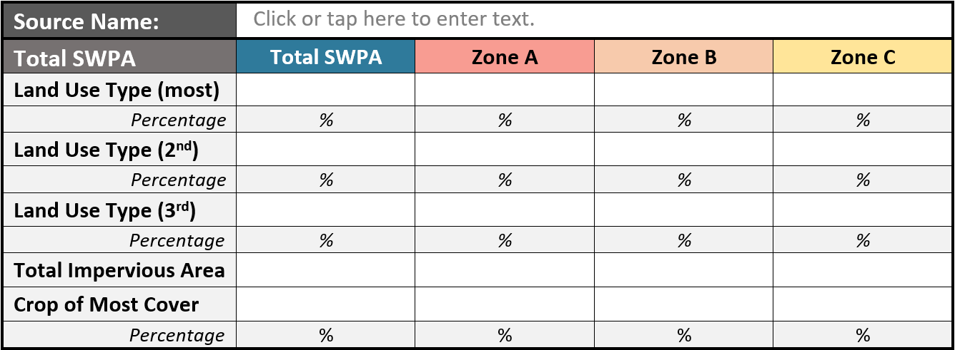
STEP 2 - Inventory
SWP Program Process
Summarizing land use:
General Characterization
Crop type
Impervious Area
Notes:
As part of the inventory, we will conduct a land use analysis, This will tell you what your primary land use types are, and if cropland is one of them, we will do further analysis into what types of crops are the most commonly grown. A percentage of how much of your SWP area is impervious area will also be provided. All of this land use information can provide insight into run-off in your area.

Slide 22
STEP 3 – Determine Susceptibility
SWP Program Process
Source Sensitivity
Source Vulnerability
Source Susceptibility
Notes:
The third of the three primary steps of the assessment is determining susceptibility. In the DEQ SWP Program, a susceptibility score is composed of an evaluation of sensitivity and another of vulnerability.

Slide 23
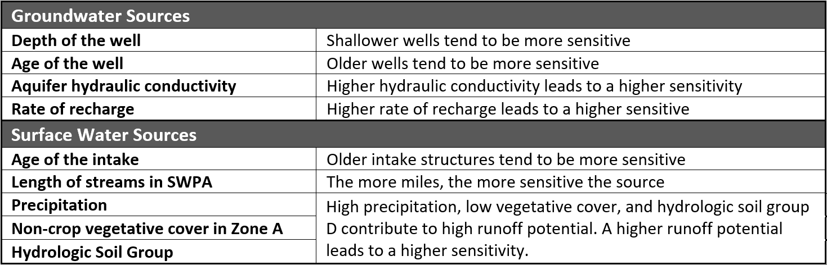
STEP 3 – Determine Susceptibility
SWP Program Process
Source Sensitivity
Notes:
Each water source for your system will receive a sensitivity score that is based on these parameters. What we are trying to determine here is how sensitive your intake/well is to actually seeing contaminants. For example, for groundwater sources, if a well is shallower and older, then it will be ranked as more sensitive since shallower groundwater tends to have higher contaminants and older wells tend to a higher likelihood for leaks, breaks, and other mechanical and structural issues. We will also look at aquifer hydrologic conductivity and rate of recharge to determine how freely water moves underground nearby your well.
For surface water sources, you’ll see we look at the age of the intake, the total length of streams in the SWPA (as that can insinuate more pathways for contaminants to travel), and then we look at precipitation, vegetative cover, and hydrologic soil group. Those last three parameters together can provide an evaluation as to the runoff potential within your SWPA.

Slide 24

STEP 3 – Determine Susceptibility
SWP Program Process
Source Sensitivity
Source Vulnerability
Consideration of Potential Sources of Contamination (PSOCs), their Risk Factor, and their proximity to the source intake/well.
Notes:
Vulnerability on the other-hand is calculated by looking at the risk factors and proximities of your inventoried potential sources of contamination. Your source is more vulnerable to PSOCs that are located closer to your source and that bring a higher risk factor, such as a petroleum storage tank that has a long history of leaking.

Slide 25
STEP 3 – Determine Susceptibility
SWP Program Process
Source Sensitivity
Source Vulnerability
Source Susceptibility
Combines sensitivity and vulnerability and may consider protection measures already implemented.
Sensitivity + Vulnerability = Susceptibility
Notes:
With sensitivity and vulnerability known, both scores are combined to then produce an overall susceptibility score for each source. If you already have implemented source water protection initiatives, your score could be slightly improved here.

Slide 26
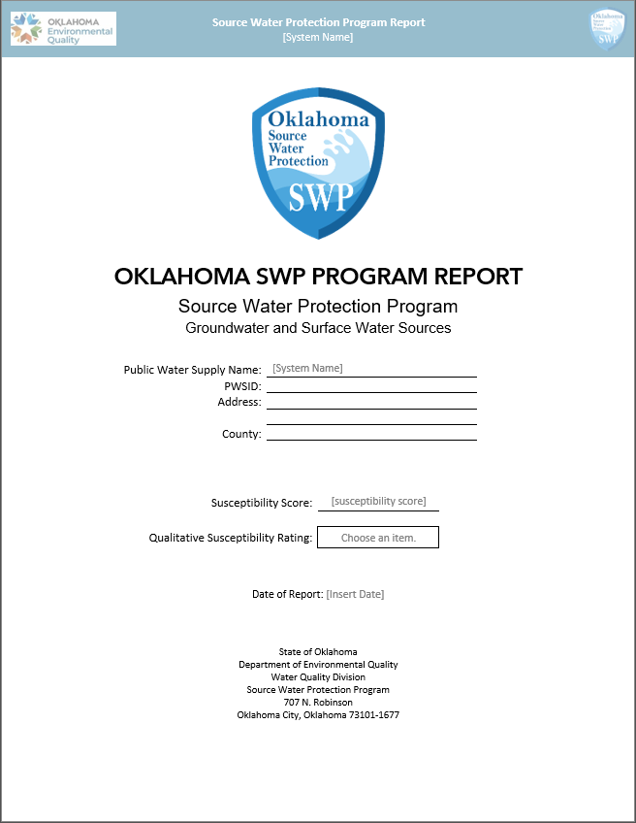
STEP 4 – Engage the Public
SWP Program Process
Provided with a comprehensive Source Water Protection Program report.
Details and discusses the results of the assessment
Provides suggestions on BMPs, funding sources, community engagement, and project ideas.
Includes informational flyers on relevant topics to the system.
Notes:
The last step in the assessment phase is providing you with a copy of your assessment report! Not only will this report contain details on the results of your assessment, but it will also provide you with various suggestions regarding best management practices, funding sources, community engagement, and project ideas as well as informational flyers on these topics and others relevant to your system.

Slide 27
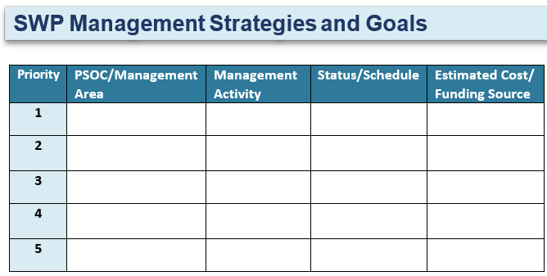
STEP 5 – Develop an Action Plan
SWP Program Process
DEQ Action Plan template is available for water systems to use.
Action Plan includes details on:
Best management practices
When to implement SWP projects
Expected cost of projects
Where to find funds.
Capacity Development is available to assist with plan development
Notes:
Then we enter the Protection phase where the first step is to create an action plan. DEQ has created a template that will help walk you through creating an action plan that details out what best management practices you want to implement, when you plan to implement them, what the expected cost of the practice or project will be, and how you obtain those funds. There are ideas and cues provided in the template, but if you would like additional input and guidance, DEQ Capacity Development is available to setup a site visit to work through the template together.

Slide 28
STEP 6 – Protect/Implement Action Plan
SWP Program Process
It is up to the system to implement their action plan
STEP 7 – Evaluate
Update Action Plans periodically
Would like to re-assess and update SWP Assessments every 5 years
Notes:
The last two steps of the protection phase are implementing the action plan and then evaluating your SWP efforts and goals. We leave it in your hands as the system to be able to implement the action plan that you developed. We highly encourage you to review your action plan periodically to determine if updates are needed, and we suggest you come back to DEQ for a reevaluation of your assessment every 5 years or so.

Slide 29
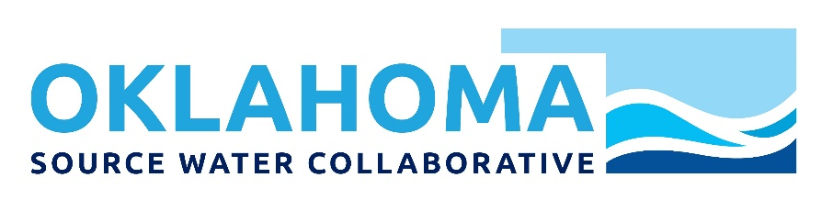
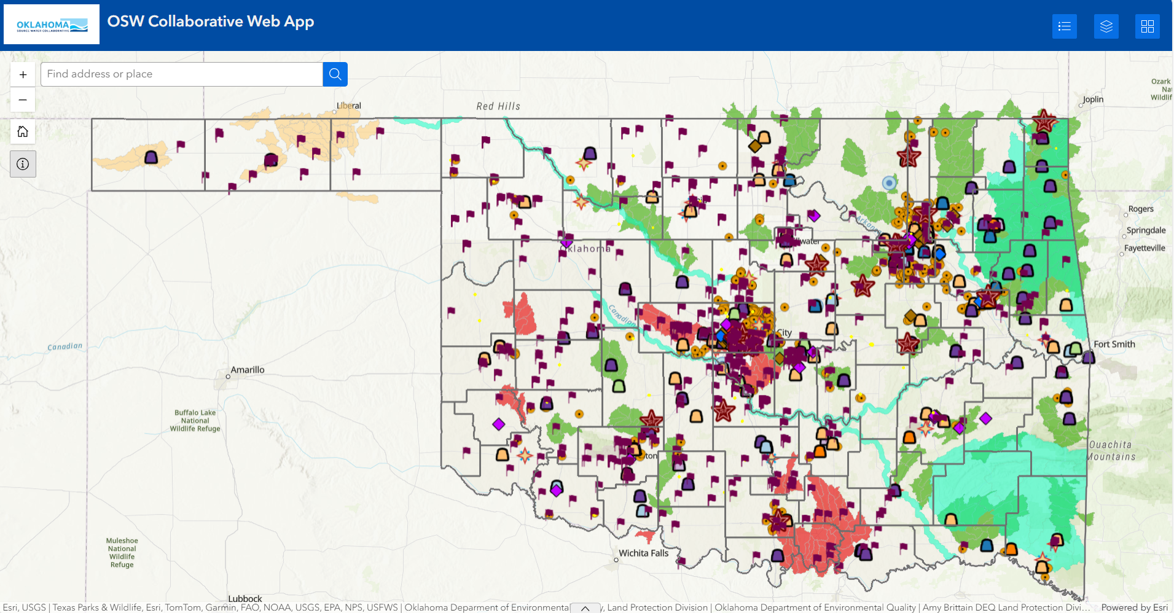
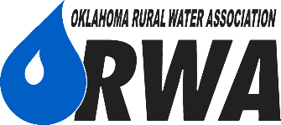

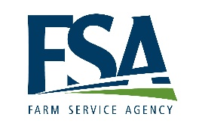

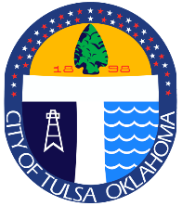
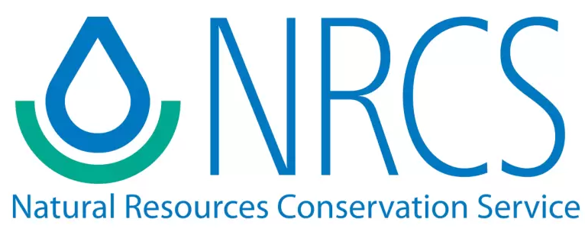
Oklahoma Source Water Collaborative
Members:
Notes:
The last thing I’d like to mention in the world of Source Water Protection in Oklahoma is the Oklahoma Source Water Collaborative.
DEQ is a member of this collaborative along with all of the partners you see here on the screen, which includes federal, state, and local level partners. This group meets regularly to identify the source water protection needs of surface and ground water systems across the state, as well as to facilitate collaboration across the agencies involved. This past year, the collaborative worked on creating a comprehensive GIS map that houses a multitude of layers relating to the topic of Source Water Protection. This map is now publicly available and can be accessed via the source water protection page of the DEQ website. Here, you can interact with all of the layers that appear in your source water assessment as well as many more!

Slide 30
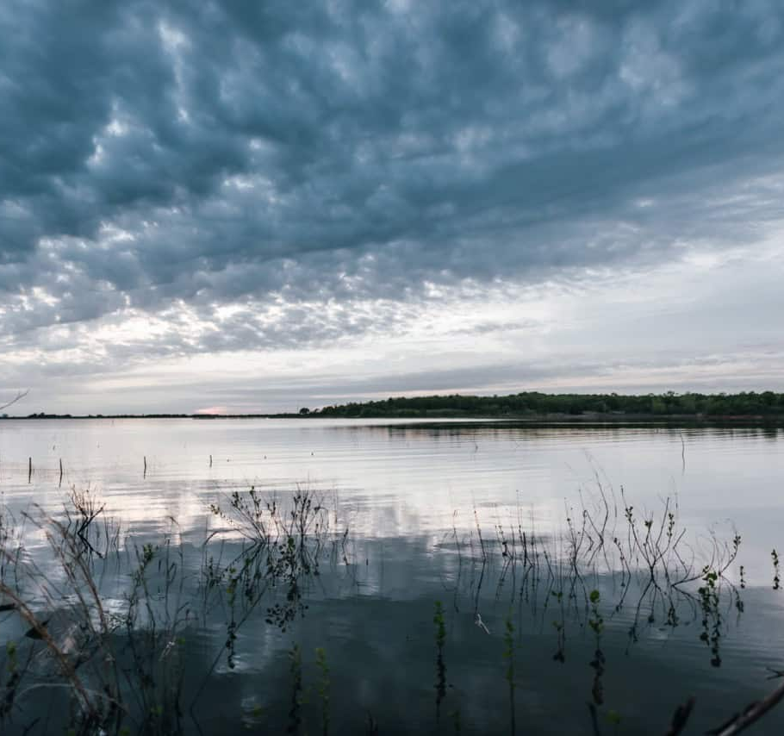
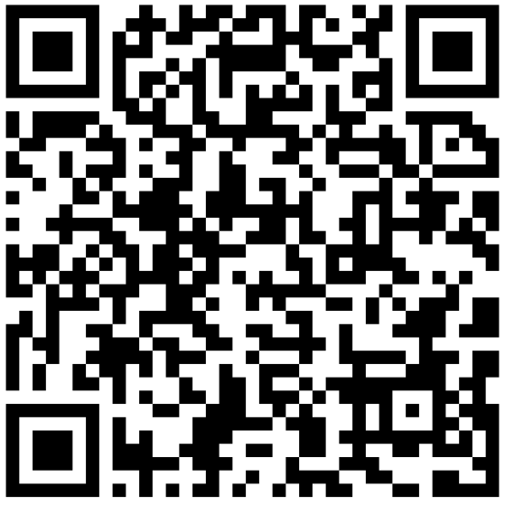
Contact Us
Source Water Protection Program
Capacity Development Section
DEQ.CapDev@deq.ok.gov
(405) 702-8141
Notes:
And that is all I have for you today. If you are interested in any of the resources mentioned today or if you would like to begin the assessment process with us, visit the SWP Program page on the DEQ website, scan this QR code, email us at DEQ.CapDev@deq.ok.gov, or call the lead of our SWP program at the number here and we will get you setup! Thank you all for listening. Are there any questions?

