Slide 1
Sanitary Survey Preparation
Department of environmental quality

Slide 2
Overview
Operations
Ground Water – Wells
Surface Water – Intakes
Clarifiers
Filters
Membranes
Chemicals
Chlorine Gas
Residuals & Recycling
Calibrations
Lab & SCADA
Storage
Pump Stations
Distribution
Financial

Slide 3
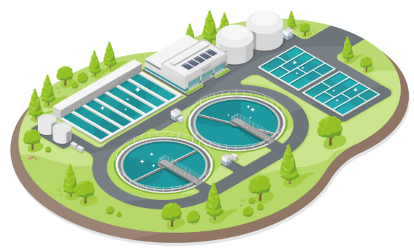
operations
Population, Number of Customers
Average & Max Day Demand
Backup Power
Emergency Connections
Purchase or Sell Water to
Operator Names & Certification Numbers

Slide 4
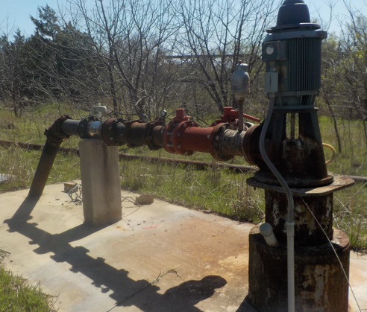
Ground water – wells
Security
Protected from surface draining and flooding
Well slab, sanitary seal
Vent
Drawdown
Depth of well
Smooth-nosed sample tap
Pressure gauge
Flow meter
Shutoff valve
Pump to waste with splash pad
Check valve
Screened air relief valve

Slide 5
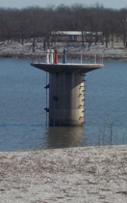
surface water – intakes
Pollution sources within 300 feet
No Trespassing signs
Intake levels
Intake depths
Trash screen or rack
Drought or Harmful Algal Blooms

Slide 6
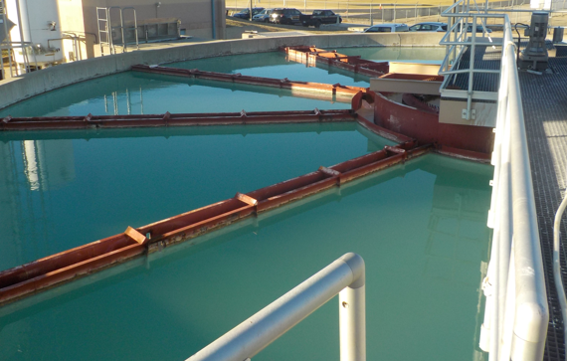
CLARIFIERS
Dimensions of flocculation and sedimentation basins, rapid mix, filters
Weirs level
Last inspected
Chemicals added

Slide 7
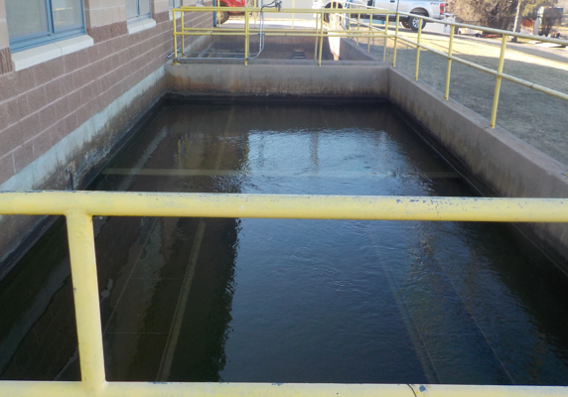
FILTERS
Number of layers and type of media
Head loss gauges
Rate of flow controllers
Turbidimeters (IFE and CFE)
Flow meters
Filter to waste
Backwash flow meter and frequency

Slide 8
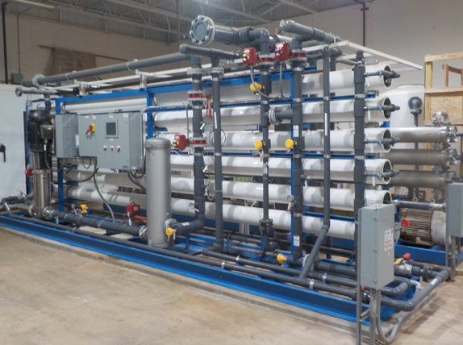
membrane
Treatment objective
Finished water quality goals
Pre-treatment or anti-scalant
Pressure gauges, flow meters, sample taps, turbidimeters, alarms
Backwash, direct integrity testing and clean-in-place frequency
How you prevent membrane fouling
Where does the wastewater flow to?

Slide 9
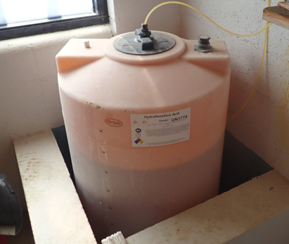
chemicals
ANSI or NSF certified
Properly labeled
Reported on MOR
Spill containment
Manually or automatically controlled
Backup pumps
Frequency of checking the feed rate

Slide 10
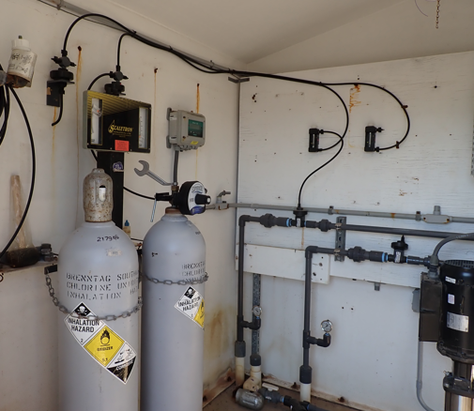
Chlorine gas
Chlorine Room
  SCBA
  Vents
  Scales & Chained
  Window & Crash Bar
  Labeled Lines
  Fan & Light Switch
  Ammonia
  Tank Storage
  Alarm
  Emergency Response Plan
Contact Time (CT) : Baffling, pH, Temperature, Chlorine Residual, Volume in gallons, Flow Through Rate in GPM

Slide 11
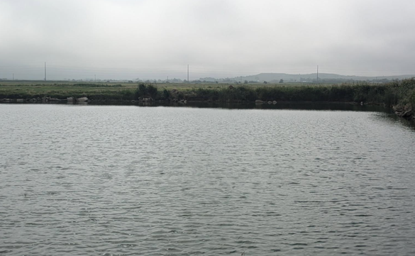
Residuals & recycling
No vegetation or erosion
Cleaning frequency
Discharge permit
3 feet of freeboard
Sludge or decant valves
Residual Management Plan
<10% recycled

Slide 12
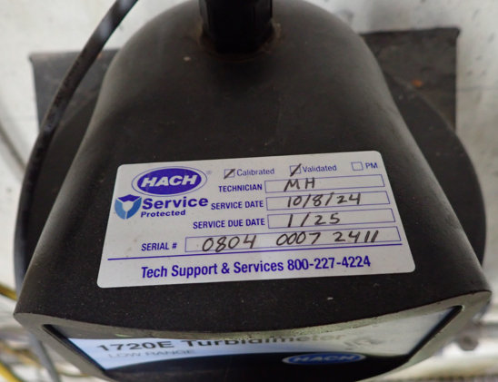
calibrations
Frequency?
Turbidimeters
Chlorine analyzer
Lab equipment:
  Pocket colorimeters
  Turbidimeter
  pH, alkalinity, phosphate, nirate, etc.

Slide 13
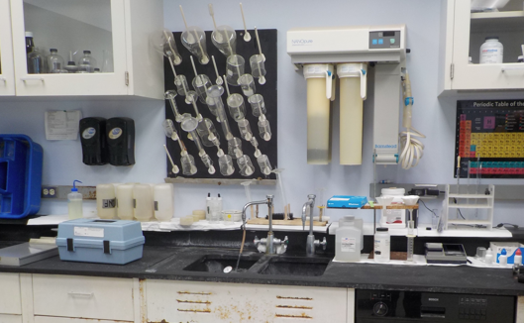
Lab & SCADA
Data verification
Types of testing done in the lab
Frequency of process control tests
Bound volume of daily lab testing results
MOR review

Slide 14
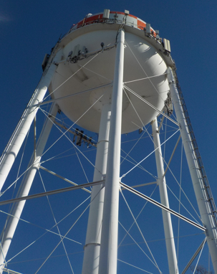
storage
Capacity
Last inspected – Screened vent and hatch
Separate inlet and outlet
Can it be bypassed?
Fence, barbed wire and No Trespassing Signs
Overflow 12-24 inches with flex gate
Protected from corrosion

Slide 15
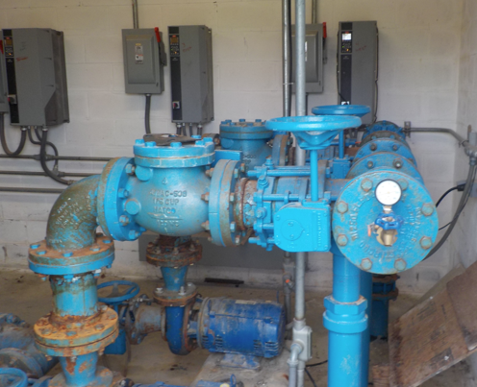
Pump stations
Security
Backup power
Surface drainage diverted
No incompatible store
Redundant pumps
Isolation valves
Pressure gauges and flow meters

Slide 16
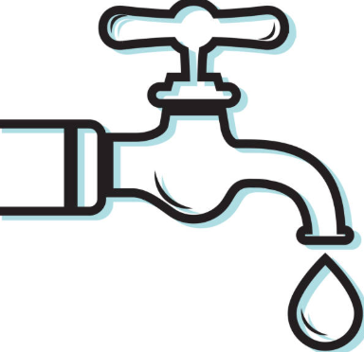
distribution
Adequate RTCR, LCR and DBP sites
Pipe materials
Number of dead ends in the system
Up to date system maps (MPP?)
Valve exercise program, isolation valves
Flushing Log? Who conducts it? Frequency? What is being recorded?
Disinfect lines and towers before installed

Slide 17

financial
Annual budget
Emergency fund
How system bills for water
Long range capital improvement plan
Asset management plan
Funding Agency Coordinating Team
  https://oklahoma.gov/owrb/financing/forms-and-guidance.html
  https://oklahoma.gov/content/dam/ok/en/owrb/documents/financing/loans-and-grants-resource-guide.pdf

Slide 18
conclusion
Operations
Ground Water – Wells
Surface Water – Intakes
Clarifiers
Filters
Membranes
Chemicals
Chlorine Gas
Residuals & Recycling
Calibrations
Lab & SCADA
Storage
Pump Stations
Distribution
Financial

Slide 19


