Slide 1
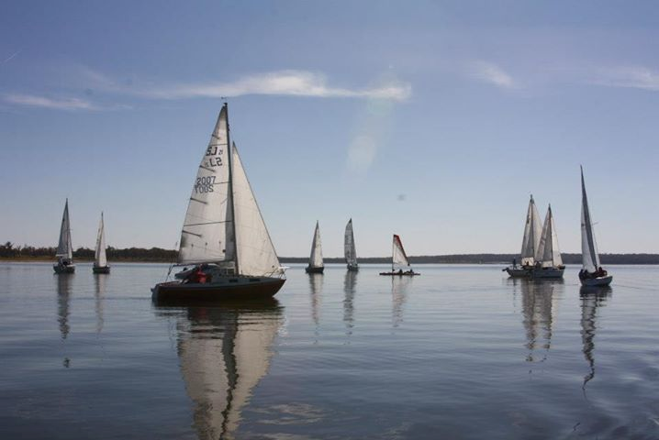

Lake Thunderbird TMDLs
Public Meeting
July 23, 2013

Slide 2
Agenda
Opening remarks
Project background
Overview of the models
TMDLs and load reductions
Recommendations & permit requirements
Informal question-answer session
Comments for the record
Project website: http://www.deq.state.ok.us/WQDnew/tmdl/thunderbird/
index.html

Slide 3


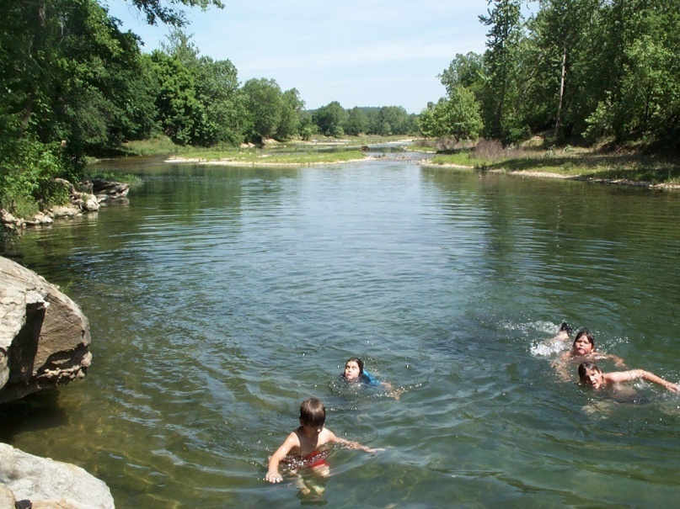
The Clean Water Act
First Adopted 1972
Clean Water Goals:
July 1, 1983
Wherever attainable, Fishable Swimmable water quality
1985
Eliminate discharge of pollutants

Slide 4
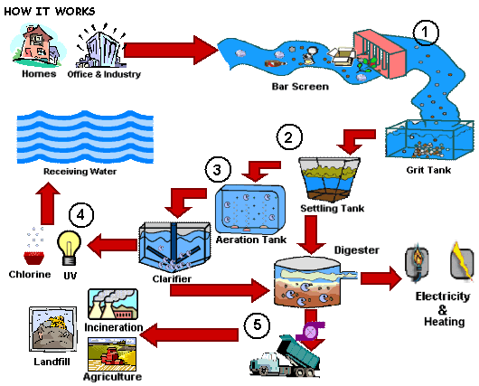

How Do We Get There ???
Two Step Approach
Technology-Based Limits For All Point Sources
Additional Water Quality Based Controls To Meet Water Quality Standards

Slide 5
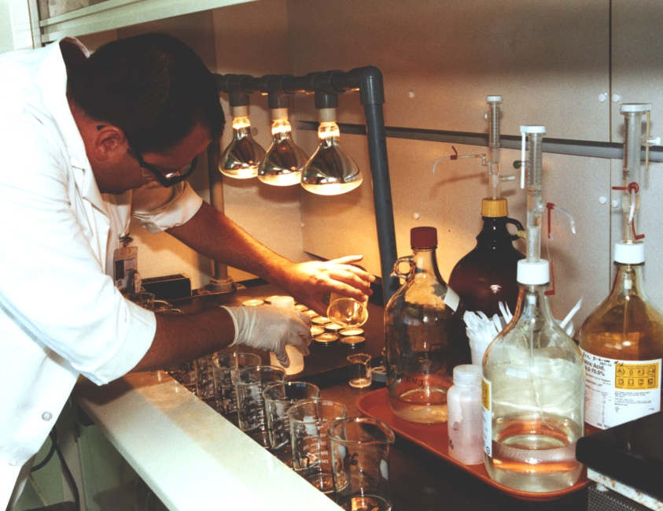
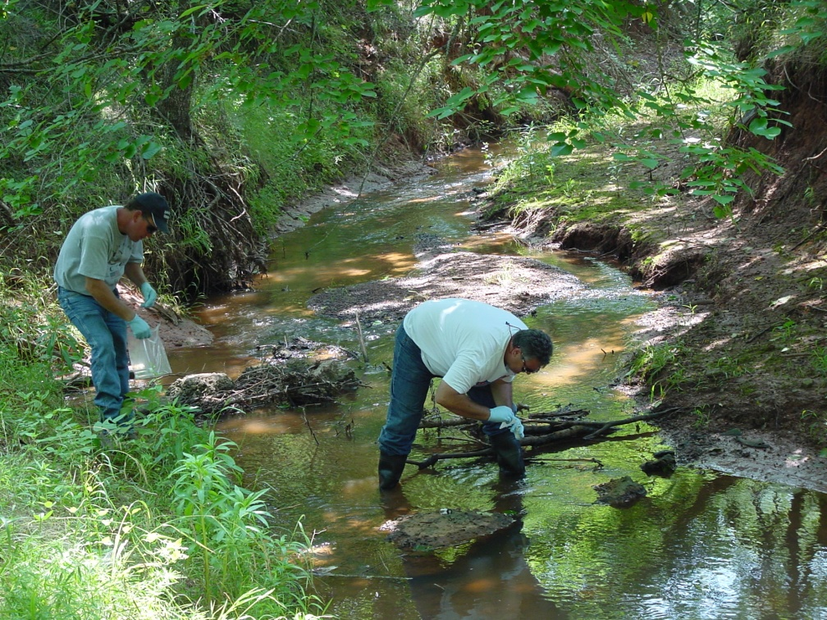
Identifying Problem Areas
Compare Monitoring Results
To
Water Quality Standards
Set Priorities
Compile Problem Areas And Priorities In the 303d List

Slide 6
Lake Thunderbird Impairments
Aquatic Life
High Turbidity
  Target
    < 10% exceeds 25 NTU
Low Dissolved Oxygen
  Targets
    When stratified
      5 mg/L at surface
      < 50% Lake volume below 2 mg/L
    When NOT stratified
      5 mg/L for the entire water column

Slide 7
Lake Thunderbird Impairments
Drinking Water
High Chlorophyll a
  Target
    Average < 10ug/L

Slide 8

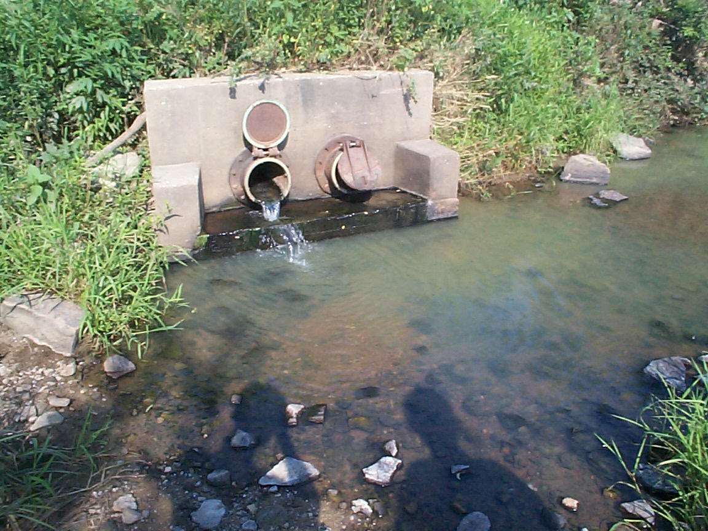
The TMDL
Amount Of Pollution A Waterbody Can Receive Without Violating Water Quality Standards
Point Sources
Wasteload Allocations
Nonpoint Sources
Natural Background
Load Allocations

Slide 9
The TMDL Pie
Total
Unallocated
Total Wasteload
Allocations
W
L
A
1
MOS
WLA 2
Reserve
WLA 3
Background
NPS 2
NPS 1
Total Load
Allocations

Slide 10
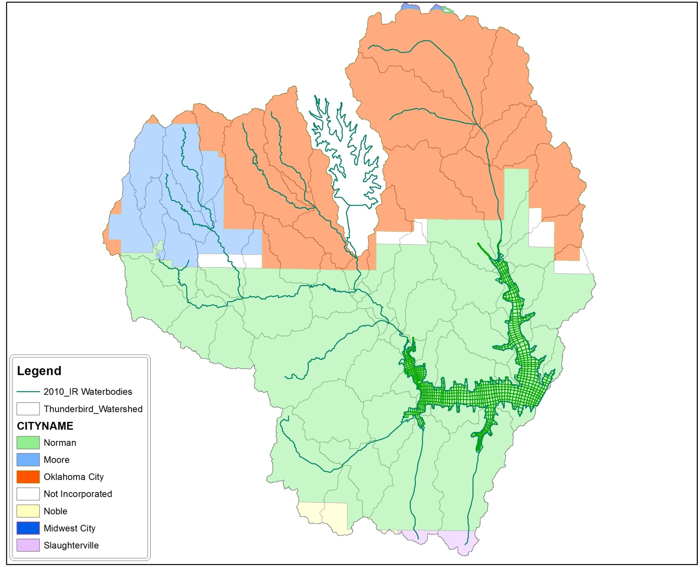
Regulated
Point
Sources

Slide 11
Project Timeline
Monitoring (2008 – 2009)
TMDL development (2010 – )
First public meeting (May 2012)
TMDL report to EPA (Nov 2012)
Public comments
Response to comments
Finalize TMDLs

Slide 12
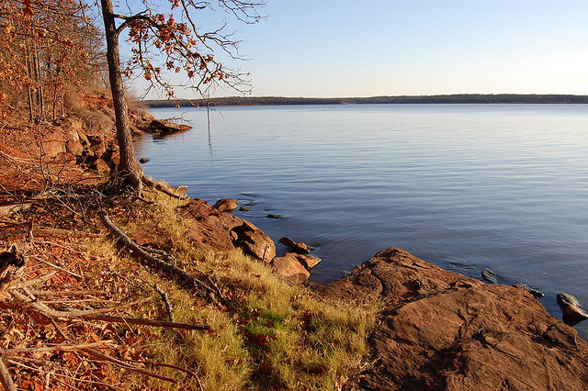

Lake Thunderbird
Watershed-Lake Model
Lake Thunderbird TMDL Project Informational meeting
July 23, 2013
Norman, Oklahoma
Andrew Stoddard
Dynamic Solutions, LLC
Knoxville, TN

Slide 13
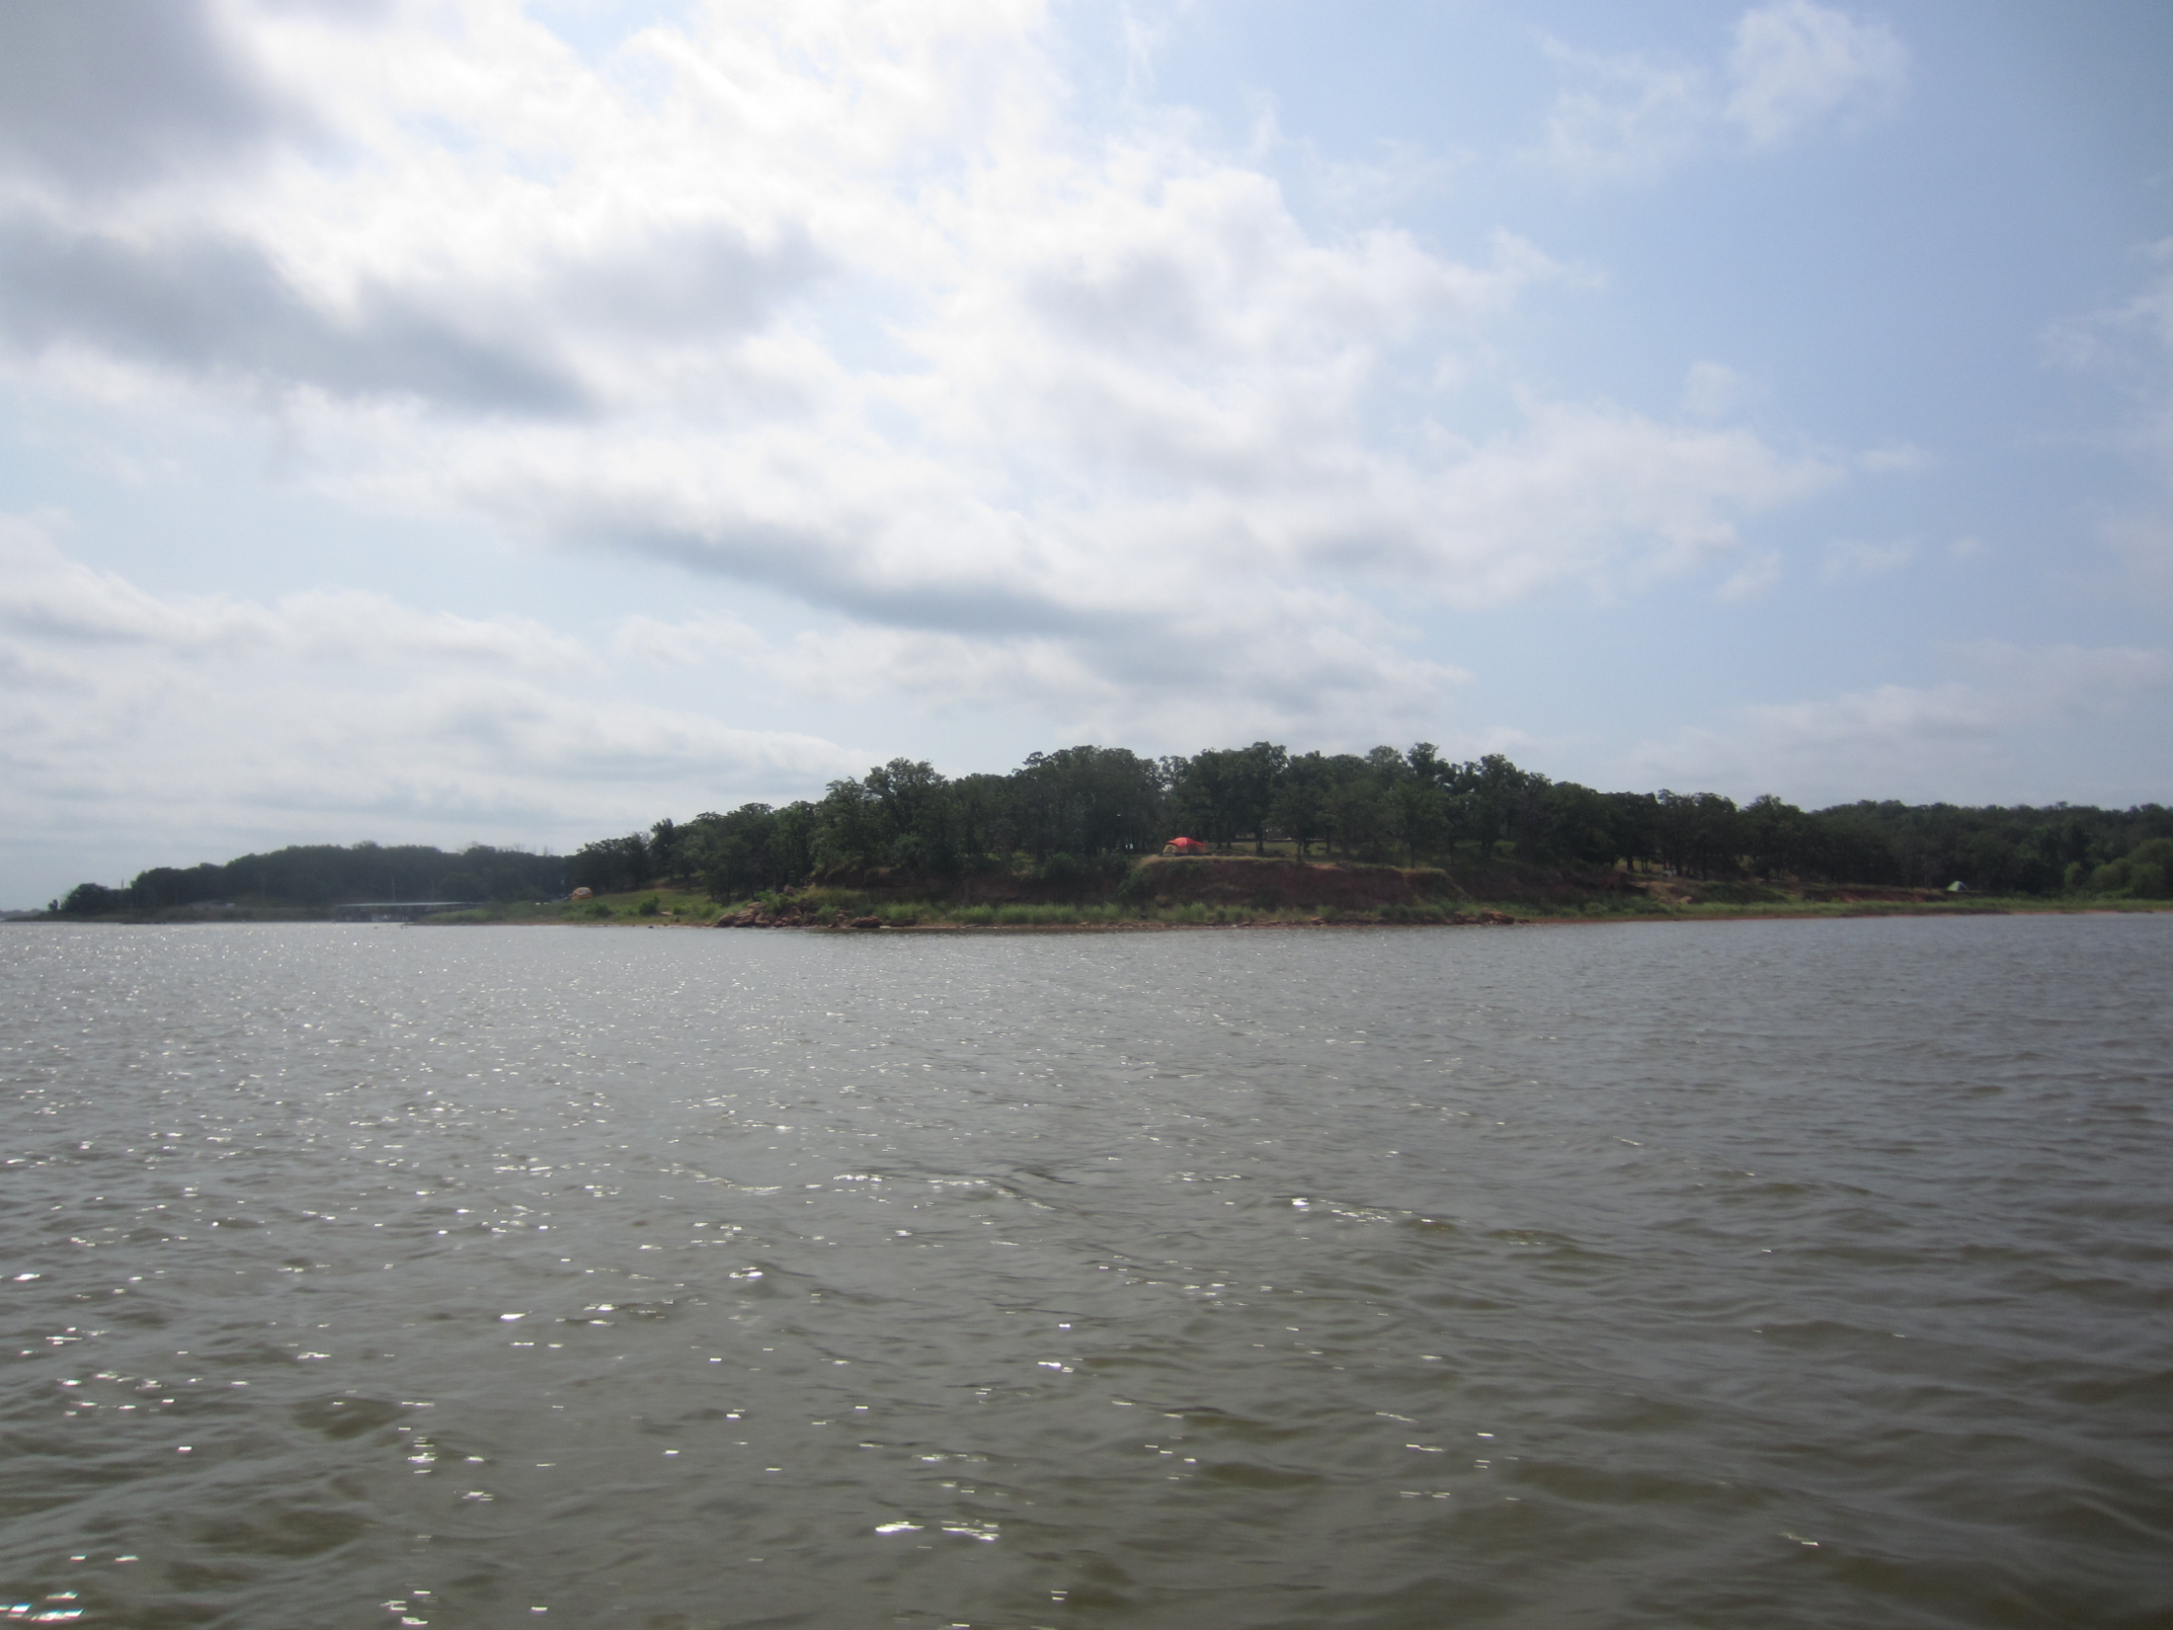
Lake Thunderbird
Watershed-Lake Model
Watershed and Lake Thunderbird
Water Quality Impairments
Pollutant Sources
Watershed & Lake Model
Management Scenario “What-if?”
TMDL for Lake Thunderbird

Slide 14
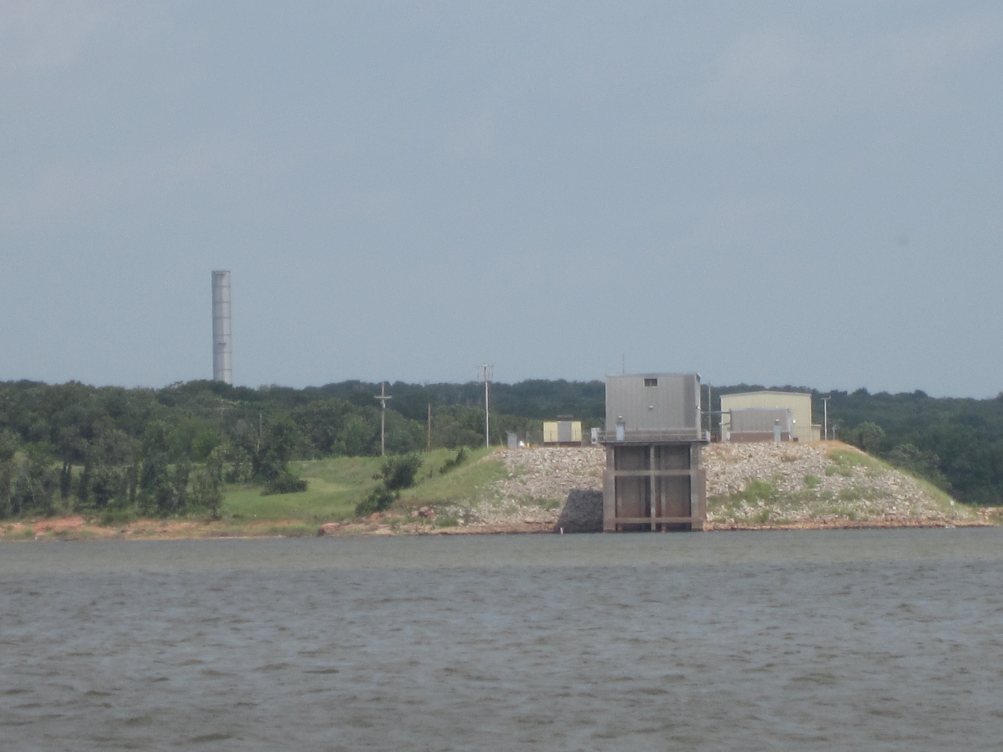
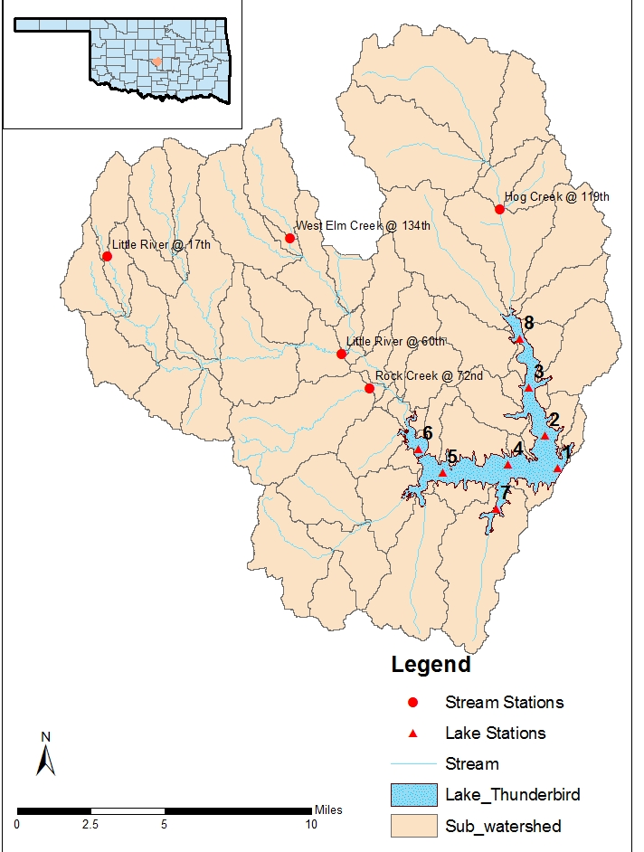
Lake Thunderbird
6,070 acre reservoir
Cleveland County
Upper Little R (256 mi²)
99,600 pop (2010)
Public water supply for Norman, Midwest City & Del City
2010 303(d) list for impairment of water supply & warm water aquatic community

Slide 15
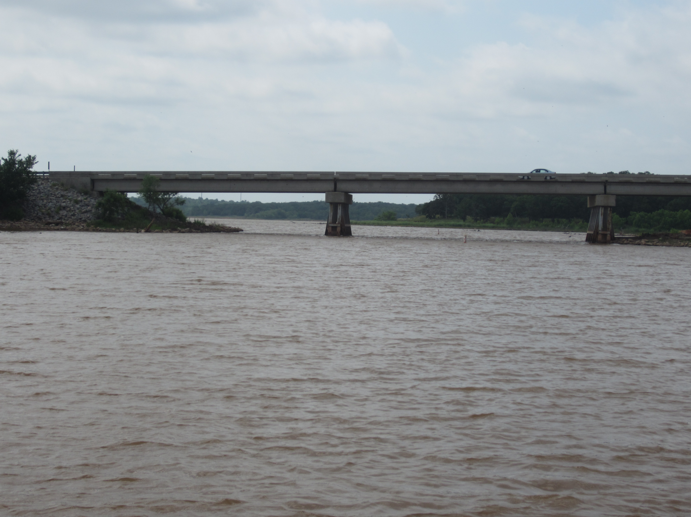
Lake Thunderbird
Designated Uses & Impairments
Flood control, water supply, recreation, fish & wildlife propagation
Lake Thunderbird is Sensitive Water Supply
Impaired for Fish & Wildlife Propagation (high turbidity and low dissolved oxygen)
Impaired for Public Water Supply (excessive chlorophyll, algae biomass)

Slide 16
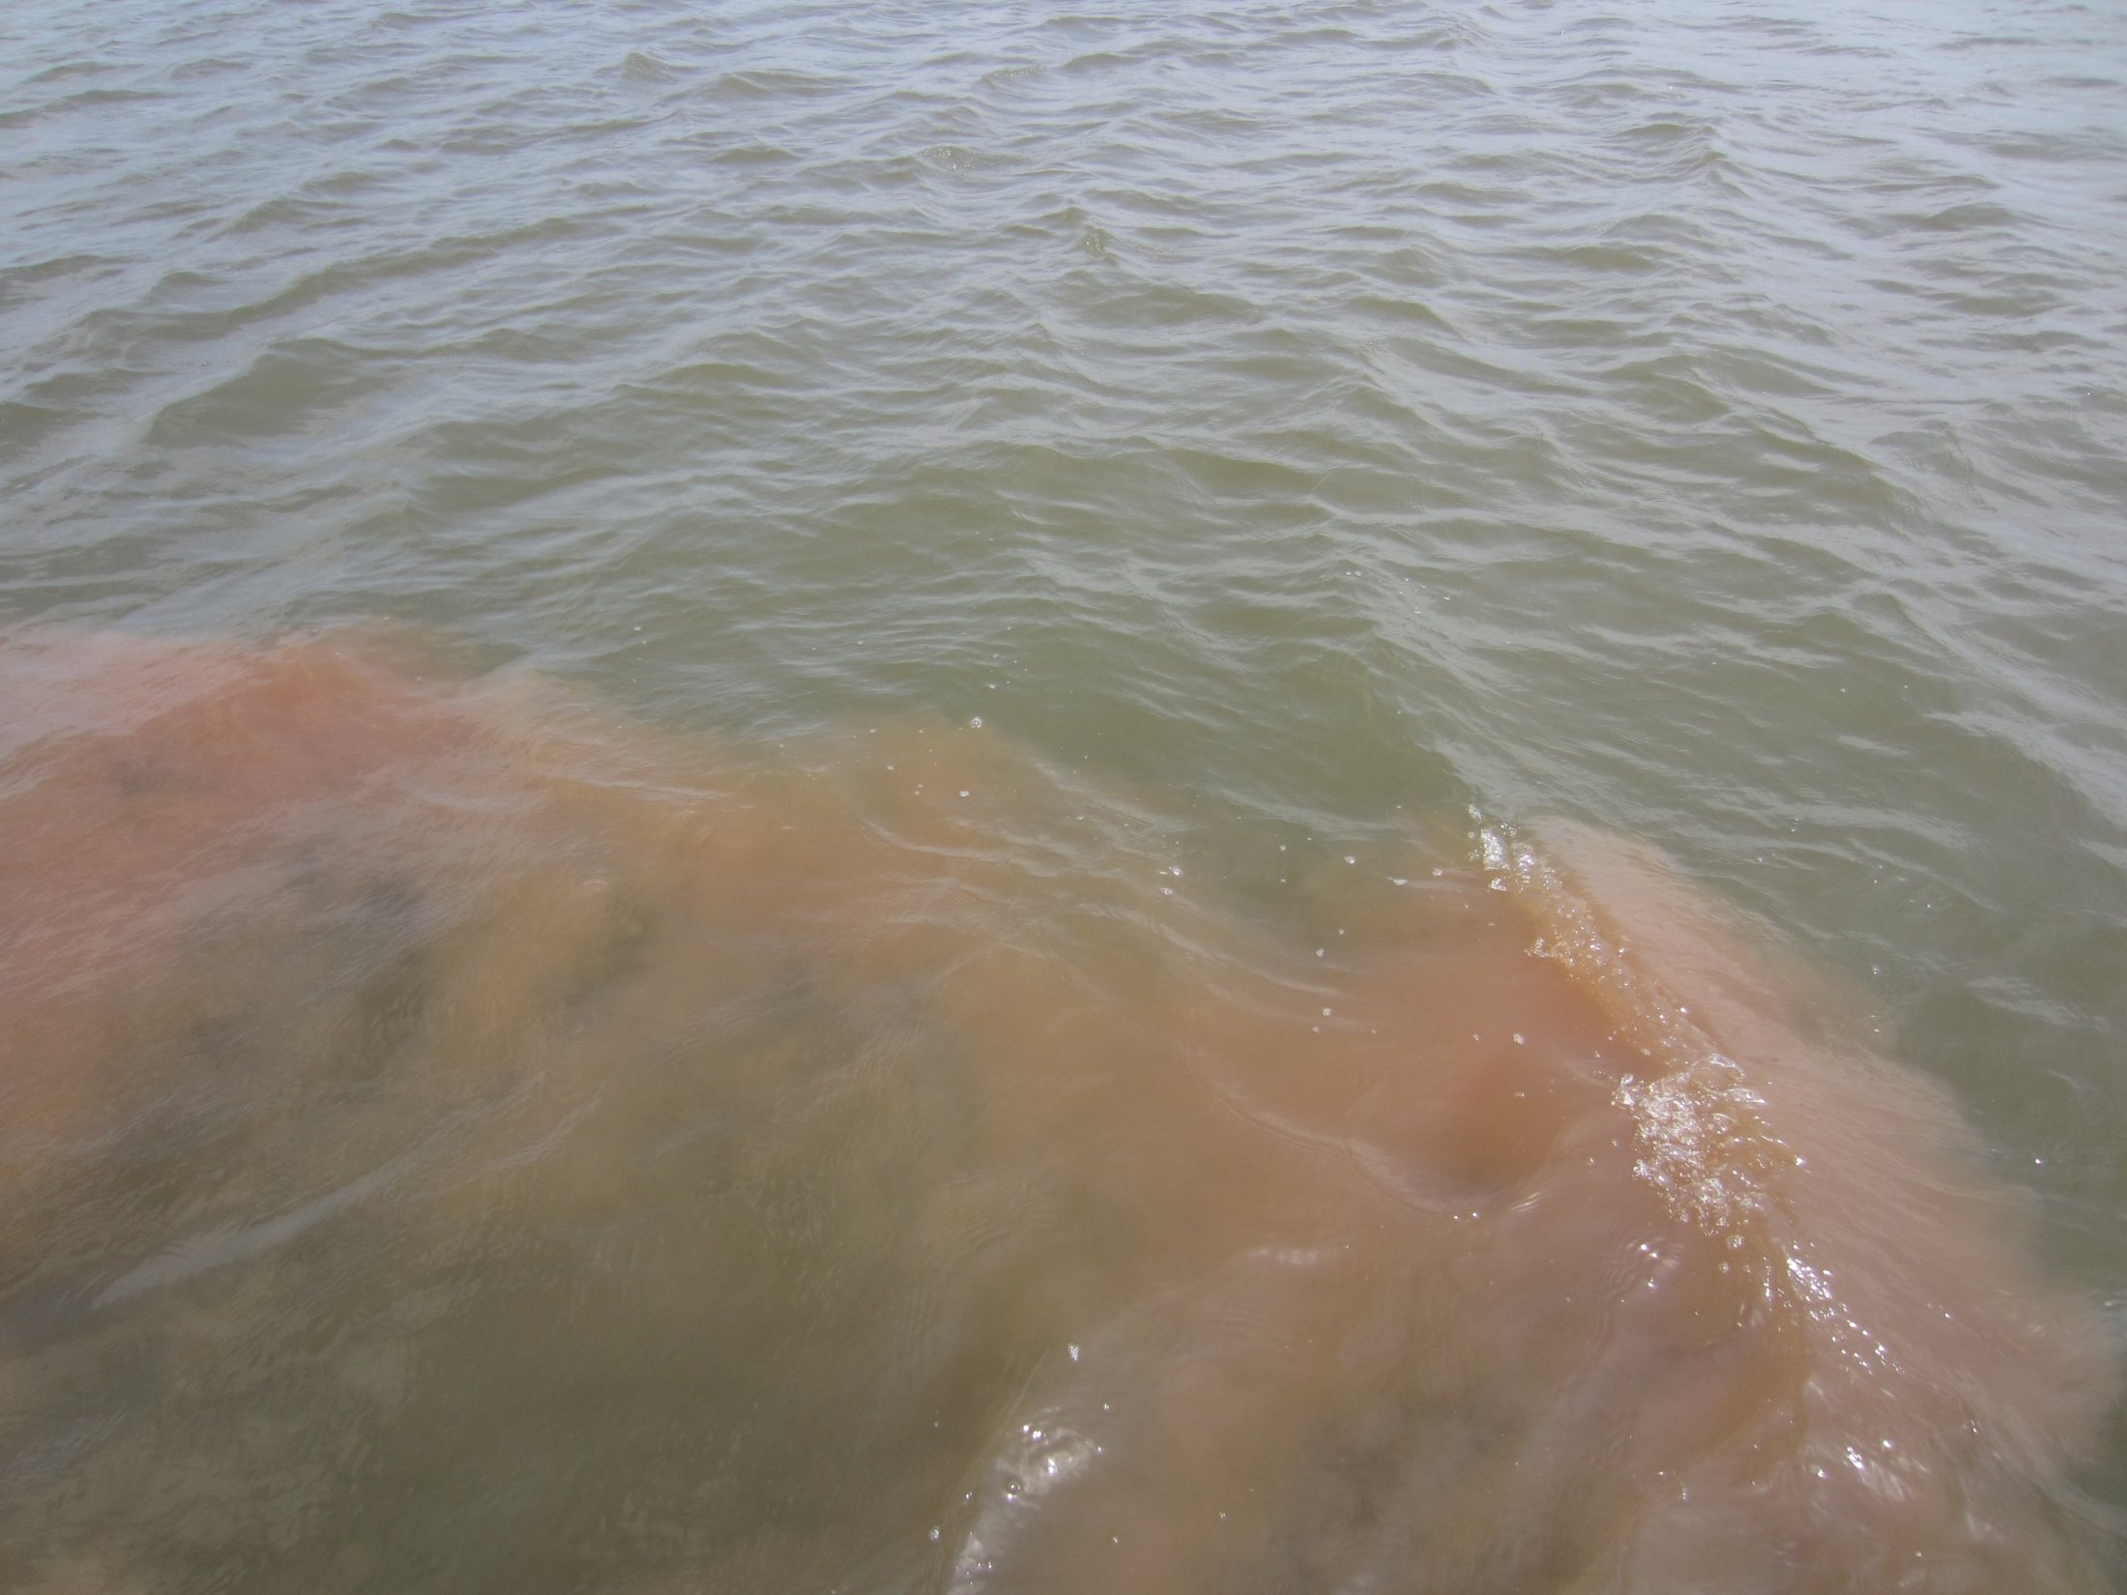
Water Quality Targets for TMDL
< 10 percent turbidity exceeds 25 NTU
Surface layer oxygen higher than 5 mg/L
< 50% lake volume below 2 mg/L
Average chlorophyll less than 10 µg/L

Slide 17
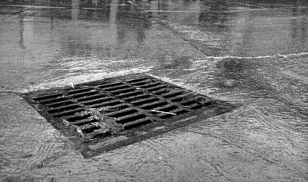
Pollutant Sources
Stormwater runoff
Oklahoma City
Moore
Norman
Nonpoint source runoff rural , unincorporated areas

Slide 18
Lake Thunderbird
Watershed-Lake Model
Watershed and Lake Thunderbird
Water Quality Impairments
Pollutant Sources
Watershed & Lake Model
Management Scenario “What-if?”
TMDL for Lake Thunderbird

Slide 19
Watershed
HSPF
Hydrodynamics
Sediment Transport
Water Quality
EFDC
Management Scenarios
Flow, Loads
Sediment Bed
Water Quality Targets

Slide 20
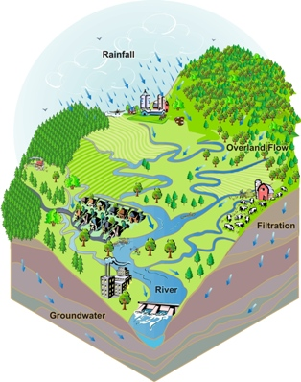
HSPF Watershed Model
Rain/meteorology
Topography
Land uses/soils
Stream channels
Overland flow
Infiltration
Groundwater
Sub-watersheds
Flow & Pollutant loads (TN,TP,BOD,TSS)

Slide 21
HSPF Model Calibration
64 Sub-Watersheds
Model simulation from 4/18/2008 to 4/27/2009
OCC stream data collected at 5 sites (2008-2009)
Model results compared to streamflow, TSS, water temperature, oxygen, nutrients

Slide 22
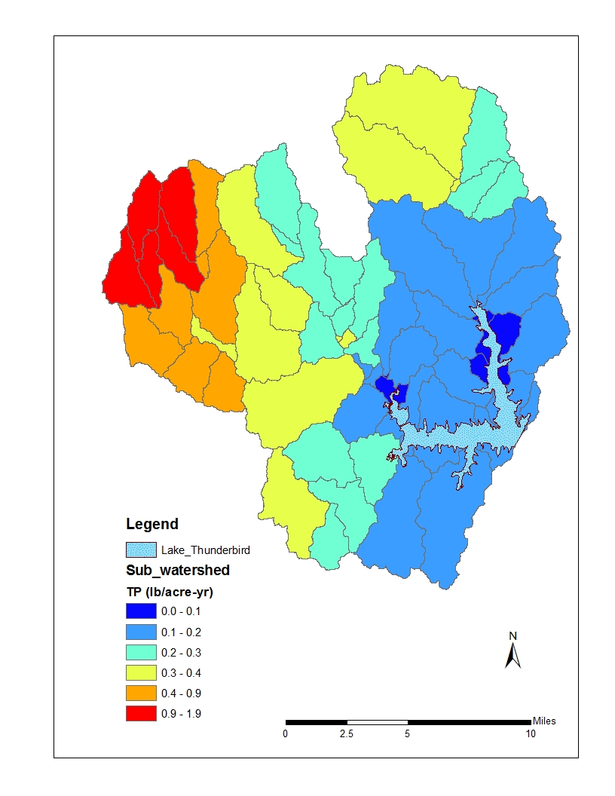
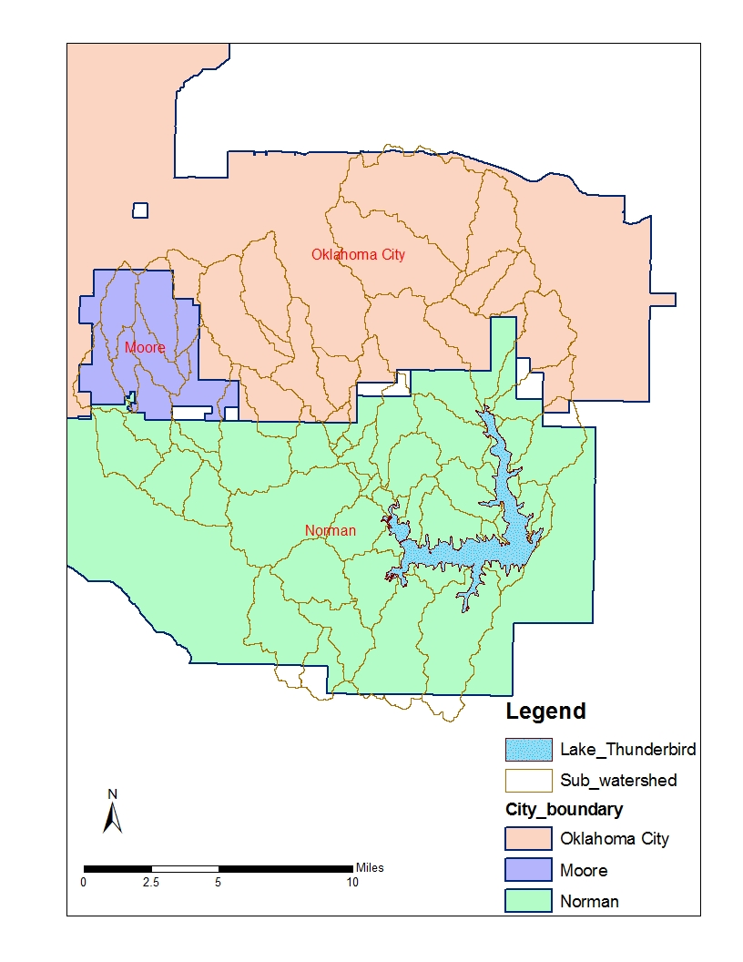
Existing Pollutant Sources
Source (kg/day) | Total-N | Total-P | BOD | Sediment
Tributary | 303 | 60 | 610 | 29,933
Overland | 19 | 3 | 37 | 1,553
Total | 322 | 63 | 647 | 31,486
Total-P
Source (%) | Total-N | Total-P | BOD | Sediment
Moore | 25% | 28% | 31% | 21%
Norman | 40% | 38% | 39% | 41%
Oklahoma City | 32% | 31% | 28% | 35%
Overland | 3% | 3% | 2% | 3%

Slide 23
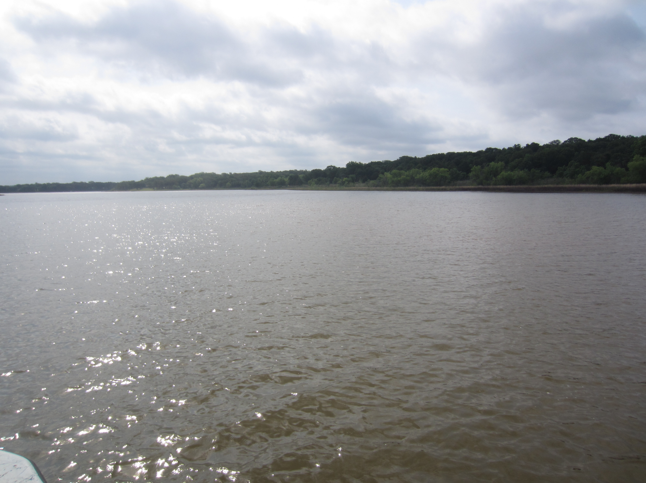
Lake Thunderbird
Conceptual Model
“Cause-effect” watershed flow, sediment, nutrient loading with lake water quality
Riverine, transition, lacustrine reservoir zones control transport and water quality
Stratified in summer; well-mixed in winter
Low summer oxygen controlled by stratification and sediment oxygen demand
Internal source of nutrients from sediment bed

Slide 24
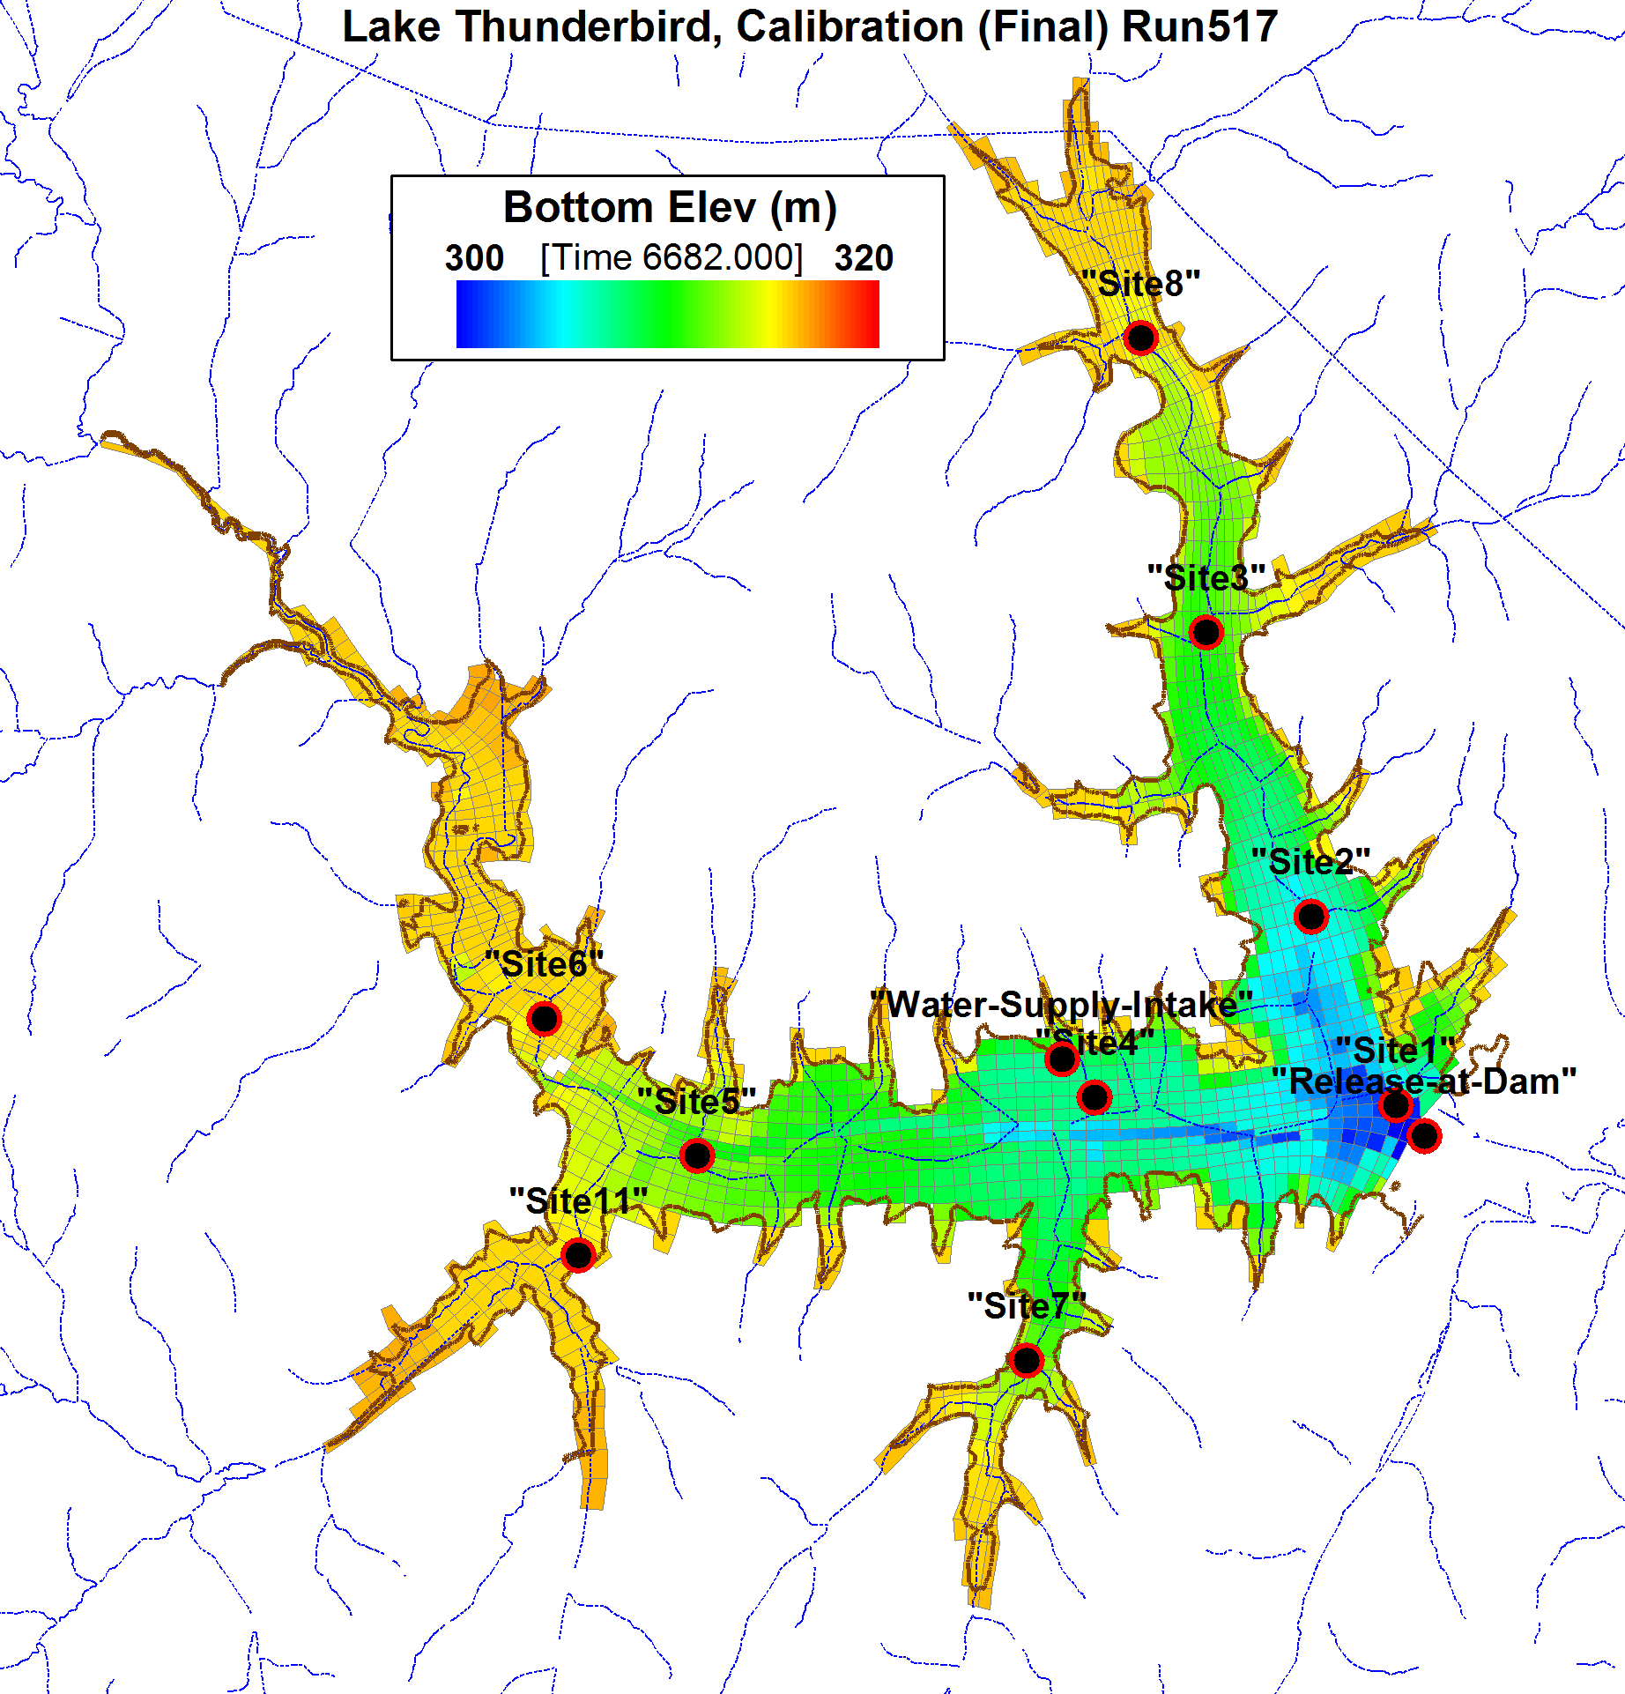
EFDC Lake Model
1660 Cells,6 Layers
HSPF Streamflow & Loads (TN,TP,BOD,TSS)
Atm-Deposition (N,P)
Internal N,P load (bed)
Velocity, Water Level
Water Temperature
Sediment (TSS)
Detrital Organic Matter
Algae
Dissolved Oxygen
Nutrients (N,P)

Slide 25
Lake Model Data Sources
Bathymetry: OWRB survey in 2001
Watershed Flow & Water Quality: HSPF watershed model
Meteorology: Winds, solar radiation, air temperature, precipitation, evaporation from MESONET
Lake level & releases at dam: USACE Tulsa District
Water supply withdrawals: COMCD (Norman, Midwest City and Del City)
Lake Water Quality: OWRB monitoring of 8 sites in 2008-2009 for model calibration
Sediment Bed: OWRB surveys in 2008 for nutrients and solids

Slide 26
Lake Model Calibration
EFDC model simulation period from 4/18/2008 through 4/27/2009
OWRB monitoring data collected at 8 sites in 2008-2009
EFDC model results compared to water level, water temperature, suspended solids, dissolved oxygen, algae chlorophyll, water clarity (secchi depth), nutrients and sediment flux

Slide 27
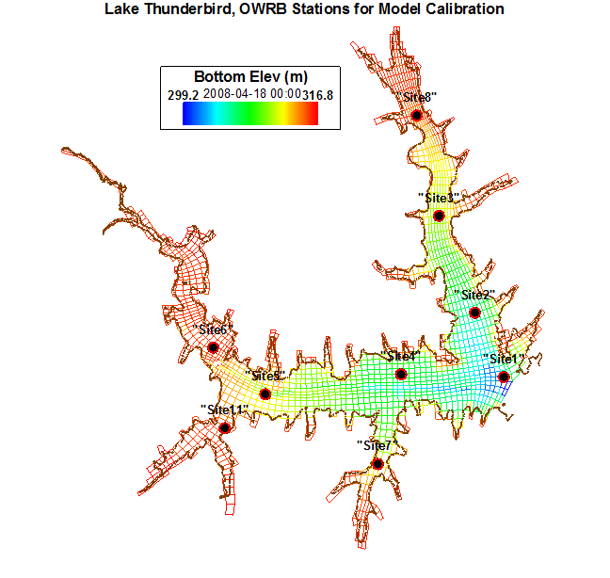
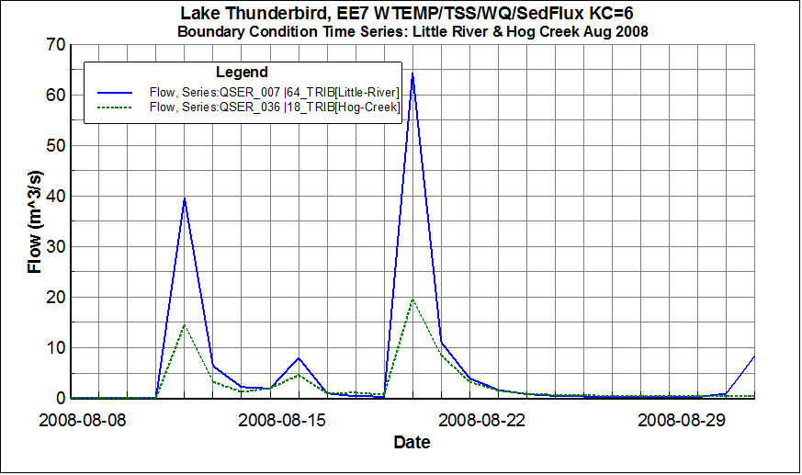
Dissolved Oxygen
Surface & Bottom Site 2
Aug-2008 Storm Event

Slide 28
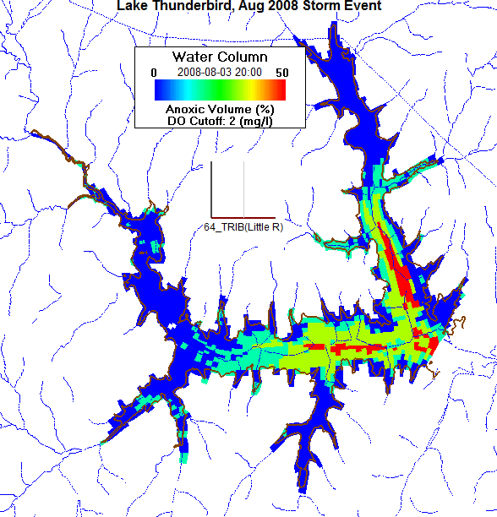
Aug-2008 Storm, Anoxic Volume

Slide 29
Algae Chlorophyll-a
Surface Site 2

Slide 30
How Well Did the Lake Model
Match Observed Data?
Model generated seasonal stratification with good match to water temperature and dissolved oxygen; Aug-2008 storm event reproduced.
Model matched seasonal trends of water temperature, dissolved oxygen, water clarity (secchi depth), nutrients and chlorophyll
Model results used to compute anoxic volume of lake as percentage
Sediment flux model accounted for internal loads of N, P

Slide 31
Lake Thunderbird
Watershed-Lake Model
Watershed and Lake Thunderbird
Water Quality Impairments
Pollutant Sources
Watershed & Lake Model
Management Scenario “What-if?”
TMDL for Lake Thunderbird

Slide 32
Management Scenario
“What-if” 35% of TSS and nutrient (N,P) load is removed?
Would lake attain WQ targets for turbidity, Chlorophyll & DO?
How long will it take to attain compliance with WQ targets?
Watershed
Watershed
Existing Loads
Reduce Loads
Lake
Lake
WQ
Impairments
WQ Target
Compliance

Slide 33
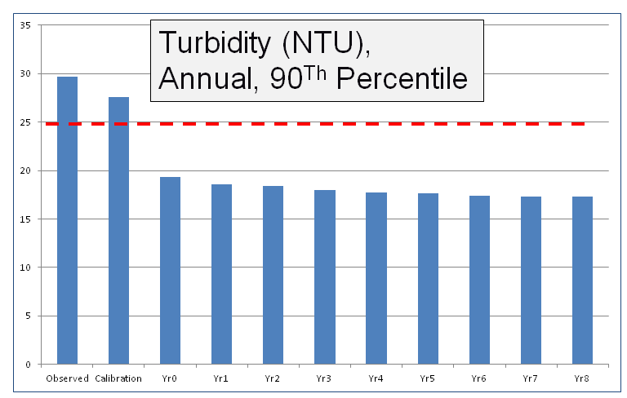
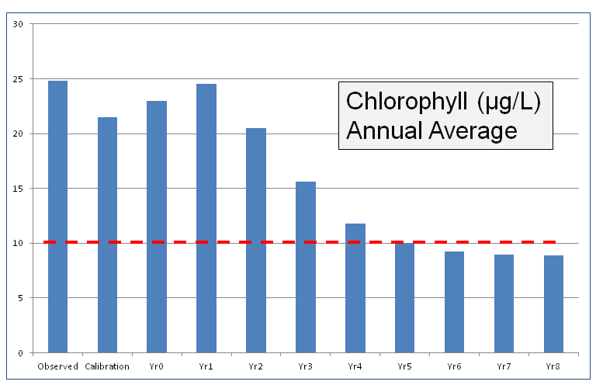
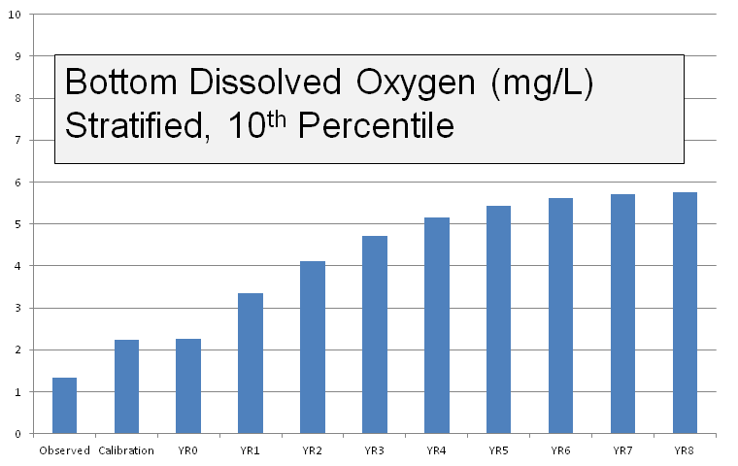
Meets WQ Target
< 25 NTU Turbidity
Meets WQ Target
<10 µg/L
Chlorophyll
Meets WQ Target
(a) Sfc DO > 5 mg/L
(b) <50% Lake Volume
< 2 mg/L

Slide 34
Lake Thunderbird
Watershed-Lake Model
Watershed and Lake Thunderbird
Water Quality Impairments & Targets
Pollutant Sources
Watershed & Lake Model
Management Scenario “What-if?”
TMDL for Lake Thunderbird

Slide 35
35% Load Reduction & TMDL
35% load reduction expected to attain compliance with water quality targets
TMDL computed from Long Term Average (LTA) load based on 35% reduction of existing loads
Pollutant flow & loads are described by log-normal distribution
Probability-based statistics of log-normal distribution of watershed loading data used to compute TMDLs

Slide 36
Total Maximum Daily Loads
(kg/day)
 | Total-N | Total-P | BOD | Sediment
Existing, 2008-2009 | 322 | 63 | 647 | 31,487
Load Removal | 35% | 35% | 0% | 35%
Long-Term Average Load | 209 | 41 | 647 | 20,466
Coeff_Var (CV) | 4.25 | 4.40 | 4.77 | 5.82
TMDL | 808 | 158 | 2,481 | 76,951

Slide 37
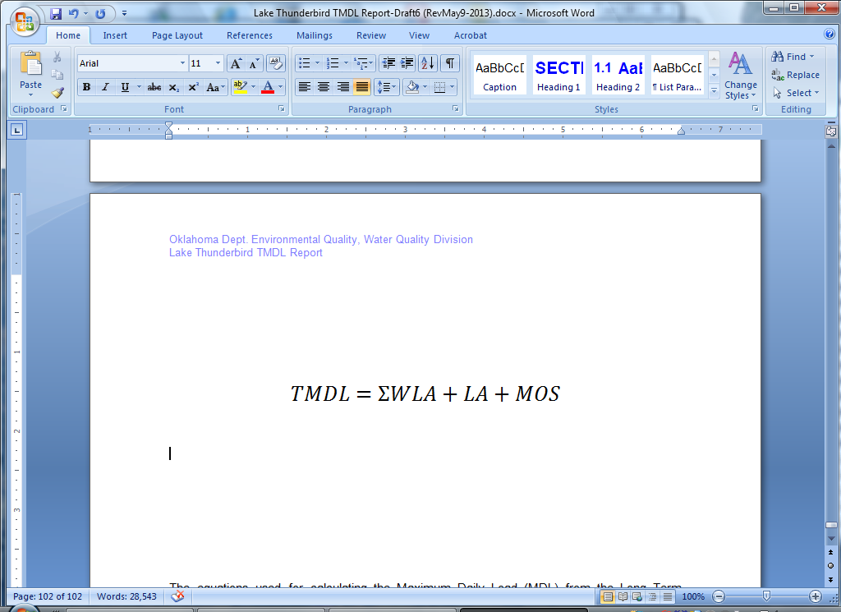
Total Maximum Daily Loads
(kg/day)
WQ | TMDL | LA | WLA | WLA | WLA | MOS
 |  |  | Moore | Norman | OKC
Total-N | 808 | 21 | 205 | 319 | 262 | Implicit
Total-P | 158 | 4 | 45 | 60 | 49 | Implicit
BOD | 2,481 | 57 | 781 | 956 | 687 | Implicit
TSS | 76,951 | 2,069 | 16,236 | 31,596 | 27,050 | Implicit

Slide 39
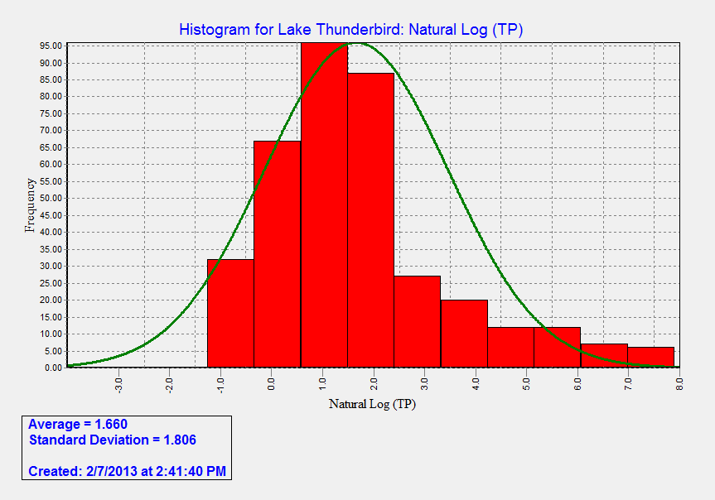
Frequency Distribution, TP

Slide 40
How were WLAs assigned?
WLA % | Moore | Norman | OKC
Total Nitrogen (TN) | 26.1% | 40.6% | 33.3%
Total Phosphorus (TP) | 28.9% | 39.0% | 32.1%
CBOD | 32.2% | 39.4% | 28.3%
Suspended Solids (TSS) | 21.7% | 42.2% | 36.1%
WLAs were assigned based on the percentage of existing loadings

Slide 41
How were WLAs assigned?
No WLA for Midwest City and Noble
  Midwest City – 0.05% of total watershed
  Noble - 0.26% of total watershed
No reductions for unincorporated area

Slide 42
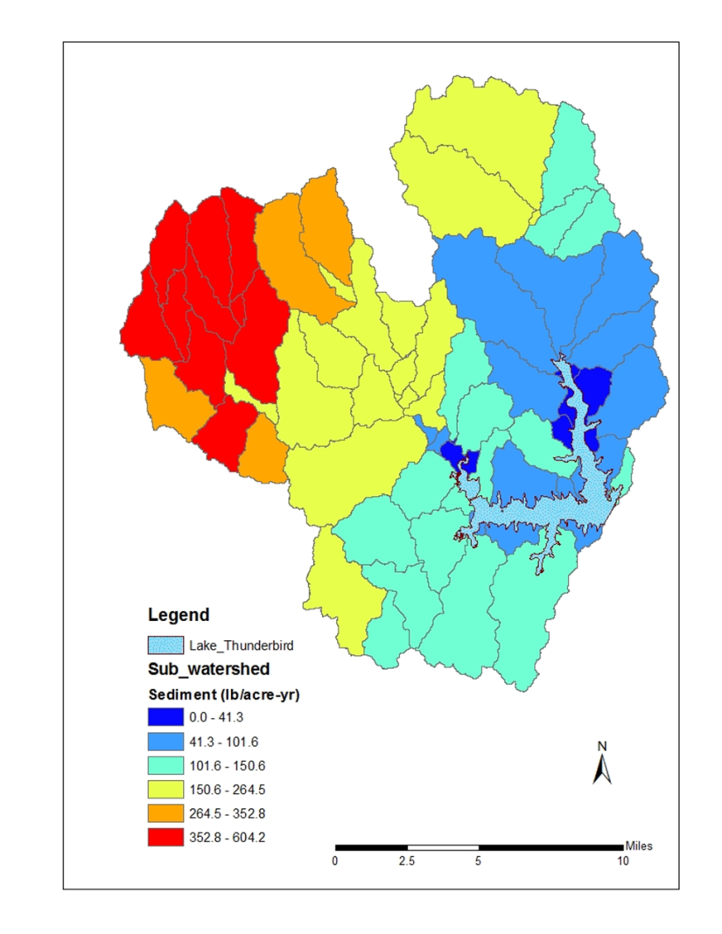

Sediment Loading TP loading

Slide 43
Lake Management
General Recommendations
Continue hypolimnetic oxygen injection project (COMCD)
Continue/expand shoreline re-vegetation establishment (COMCD/OWRB)
Consider establishing treatment wetlands on Little River arm above Twin Bridges

Slide 44
What does it mean for MS4 Permits?
General Recommendations
Improve controls of sewer overflows
Implement enhanced controls for on-site wastewater systems (septic tanks)
Establish a stakeholder/citizen advisory committee

Slide 45
What does it mean for MS4 Permits?
MS4s (Moore, Norman, OKC)
Submit an approvable TMDL compliance Plan within 24 months of EPA approval
  Identify potential significant sources
  Select a General Strategy for meeting the WLAs
  Implement enhanced or more frequent construction site inspections. Consider enhanced enforcement measures.
  Determine a schedule for achieving the WLA
  Track BMP implementation
  Implement educational programs

Slide 46
What does it mean for MS4 Permits?
MS4s (Moore, Norman, OKC) - continued
Submit either a TMDL monitoring plan or a commitment to participate in a coordinated regional monitoring program within 24 months of EPA approval
Monitoring program shall be fully implemented within 3 years of EPA approval
Utilize the monitoring data to evaluate effectiveness of BMPs and demonstrate progress toward attaining the WLAs
If progress cannot be shown, revise the compliance plan
Annual Reporting

Slide 47
What does it mean for Construction sites?
Stormwater Construction General Permit (OKR10)
Meet all conditions in Construction General Permit (OKR10)
Additional general requirements under this TMDL
  Comply with any additional pollutant prevention or discharge monitoring requirements established by the local MS4 municipalities.
  Submit to the DEQ all Storm Water Pollution Prevention Plans (SWP3) for sites of five acres or larger

Slide 48
What does it mean for Construction sites?
Site-specific requirements in all authorizations issued by DEQ in the Lake Thunderbird watershed
  Vegetated buffer: 100 ft minmum for all streams (or equivalent controls)
  Sediment basins for all locations draining 5 acres or more
  Weekly site inspections
  Quicker corrective actions
  Immediate stabilization
  Soil nutrient testing before using fertilizer

Slide 49
What does it mean for Industrial Stormwater?
Industrial Stormwater
Meet conditions in Multi-Section General Permit (OKR05)
Additional requirements under this TMDL
  Update the SWP3 for additional TSS & nutrient reduction measures within 12 months
  Monthly inspection & maintenance
  Monitoring and reporting once a month if the permit has numeric effluent limits
  Comply with any additional pollutant prevention or discharge monitoring requirements established by the local MS4 municipalities
Applies to – Asphalt Paving, Concrete Products, Sand & Gravel Mining

Slide 50
What Happens Next ?
Comments Accepted Through August 1
Comment Responsiveness Summary
Final Report Submitted For EPA Approval
Incorporate In Water Quality Management Plan

Slide 51
How To Provide Comments
Oral or Written Comments Accepted This Evening
By Mail:
    Dr. Karen Miles
    Water Quality Division
    Oklahoma Department of Environmental Quality
    P.O. Box 1677
    Oklahoma City, OK 73101-1677
By Email:
    Karen.Miles@deq.ok.gov
Comments Must be Received by
Thursday August 1, 2013 !
Project website: http://www.deq.state.ok.us/WQDnew/tmdl/thunderbird/index.html

Slide 52

QUESTIONS ?

Slide 53

COMMENTS
for the record

Slide 54
How To Provide Comments
Oral or Written Comments Accepted This Evening
By Mail:
    Dr. Karen Miles
    Water Quality Division
    Oklahoma Department of Environmental Quality
    P.O. Box 1677
    Oklahoma City, OK 73101-1677
By Email:
    Karen.Miles@deq.ok.gov
Comments Must be Received by
Thursday August 1, 2013 !
Project website: http://www.deq.state.ok.us/WQDnew/tmdl/thunderbird/index.html

Slide 55

Thanks For Coming
Please Drive Safely

