Slide 1

PFAS Treatment Options
PWSES Presentation
Operator Renewal Treatment
2026
Notes:
Good morning everyone, today we are going to going through the current treatment options for PFAS removal.

Slide 2
Overview
“Drinking Water Treatment for PFAS Selection Guide” from AWWA
1: Different types and ease of removal
2: Efficacy of treatment
3: Operation of treatment process
4: Emerging and Noval Technologies
Notes:
This presentation aims to summarize the treatment options currently available. Most of the information presented here today comes from AWWA’s “Drinking Water Treatment for PFAS Selection Guide”. It is a 50 page pdf that can easily be found online. It is something I would recommend reading, but especially so for those who know they will be affected by the final rule. It goes further into the science behind the treatments than we have time to, but I will do my best to summarize it.
Because we have already had a presentation today focused on the importance of

Slide 3
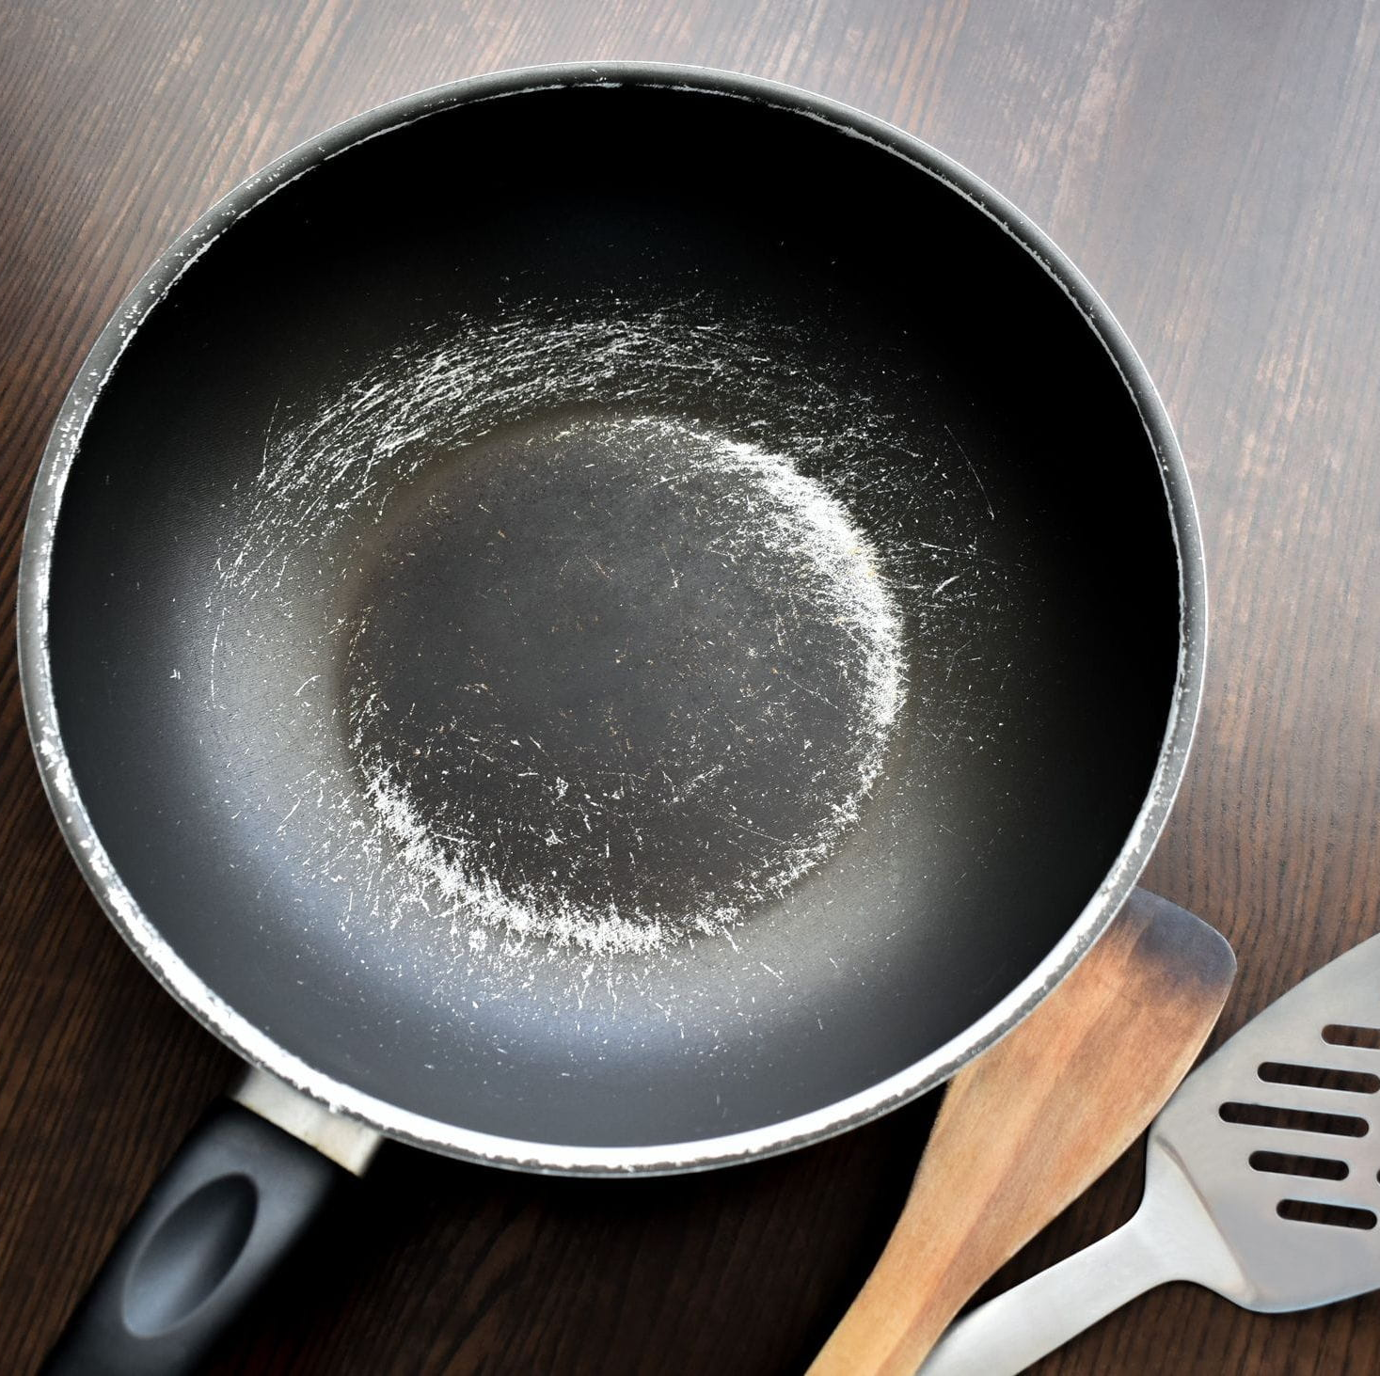
Polymer PFAS
“Polymers of low concern”
Large and more stable molecules
Less environmental studies
Lower direct health risk
Can degrade into non-polymer PFAS

Slide 4
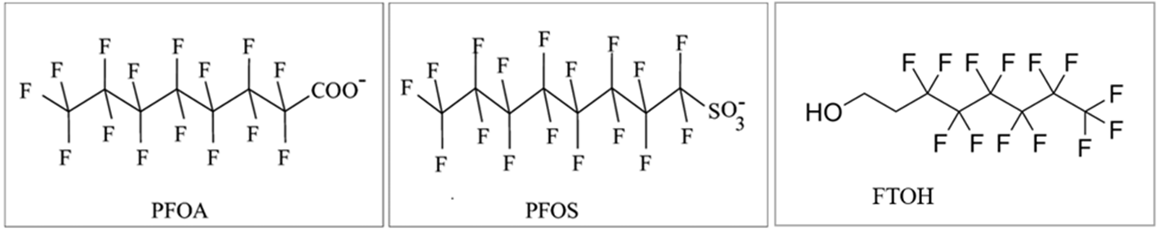
Non-Polymer PFAS
Perfluoroalkyl Acids (PFAAs)
Fully fluorinated carbon chain with a functional group
“Long-chain” PFAS
Higher Toxicity
Includes PFOA and PFOS
Polyfluoroalkyl Substances
Not fully fluorinated
More variations
Majority are precursors to PFAAs
Prominent Precursor: Fluorotelomers (FT)
Notes:
We are going to dive a little deeper into chemistry here to try and understand the distinction between the compounds.
Non-polymer PFAS can be divided into two groups, Perfluoroalkyl acids or PFAAs and Polyfluoroalkyl substances
PFAAs have a functional group at the head with fully fluorinated carbon chains or tails. The bond between the carbon and fluorine bond is one of the strongest, thus the term “forever chemicals”
PFAAs have been shown to have a higher biotoxicity. These include PFOA and PFOS, the two compounds that are currently regulated.
Polyfluoroalkyl substance have a very similar structure to PFAAs, with a fluorinated carbon chain tail. The difference is there is a carbon in the chain that is bonded to an element that is not a fluoride.
This group is a lot larger, including thousands of compounds. This makes the group much more difficult to regulate.
They are considered precursors to PFAAs, as the bond at the non-fluororinated carbon can break and form a PFAA. One of the common groups is fluorotelomers or FTs.

Slide 5
Treatment Technologies
Effective removal of PFAS, not destruction
Create concentrated waste streams
Powdered Activated Carbon (PAC)
Granular Activated Carbon (GAC)
Ion Exchange (IX)
Nanofiltration (NF)
Reverse Osmosis (RO)
Notes:
There are a handful of common technologies that have been studied and proven to be effective at the removal of PFAS from drinking water at full scale. Unfortunately, effective destruction of PFAS is not readily available at large scale, meaning that highly concentrated waste streams are being generated without a clear means of disposal at this time.
Read through common technologies
There are some novel approaches available, but we will touch on those towards the end of the presentation.
There are also a few factors that will affect the efficacy of treatment, such as:
Target PFAS
PFAS concentration
TOC
Nitrates
And Sulfates

Slide 6
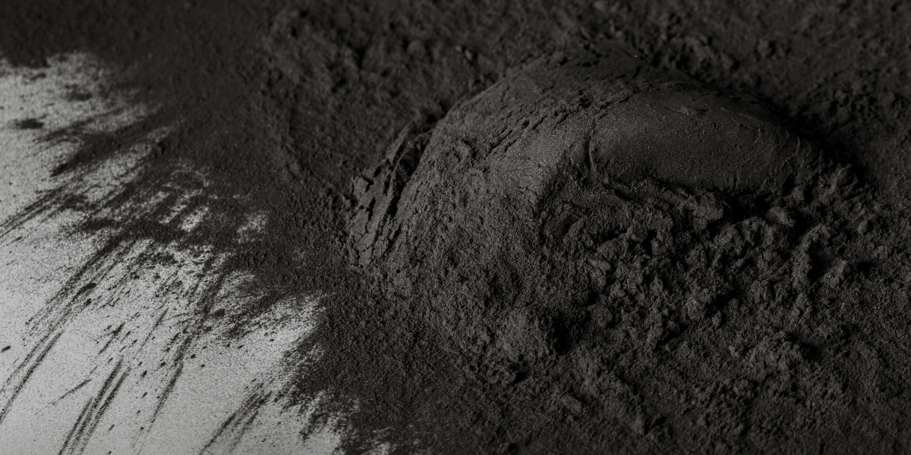
Powdered Activated Carbon (PAC)
PFAS is diffused and adsorbed to PAC
Currently used for taste and odor, organics, and color
Commonly applied at source water intake or prior to rapid mix
Effectiveness increases with contact time
Moderately effective for long-chain (>80%)
Less effective for short-chain (<40%)
Recommended dosing typically double that for taste and odor

Slide 7
Powdered Activated Carbon (PAC)
Advantages
Quick Implementation
Good for periodic uses
Taste and Odor Removal
TOC Removal
Disadvantages
Increased solids production
Decreased filter run times
Decreased dewatering efficacy of solids
Environmental contamination resulting from land application

Slide 8
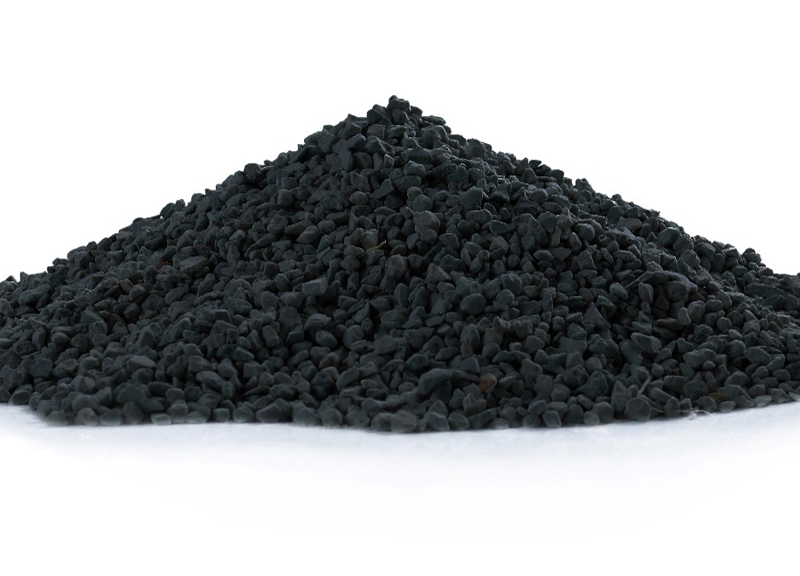
Granular Activated Carbon (GAC)
Similar mechanism to PAC, PFAS adsorption to media
Most studied treatment method to date
Benefits taste and odor, color, TOC, and VOC
Efficacy impacted by other constituents in the water, such as DOC
Short-chain PFAS are shown to be more sensitive
Removal shown to range from 66% to 100% depending on target PFAS
If GAC is overloaded, can produce a sudden release of concentrated PFAS

Slide 9
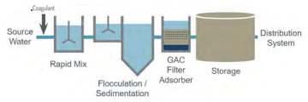
Granular Activated Carbon (GAC)
Advantages
Small footprint
Can be retrofit to existing filters
GAC Vessels can be temporarily installed
Less frequent backwashing compared to traditional filters
Disadvantages
Unable to regenerate media
High O&M costs
Increased nitrification risks
Backwash wastewater must be disposed

Slide 10
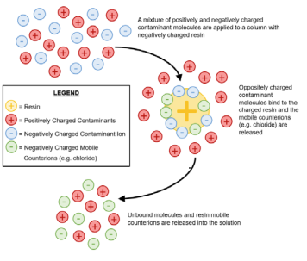
Ion Exchange (IX)
Influent ran through resin to remove charged particles
Anion exchange used to target negatively charged PFAS
Weak base anion have been most promising, but strong base still applicable
Salt or base mixed with methanol or ethanol for regeneration
Better at short-chain PFAS removal
Requires specific pH range to be effective

Slide 11
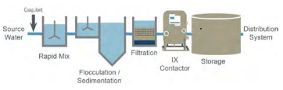
Ion Exchange (IX)
Advantages
PFAS-selective resins available
Moderate capital costs
Shorter contact time requirements than GAC
Resin replaced less than GAC
Disadvantages
Higher O&M cost
Less secondary water quality benefits
Spent media may be considered hazardous waste

Slide 12
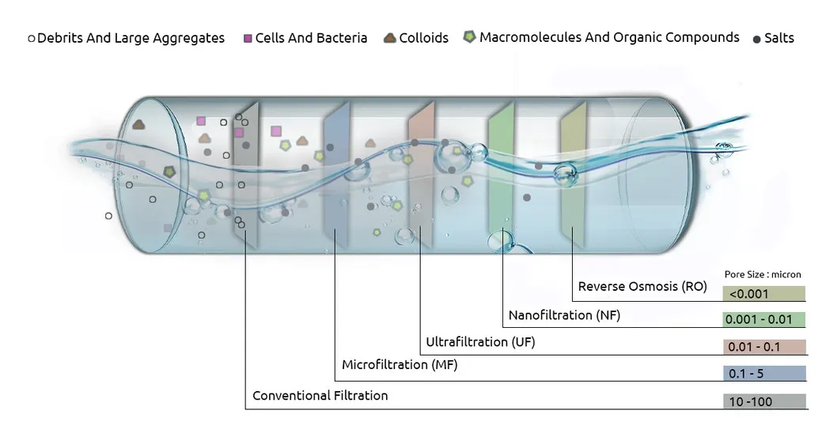
Nanofiltration (NF) & Reverse Osmosis (RO)
Semipermeable membrane is used to retain contaminants inside, producing filtered permeate
Consistent removal throughout lifetime of membranes
NF considered more cost effective than RO
Removal of both short- and long- chain PFAS

Slide 13
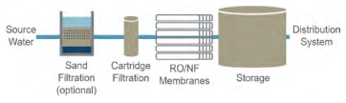
Nanofiltration (NF) & Reverse Osmosis (RO)
Advantages
Removes wide variety of PFAS
Can treat high concentrations
Compact footprint
Removal of CECs, TOC, and pathogens
Disadvantages
Implementation of corrosion control, particularly for RO
High capital and O&M costs
Energy intensive

Slide 14
Emerging Technologies
Ozofractionation: Ozone bubbles pass through columns of water to oxidize PFAS and create concentrated foam
Advanced Oxidation Process: Persulfate, with activation, has been shown to degrade PFAS
Sonolysis: Uses sound waves to degrade PFAS. High energy use. Have not been able to replicate at large-scale

