Slide 1

OKR05 Permit Overview
Presented By: Carrie J. Evenson, Ph.D., P.E.
Industrial Wastewater Enforcement Section
Water Quality Division
Department of Environmental Quality

Slide 2

Outline
Regulation History
Stormwater Permits in Oklahoma
OKR05
  Who?
  What?
  Where?
  When?

Slide 3

Regulatory History
Clean Water Act
  Passed in 1972
  Focused on point source discharges
    Pipes, drains, easily identified points of discharge
  Established the National Pollutant Discharge Elimination System (NPDES)
  Amended in 1987
    Addressed more diffuse sources of pollution, such as stormwater discharges

Slide 4
Regulatory History
Stormwater Regulations
  Phase I
    Promulgated in 1990
    Required the following to be permitted:
      Medium and large municipal separate storm sewer systems (MS4s) – generally with populations ≥100,000
      Construction activities disturbing ≥ 5 acres
      Industrial activities

Slide 5
Regulatory History
Stormwater Regulations
  Phase II
    Established December 8, 1999
    Required the following to be permitted:
      Small and medium MS4s and those within urbanized areas
      Construction activities disturbing ≥ 1 acre or part of a larger common plan of development

Slide 6

Regulatory History
Delegation of NPDES Programs to ODEQ
  November 19, 1996
    Permitting and enforcement of municipal and industrial wastewater
  September 9, 1997
    Stormwater discharges associated with construction and industrial sites
    Industrial pretreatment

Slide 7
Stormwater Programs
DEQ has regulatory authority over the following stormwater discharges:
  From MS4s
  From industrial activities
  From construction activities
  Through the requirements of individual permits or OKG11 (concrete batch plants)

Slide 8

MS4s
Municipal Separate Storm Sewer Systems

Slide 9
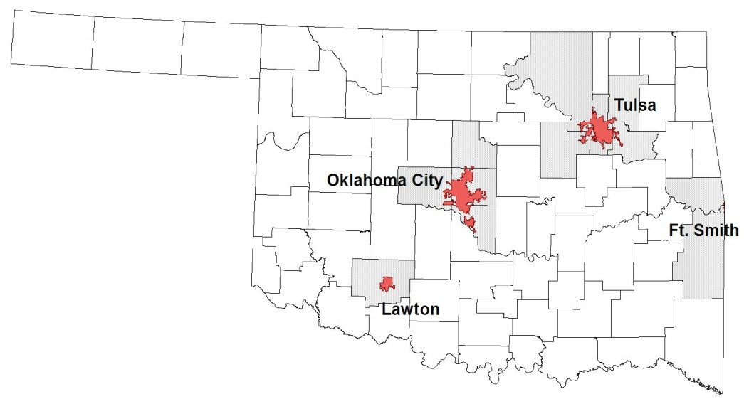
Oklahoma’s MS4 Permit Holders
Phase I (2 permittees)
  Individual Permits
    City of Oklahoma City
      First issued September 1, 1995
    City of Tulsa
      First issued April 1, 1997
    Both are co-permittees with ODOT and OTA
  Both are co-permittees with ODOT and OTA
  Pollution Prevention Approach
  Includes a requirement to address runoff from industrial and high risk runoff sites

Slide 10
Oklahoma’s Phase II MS4 Permits
Phase II (43 permittees)
  General Permit, OKR04
    34 Cities
    5 Counties
    4 Non-Traditional Entities (e.g. Tinker AFB, OU)
      Other entities including ODOT will be permitted when OKR04 is reauthorized
Pollution prevention approach
  Must address six minimum control measures
    Includes public education and outreach, illicit discharges, construction site stormwater runoff, and good housekeeping

Slide 11
Local Stormwater Permits
Oklahoma City and Tulsa
  Have own stormwater permitting requirements
  Required as part of MS4 program
  Can be more stringent than state requirements
Be sure to check with local authorities to ensure you have the appropriate permits and are meeting all local stormwater regulations

Slide 12

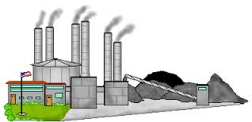
Industrial Stormwater
Multi-Sector General Permit for Stormwater Discharges Associated with Industrial Activities, OKR05

Slide 13
OKR05
Applies to certain industrial activities
  Defined by the Standard Industrial Classification (SIC) code
    Listed in Table 1-2 of permit by sector
    Only those industrial activities with SIC code in Table 1-2 need to have permit coverage
      Can cross-reference SIC code with NAICS code

Slide 14
No Exposure Certification
No permit coverage needed due to existence of a condition of no exposure.
Occurs when facility provides a storm resistant shelter to prevent exposure to rain, snow, snowmelt, and / or runoff protects all industrial materials and activities
Items not required to be under cover:
  Tightly sealed drums, barrels, tanks, and similar containers
    "Sealed" = banded or otherwise secured and without operational taps or valves
  Adequately maintained vehicles used in material handling
  Final products if unable to be mobilized in stormwater

Slide 15
No Exposure Checklist
Are any of the following activities/materials exposed to stormwater?
  Using, storing, or cleaning industrial machinery or equipment
  Materials/residuals on ground or in stormwater inlets from spills/leaks
  Materials/products from past industrial activity
  Material handling equipment
  Materials/products during loading / unloading or transporting
  Materials/products stored outdoors (except finished products intended for outside use)

Slide 16
No Exposure Checklist
Are any of the following activities/materials exposed to stormwater?
  Materials contained in open, deteriorated, or leaking storage drums, barrels, tanks, etc.
  Materials/products handled/stored on roads or railways owned or maintained by the discharger
  Waste Material (except waste in covered, non-leaking containers)
  Application or disposal of process wastewater
  Particulate matter or visible deposits of residuals from roof stacks and/or vents not otherwise regulated (i.e., under an air quality control permit) and evident in the storm water outflow

Slide 17

Basic Requirements
Submit a Notice of Intent (NOI) and permit application fee
Develop and Implement a Stormwater Pollution Prevention Plan (SWP3)
Pay annual permit fees
Receive an authorization from DEQ
Install and maintain best management practices (BMPs)
Conduct quarterly visual monitoring
Perform regular site inspections

Slide 18

NOI
Form is available at:
http://www.deq.state.ok.us/WQDnew/forms/stormwater/Exhibit%202%20Notice%20of%20Intent_August2011.pdf

Slide 19

Who Needs to Submit an NOI?
    Any facility/industry with an SIC or activity code listed in Table 1-2
    Fish hatcheries and preserves under industry group number 092
    Natural gas liquid extraction plants identified under SIC code 1321
    Service company base operating stations identified under SIC 1389

Slide 20
When do I Submit an NOI?
90 days following effective date of the OKR05 permit
30 days prior to starting operation of a facility stormwater discharges associated with industrial activity
When there is a change in owner/operator or of location for a permitted facility

Slide 21

What’s Included on an NOI?
Name, mailing address & phone number of owner/operator
Status of owner/operator
  What is the legal status of owner/operator: State/Federal/Municipal/Private?
MS4 operator
Receiving water body
  Is it on 303(d) list?
Primary & secondary SIC codes or two letter activity code

Slide 22

What Needs to be in the SWP3?
Requirements listed in Part 4 of OKR05
Must be prepared prior to submission of NOI
Should be prepared in accordance with good engineering practices
  Licensed PE only required for those parts of SWP3 involving the practice of engineering
Only needs to be submitted to DEQ if facility discharges to an Aquatic Resource of Concern
  Option b. under Endangered Species Eligibility on NOI

Slide 23
What Needs to be in the SWP3?
List of personnel responsible for stormwater-related duties (aka “Pollution Prevention Team”)
Description of the nature of the activities at your facility
General location and site maps
Name of nearest receiving water(s)
Identification of areas where industrial materials or activities are exposed to storm water
  Include activities and pollutants associated with each

Slide 24

What Needs to be in the SWP3?
Identification of potential spill and leak locations
List of all significant spills & leaks at facility during last 3 years
Description of type and location of BMPs
  Non-structural – good housekeeping, exposure minimization, spill prevention & response, etc.
  Structural – sediment & erosion control, runoff management, etc.
Procedures for maintaining BMPs

Slide 25
What Needs to be in the SWP3?
Procedures for conducting analytical and quarterly visual monitoring
Identify frequency of:
  Employee training (minimum annually)
  Site inspection (minimum quarterly)
List of allowable non-stormwater discharges and location
Sector-specific requirements

Slide 26
SWP3 Template
EPA template is available at:
http://water.epa.gov/polwaste/npdes/stormwater/EPA-Multi-Sector-General-Permit-MSGP.cfm

Slide 27
Monitoring
Two categories:
  Quarterly visual monitoring (QVM)
    Applies to all facilities
  Numeric effluent limitation monitoring (NELM)
    Only applies to certain types of industrial activities
    Check Part 12 and Table 1-3
Applies to each outfall
  Exceptions for substantially identical outfalls
Inactive and unstaffed sites
  Can insert a statement that site is inactive during stated period to waive monitoring requirements

Slide 28
Monitoring
Adverse climatic conditions
  Provides provisions for collecting substitute sample during next qualifying storm event
  Includes flooding, high winds, electrical storms, drought, extended frozen conditions
  Report failure to monitor and reason(s) in inspection report

Slide 29

Representative Outfalls
Substantially identical stormwater discharged at two or more outfalls
  Determined based on activities that occur in areas that drain to outfalls
Allows facility to select one to monitor
  Results apply to other outfall(s)
  Can monitor on rotating basis
Not applicable to outfalls subject to NELM
SWP3 must indicate:
  Location of outfalls
  Justification for identifying outfalls as substantially identical
  Size of drainage area for each outfall
  Estimate of runoff coefficient for each drainage area

Slide 30
Quarterly Visual Monitoring
Must occur during a qualifying rain event
  Equivalent to 0.1 inch of rainfall or greater
  At least 72 hours after the previously measurable event (0.1 inch or greater)
Grab sample collected during daylight hours
Collected within first 30 minutes (not to exceed 1 hour) of discharge
Document observations
Retain records of observations with SWP3

Slide 31

Quarterly Visual Monitoring
Must track:
  Examination date and time
  Location
  Personnel who did testing
  Nature of discharge
  Results of observations
  Probable sources of any observed storm water contamination

Slide 32
Quarterly Visual Monitoring Observations
Parameter | Method | Results
Color and Extent | Visual | Clear, yellow, red, blue, green, brown, black, milky, etc.
Odor | Smell | None, earthy, sewage, musky, rotten eggs, petroleum, etc.
Clarity or Turbidity | Develop a test such as, clean off the label from a 2 liter clear plastic bottle, fill with the sample, and try to see things through it. | 1) can’t see through the bottle 2) can see through but could not read newsprint 3) can see through and can read newsprint 4) pretty clear, but not as clear as bottled water 5) as clear as bottled water
Floating solids | Visual | Yes/no - describe what they are.
Settled solids | Use same 2 liter bottle | Tablespoons or cups of material or millimeters of solids on bottom after 24 hours
Suspended solids | Look through the container. | What do you see?
Foam | Visual | Yes/no - how thick is the foam? How much of the surface does it cover? What color is the foam?
Oil sheen | Visual | Color and extent
Other obvious indicators of stormwater pollution | Indicate what was observed that would lead a reasonable person to believe that the stormwater was polluted. | Tell it like you see it.

Slide 33
Numeric Effluent Limitation Monitoring
Check Table 1-3 to determine applicability
Monitor once per calendar year at each outfall
  Monitoring period = January 1st thru December 31st
Analyze discharge for parameters listed in sector-specific information
  Can be collected by facility personnel
  Must be analyzed by DEQ-certified laboratory
Can’t combine samples from multiple outfalls
Notes:
If permit becomes effective less than 1 month from end of year period, then first monitoring period starts with next annual period

Slide 34
Numeric Effluent Limitation Monitoring
Submitting monitoring information:
  Fill out a Discharge Monitoring Report (DMR)
  Send to DEQ by March 1st each year
  Send signed copy to MS4 operator
What if a limit is exceeded?
  Conduct follow-up monitoring within 30 calendar days or next qualifying storm event after implementing corrective actions
  Continue to monitor at least quarterly until discharge is in compliance with limit or until DEQ waives requirement

Slide 35

Annual Comprehensive Site Compliance Evaluation Report
Must be sent to DEQ by March 1st of each year
Covers the prior year
Must be signed and dated
Summarizes monitoring activities, BMP changes, spills, leaks, etc. that happened during that year.

Slide 36
ACSCER
Form can be found at:
http://www.deq.state.ok.us/wqdnew/forms/stormwater/Exhibit%205%20Annual%20Comprehensive%20Site%20Comliance%20Evaluation%20Report_August2011.pdf

Slide 37

Reports & Recordkeeping
No need to submit Quarterly Visual Monitoring Reports unless requested
Retain copies of all monitoring reports on site for at least the last 3 years
Keep SWP3 and copy of OKR05 on site or at other local location that is easily accessible
Must be made available to enforcement personnel upon request

Slide 38

Signatory Requirements
NOIs or NOTs
  Signed by responsible corporate official, general partner or proprietor, principal executive officer or ranking elected officer
Reports or other information requested by DEQ
  Signed by officials above or duly authorized representative

Slide 39

What do I do if…?
…there is no discharge from one of my outfalls for the Quarterly Visual Monitoring Report?
A. Complete a form indicating that there was “No Discharge” for that outfall during the quarter.
…there were no qualifying rain events for an entire quarter?
A. Complete a form indicating that there was “No qualifying rain event for this quarter” and try again next quarter.

Slide 40
What do I do if…?
…I forgot to complete a Quarterly Visual Monitoring Report or other form?
A. Place a sheet of paper in your records stating that records were unavailable for that date and make sure to get it the next time!
…the SWP3 isn’t up to date because something/someone changed?
A. The SWP3 is a “living document”. Update it as needed. Simply take a pen, make the changes, then initial and date. Or type up a new page and make a note in “Amendment Log”.

Slide 41
What do I do if…?
…the outfall is overgrown/too muddy/inaccessible to get to where I need to take a sample?
A. Find a way to make it accessible. Trim grass, lay down gravel, whatever is necessary so you can reach your outfall.
…if a stormwater BMP fails and/or is insufficient for a coming storm?
  A. Document when a BMP needs maintenance or is insufficient in the SWP3. If it needs maintenance, do it before the next storm. If it just won’t be enough, put in secondary BMPs or remove the original BMP and replace with a better one. Document why you made your choices.

Slide 42
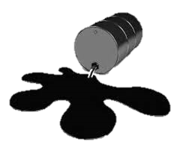
What do I do if…?
...I find a leak or open trash container?
    A. Stop that leak & clean it up right away! If it is small and doesn’t leave property, document in SWP3 and make any changes to prevent it in the future. If it leaves your property, call DEQ and report it. Make changes to your SWP3 to prevent it from happening again. If it is oil or a hazardous waste and a “reportable quantity” (amount based on substance), then must call National Response Center (NRC) and DEQ 24-hr Hotline.

Slide 43

What do I do if…?
…I detect pollutants in my Quarterly Visual Monitoring Samples?
      A. It probably means that a BMP is ineffective or in need of maintenance. Conduct maintenance, add another BMP, or replace the original BMP. Monitoring is how know if BMP is doing its job!

Slide 44
When do I submit a Notice of Termination (NOT)?
Within 30 days of one or more of the following:
  New owner/operator has assumed responsibility for the facility.
  Operations have ceased at the facility and there no longer are discharges of storm water associated with industrial activity from the facility.
  Coverage under an individual or alternative general permit has been obtained.

Slide 45
NOT
Form is available at:
http://www.deq.state.ok.us/wqdnew/forms/stormwater/NOTICE%20OF%20TERMINATION%20Form605-003.pdf

Slide 46
What’s Included on an NOT?
  OKR05 permit authorization number
  Permittee name, address, and telephone number
  Name and street address of facility
  Latitude and longitude of facility
  Information about new operator if you are no longer the operator (who you sold the business to)
  Signature of a responsible corporate official

Slide 47
All Forms
Send hard copies to DEQ :
    DEQ/Environmental Complaints & Local Services
    P.O. Box 1677
    Oklahoma City, OK 73101-1677
    Fax: (405)702-6226
Email scanned copies to DEQ:
  ecls-StormwaterPermitting@deq.ok.gov

Slide 48
Enforcement

Slide 49
Stormwater Enforcement
Stormwater is the second largest category of complaints.
Compliance with CWA provisions is the goal.
The responsiveness of the RP determines if enforcement is necessary.
If enforcement is necessary, it will be taken.
Enforcement will require an administrative penalty.

Slide 50
Enforcement Actions
Inspections (~14 day compliance period)
Notice of Violation (NOV)
Expedited Consent Order (ECO)
Consent Order (CO)
  With Penalty/Supplemental Environmental Project (SEP)
Administrative Compliance Order (ACO)
  With Penalty/SEP

Slide 51
Enforcement Data
FY 2012
  13 NOVs issued, 4 Orders issued
  $30,750 in penalties were collected
FY 2013
  8 NOVs issued, 6 Orders issued
  $12,375 in penalties were collected
FY 2014
  8 NOVs issued, 6 Orders issued
  $26,00 in penalties were collected
Notes:
Currently: NOVs=6, Orders=3, penalties=$6500

Slide 52

DEQ Stormwater Contacts
Permitting
    Michael Moe– (405) 702-8184
    Karen Milford – (405) 702-8191
    Ismat Esrar – (405) 702-8193
Permit Administration
    Loree Boyanton- (405) 702-6177
    Anamari Holcomb- (405) 702-6178
    Sandra Purvis- (405) 702-6182
Compliance/Enforcement
    Wayne T. Craney - (405) 702-8139
    Michele Loudenback (North) - (405) 702-8116
    Michelle Chao (West) - (405) 702-8112
    Lorinda Mollenkamp (South) - (405) 702-8156

Slide 53


Questions, Comments, Discussion

