Slide 1
The Lead and Copper Rule
DWLC@deq.ok.gov

Slide 2
Who is subject to the Lead and Copper Rule
All community water systems (CWS)
and
All non-transient, non-community (NTNC) water systems.

Slide 3
Lead Service Line Inventory (LSLI)
Due October 16th, 2024
Every system must submit an initial inventory
  Updated Inventory due annually beginning November 2027 until all unknowns are identified and all Lead/GRR are replaced
If you have not completed this, please get in touch with us after this presentation.
  Technical assistance is available through DEQ and other organizations.
Notes:
We are still accepting inventories, so please submit if you have not done so already.
Templates and the certification form for the service line consumer notice are available on our website. If you would like to create your own notification it will have to be approved by the PWS compliance section before it can be sent out.

Slide 4
Material Notice
Annual requirement to notify ALL customers served by Unknown, Lead, or Galvanized Requiring Replacement service lines.
  ANY portion of the service line will classify the entire service line as unknown, GRR, or lead.
DEQ has approved templates on website
Must get prior approval to use your own templates

Slide 5
Monitoring Periods For Sampling
Standard monitoring is one round every 6 months
  January 1 through June 3
  July 1 through December 31
Reduced monitoring is one round every year, or every three years
  June 1 through September 30
  Systems qualify for reduced monitoring based on the results of the most recent round of standard monitoring
Samples can be collected on any day within the monitoring period
  Sample collection can be split up if it is easier to collect on multiple days
  Collect early in monitoring period, if possible, to provide time for recollections if needed

Slide 6
Returning to Standard Monitoring
Missing routine Lead and Copper sampling event
  Samples cannot be accepted if taken outside of the monitoring period
Lead or Copper exceedance

Slide 7
LCR Sample Sites
Lead service lines and newer indoor copper plumbing (after 1982) are preferable, “tier 1 sites” because they are more at-risk of leaching
If possible, all sample sites must be tier 1 and spread throughout system
If LSLs exist, 50% of sites sampled in a monitoring period must be from those sites

Slide 8
Community Water System Sites
Tier | Single Family Residence | Multiple Family Residence/ Buildings
1 | Copper pipes w/ lead solder installed AFTER 1982 Lead Pipes Lead service lines | -
2 | - | Copper pipes w/ lead solder installed AFTER 1982 Lead Pipes Lead service lines
3 | Copper pipes with lead solder installed BEFORE 1983 | -
Non-Tier | Non-copper and non-lead | Copper pipes with lead solder installed BEFORE 1983 Non-copper and non-lead

Slide 9
Non-Transient Non-Community Sites
Tier | Type of Plumbing
1 | Copper pipes w/ lead solder installed AFTER 1982 Lead Pipes Lead service lines
2 | Copper pipes with lead solder installed BEFORE 1983
- | - Non-copper and non-lead

Slide 10
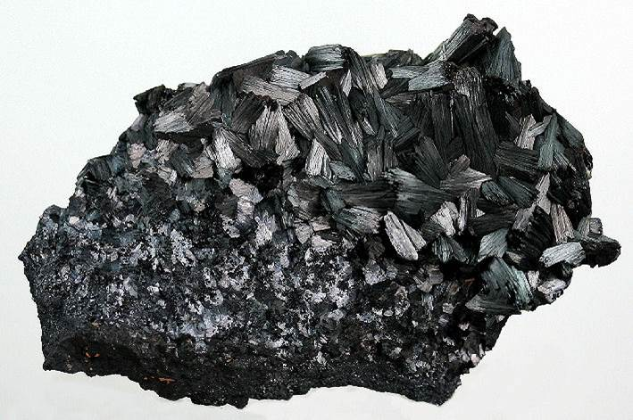
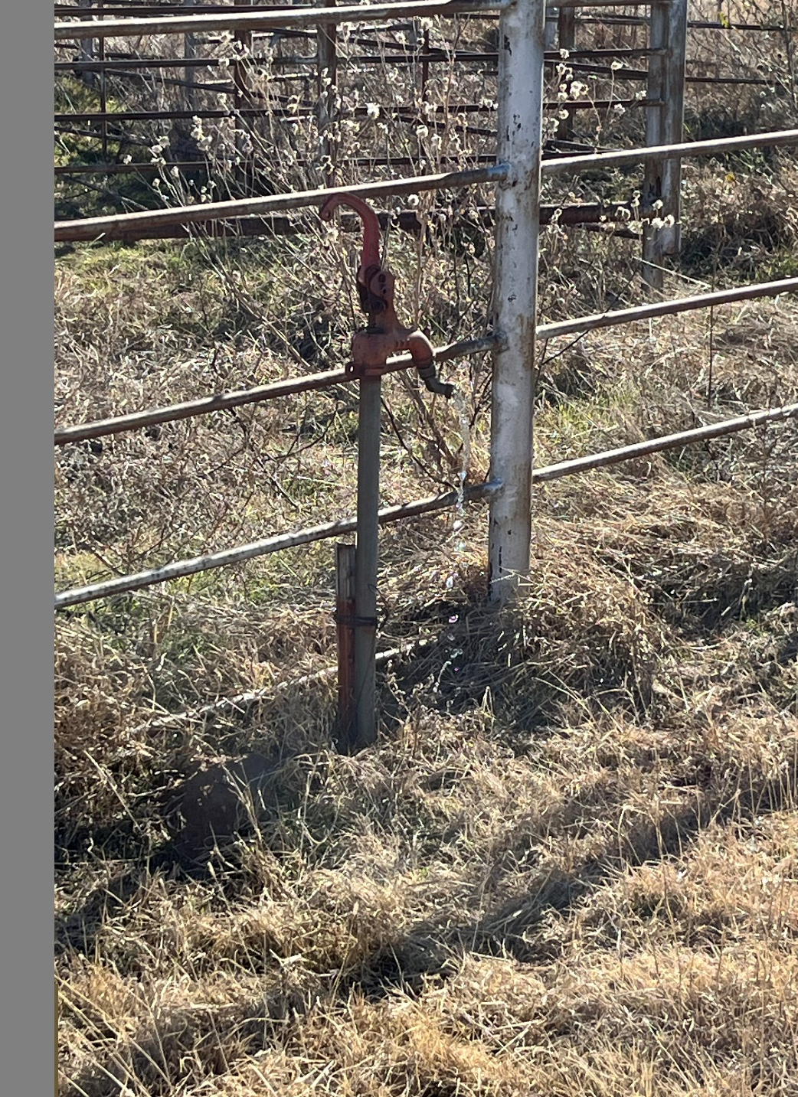
DO NOT SAMPLE FROM OUTSIDE TAPS
They are not approved sample sites.
Usually result in a high lead detect because they are usually not lead-free taps
By the time sample results are available it is too late to invalidate the sample and provide recollections. So contact us immediately if you are concerned about how or where a sample was collected. It is better to recollect than to have an action level exceedance
Sampling location that resulted in a Lead ALE

Slide 11
Lead Results Consumer Notification
Must go out to every homeowner who took a lead/copper sample in their home, regardless of results
Template available if needed
Should be delivered soon as possible after results have been received from lab (30 days),
You have 3 months to report back to DEQ with those notices
Notes:
This is different from the Service Line Material Notice

Slide 12
Lead and Copper Action Level Exceedance (ALE)
The 90th percentile value which can not be exceeded:
  0.015 mg/L or 15 µg/L for lead
  1.3 mg/L or 1300 µg/L for copper

Slide 13
Tier 1 Lead ALE based on the 90th percentile
New requirement based on the LCRR and LCRI
  Only for lead
Must conduct a Tier 1 Public Notice to all customers within 24 hours of learning about the Lead ALE based on the 90th percentile
The State receives notification from the labs anytime a sample result is over 0.015 mg/L
  The State then calculates the 90th percentile to determine if it is a Lead ALE
  The State has templates available and will help systems through the notification process
  In the event you learn of an ALE and are not contacted by the State, you must reach out to the State within 24 hours of receiving those results.

Slide 14
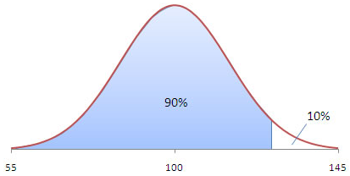
90th Percentiles
More than 10% of tap water samples must exceed the action level for it to be an exceedance

Slide 15
Calculating 90th percentiles
Rank the number of samples in ascending order (lowest to highest) assign each a #
Multiply the number of samples taken by 0.9, which yields a sample #
The contaminant concentration in the numbered sample is the 90th percentile value for that monitoring period

Slide 16
Calculating 90th percentiles
If only 5 samples are submitted, then the two highest values are averaged and that is the 90th percentile
In the event less than 5 samples are collected, the highest value is considered the 90th percentile
It is possible to have results over the action level but not have an official exceedance

Slide 17
What happens after a 90th percentile exceedance?
Tier 1, 24-hour Public Notice if it is lead
Notice of Exceedance is issued by State
Go back to standard, 6-month monitoring
Must take water quality parameter and source water lead and copper samples
Must deliver public education if it is a lead exceedance
Corrosion Control requirements

Slide 18
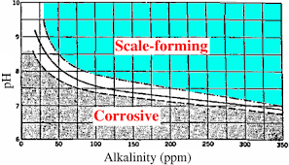
Water Quality Parameters (WQP)
Determines water corrosivity
From these results, engineers use a Baylis curve to determine the water’s corrosivity, and they utilize the other parameters to determine the best method of treatment

Slide 19
WQP Continued
Parameters measured:
Frequency and locations of WQP sampling:
Twice every 6-months that the system is on standard monitoring following an exceedance
Measured at each entry point to distribution
Measured at bacteriological or LC sites
pH
Alkalinity
Conductivity
Calcium
Temperature
Orthophosphate (if phosphate inhibitor is installed by them or parent system)

Slide 20
Source Water Lead and Copper
Collected once at each entry point.

Slide 21
Public Education for Lead Exceedance
We have resources for systems to create their Public Education materials
Deliver ASAP no later than 60 days after end of monitoring period (or NOE)
Must be delivered via multiple methods of distribution

Slide 22
Public Education, cont’d
Full education to be delivered annually.
Additionally:
  Water bill inserts: quarterly
  Press releases: 2X year
  Web posting (for large systems): continuous
Posting and distribution to all customers acceptable for NTNC and prisons

Slide 23
Coming Up
Fall 2027 Lead and Copper Rule Improvements implementation
  New lead action level of 0.010 mg/L
  Lead testing in schools and childcare facilities
  Lead service line replacement plans
  New sampling protocol
  New sample site selection
  New Lead and Copper requirements on the CCR (CWS)

Slide 24
Voluntary Lead Testing in Schools and Child Care Facilities Program
Free sampling program through DEQ
Reimbursement remediation program
Systems that participated starting in 2021 may be eligible for a waiver for future required lead testing in schools
Contact LWSC@deq.ok.gov

Slide 25
Questions?
For all questions regarding Lead and Copper, please reach out to the newly formed Lead and Copper Unit
405-702-8100
DWLC@deq.ok.gov

