Slide 1


Slide 2



Slide 3
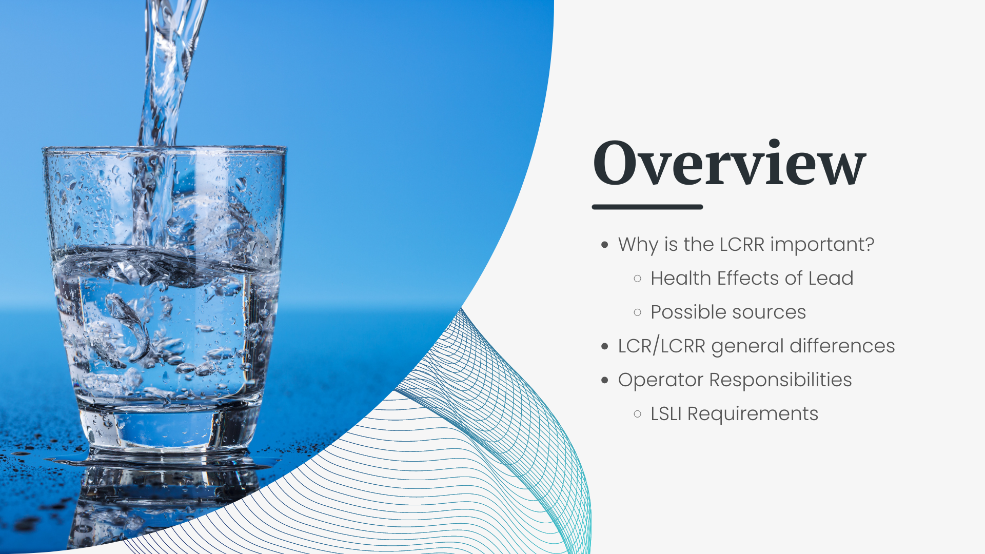

Notes:
Why is the LCRR important? In other words, why should you care about it?
Health effects and how there may be lead in the home’s drinking water supply
General changes that are coming with the LCRR, and what the requirements will be for operators moving forward.

Slide 4
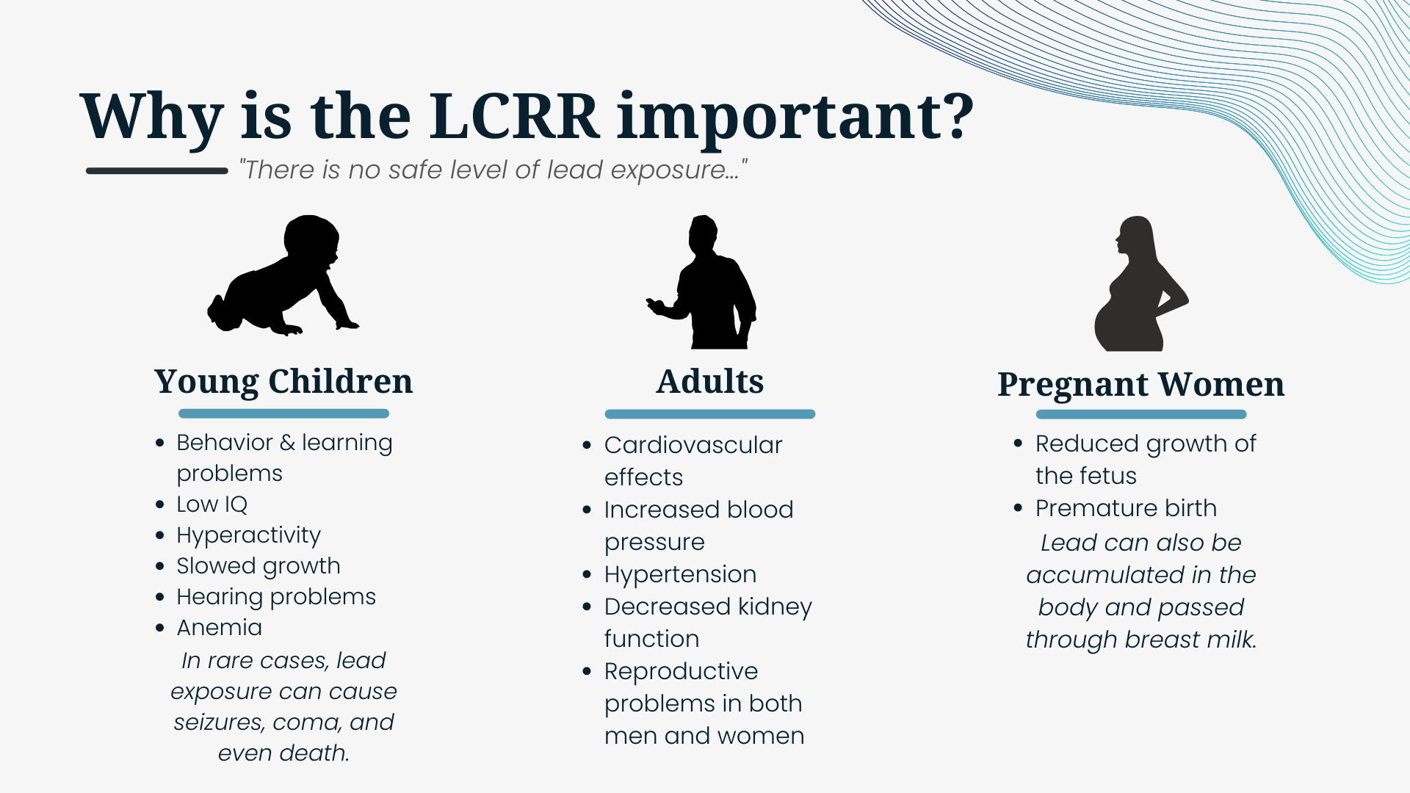
Notes:
There is no safe level of lead exposure. Lead exposure can cause…

Slide 5

Notes:
Young children are the most susceptible. And this is a huge risk because due to the lack of immediate symptoms, lead exposure often goes unrecognized.

Slide 6
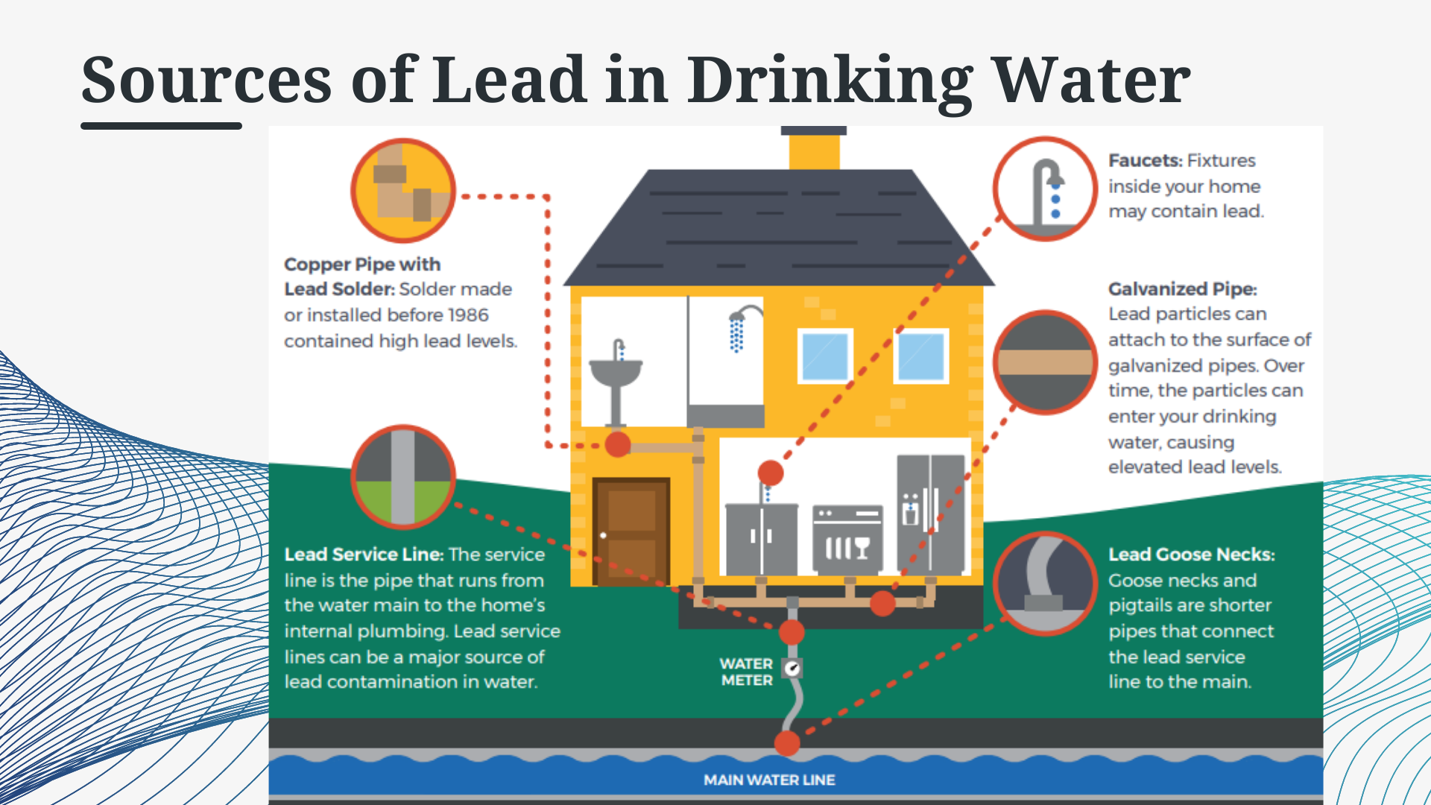

Slide 7
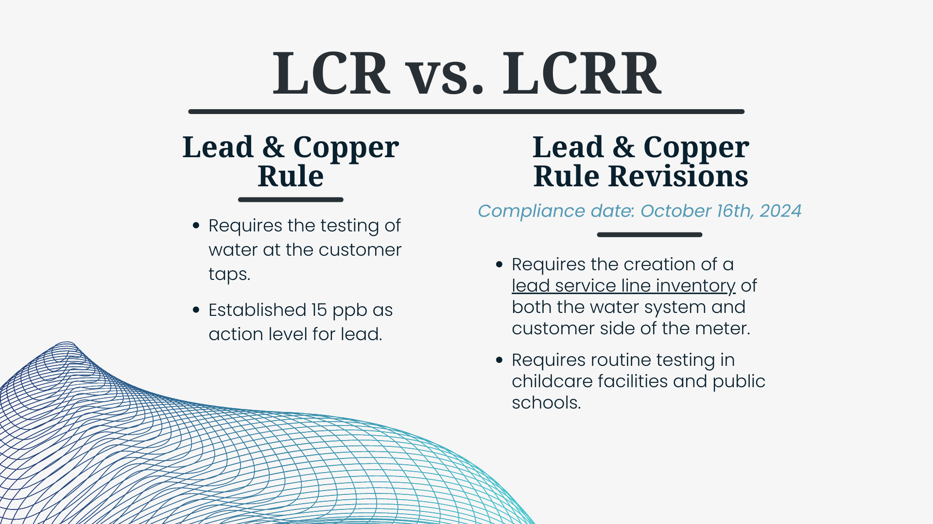
Notes:
So, right now the LCR requires testing at customer taps, and they have established an action level of 15 ppb as the action level for lead. The LCRR will require systems to create a lead service line inventory of both sides of the meter – the system owned AND customer owned sides. It will also require routine testing in childcare facilities and public schools. The exact requirements on how often the schools are likely to test is still subject to change, but if you would like to get ahead of it while there is assistance with funding remediation, we do offer our lead testing in public schools program. For more information on that please consult your handout or come speak to me afterwards. But the big thing that you should take away from this slide is the compliance date: October 16th 2024.

Slide 8
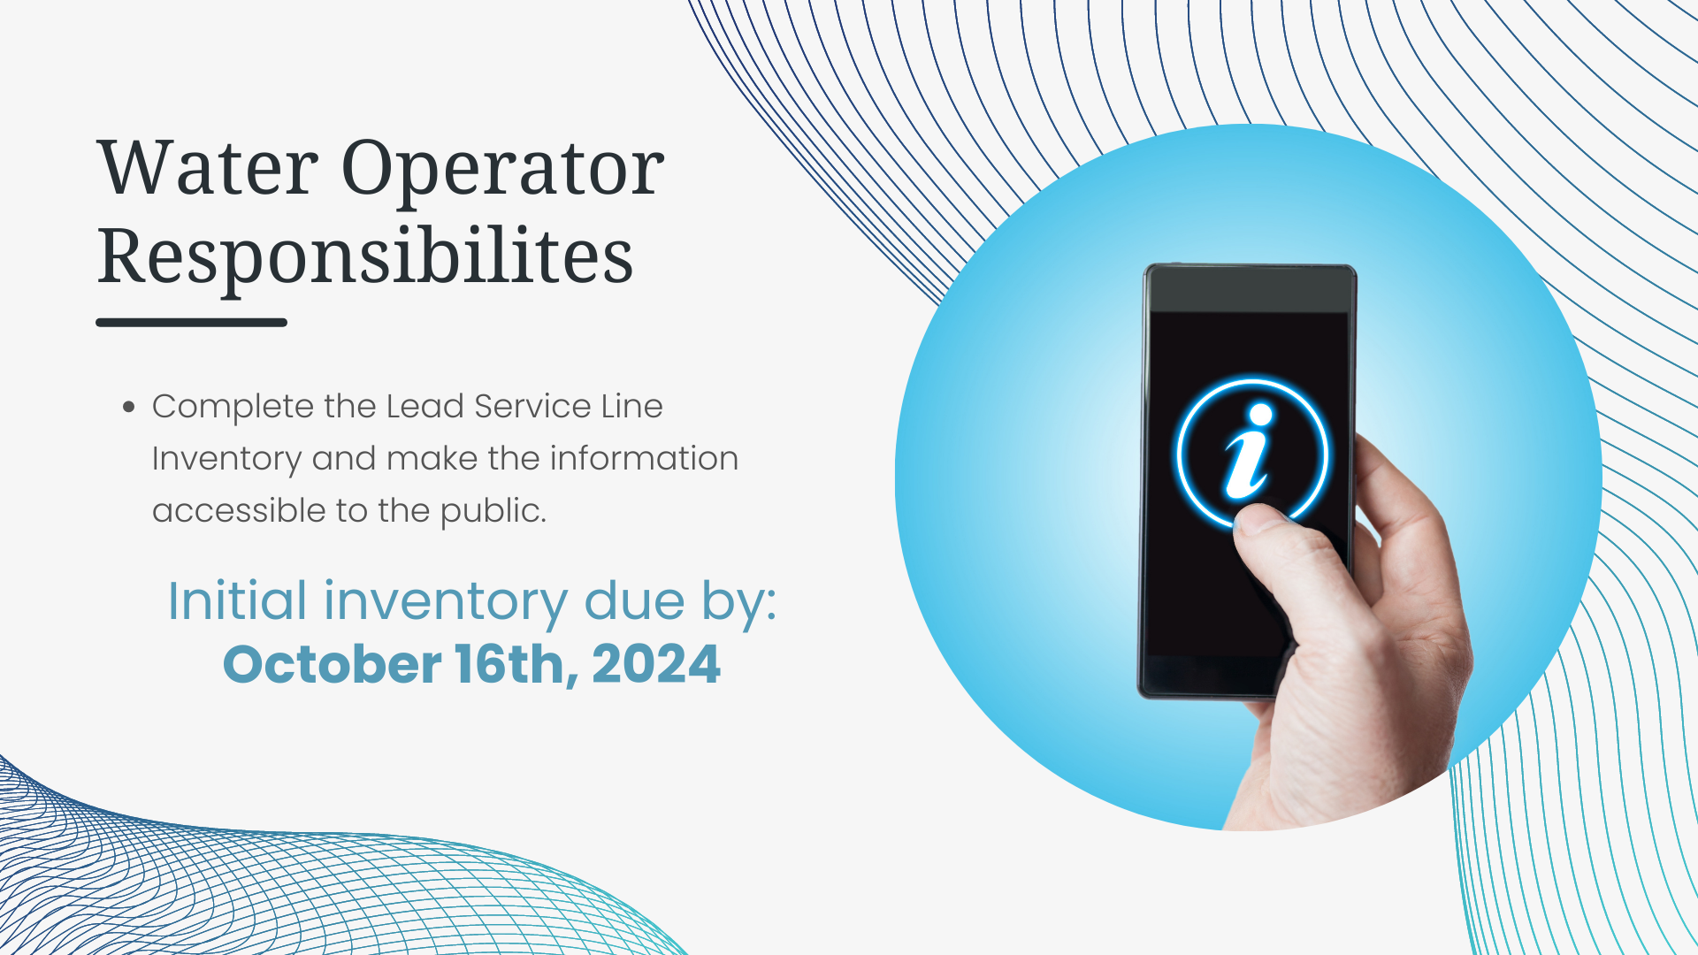
Notes:
That compliance date: October 16th 2024 is when the first inventory of your system is due to be submitted to EPA and be available to the public. It will be YOUR responsibility to complete the inventory, submit it, and make it accessible to the public by that date.

Slide 9
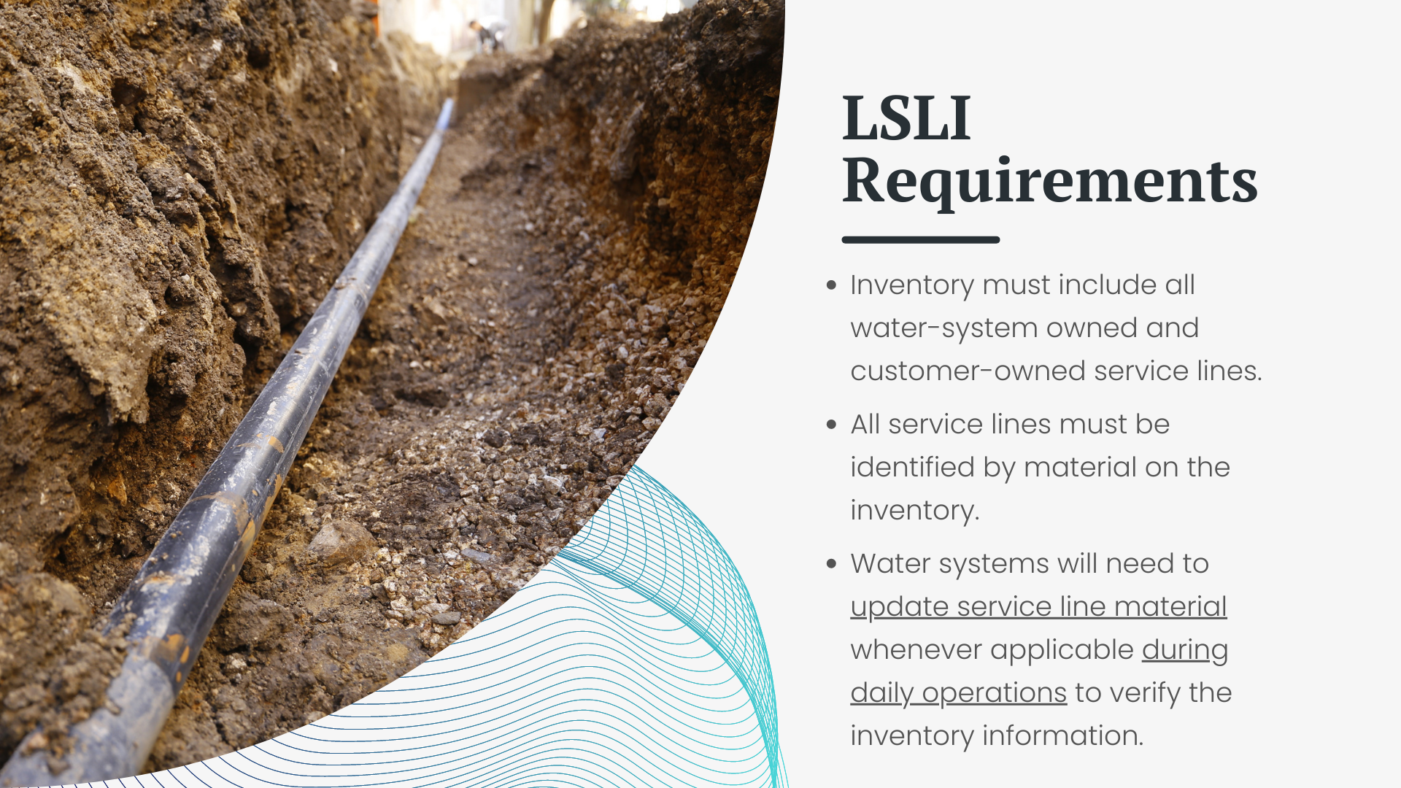
Notes:
The inventory that must be submitted by OCTOBER 16th 2024 – must include all the water-system owned AND customer-owned service lines, and all of these lines must be identified by material on the inventory. Meaning, you will have to list what they are made of for each one, but we will go into more detail about that in the next presentation. You will also need to keep it updated as new line material information becomes available. So when you are out doing your daily operations, checking meters, fixing line breaks, etc. take note of what the material of the lines are so you can update your inventory information.

Slide 10
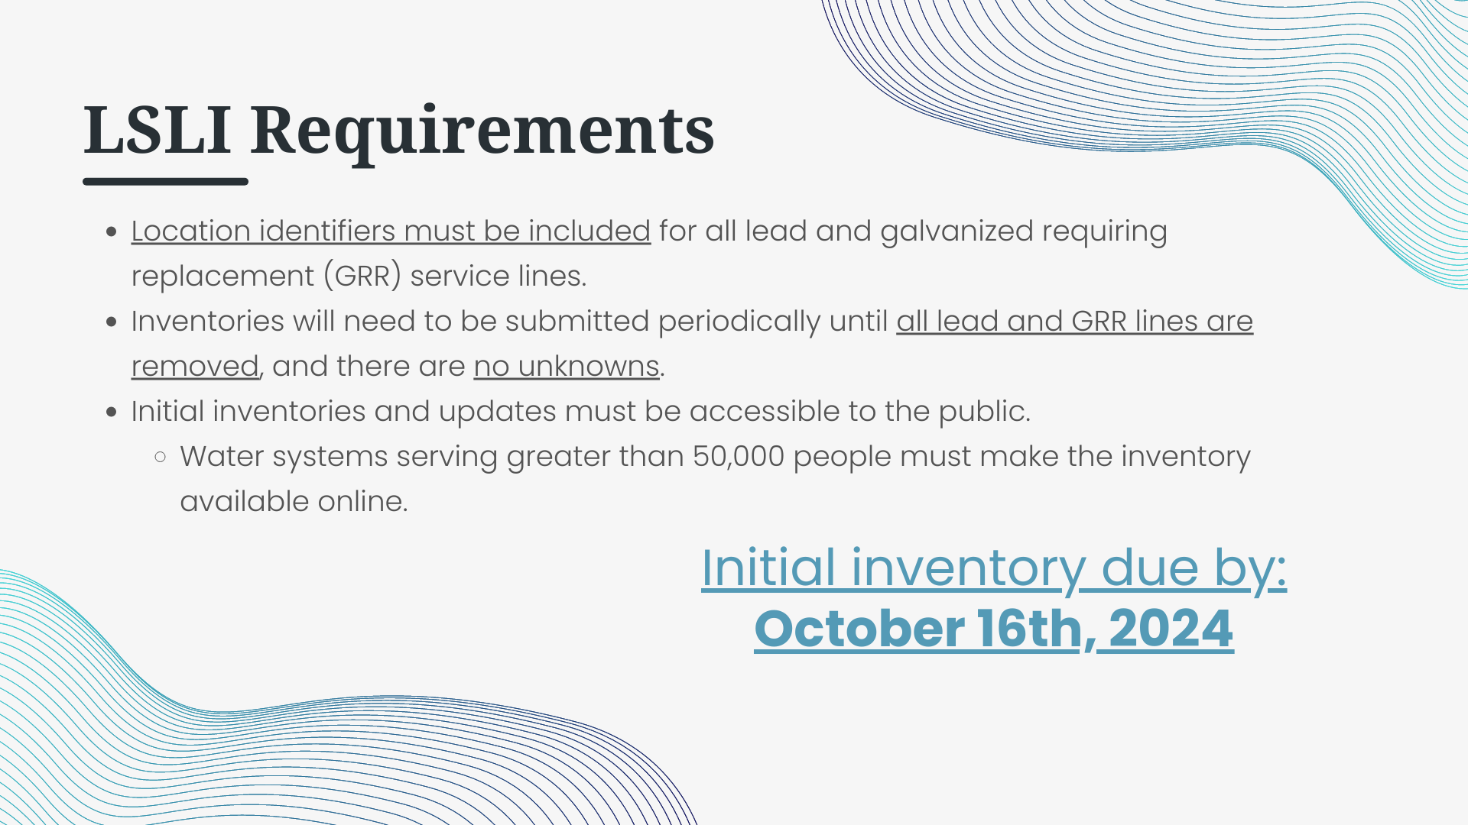
Notes:
Location identifiers must be included for all lead and galvanized requiring replacement service lines – but really you should put location identifiers on EVERY line. This is because IF you have any lead, galvanized requiring replacement, or unknown lines, you will have to resubmit your inventory periodically until everything is known, and there are no lead or GRR lines left in the system.
And then, once the inventory is completed, you must make it accessible to the public. This is true for the initial inventory and any updates – they must be made publicly accessible. Now, if you are a system that serves greater than 50,000 people, the inventory and all updates must be made available to the public ONLINE. We have a presentation a little later that will help you with figuring out how to do this, so don’t panic!
And again, all of this must be completed by OCTOBER 16th, 2024. I know the 2024 date makes it seem very far away, but the sooner you can begin gathering the information, the easier it will be for you later.

Slide 11
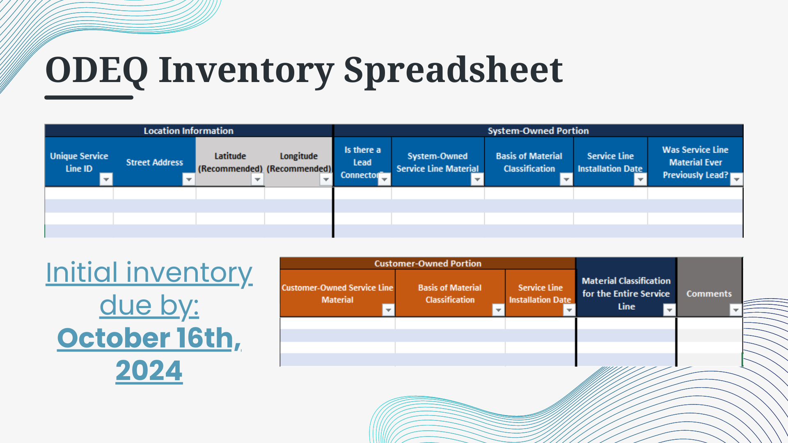

Slide 12


Slide 13
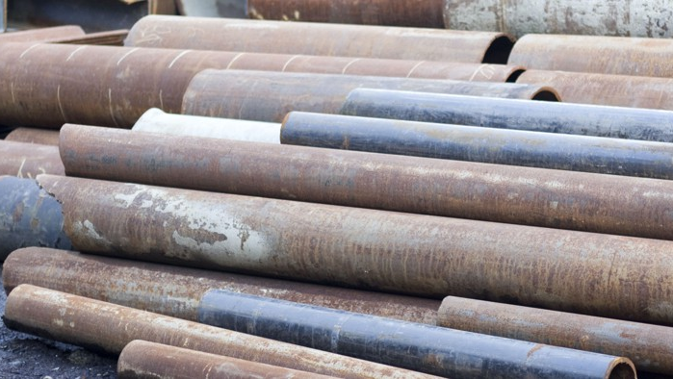

Material Classification Methods

Slide 14
Overview
Types of Materials
Historical Records Review
Identifying Service Line Material Under Normal Operations
Service Line Investigations

Slide 15
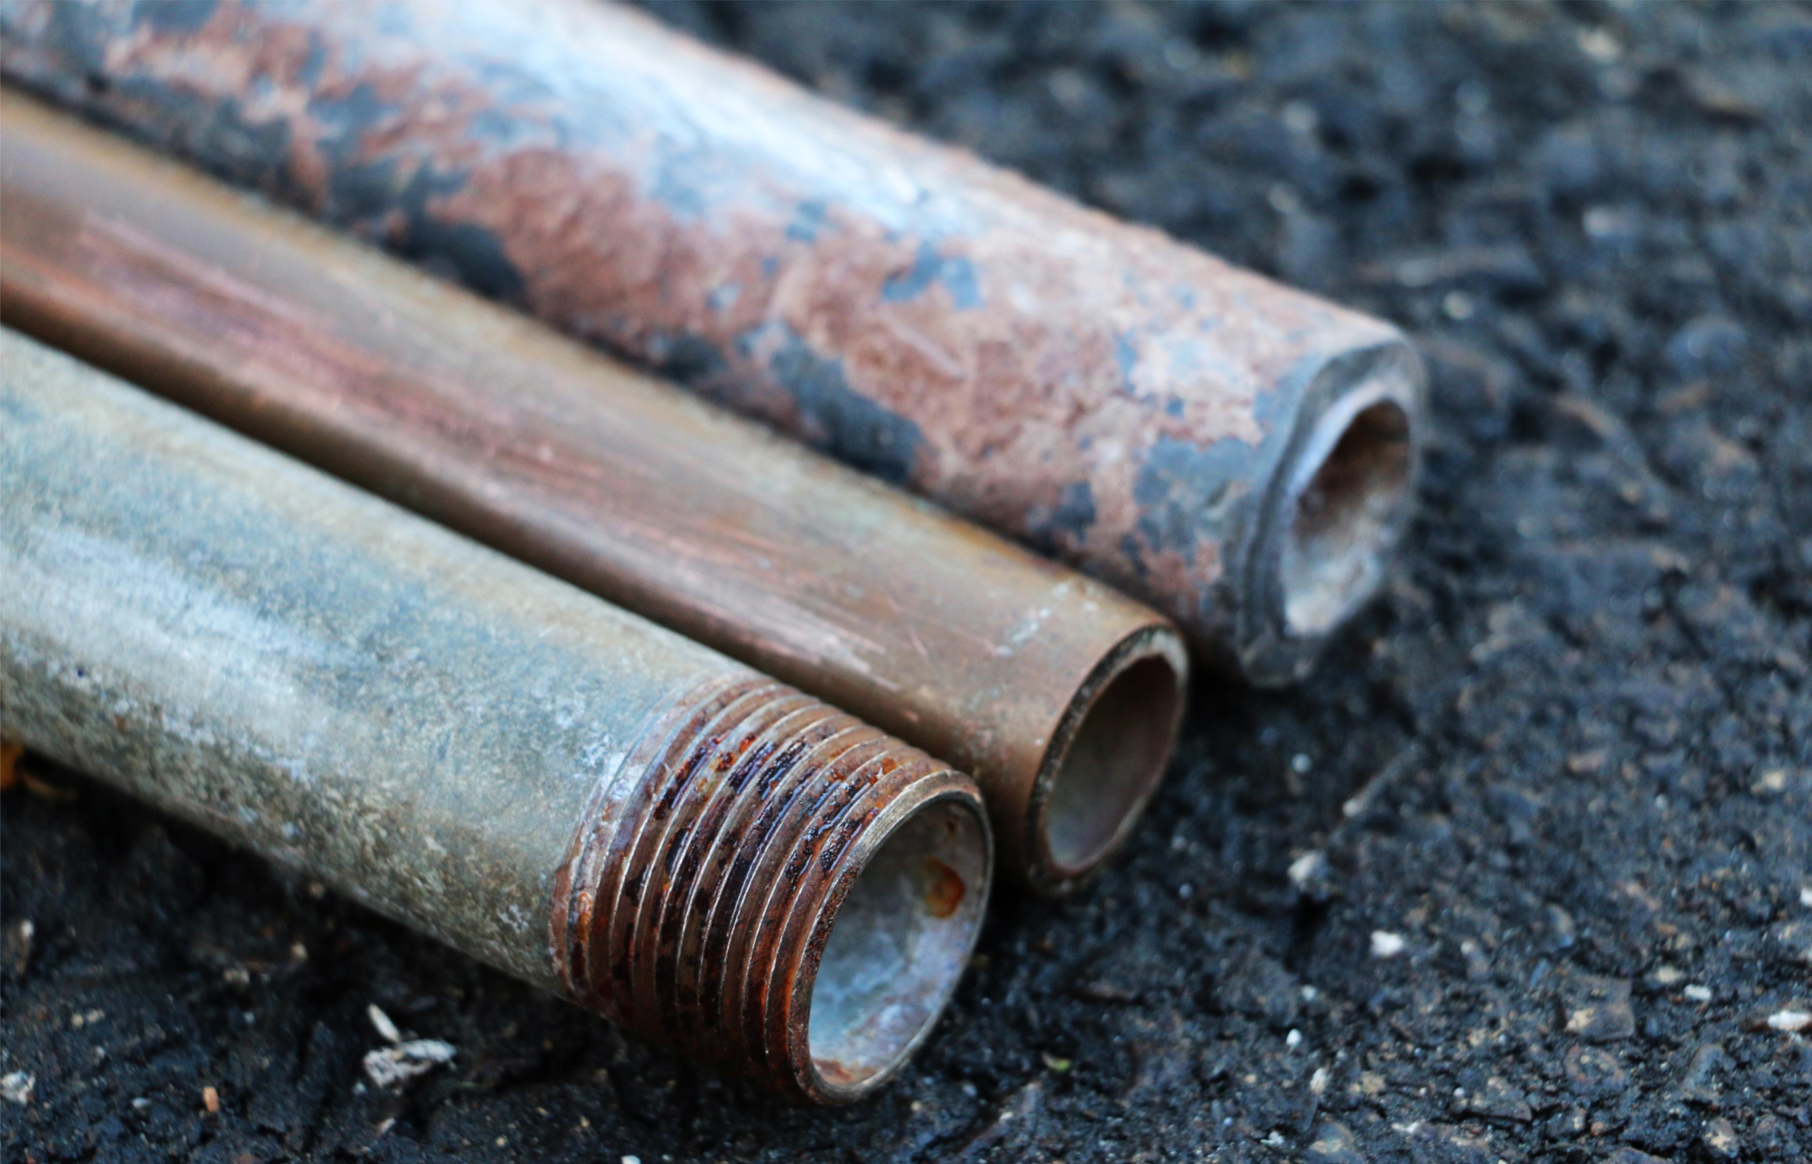
Types of Materials
Lead
Galvanized Iron/Steel
Non-Lead
  Copper
  Plastic (PVC, CPVC, PEX)
  Other (list specific material in comments)
  Specific Material Unknown
Unknown (material is completely unknown)

Slide 16
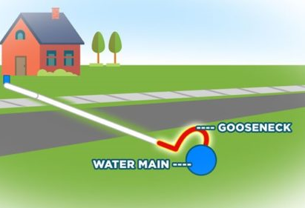
What is a lead service line?
A lead connecter such as a gooseneck or pigtail, no matter the length, is NOT considered part of the service line.
There is a separate place to record lead connectors if they are discovered during your inventory activities.

Slide 17
Historical Records Review
The Lead and Copper Rule Revisions (LCRR) requires systems to review the following documents when completing their service line inventory:
  Previous Materials Evaluation
  Construction and Plumbing Codes and Records
  Water System Records
  Distribution System Inspections and Records

Slide 18

Previous Materials Evaluation
Systems must review information collected for the 1991 Lead and Copper Rule (LCR) when preparing their initial inventory.
Some systems may have previously reviewed historical records proactively for asset management, LSLR activities, and selecting LCR sampling sites.
Records that have already been reviewed for service line material information do not need to be reviewed again.

Slide 19

Construction & Plumbing Codes and Records
The “lead ban” of the Safe Drinking Water Act Amendments of 1986 took effect in Oklahoma on May 6, 1987, but many systems stopped installing lead service lines earlier.
Systems should verify local plumbing requirements to determine when it became effective in their community.
Building construction dates can usually be found in municipal tax records.

Slide 20

Most lead service lines (LSLs) are 2” or less in diameter and serve single-family homes or small multi-family residences.
Permits are usually required to install or replace service lines. These permits should include the location and date and may include information on the line material.

Slide 21
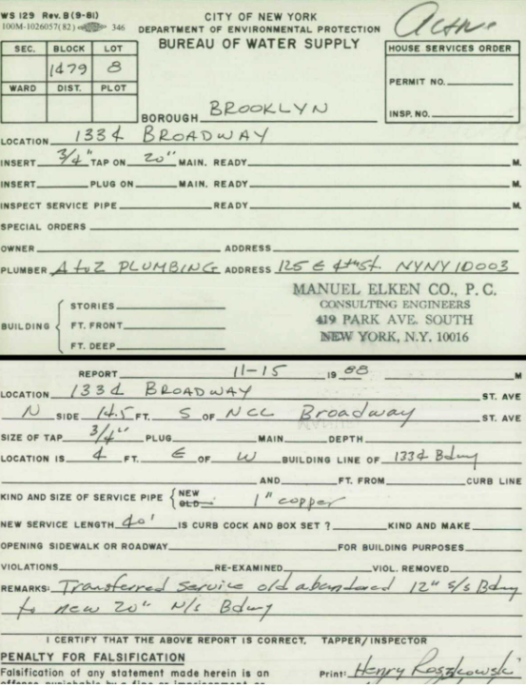
Water System Records
Systems can use any relevant water system records they may have to develop their inventory.
On the left is an example of service line installation record, usually called a tap card.
  They are often handwritten and digitizing these is a great first step in building an inventory.
  Sometimes these records are inaccurate due to maintenance conducted since the line was installed.
The rule requires that certain types of records must be reviewed.

Slide 22
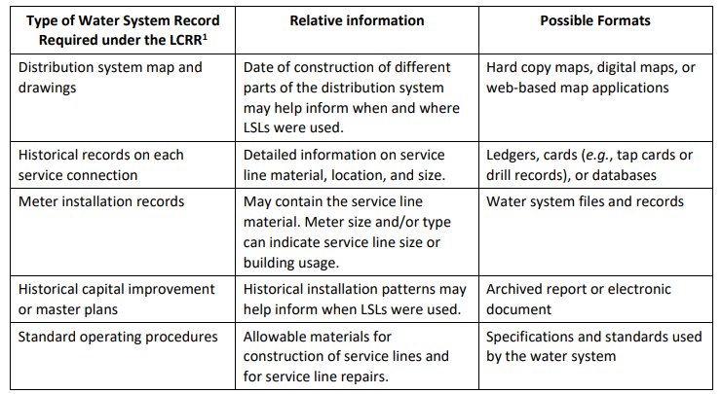

Slide 23
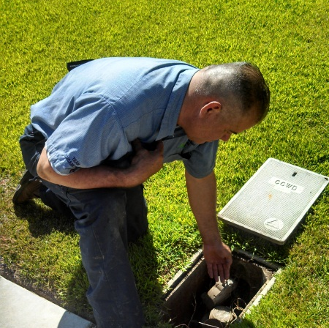
Distribution System Inspections and Records
Inspection records might indicate service line materials or can be used to verify other records.
Sources of information include:
  responses to customer complaints
  inspections to locate leaks
  cross connection inspection
  inspections to investigate meter issues

Slide 24
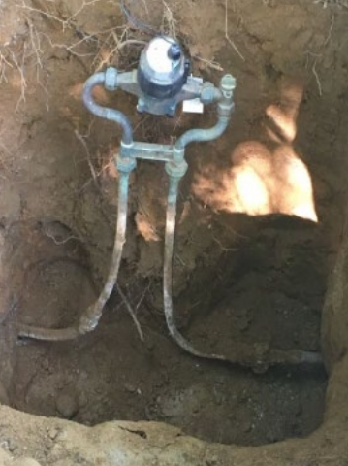
Identifying Service Line Material During Normal Operations
Inventory activities should be worked into the day-to-day activities of the system, and as information is collected regarding service line materials, the inventory must be updated.
Routine opportunities for service line data collection include:
  Water meter reading
  Water meter repair or replacement
  Service line repair or replacement
  Water main repair or replacement
  Backflow prevention device inspection
  Other (e.g., street repair or project with open cut excavations)

Slide 25
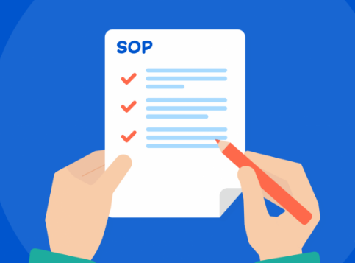
It’s recommended that standard operating procedures (SOPs) be developed or modified to include the collection and update of inventory information by system staff and contractors.
SOPs may also be used to:
  obtain permission for system personnel to access the home for line identification
  to educate customers about the importance of the service line inventory and ways they can self-identify their portion of the line
SOPs can help ensure that a consistent method of tracking, updating, and reporting is used by everyone.

Slide 26
Service Line Investigations
Field investigations are not required by LCRR but are recommended by EPA to verify historical records and to supply information where records do not exist.
Before using field investigation methods, check with DEQ to verify that these methods will be acceptable.
Investigative methods can include the following:
  Visual Inspection
  Excavation
  Other Methods

Slide 27
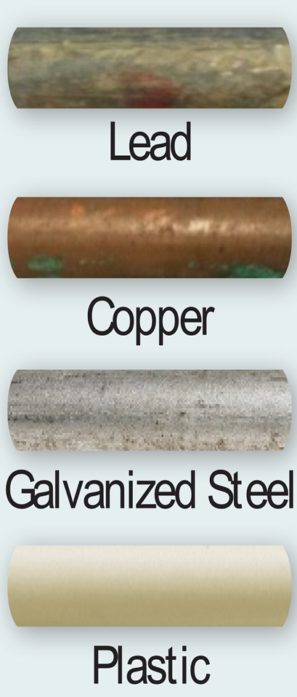
Visual Inspection
A service line may be visible at the meter box and where it enters the building.
  Lead - soft metal that is a dull, silver-gray color. It is easily scratched with a coin or key, and the scratched areas will be shiny. It is non-magnetic, meaning a magnet will not stick to it
  Copper - is the color of a penny
  Galvanized iron/steel - a dull, silver-gray color that is difficult to scratch and is magnetic
  Plastic - a smooth pipe and is usually white

Slide 28
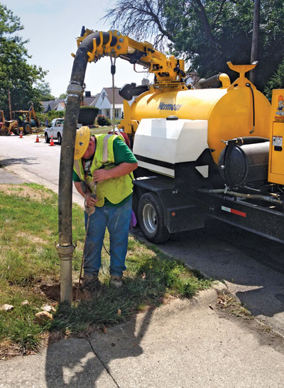
Excavation
Mechanical – uses a backhoe or other mechanical excavator to dig a “pothole” or test pit to expose the service line.
Vacuum – uses a water jet or compressed air to create a small hole to access the service line. This method is faster, less intrusive, less likely to disrupt or damage the service line or other utilities, and often cheaper than mechanical.
If an LSL or a galvanized service line requiring replacement (GRR) is disturbed, EPA recommends alerting the customer about the potential of temporarily elevated lead levels in their water. Systems should provide information about methods to reduce lead levels, such as flushing.

Slide 29
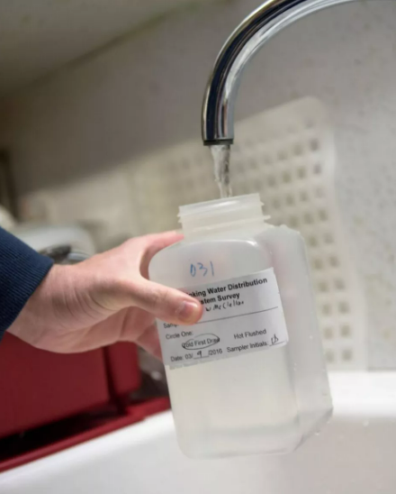
Other Methods
Water quality sampling can be used together with other investigative methods. It can help determine the presence of LSLs or household plumbing containing lead; however, lead-containing materials are not always detected in water quality sampling.
Predictive models look for patterns in a known dataset to make predictions about areas of unknown condition. Can be used to prioritize areas for further investigation.

Slide 30
Questions?
www.deq.ok.gov/lead-service-line-inventory/
405-702-8100

Slide 31
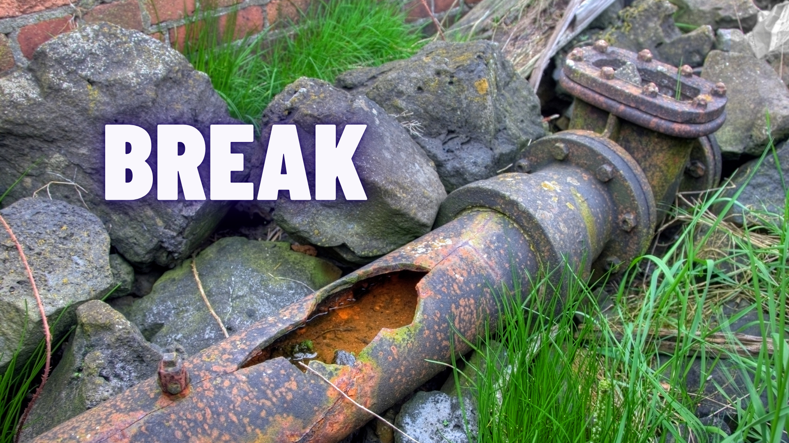
www.deq.ok.gov/lead-service-line-inventory

Slide 32



Slide 33
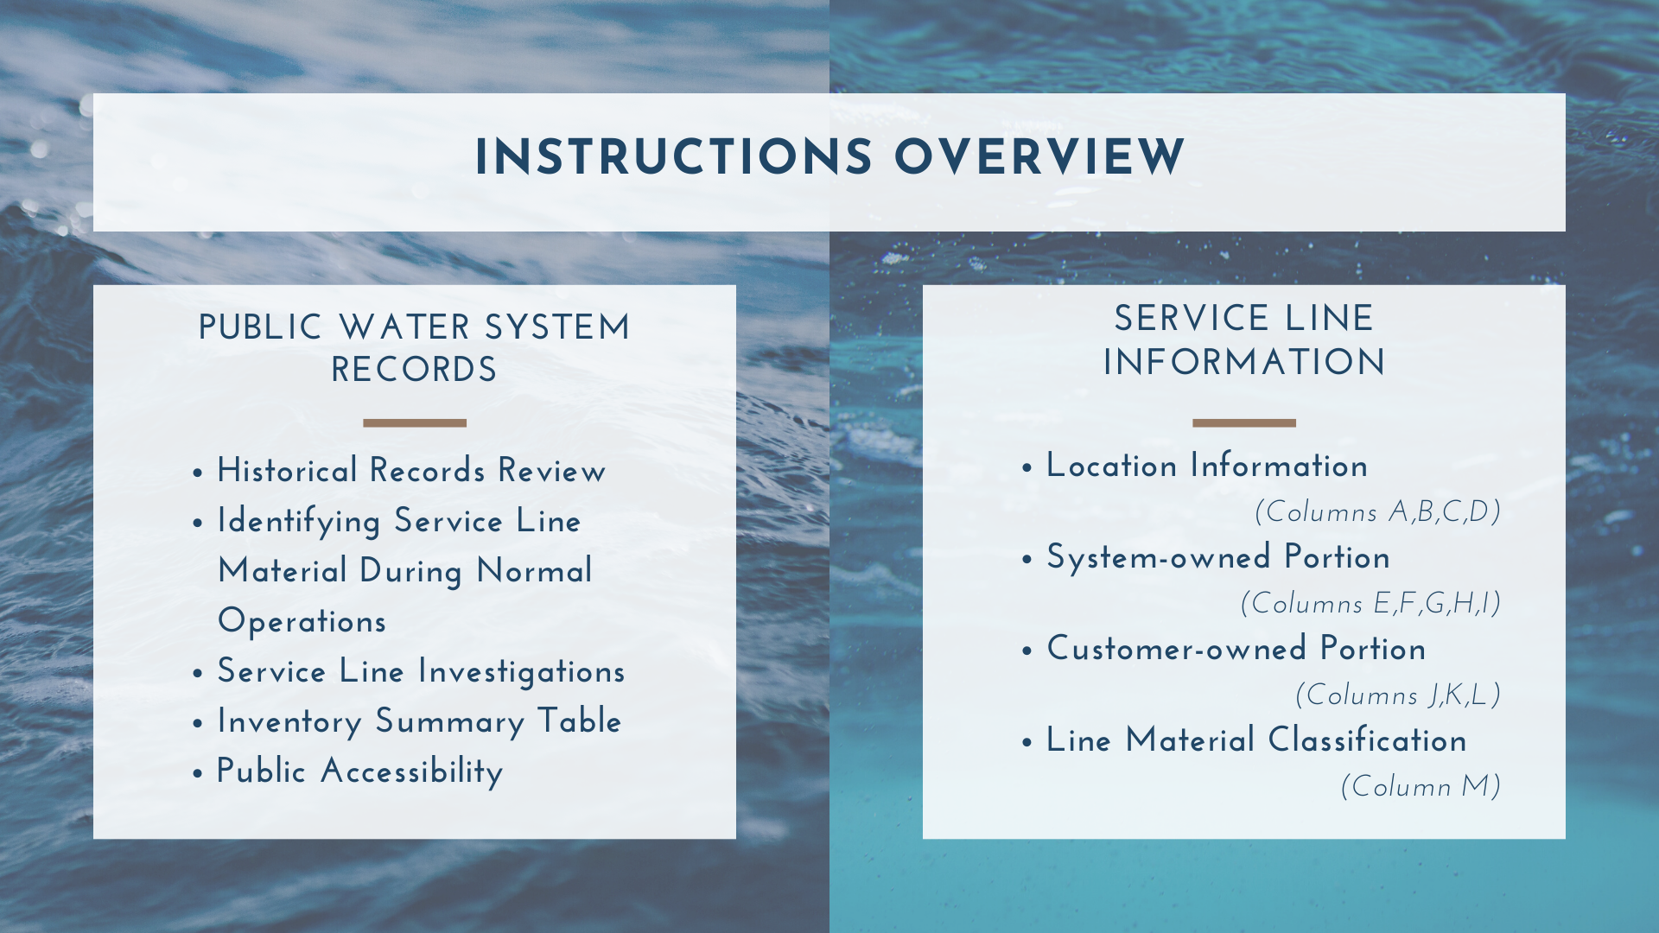

Slide 34
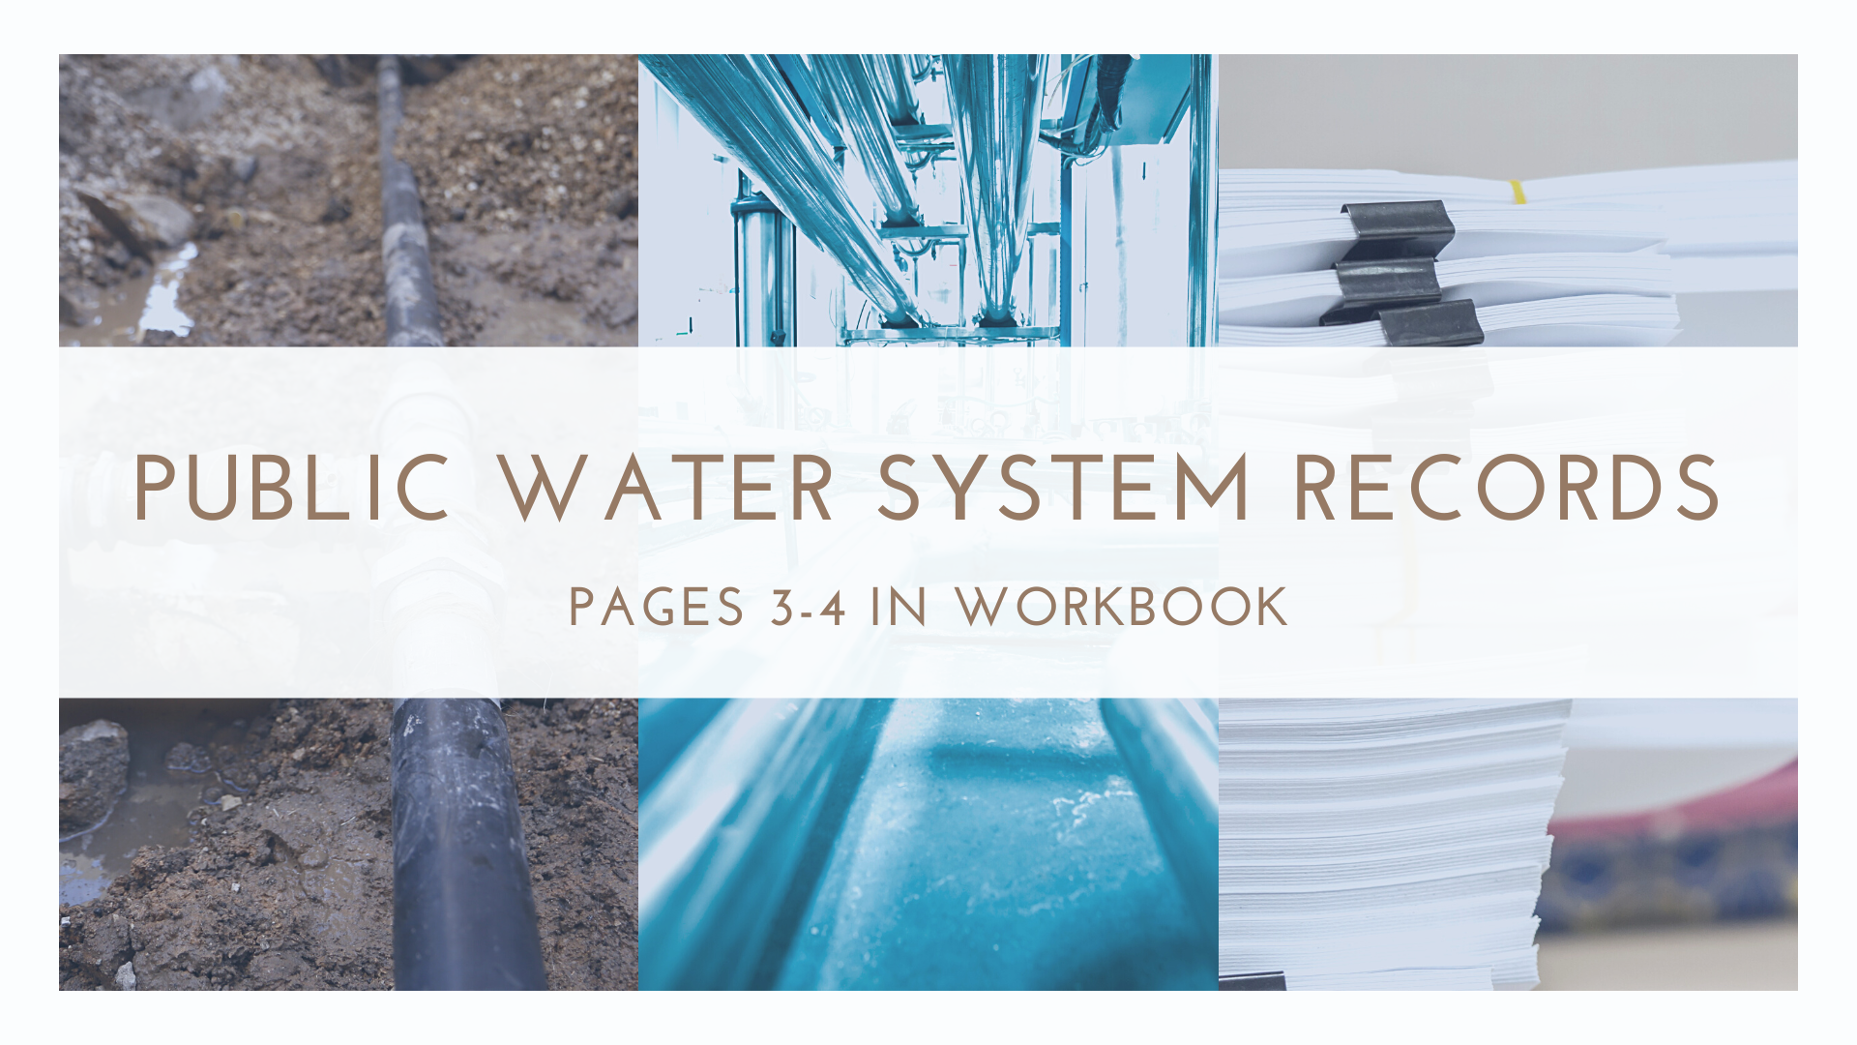

Slide 35
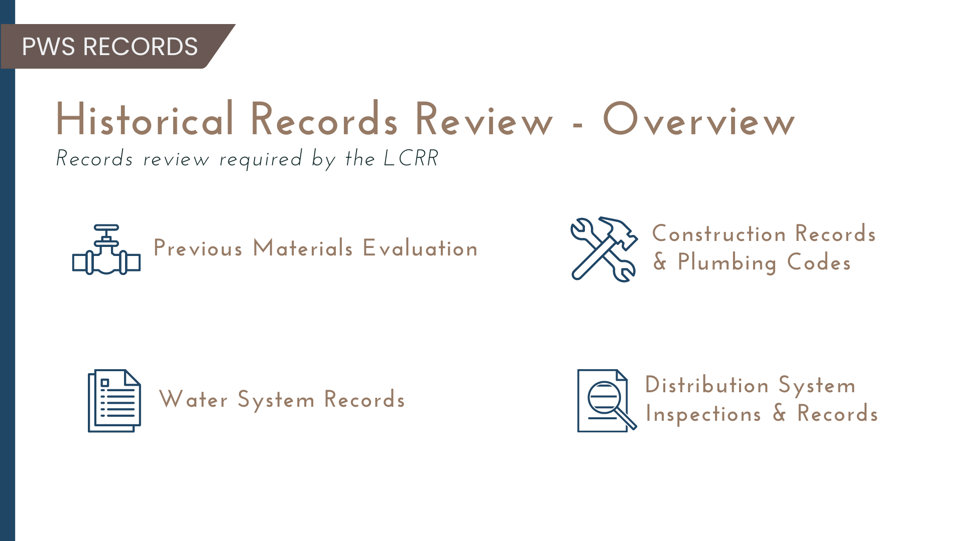

Slide 36
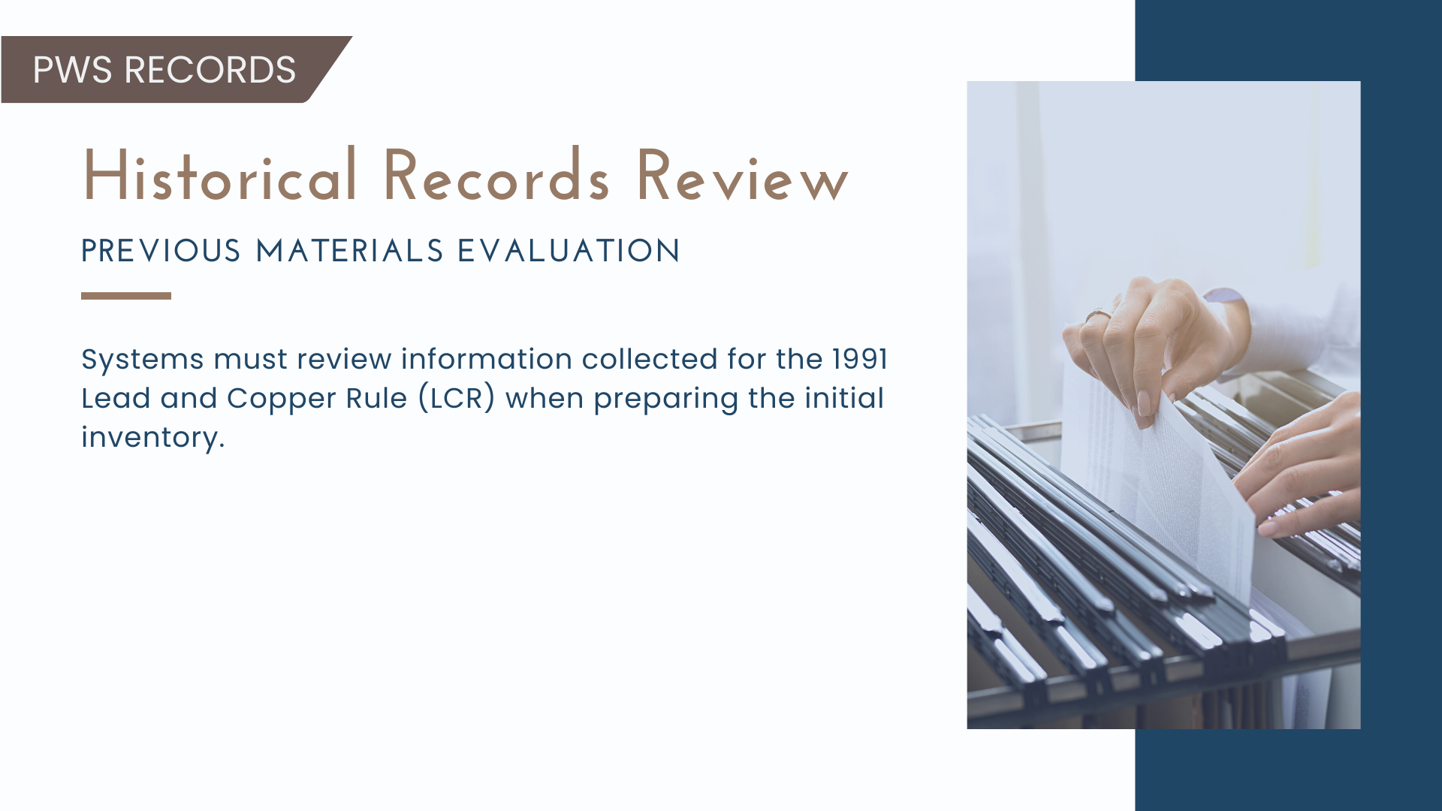

Slide 37


Slide 38
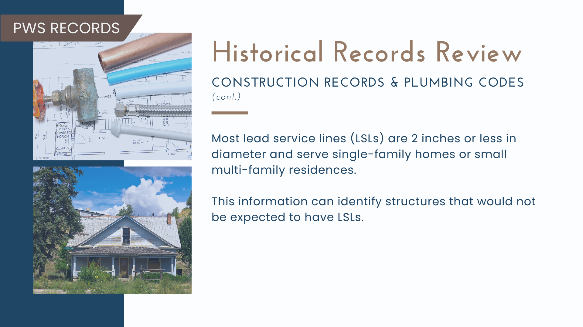

Slide 39
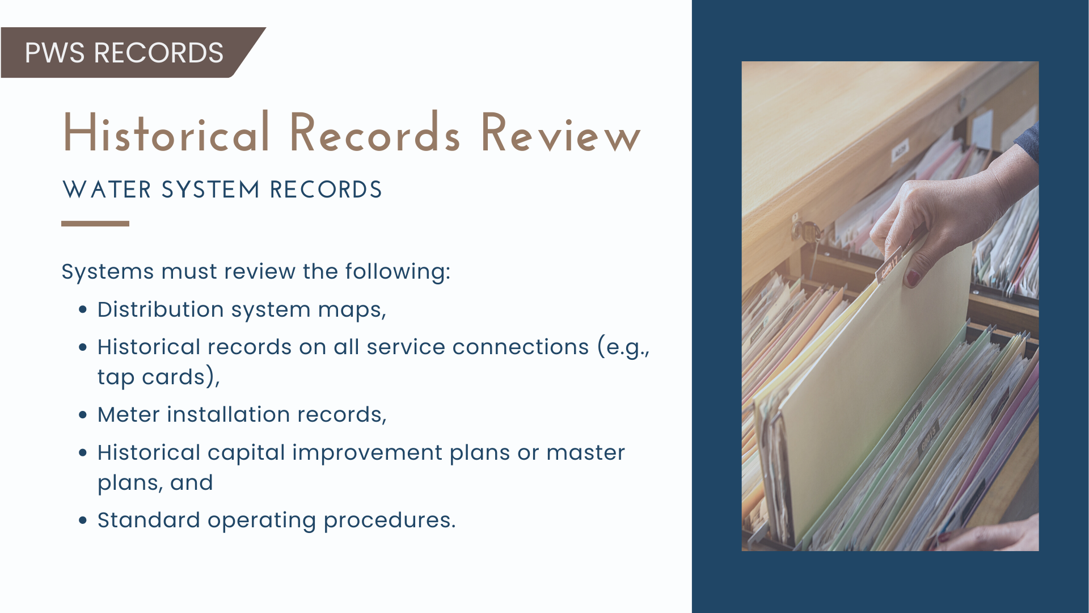

Slide 40
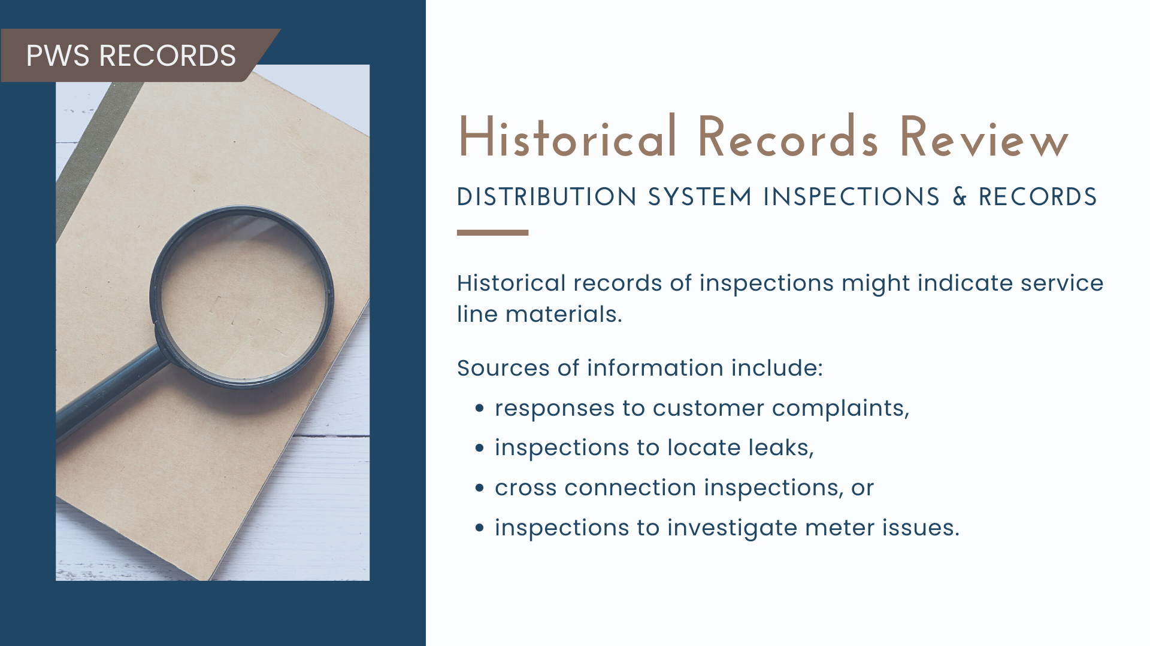

Slide 41
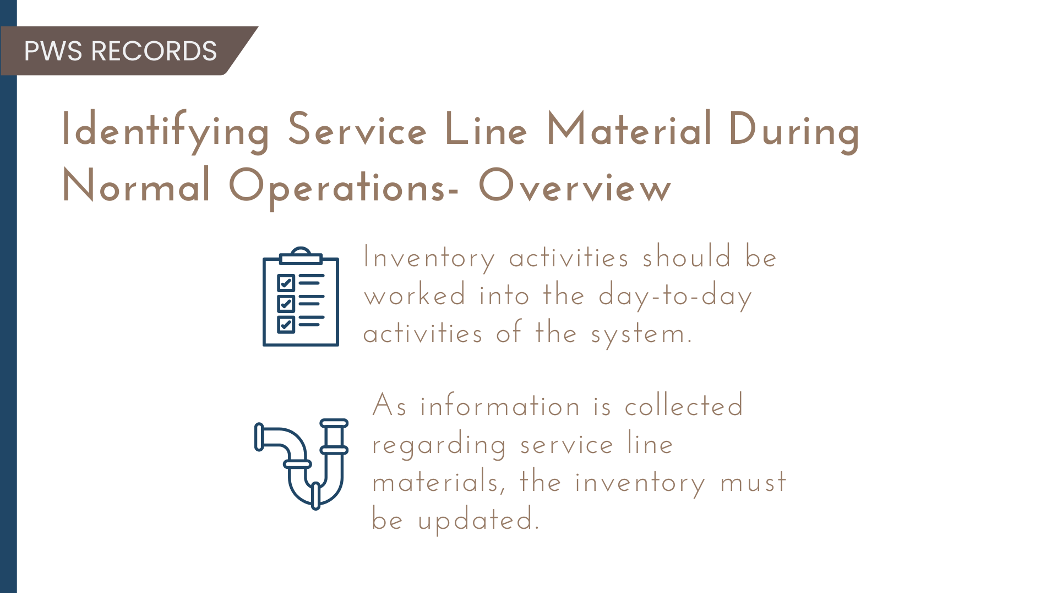

Slide 42
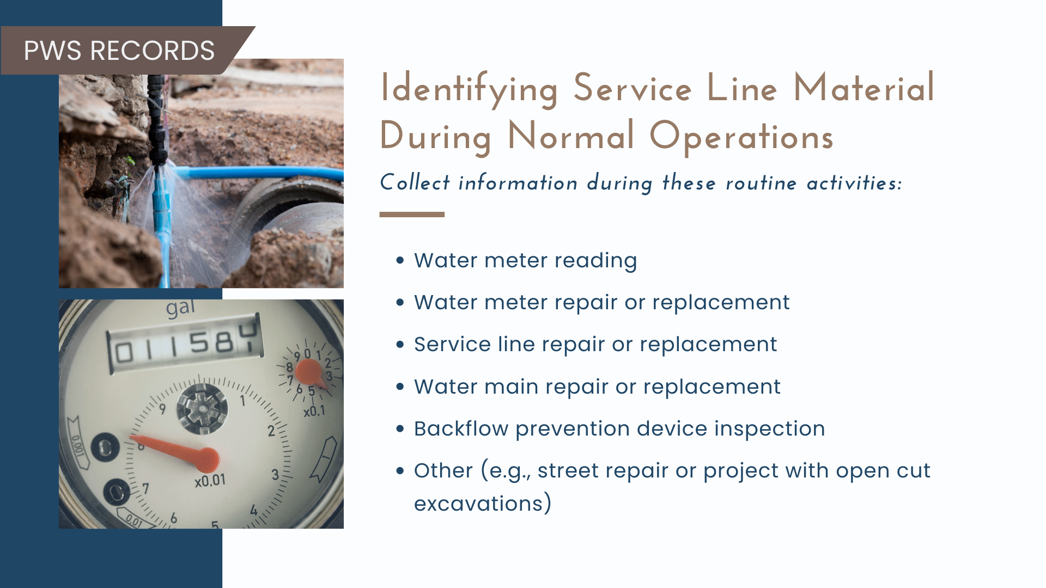

Slide 43
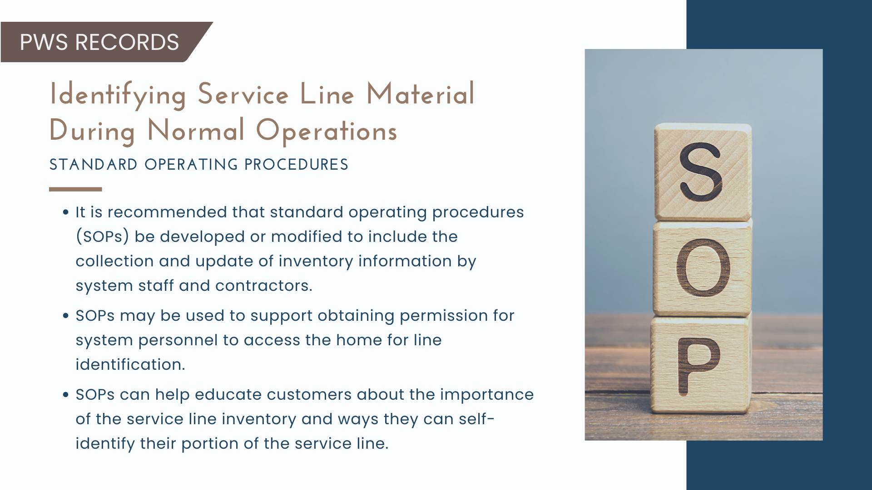

Slide 44
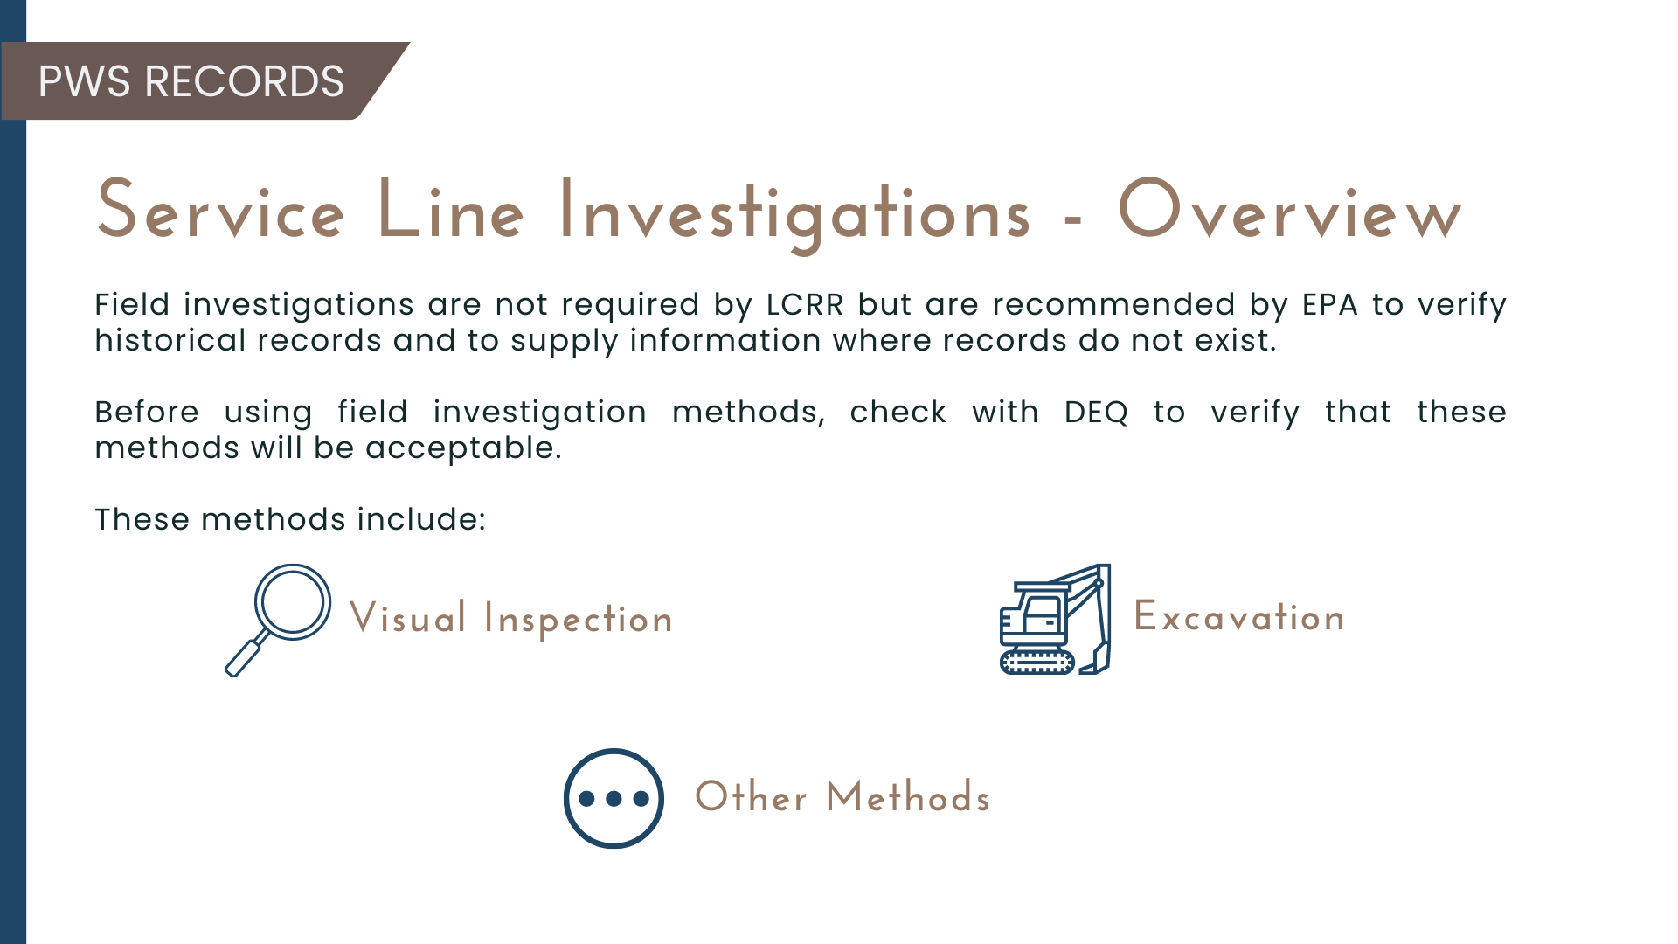

Slide 45
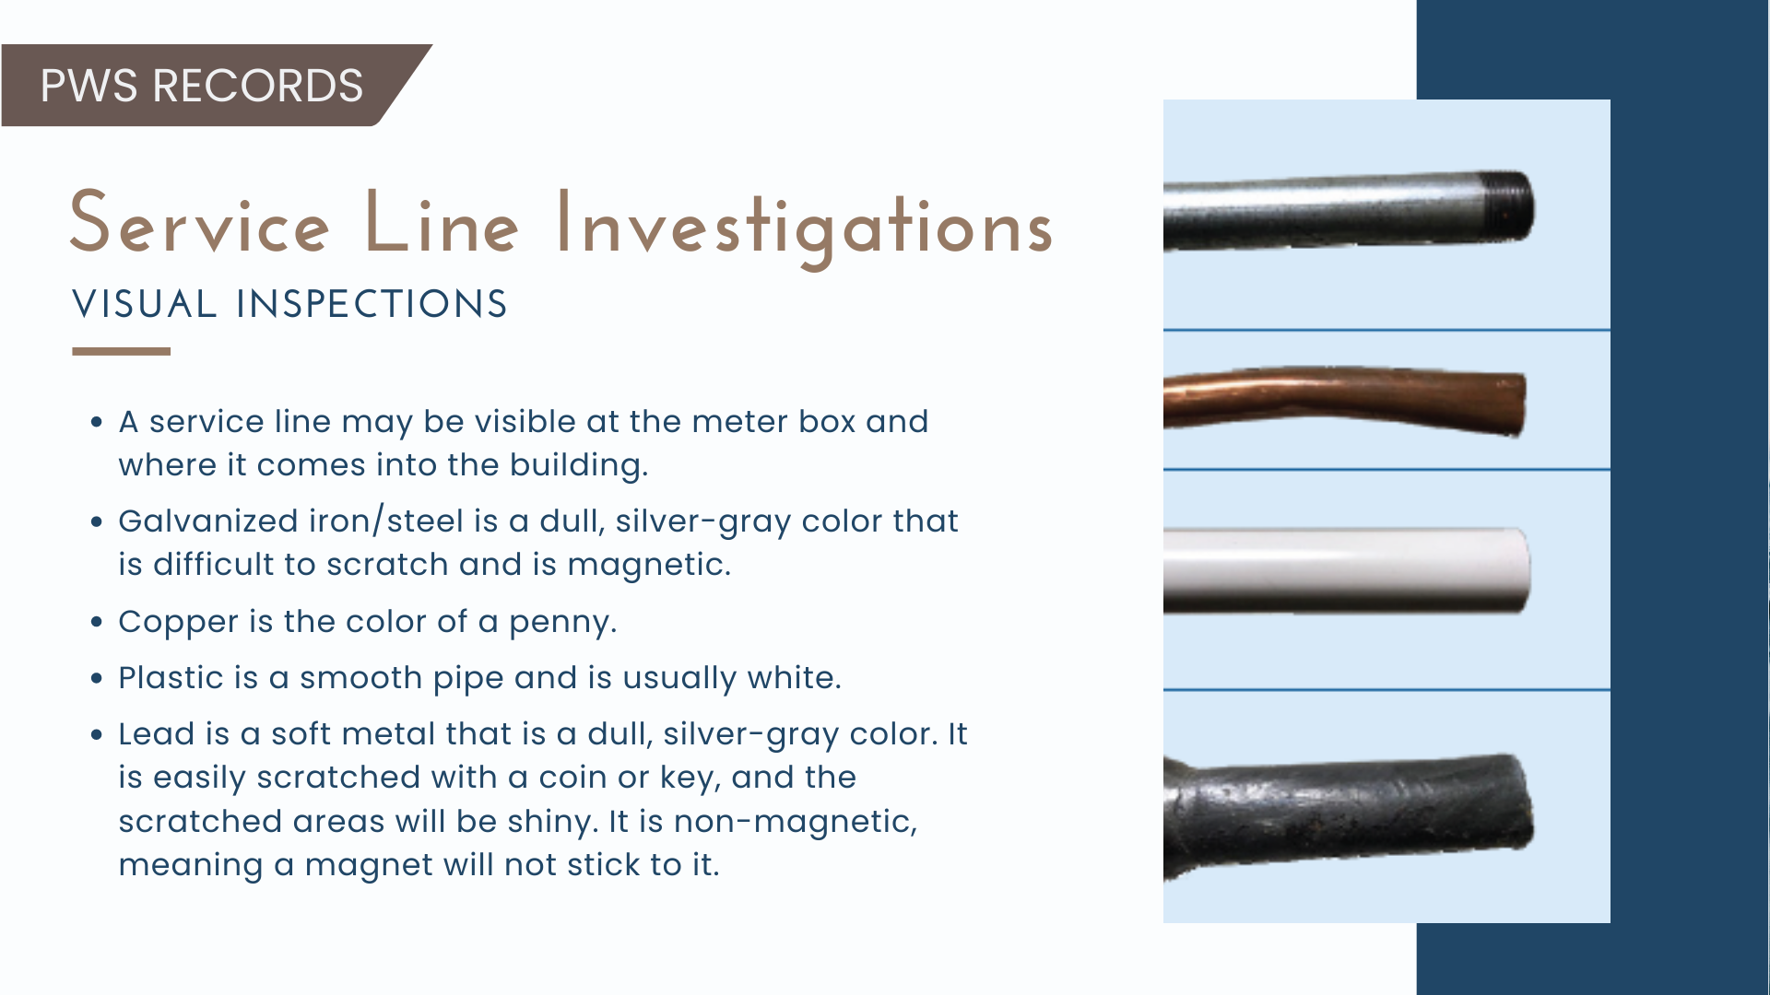

Slide 46
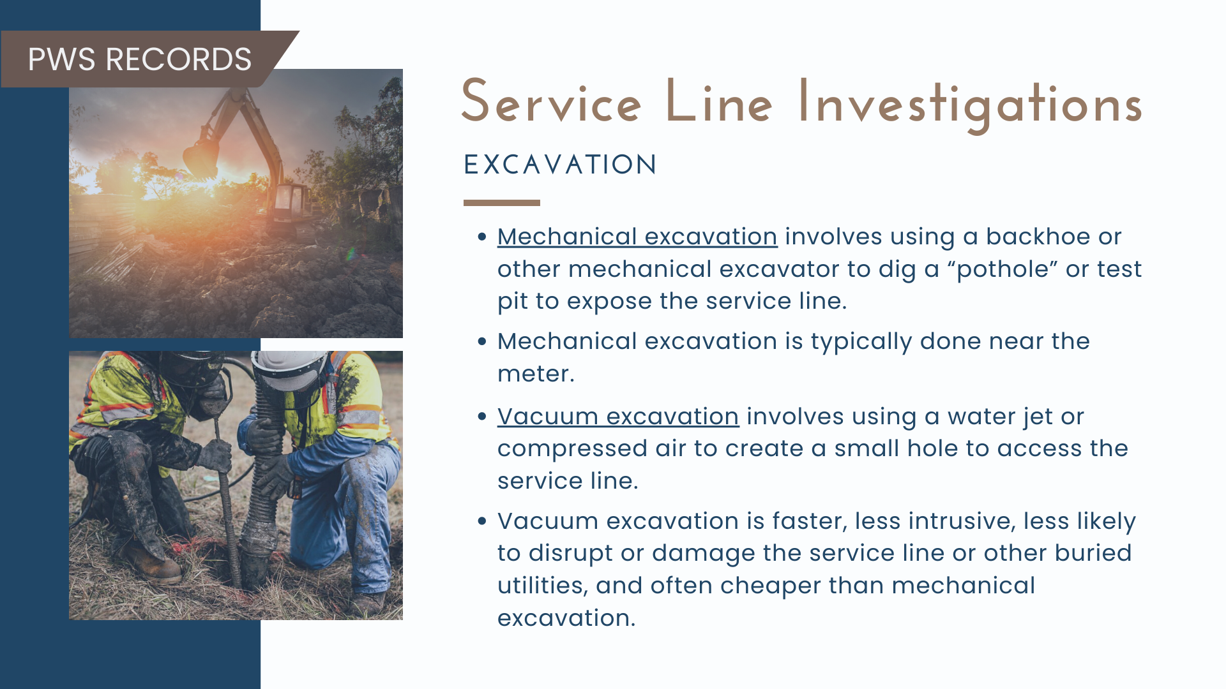

Slide 47
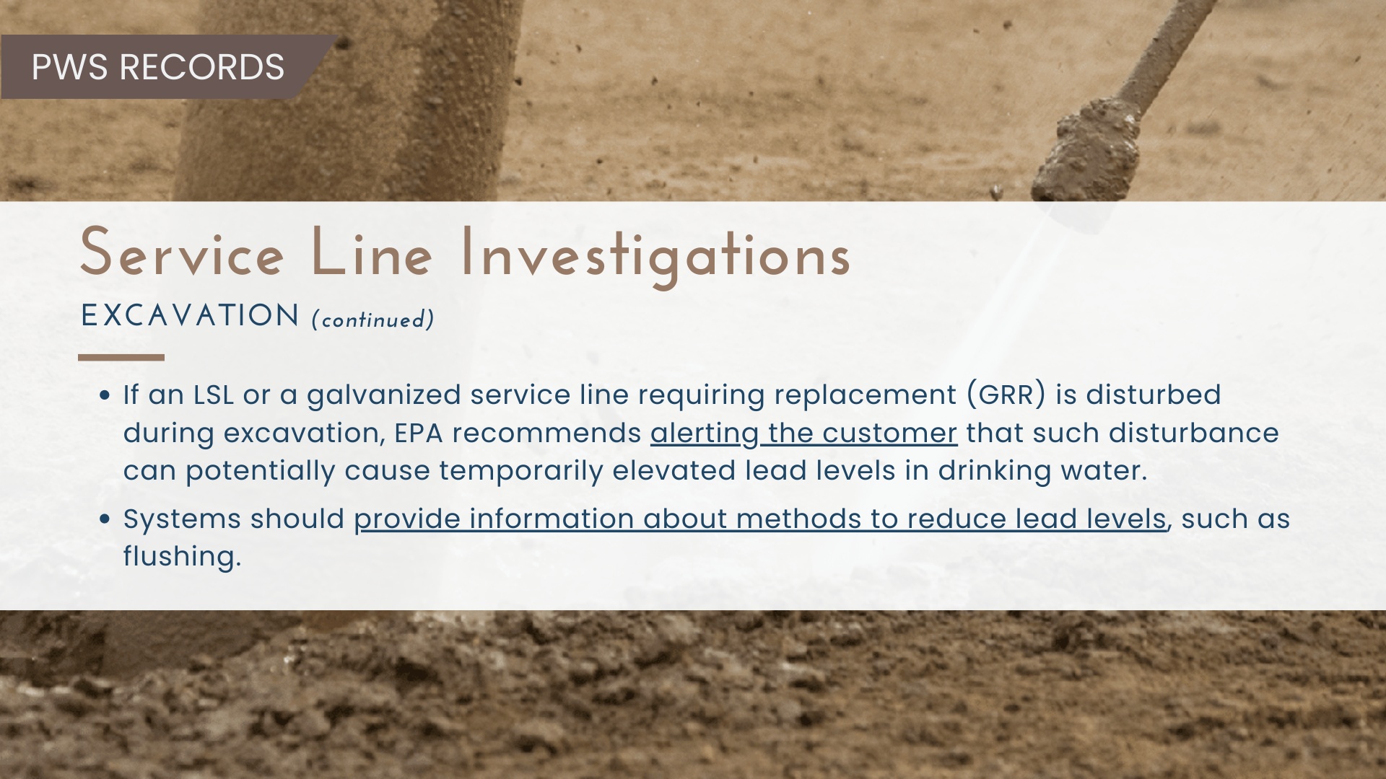

Slide 48
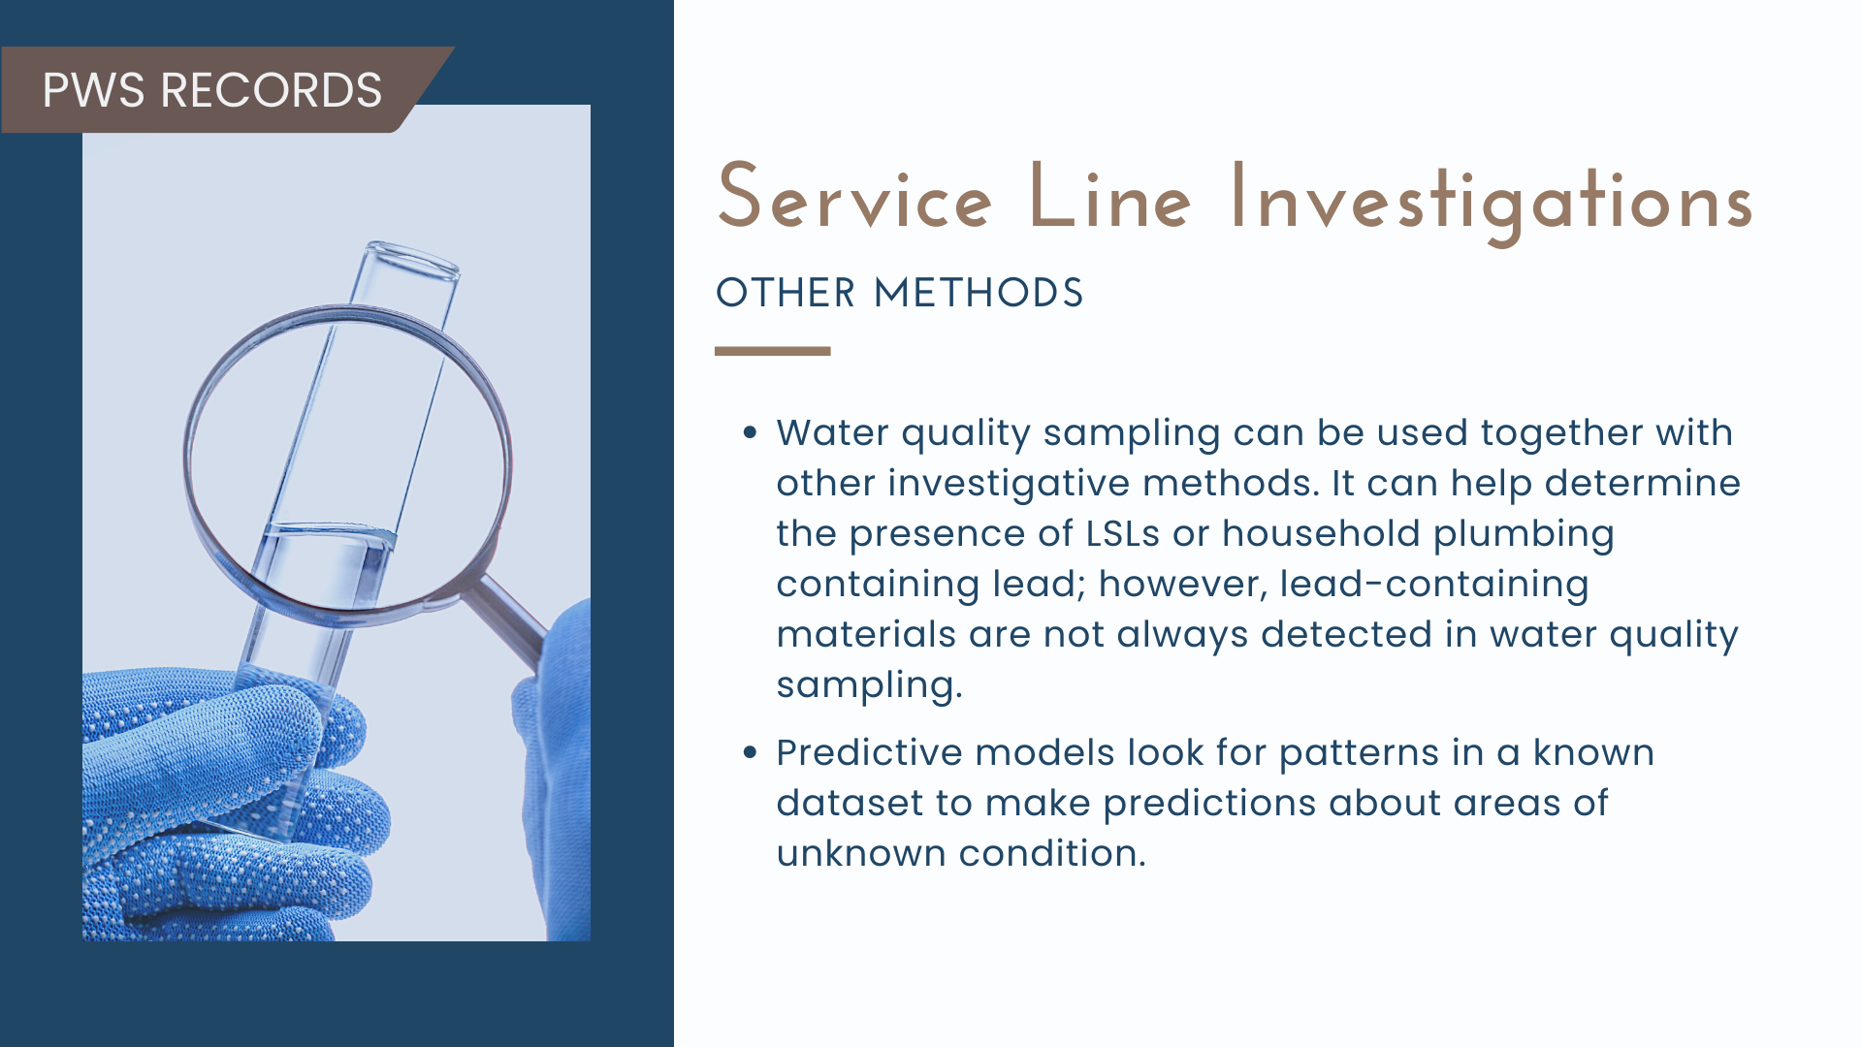

Slide 49
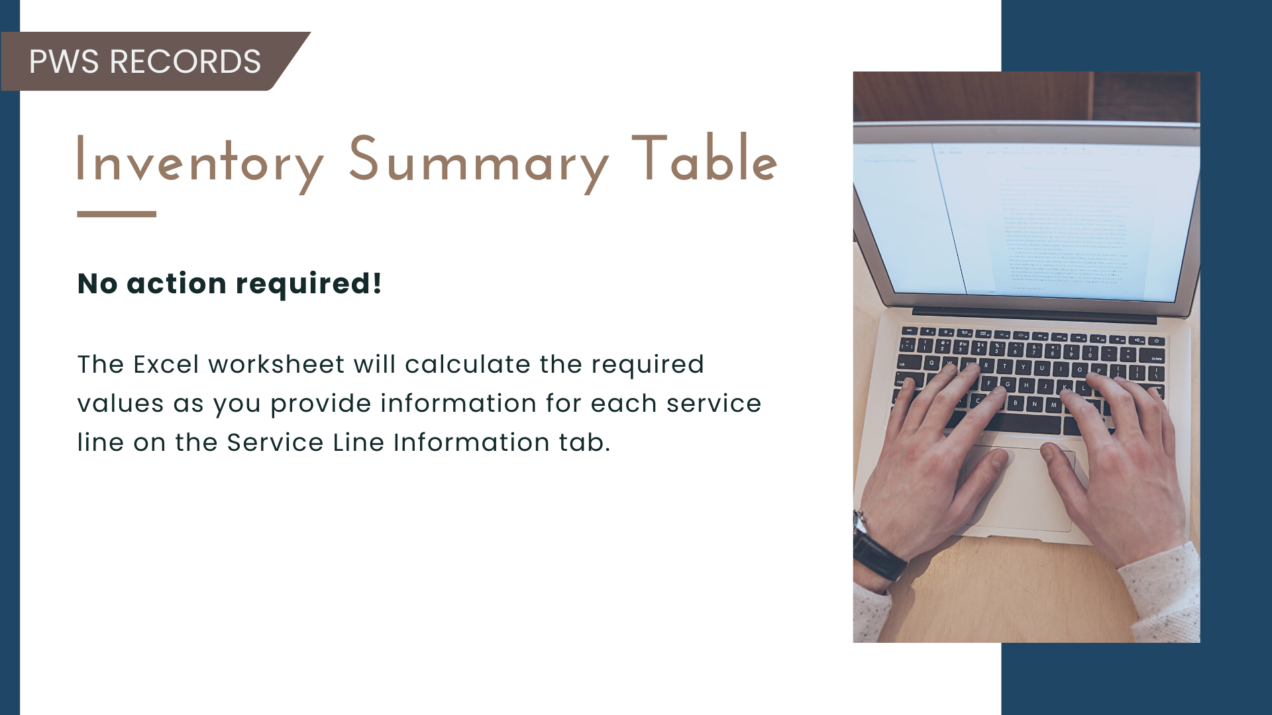

Slide 50
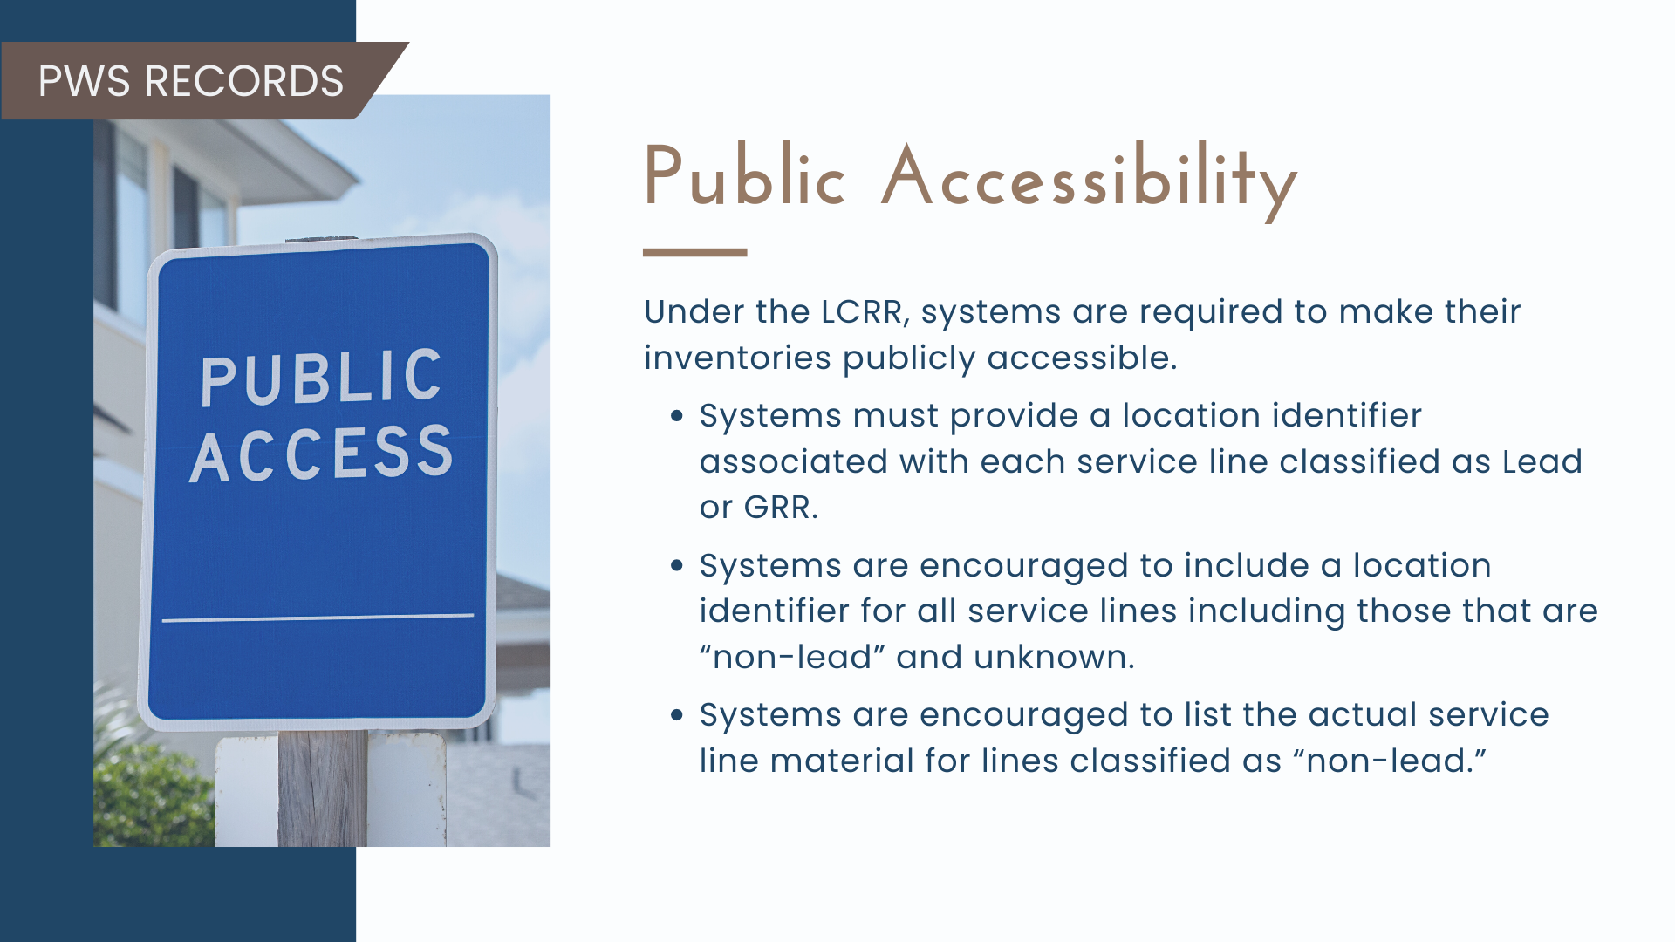

Slide 51
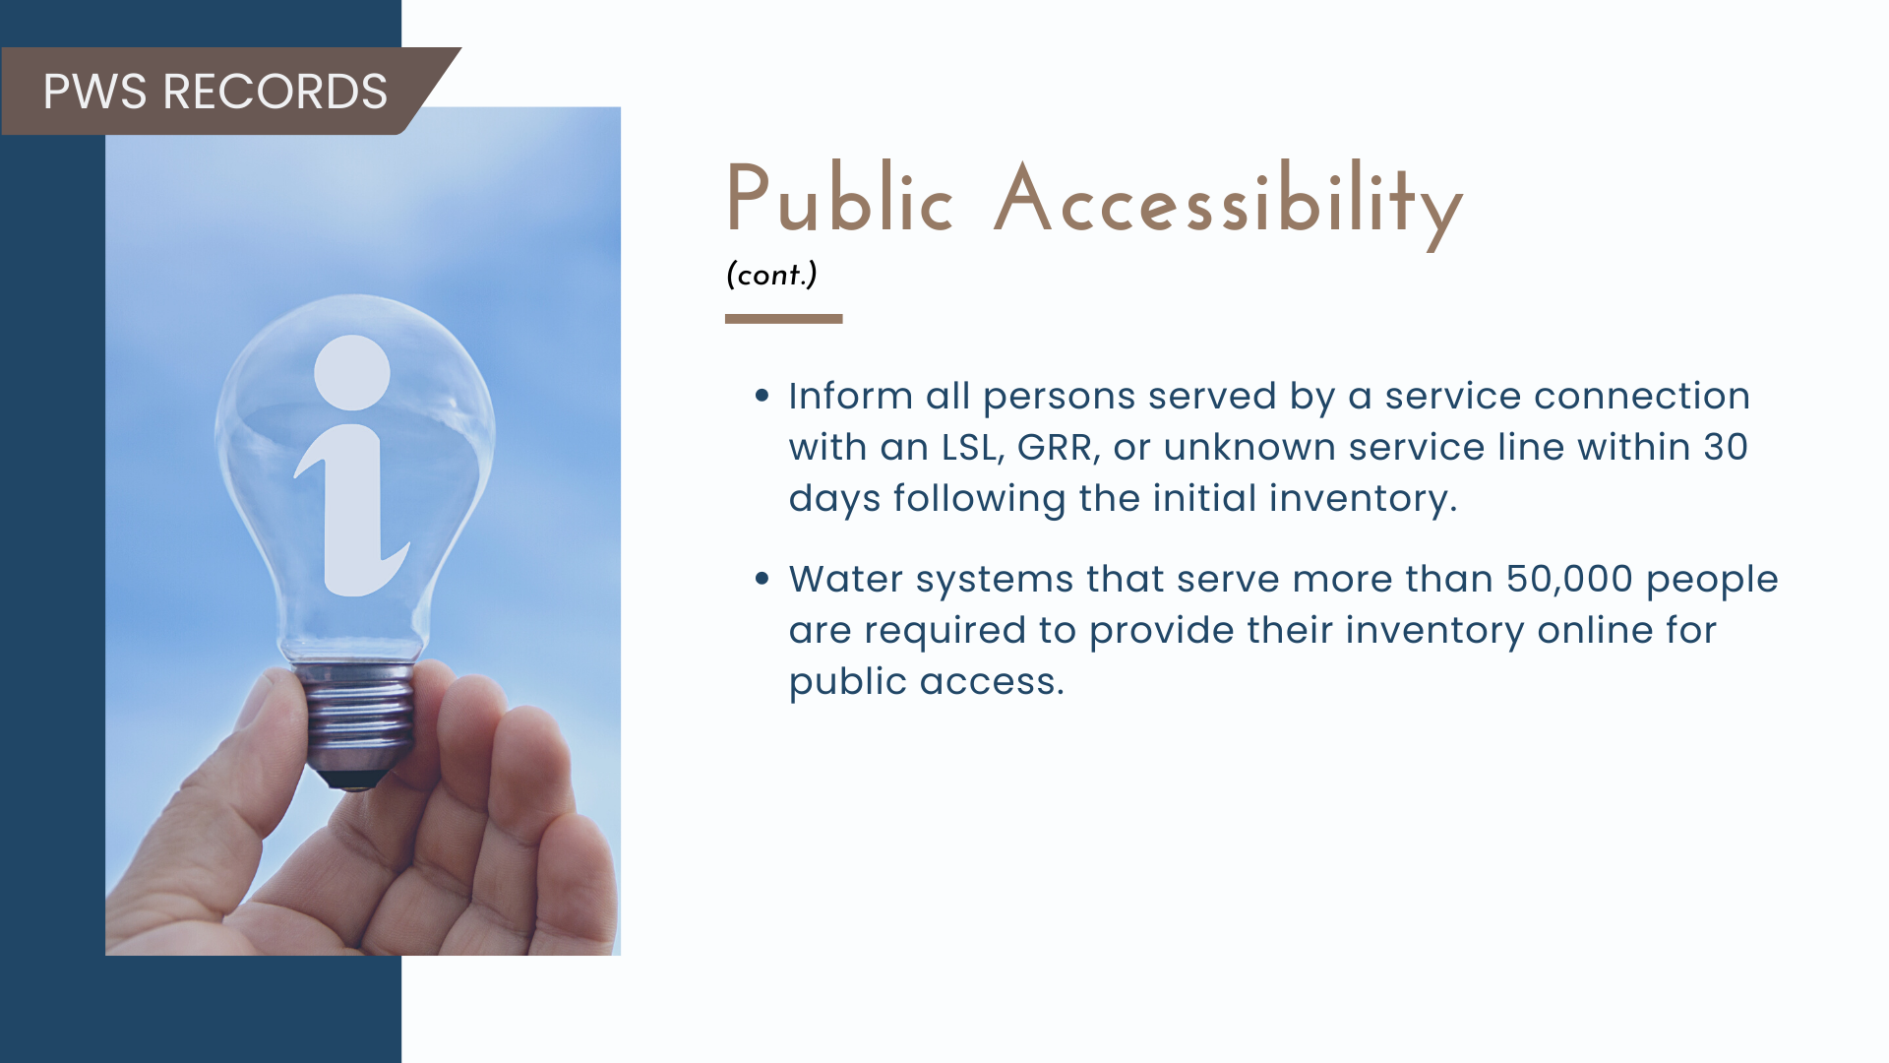

Slide 52
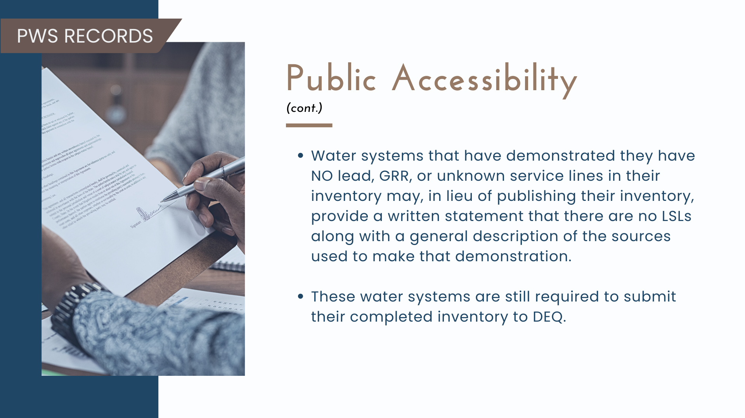

Slide 53
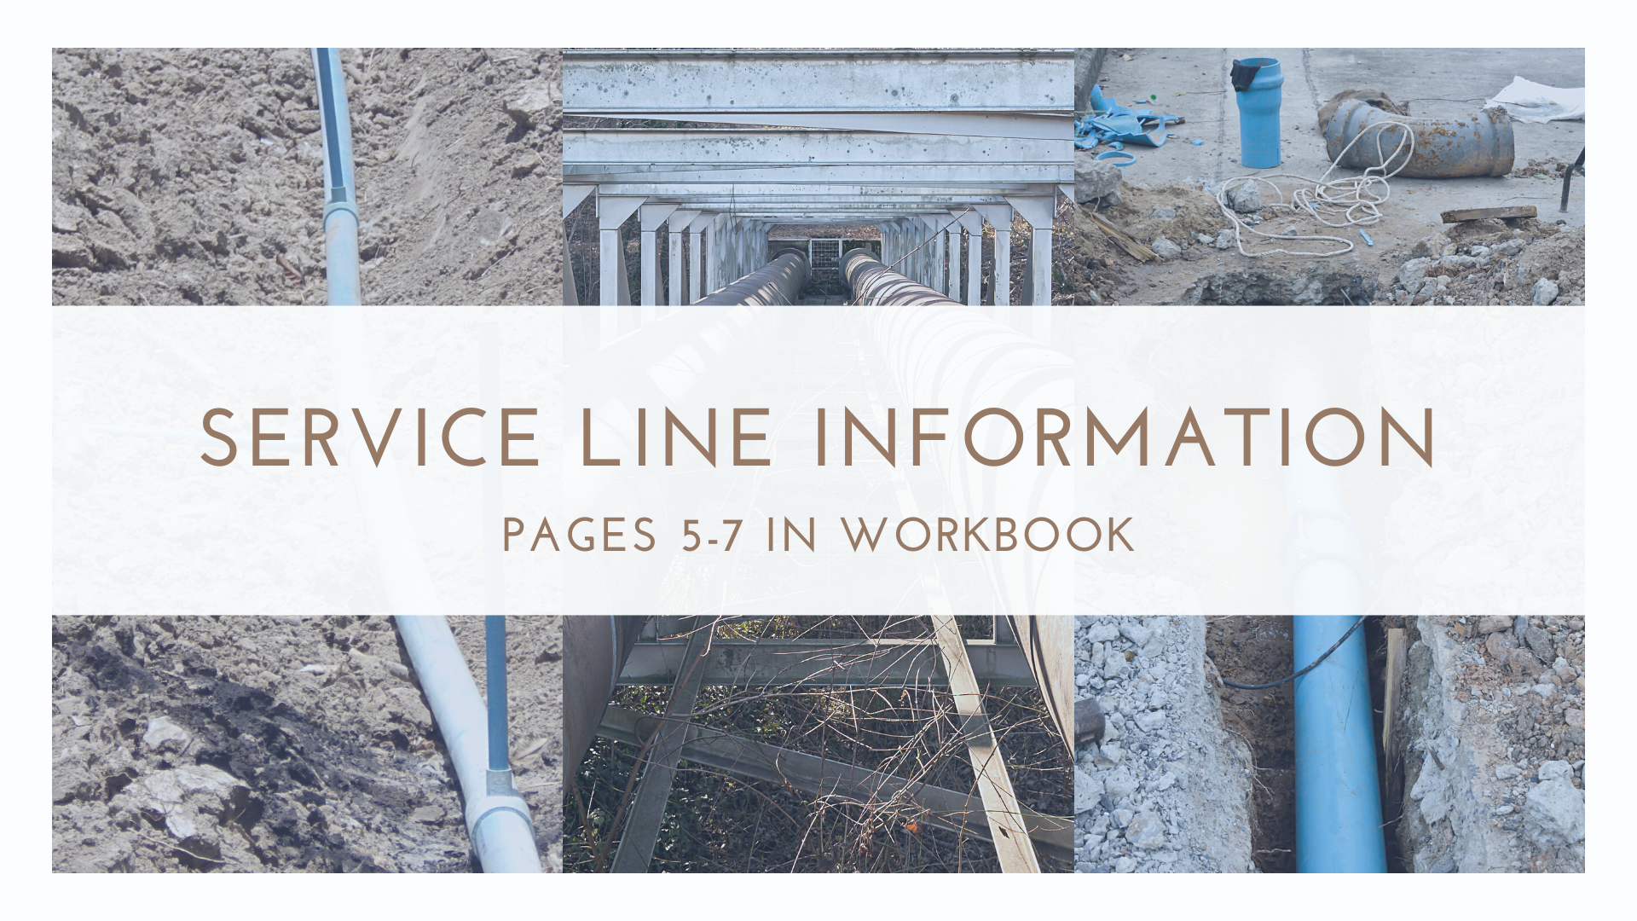
Pages 4-6 in Workbook

Slide 54
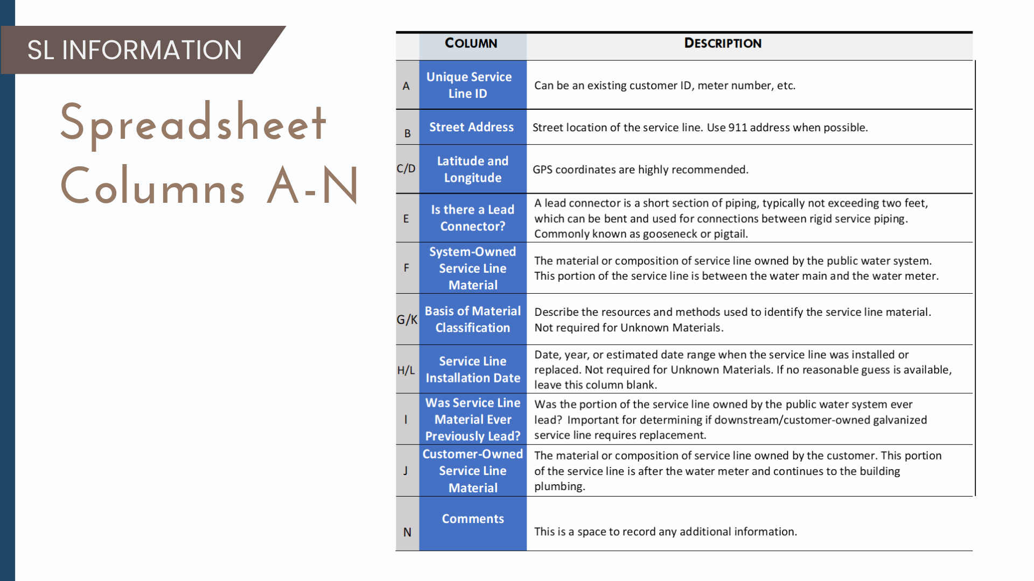

Slide 55
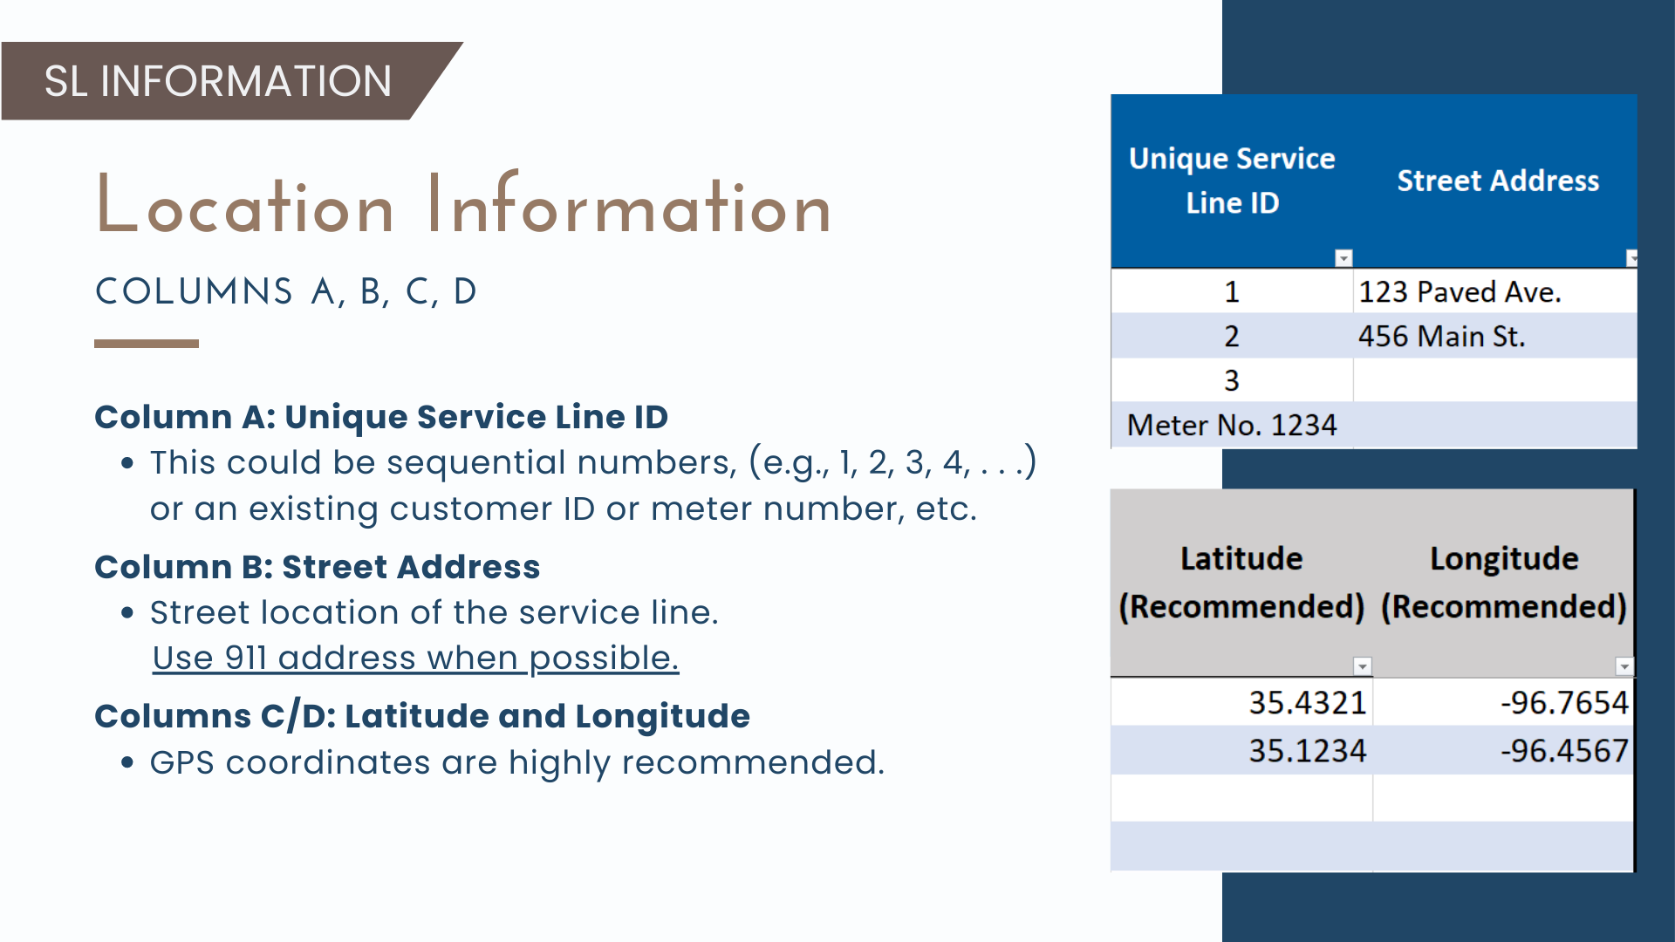

Slide 56
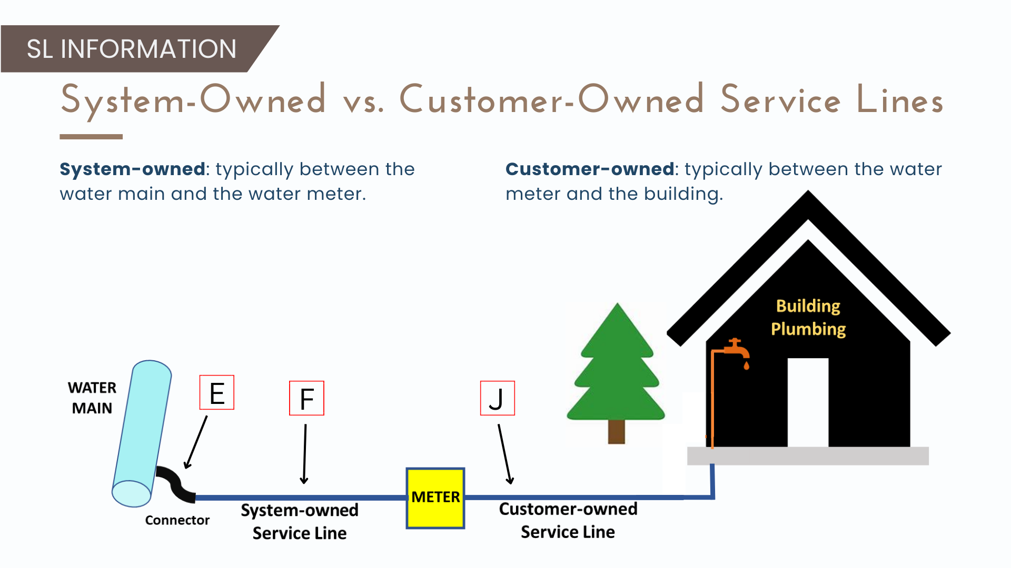

Slide 57
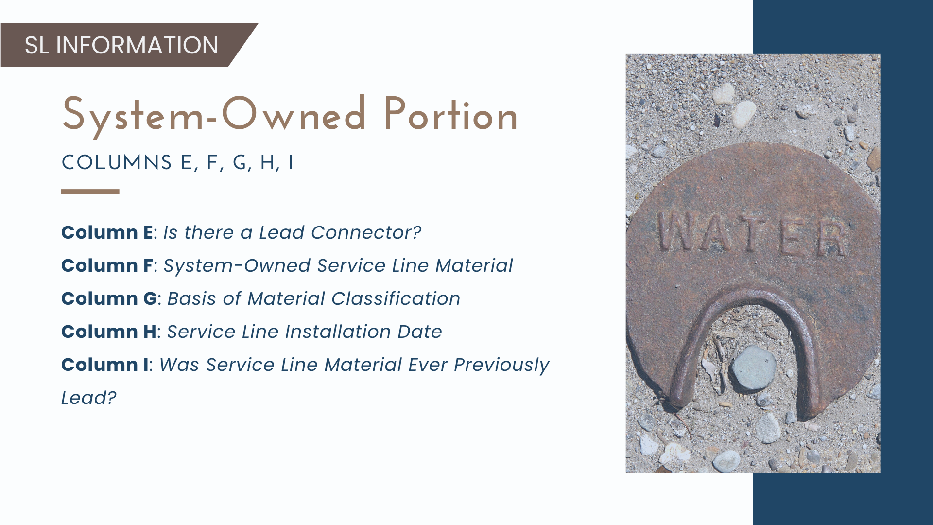

Slide 58
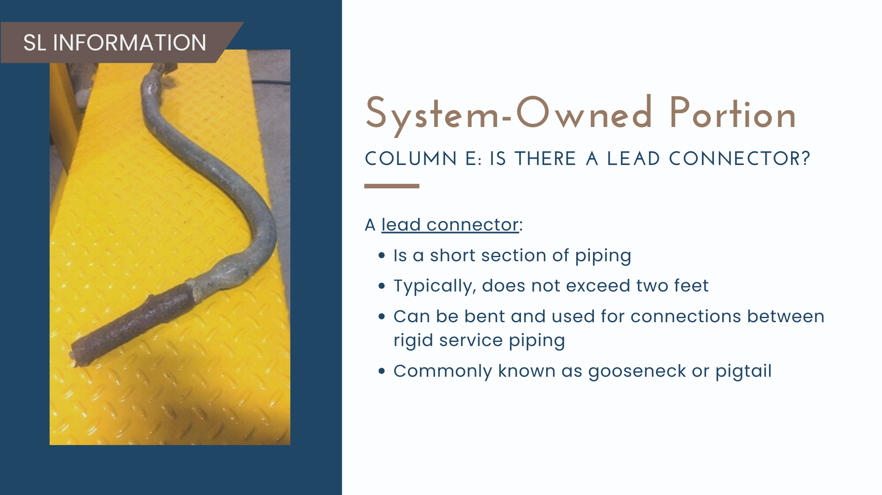

Slide 59
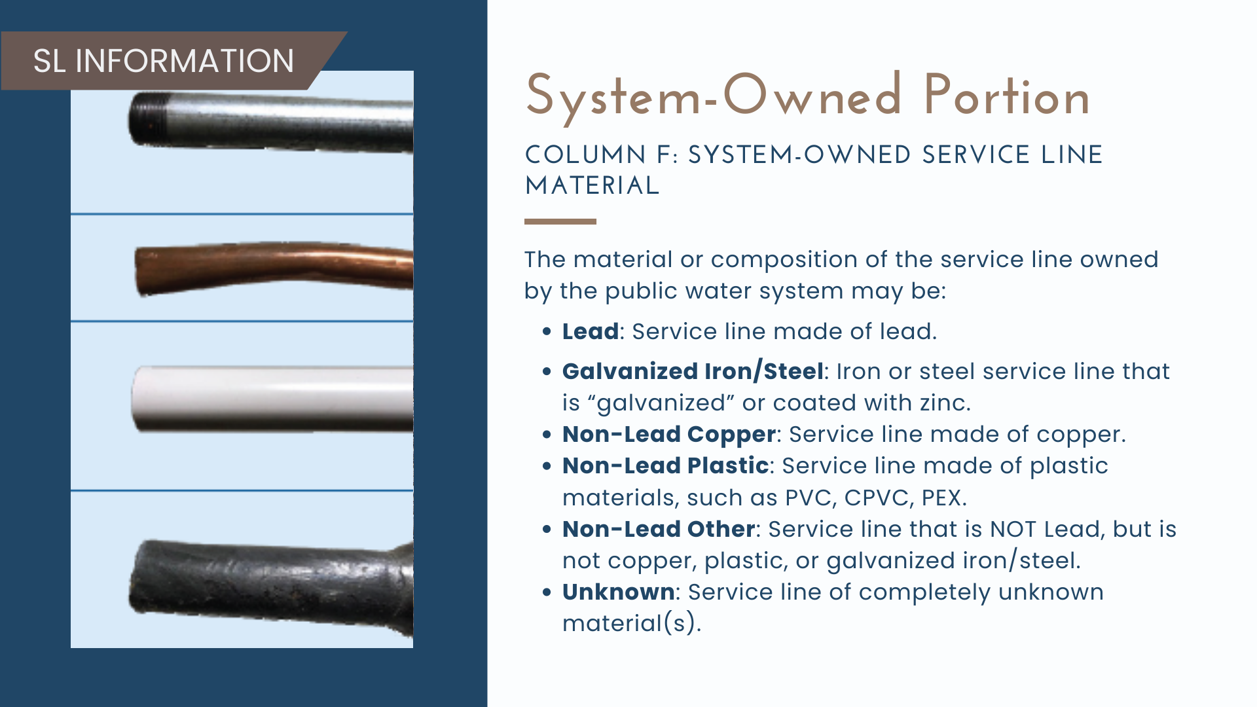

Slide 60
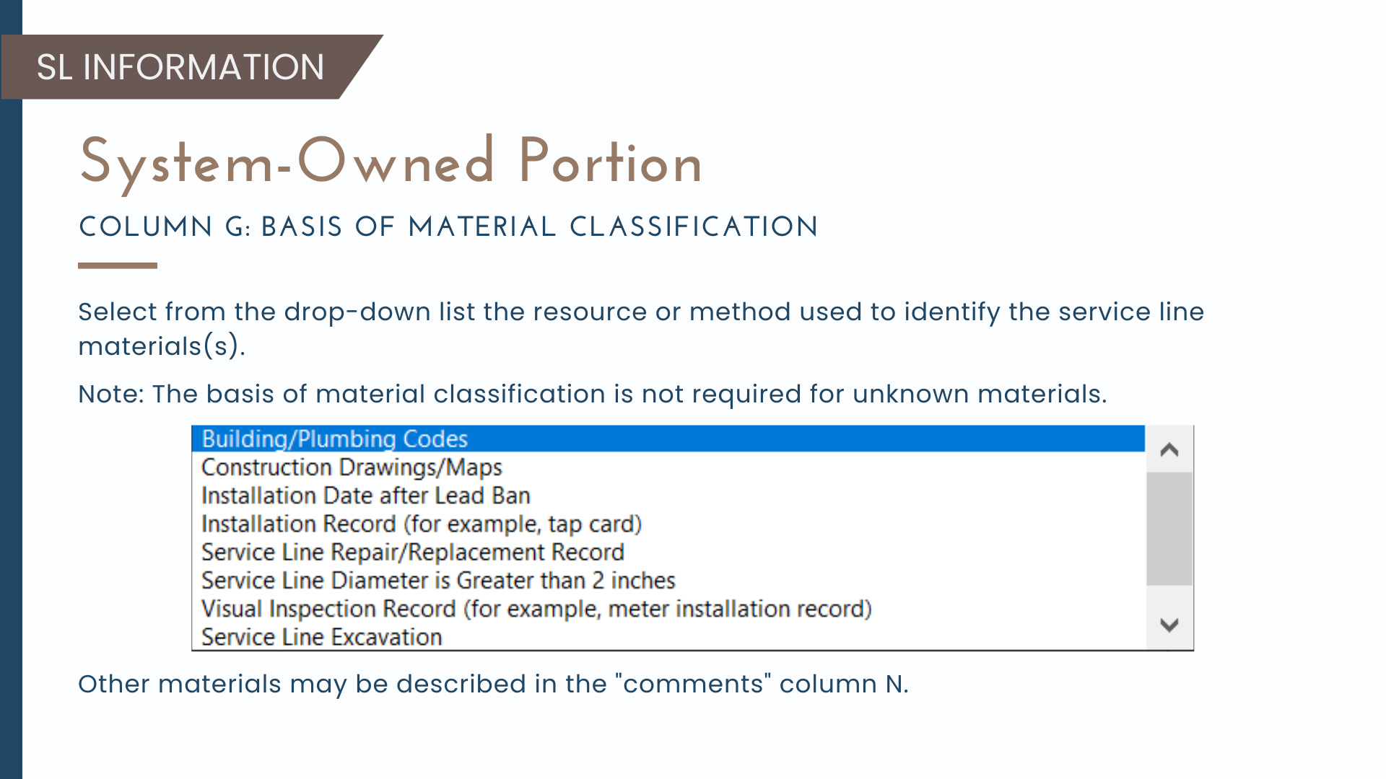

Slide 61
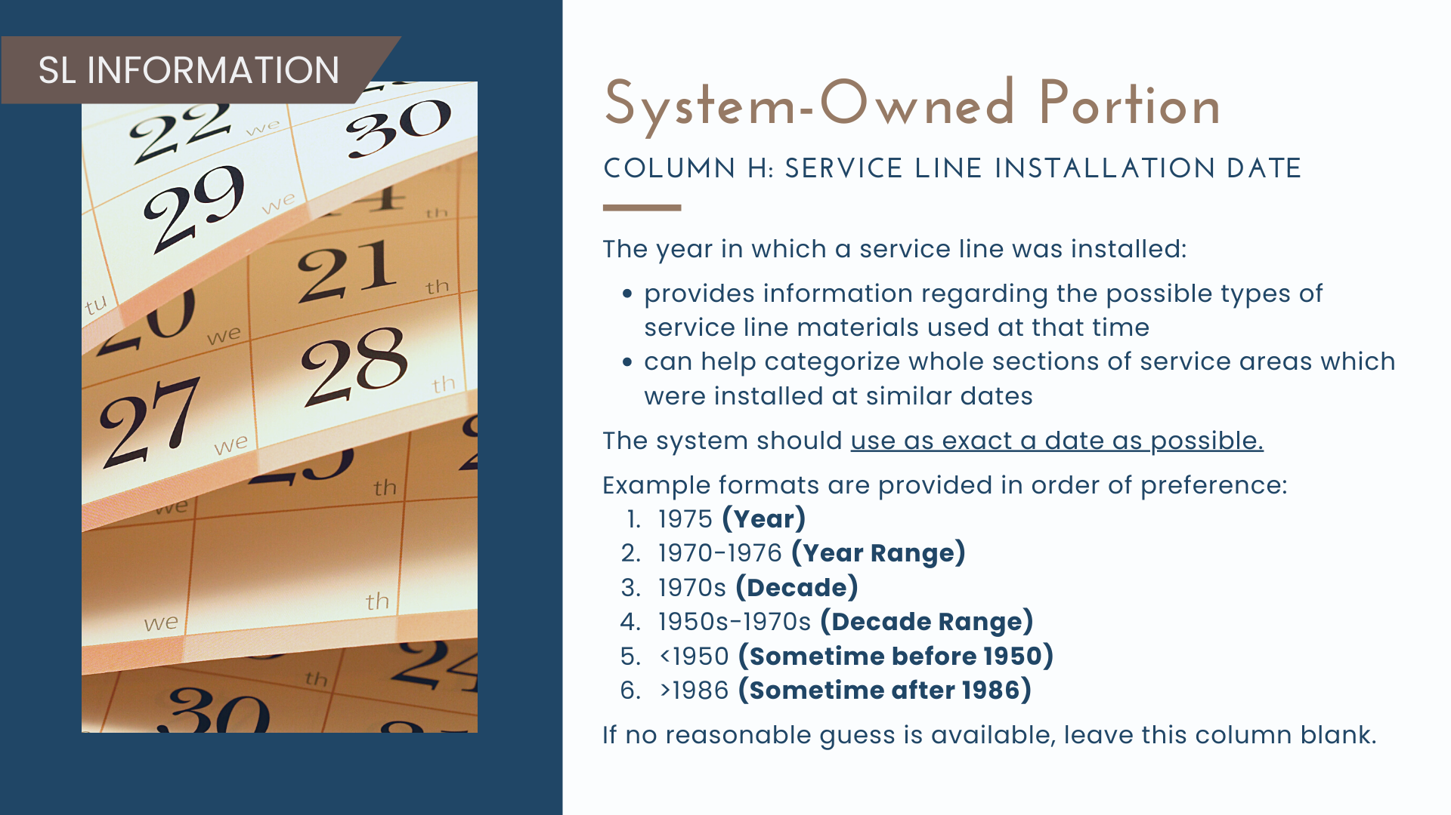

Slide 62
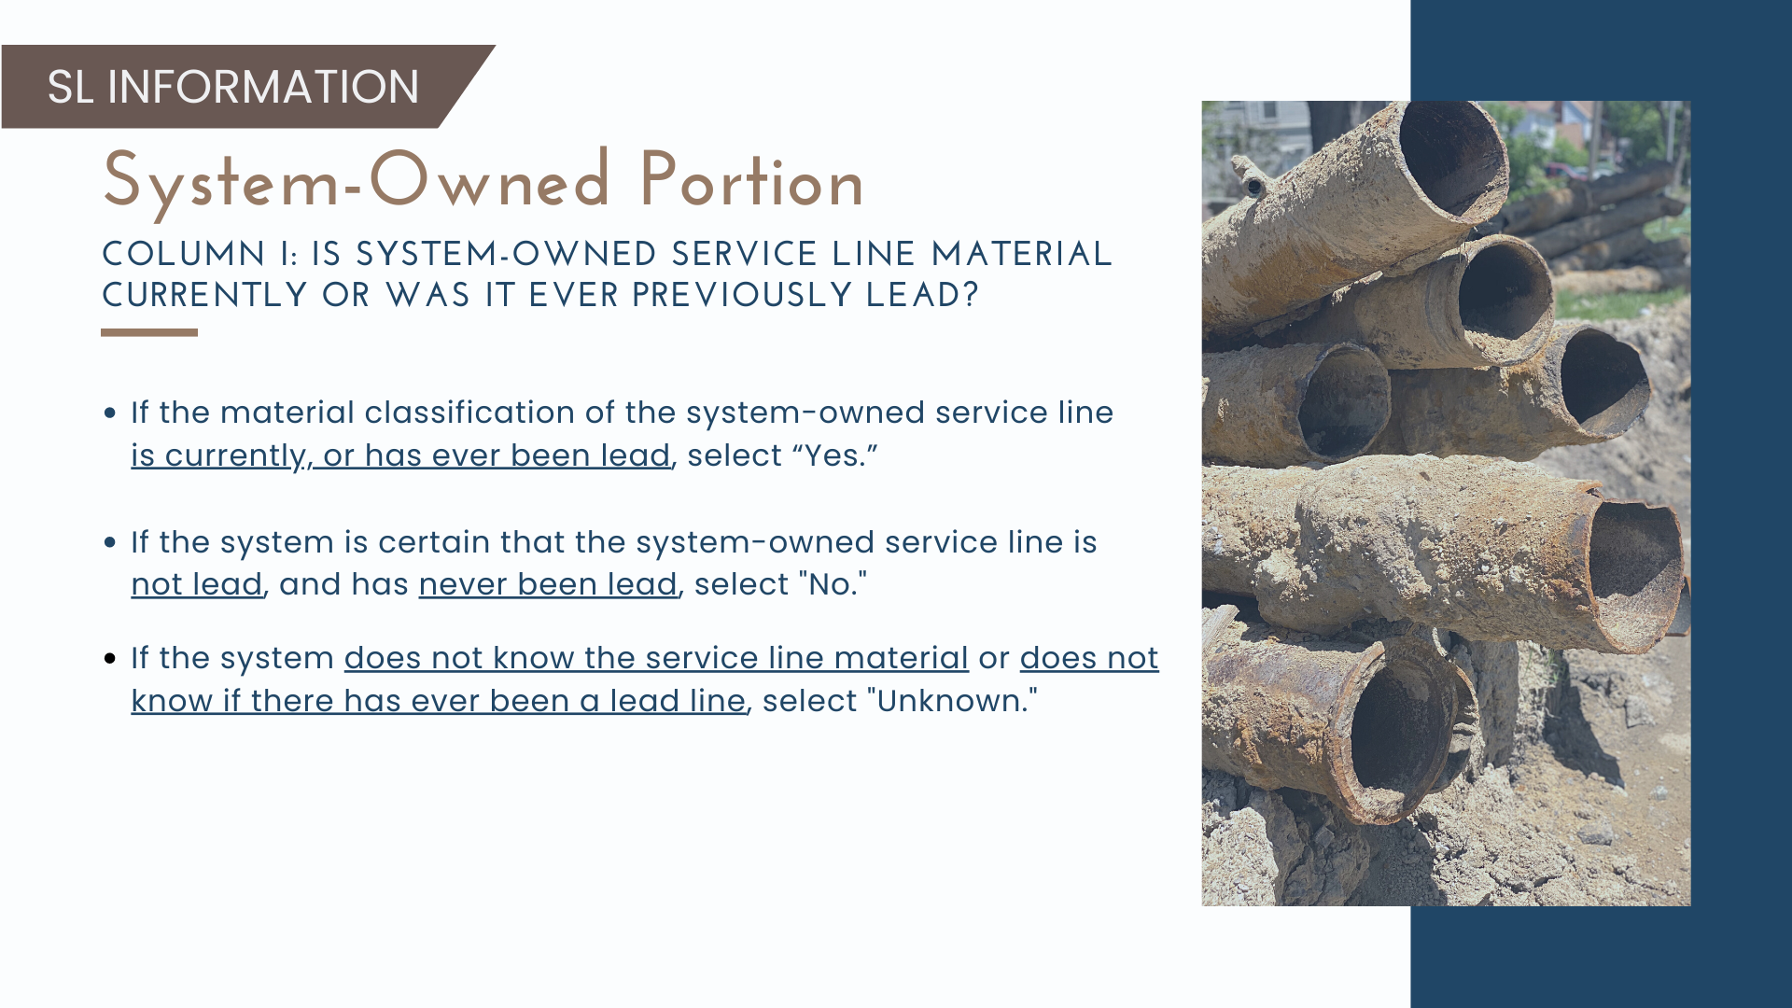

Slide 63
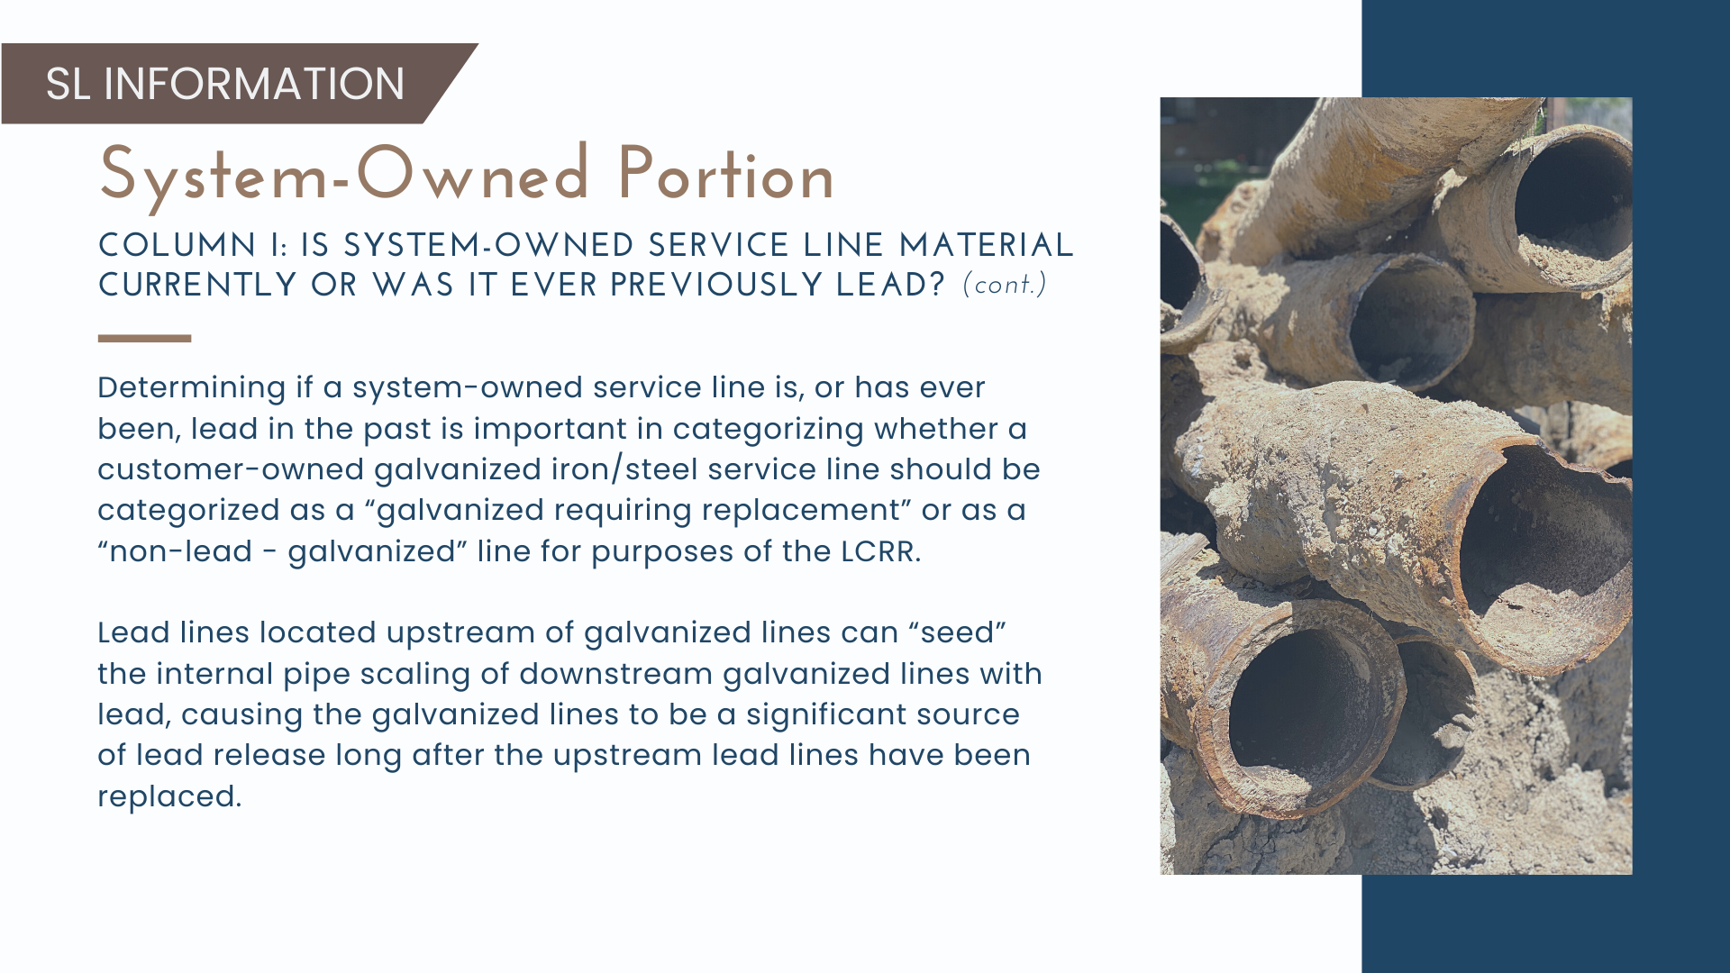

Slide 64


Slide 65


Slide 66


Slide 67


Slide 68


Slide 69


Slide 70


Slide 71


Slide 72

www.deq.ok.gov/lead-service-line-inventory

Slide 73


Slide 74


Slide 75

Why are GPS Coordinates Useful?
GPS coordinates are permanent, addresses change.
A coordinate will always be tied to a physical location, and that location never changes, while addresses may change with new development or construction.
GPS coordinates can be collected with a high degree of accuracy and precision with commonly available tools.
Twenty years ago, sophisticated equipment was required for accurate coordinates. Today the average smart phone or other handheld GPS devices are accurate within 5 meters.
Compared to a street address which identifies a plot of property; GPS coordinates can identify specific structures on a property, like a meter box.

Slide 76


Slide 77


Slide 78


Slide 79


Slide 80


Slide 81


Slide 82


Slide 83


Slide 84


DEQ Data Viewer
3. Zoom in to the area you are collecting Latitude and Longitude (Lat, Long). Left click to drop a pin on the location of the meter If the pin is not in the correct location move the pin until it is over the location of the meter. The Lat, Long will populate in the box.

Slide 85


Slide 86


Slide 87


Slide 88


Slide 89


Slide 90


Slide 91


Slide 92


Slide 93


Slide 94


Slide 95


Slide 96

www.deq.ok.gov/lead-service-line-inventory

Slide 97


Slide 98

Notes:
Does not have to be the entire inventory just location and material type of unknown, LSL, or GRR

Slide 99


Slide 100


Slide 101


Slide 102


Slide 103


Slide 104

Notes:
Recommendations on what to include from the inventory that is made public

Slide 105


Slide 106

Notes:
Social media has be to available to anyone even if they don't have an account with the platform.

Slide 107


Slide 108


Slide 109


Slide 110


Slide 111


Slide 112

Notes:
Use Multiple Information Sources to Develop the Inventory. GCWW used a variety of records to initially build the inventory and then verified and improved accuracy using a custom-built app as well as information provided by customers.
• Develop User-friendly Tools. It is important to ensure that public-facing tools are understandable by a range of users. Hiltner et al. (2019) found the GCWW map very comprehensible, especially in comparison to other similar tools. A visual, with clear legends can aid users’ understanding. Providing property-specific LSL information, distinguishing private- and public-side information, being clear about what is not known, and choosing legend colors and icons carefully, are all factors that can improve the usability and understandability of a tool.

Slide 113


Slide 114


Questions?

Slide 115


Slide 116


Slide 117


Slide 118



Slide 119


Slide 120



Slide 121


Slide 122


Slide 123



Slide 124


Slide 125



Slide 126


Slide 127


Slide 128



Slide 129



Slide 130

Questions?

Slide 131


