Slide 1
E2 Signatory
How to Finalize an eDMR created by a Preparer.

Slide 2
E2 Signatory Information:
To create an E2 Signatory account, you must go to DEQ CROMERR account registration system and follow the screen instructions to complete the registration.
Each Signatory will manage the preparers attached to his/her facility(s). DEQ will not be involved.
Each Signatory could link any existing E2 Preparer account to his/her facility.
If the Signatory is unable to find the Preparer in the E2 system, they will instruct the Preparer to go to the following web address to set up a Preparer Account:
  Https://applications.deq.ok.gov/e2

Slide 3
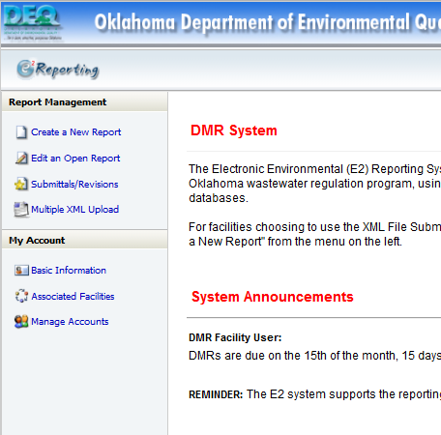
E2: Return to the E2 Home Page
Submitting a Preparer Created eDMR
After adding a Preparer to an account you will return to the E2 home page to review an eDMR created by a Preparer or a Signatory.
Click Here to edit an eDMR submitted by a preparer

Slide 4
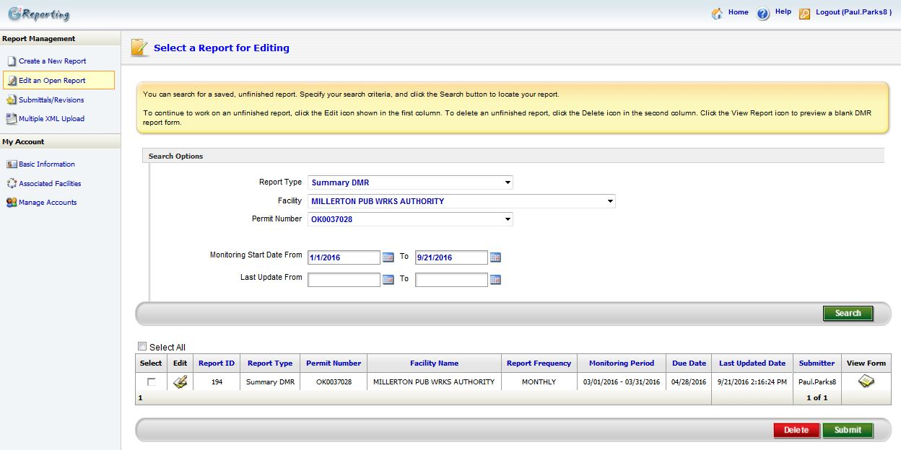
E2: Reviewing and Submitting a Saved eDMR
Submitting a Preparer Created eDMR
Enter Facility Information Here
Enter Monitoring Start and End dates here
Remove any information in these fields
Click here to Search by the given criteria
List of search results
Click here to edit and review a particular eDMR

Slide 5
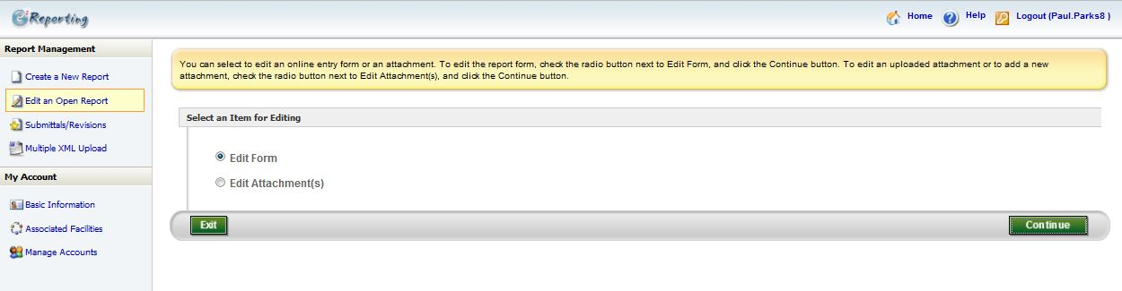
E2: Reviewing and Submitting a Saved eDMR
Submitting a Preparer Created eDMR
Choose Edit Form
Click Continue

Slide 6
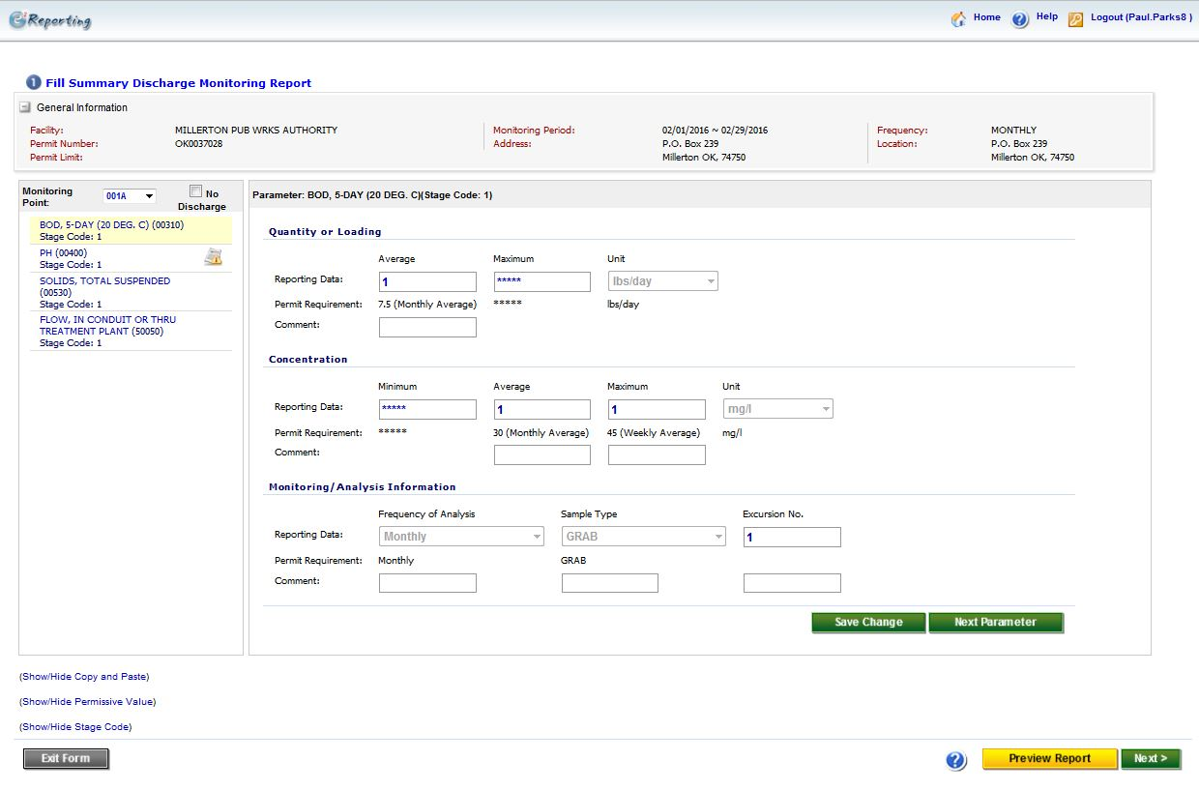
E2: Reviewing and Submitting a Saved eDMR
Submitting a Preparer Created eDMR
Click through each Parameter
Make sure the values for each parameter are correct
If everything looks correct, click Next
Click here to preview what the eDMR will look like

Slide 7
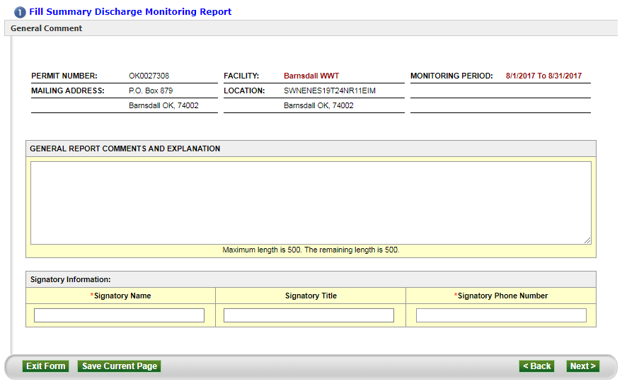
E2: Signatory Create eDMR
Use this field to add any comments you may want (Optional)
Enter the Signatory’s name
Click Next
Enter the Signatory’s phone number

Slide 8
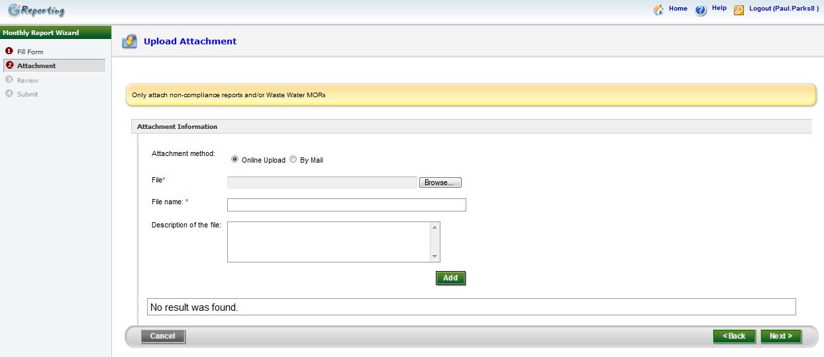
E2: Reviewing and Submitting a Saved eDMR
Submitting a Preparer Created eDMR
This page is optional. If you have a “Non-Compliance Report” and/or “Waste Water MORs” you can use this page to attach it to your eDMR submission
Click Next

Slide 9
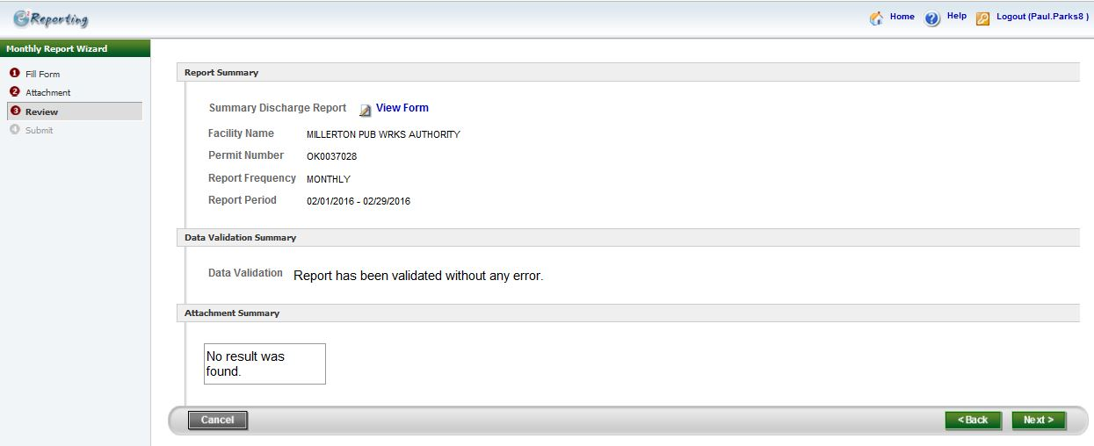
E2: Reviewing and Submitting a Saved eDMR
Submitting a Preparer Created eDMR
Click here to view a copy of the eDMR you will be submitting
Click Next

Slide 10
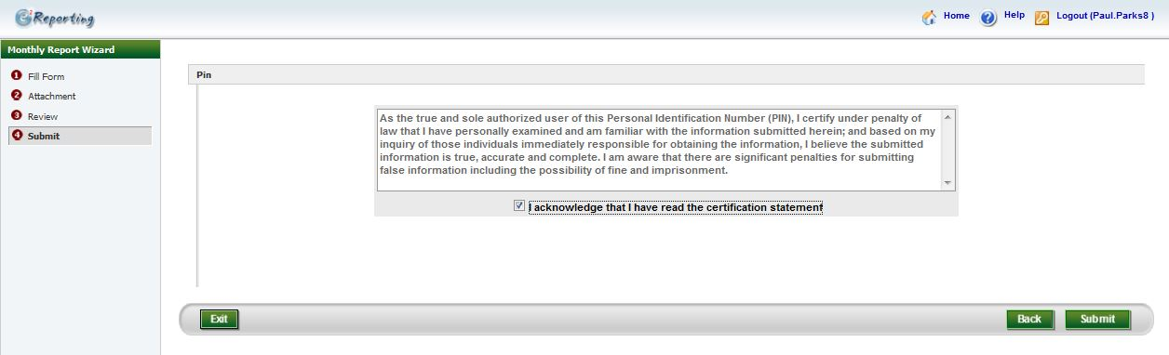
E2: Reviewing and Submitting a Saved eDMR
Submitting a Preparer Created eDMR
Read the Agreement
Click Submit
Check the “I acknowledge that I have read the certification statement”

Slide 11
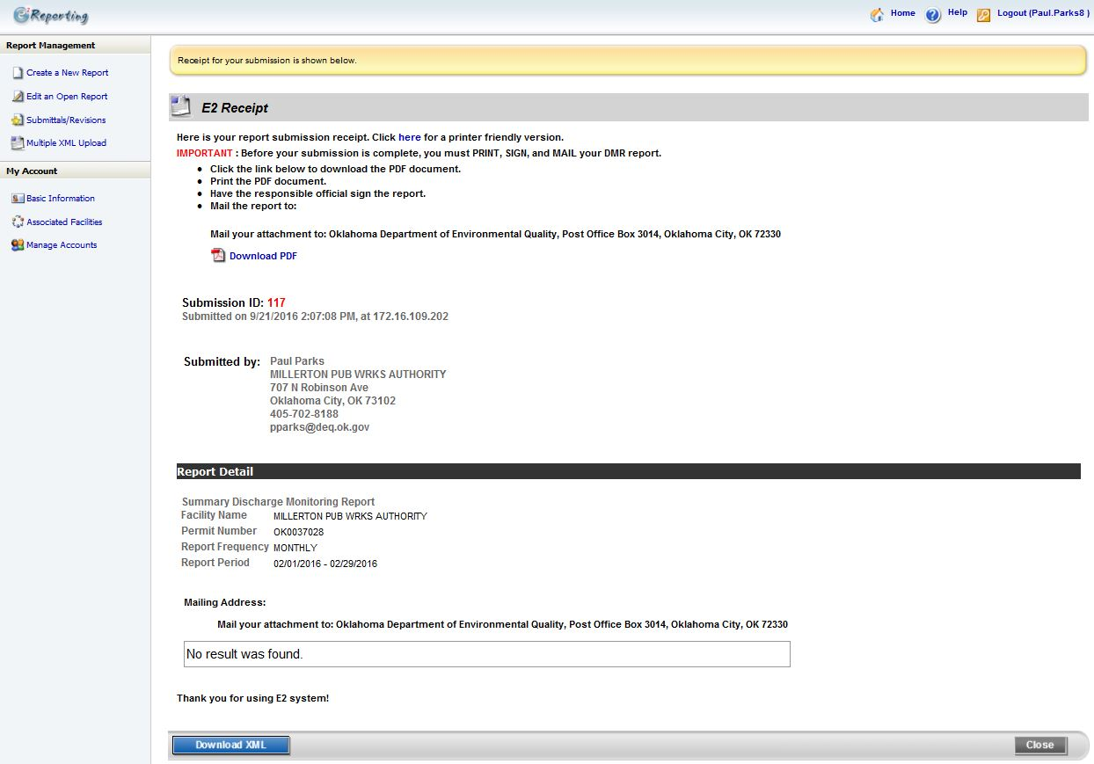
E2: Submission Receipt
Submitting a Preparer Created eDMR
After submitting the eDMR in E2, you will get an E2 Receipt. You will then click the home button above.

Slide 12
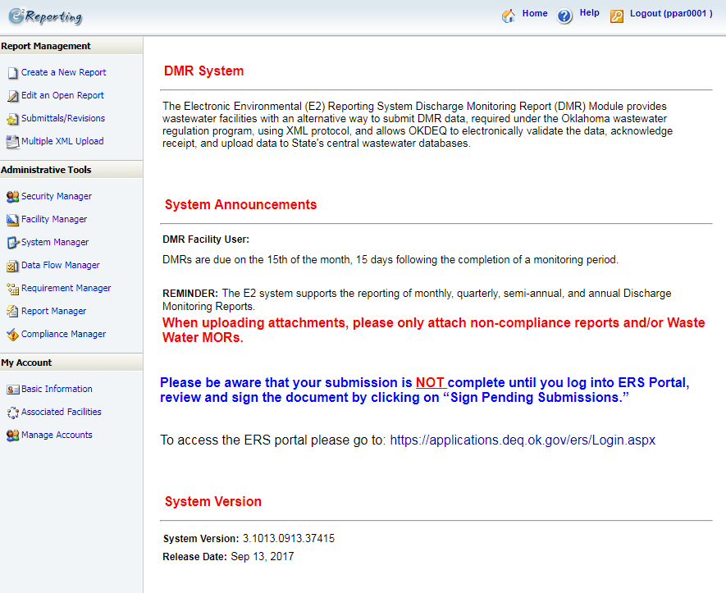

E2: Home Page
Submitting a Preparer Created eDMR
Click here to go to ERS to sign your submission.

Slide 13
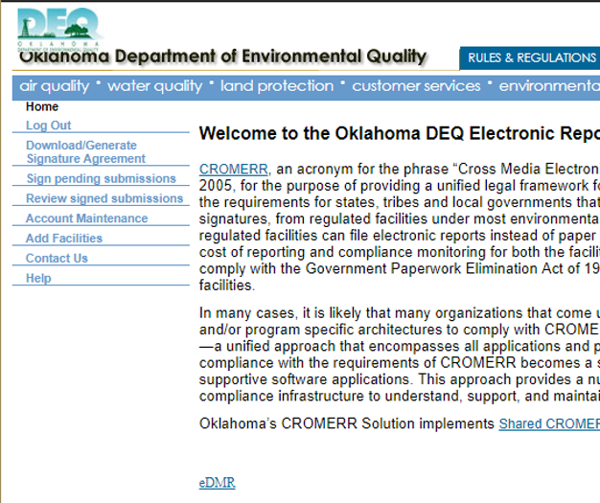
ERS: Signatory Sign and Submit eDMR
Submitting a Preparer Created eDMR
From the ERS Home Page, after you log in
Click here to view all e-DMR submissions.

Slide 14
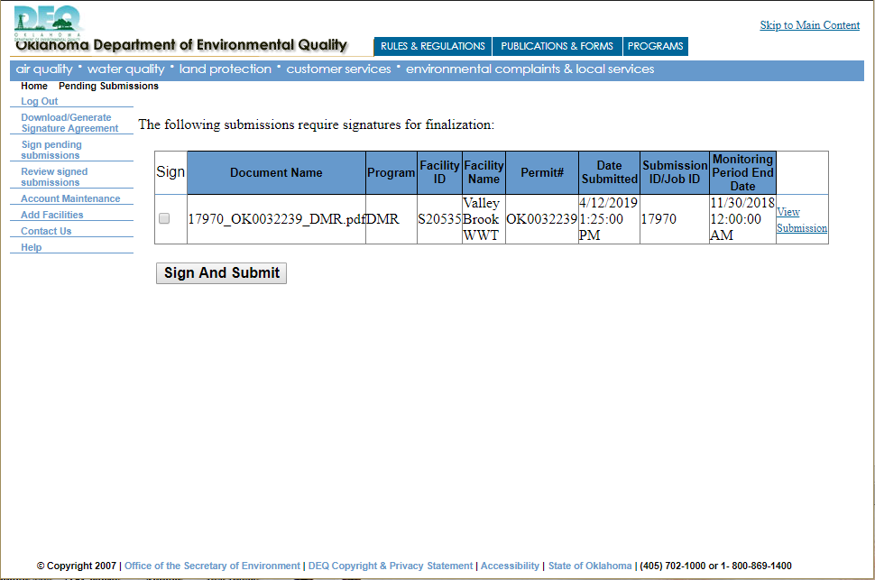
ERS: Signatory Sign and Submit eDMR
Submitting a Preparer Created eDMR
Check Mark this Box
Click on “View Submission” to view your eDMR.
Click “Sign and Submit”

Slide 15
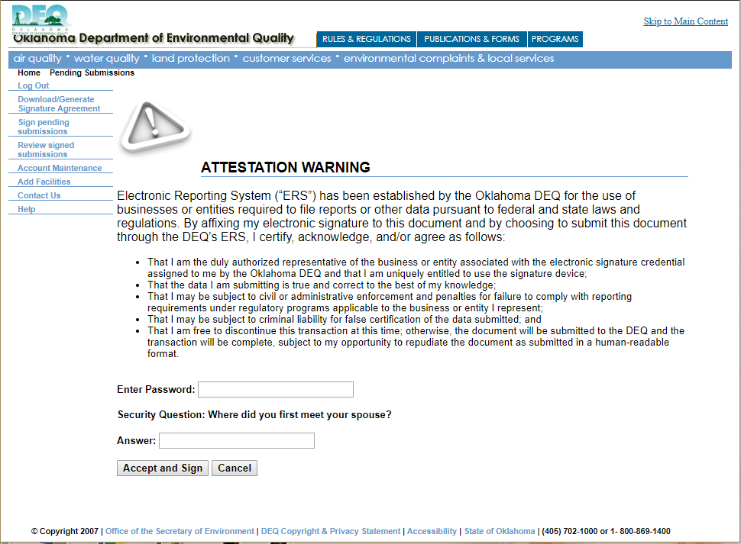
ERS: Signatory Sign and Submit eDMR (Sign and Submit)
Submitting a Preparer Created eDMR
Read the Statement
Enter your Account Password
Click “Accept and Sign”
Answer the Security Question

Slide 16
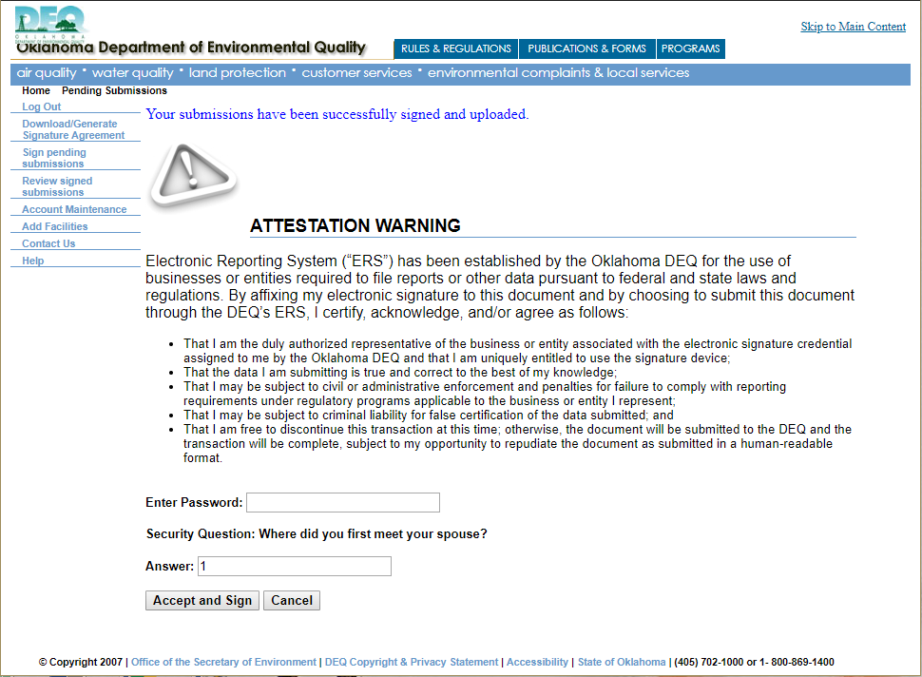
ERS: Signatory Sign and Submit eDMR (Sign and Submit)
Submitting a Preparer Created eDMR
Once the submission has been submitted, you will receive the above message, and an email saying that it was received. You are done with the eDMR submission process.

