Slide 1
E2 Signatory Is the Preparer
Creating and submitting eDMRs when the Signatory is also the preparer.

Slide 2
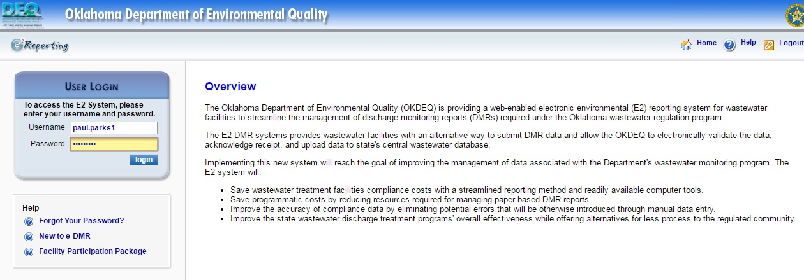
E2: Login Page (Web Address: https://applications.deq.ok.gov/e2)
Login for E2

Slide 3
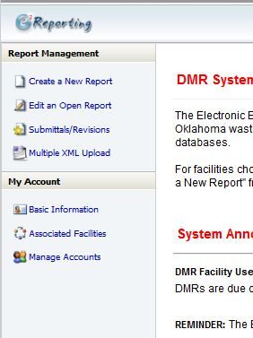
E2: Home Page after Login
Click here to begin the eDMR process

Slide 4
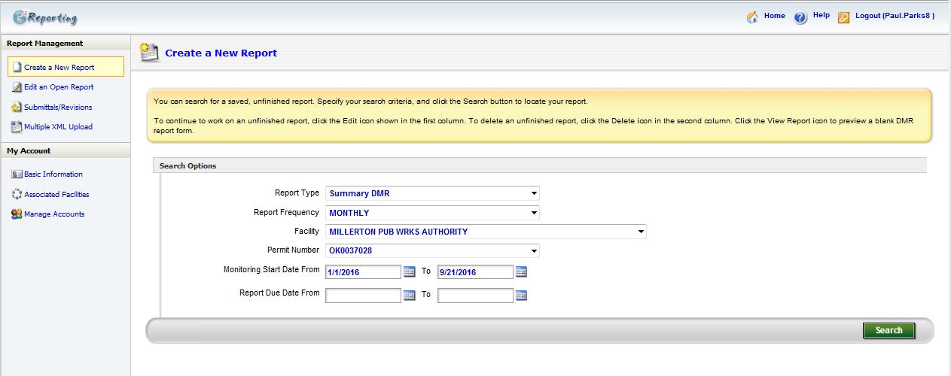
E2: Signatory Create eDMR
Enter Facility Information Here
Enter Monitoring Start and End dates here
Remove any information in these fields
Click here to Search by the given criteria

Slide 5
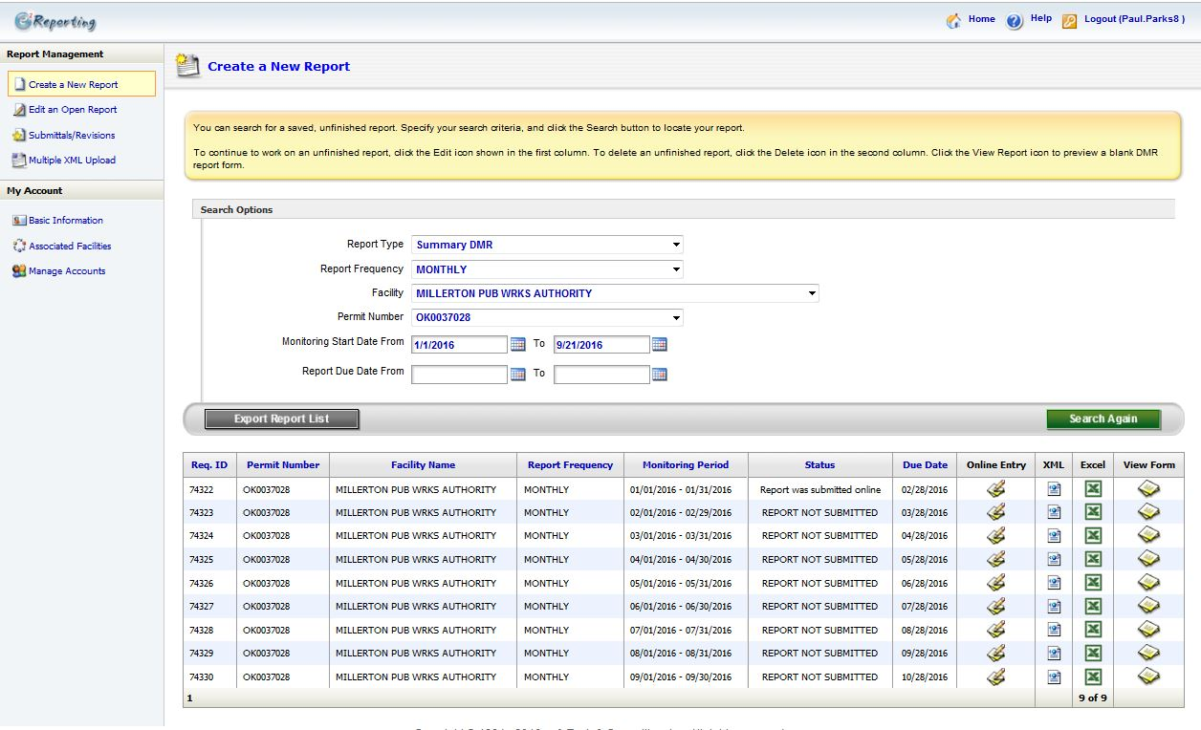
E2: Signatory Create eDMR
List of eDMRs found within your search criteria
Click one of these icons to open that particular eDMR that you would like to create

Slide 6
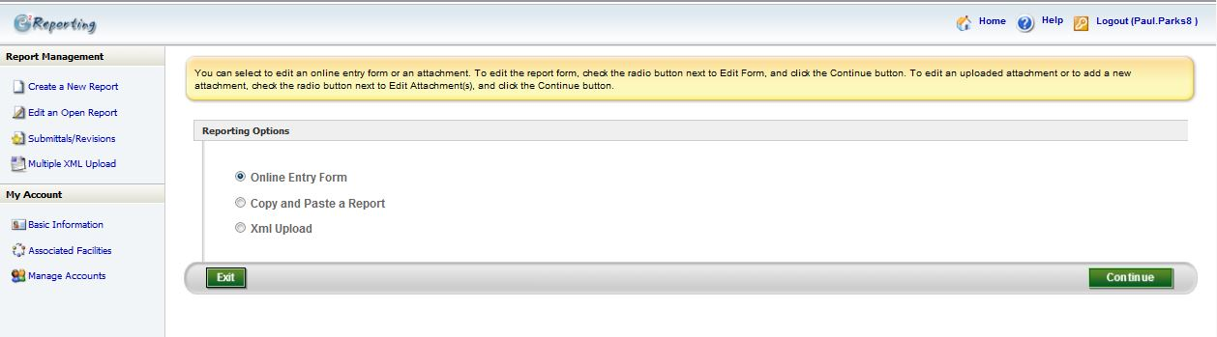
E2: Signatory Create eDMR
Select “Online Entry Form”
Click “Continue”

Slide 7
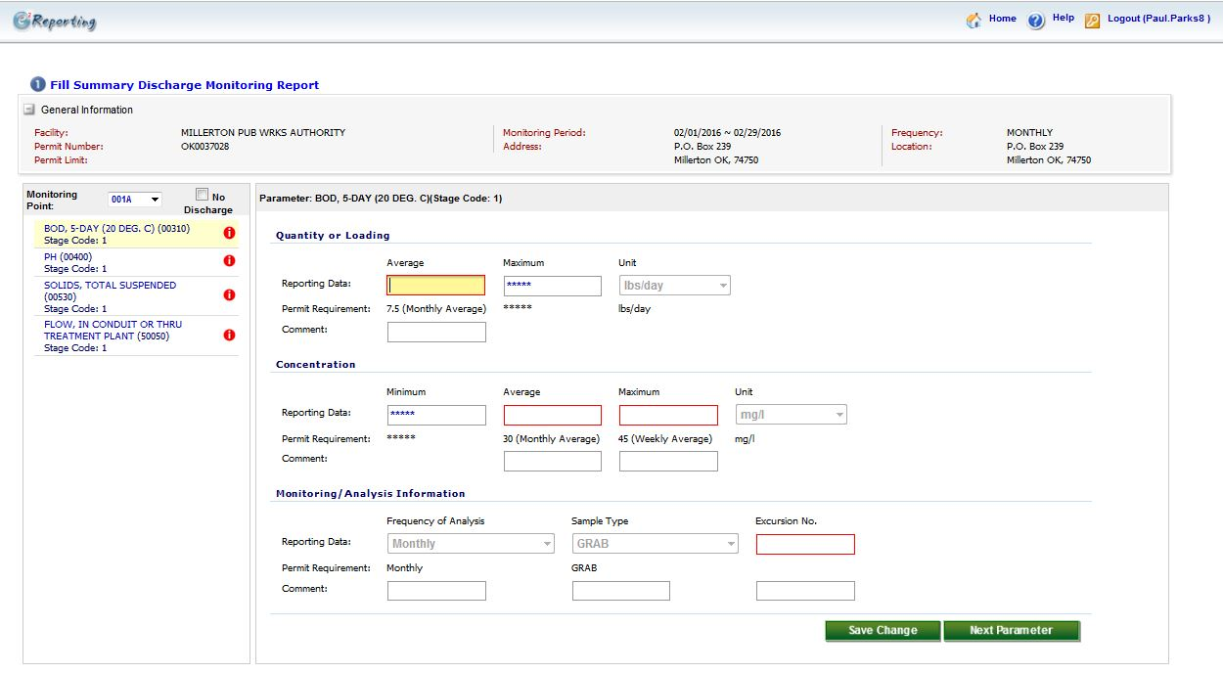
E2: Signatory Create eDMR
Click through each Parameter
Enter the values for each of the red boxes
After entering all the values for a particular parameter, click here to go to the next parameter.

Slide 8
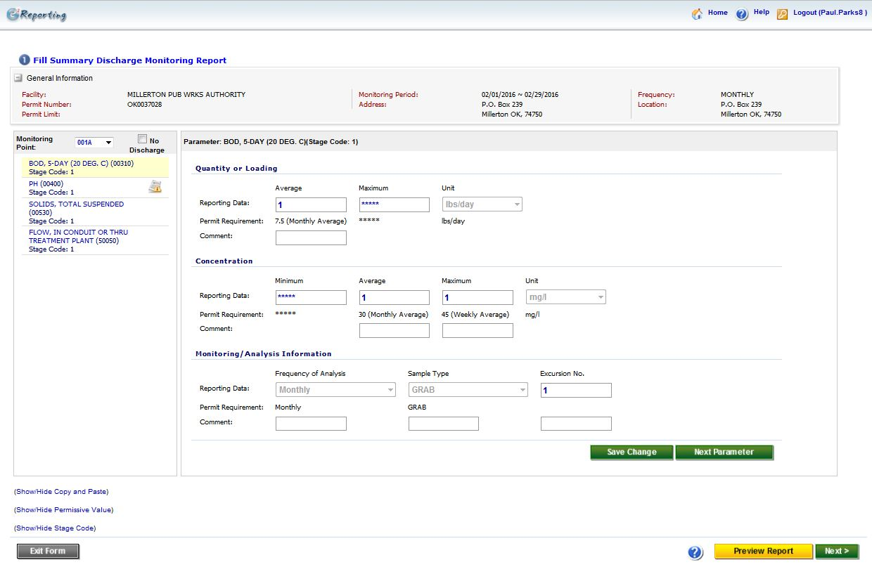
E2: Signatory Create eDMR
Notice that the red action symbols are gone. This means that all the values needed have been entered.
If everything looks correct, click Next
Click here to preview what the eDMR will look like

Slide 9
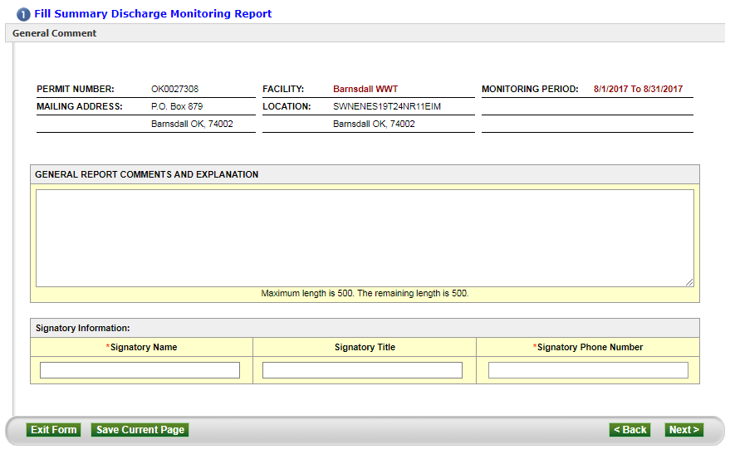
E2: Signatory Create eDMR
Use this field to add any comments you may want (Optional)
Enter the Signatory’s name
Click Next
Enter the Signatory’s phone number

Slide 10
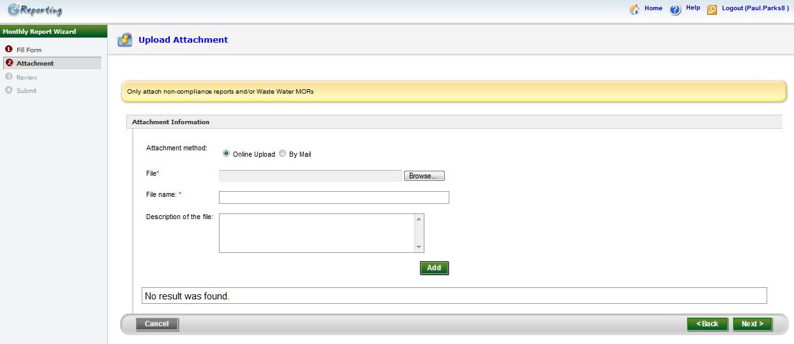
E2: Signatory Create eDMR
This page is optional. If you have a “Non-Compliance Report” and/or “Waste Water MORs” you can use this page to attach it to your eDMR submission
Click Next

Slide 11
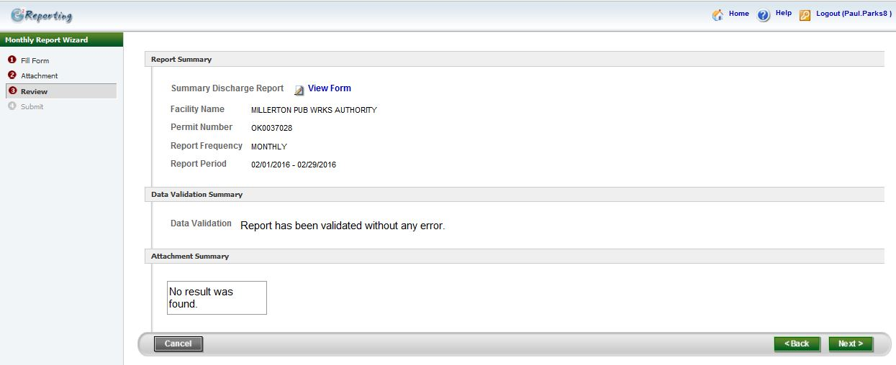
E2: Signatory Create eDMR
Click here to view a copy of the eDMR you will be submitting
Click Next

Slide 12
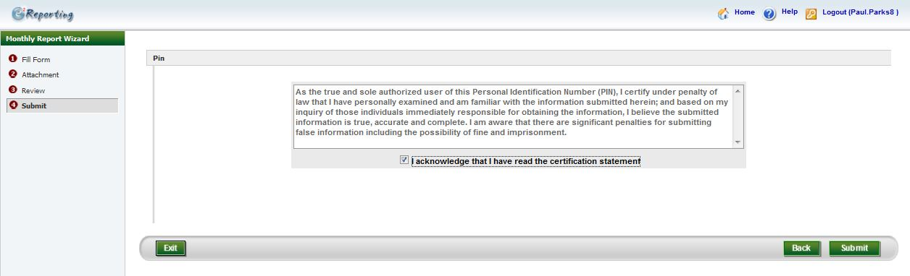
E2: Signatory Create eDMR
Read the Agreement
Click Submit
Check the “I acknowledge that I have read the certification statement”

Slide 13
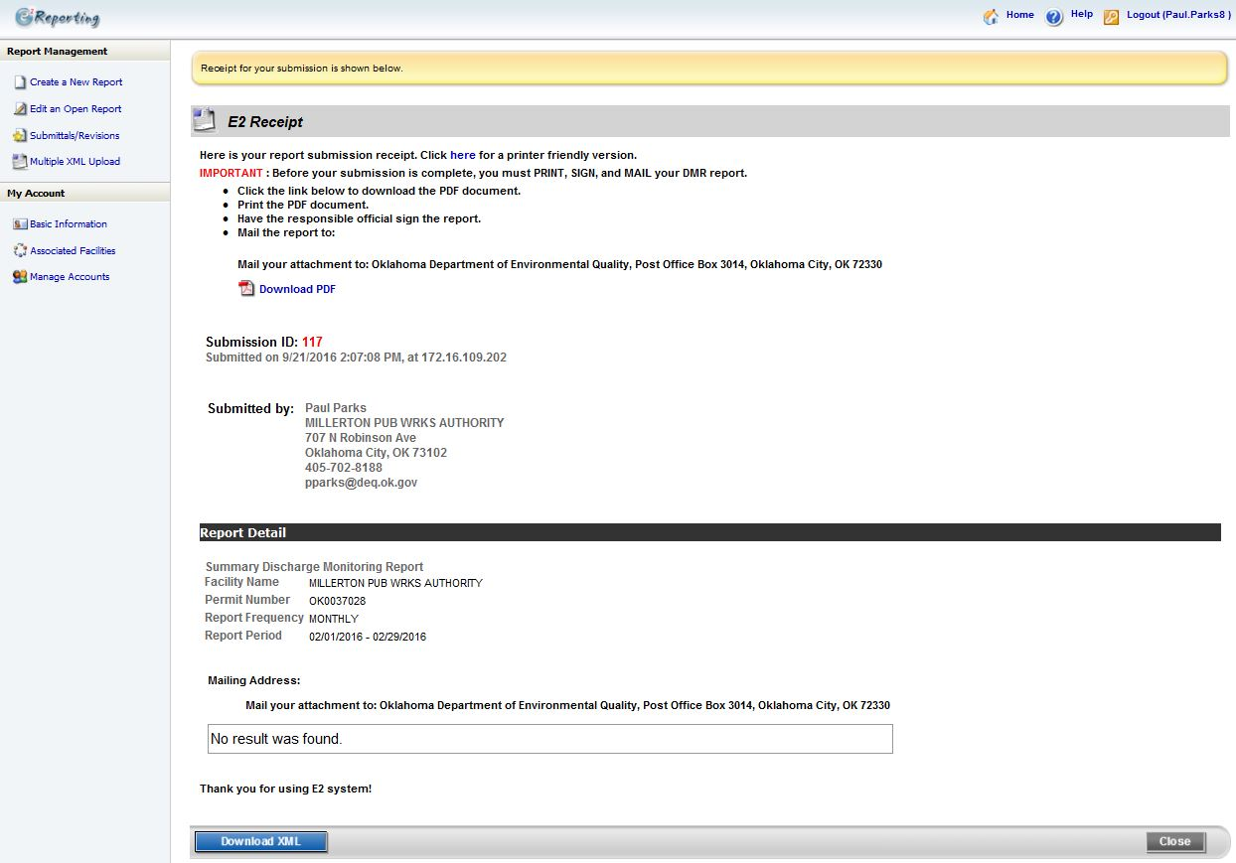
E2: Submission Receipt
After submitting the eDMR in E2, you will get an E2 Receipt. You will then click the home button above.

Slide 14
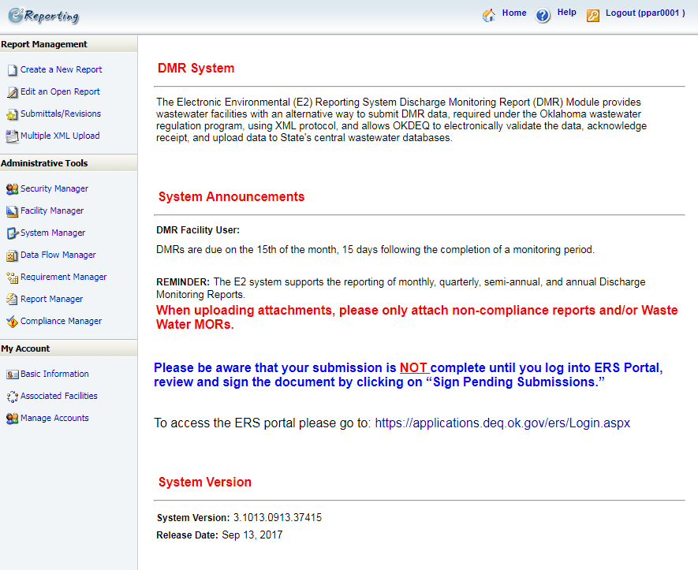

E2: Home Page
Click here to go to ERS to sign your submission.

Slide 15
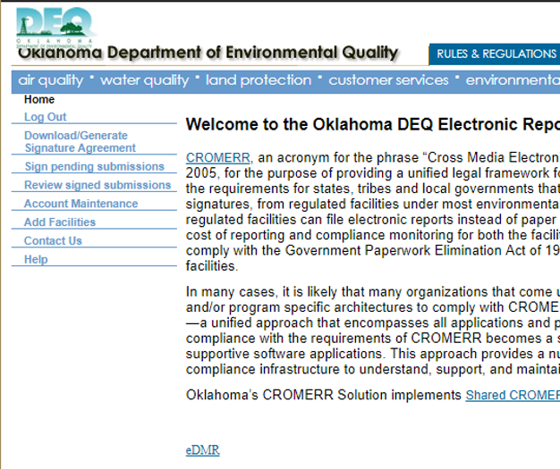
ERS: Signatory Sign and Submit eDMR
Submitting a Preparer Created eDMR
From the ERS Home Page, after you log in
Click here to view all e-DMR submissions.

Slide 16
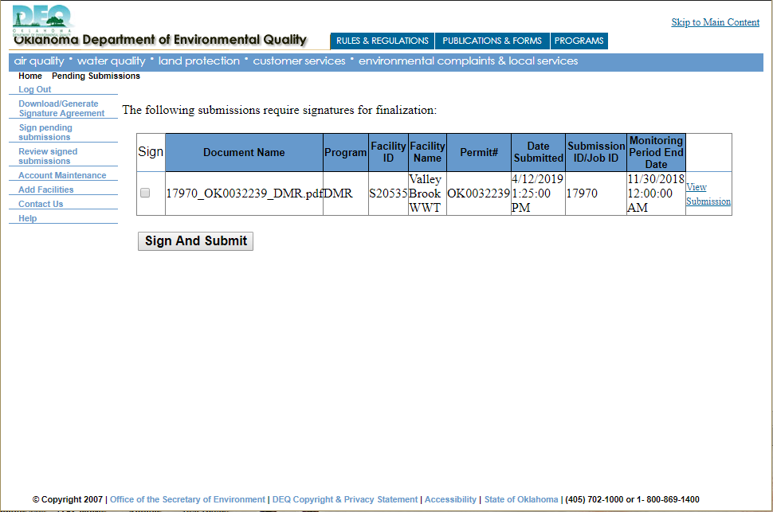
ERS: Signatory Sign and Submit eDMR
Submitting a Preparer Created eDMR
Check Mark this Box
Click on “View Submission” to view your eDMR.
Click “Sign and Submit”

Slide 17
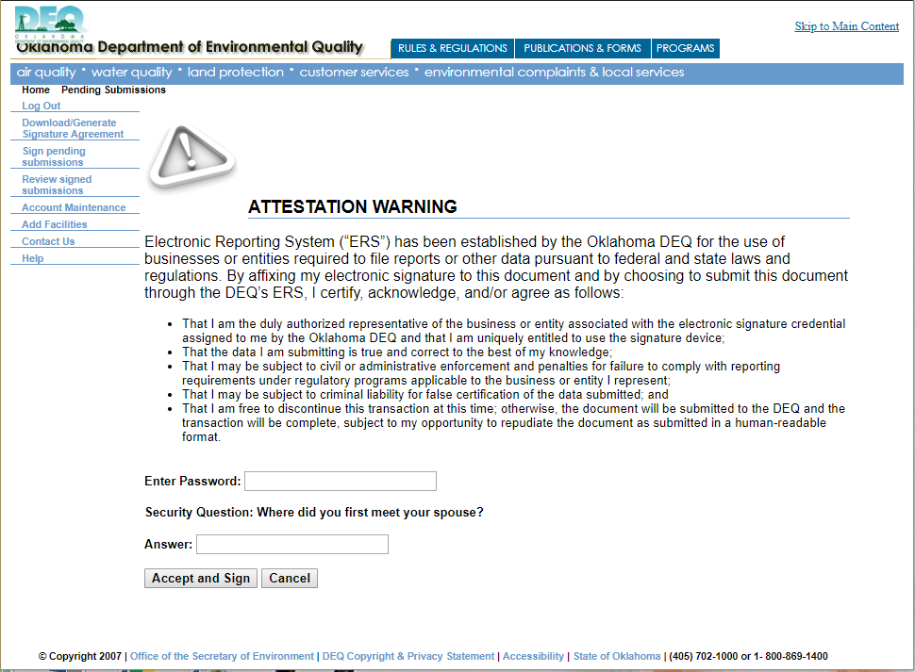
ERS: Signatory Sign and Submit eDMR (Sign and Submit)
Submitting a Preparer Created eDMR
Read the Statement
Enter your Account Password
Click “Accept and Sign”
Answer the Security Question

Slide 18
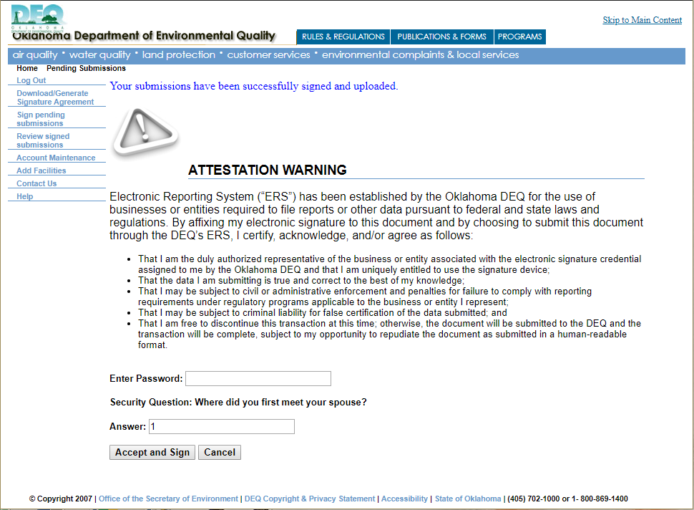
ERS: Signatory Sign and Submit eDMR (Sign and Submit)
Submitting a Preparer Created eDMR
Once the submission has been submitted, you will receive the above message, and an email saying that it was received. You are done with the eDMR submission process.

