Slide 1
ERS & E2
How to Register with ERS and E2

Slide 2
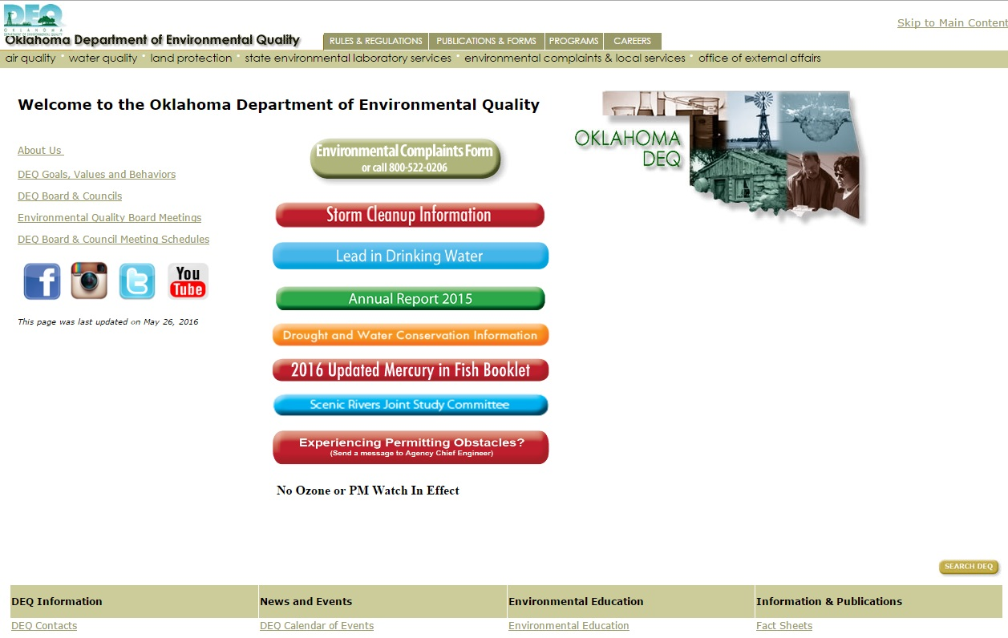
Start at DEQ Home Page: www.deq.state.ok.gov
Scroll
Down

Slide 3
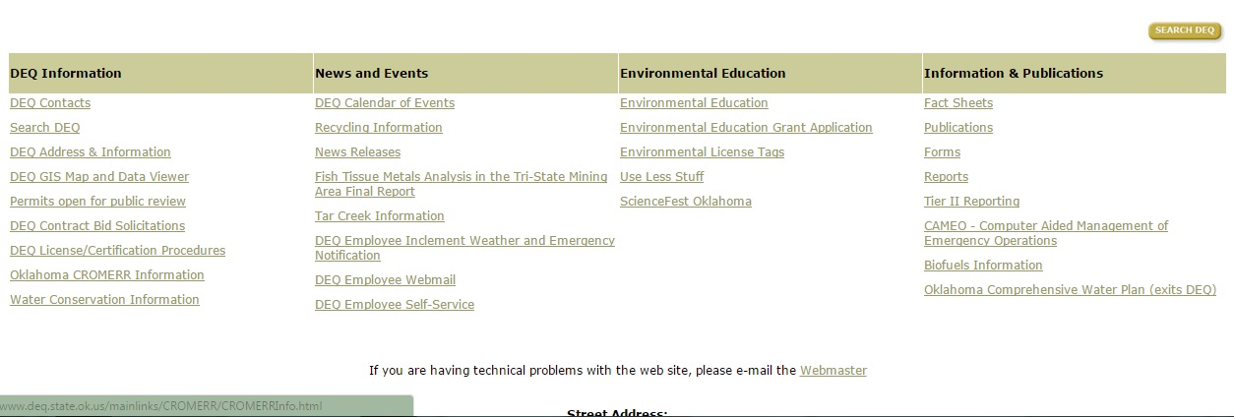
Links at bottom of DEQ Home Page
Click on “Oklahoma CROMERR Information”

Slide 4
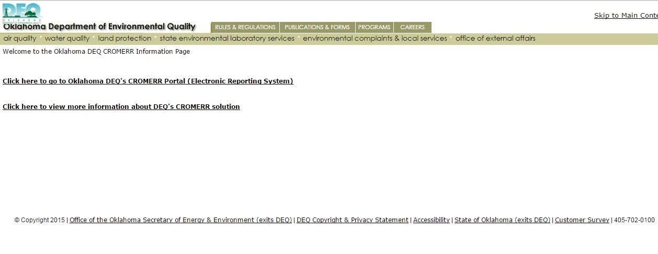
ERS Link Page
Click Here

Slide 5
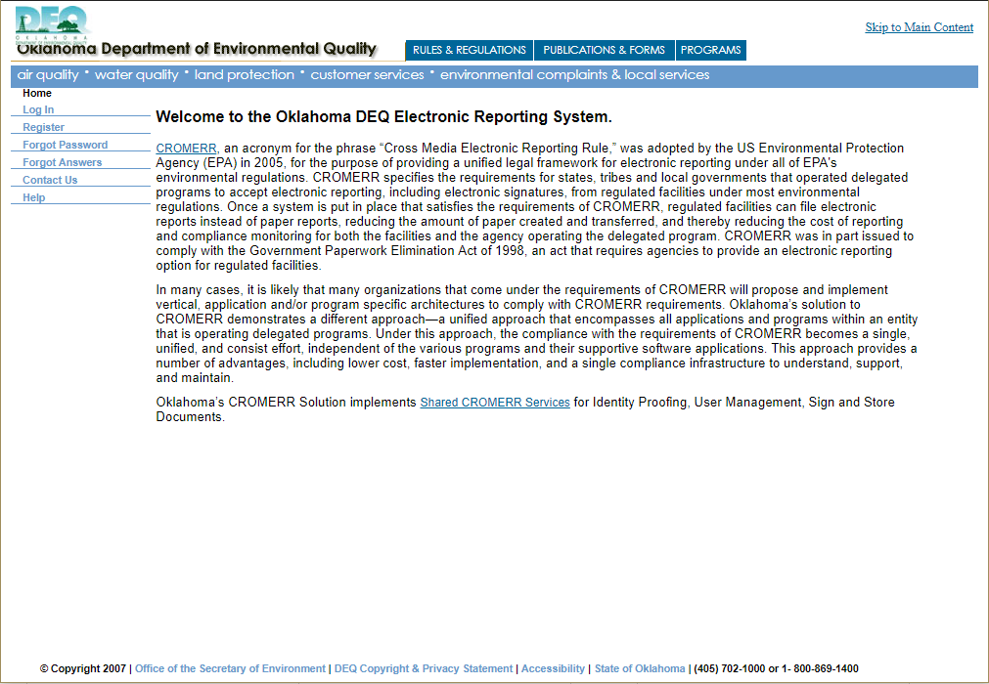
ERS Home Page
Click “Register” to begin

Slide 6
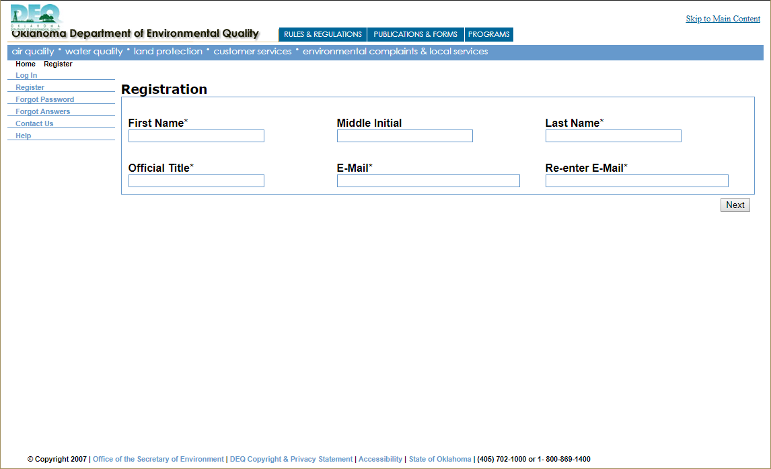
Enter your Legal First and Last name, Official Title and Email
Click Next

Slide 7
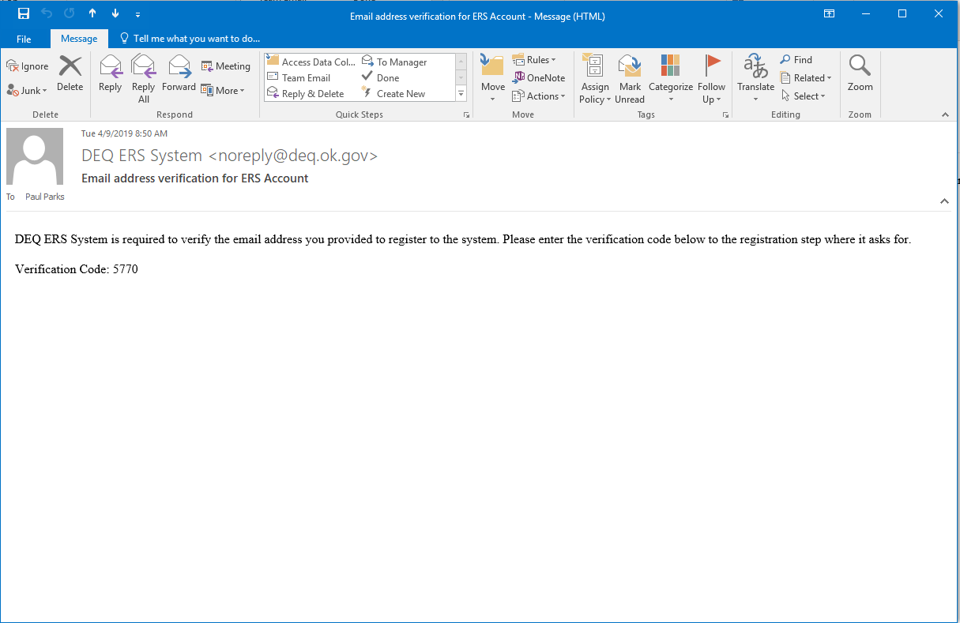
After you click “Next” on the previous screen you will receive an Email that has a “Verification Code” in it. This is used to Verify your email address. Copy down this number.

Slide 8
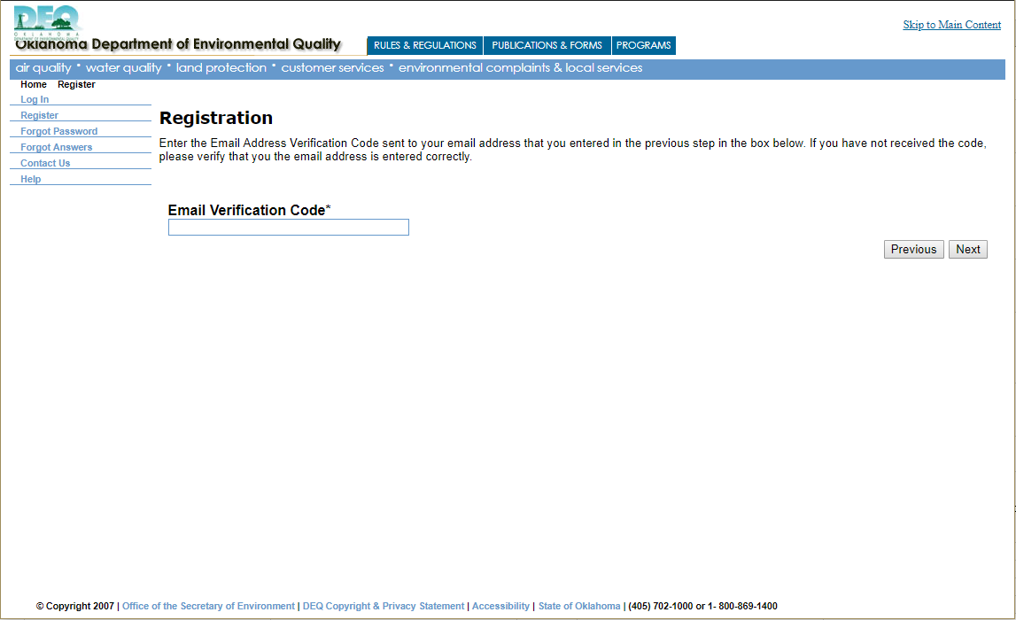
Enter the code from the Email here.
Click “Next”

Slide 9
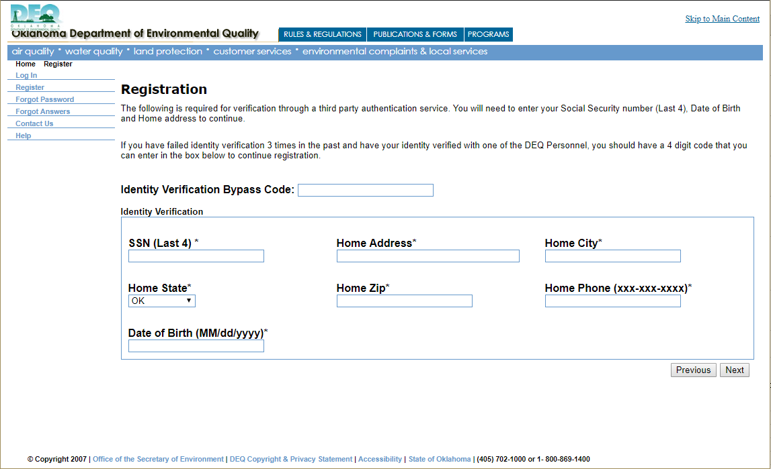
If you hit next and get to a screen that says “You have failed Identity Verification…” it will give you the number of the appropriate person to contact at DEQ. Contact them, and they will provide you with a code that you will enter here. Once you enter the code, you will then click “Next” to continue.
Fill these boxes with your personal information. All this information will be deleted from the system when you click “Next”
Click “Next”

Slide 10
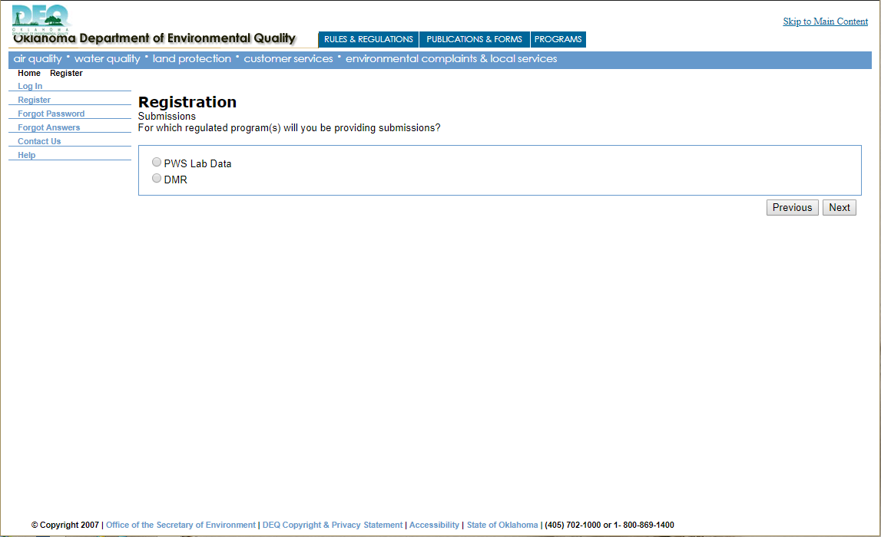
Choose the program that you are signing up for. If you are PWS Lab to State, then you click “PWS Lab Data”. If you are signing up for Electronic Reporting of DMRs, you will select “DMR”
Click “Next”

Slide 11
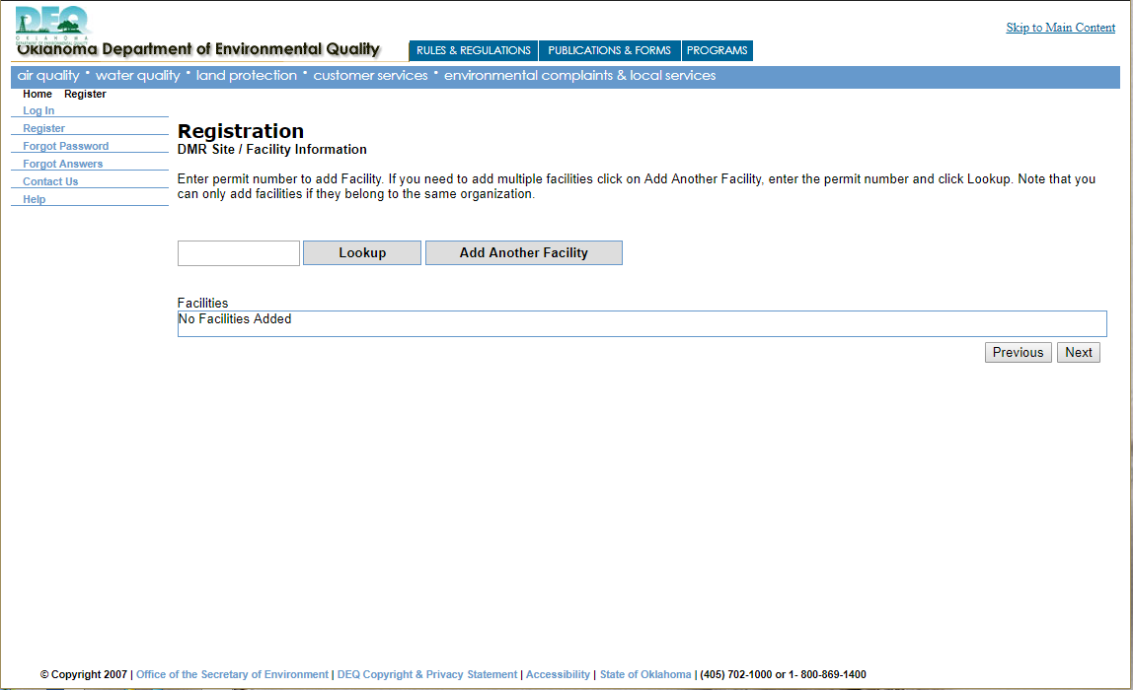
Put in your NPDES Permit Number if you chose “DMR” as your program. Put in your PWS Number if you chose “PWS Lab Data” as your program. Then click “Lookup”

Slide 12
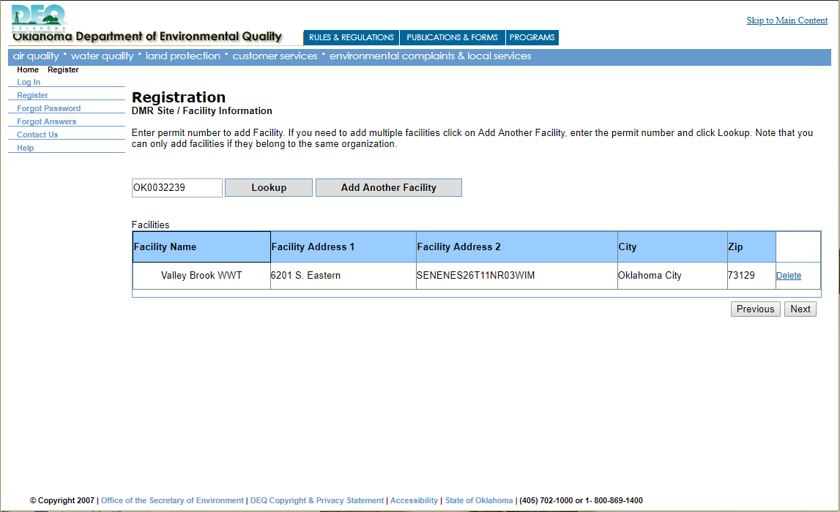
If you need to add and additional facility, click “Add Additional Facility”.
After you hit “Lookup” your facility should show up here. If it doesn’t, you will need to check and make sure you are using the appropriate number and try again.
Click “Next”

Slide 13
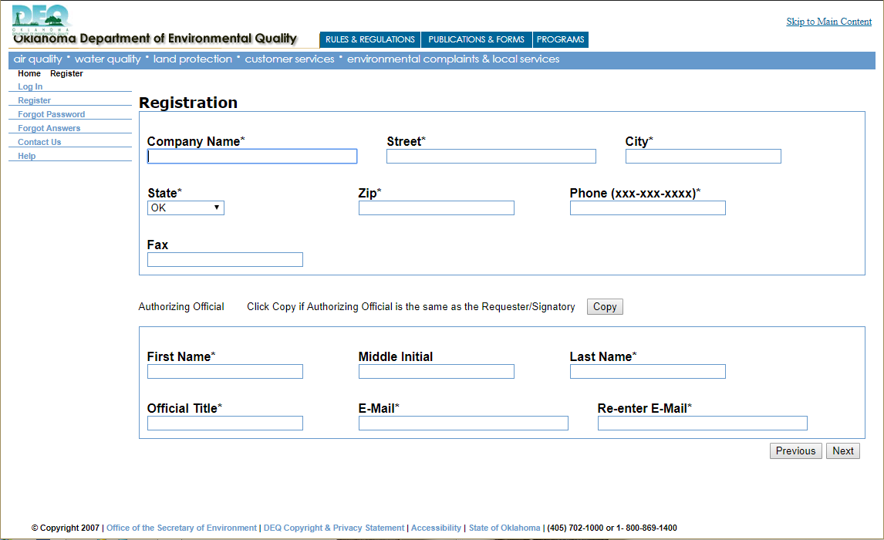
Fill out your company information.
Enter the person that Authorized you as the Signatory for the Facility here. If you are that person, just hit the copy button.
Click “Next”

Slide 14
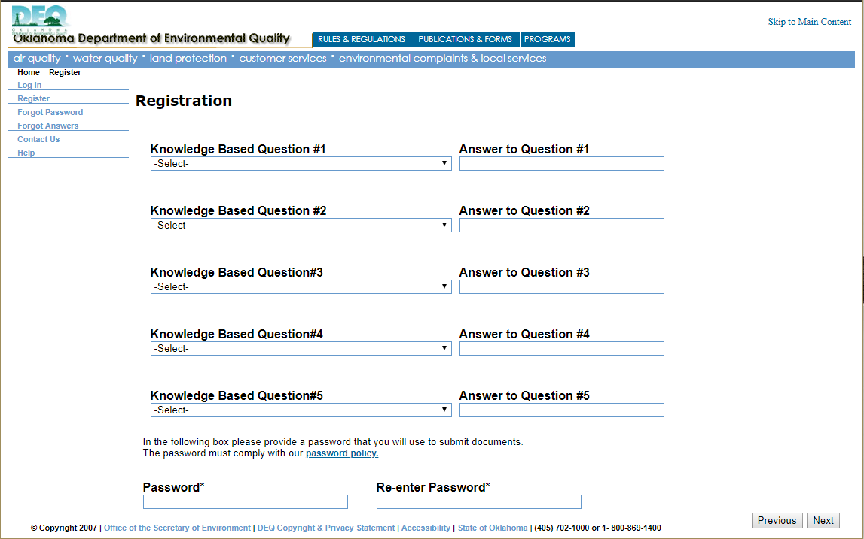
Enter 5 Security questions. You cannot choose the same question twice. (Tip: choose questions with one word answers)
Create a password. It needs to be at least 8 Characters long, have an Upper and Lower Case letter, and have a Number.
Click “Next”

Slide 15
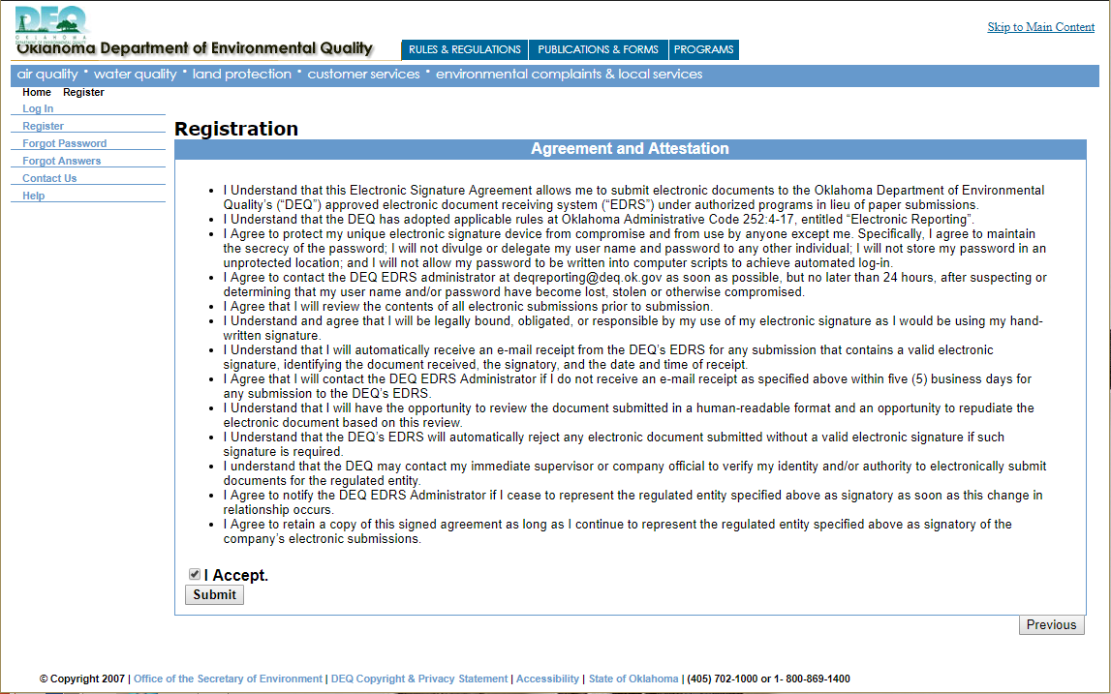
Read the Agreement
Check the “I Accept” box then click “Submit”

Slide 16
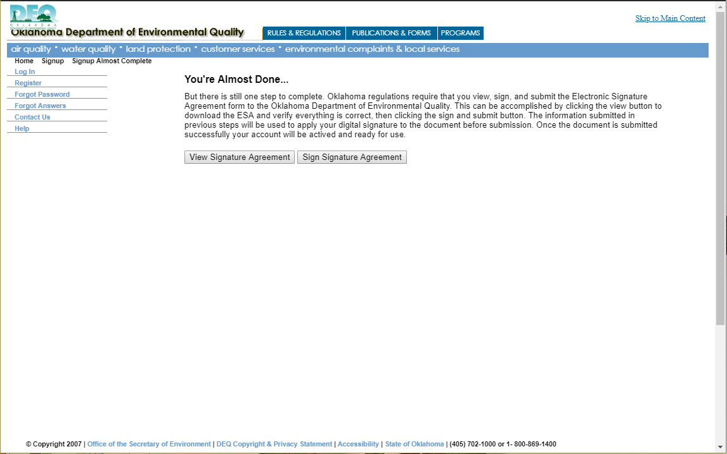
Click “View Signature Agreement” and download and view the agreement.

Slide 17
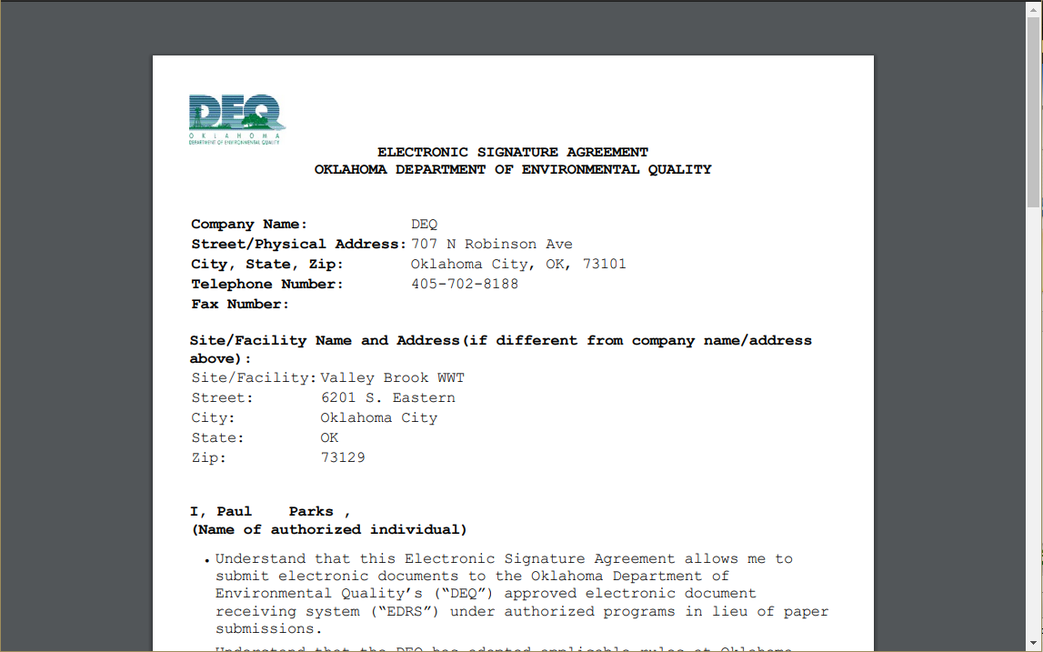
This is what the Signature Agreement looks like.

Slide 18
After viewing the Signature Agreement, click “Sign Signature Agreement”

Slide 19
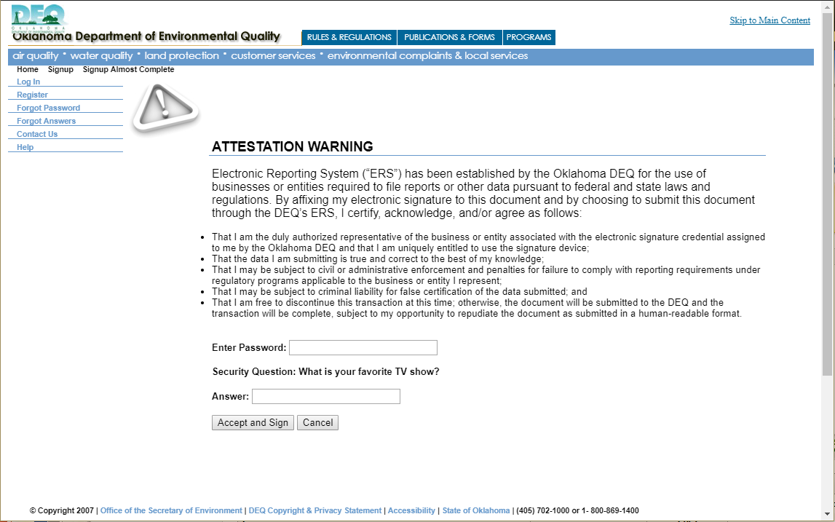
Read the Statement
Enter your Account Password
Click “Accept and Sign”
Answer the Security Question

Slide 20
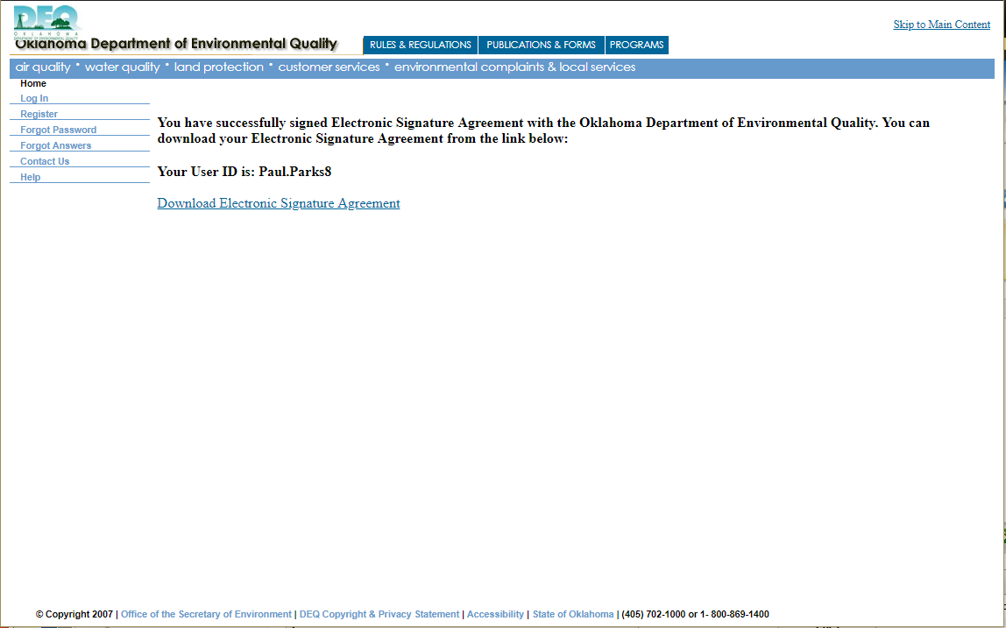
After you have Signed your agreement, you will get this screen that confirms your account creation and shows you what your username is.

Slide 21
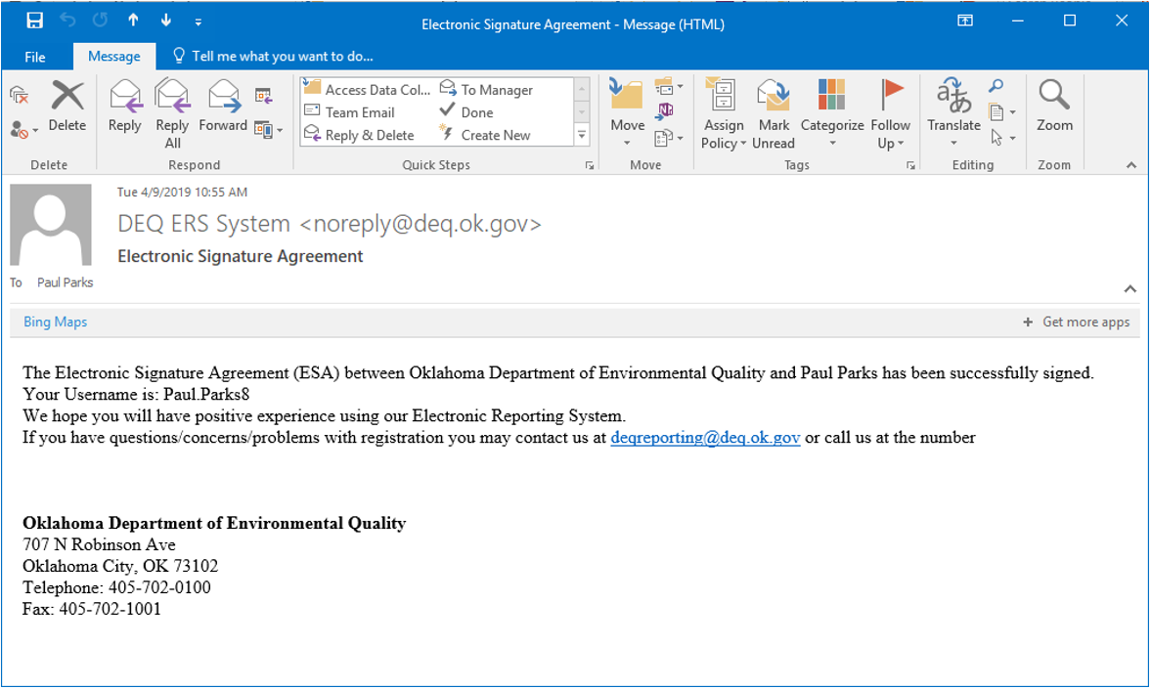
Account Registration Completion Email
Congratulations! You have completed your Signatory Account creation.

